Slide 1
Ansible

Slide 2
Topics
Understanding Configuration Management and its origins
The aims of Configuration Management
Basic principles of Configuration Management
Configuration Management best practices
How Ansible simplifies DevOps implementations
Binary Artifact Management and Ansible

Slide 3
What is Configuration Management ?
Provision infrastructure, deploy code, and maintain the operational consistency of environments.
A way of development where automation can be used to provision and enforce the state, consistency, and accuracy of a set of systems.

Slide 4
What is Configuration Management ?
Hosts can now be automatically configured and provisioned to be in a specific state via code
Packages Installed, Users Created and so on…
The idea that infrastructure can be defined and codified is not only novel but is now the norm

Slide 5
What is Configuration Management ?
Configuration Management is the detailed recording and updating of information that describes an enterprise's hardware and software.
Such information typically includes the versions and updates that have been applied to installed software packages and the locations and network addresses of hardware devices.

Slide 6
Why Automation is must for companies ?
Significant amount of pressure to maintaining clean and stateful systems in production
With the rapid adoption of broadband, mobile devices, SaaS, and internet access, consumers now demand more frequent updates
Automation is a must for any company wishing to manage distribution channels in order to remain competitive

Slide 7
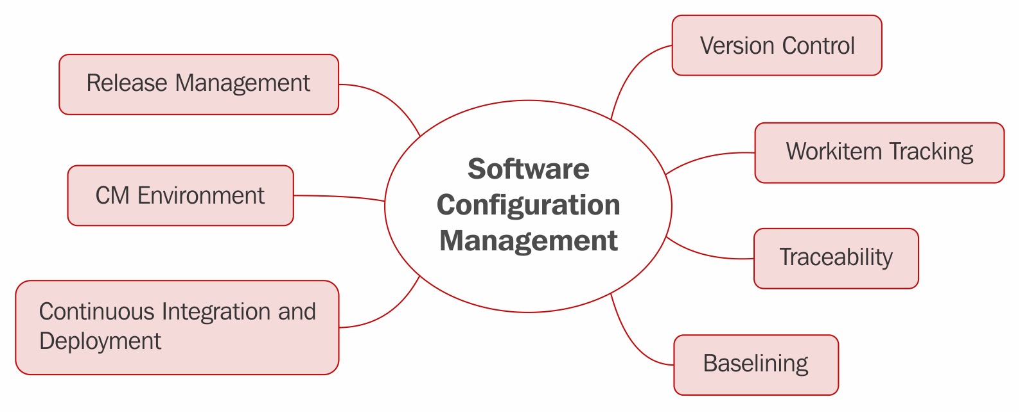
Core concepts of CM

Slide 8
Core concepts of CM
Release Management
      Reliably publish a piece of software for consumption by the target end user.
CM Environment
Represent a set of physical or virtual replications of a production-release environment
Continuous Integration and Deployment
Important set of practices that encourage collaboration and span the entire delivery pipeline.

Slide 9
Core concepts of CM
Version Control
      where all source code and development efforts should be stored.
      Management scripts, Ansible playbook's, development code, and automated QA tests.
Work item Tracking
Practice of dividing, tracking, developing, testing and deploying large implementation efforts for a project into smaller, more reasonable chunks that can be worked on individually.
Traceability
Traceability of each change to a given software system be available throughout the delivery pipeline.

Slide 10
Core concepts of CM
Baselining
- An infrastructure solution is important because it provides a solid starting point for all future infrastructure implementations.
- This means that at any given time, you can reimage a system with the known good baseline and build on it from there.
- In many ways, this also provides a level of consistency.

Slide 11
Origins of CM
1990s
  IBM and the Department of Defense
  Effort to track the steps necessary to recreate the system or deployment if the system were to fail or have some kind of fault

Slide 12
The Aims of Configuration Management
If I spend four hours configuring a given development system for a developer to use, and then the developer quits the next day, and a new developer gets hired, I have just wasted eight hours.
Whereas if I spend eight hours writing a single set of automated scripts to automatically provision a development system and the automation takes 20 minutes to run from start to finish, I can now recreate the developer system easily and with minimal fuss and ceremony.

Slide 13
The Aims of Configuration Management
Configuration Management is all about:
saving time,
saving money,
saving resources, and
minimizing waste

Slide 14
Aims of Configuration Management
To track changes made to a given system or set of systems
To provide traceability and auditability for defects that may arise as part of a set of changes made to a given system
To help reduce the amount of manual effort made by developers, QA, and operations folks by maintaining a set of automated solutions that can aid in the provisioning and configuration of a given system
To provide a level of repeatability to the organization by clearly defining (in automation form) the steps required to build out a given system

Slide 15
Examples of CM and how it could potentially benefit an organization
Scenario 1 :
Bob works in a large IT software organization as a developer. Bob is working on a bug that he needs some help with.
With a proper Configuration Management strategy in place, Bob could easily automate the recreation of his bug environment (the virtual machine used for his local testing and bug recreation efforts) so that both he and his coworker can work on the same bug simultaneously and with minimal fuss in recreating the environment.

Slide 16
Examples of CM and how it could potentially benefit an organization
Scenario 2 :
The development team has been working very hard at completing this month's release. The release includes a number of infrastructure changes and environment spin-up requirements.
As a result of a solid Configuration Management plan and successful automation, the implementation and rollout of this production release will take a matter of minutes instead of the previous month's hours-long rollout.

Slide 17
Examples of CM and how it could potentially benefit an organization
Scenario 3 :
Randy is working hard to help the company's documentation efforts by documenting the recipes of their cloud computing infrastructure.
This documentation involves great care while recreating the individual components of the system to ensure that new hires have the proper information they need to set up a local working copy of the computing infrastructure
Randy has been able to save the numerous hours needed to document this setup solution by simply reading the Configuration Management automation already created and stored in the source control.

Slide 18
Basic Principles of Configuration Management
Automate where automation is possible
Provide traceability within the enterprise
Provide developers, QA, operations, and management with a reproducible infrastructure that is managed through software-development best practices
Develop a strategy for how new hardware will be provisioned and configured (in an automated way)
Manage hardware configurations effectively and with strategy
Develop mechanisms that provide a self-service model for deploying infrastructure changes
Educate the organization on Configuration Management practices

Slide 19
Configuration Management Best Practices
Some of the more popular tools for Configuration Management
  Ansible
  Chef
  Puppet
  CFEngine
Most of the tools are open source
Provide the ways to keep and maintain infrastructure in code form, or IaC (Infrastructure as Code)

Slide 20
Infrastructure as Code
Infrastructure as Code is the process of managing and provisioning computing infrastructure (processes, bare-metal servers, virtual servers, and so on) and their configuration through machine-processable definition files, rather than physical hardware configuration or the use of interactive configuration tools.

Slide 21
How Ansible Simplifies DevOps Implementations
The initial implementation of Ansible was derived in 2012 with following principles
  Minimal development required
  Consistent in execution
  Secure
  Scalable
  Highly reliable in nature
  Easy to learn

Slide 22
Users of Ansible
Twitter
Logitech,
NASA,
NEC,
Microsoft,
and
hundreds more.

Slide 23
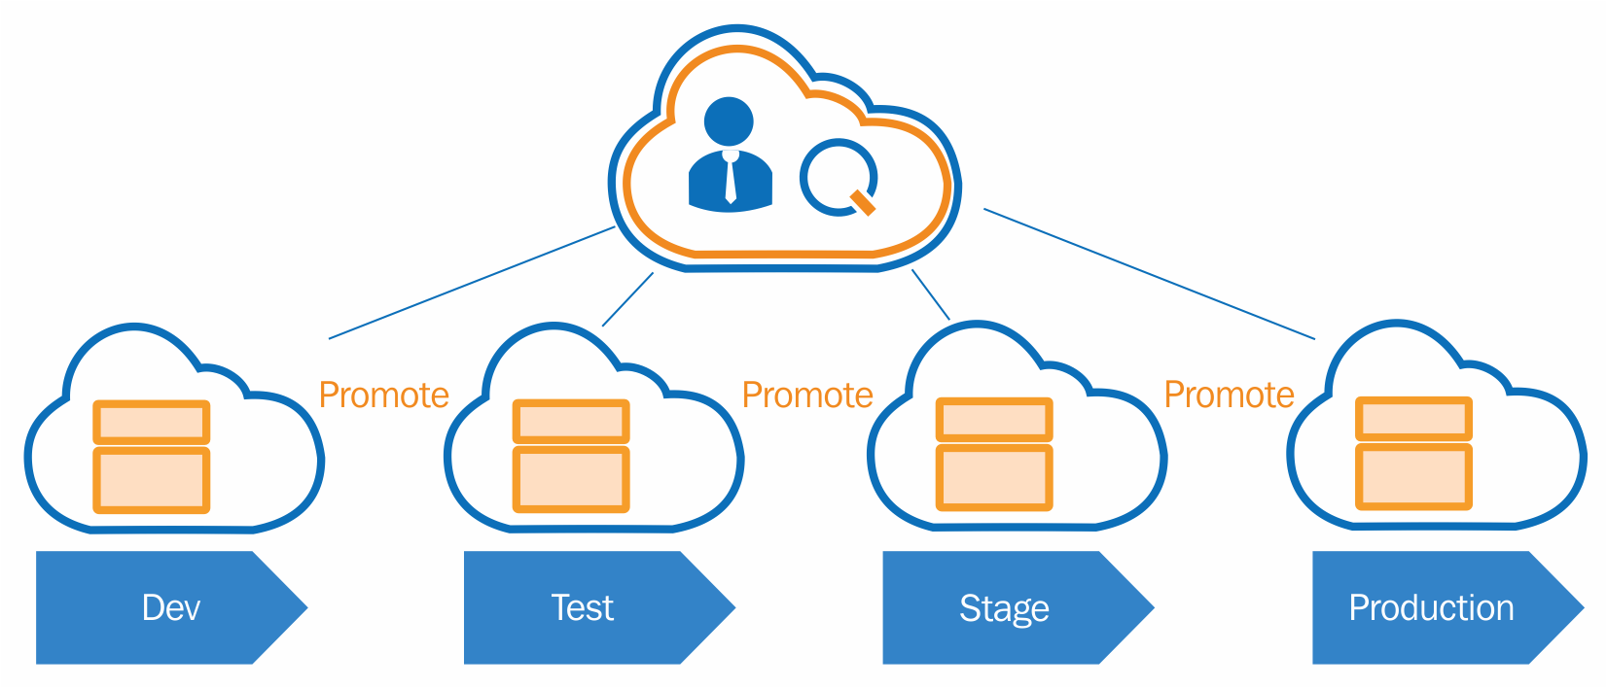
How ansible fits in DevOps envirnment ?

Slide 24
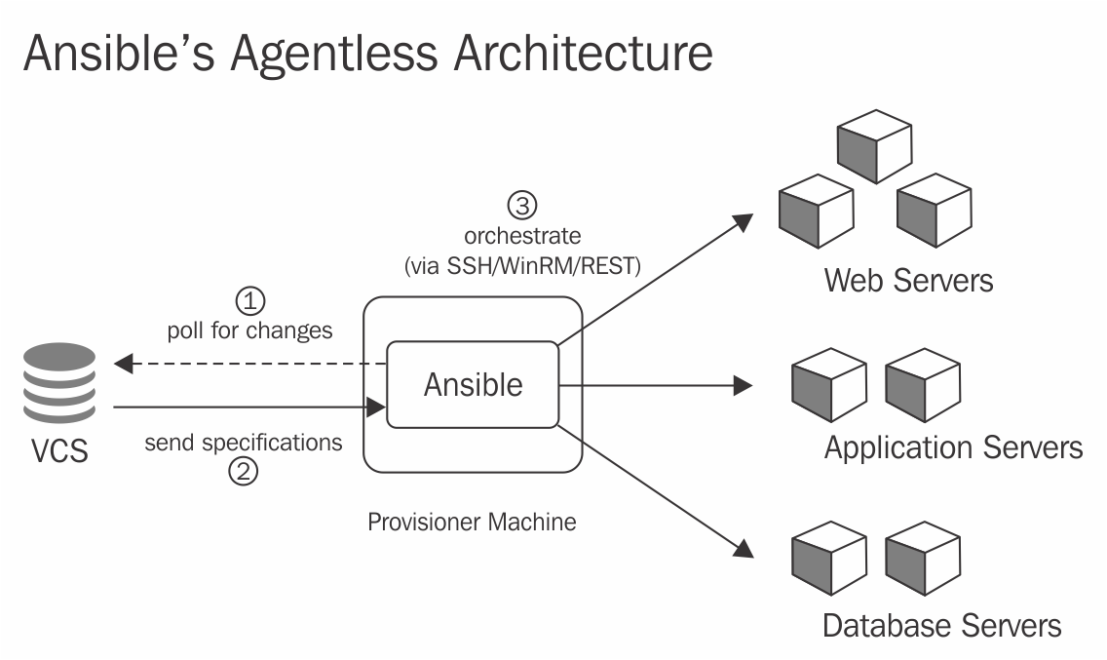
Push-model architecture of ansible

Slide 25
Binary Artifact Management
An artifact is one of many kinds of tangible by-products produced during the development of software
Some artifacts (e.g., use cases, class diagrams, and other Unified Modeling Language (UML) models, requirements and design documents) help describe the function, architecture, and design of software.
Build tools often refer to source code compiled for testing as an artifact, because the executable is necessary to carrying out the testing plan

Slide 26
Binary Artifact Management
Most organizations also utilize libraries and other resources licensed from outside companies
licensed for particular uses and, usually, for contract-specified lengths of time. Managing and complying with these requirements by hand
an artifact-management system should exist to manage these limitations and ensure the same version of any given resource is available to each developer, no matter where they might be.

Slide 27
Binary Artifact Management
With this in mind, the concept of the artifact repository was born.
A central location for all things to be used, created, and managed during the development process resides here until called upon for use in any given software project, however great or small in nature.
Managing dependencies is another important aspect of resource management that cannot be downplayed, as very few software development projects are without dependencies of some sort.

Slide 28
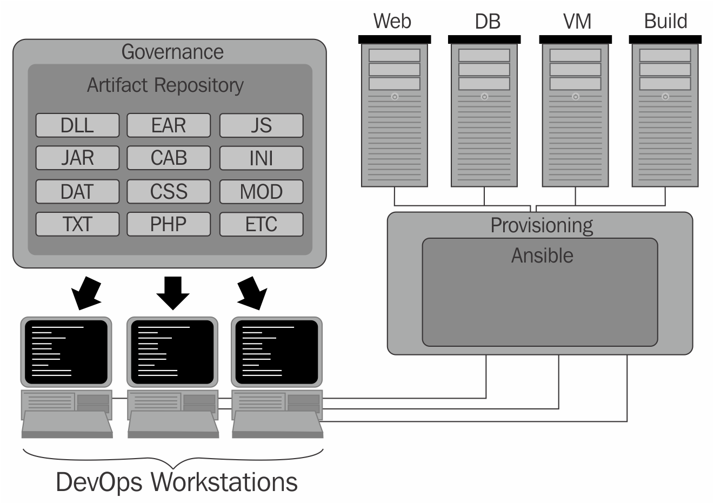
Binary Artifact Management

Slide 29
See you with hands on session

