Slide 1
Geospatial development Using Python Programming

Slide 2
Agenda

Slide 3
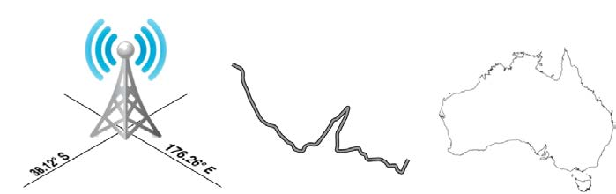
Geospatial development
The term geospatial refers to finding information that is located on the earth's surface.

Slide 4
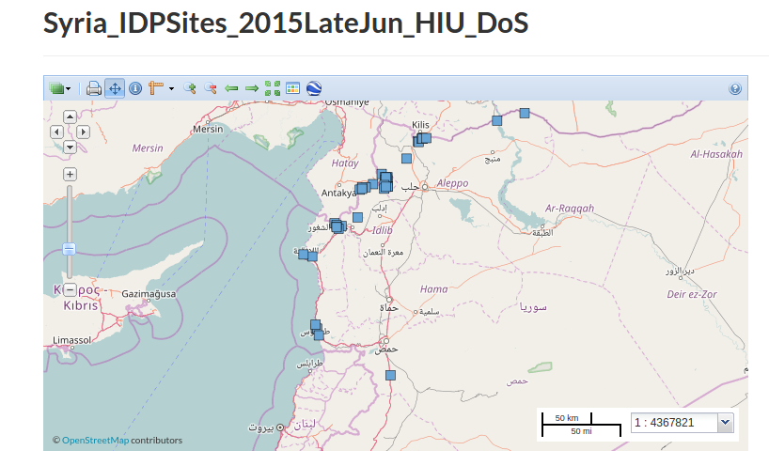
Geospatial maps example
This dataset contains open source derived data about the geographic locations (point geometry) of identified tent camps and other locations, such as collective centers, schools, mosques, sports facilities, host families, etc. in towns inside Syria
Source :
http://geonode.state.gov/layers/geonode%3ASyria_IDPSites_2015LateJun_HIU_DoS#abstract-more

Slide 5
Applications of geospatial development
Analysing geospatial data
Visualizing geospatial data
Creating a geospatial mash-up

Slide 6
Analysing geospatial data application(1)
Imagine that you have a database containing a range of geospatial data for San Francisco. This database might include geographical features, roads, the location of prominent buildings, and other man-made features such as bridges, airports, and so on.
Such a database can be a valuable resource for answering various questions such as the following:
• What's the longest road in Sausalito?
• How many bridges are there in Oakland?
• What is the total area of Golden Gate Park?
• How far is it from Pier 39 to Coit Tower?

Slide 7
Analysing geospatial data application(2)
Tree Mapping database in a Mumbai city ?
  School mapping in Thane City ?
  Near By Toilets ?
  What all questions you can ask ?

Slide 8
How these questions are answered ?
Many of these types of problems can be solved using tools such as the PostGIS spatially-enabled database toolkit.
For example, to calculate the total area of Golden Gate Park, you might use the following SQL query:
select ST_Area(geometry) from features
where name = "Golden Gate Park";

Slide 9
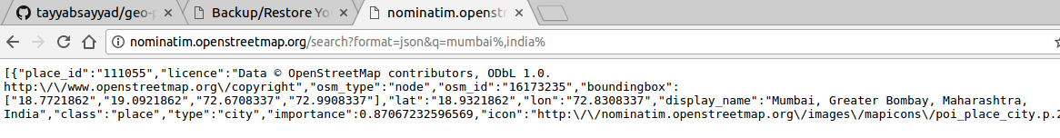
How these questions are answered (2)?
In order to run above query we need geolocations of these two places which we can get from webservices as follows,
http://nominatim.openstreetmap.org/search?format=json&q=mumbai%,india%

Slide 10
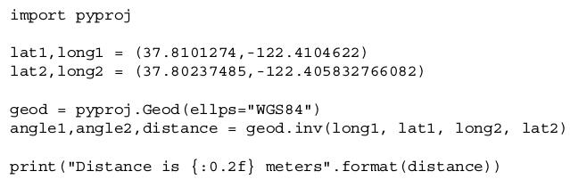
How these questions are answered (3)?
Once we find such geolocations of two cities we can calculate the distance using pyproj Python library as shown below,
Distance is 952.17 meters

Slide 11
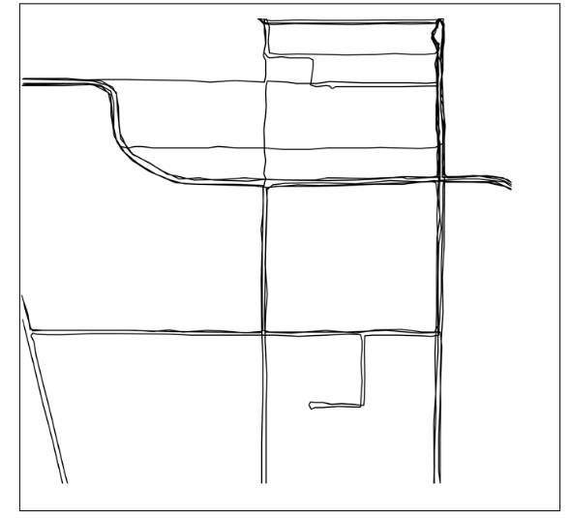
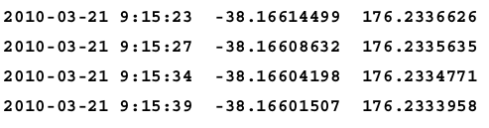
Visualizing geospatial data
Imagine you wanted to see which areas of a city are typically covered by a taxi during an average working day. You might place a GPS recorder in a taxi and leave it to record the taxi's position over several days. The result would be a series of timestamps and latitude and longitude values, like this

Slide 12
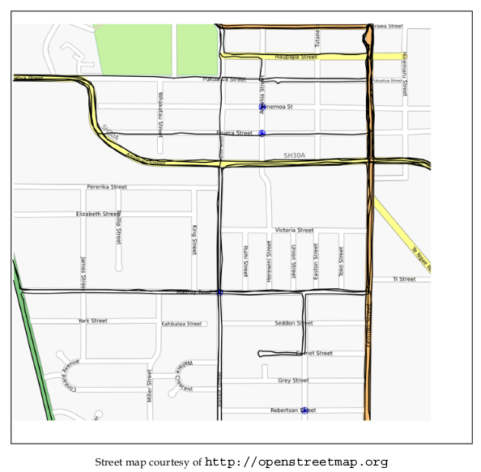
Visualizing on openstreetmap

Slide 13
Creating a geospatial mash-up
Mash-ups are applications that combine data and functionality from more than one source.
For example, a typical mash-up might collect details of houses for rent in a given city and plot the location of each rental on a map

