Slide 1

Modeling & Simulation
Simulation: When is it an Appropriate Tool?

Slide 2
Simulation: When is it an Appropriate Tool?
In this module, we shall see how simulation can be an appropriate tool in certain cases

Slide 3
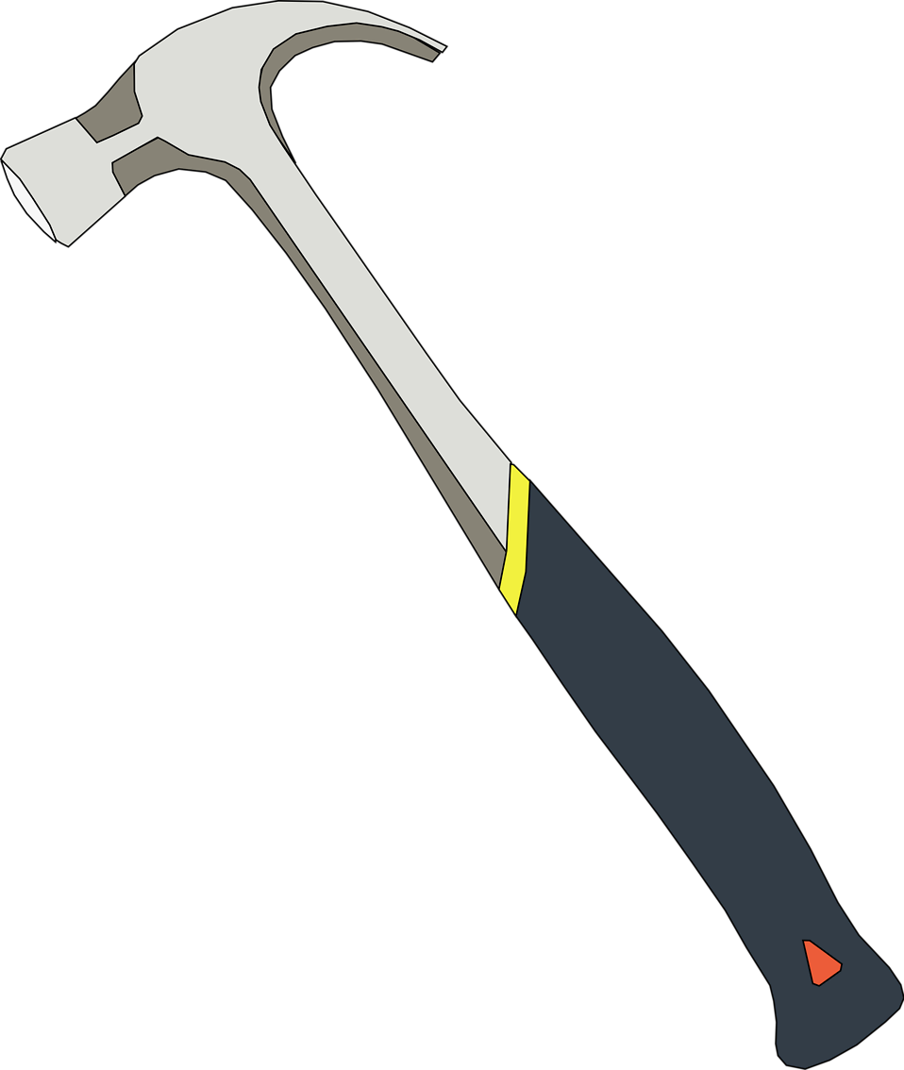
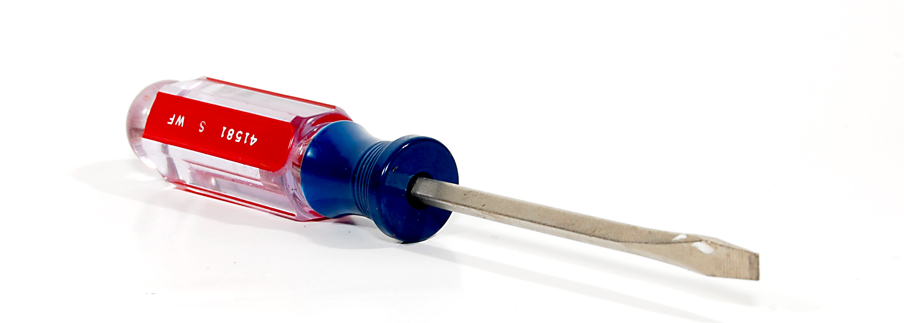
Differences in Tools
Every tool has a different purpose
A hammer cannot be used in place of a pliers or a screw driver

Slide 4
Analysis of Complex Systems
  Simulation enables the study of, and experimentation with, the internal interactions of a complex system or of a subsystem within a complex system.

Slide 5
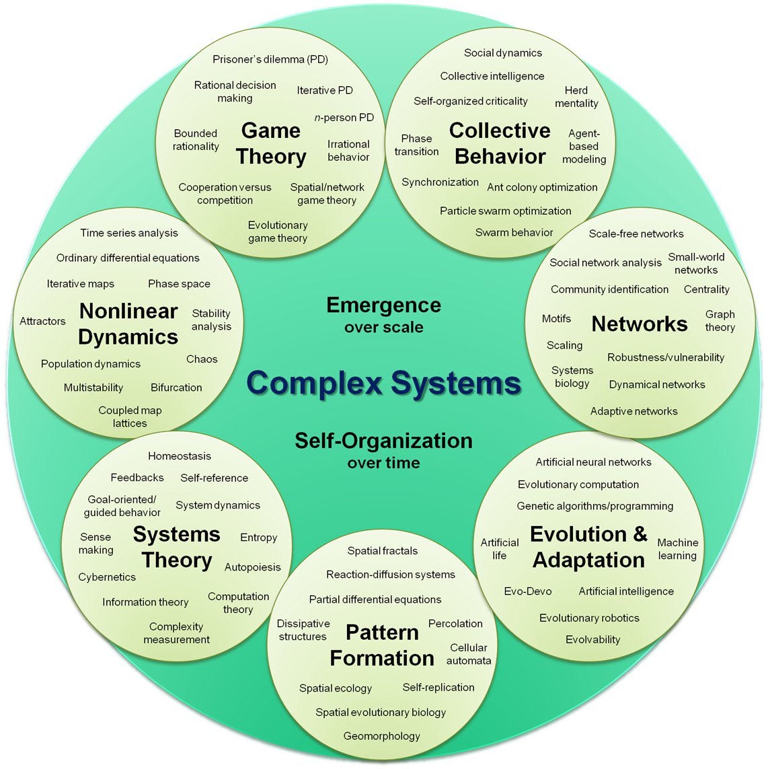
Complex System

Slide 6
Defining Changes
  Informational, organizational, and environmental changes can be simulated, and the effect of these alterations on the model's behavior can be observed.

Slide 7
Knowledge from Simulation
The knowledge gained during the designing of a simulation model could be of great value toward suggesting improvement in the system under investigation.

Slide 8
Learning from Change
Changing simulation inputs and observing the resulting outputs can produce valuable insight into which variables are the most important and into how variables interact.

Slide 9
Pedagogical Value
Simulation can be used as a pedagogical device to reinforce analytic solution methodologies.

Slide 10
Trial & Error
Simulation can be used to experiment with new designs or policies before implementation, so as to prepare for what might happen.

Slide 11
Verification of Mathematical Models
  Simulation can be used to verify analytic solutions.

Slide 12
Learning Requirements for a Machine
Simulating different capabilities for a machine can help determine the requirements on it.

Slide 13
Replacement for Training
  Simulation models designed for training make learning possible without the cost and disruption of on-the-job instruction.

Slide 14
Animation of Simulation
Animation shows a system in simulated operation so that the plan can be visualized.

Slide 15
Visually Understanding Modern Factories
The modem system (factory, wafer fabrication plant, service organization, etc.) is so complex that its internal interactions can be treated only through simulation.

Slide 16
Other reasons!
Explain (very distinct from predict)
Guide data collection
Illuminate core dynamics
Suggest dynamical analogies
Discover new questions
Promote a scientific habit of mind
Bound (bracket) outcomes to plausible ranges

Slide 17
Other reasons!
Illuminate core uncertainties.
Offer crisis options in near-real time
Demonstrate tradeoffs / suggest efficiencies
Challenge the robustness of prevailing theory through perturbations
Expose prevailing wisdom as incompatible with available data

Slide 18
Other reasons!
Train practitioners
Discipline the policy dialogue
Educate the general public
Reveal the apparently simple (complex) to be complex (simple)

Slide 19
Summary
A large number of uses
Additional Reading: Joshua M. Epstein, Why Model?
http://jasss.soc.surrey.ac.uk/11/4/12.html

