Slide 1

Library Management System
by: Abdul Tayyeb
Supervisor: Mr. hitesh patidar

Slide 2
Library
According to Stephen, Maeve & Philips (2007), in a traditional sense, a Library is a large collection of books, and can refer to the place in which the collection is housed. Today, the term can refer to any collection, including digital sources, resources, and services. The collections can be of print, audio, and visual materials in numerous formats, including maps, prints, and documents, microform, CDs, cassettes, videotapes, DVDs, video games, e-books, audio books and many other electronic resources. The places where this material is stored can range from public libraries, subscription libraries, private libraries, and can also be in digital form, stored on computers or accessible over the internet.
As technology is the faster growing trends, computers now a days are being part of human life. Through computers business, organizations, schools, companies and etc. can transact to their clients in a convenient way using advance technologies and specially the application-software, The application software is created for library functions through this “Library Management System” librarian can lessen their errors and efforts in every book processing and transactions and in making reports.

Slide 3
Library Management System (LMS)
Function
LMS is a network of computers that uses a certain program to facilitate technical functions of the library. One such function is electronic cataloguing. With LMS, library users can trace desired items electronically with outgoing through shelves. LMS also facilitates the lending process by keeping records of items lent and borrowers information. LMS supports other administrative tasks such as inventory and data processing.
Advantages
Keeping Stock.
Manage Student Records.
Manage Issued Books.
Manage Transactions.

Slide 4
Library Management System (LMS)
The project titled Library Management System (LMS) is Library management software for monitoring and controlling the transactions in a library. The project “Library Management System” is developed in PHP 7, which mainly focuses on basic operations in a library like adding new student, new books, and updating new information, searching issued books and students and facility to issued and return books. The system will be used to be able to help Librarian to make their transactions faster.

Slide 5
Solution overview
The systems development life cycle (SDLC) is a common methodology for systems development in many organizations.
The phases of SDLC (System development lifecycle)
System Planning and selection
Identifies the need for a new or enhanced system
Investigate the system and determine the proposed system’s scope.
System Analysis
Studies the organization’s current procedures and the information systems.
Study the requirements and structure them according to their interrelationships, eliminating any redundancies
System Design
Uses the information collected earlier to accomplish the logical design of the information system. (input and output screens, reports, databases, computer processes)
System Implementation and Operation
Turn system specifications into a working system that is tested and then put into use.

Slide 6
System analysis: Objective
Develop a system that can replace the manual library managing system.
Develop a database which stores user details & items details.
Administrator, librarian & users should have separate logins.
Create an easy to understand user friendly environment.
Attractive user interfaces to navigate through the system for the users.
Develop the system documentation with detailed UML specifications
Record every transaction in computerized system so that problem such as record file missing won’t happen again.
Develop a system that will record the items borrowed.
To produce technical report that documents the phases, tasks and deliverables in the project.
Provides security (i.e. only the administrator can update any information to the database).

Slide 7
System analysis: SCope
Search Module
In this module the User can search issued books
2. Security Module
In this module the user need login to system to use the system
3. Student Module
This module allows user to store the student record and managing the records
4. Issue Item Module
This module allows user to issue the book to the student
5. Other Modules
Class Module
Author Module
Publisher Module
Transaction Module
User Module

Slide 8
System Design: Introduction to Database
Database:
An organized collection of logically related data.
A database consists of a number of interrelated tables.
Each table has a number of records which are used to represent real world objects.
Each record has a number of fields which are data items used to specify a characteristic of the record.
A Database Management System, or DBMS:
is a computer application that allows you to work with databases on a computer. A database management system allows you to easily...
– Create / Delete tables
– Modify tables: (e.g., adding, deleting, editing and rearranging records, changing the table structure)
– Retrieve data from a table or a number of tables: (e.g., finding and displaying an individual record).
– Create reports.

Slide 9
System Design: Introduction to Database
Primary Key: Value unique for each record in a table. This value can be used twice
Foreign Key: Used to create relationships between tables.
Relation between primary and foreign keys: same format same values.

Slide 10
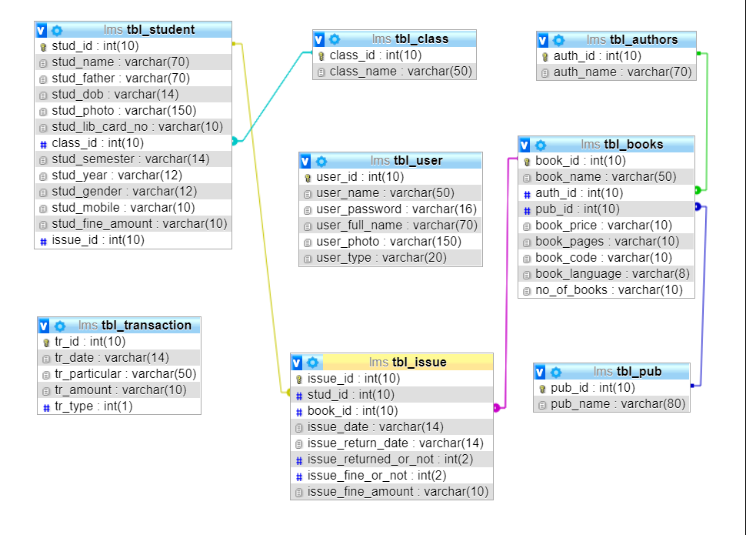
System Design: Entity Relationship ‘ER’ Diagram
An entity-relationship Diagram is an abstract conceptual representation of structured data.

Slide 11
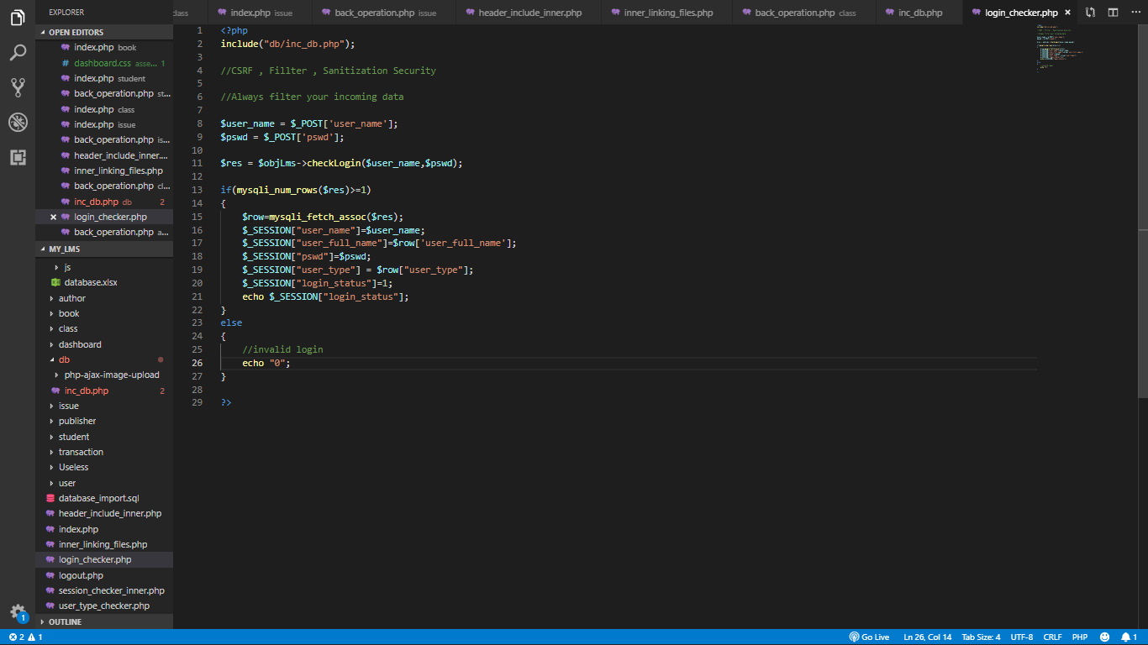
System Design: Coding

Slide 12
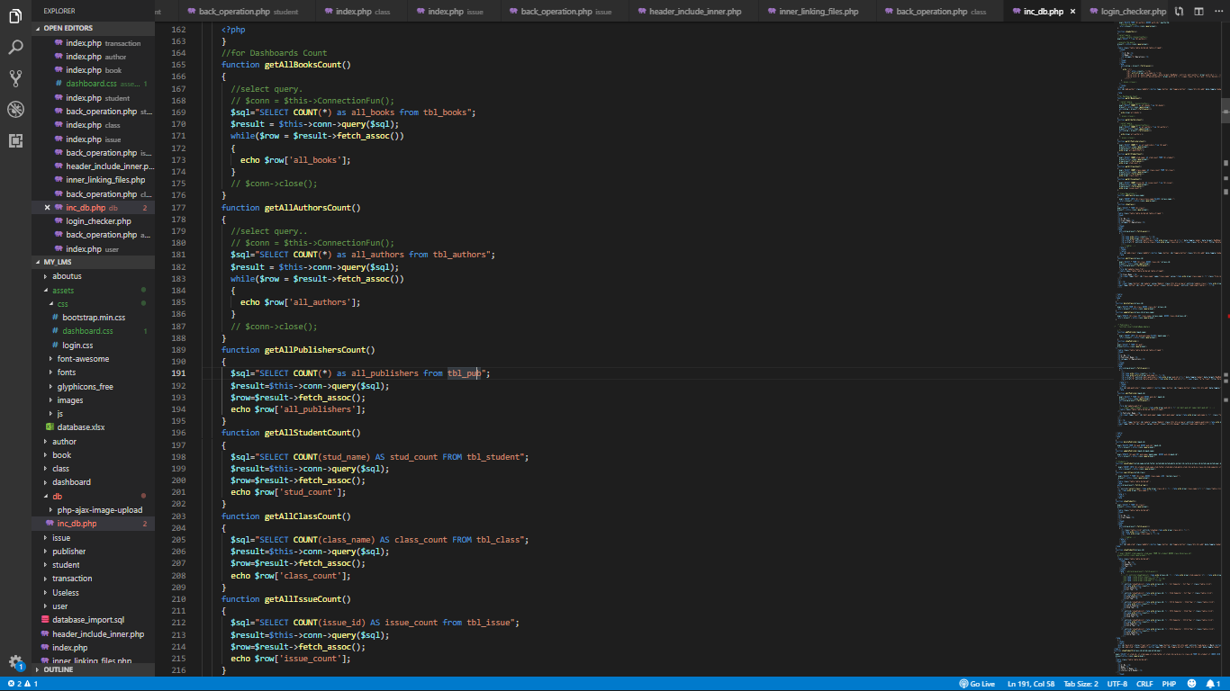
System Design: Coding

Slide 13
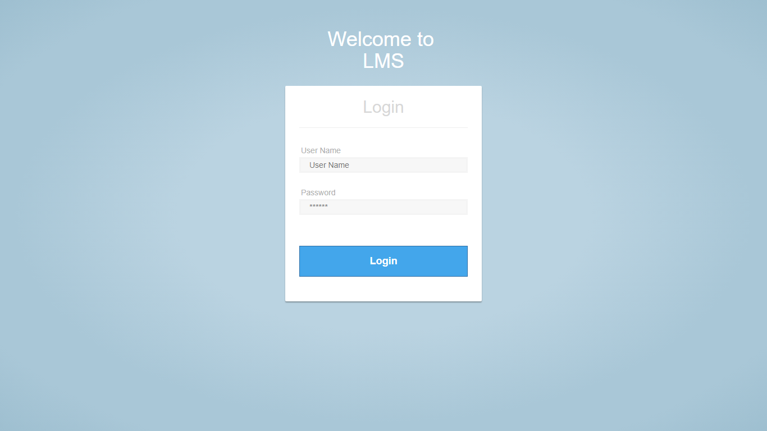
System Implementation: User Manuals
Login Page
This is the index page of the project. Before entering into the system the user has to enter his/her login credentials. There are two type of user in this system. One is normal user and another is administrator. The snap shot of the login page:

Slide 14
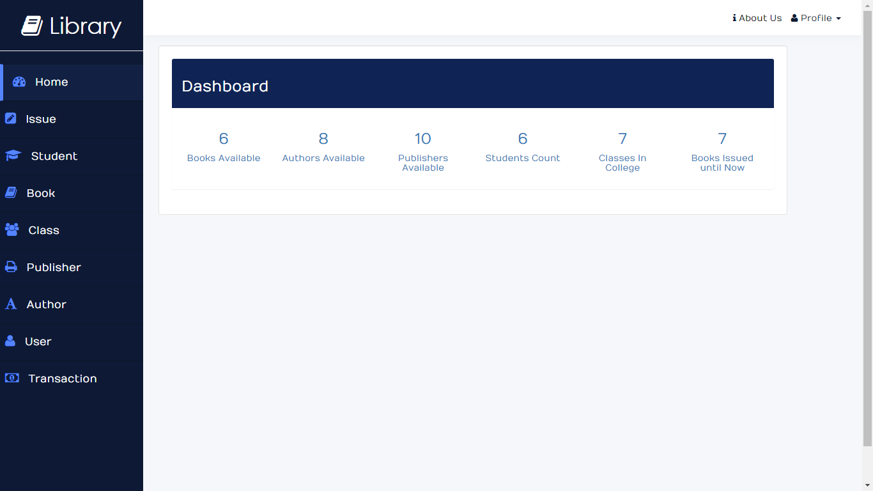
System Implementation: User Manuals
Dashboard
This is the Dashboard page of the system. It contains the link of the every module of the system. After log in the user will be redirected to this page. The dashboard also contains the summary of the transactions.

Slide 15
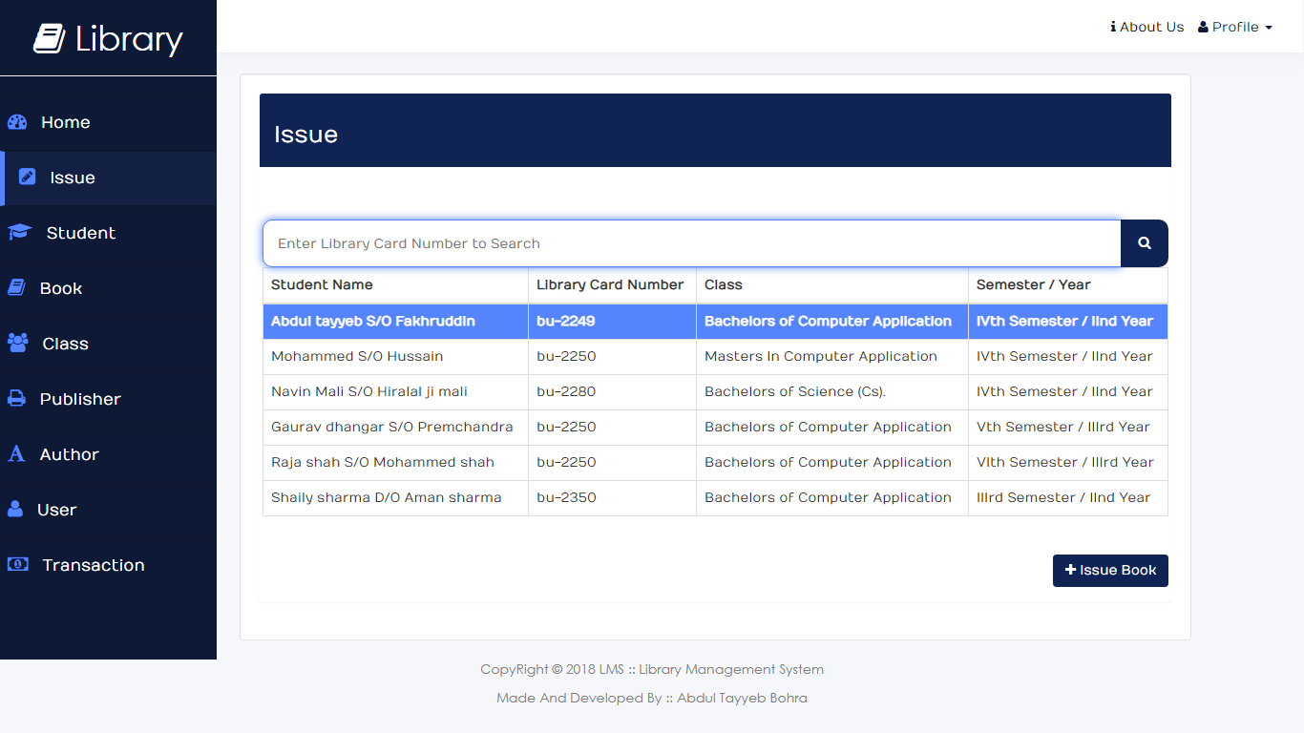
System Implementation: User Manuals
Issue Search
With the help of this page the user can search and select the student to see the books issued to them.

Slide 16
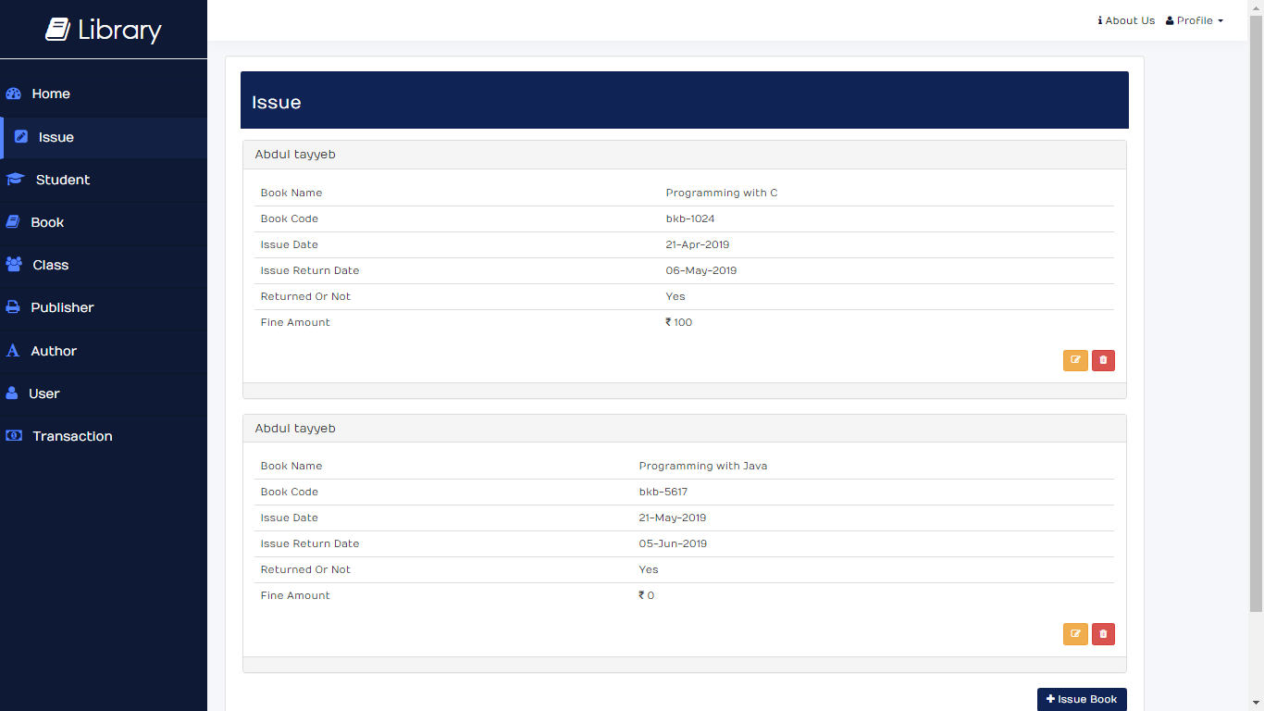
System Implementation: User Manuals
Issue Card
This is page contains the description of the issued book to the student. This page appears when the user selects the student from issue search module.

Slide 17
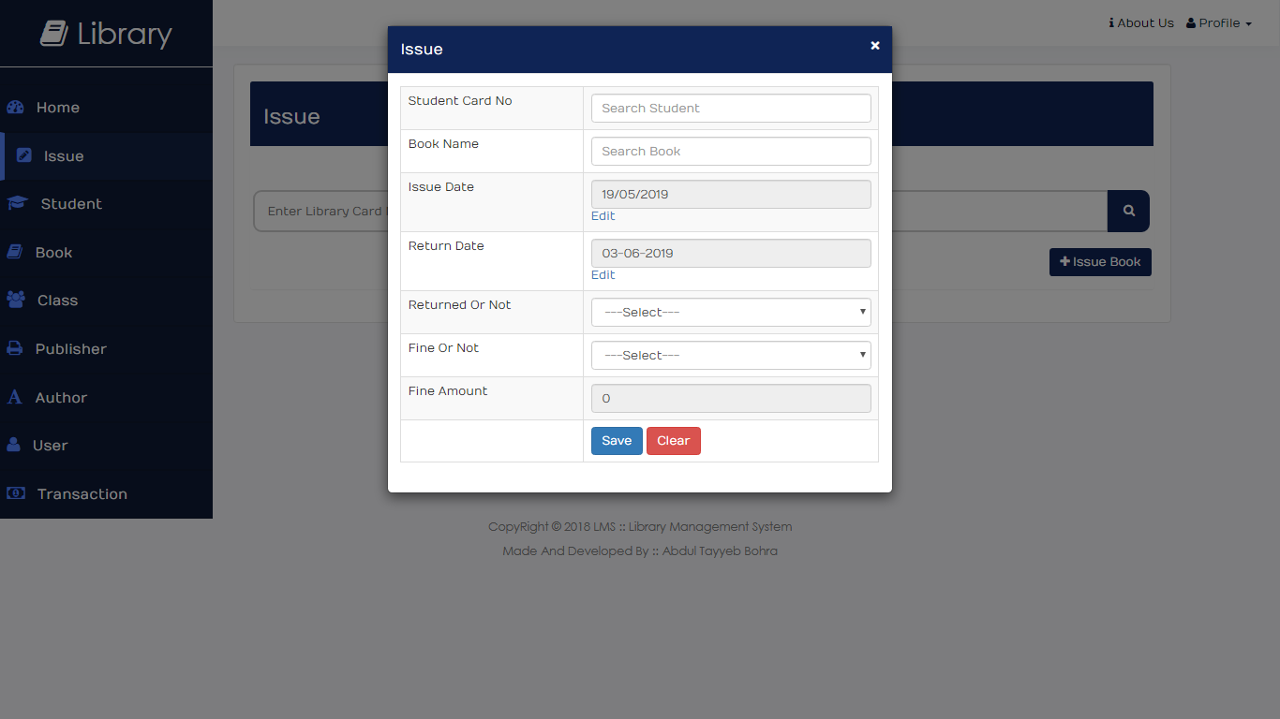
System Implementation: User Manuals
Issue Form
This is the issue form modal. With help of this modal the user can issue the book to the student. This modal can be triggered by clicking issue book button available at bottom right corner.

Slide 18
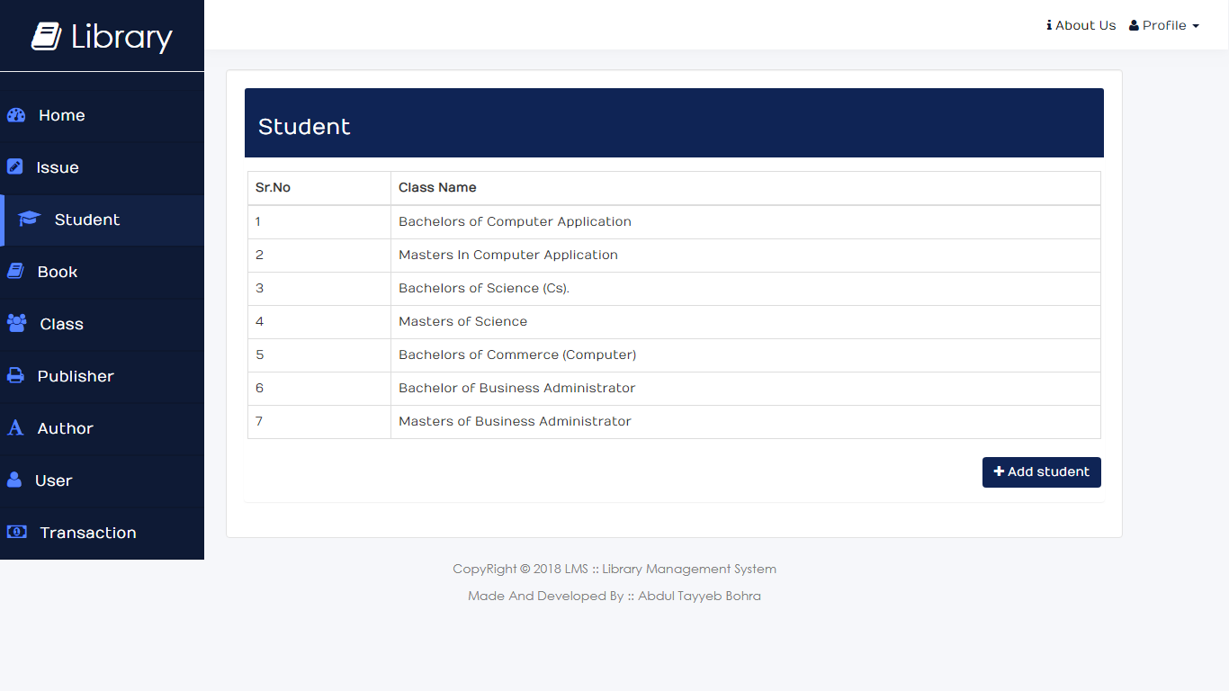
System Implementation: User Manuals
Student Records (Class wise filter)
In this module the user can see the student record. This figure is the list of classes by clicking on one of the class the user will be redirected to the semester list page.

Slide 19
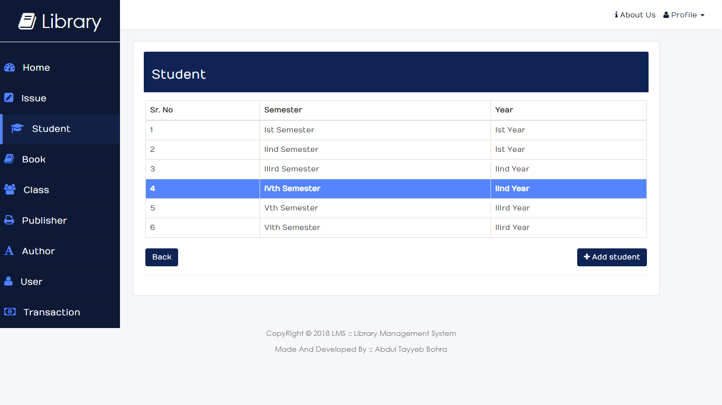
System Implementation: User Manuals
Student Records (Semester / Year wise filter)
This Page appears after the selecting the class shown in previous slide. After Selecting the Semester the user will be redirected to the student records page which shows the student records based on selected class and semester.

Slide 20
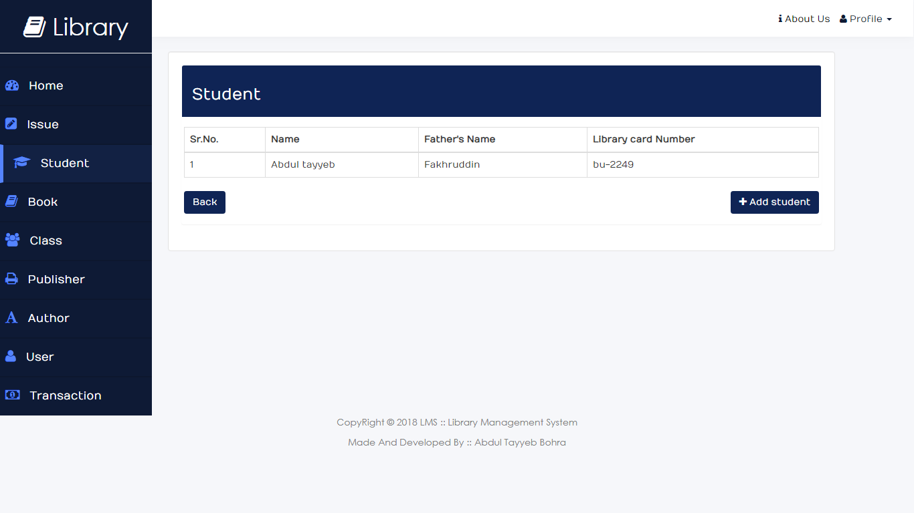
System Implementation: User Manuals
Student Records
This page is the student record page which will show all the student of the particular class and semester or year which was selected in the previous pages.

Slide 21
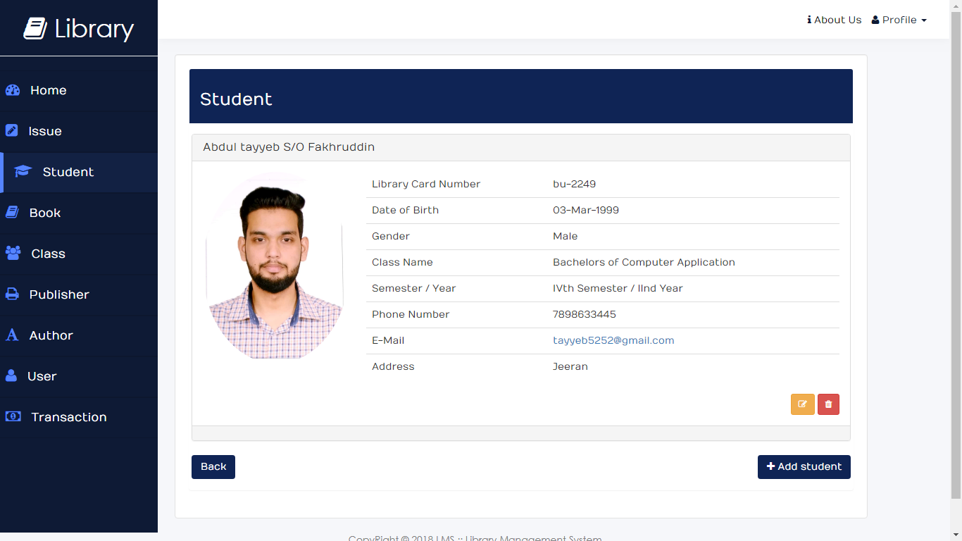
System Implementation: User Manuals
Student Records (Individual)
This page will be appear when user selects one of the student from previous page. This page will display whole information of the student with the picture of the student. The User further edit or delete the student by clicking edit or delete button available on bottom right corner.

Slide 22
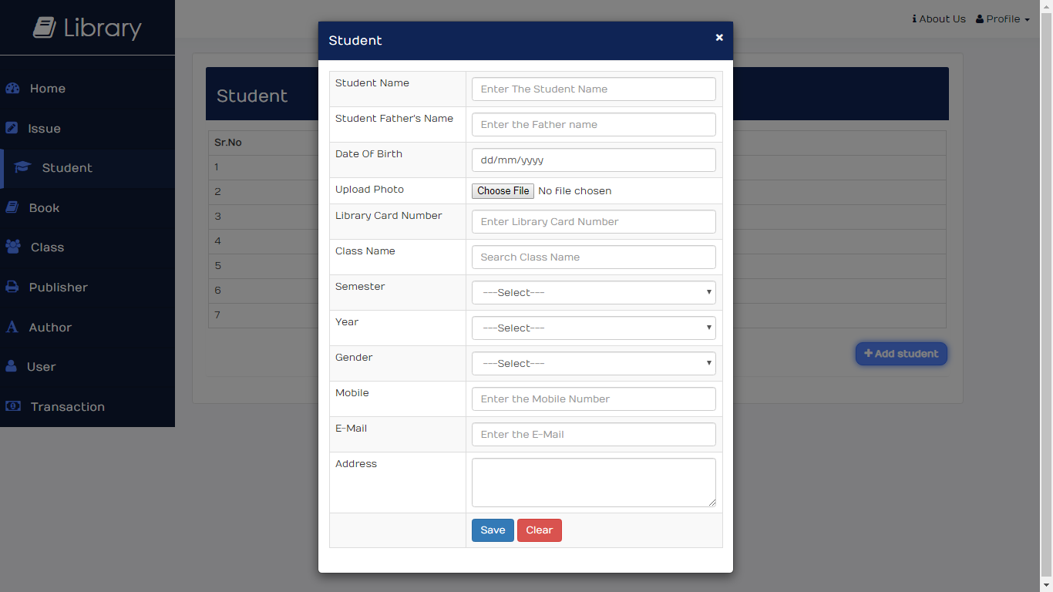
System Implementation: User Manuals
Student Entry
With the help of this modal the user can add the student record. This modal can be triggered by clicking Add Student button on bottom right corner of the page.

Slide 23
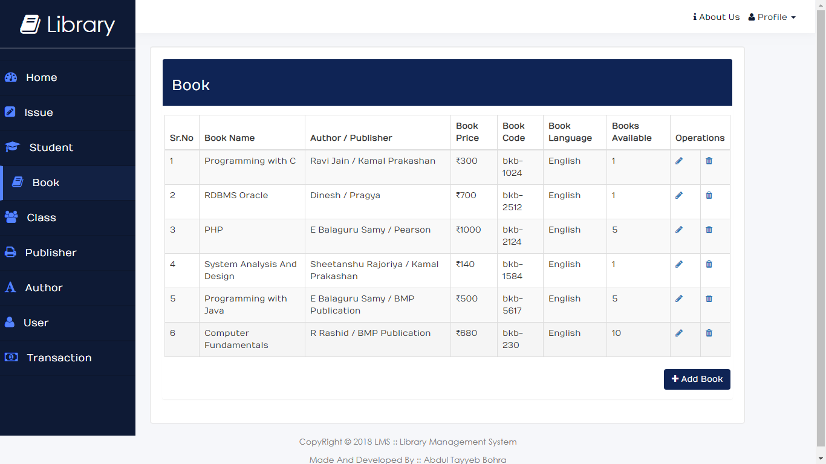
System Implementation: User Manuals
Books Records
This page displays the book available in the library. With The help of this Page the user can insert update and delete the books.

Slide 24
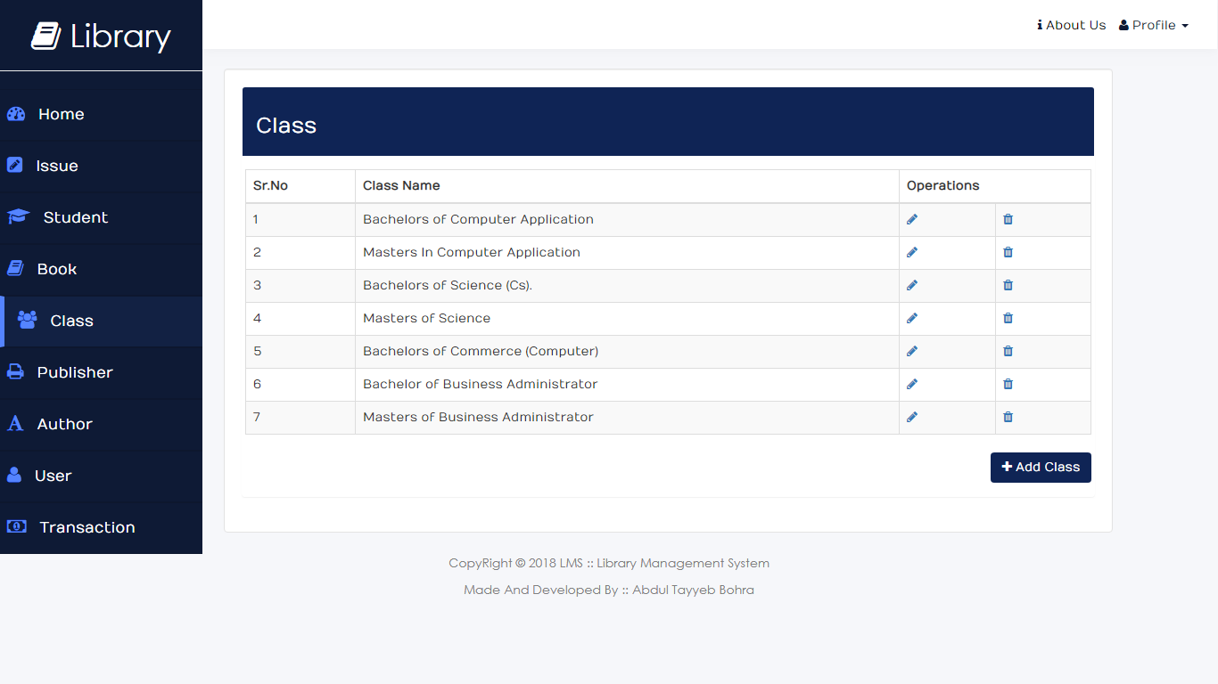
System Implementation: User Manuals
Class Records
This page shows the class records.

Slide 25
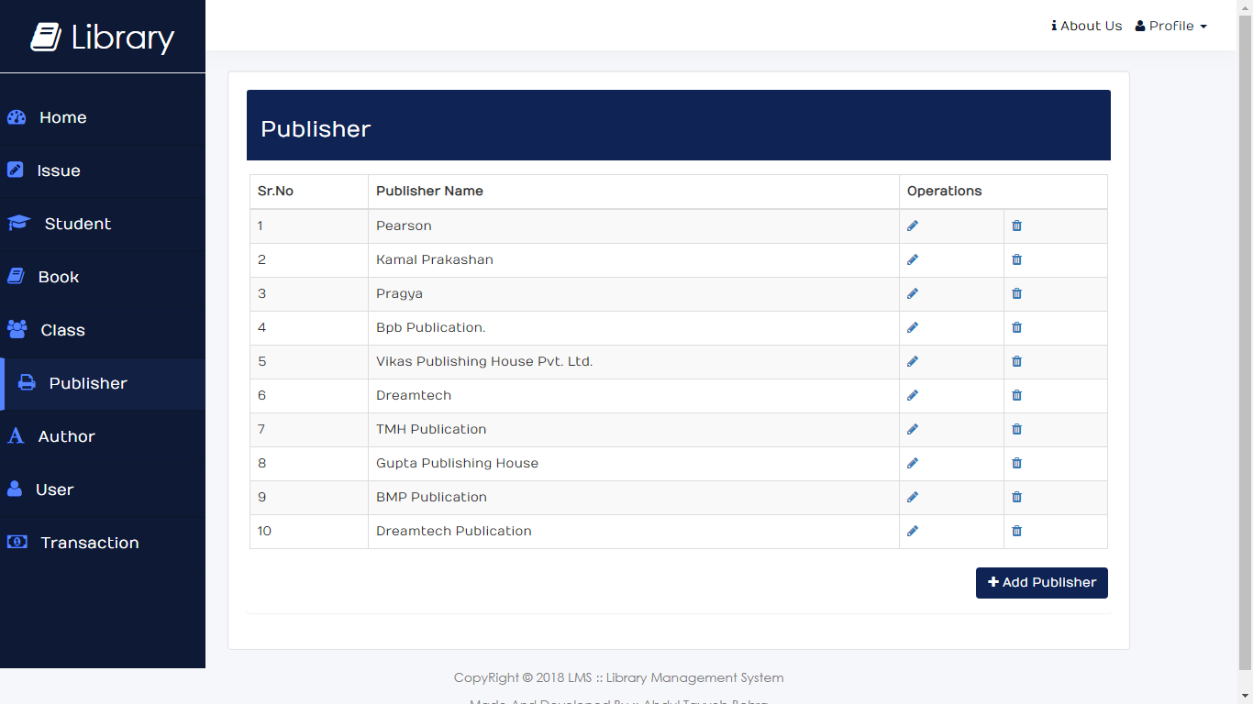
System Implementation: User Manuals
Publisher Records
This page shows the publishers available in the library

Slide 26
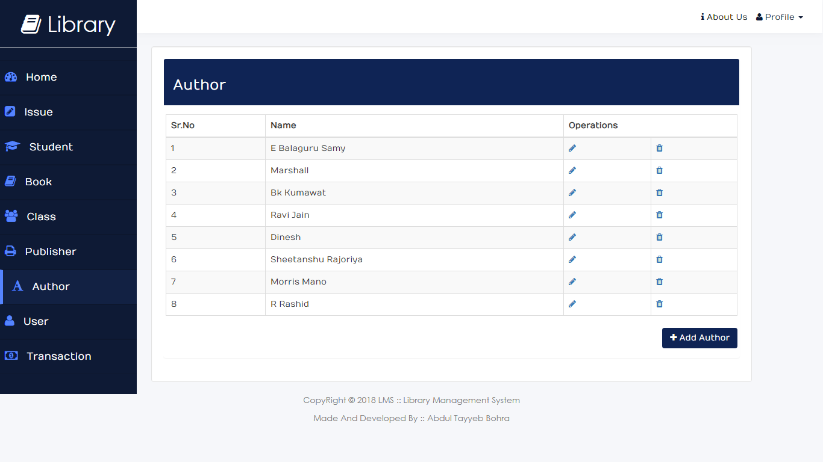
System Implementation: User Manuals
Author Records
This page shows the author available in the library.

Slide 27
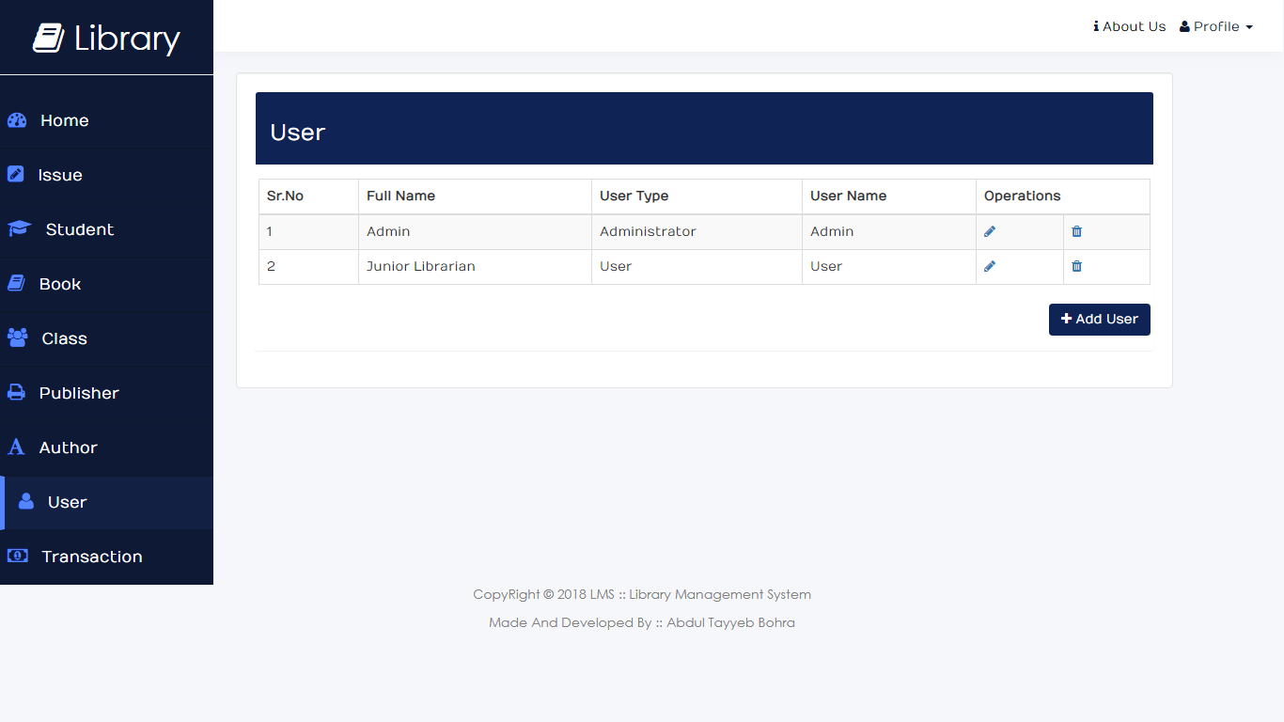
System Implementation: User Manuals
User Records
This module is only available for the user with administrative privilege. With the help of this page the user can manage the user of the system

Slide 28
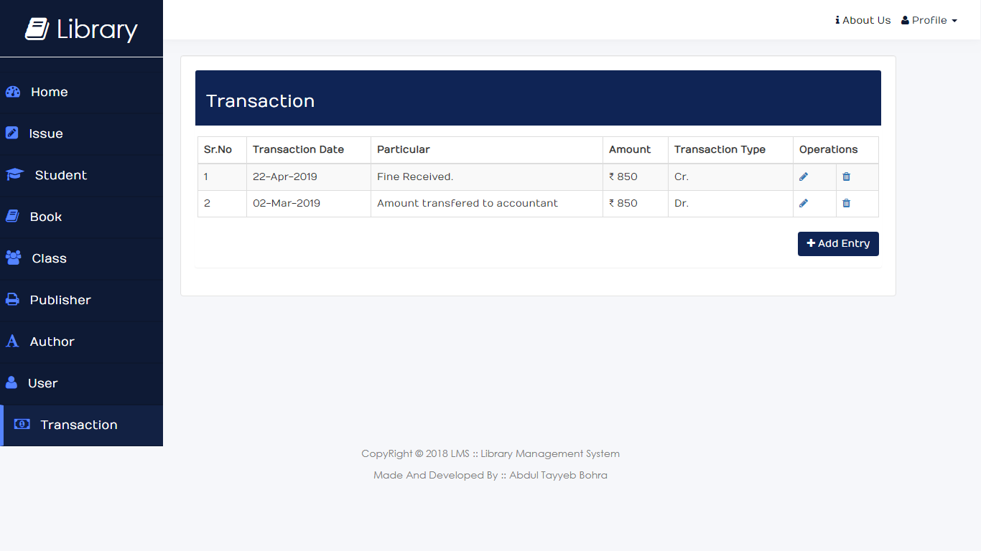
System Implementation: User Manuals
Transaction Records
This module is also only available for the user with administrative privilege. With the help of this module the user can manage the day to day monetary transaction of the library.

Slide 29
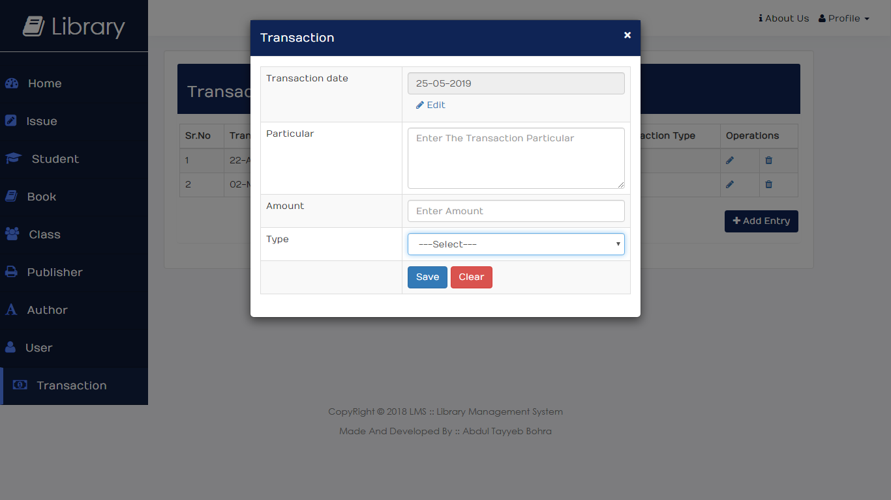
System Implementation: User Manuals
Transaction Entry
This is a transaction entry module. With the help of this modal the admin can record a transaction.

Slide 30
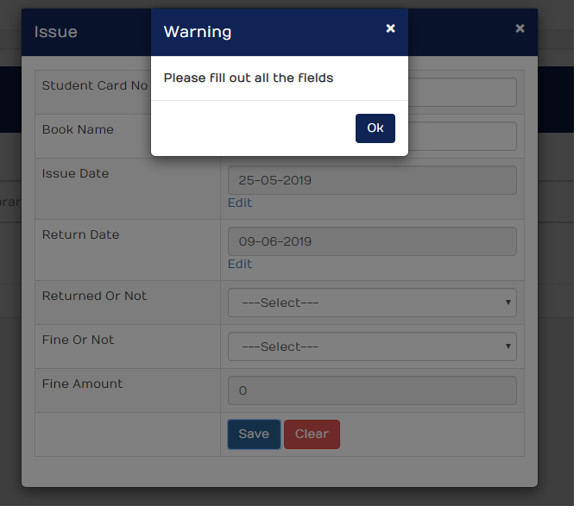
System Implementation: User Manuals
Warning Modal
The warning modal appears when user misses the required field of the form

Slide 31
System Implementation: User Manuals
Message alert
The Message regarding the insert, update, delete operations will display in following ways.

Slide 32
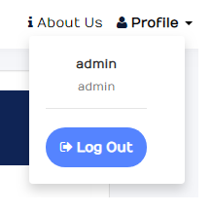
System Implementation: User Manuals
Profile dropdown
The profile dropdown appears when the user clicks the profile menu from the navbar. It contains the log out button to log out the user from the system.

Slide 33

Library Management System by Abdul Tayyeb Supervisor: Prof. hitesh patidar Balkavi Bairagee College

