Slide 1

Full-Stack and nothing else matters
Bu-Ali Sina University, Summer 2019

Slide 2
Session 1

Slide 3
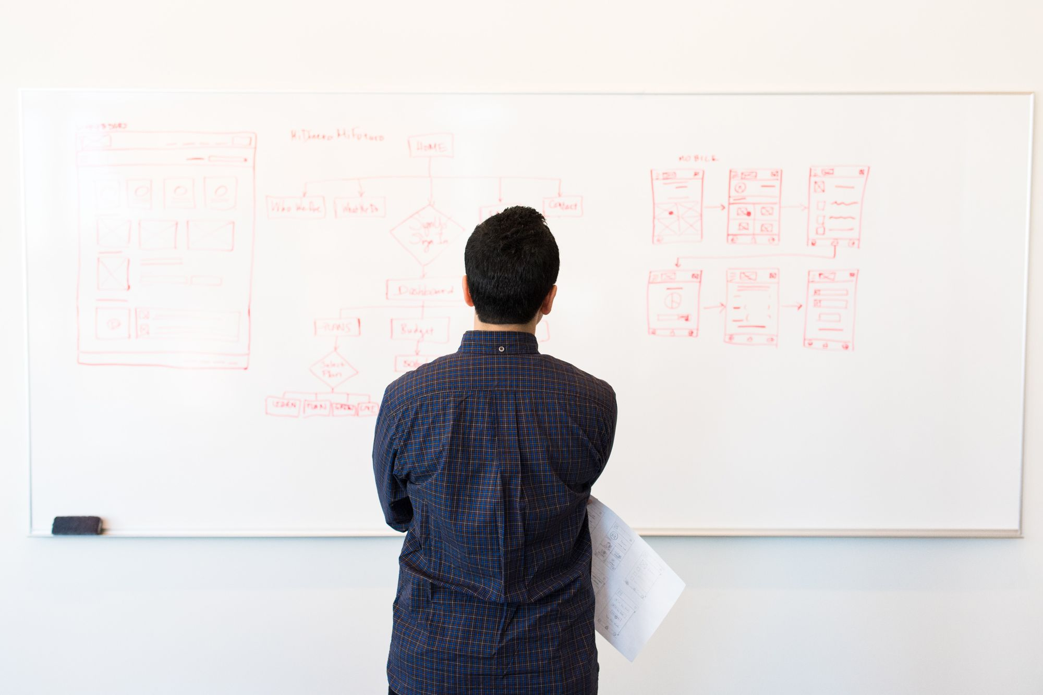


Greetings

Slide 4

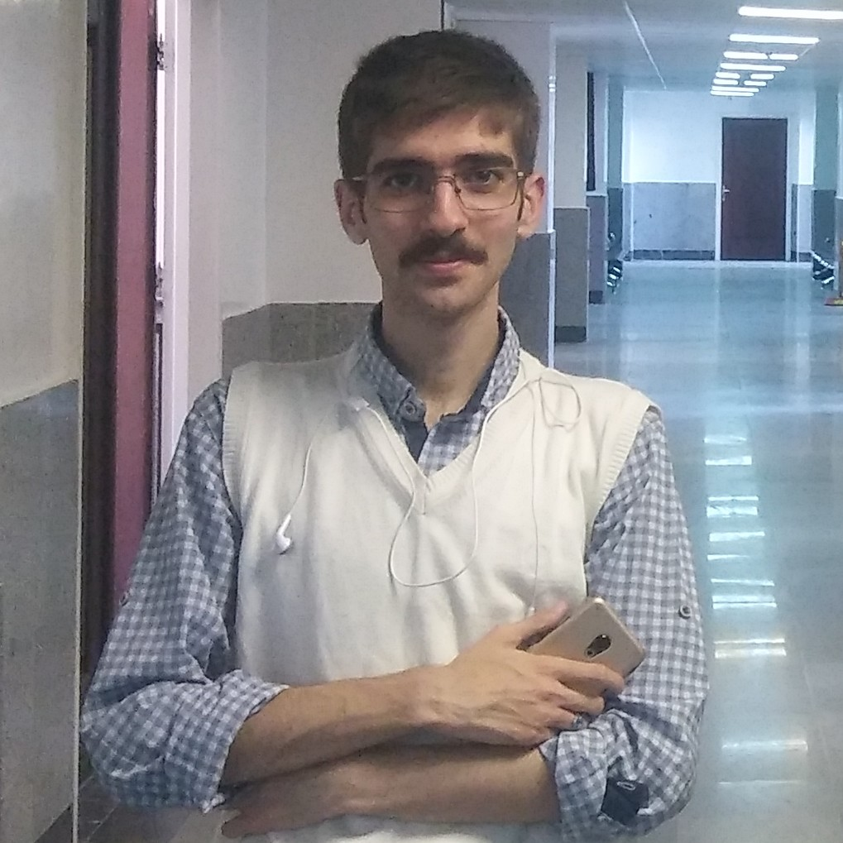
MOHAMMAD R. TAYYEBI
Undergraduate, Computer Engineering
Background:
WorldSkills Competitor,
Khwarizmi Awarded
Contacts:
mailto:rexa@gordarg.com
http://kouy.ir/tayyebi

Slide 5
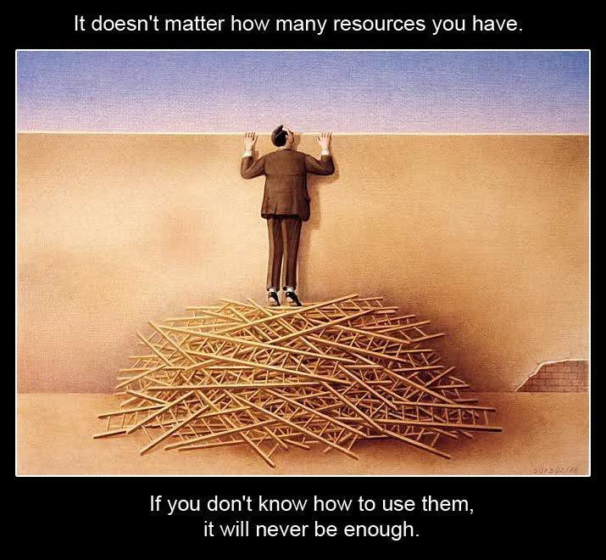

Slide 6
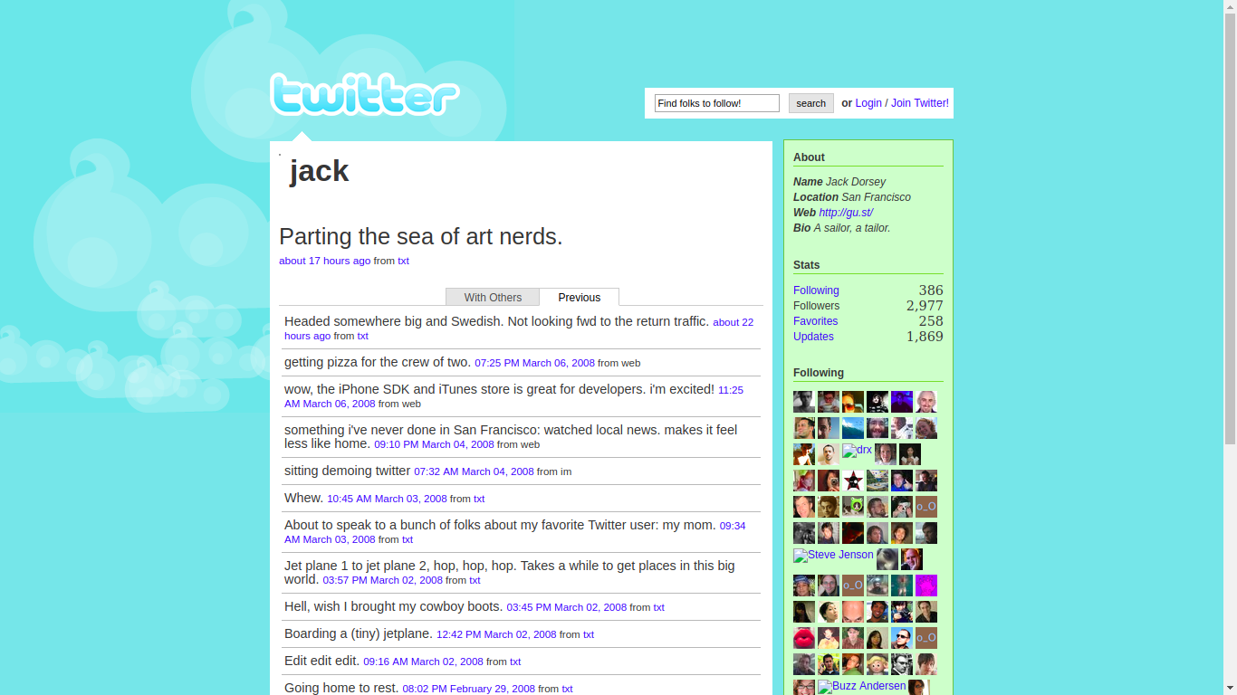
Project

Slide 7
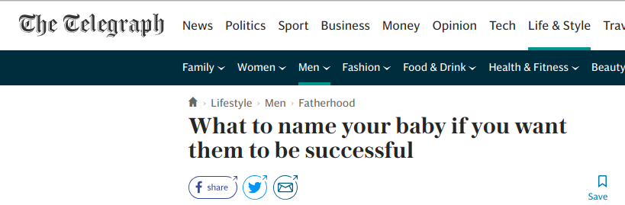
named.service
Let’s call it Kuku
Common Cuckoo
kukuapp.ir

Slide 8


Twitter Logo (Just4Fun)

Slide 9
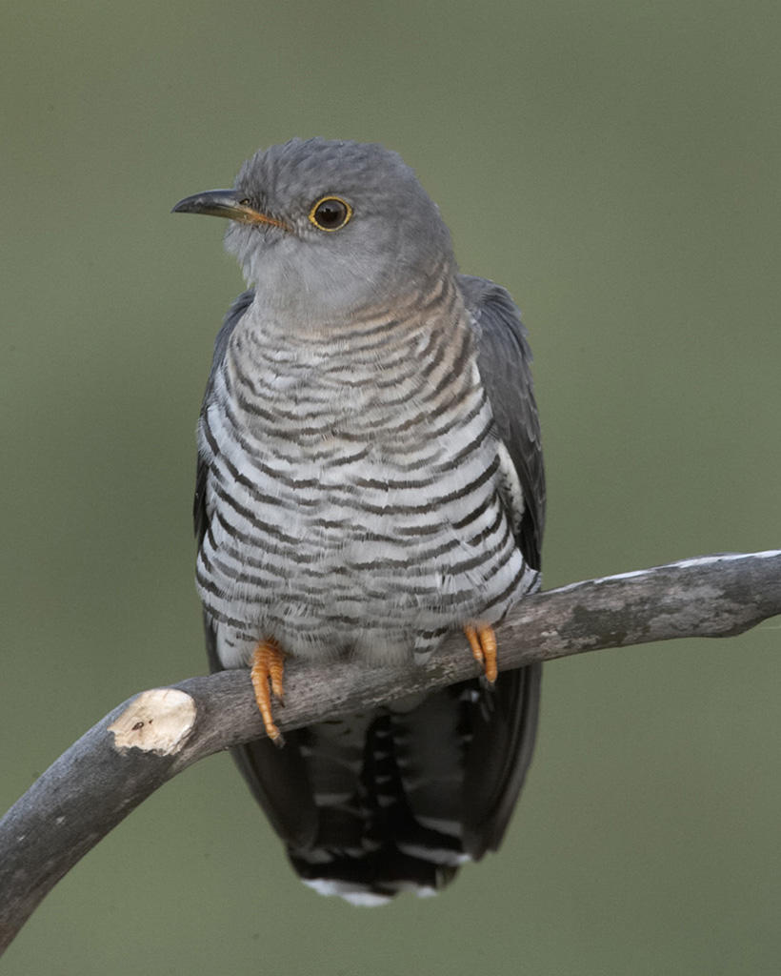

KUKU LOGO

Slide 10
Limitations
Are them real?
“What if not … “

Slide 11
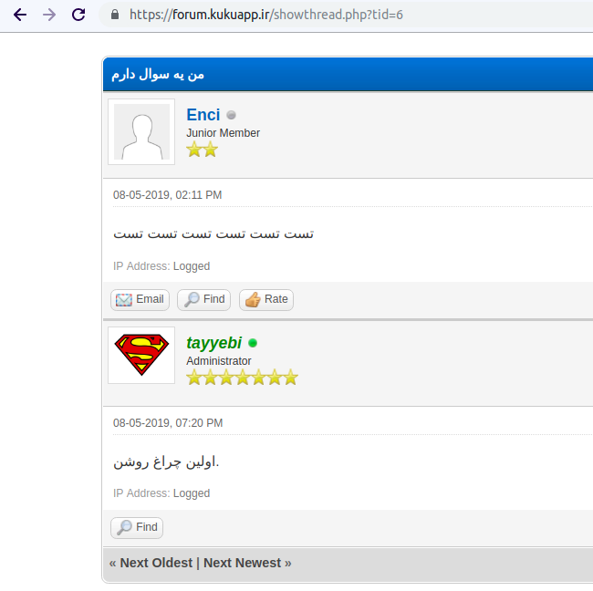
Forum

Slide 12
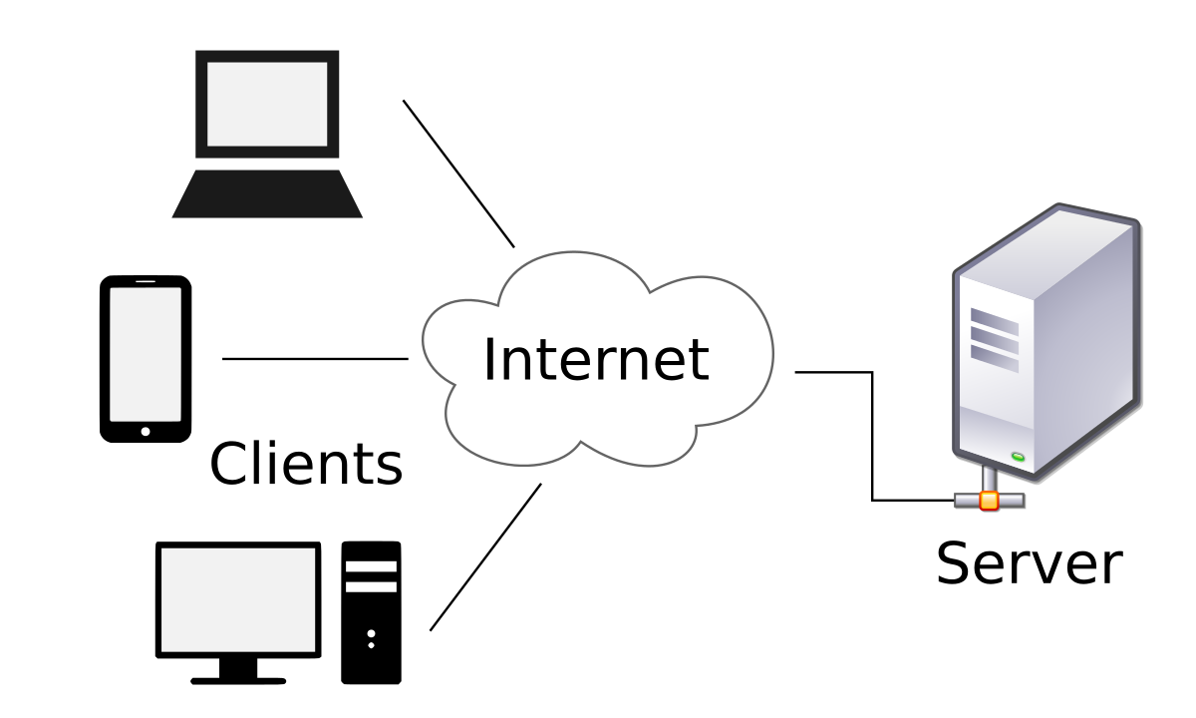
Demo
http://Skills.Community
Website
App (Flutter)

Slide 13
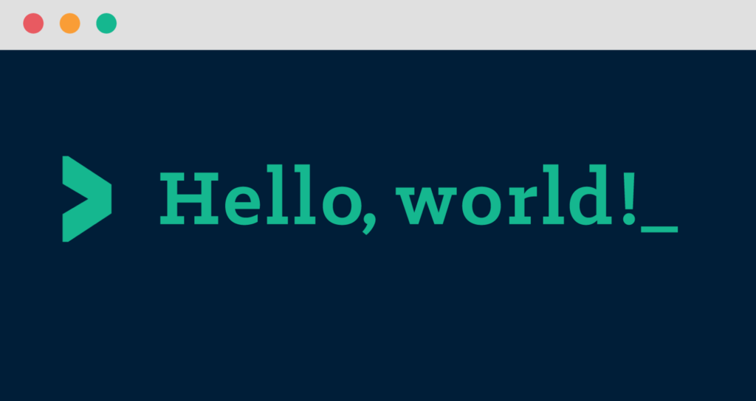
Implementation
Hands on HTML, CSS, and JS

Slide 14
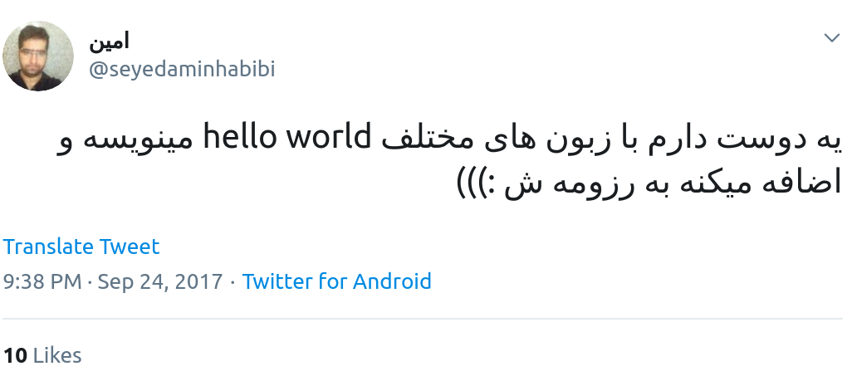

We just quote content, and shout their author’s name for rights!
No responsibility about any mentioned person or reference!

Slide 15
Resources and Images
https://www.chrisblakely.dev/the-10-minute-road-map-to-becoming-a-junior-full-stack-web-developer/
https://www.reddit.com/r/im14andthisisdeep/comments/7ouel5/it_doesnt_matter_how_many_resources_you_have_if/
https://www.audubon.org/field-guide/bird/common-cuckoo
https://web.archive.org/web/20080309215840/http://twitter.com/Jack

Slide 16
Resources and Images
https://www.adweek.com/brand-marketing/how-twitters-logo-perched-in-our-cultural-consciousness-and-came-to-signify-the-brand-all-by-itself/
https://hackernoon.com/a-repository-with-the-example-of-printing-hello-world-in-a-lot-of-programming-languages-1f870ad8d167
https://en.wikipedia.org/wiki/Client%E2%80%93server_model

Slide 17

Session 2

Slide 18
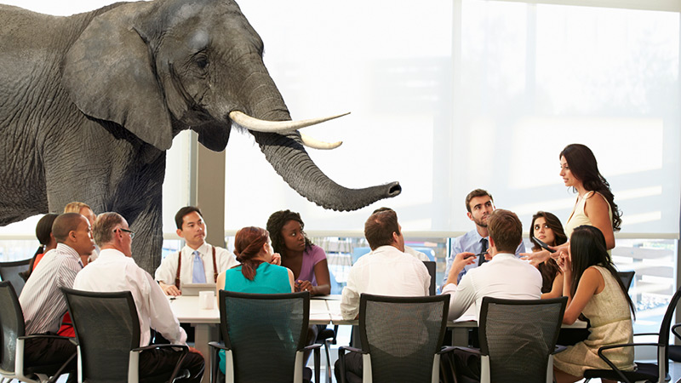
"Elephant in the room" is a metaphorical idiom in English for an obvious problem or risk that no one wants to discuss. Wikipedia

Slide 19
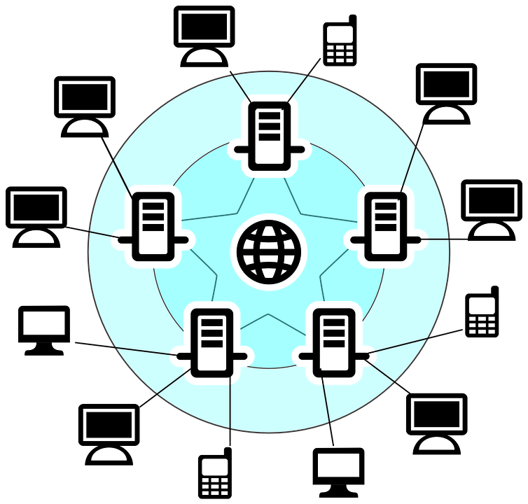
Session 1 - Review
What is Internet?

Slide 20
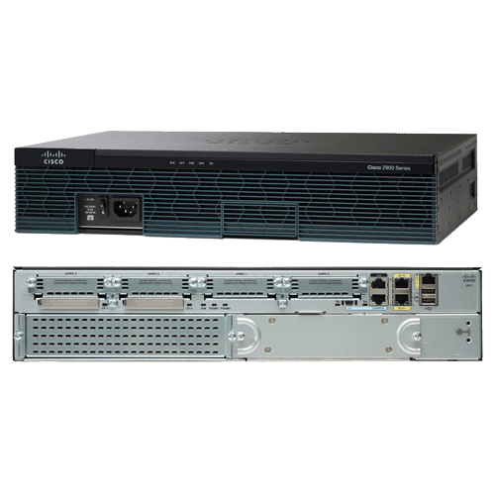
Session 1 - Review
Lower level network. (Router)

Slide 21
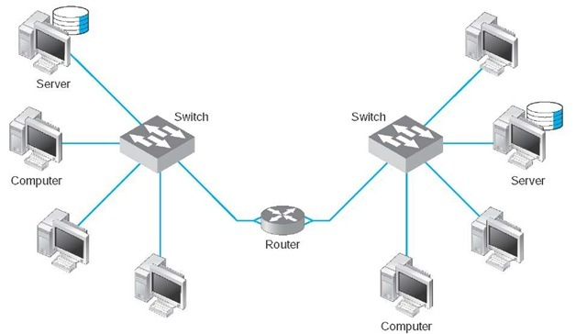
Session 1 - Review
Lower level network. (Router)

Slide 22
Session 1 - Review
Routers in Internet?

Slide 23
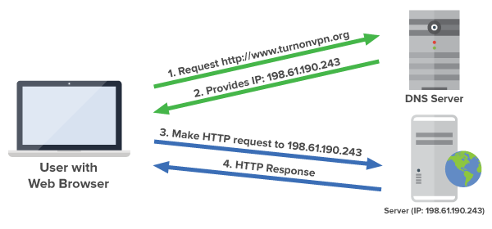
Session 1 - Review
Lower level network. (Domain Name Server)

Slide 24
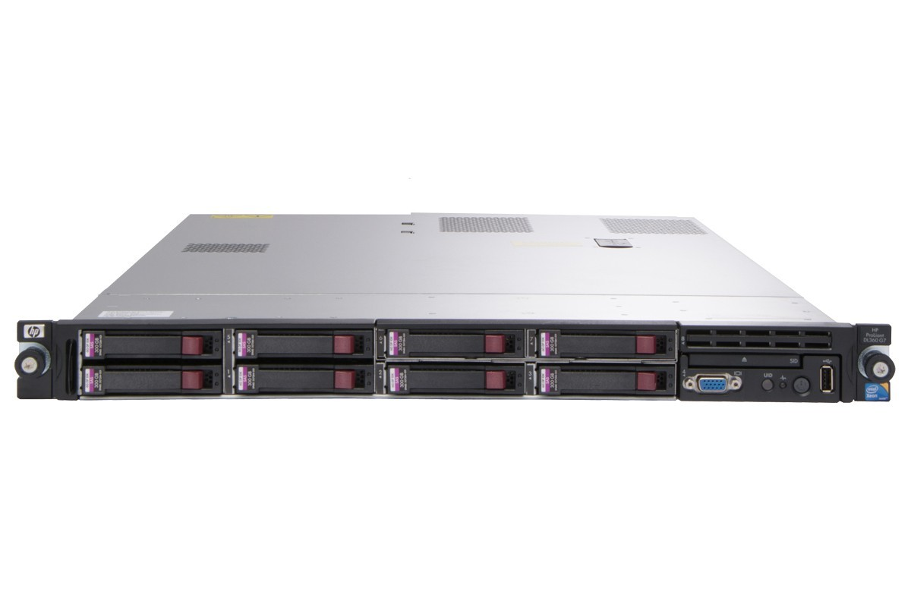
Session 1 - Review
Best machine for a hosting server

Slide 25
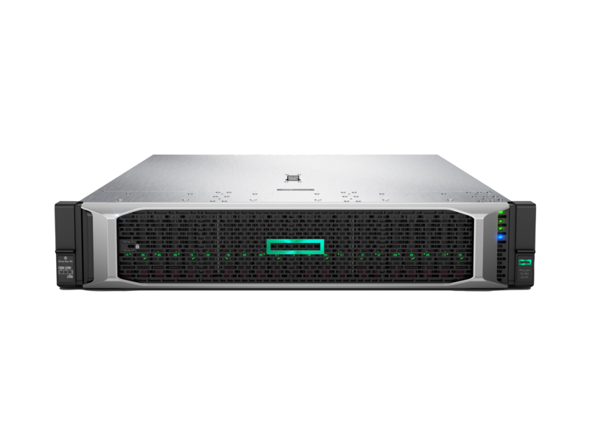
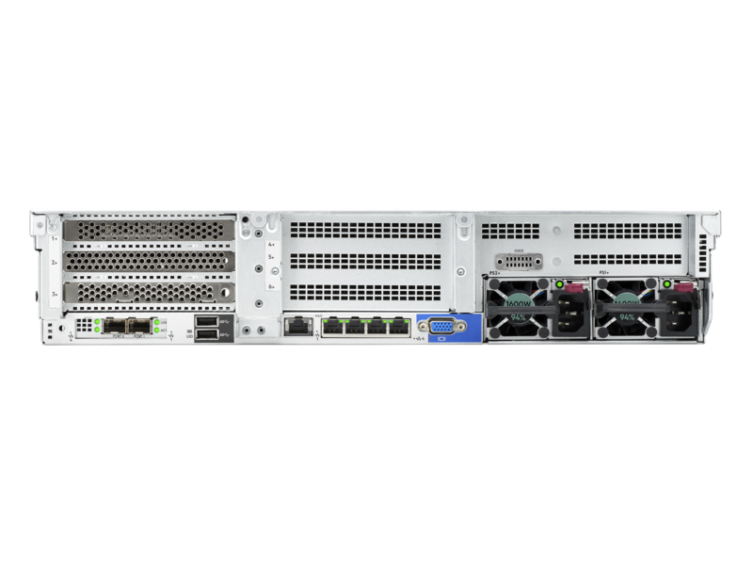
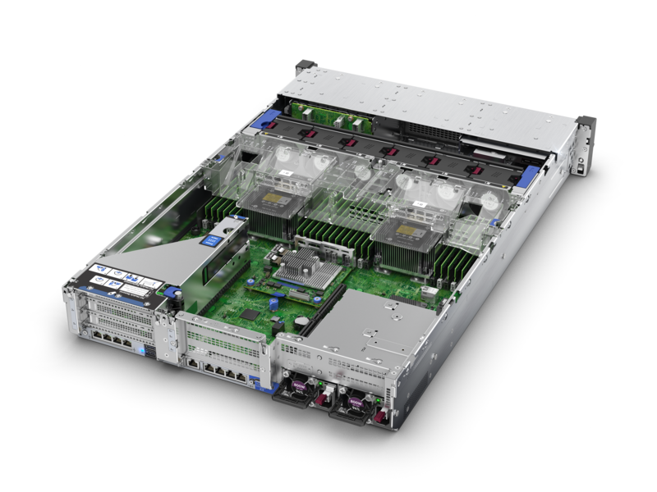
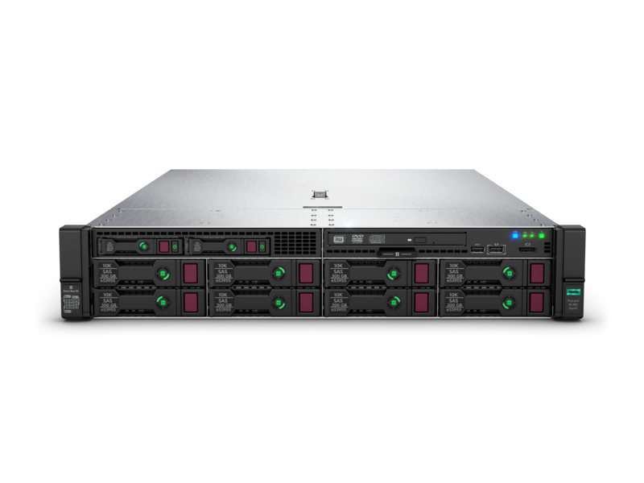
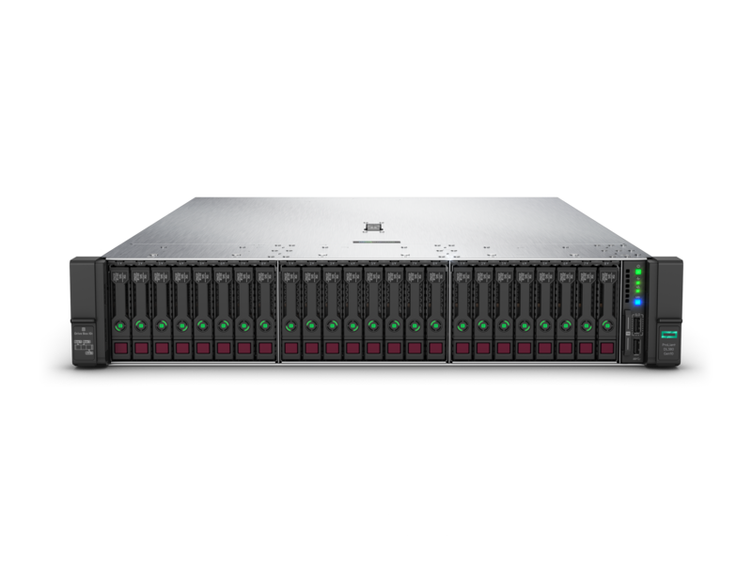
Session 1 - Review
Best machine for a hosting server

Slide 26

Session 1 - Review
HP ProLiant DL380 G10

Slide 27
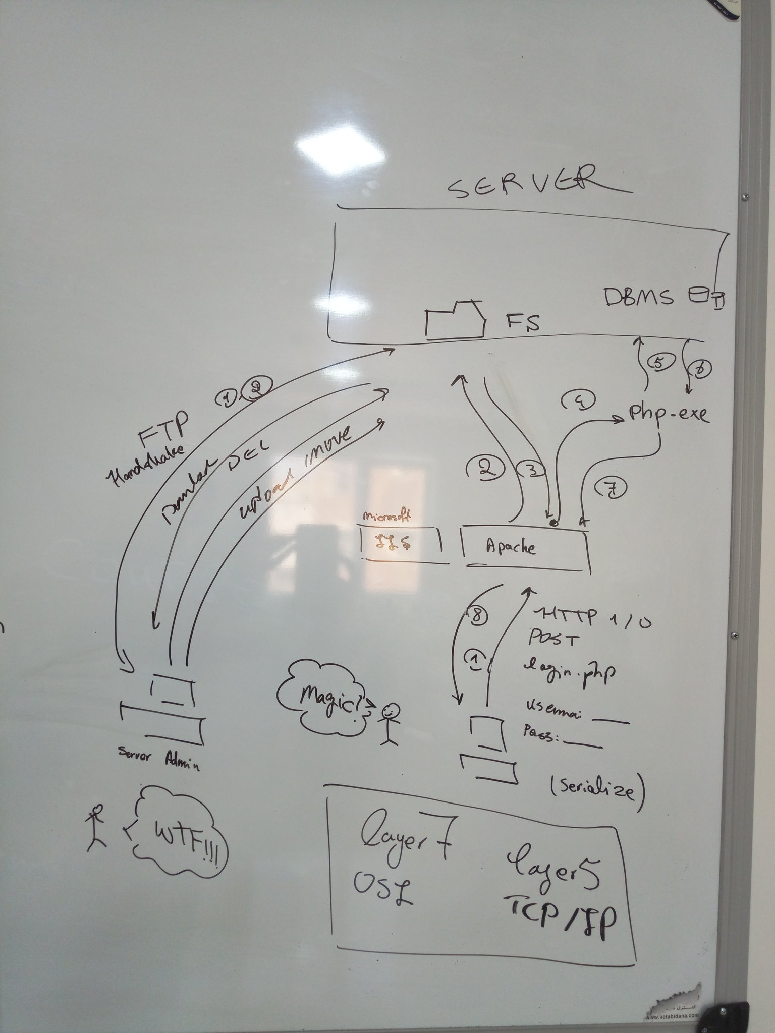
Session 1 - Review
What is a Web Server?

Slide 28
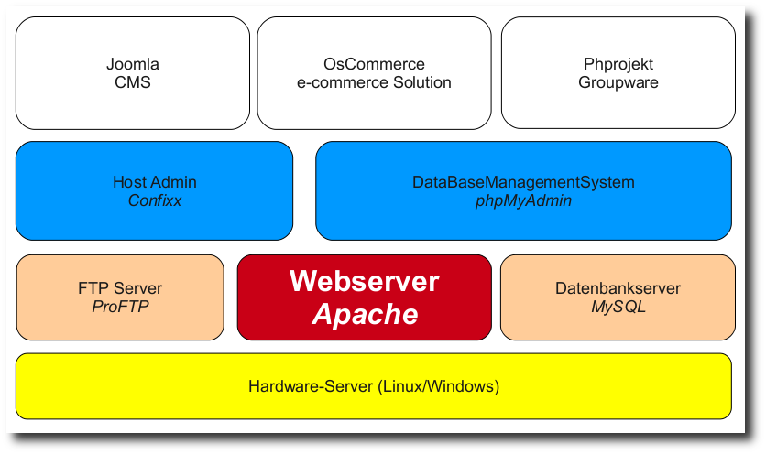
Session 1 - Review
What is a Web Server?

Slide 29
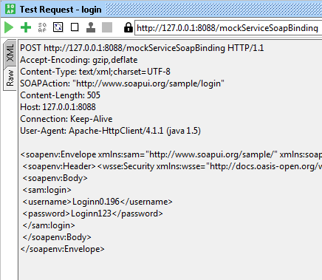
Session 1 - Review
HTTP Header

Slide 30
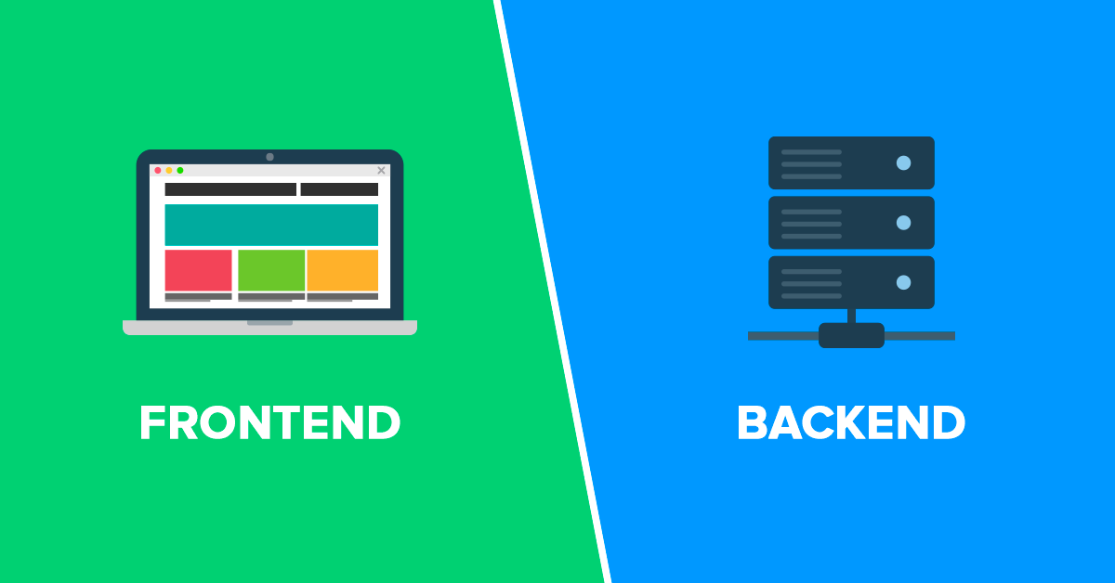
Session 1 - Review
What is a client-side program?

Slide 31

Session 1 - Review

Slide 32
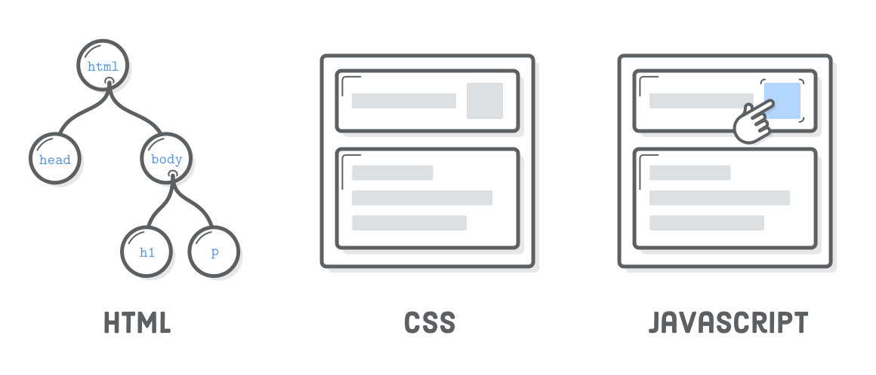
Session 1 - Review

Slide 33


Slide 34
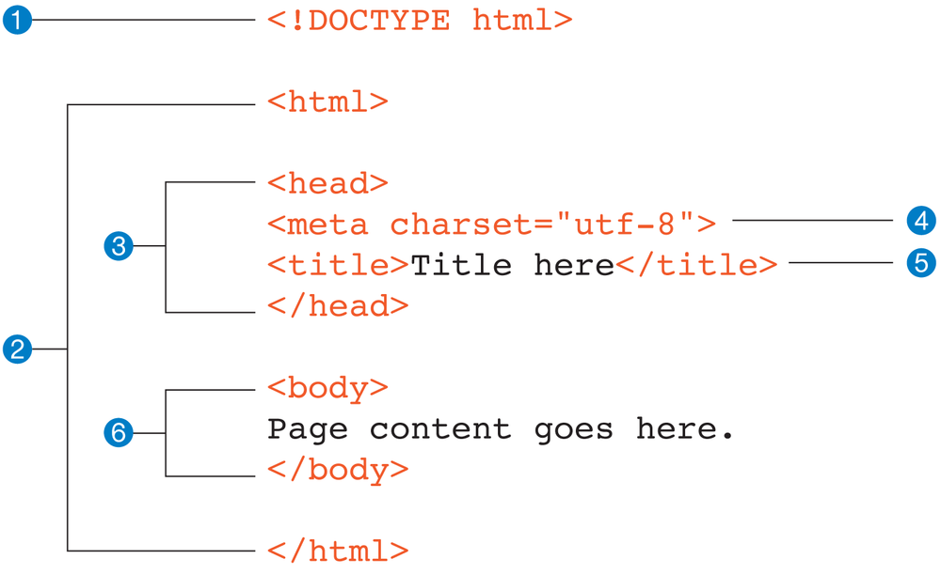
Session 1 - Review

Slide 35
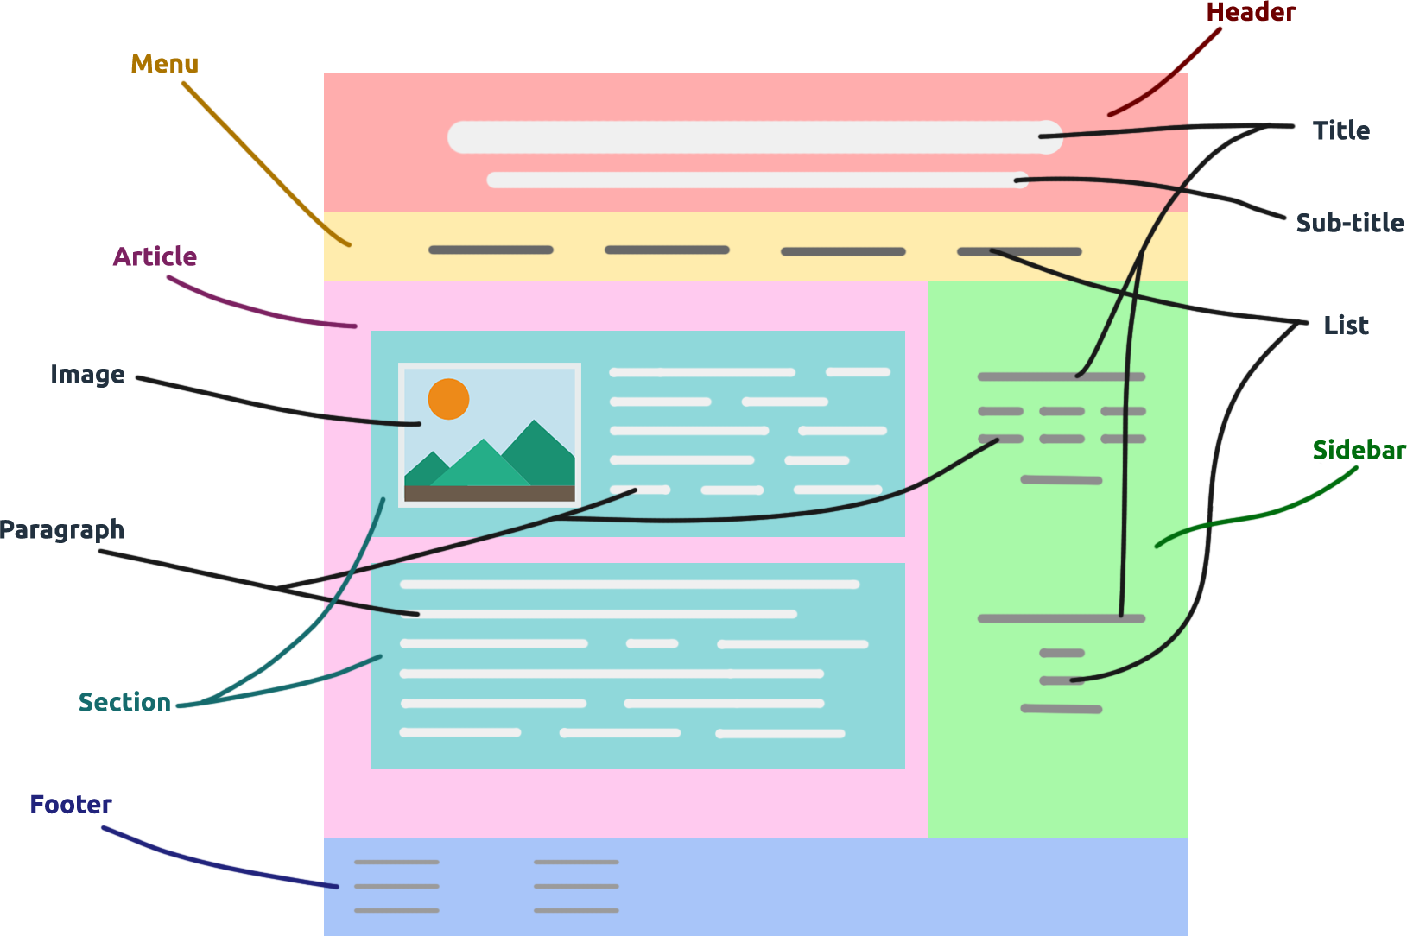
Session 1 - Review

Slide 36


Slide 37
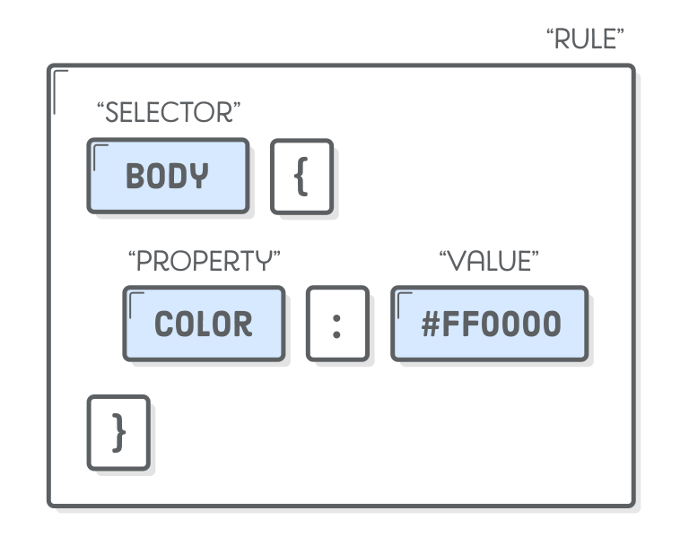
Session 1 - Review

Slide 38
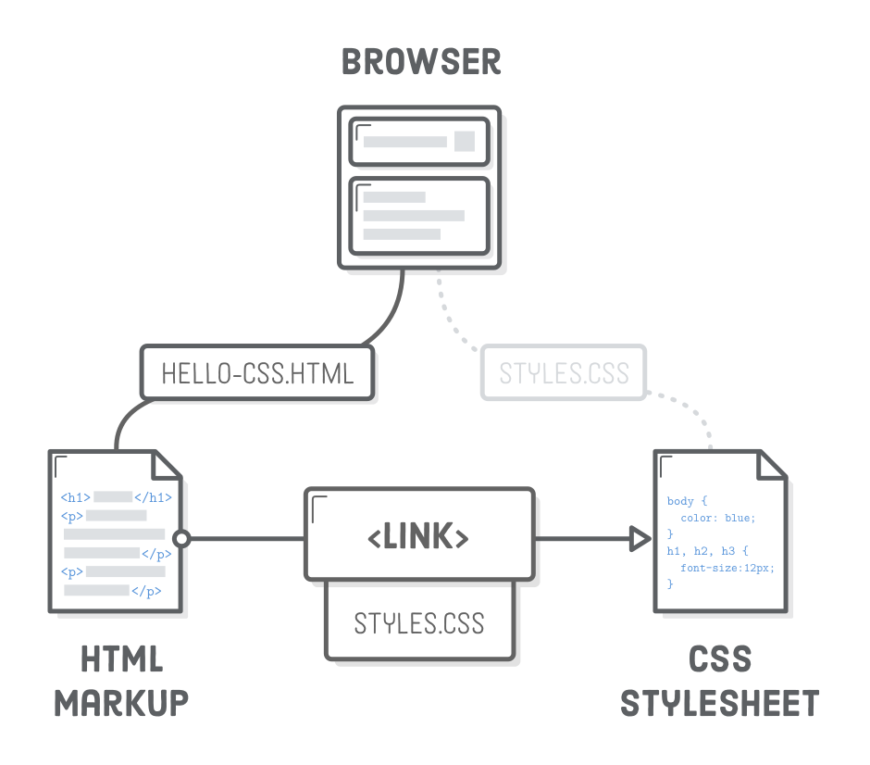
Session 1 - Review

Slide 39
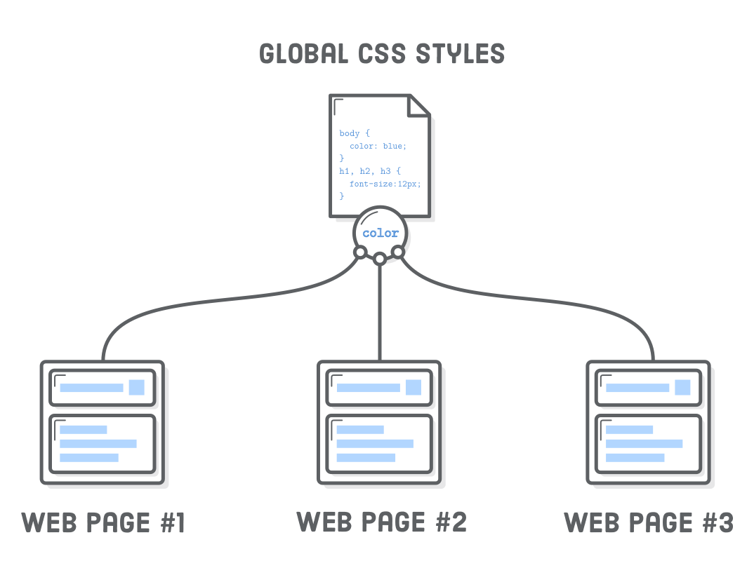
Session 1 - Review

Slide 40


Slide 41

Session 1 - Review

Slide 42

Session 1 - Review
Codes, Codes, Codes everywhere!

Slide 43

Session 1 - Review
Solution,

Slide 44
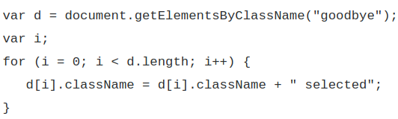


Session 1 – Review

Slide 45
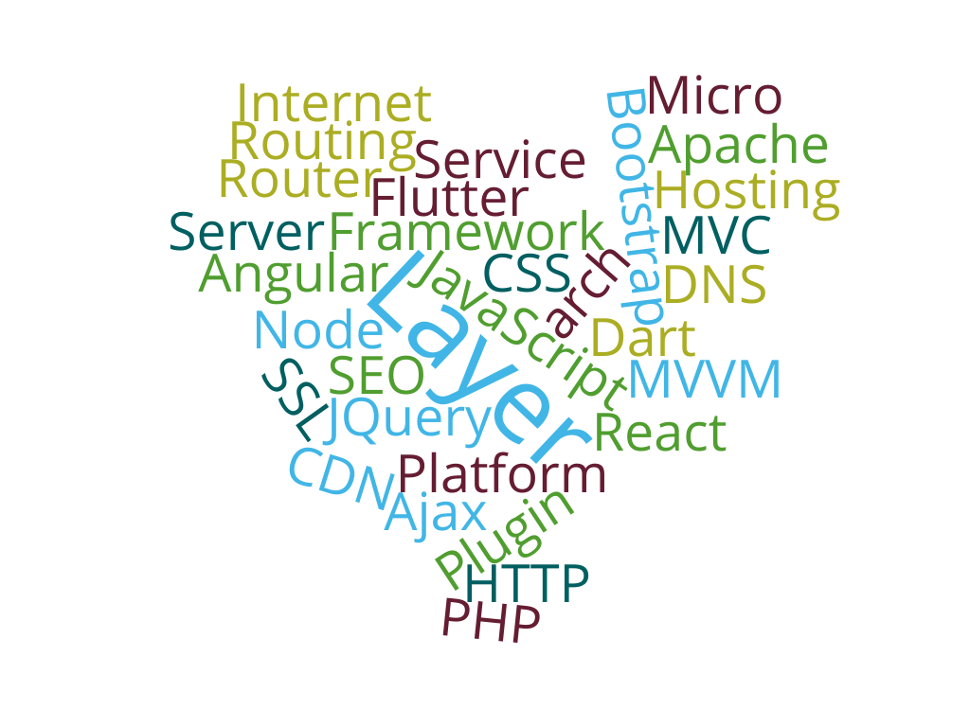
Session 1 - KWRDs
(Thanx to wordclouds.com)

Slide 46

Very first days

Slide 47

Last days :))))))

Slide 48

(10:10)
Every night to check the Forum

Slide 49
Forum Top Members (S1)
From community for the community
We are proud of you! <3

Slide 50
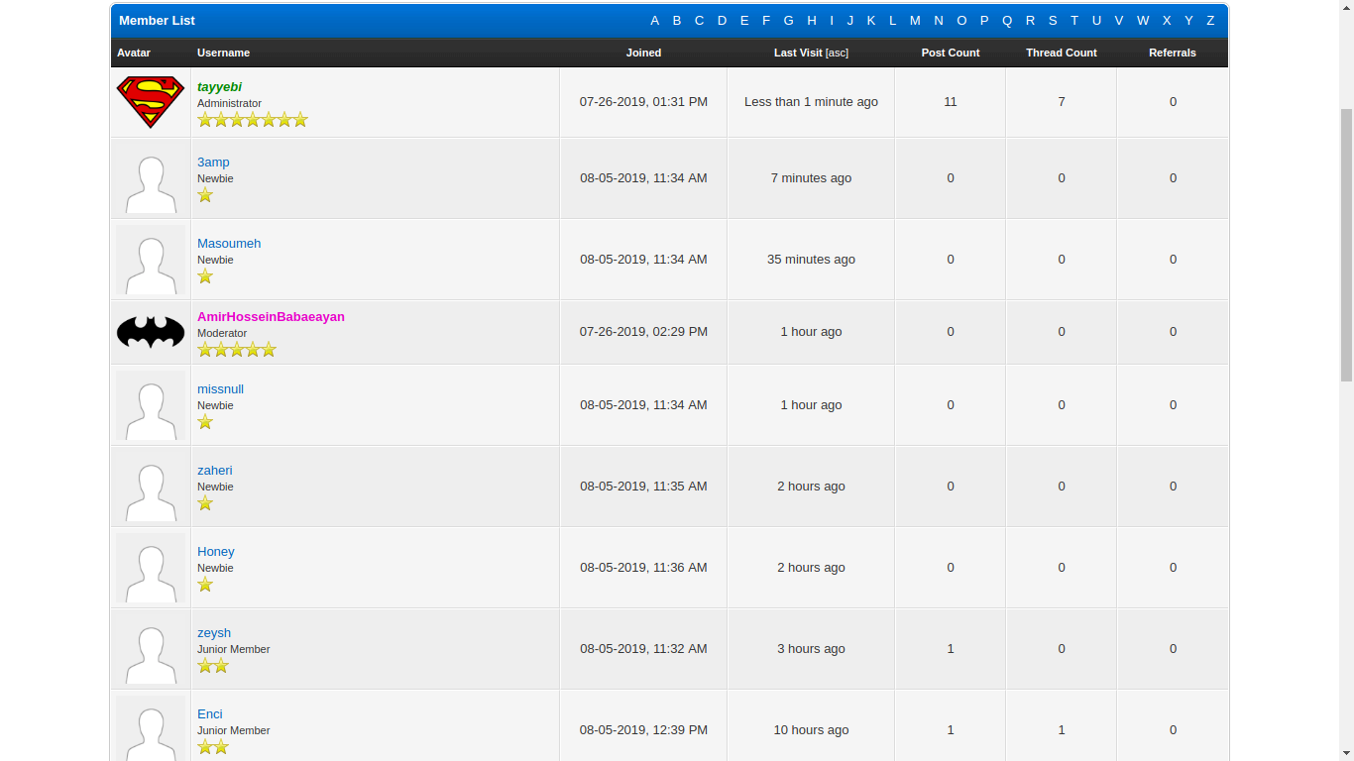

Slide 51


Slide 52
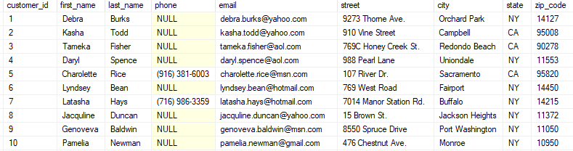
Table

Slide 53
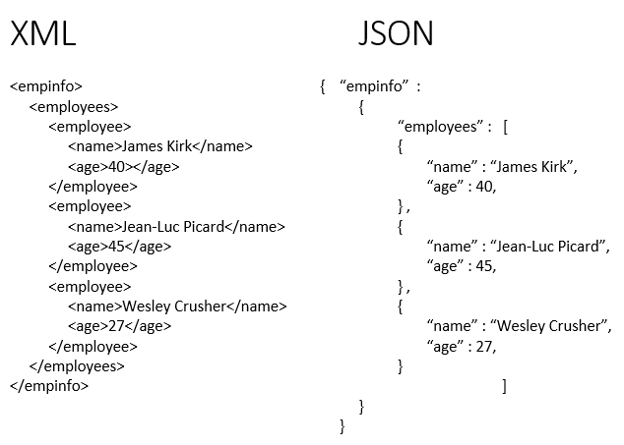

Slide 54
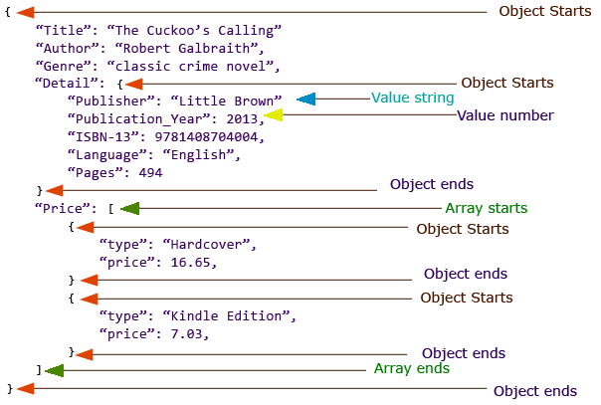
JSON

Slide 55
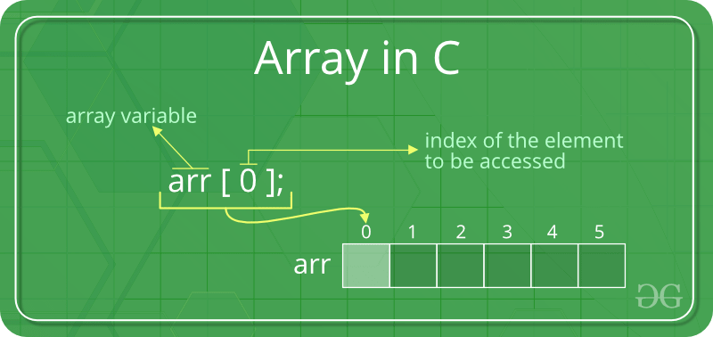
What is an ARRAY?
Simply it’s a table and nothing else matters!

Slide 56
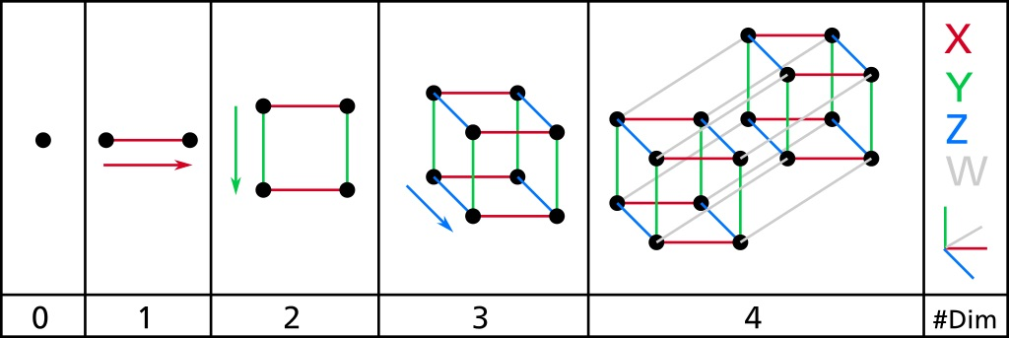
Dimensions

Slide 57

Variables in PHP

Slide 58

echo

Slide 59
Arrays in PHP
$name_one = array("Reza", "Ali", "Sara");
$name_two[0] = "Reza";
$name_two[1] = "Ali";
$name_two[2] = "Sara";

Slide 60
var_dump()

Slide 61
json_encode()

Slide 62
HTTP GET (jQuery)
$.get("index.php" , function(data, status){
data = jQuery.parseJSON(data);
data.forEach(obj => {
// obj is your element
});
}).always(function(){
// finally
});

Slide 63
jQuery parse focused
$.get( "home.php", function( data ) {
$.each(JSON.parse(JSON.stringify(data)), function(idx, obj) {
$('#posts').append(` <div><strong>` +
obj.Username + `</strong> ` + obj.Text + ` </div>`
);
});
});

Slide 64
Next session
Software Engineering (Diagrams, …)
Project Management (Theory, Tools, ...)
GIT
SQL
And following slides:

Slide 65

Time for KukuApp.ir
I wish we could upload smth to the net today

Slide 66

$_GET $_POST
<?php
foreach (getallheaders() as $name => $value) {
echo "$name: $value\n";
}
?>

Slide 67

getpostman.com

Slide 68
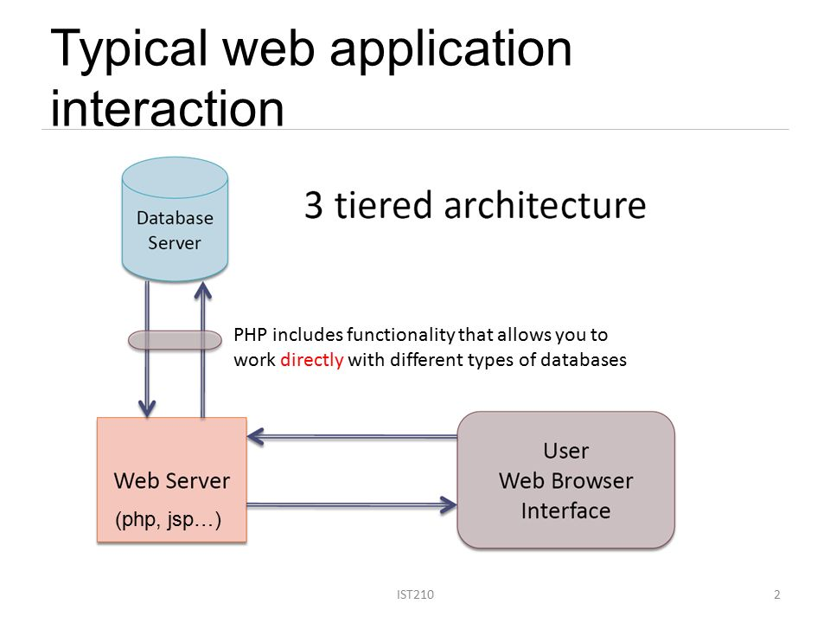
DBMS

Slide 69
Exercise
Find friends and join groups (Right now)
Create a thread for your group on the forum and also chat in there! We wanna learn team work from teach other.
Notes! Please check forum on 10:10 every night!
Move the community forward with participating Q&A and debugging.
Design your own apps using ‘Pencil’
Follow further exercises on forum

Slide 70
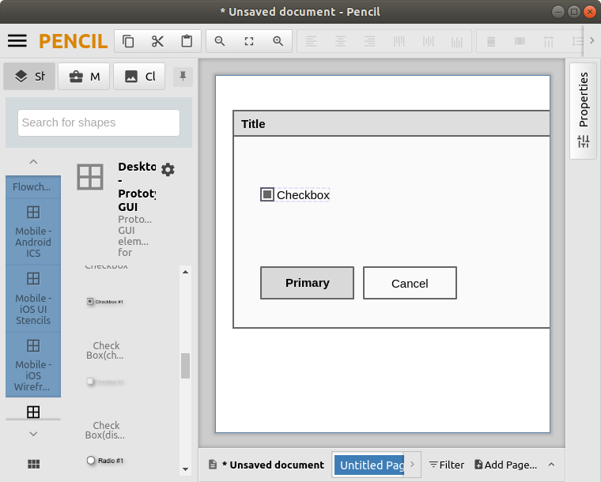
Pencil
https://pencil.evolus.vn/

Slide 71

Sepas =°

Slide 72
Resources and Images
https://pixabay.com/ro/vectors/internet-re%C5%A3ea-schema-globalizarea-154450/
https://devopedia.org/domain-name-system
https://www.network-options.co.ke/product/cisco-2911/
http://what-when-how.com/data-communications-and-networking/backbone-network-components-data-communications-and-networking/
https://www.hpe.com/de/de/product-catalog/servers/proliant-servers/pip.hpe-proliant-dl380-gen10-server.1010026818.html

Slide 73
Resources and Images
https://www.canva.com/icons/multimedia/MAB7k9BEo1A-play-video-icon/
https://www.html5live.at/2014/01/webserver-work/
https://www.soapui.org/soap-and-wsdl/working-with-messages.html
http://www.effortexperts.com/blog/the-importance-of-the-elephant-in-the-room/2017/9/25
https://metamug.com/article/server-side-rendering-vs-client-side-rendering-ajax.html

Slide 74
Resources and Images
https://www.oreilly.com/library/view/learning-web-design/9781449337513/ch04.html
https://www.development-tutorial.com/basic-structure-html-page/
https://internetingishard.com/html-and-css/hello-css/
https://ui-ex.com/explore/css-svg-html-javascript/
https://de.wikipedia.org/wiki/Datei:JQuery-Logo.svg

Slide 75
Resources and Images
https://koreanhistoricaldramas.com/resources/three-legged-crow-of-goguryeo/jumong-three-legged-crow/
https://www.thoughtco.com/what-is-javascript-2037921
https://smartslider3.com/blog/image-slider/
https://learn.onemonth.com/jquery-vs-javascript/
https://boards.na.leagueoflegends.com/en/c/skin-champion-concepts/HNlyprZd-the-next-vs-event

Slide 76
Resources and Images
https://www.geeksforgeeks.org/introduction-to-arrays/
https://www.godchecker.com/greek-mythology/ECHO/
https://slideplayer.com/slide/10788082/
https://giphy.com/stickers/ob-6UUZX9qPA3m7K
https://www.degreesymbol.net/

Slide 77
Resources and Images
https://harrypotter.fandom.com/wiki/Bellatrix_Lestrange%27s_second_wand

Slide 78
Session 3
AUG 26 2019

Slide 79
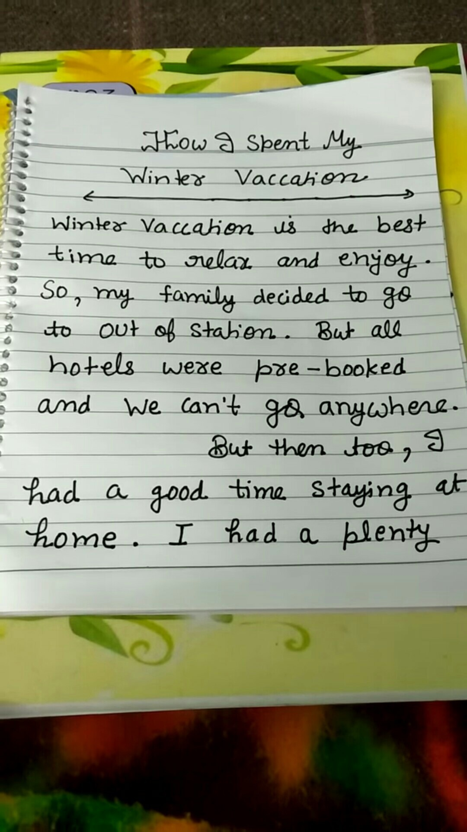
How did you spent your SHOLIDAYs?

Slide 80
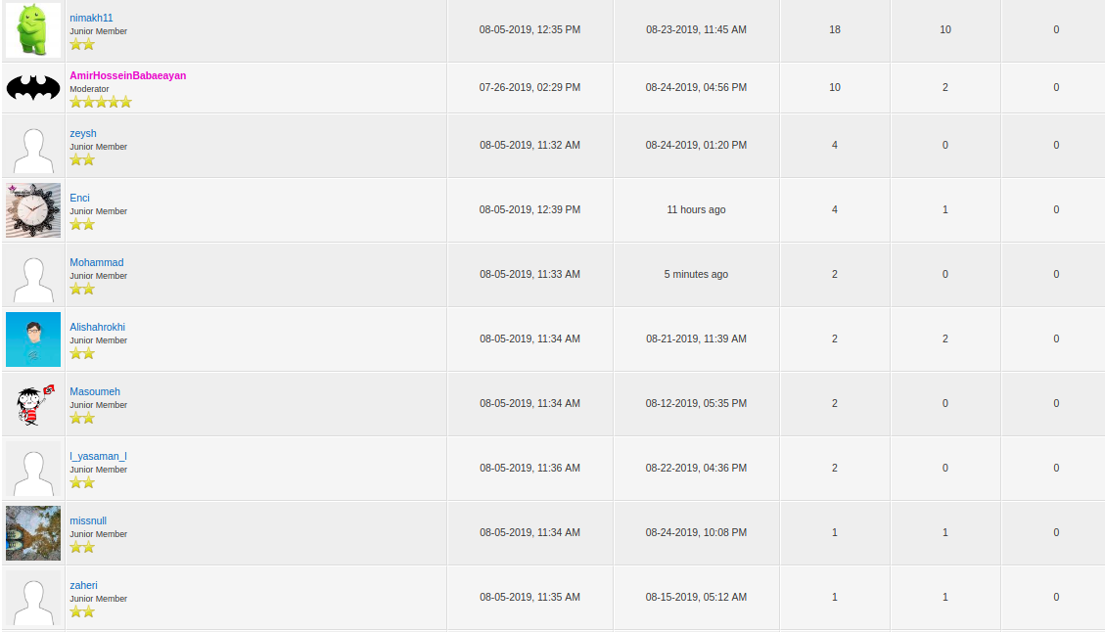
Top Community Members

Slide 81
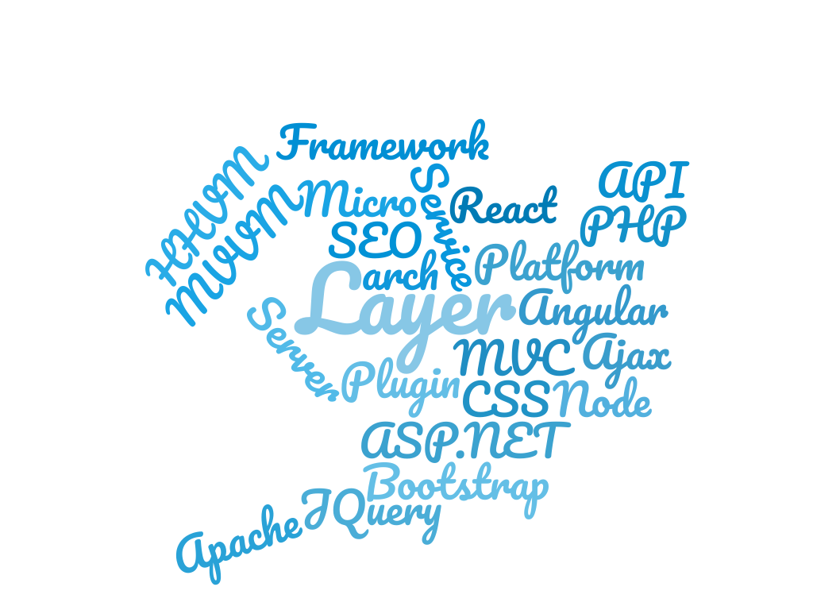
Session 1 & 2 - Review

Slide 82
Session 1 & 2 - Review
How internet works
Network layers,
Web Servers,
Routers,
CDN, DNS, Hosting, ISP,
...

Slide 83

Session 1 & 2 - Review
Front-end s

Slide 84
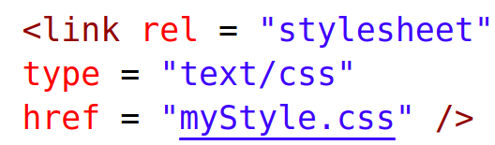
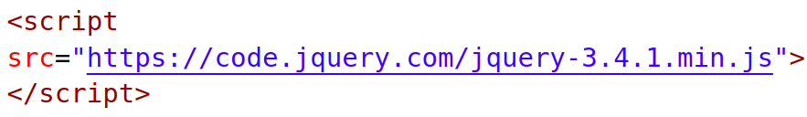
Session 1 & 2 - Review
How to refer to external CSS and JS files?

Slide 85

Session 1 & 2 - Review
“Improved” not “Improvised”!

Slide 86
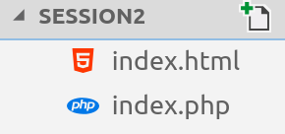
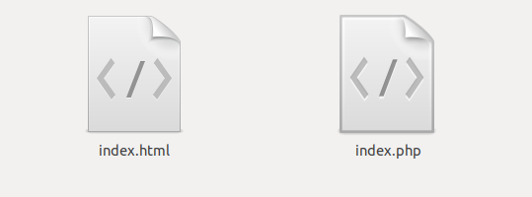
Session 1 & 2 - Review
The project

Slide 87
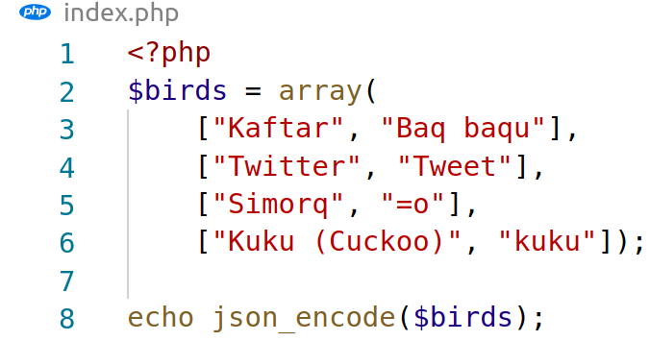
Session 1 & 2 - Review
The project

Slide 88
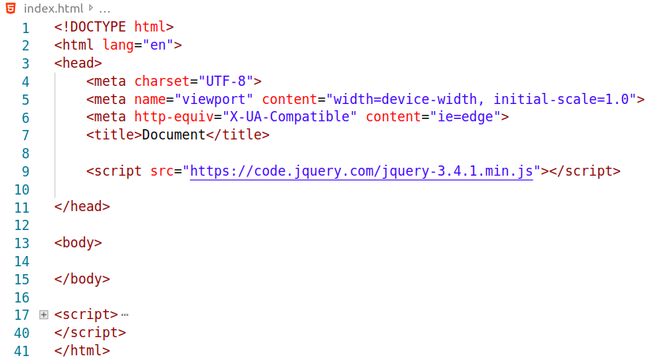
Session 1 & 2 - Review
The project

Slide 89

Session 1 & 2 - Review
The project

Slide 90

https://twitter.com/hashtag/inspiranus

Slide 91
Al-vade vafaa
But in a different order!
GIT, GitHub, TFS, GitLab,
$_GET, $_POST, Postman, cURL
DBMS

Slide 92

GIT

Slide 93

GIT

Slide 94

GIT

Slide 95

git-scm.com
–- Antares (the core I mean btw)

Slide 96

Sorcerer Supreme

Slide 97



Slide 98


Slide 99

KeyBase.io
~Read more around Internet of Trust~ Plz!

Slide 100

Kuku project on KeyBase

Slide 101
Git commands
# git init
# git clone <url>
# git pull
# git add <filename>
# git add *
# git commit -m “<message>”
# git status
# git push
# git log

Slide 102

Terminals aren’t aliens

Slide 103
<br />
Free discussion after break

Slide 104


Slide 105

Hosting
Just upload and hallelujah
WHM, Cpanel, Plesk, etc...

Slide 106

Login and Register

Slide 107
fopen() fgets()
<?php
$fn = fopen("myfile.txt","r");
while(! feof($fn)) {
$result = fgets($fn);
echo $result;
}
fclose($fn);
?>

Slide 108
fwrite()
<?php
$fp = fopen('lidn.txt', 'w');
fwrite($fp, 'Cats chase mice');
fclose($fp);
?>

Slide 109
Exercise
Install KeyBase and join the team. (done ?)
Install MySQL.
Complete your project’s prototype, wireframes, business canvas, SWOT, style guide, Gantt chart, and etc.
Be ready for presentation.
Self-study on UML 2.0: Use Case Diagram, Entity Relationship Diagram, Sequence Diagram.
CHECK THE FORUM ON 10:10 (PLZ ASK)

Slide 110
Coming up.
Software Engineering Diagrams
Project Management Basics
MySQL
KukuApp Register, Login and post “Status”
Android Andervid adapters, Java arrays, JSON parse, and etc… (Simply: a ping-pong app or a simple feed reader).

Slide 111
Sepas =°

Slide 112
Resources and Images
https://brainly.in/question/7434097
https://seeklogo.com/vector-logo/138483/the-godfather
https://keybase.io
https://www.quora.com/What-is-Git-and-why-should-I-use-it
https://www.nobledesktop.com/blog/what-is-git-and-why-should-you-use-it
https://www.businessinsider.com/a-peek-at-linus-torvalds-little-desk-2015-2?IR=T

Slide 113
Resources and Images
http://www.commitstrip.com/en/2016/12/22/terminal-forever/
https://en.wikipedia.org/wiki/Delphi
https://stackoverflow.com/questions/1768894/how-to-write-into-a-file-in-php
https://tecadmin.net/php-read-file-line-by-line-fgets-function/
https://commons.wikimedia.org/wiki/File:Open_Access_Reader_Login_Wireframe.png

Slide 114
Resources and Images
https://hostingcanada.org/cpanel-vs-plesk-compared/

Slide 115
Session 4

Slide 116
Session 3 - Review
How to share our code on GIT and tools.

Slide 117

Session 3 - Review
File Based Data Storage,
Ready for Three Tier Architecture!

Slide 118
Session 3 - Review
Hosting,
Name Servers,
Domains,
Web-Based Control Panels

Slide 119

PhpMyAdmin ≠ MySQL

Slide 120

phpMyAdmin
Web-Based Graphical User Interface (GUI)

Slide 121

WorkBench

Slide 122
Tables | _ | _ | _ | _ |
CREATE TABLE [IF NOT EXISTS] table_name (
column_name data_type(length) [NOT NULL] [DEFAULT value] [AUTO_INCREMENT],
…
PRIMARY KEY (column_id)
) ENGINE=storage_engine

Slide 123

(If it work’s, don’t touch it! There isn’t any note for today; so, I suppose to be a good listener)

Slide 124

Your time – Presentation

Slide 125
PHP MySQL Connector
<?php
$servername = "localhost";
$username = "username";
$password = "password";
$conn = new mysqli($servername, $username, $password);
if ($conn->connect_error) {
die("Connection failed: " . $conn->connect_error);
}
echo "Connected successfully";
?>

Slide 126
Charset
mysqli_set_charset($conn,"utf8");

Slide 127
PHP MySQL fetch
$sql = "SELECT id, firstname, lastname FROM MyGuests";
$result = $conn->query($sql);
if ($result->num_rows > 0) {
while($row = $result->fetch_assoc()) {
echo "id: " . $row["id"]. " - Name: " . $row["firstname"]. " " . $row["lastname"]. "<br>";
}
} else {
echo "0 results";
}

Slide 128


Think twice code once
Gantt Chart
1st ERD
2nd WireFrame
3rd Code
4th Test
5th Upload

Slide 129

Gantt

Slide 130

Chen’s Notation of ERD

Slide 131


Slide 132
Coding is all about practice.

Slide 133
Hissss, Programmers don’t scream!
تو یک جا گم شده ای
من همه جا را باید بگردم...!
(Who? -Next Slide)

Slide 134
Double check everything
;

Slide 135
Exercise
Work on your projects
KISS!
Share your updates on Kuku; in this case: Commit your changes and don’t forget to push!
Share knowledge on Forum and don’t be shy: ASK questions.
Read about Laravel, Yii, CakePHP, etc ...

Slide 136
Be ready for
MVC Architecture,
Class Inheritance,
API CRUD: GET, POST, PUT, DELETE
Android Client

Slide 137


Slide 138
Sepas =°

Slide 139
Resources and Images
http://hussainbashaapps.blogspot.com/2016/01/multi-tier-or-3-tier-architecture-in.html
https://mysqlserverteam.com/mysql-guide-to-ports/
https://commons.wikimedia.org/wiki/File:PhpMyAdmin_logo.svg
https://quotescover.com/a-good-listener
https://www.salesforce.com/ca/blog/2016/08/make-next-presentation-best-yet.html
https://www.macupdate.com/app/mac/31829/mysql-workbench

Slide 140
Resources and Images
https://www.projectmanager.com/gantt-chart

Slide 141
Session 5

Slide 142
Session 4 - Review
DBMS Why and How
Service Software
MySQL fetch
Wireframe
ERD Chen Notation

Slide 143
شنیدم که پروانه با شمع گفت:
که ای مدعی! عشق کار تو نیست
که نه صبر داری، نه یارای ایست
از بوستان

Slide 144
PHP MySQL execute
$sql = "INSERT INTO MyGuests (firstname, lastname, email)
VALUES ('John', 'Doe', 'john@example.com')";
if ($conn->query($sql) === TRUE) {
echo "New record created successfully";
} else {
echo "Error: " . $sql . "<br>" . $conn->error;
}

Slide 145
SQL Triggers
CREATE TRIGGER before_insert_post
BEFORE INSERT ON posts
FOR EACH ROW
SET new.Id = UUID();
-- Creates a default Generic Unique IDentifier (GUID) value for a varchar(36) column.

Slide 146
SQL Injection Attack
sql = “SELECT id FROM users WHERE username=’” + uname + “’ AND password=’” + passwd + “’”
passwd = “password' OR 1=1; #”
BOOM: SELECT id FROM users WHERE username='username' AND password='password' OR 1=1; #'

Slide 147
SQL Injection Solution
$insert = "INSERT INTO " .$new_table. " VALUES(?, ?, ?)";
$q = mysqli_prepare($db, $insert);
mysqli_stmt_bind_param($q, "iss", $ID, $Partner, $Merchant);
mysqli_stmt_execute($q);
(What is ORM?)

Slide 148
Basic Authentication
<?php
if (!isset($_SERVER['PHP_AUTH_USER'])) {
header('WWW-Authenticate: Basic realm="My Realm"');
header('HTTP/1.0 401 Unauthorized');
echo 'Text to send if user hits Cancel button';
exit;
} else {
echo "<p>Hello {$_SERVER['PHP_AUTH_USER']}.</p>";
echo "<p>You entered {$_SERVER['PHP_AUTH_PW']} as your password.</p>";
}
?>

Slide 149

set_cookie()

Slide 150

$_COOKIE

Slide 151

header(‘Location: ...’)

Slide 152

.htaccess & httpd.conf

Slide 153

.htaccess & httpd.conf

Slide 154

form action

Slide 155

input [type=hidden]

Slide 156
Shorthand <?= ...
short_open_tag = On
<? echo ...
<?php echo …
config: php.ini

Slide 157

CORS
header("Access-Control-Allow-Origin: *");

Slide 158
include_once()

Slide 159
Exercise (Code on Kuku)
Profile Pages
Direct Messages
Search
Hash Tags Processing
API Text Limitations
Link
Follow
Lists

Slide 160
Wait for it
Android Client
MVC Architecture (Inheritance, Scaffolding, etc.)
Data Warehousing
Artificial Intelligence

Slide 161
Sepas =°

Slide 162
Resources and Images
https://httpd.apache.org/docs/2.4/vhosts/examples.html
https://en.wikipedia.org/wiki/HTTP_cookie
https://www.w3schools.com/tags/att_form_action.asp
https://portswigger.net/blog/xss-in-hidden-input-fields
https://www.keycdn.com/support/cors
https://stackoverflow.com/questions/34413956/cannot-get-location-header-in-response-using-httpclient

Slide 163
Session 6

Slide 164


Slide 165


Exercise
Present your dream job. “Find a job you enjoy doing, and you will never have to work a day in your life” - Mark Twain
Ideas: High tech,
Nice payments,
Nice team,
Blue sky in vision, ...

Slide 166

Session 5 - Review

Slide 167

Session 5 - Review

Slide 168
Why to learn
Software Architecture?
(Thanx to Jobinja.ir)

Slide 169




Slide 170



Slide 171


Slide 172



Slide 173



Slide 174


Slide 175


Slide 176



Slide 177


Slide 178
Android Programming
Java
Kotlin
Xamarin (C#)
Native Development Kit (C++)
React Native (Java Script)
Flutter
Unity Game Engine (C#)
Cordova, Angular JS, Kivy (Pyhton)

Slide 179


Slide 180



Slide 181


Android IDEs
Android Studio
Visual Studio Code
Notepad.exe

Slide 182

Android IDEs – Eclipse

Slide 183
Software Development Kit
Android software development is the process by which new applications are created for devices running the Android operating system. Google states that "Android apps can be written using Kotlin, Java, and C++ languages" using the Android software development kit, while using other languages is also possible.
- Uncle Wikipedia

Slide 184

SDK Manager

Slide 185
JDK, JRE
$ sudo apt-get install openjdk-8-jre
$ sudo update-alternatives --config javac
$ sudo apt-get install openjdk-8-jdk
$ sudo update-alternatives --config javac

Slide 186
SymLink & Export
$ ln -s /opt/myapp/executable /usr/bin/myappshort
$ myappshort
$ export PATH_TO_SOMETHING=/path/to/smt
$ echo $PATH_TO_SOMTHING

Slide 187
Android Debug Bridge
Android Debug Bridge (adb) is a versatile command-line tool that lets you communicate with a device. The adb command facilitates a variety of device actions, such as installing and debugging apps, and it provides access to a Unix shell that you can use to run a variety of commands on a device. It is a client-server program that includes three components:

Slide 188
Android Debug Bridge
A client, which sends commands. The client runs on your development machine. You can invoke a client from a command-line terminal by issuing an adb command.
A daemon (adbd), which runs commands on a device. The daemon runs as a background process on each device.
A server, which manages communication between the client and the daemon. The server runs as a background process on your development machine.

Slide 189
ADB Location
android_sdk/platform-tools/

Slide 190
ADB Common Commands
$ adb devices
$ adb shell
$ adb uninstall ${PACKAGE_NAME}
$ adb logcat

Slide 191
Generate Certificate
$ keytool -genkey -v -keystore my-release-key.keystore -alias alias_name -keyalg RSA -keysize 2048 -validity 10000

Slide 192
Behind the scenes
https://medium.com/@authmane512/how-to-do-android-development-faster-without-gradle-9046b8c1cf68

Slide 193
Compile to APK
APP_NAME="Your App Name"
PACKAGE_NAME="your.pkg.name"
AAPT="/path/to/android-sdk/build-tools/<your version>/aapt"
DX="/path/to/android-sdk/build-tools/<your version>/dx"
ZIPALIGN="/path/to/android-sdk/build-tools/<your version>/zipalign"
APKSIGNER="/path/to/android-sdk/build-tools/<your version>/apksigner"
PLATFORM="/path/to/android-sdk/platforms/android-<your version>/android.jar"

Slide 194
Compile to APK
echo "Cleaning..."
rm -rf obj/*
rm -rf "$PACKAGE_DIR/R.java"
echo "Generating R.java file..."
$AAPT package -f -m -J src -M AndroidManifest.xml -S res -I $PLATFORM

Slide 195
Compile to APK
echo "Compiling..."
ant compile -Dplatform=$PLATFORM
echo "Translating in Dalvik bytecode..."
$DX --dex --output=classes.dex obj

Slide 196
Compile to APK
echo "Making APK..."
$AAPT package -f -m -F bin/app.unaligned.apk -M AndroidManifest.xml -S res -I $PLATFORM
$AAPT add bin/app.unaligned.apk classes.dex

Slide 197
Compile to APK
echo "Aligning and signing APK..."
$APKSIGNER sign --ks debug.keystore --ks-pass "pass:123456" bin/app.unaligned.apk
# $ZIPALIGN -f 4 bin/app.unaligned.apk bin/app.apk
cp bin/app.unaligned.apk bin/app.apk

Slide 198
ADB Install and Run apk
adb install -r bin/app.apk
adb shell am start -n "${PACKAGE_NAME}/.MainActivity"

Slide 199

Android Emulators

Slide 200

Android App Parts to Learn
Activities
List Adapters
Network
Database
Manifest
Resources

Slide 201
MVP
Minimum Viable Product (Project Management)
Model-View-Presenter (Software Engineering)

Slide 202

MVP

Slide 203

MVVM (Extra Info)
Model-View-ViewModel

Slide 204


implement/extend

Slide 205


override/overwrite

Slide 206
Interface
public interface IMyClass {
public void process(String input) throws IOException;
}

Slide 207
Abstract class
public abstract class MyClass implements IMyClass {
public void process(String input) throws IOException {
try {
SecondaryFunc(input);
} finally {
// ...
}
}
protected abstract void SecondarFunc(InputStream input)
throws IOException;
}

Slide 208
Subclass
public class MyClassSlave extends MyClass {
@Override
protected void SecondaryFunc(InputStream input) throws IOException {
// logic here ...
}
}

Slide 209

public/private/protected

Slide 210

dynamic/static

Slide 211

thow Exception ()

Slide 212
`Model` inside
public class MyEntity {
private String prop1 = "", prop2 = "";
public User(String input_prop1, String input_prop2) {
this.prop1 = input_prop1;
this.prop2 = input_prop2;
}
public String getProp1() {
return this.prop1;
}
public void setProp1(String value) {
this.prop1 = value;
}
}

Slide 213
`Presenter` inside
public class MainActivityPresenter {
private MyEnt myent;
private MyView view;
public MainActivityPresenter(View view) {
this.myent = new MyEntity();
this.view = view;
}
public void MyFunc(String input) {
myent.setProp1(input);
view.UpdateGUI();
}
}

Slide 214
`View` inside
public class MainActivity extends Activity implements MainActivityPresenter.View {

Slide 215
`View` inside
@Override
protected void onCreate(Bundle savedInstanceState) {
// ...
presenter = new MainActivityPresenter(this);
Event(){
presenter.MyFunc(thetextbox.getText());
}
}

Slide 216
`View` inside
@Override
public void UpdateGUI() {
thetextbox.setText(“Hello world”);
}

Slide 217

Break;

Slide 218

Time for Back-end

Slide 219
Network T-Shooting
$ traceroute <dest>
$ ping <dest>
$ nslookup <dest>
$ ifconfig
$ arp -a
win> tracert
win> ipconfig

Slide 220

cURL

Slide 221
cURL with basic auth
curl --user name:password --location --request POST "http://localhost/kukuapp/the/post.php" --header "Content-Type: application/x-www-form-urlencoded" \
--data "send=&Text=[contenthere]&UserId=[userid]"

Slide 222

HTTP Connection - GET

Slide 223

HTTP Connection - POST

Slide 224

JSON Decode

Slide 225


Time for Android stuff

Slide 226

List Adapter

Slide 227

List Adapter

Slide 228

List Adapter

Slide 229

ListView

Slide 230

ListView Item

Slide 231

Manifest

Slide 232

Toast
Toast toast =
Toast.makeText(getApplicationContext(),
"This is a message displayed in a Toast",
Toast.LENGTH_SHORT);
toast.show();

Slide 233

Intent
Intent browserIntent =
new Intent(Intent.ACTION_VIEW, Uri.parse("http://www.google.com"));
startActivity(browserIntent);

Slide 234

SharedPrefrences

Slide 235

SharedPrefrences

Slide 236

drawable - XML

Slide 237

drawable - PNG

Slide 238
Multi-Threading
new Thread(new Runnable() {
@Override
public void run() {
try {
// Your code goes here
activity.runOnUiThread(new Runnable() {
public void run() {
// UI stuff here
}
});
} catch (Exception e) {
e.printStackTrace();
}
}
});

Slide 239
Home Activity Logic
Validate login
Redirect to LoginActivity (if step 1 not valid)
Download data from web server
Decode JSON
Cast to an array of model object
Pass the array to adapter
Assign adapter to ListView
Listen for UI component events

Slide 240
Recipes
Android Java, Back-end PHP, Database MySQL
Android React, Back-end Golang, Database Mongo
Android Flutter, Back-end Dart, Database SQLite
Android C++, Back-end C++, Database File System (Just for fun!)

Slide 241
What’s next?
Session 7
Artificial Intelligence (Recommender System using T-SQL)
Session 8
MVP implementation
MVC Architecture in web API
MVC Implementation

Slide 242
Exercise
Think about dream job, path, and goal.
Develop a simple sample project using MVP architecture.
Have a self-study on recommender algorithms, applied data science, business intelligence; and find some examples.
Keep an eye on R, Tensorflow, and MS SQL MDX
Present all the items above.

Slide 243
Sepas =°

Slide 244
Resources and Images
https://www.goodreads.com/quotes/646569-find-a-job-you-enjoy-doing-and-you-will-never
https://brainchase.com/5-ways-earn-free-books-summer/
https://www.goodreads.com/quotes/646569-find-a-job-you-enjoy-doing-and-you-will-never
https://emulatorlab.com/bluestacks-vs-andy-nox-koplayer-memu/
https://www.raywenderlich.com/7026-getting-started-with-mvp-model-view-presenter-on-android

Slide 245
Resources and Images
https://bigprogram.wordpress.com/interface-in-java/
http://tutorials.jenkov.com/java/interfaces-vs-abstract-classes.html
https://stackoverflow.com/questions/215497/what-is-the-difference-between-public-protected-package-private-and-private-in
https://documentation.devexpress.com/WPF/15112/MVVM-Framework

Slide 246
Resources and Images
https://medium.com/cr8resume/make-you-hand-dirty-with-mvp-model-view-presenter-eab5b5c16e42
http://java82.blogspot.com/2016/07/how-to-install-android-development.html
https://stuff.mit.edu/afs/sipb/project/android/docs/tools/help/sdk-manager.html
https://stackoverflow.com/questions/18507351/how-to-create-custom-button-in-android-using-xml-styles

Slide 247
Resources and Images
https://stackoverflow.com/questions/42467989/android-box-shadow-and-border-radius-layout
https://developer.android.com/about/versions/10
https://www.snapclicksupply.com/digital-products/hip-hip-hooray-svg-cut-file/
https://stackoverflow.com/questions/19196616/is-there-a-way-to-create-xxhdpi-xhdpi-hdpi-mdpi-and-ldpi-drawables-from-a-lar
http://tutorials.jenkov.com/android/toast.html

Slide 248
Resources and Images
https://www.webucator.com/how-to/how-throw-an-exception-java.cfm
https://beginnersbook.com/2013/04/java-static-dynamic-binding/
https://www.askdifference.com/overwrite-vs-override/

Slide 249
Session 7

Slide 250
Session 6 - Review
Hiring Software Companies in IRAN
Android Integrated Development Environments
Android Software Development Kit
Android Debug Bridge
Java Development Kit
Certificates
throw Exception

Slide 251
Session 6 - Review
Linux Symbolic Links
Model-View-Presenter Architecture
Model-View-ViewModel Architecture
implement/extend
override/overwrite
class
interface
dynamic/static

Slide 252
Session 6 - Review
Network Commands
cURL
Java’s HttpsUrlConnection
JSON Decode
ListAdapter
Android Manifest
Toast

Slide 253
Session 6 - Review
Intent
SharedPrefrences
Multi-Threading

Slide 254


Slide 255


Slide 256


Slide 257

MVC Demo

Slide 258

MVP Demo

Slide 259

We are done!

Slide 260



Collaborative Filtering and Recommendation

Slide 261

Recommender

Slide 262

Our very first logic

Slide 263

SQL Create Table As Select

Slide 264

Multidimensional Data

Slide 265

Multidimensional Data

Slide 266

OLTP

Slide 267

OLTP

Slide 268

OLTP

Slide 269

OLAP

Slide 270

OLAP

Slide 271

OLAP

Slide 272

OLAP

Slide 273

DW

Slide 274

DW

Slide 275

DW

Slide 276


Slide 277
Test Project
(Wireframes from: behance.net)

Slide 278

Crowdfunding

Slide 279



Examples (Random Selected)

Slide 280
Examples (Random Selected)
Mehrabane.ir /
2nate.com /
Ratacf.ir /
Nikstarter.com /
KickStarter.com /
...

Slide 281


Slide 282


Slide 283
Exam
10 Marks to Project
3 Marks to class activity
7 Marks to paper

Slide 284
Exam
It’s a pleasure to accept your projects on September 18th (Shahrivar-maah 27th)

Slide 285
What’s next?
Paper test
Q&A
Skills test

Slide 286
Sepas =°

Slide 287
Resources and Images
https://www.etsy.com/listing/258326089/cherokee-legend-two-wolves-quote-used-in
https://www.pinterest.com/pin/382172718364595925/?lp=true
https://towardsdatascience.com/intro-to-recommender-system-collaborative-filtering-64a238194a26
https://en.wikipedia.org/wiki/File:Collaborative_filtering.gif#/media/File:Collaborative_filtering.gif

Slide 288
Resources and Images
https://www.behance.net/gallery/11066983/Crowdfunding-Wireframes
https://hamijoo.com/%DA%A9%D8%B1%D8%A7%D9%88%D8%AF-%D9%81%D8%A7%D9%86%D8%AF%DB%8C%D9%86%DA%AF-crowdfunding-%DA%86%DB%8C%D8%B3%D8%AA%D8%9F-%D9%82%D8%B7%D8%B1%D9%87-%D9%82%D8%B7%D8%B1%D9%87-%D8%AA%D8%A7-%D8%AF%D8%B1/
https://database.guide/what-is-oltp/

Slide 289
Resources and Images
https://database.guide/what-is-olap/
https://database.guide/what-is-a-data-warehouse/
https://panoply.io/data-warehouse-guide/data-warehouse-architecture-traditional-vs-cloud/
https://selfservedbi.com/2017/11/26/bi-theory-7-multidimensional-vs-tabular/

Slide 290
YouTube
https://www.youtube.com/playlist?list=PL814DN-Ek494jxAfmsoG_wNcHbkY2PQWL

Slide 291
Session N

Slide 292
Quote of the day

Slide 293
Session [N-1] - Review

Slide 294
What’s next?

Slide 295
Exercise

Slide 296
Sepas =°

Slide 297
Resources and Images

