Slide 1
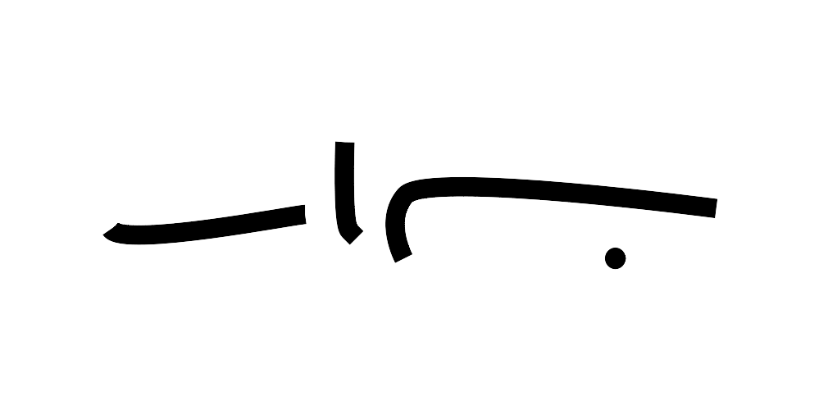

Slide 2
Fundamentals of Programming
Bu-Ali Sina University, Tuyserkan Faculty of Engineering
Mohammad R. Tayyebi
Session 1: Dec 7 2019

Slide 3
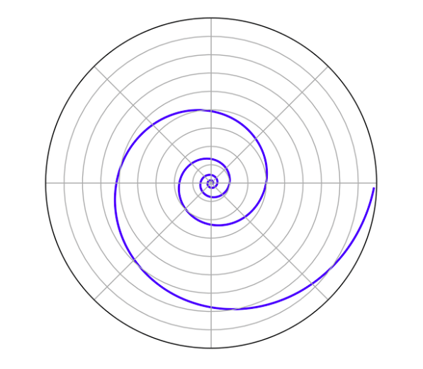
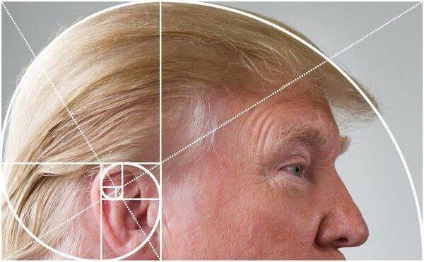
Logarithmic spiral

Slide 4
Compound interest
An account starts with $1.00 and pays 100 percent interest per year. If the interest is credited once, at the end of the year, the value of the account at year-end will be $2.00. If the interest is credited twice in the year, the interest rate for each 6 months will be 50%, so the initial $1 is multiplied by 1.5 twice, yielding $1.00 × (1.5 ^ 2) = $2.25 at the end of the year. Compounding quarterly yields $1.00 × (1.25 ^ 4) = $2.4414…, and compounding monthly yields $1.00 × (1 + 1/12) ^ 12 = $2.613035… If there are n compounding intervals, the interest for each interval will be 100%/n and the value at the end of the year will be $1.00 × (1 + 1/n) ^ n.

Slide 5
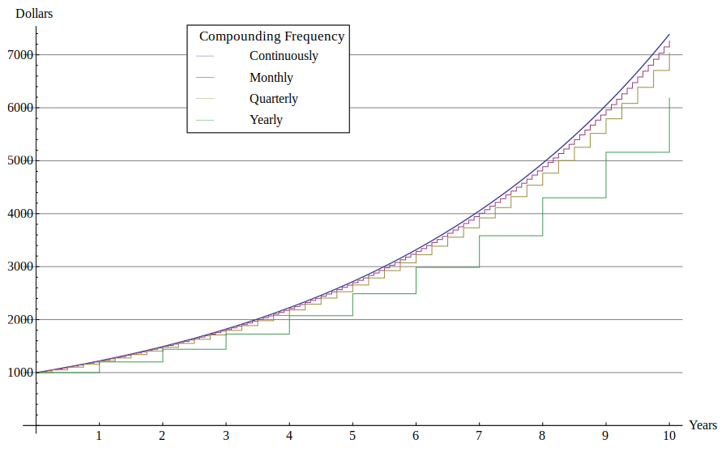

Slide 6
Euler’s constant
2.7 1828 1828 45 90 45

Slide 7
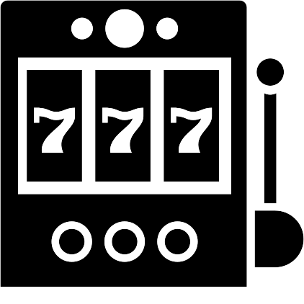
تاریخچه عدد طبیعی
اولین اشاره به این عدد، در جدولی که در ضمیمهٔ مقالهٔ مربوط به لگاریتم جان نپر در سال ۱۶۱۸ انتشار یافته بود مشاهده می‌شود. با این حال، این مقاله توضیحی راجع به این عدد نمی‌داد بلکه تنها لیستی از لگاریتم‌های حساب شده در مبنای این عدد را نشان می‌داد. به نظر می‌رسد که این جدول توسط ویلیام اوترد (مخترع خط‌کش محاسبه) تهیه شده‌است. اما «کشف» این عدد توسط ژاکوب برنولی به انجام رسید.

Slide 8
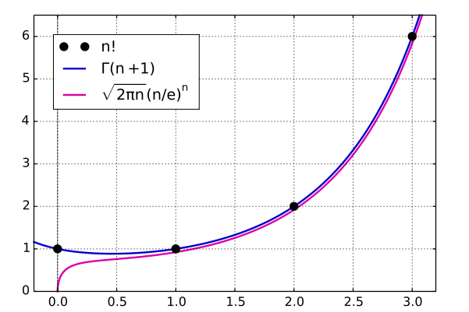
Strirling’s Approximation

Slide 9
Euler’s constant

Slide 10
Flowchart
e = 0
i = 0
e = e + 1 / fct
i++
i <= 32
fct = 1
j = 1
j <= i
e
fct = fct * j
j++

Slide 11
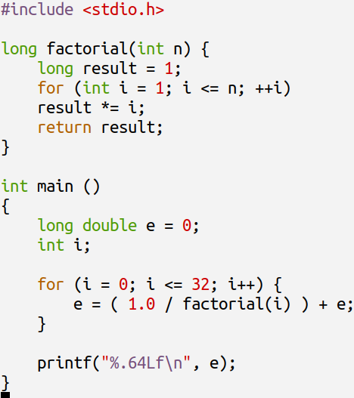
Code
#include <stdio.h>
long factorial(int i) {
long result = 1;
for (int j = 1; j <= i; ++j)
result *= j;
return result;
}
int main ()
{
long double e = 0;
int i;
for (i = 0; i <= 32; i++) {
e = ( 1.0 / factorial(i) ) + e;
}
printf("%.64Lf\n", e);
}

Slide 12
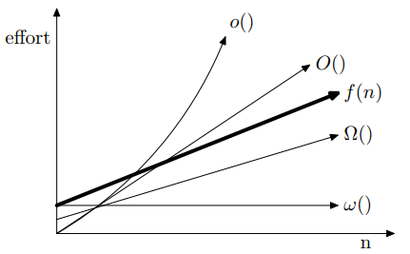

Algorithm Complexity (Big Ohhh!)
O(N^2)
O(n): in worst situations, your algorithm has a complexity of n
Ω(n): in best case, your algorithm has a complexity of n
Θ(n): in every situation, your algorithm has a complexity of n

Slide 13
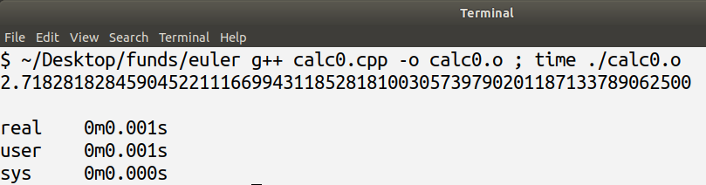
How to run the code
g++ calc0.cpp -o calc0.o ; time ./calc0.o

Slide 14
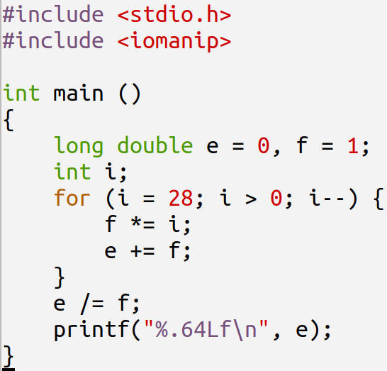
Optimized Code
long double e = 0, f = 1;
int i;
for (i = 8; i >= 1; i--) {
f = f * i;
e = e + f;
}
e = e / f;

Slide 15
Optimized Code Traced
i | f | e | f = f * i | e = e + f | e / f
8 | 1 | 0 | 1 * 8 = 8 | 0 + 8 = 8 | 1.00000
7 | 8 | 8 | 8 * 7 = 56 | 8 + 56 = 64 | 1.14286
6 | 56 | 64 | 56 * 6 = 336 | 64 + 336 = 400 | 1.19048
5 | 336 | 400 | 1680 | 2080 | 1.23810
4 | 1680 | 2080 | 6720 | 8800 | 1.30952
3 | 6720 | 8800 |  |  | 1.43651
2 | 20160 | 28960 |  |  | 1.71825
1 | 40320 | 69280 |  |  | 2.71825
0 |  |  | END OF LOOP | END OF LOOP | e = e / f = 2.7182539682

Slide 16
Programming Languages
An account starts with $1.00 and pays 100 percent interest per year. If the interest is credited once, at the end of the year, the value of the account at year-end will be $2.00. If the interest is credited twice in the year, the interest rate for each 6 months will be 50%, so the initial $1 is multiplied by 1.5 twice, yielding $1.00 × (1.5 ^ 2) = $2.25 at the end of the year. Compounding quarterly yields $1.00 × (1.25 ^ 4) = $2.4414…, and compounding monthly yields $1.00 × (1 + 1/12) ^ 12 = $2.613035… If there are n compounding intervals, the interest for each interval will be 100%/n and the value at the end of the year will be $1.00 × (1 + 1/n) ^ n.

Slide 17
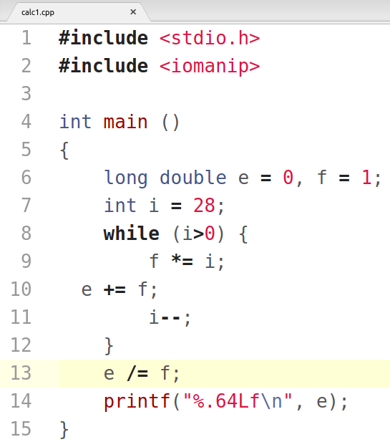
C++
#include <stdio.h>
#include <iomanip>
int main ()
{
long double e = 0, f = 1;
int i = 28;
while (i>0) {
f *= i;
e += f;
i--;
}
e /= f;
printf("%.64Lf\n", e);
}

Slide 18
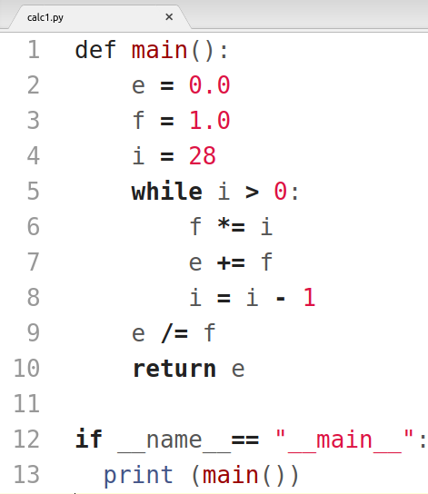
Python
def main():
e = 0.0
f = 1.0
i = 28
while i > 0:
f *= i
e += f
i = i - 1
e /= f
return e
if __name__== "__main__":
print (main())

Slide 19
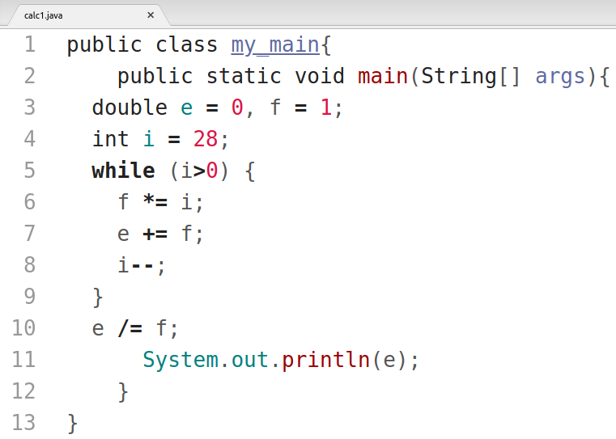
Java
public class my_main{
public static void main(String[] args){
double e = 0, f = 1;
int i = 28;
while (i>0) {
f *= i;
e += f;
i--;
}
e /= f;
System.out.println(e);
}
}

Slide 20
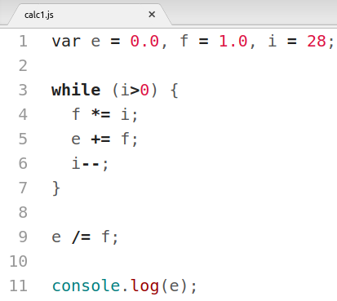
JavaScript
var e = 0.0, f = 1.0, i = 28;
while (i>0) {
f *= i;
e += f;
i--;
}
e /= f;
console.log(e);

Slide 21
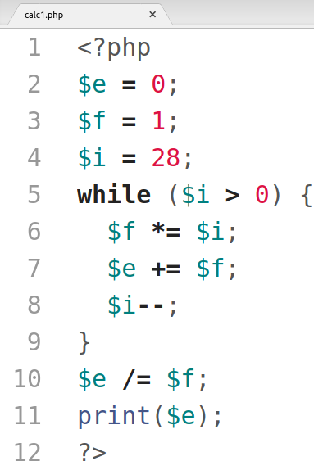
PHP
<?php
$e = 0;
$f = 1;
$i = 28;
while ($i > 0) {
$f *= $i;
$e += $f;
$i--;
}
$e /= $f;
print($e);
?>

Slide 22
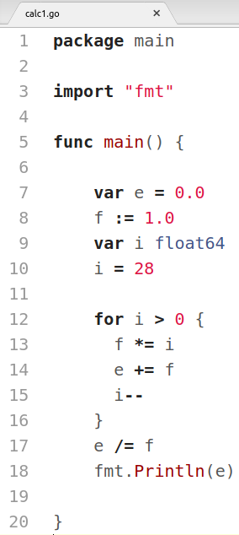
Go
package main
import "fmt"
func main() {
var e = 0.0
f := 1.0
var i float64
i = 28
for i > 0 {
f *= i
e += f
i--
}
e /= f
fmt.Println(e)
}

Slide 23
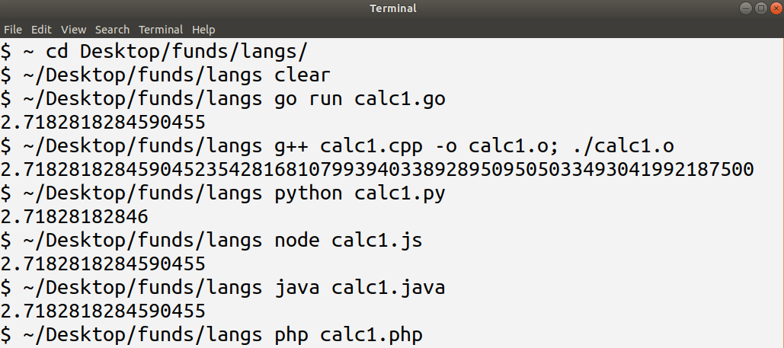
Linux is your friend

Slide 24

Sepas <3
Contacts:
http://kouy.ir/tayyebi
Proudly a Sariab Blogger:
www.sariab.ir, info@sariab.ir

Slide 25
Reference:
https://en.wikipedia.org/wiki/E_(mathematical_constant)
https://codereview.stackexchange.com/questions/33015/
https://stackoverflow.com/questions/27873104/

