Slide 1


Slide 2
Intro

Slide 3





MVC Nowruz Workshop
Presented by:
Scientific Society of Computer Engineering Students (SSCES), Bu-Ali Sina University (https://t.me/SSCES)
Instructor:
Mohammad R. Tayyebi; B. Sc. Student, Information Technology, Bu-Ali Sina University (http://tyyi.net)
Host:
Skills Community (https://skills.community)

Slide 4
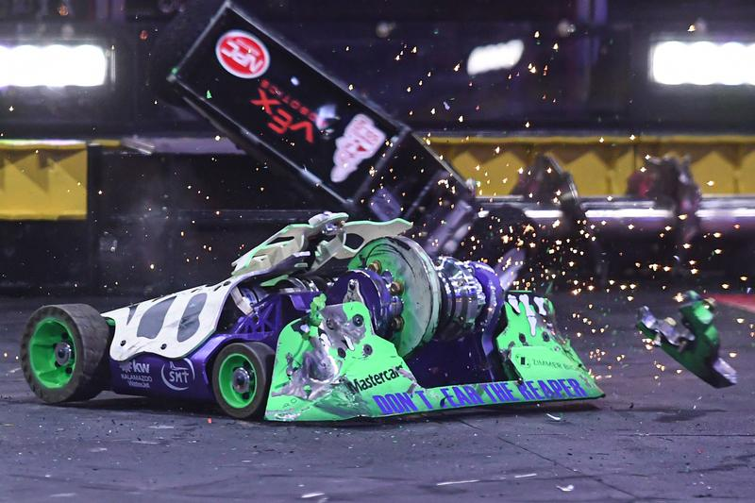
Mission: Implementation of a Robot Fighting Platform
Before letting your minds go crazy, let me notice that it will not be like:
(https://hypebeast.com/2019/8/youtube-robot-fighting-animal-cruelty-confusion)

Slide 5


Idea

Slide 6
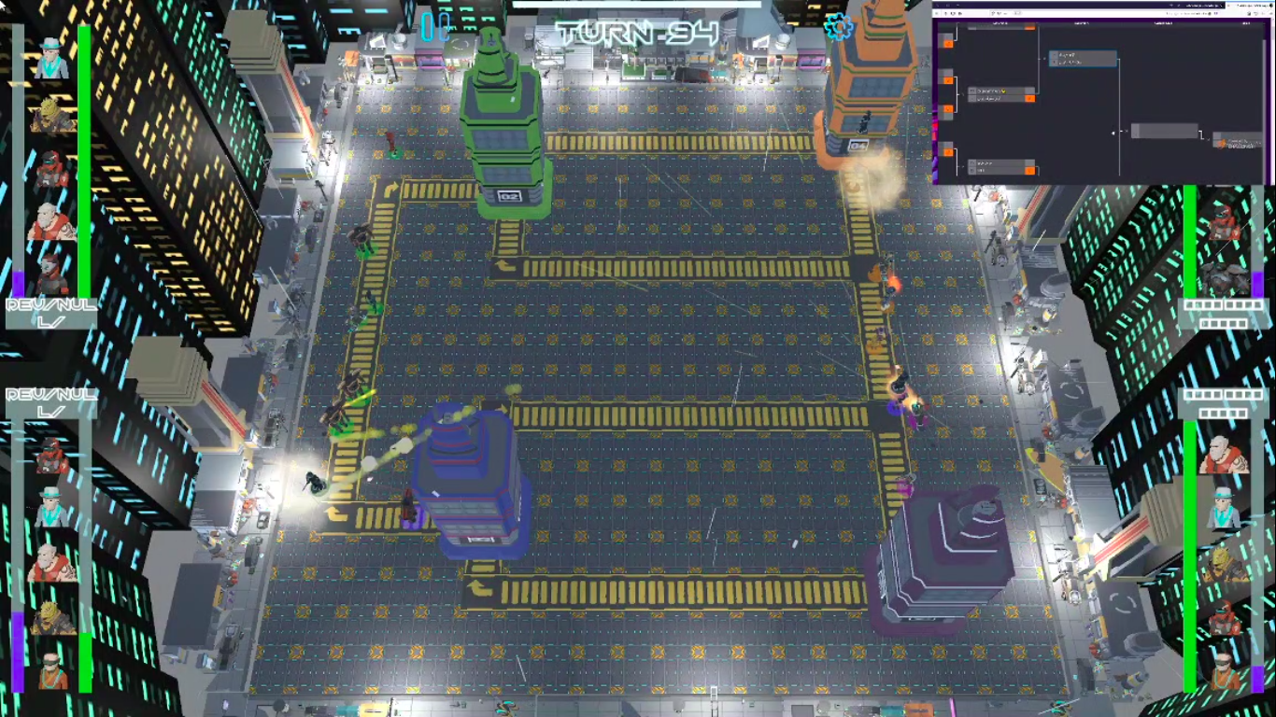
Idea

Slide 7
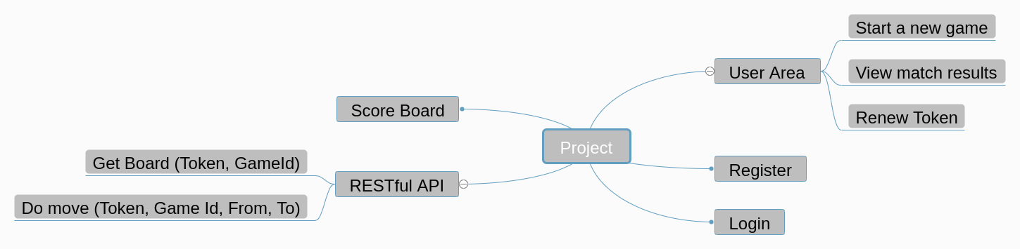
Project map
(https://skills.community/index.php/f/2146)

Slide 8
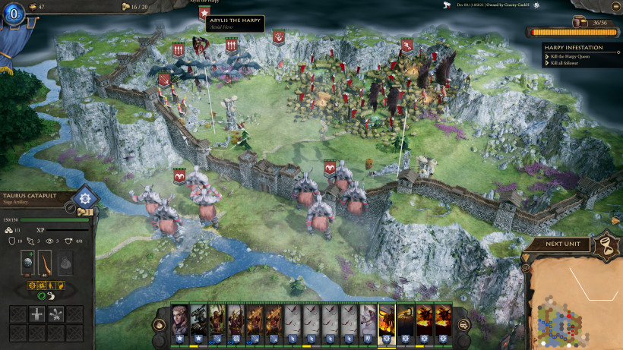
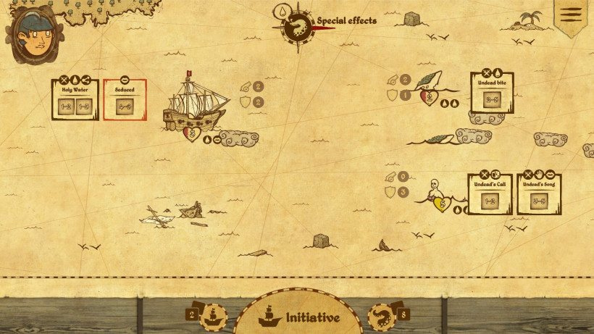
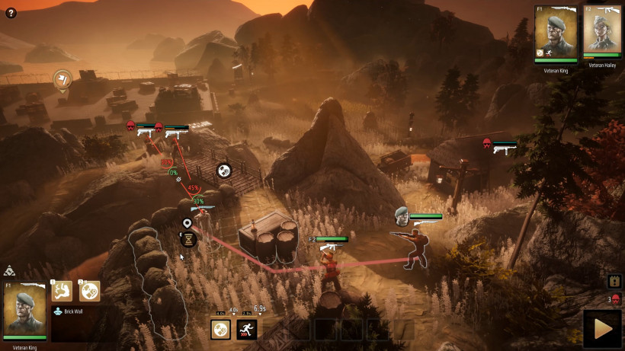
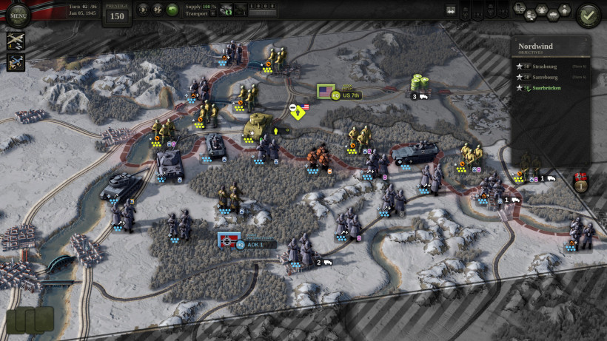
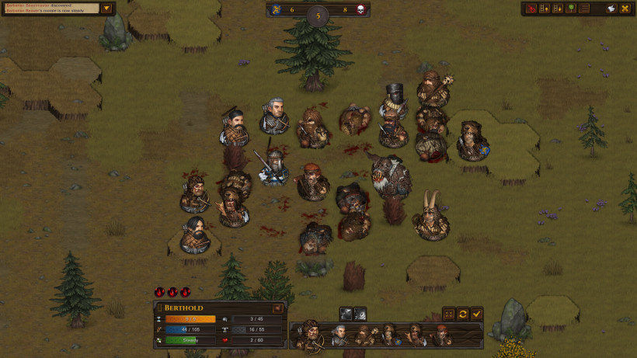
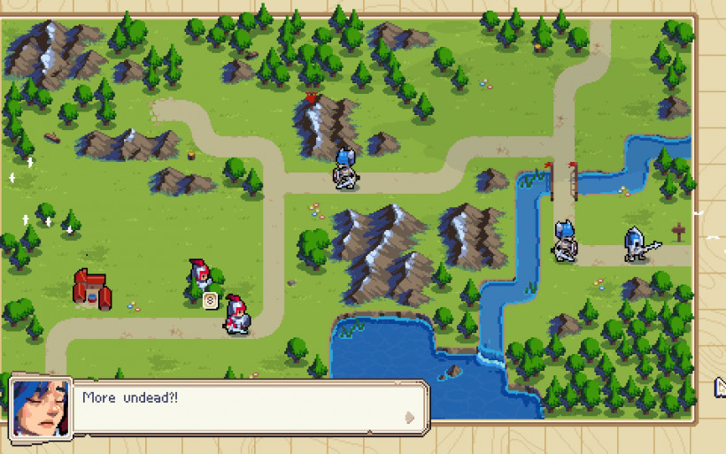
Game subject
It’s a simple turn-based strategy game
(https://www.strategygamer.com/articles/best-turn-based-strategy-games/)

Slide 9
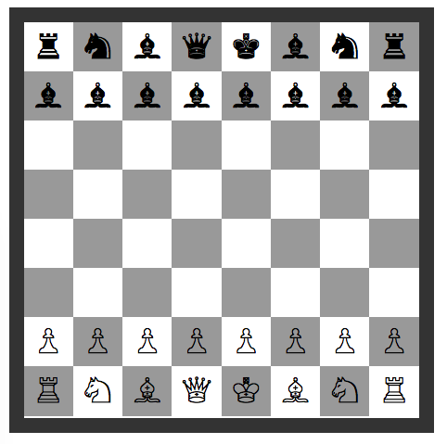
Game subject
(Maybe chess)
(https://gist.github.com/tayyebi/00496bb6ab54ab85c2ecbc765554c8ca)

Slide 10

Game subject
(Definitely Rock-Paper-Scissors => RPS)
(https://ac-illust.com/en/clip-art/136730/rock-paper-scissors)

Slide 11
Repository
https://github.com/tayyebi/BASU-MVC-99

Slide 12
Session 1
(Fundamentals)

Slide 13
I know there is a reason behind MVC, but what the why?
Simultaneous development — Multiple developers can work simultaneously on the model, controller and views.
High cohesion — MVC enables logical grouping of related actions on a controller together. The views for a specific model are also grouped together.
Low coupling — The very nature of the MVC framework is such that there is low coupling among models, views or controllers.

Slide 14
I know there is a reason behind MVC, but what the why?
Ease of modification — Because of the separation of responsibilities, future development or modification is easier i.e. scalability of the product is increased.
Multiple views for a model — Models can have multiple views.
(src: medium.com/@socraticsol)

Slide 15

MVC, like a for the BOSS

Slide 16
MVC, like a for the BOSS
My Boss arrived at work in a brand new Ferrari.
I told him: “Wow that’s a nice car”.
“If you work hard, put all your hours in, and strive for Excellence, I'll get another one next year”, He replied!

Slide 17
Design Pattern \vs/ Architecture
(🏳 I’m a peace fan)
A system can have multiple levels and scope:
Function- implementation of a function
Class- implementation of a class
Project- relations between classes
Solution- relations between projects
System- relations between solutions
Architecture is the highest level design of a solution as a whole. Usually, you think big there, as you don't go too much into details of different components. Architecture ensures that different parts of solution can easily talk with one another either directly or through a mediator, it concerns security, performance, non functional deployment and system requirements. Architecture takes care of 4 and 5 scopes and sometimes 3.
(www.quora.com/profile/Almantas-Karpavičius)

Slide 18
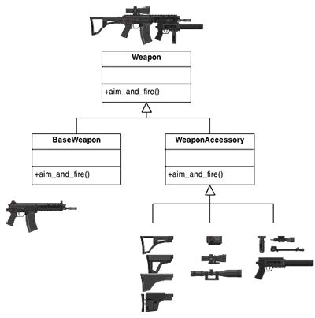
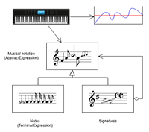
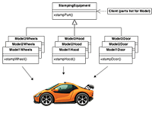
Design Patterns and Their Usage
A system can have multiple levels and scope:
Structural Design Patterns
Behavorial Design Patterns
Creational Design Patterns
(https://sourcemaking.com/design_patterns)

Slide 19
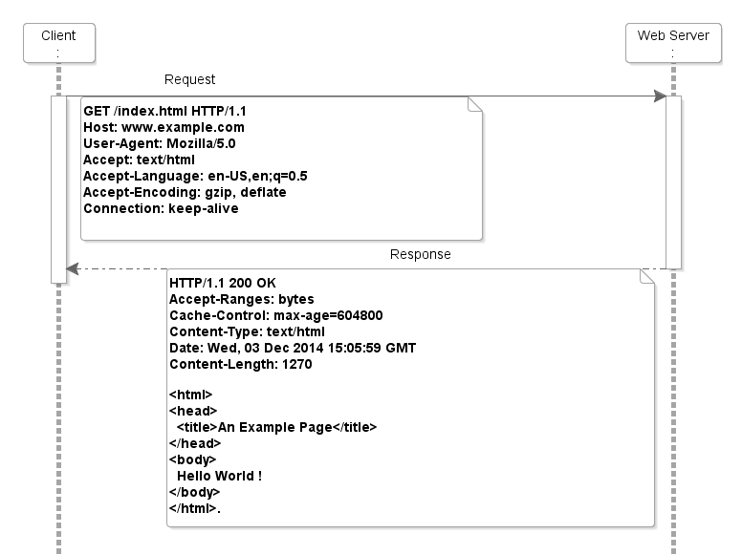

What happens to your HTTP request? (Bottom to top approach)
(https://www.oreilly.com/library/view/restful-java-web/9781788294041/1889f99d-f907-41c3-a0f0-925bbf1d3825.xhtml)

Slide 20
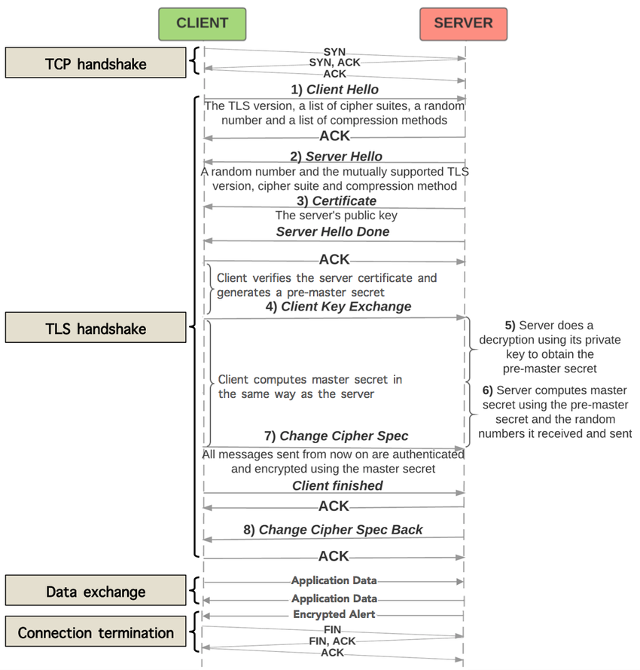
Finding Nemo
(Network Segments)
(https://www.researchgate.net/figure/HTTPS-message-sequence-diagram-with-detailed-TLS-handshaking-steps_fig1_306187575)

Slide 21
Finding Nemo (System Layers)
Business Layer | Business Process | Our Business Process
Application Layer | Applications | Our program
Infrastructure Layer | Middleware | Apache + MySQL + PHP
 | OS | Linux / Windows Server
 | Hardware | Intel CPU + HDD + SSD + RAM

Slide 22
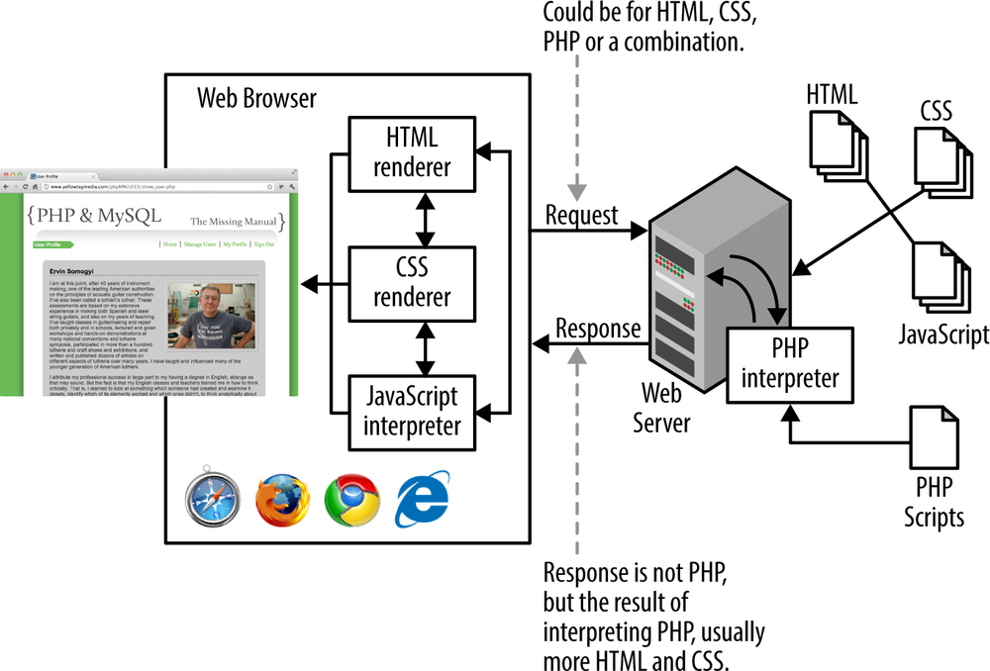
Finding Nemo
(Web Server)
(https://www.oreilly.com/library/view/php-mysql/9781449355517/ch01.html)

Slide 23
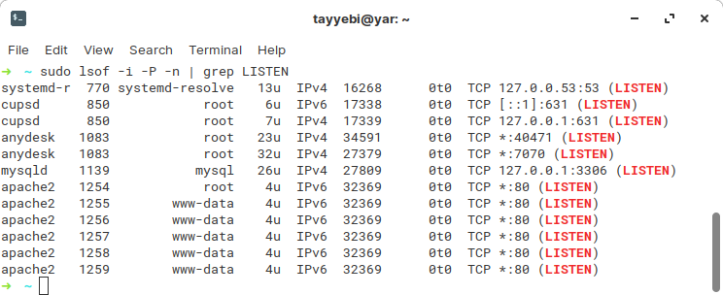
A server usually listens on a port

Slide 24
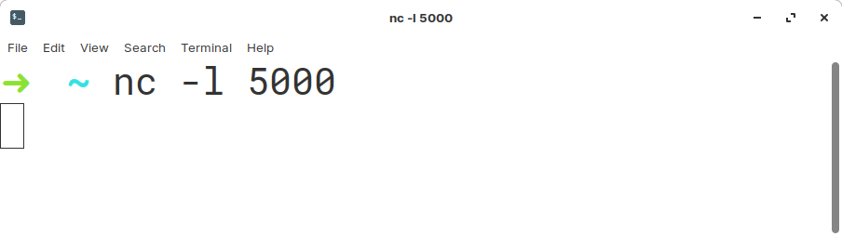
That can be as simple as

Slide 25
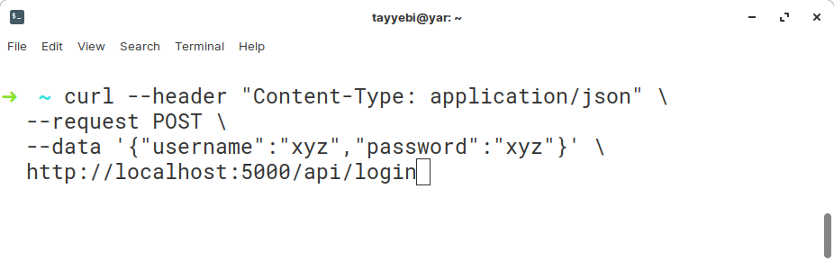
A client can be as simple as

Slide 26
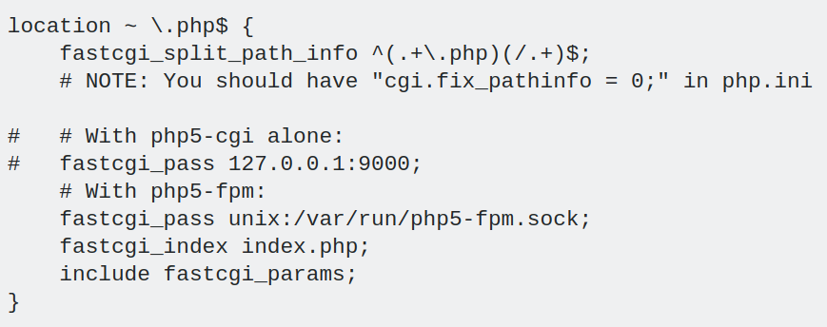
Finding Nemo (Web Server)
(https://askubuntu.com/questions/134666/what-is-the-easiest-way-to-enable-php-on-nginx)

Slide 27
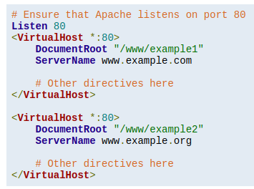
Finding Nemo (VirtualHost)
Virtual hosting is a method for hosting multiple domain names (with separate handling of each name) on a single server (or pool of servers). This allows one server to share its resources, such as memory and processor cycles, without requiring all services provided to use the same host name. The term virtual hosting is usually used in reference to web servers but the principles do carry over to other internet services.
Name-based
IP-based
Port-based
(https://en.wikipedia.org/wiki/Virtual_hosting,
https://httpd.apache.org/docs/2.4/vhosts/examples.html)

Slide 28
Finding Nemo (HTTP Methods)
GET
The GET method requests a representation of the specified resource. Requests using GET should only retrieve data.
POST
The POST method is used to submit an entity to the specified resource, often causing a change in state or side effects on the server.
(https://developer.mozilla.org/en-US/docs/Web/HTTP/Methods)

Slide 29
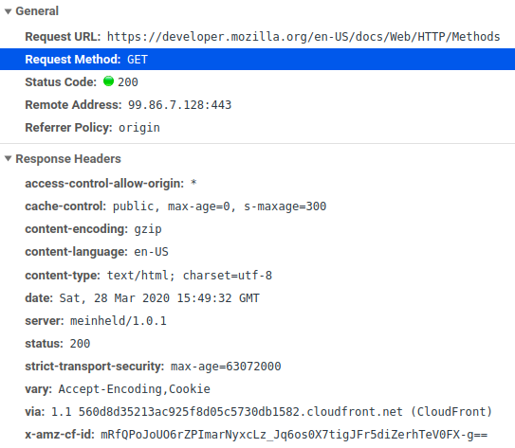
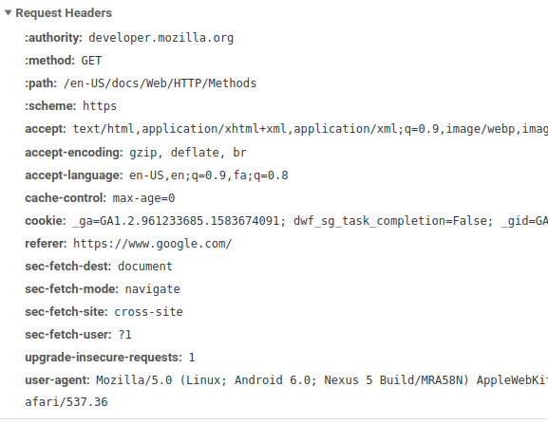
Finding Nemo (HTTP Methods)

Slide 30
Finding Nemo (Web Routing)
Routing or router in web development is a mechanism where HTTP requests are routed to the code that handles them. To put simply, in the Router you determine what should happen when a user visits a certain page.
(https://divpusher.com/glossary/routing/)

Slide 31
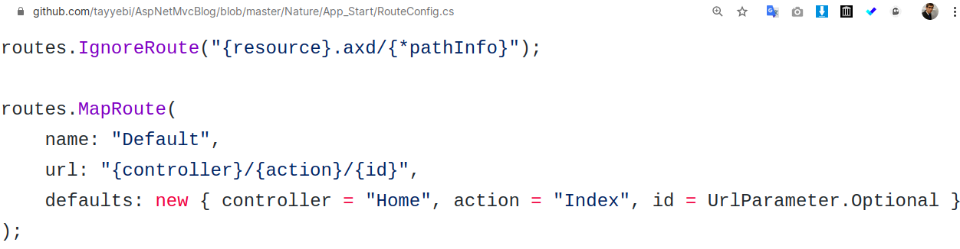
Finding Nemo (Web Routing, ASP.NET)

Slide 32
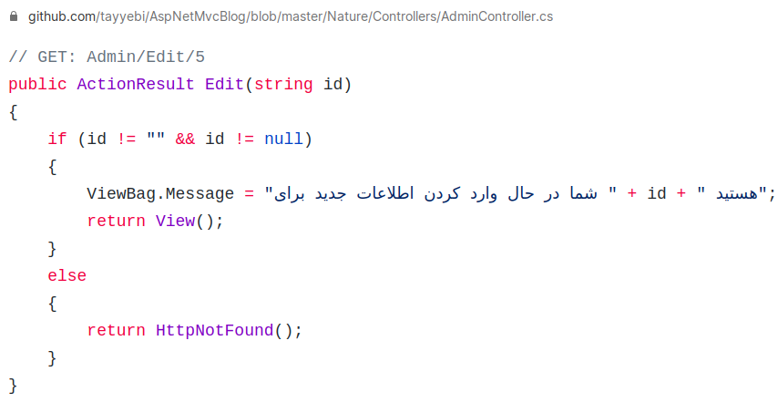
Finding Nemo (Web Routing, ASP.NET)

Slide 33
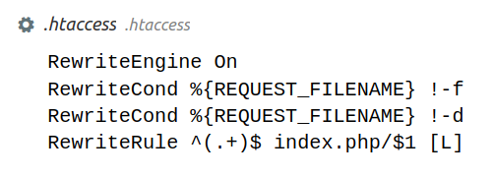
Finding Nemo (Web Routing, .htaccess)

Slide 34
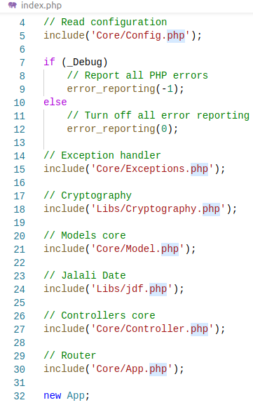
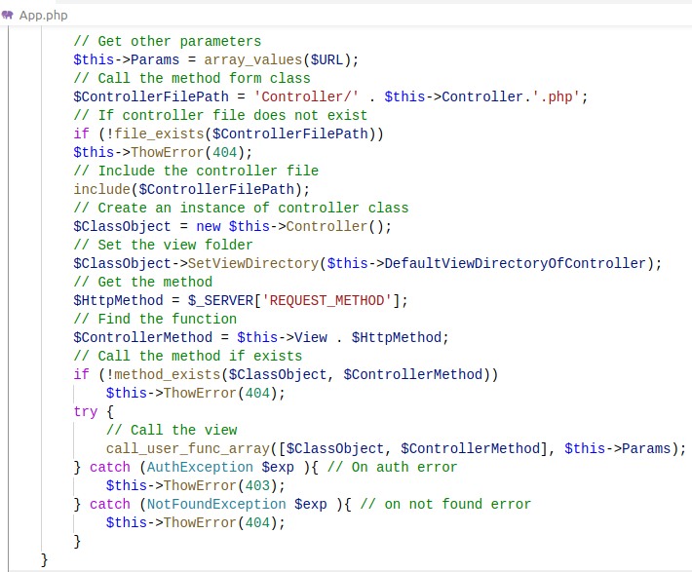
Index.php, App.php

Slide 35
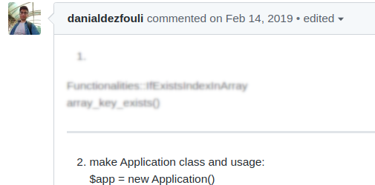
Application Class

Slide 36
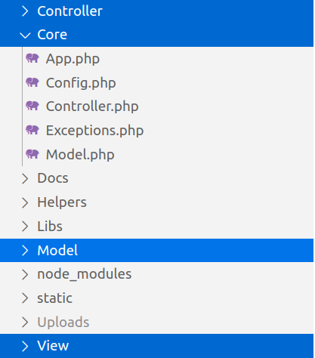
File Structure

Slide 37
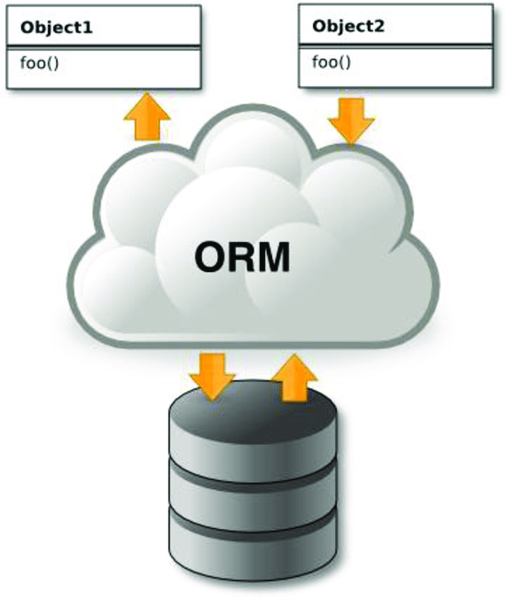
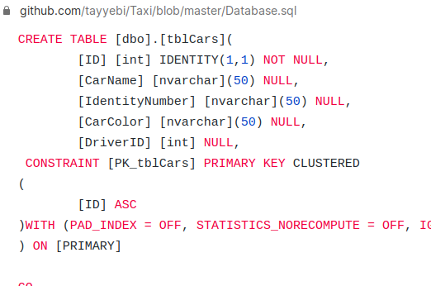
Data Models and Database

Slide 38
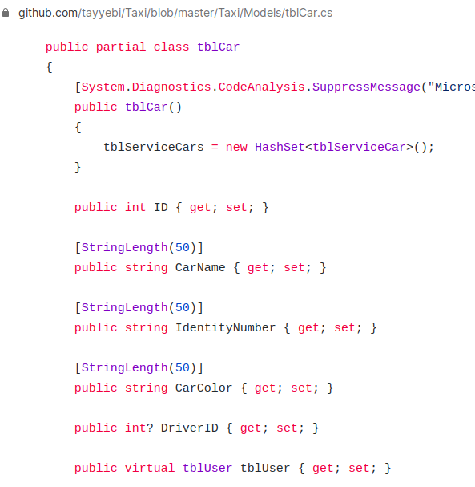
Data Models and Database

Slide 39
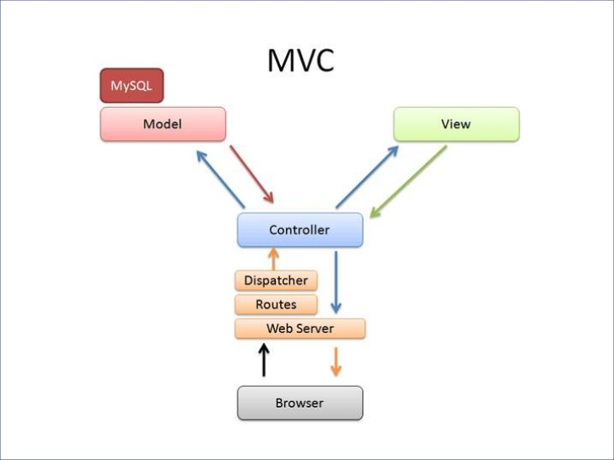
Model-View-Controller
(https://www.slideshare.net/victorporof/beginners-guide-to-ruby-on-rails/6)

Slide 40
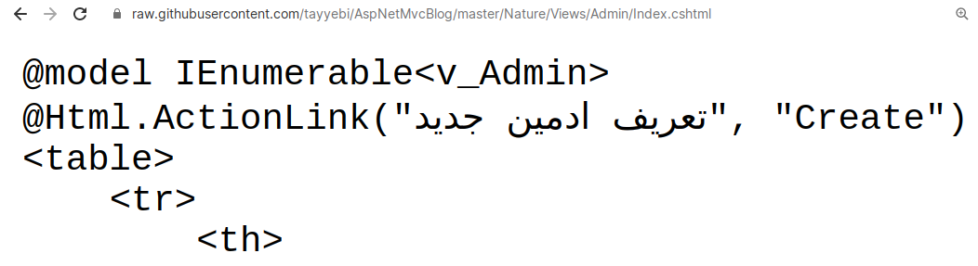
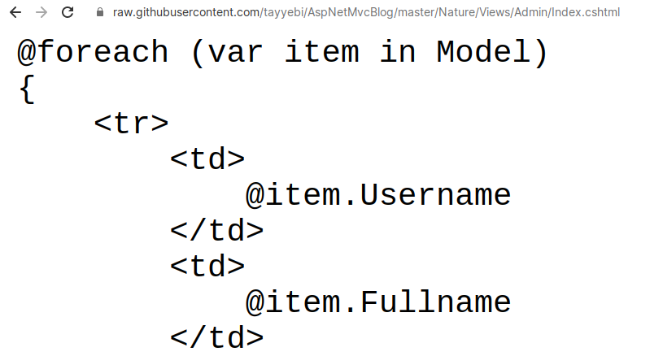
Model-View Communications, But How?

Slide 41
Exercise
1. Rent/Install a VPS
2. Host different websites with different domains on the same server.
3. (In case of virtualization) You can use /etc/hosts/ for a sense of different host names.

Slide 42
Session 2
(Application Class & Rewrite Rules)

Slide 43
Index.php, App.php

Slide 44
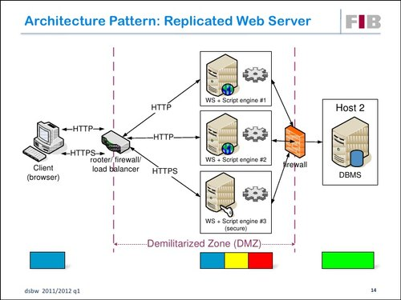
Multi-Tier Architecture
(https://www.indiamart.com/proddetail/server-architecture-design-11677941412.html)

Slide 45
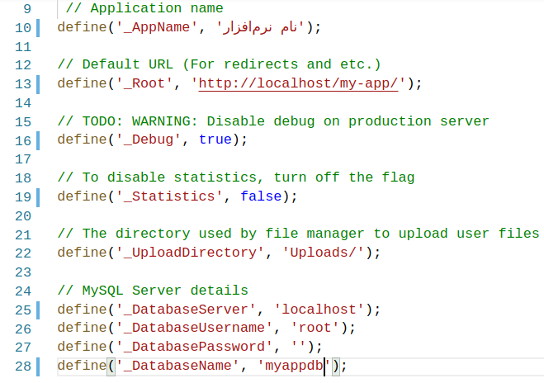
Config.php

Slide 46
$_SERVER["PATH_INFO"] vs QUERY STRING
A Query String is the part of a uniform resource locator (URL) which assigns values to specified parameters.
http://.../?key1=val1&key2=val2
(https://en.wikipedia.org/wiki/Query_string)

Slide 47
$_SERVER["PATH_INFO"] vs QUERY STRING
Another form
http://.../?/val1/val2

Slide 48
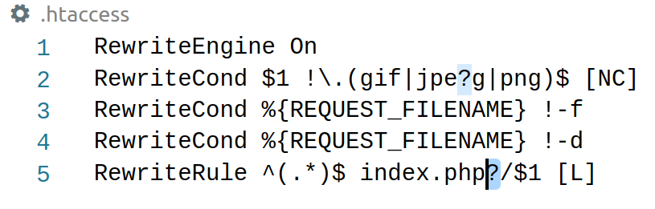
$_SERVER["PATH_INFO"] vs QUERY STRING

Slide 49
$_SERVER["PATH_INFO"] vs QUERY STRING
The PATH_INFO variable is only present if you invoke a PHP script like this:
http://.../val1/val2
(https://stackoverflow.com/questions/5629683)

Slide 50
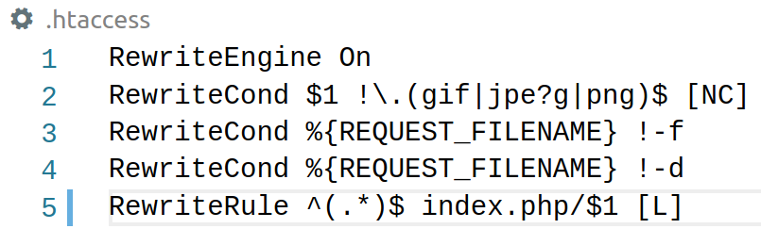
$_SERVER["PATH_INFO"] vs QUERY STRING

Slide 51
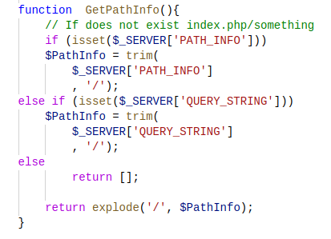
$_SERVER["PATH_INFO"] vs QUERY STRING

Slide 52
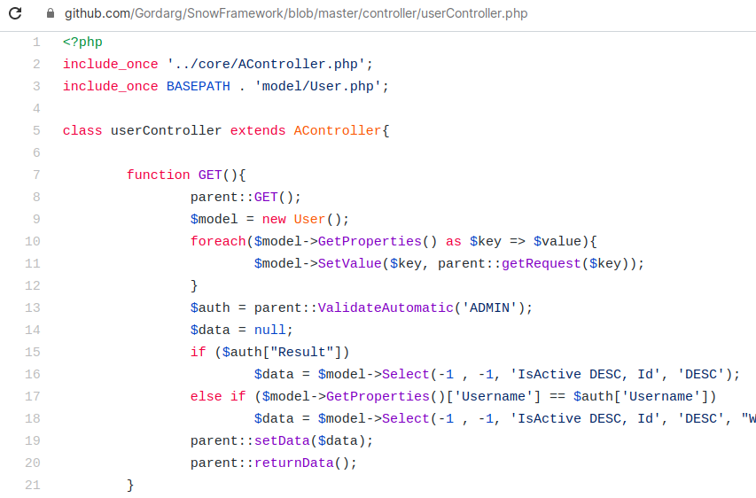
Evaluate with include – DP 1

Slide 53
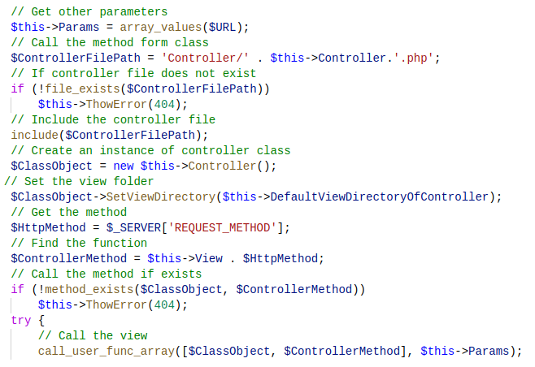
Evaluate with include – DP 2

Slide 54
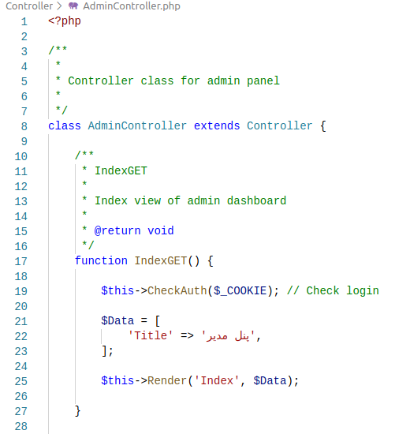
Inheritance for DP 2

Slide 55
Exercise
Please implement your own application class.

Slide 56
Session 3
(Model and Controller Structure)

Slide 57
PHP Data Objects (PDO)
The PHP Data Objects (PDO) extension defines a lightweight, consistent interface for accessing databases in PHP. Each database driver that implements the PDO interface can expose database-specific features as regular extension functions. Note that you cannot perform any database functions using the PDO extension by itself; you must use a database-specific PDO driver to access a database server.
PDO provides a data-access abstraction layer, which means that, regardless of which database you're using, you use the same functions to issue queries and fetch data. PDO does not provide a database abstraction; it doesn't rewrite SQL or emulate missing features. You should use a full-blown abstraction layer if you need that facility.
PDO ships with PHP 5.1, and is available as a PECL extension for PHP 5.0; PDO requires the new OO features in the core of PHP 5, and so will not run with earlier versions of PHP.
- php.net

Slide 58

PDO features
extension=php_pdo.dll
extension=php_pdo_firebird.dll
extension=php_pdo_informix.dll
extension=php_pdo_mssql.dll
extension=php_pdo_mysql.dll
extension=php_pdo_oci.dll
extension=php_pdo_oci8.dll
extension=php_pdo_odbc.dll
extension=php_pdo_pgsql.dll
extension=php_pdo_sqlite.dll
TODO:
How to build a simple “PDO” thing.

Slide 59
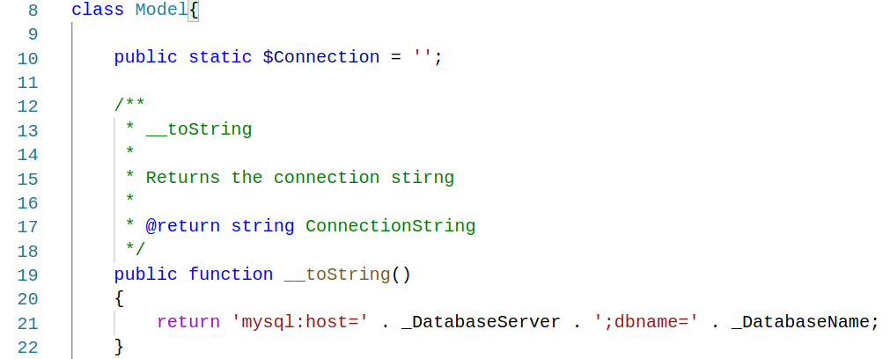
Core/Model.php

Slide 60
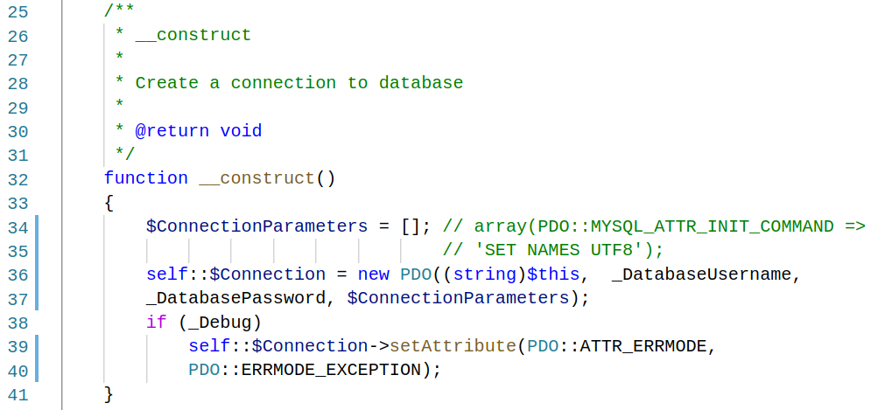
Core/Model.php

Slide 61
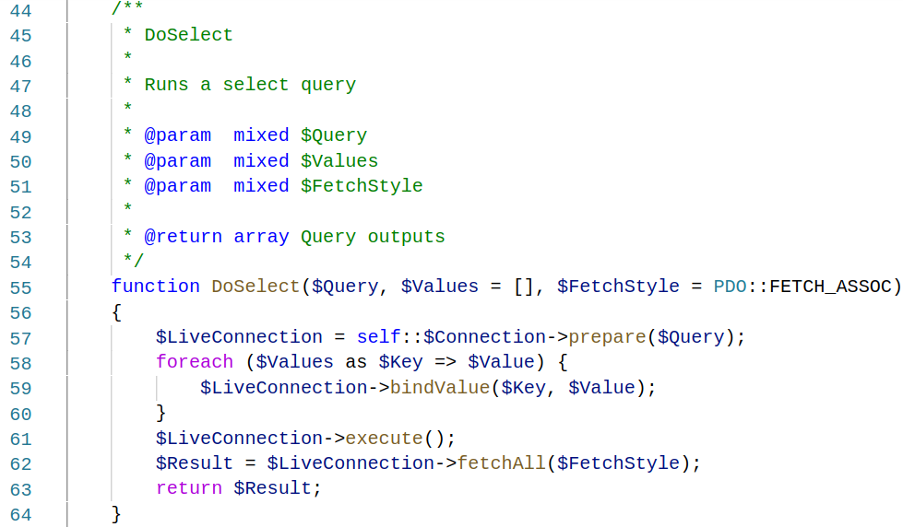
Core/Model.php

Slide 62
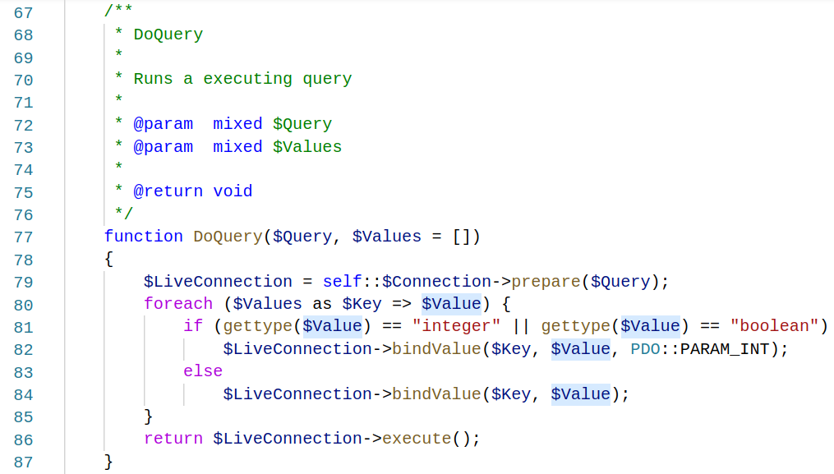
Core/Model.php

Slide 63
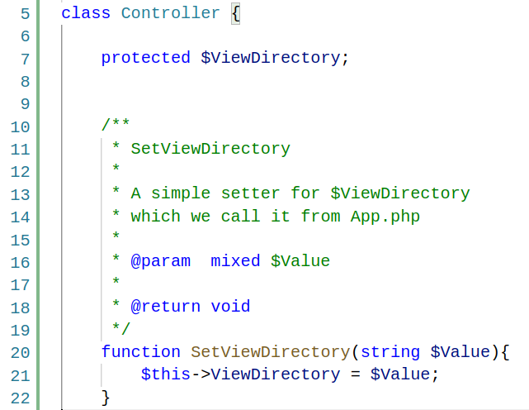
Core/Controller.php

Slide 64
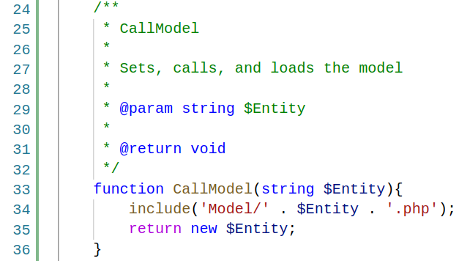
Core/Controller.php

Slide 65

Core/Controller.php

Slide 66

Core/Controller.php

Slide 67

Core/Controller.php

Slide 68

Core/Controller.php

Slide 69

Core/Controller.php

Slide 70

Core/Controller.php

Slide 71

Controller/AdminController.php

Slide 72

Controller/AdminController.php

Slide 73

Model/User.php

Slide 74

Database: Table: Users

Slide 75
Exercise
Please implement your own core and subclasses.

