Slide 1
Cloud Computing - First Assignment (SoSe2018)
Atlihan, Tayyip
Gedrat, Carsten

Slide 2
Contents
Mockup
UML1
UML2
Werkzeuge
IDE
Modules
Libraries
Lessons-learnt

Slide 3
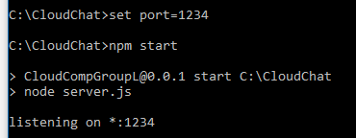
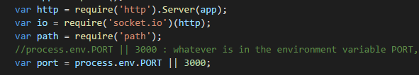
Lessons learnt:
process.env.PORT

Slide 4
Lessons learnt:
Path module

