Slide 1
Cloud Computing - First Assignment (SoSe2018)
Atlihan, Tayyip
Gedrat, Carsten

Slide 2
Contents
Mockup
UML
Tools
IDE
Modules
Lessons-learnt
Live-demo

Slide 3
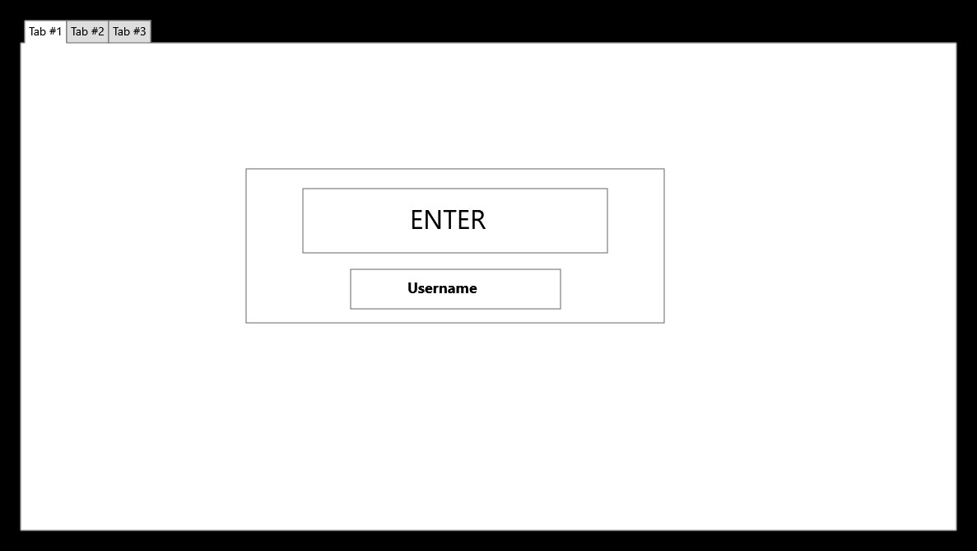

Slide 4
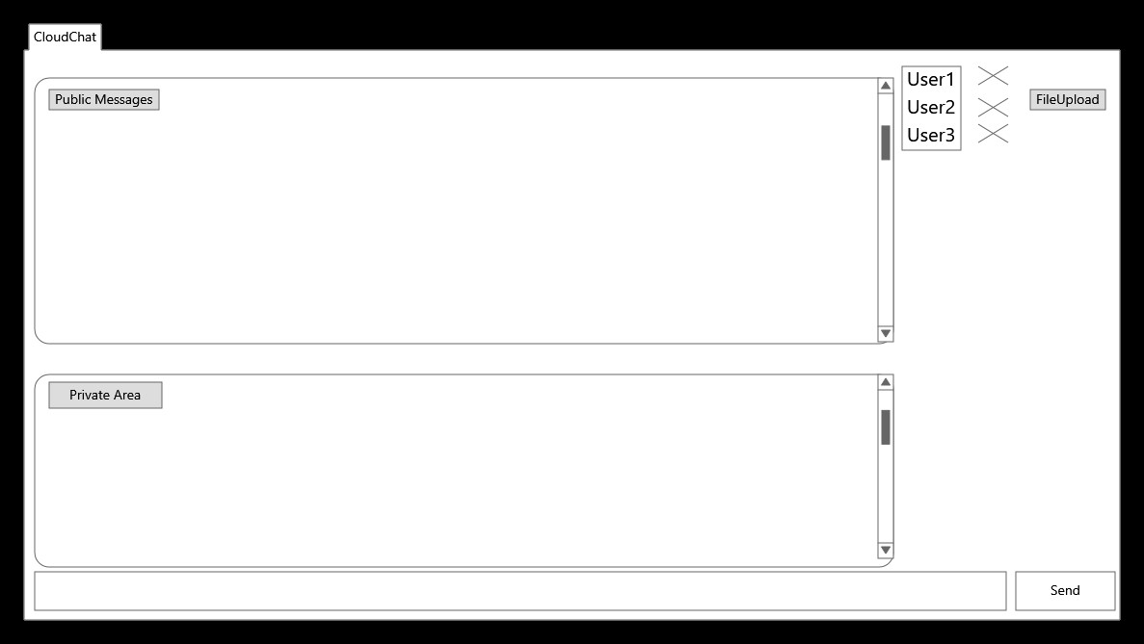

Slide 5
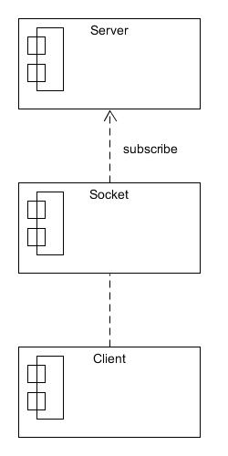
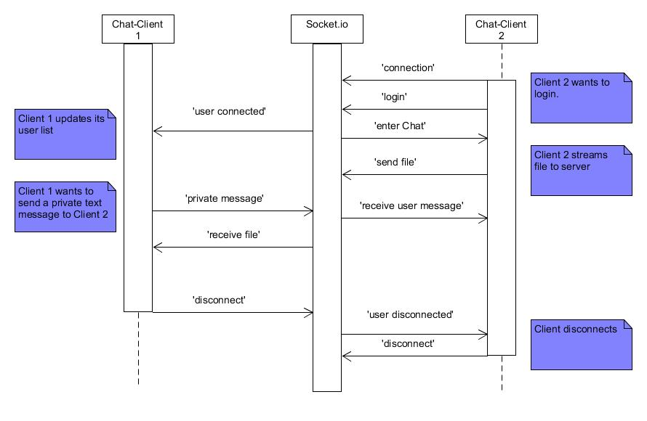
component diagram:
sequence diagram:

Slide 6
Contents
Tools:
IDE:
Carsten:
Started with Notepad++, then Nodeclipse,
stuck with Visual Studio Code
Tayyip:
Notepad++ and github Desktop

Slide 7
Contents
Tools:
Modules:
"express": "^4.15.2",
"express-validator": "^5.1.2", "socket.io": "^2.0.4",
"socket.io-stream": "^0.9.1"
And our own logicHelper.js as a module
module.exports = {
foo: function(param1, paramN){
},
bar: function(param1, paramN){
}
};
In server.js
var logic = require('./util/logicHelper')

Slide 8
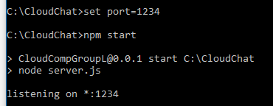
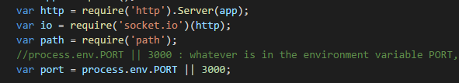
Lessons learnt:
process.env.PORT

Slide 9

Lessons learnt:
Using node.js “file system” (‘fs’) on client-side is difficult to achieve.
It would require using and implementing ‘browserify’

Slide 10
Live demo:
http://localhost:3000

