Slide 1
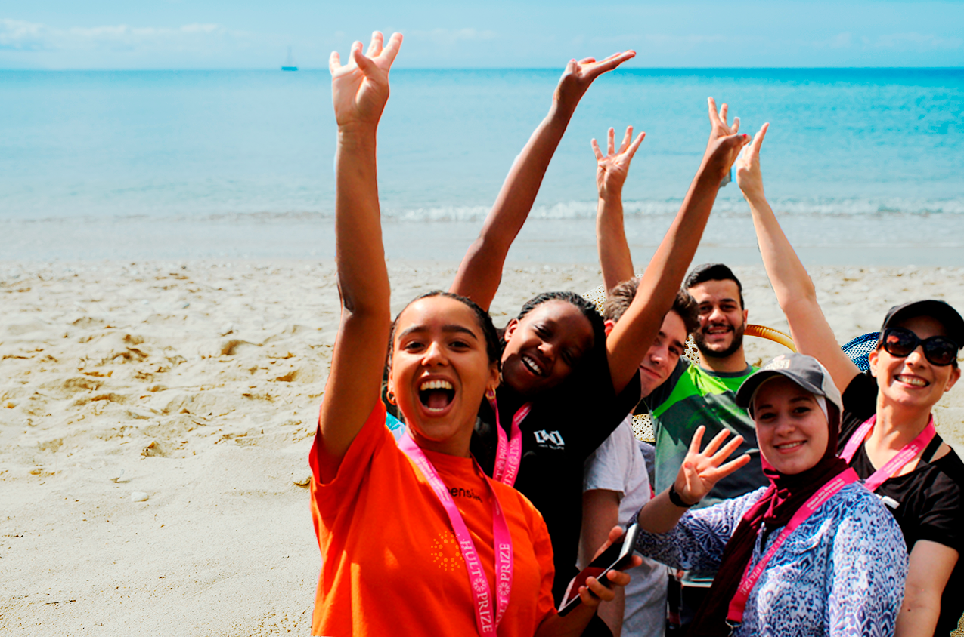

Slide 2








Slide 3
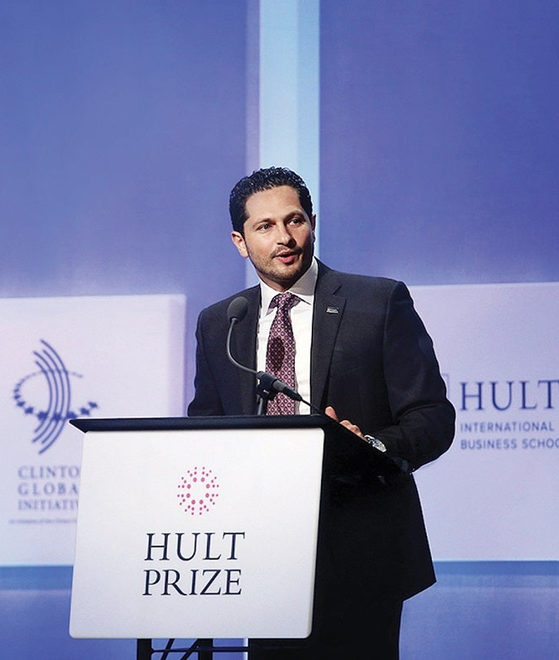

Slide 4
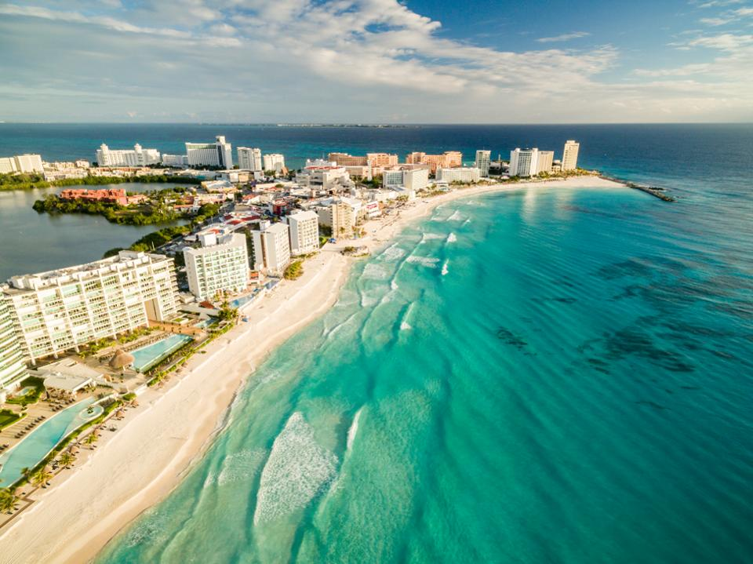
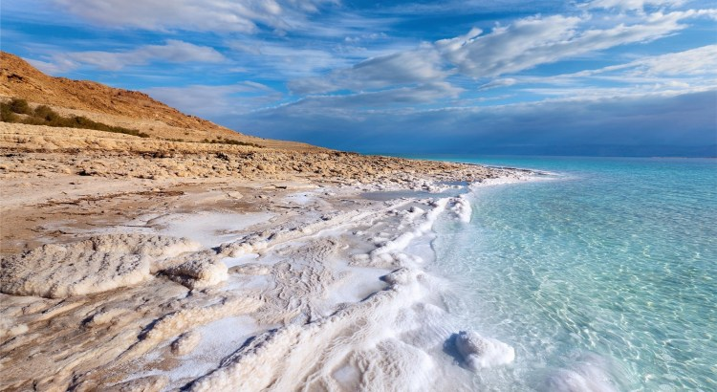




Dead Sea
Jordan
Hotel Paradisus
28th – 31th May, 2020
Crown Plaza
7th – 8th May, 2020

