Slide 1

Uber Data Analysis
Final Evaluation
Presenter: Tazeem Nazir (2020A1R017)
DEPARTMENT OF COMPUTER SCIENCE AND ENGINEERING
MIET(Autonomous), JAMMU

Slide 2
Contents
Internship Overview
Introduction
Objective
Flow Diagram
Implementation
Conclusion
Tech Stack
References

Slide 3
Internship Overview – (Python with Machine Learning)
Python Basics:
Data Types
Functions
Conditional Statements
Loops
OOP Concepts
Libraries:
Numpy, pandas, tkinter, Matplotlib, seaborn etc.
Machine Learning Basics

Slide 4
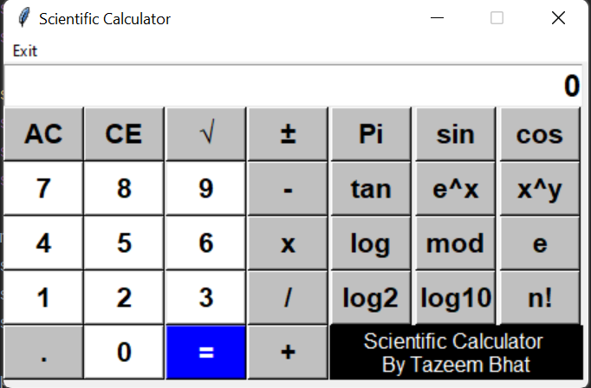
Mini Project:
Scientific Calculator using Tkinter GUI.

Slide 5
Introduction – (Uber Data Analysis)
Uber Technologies, Inc. (Uber), formerly UberCab is an American mobility as a service provider, allowing users to book a car and driver to transport them in a way similar to a taxi. It is based in San Francisco with operations in approximately 72 countries and 10,500 cities in 2021. [1]

Slide 6
Objective:
Study the data of Uber which is present in tabular format using different libraries like NumPy, pandas and matplotlib etc.
To use data analytics to analyze the transaction dataset provided by Uber to predict the possible outcomes and the changes to be made.

Slide 7
Based on a Research Paper:
“An approach to predict taxi-passenger demand using
quantitative histogram on Uber data.” [2]
This paper presents the use of data analytics in analyzing the transaction dataset provided by Uber to predict the possible outcomes and the changes to be made. The histograms and heat maps drawn provide us a clear visualization of the dataset and we must predict the rest out of it.
Published By: IEEE in 2019

Slide 8
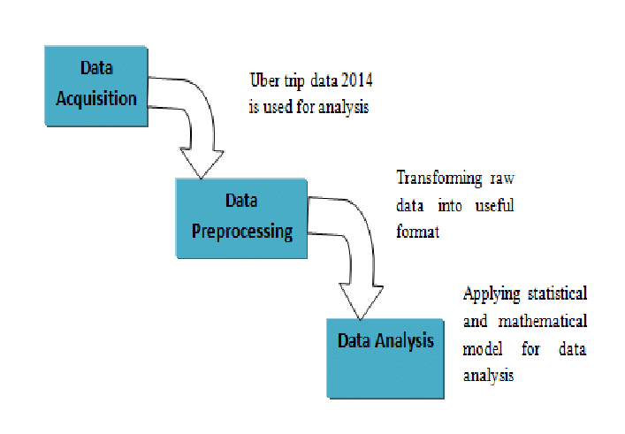
Flow Diagram:
Diagram taken from Research paper. [2]

Slide 9
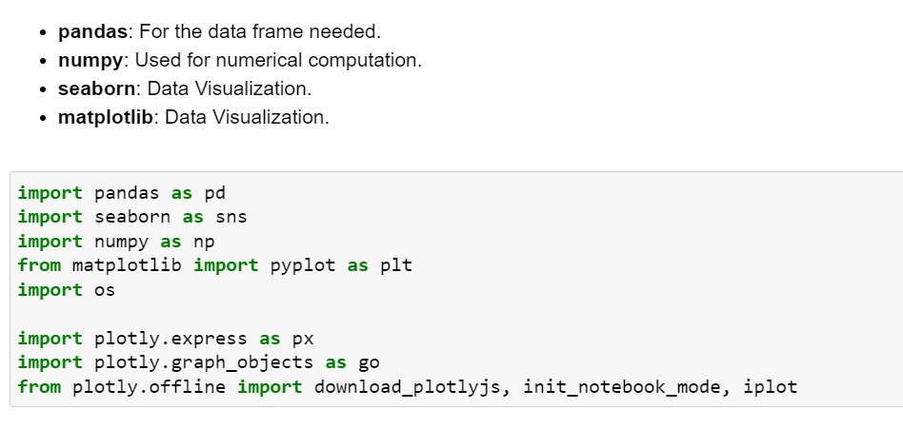
Implementation:
Step1: Importing libraries and data:

Slide 10
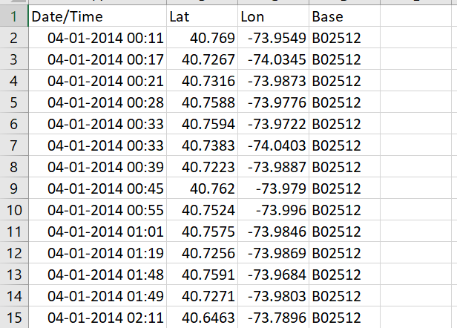
Step2: Reading and Cleaning the data:
Datasets taken from Kaggle. [3]

Slide 11
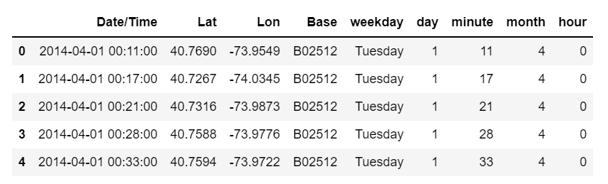
Step3: Transforming the data:
Getting hour, days of week, a month from the date of the trip.

Slide 12
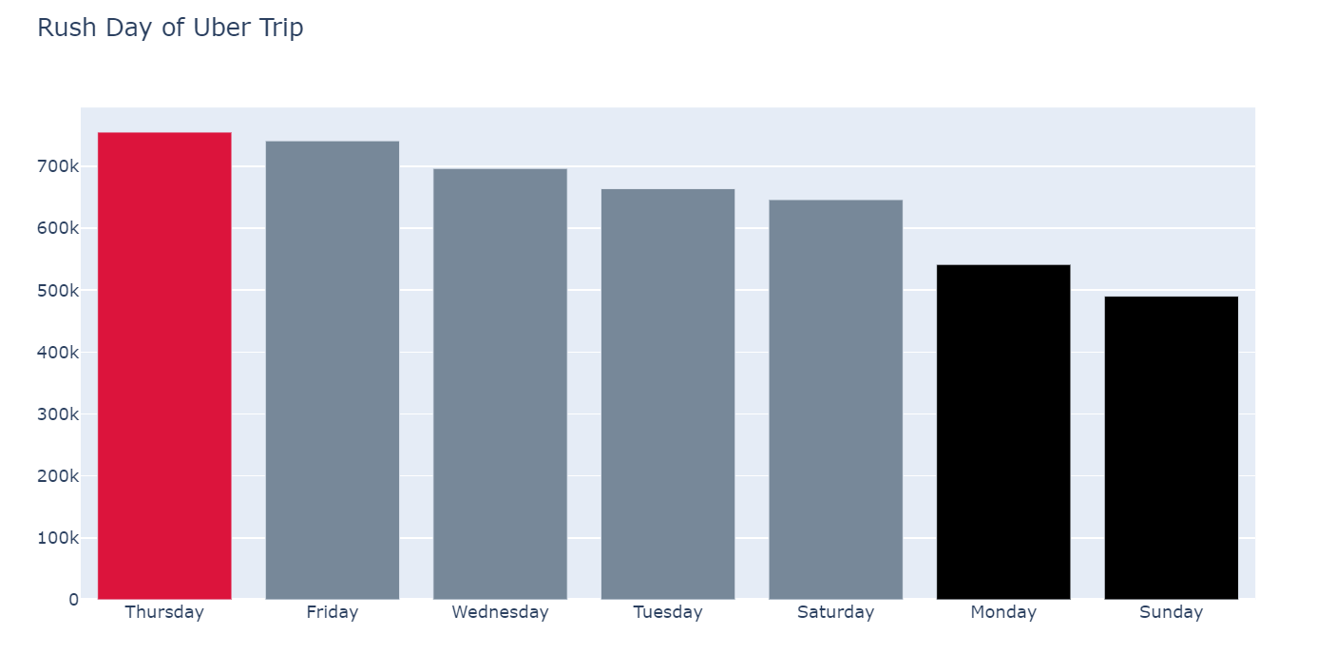
Step4: Visualizing the Data.
Fig: Analyze the week day.

Slide 13
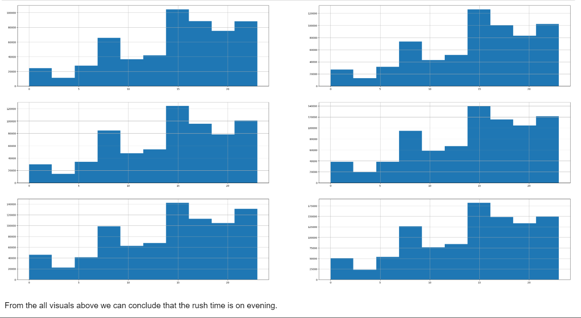
Analyzing peak time in all 6 months

Slide 14
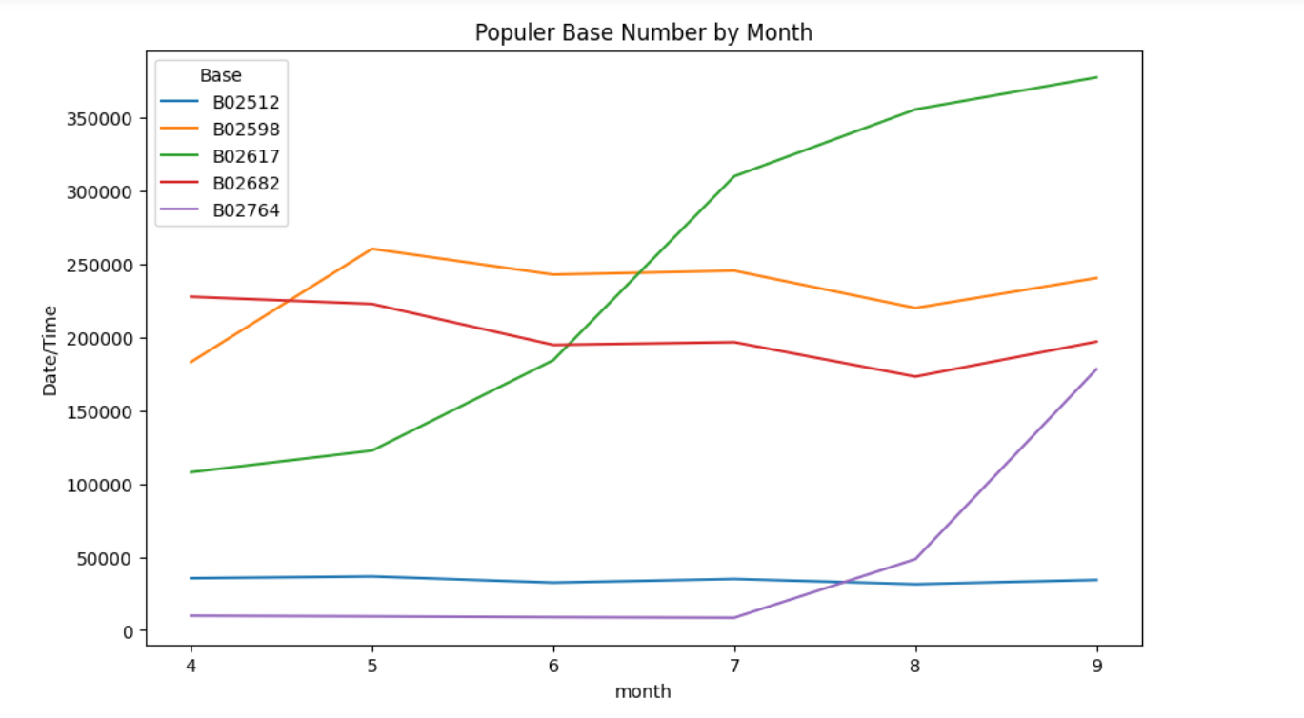
B02617 is the popular base number by month

Slide 15
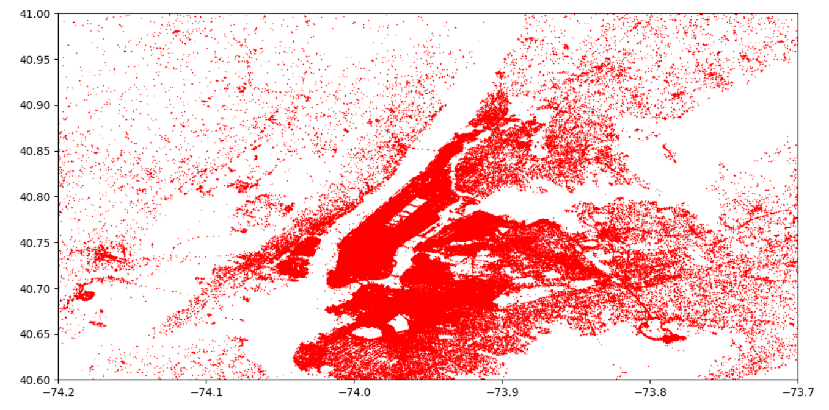
Fig: Heat Map showing the number of transactions that had taken place over both the latitude and the longitude.

Slide 16
Conclusion
From the analysis we come to know the busy zones in the interior of the city. This information will be useful in knowing the taxi necessities of each zone within the city limits and also in the outskirts.
The peak hours calculated is helpful in predicting the taxi necessities at each hour of a day which is useful in planning the time of the taxi pickup accordingly.

Slide 17
Tech Stack
Python
Numpy
Pandas
Matplotlib
Jupyter Notebook
Seaborn

Slide 18
References:
[1] Uber (Definition) - https://en.wikipedia.org/wiki/Uber
[2] Research Paper – (IEEE) https://ieeexplore.ieee.org/document/9079980
[3] Datasets - (Kaggle) Link

Slide 19


