Slide 1

Secure Password Generator

Slide 2
CONTENT:
Problem Statement
Solution
Tech Stack
Workflow
Demonstration
Team Details

Slide 3
Problem Statement
Having a weak password is not good for a system that demands high confidentiality and security of user credentials. It turns out that people find it difficult to make up a strong password that is strong enough to prevent unauthorized users from memorizing it.

Slide 4
Solution
A password generator is a software tool that creates random or customized passwords for users. It helps users create stronger passwords that provide greater security for a given type of access.

Slide 5
TECH STACK
Python
Tkinter GUI

Slide 6
Workflow
START
ENTER LENGTH
Using Checkbox
n == 8
||
n == 12
||
n ==16
TRUE
GENERATE PASSWORD
OF Length = n
FALSE
PASSWORD LENGTH = 0
PRINT
END

Slide 7
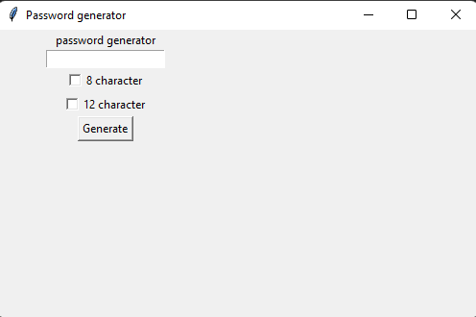
Demonstration
Fig: GUI for Secure Password Generator

Slide 8
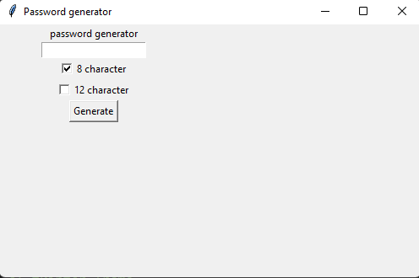
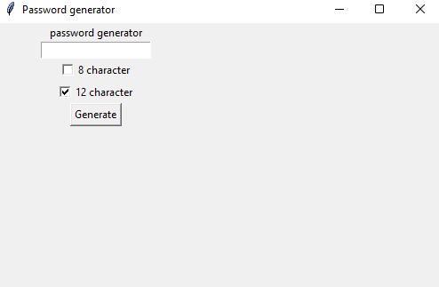
We can choose between 8 or 12 characters long password.

Slide 9
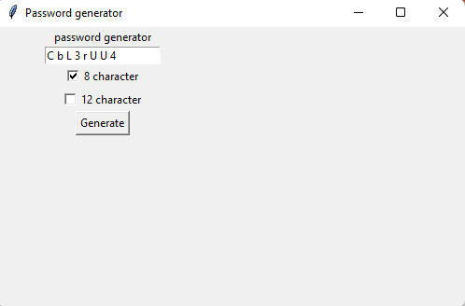
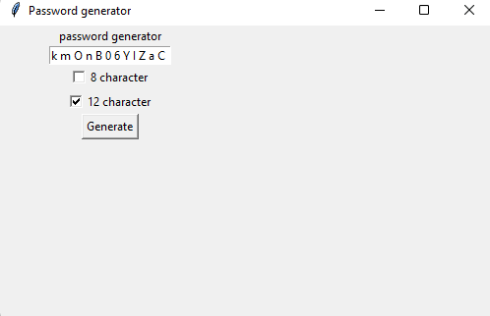
Generated passwords:

Slide 10
Team:-
Shrutam Chalotra (2020a1r006)
Aditya Kotwal (2020a1r015)
Tazeem Nazir (2020a1r017)
Shakir Malik (2020a1r019)
Prince Sadotra (2020a1r022)
CSE SEM 5TH A1

