Slide 1


Capstone Machine Learning Projects
Loan Approval Prediction + Disease Prediction
Lab Sheet-10 | MCA III Semester (Session 2026-2027)
COER University, Roorkee, Uttarakhand
Notes:
Introduce the two projects: both follow the same end-to-end workflow - data, preprocessing, model comparison, evaluation, saved model, web UI.

Slide 2
Two projects, one workflow
Project 1: Loan Approval
Project 2: Disease Prediction
Predict whether a loan is approved from income, education, employment, loan amount, credit history and marital status.
Predict the most likely disease from 26 symptoms plus age, gender and body temperature; shows the top-3 candidates.
Best model: Logistic Regression
Best model: Logistic Regression

Slide 3




Objectives and approach
Preprocess real-world style data
Missing values imputed, categories encoded, numbers scaled, new features engineered.
Compare multiple algorithms
5 classifiers (loan) and 7 classifiers (disease) judged with 5-fold cross-validation.
Evaluate with suitable metrics
Accuracy, precision, recall, F1, ROC-AUC, macro-F1 and top-3 accuracy.
Deploy a simple interface
Trained pipelines saved with joblib and served through Streamlit apps.

Slide 4


Tools and technology
Python
Pandas / NumPy
Scikit-learn
Core language
Data handling
Pipelines, models, CV
Matplotlib / Seaborn
Streamlit
Joblib + GitHub
EDA and evaluation plots
Prediction interface
Saved models, version control

Slide 5
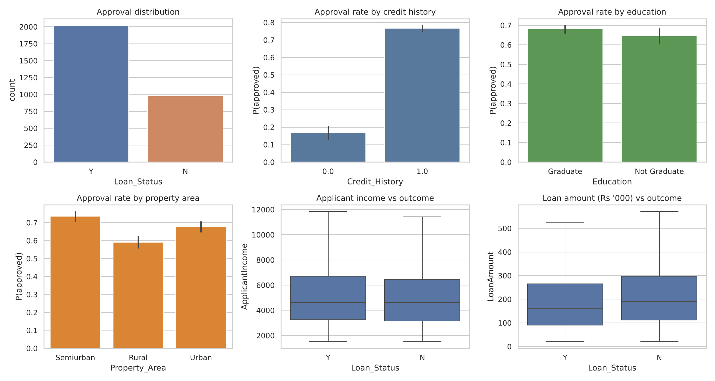
Loan data and EDA
3,000
applicants, 11 input features
67.3%
approved (class imbalance)
8.0%
missing credit history, imputed
Notes:
Credit history is the strongest separator of approved vs rejected. Data is simulated for the lab; the script runs unchanged on a real Loan Prediction CSV with the same columns.

Slide 6
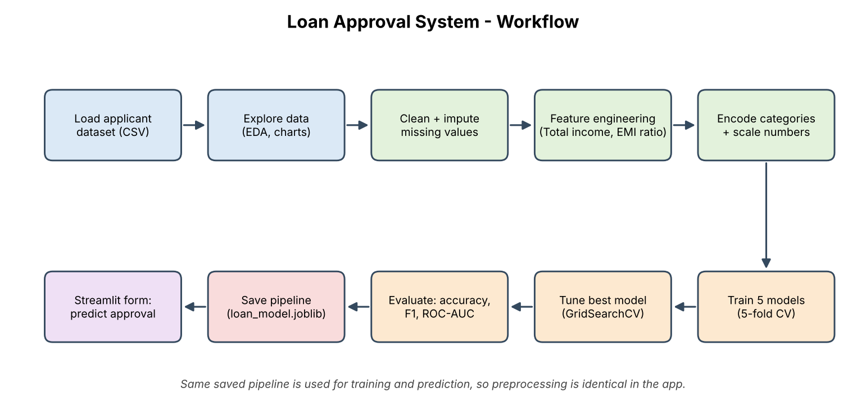
Loan workflow
Median / most-frequent imputation inside the pipeline (no data leakage)
Engineered features: total household income and EMI-to-income ratio

Slide 7
Loan: model comparison
78.7%
test accuracy (tuned LR)
0.790
ROC-AUC
92.3%
recall on approved loans

Slide 8
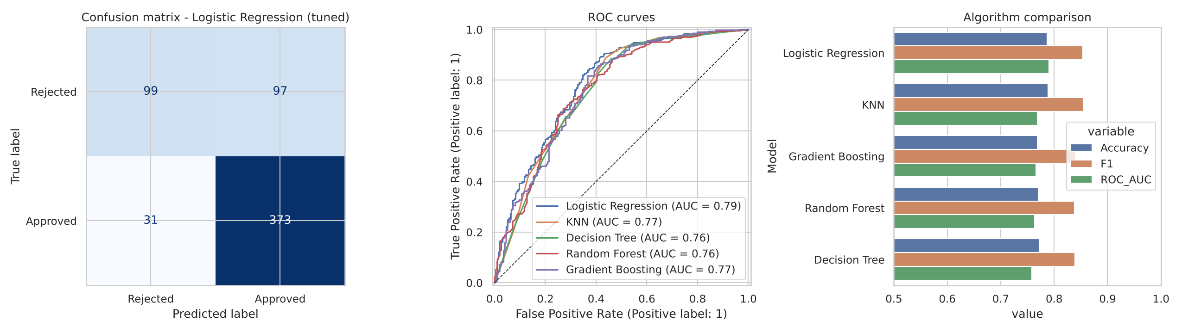
What drives approval
Top drivers
Credit History, Applicant income, Loan amount
Trade-off
Catches 92% of approvals but only 51% of rejections; the cut-off can be tuned to risk appetite.

Slide 9
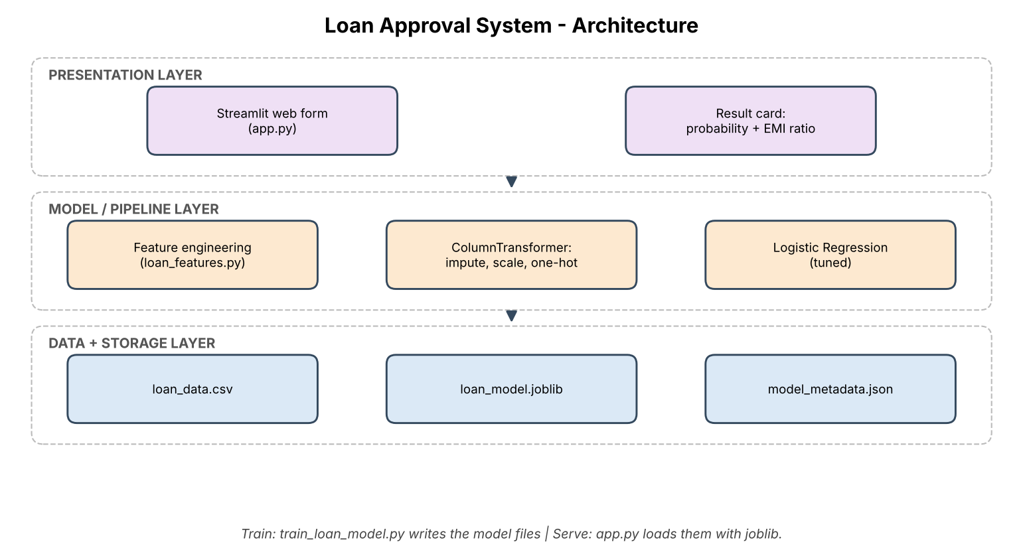
Loan system architecture
Streamlit form collects applicant details
One saved pipeline: features, preprocessing and model
Result: approval probability, monthly EMI and EMI-to-income ratio
Hints explain weak points such as poor credit history

Slide 10
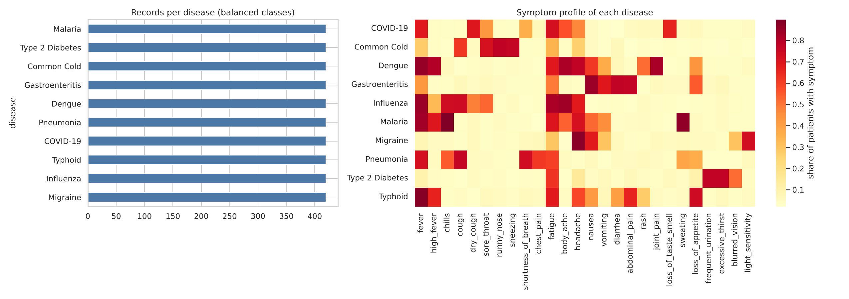
Disease data and symptoms
4,200
patient records, 10 diseases
26
symptoms + age, gender, temp
Overlap
fever, headache, fatigue shared

Slide 11
Disease: model comparison
90.5%
test accuracy
90.5%
macro F1
98.8%
top-3 accuracy

Slide 12
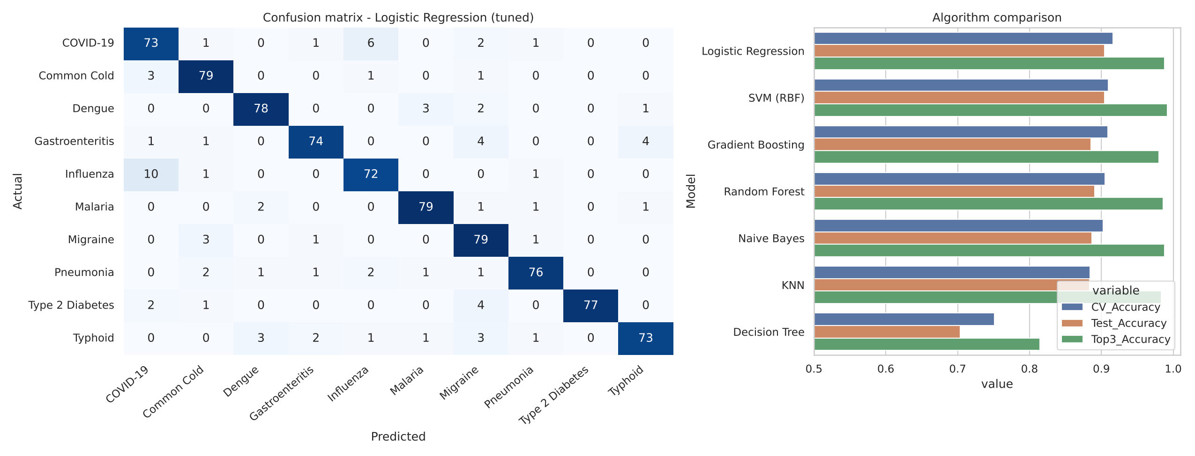
Where the model confuses
Decision Tree was weakest (about 70%); linear and kernel models handled overlapping symptoms best
Most common error: influenza vs COVID-19 (16 of 80 mistakes), so the app shows the top 3 candidates

Slide 13
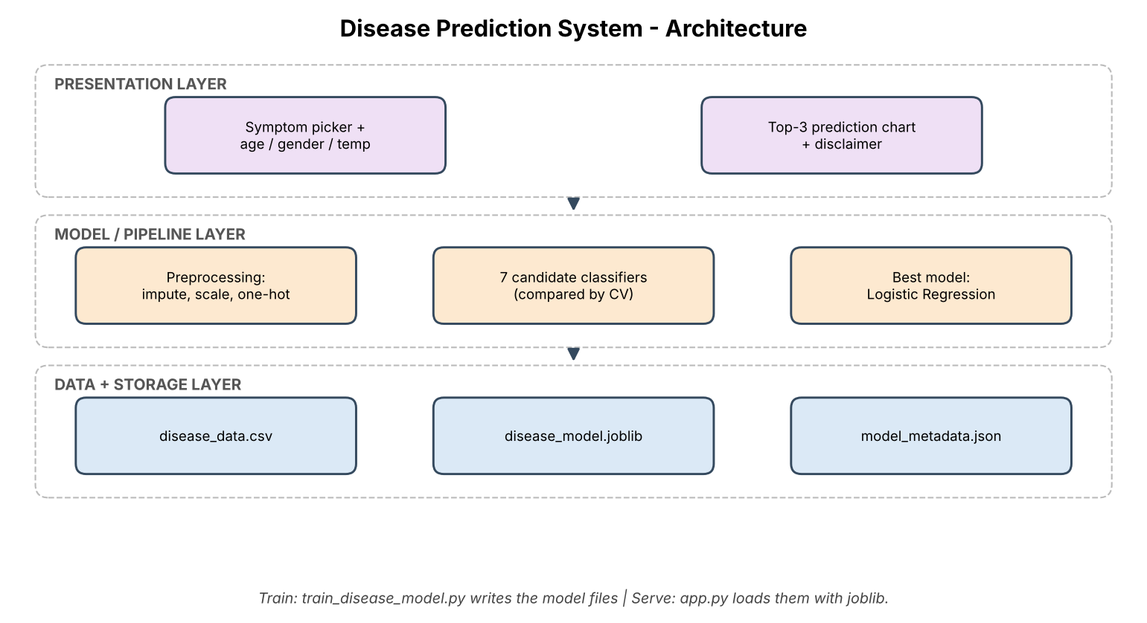
Disease system and UI
Pick symptoms, enter age, gender and temperature
Top-3 diseases with probabilities in a bar chart
Low-confidence warning when the top choice is under 50%
Clear 'not a medical device' disclaimer

Slide 14


Conclusions and future work
What we achieved
Limitations
Next steps
Loan model 79% accurate (AUC 0.79); disease model 90% (top-3 99%). Both saved and served via Streamlit.
Both datasets are simulated. Real data needs fairness checks (loans) and clinical validation (health).
Train on real datasets, add explainability (SHAP), monitor drift, deploy to a cloud host.

