Slide 1

Bangladesh Army University of Science and Technology
Project: Pdf Reader (Android App)
Course Code: CSE 2200
Course Title: Software Development Project II
Submitted by:
Name: Tazrian Billah
Roll: 180201069
Batch: 8th
Level: 2
Term: II
Sec and Group: A Sec, G2
Dept. of CSE, BAUST.
Supervised By:
Md. Toukir Ahmed
Lecturer,
Dept. of Computer Science and Engineering,
Bangladesh Army University of Science & Technology (BAUST),
Saidpur Cantonment, Saidpur, Nilphamari

Slide 2
Pdf Reader
Pdf reader is a very essential tool this days, especially for a android phone. This app of mine is very easy to use. This app has all the basic feature that one needs to read pdf.

Slide 3

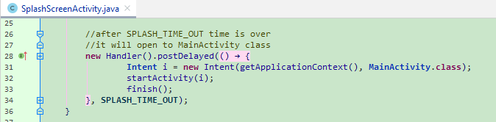
This is the opening screen. When the app icon will be pressed this screen will come first. This is also called splash screen.

Slide 4
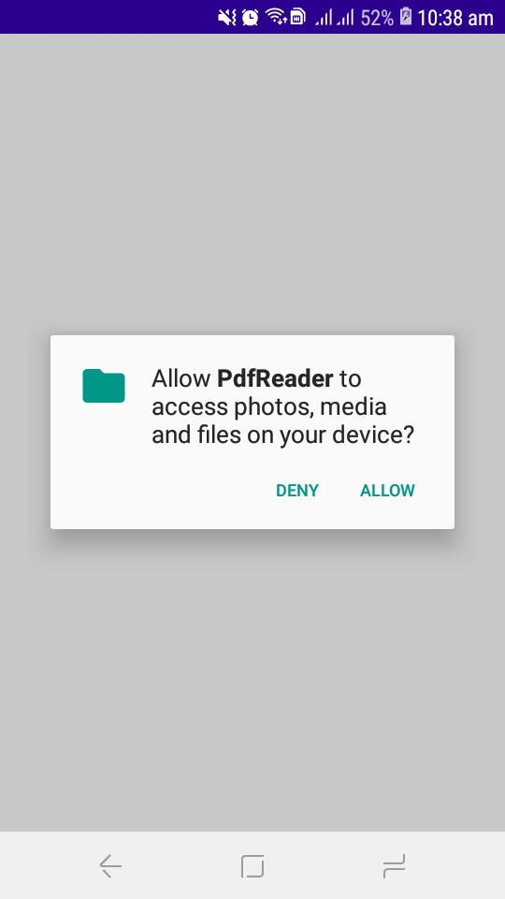
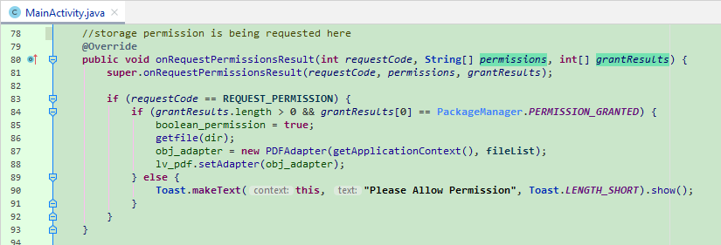
When the app will be opened for the first time it will ask for storage permission. If the permission is denied, it will not work. For the app to work smoothly permission has to be given.

Slide 5
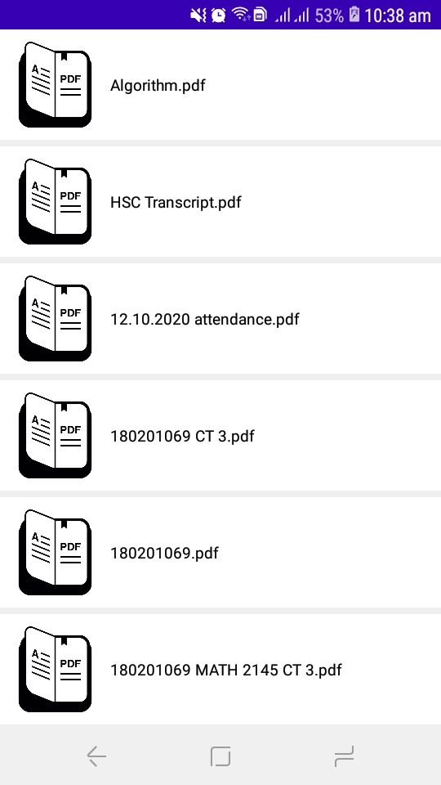
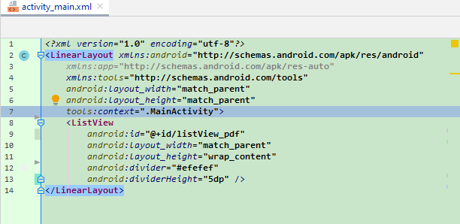
After permission is given, all the pdf file (from the storage of the app) will be shown in list view automatically.

Slide 6

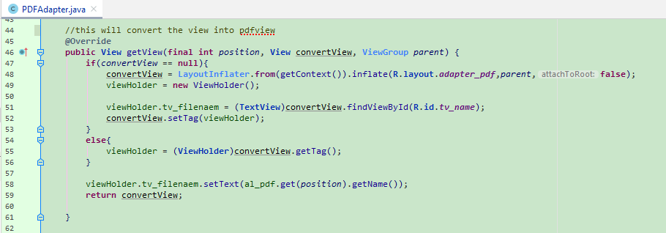
After opening any pdf file it will open at the first page in portrait mode. Its page no will be shown at the side.

Slide 7
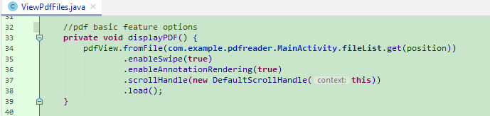
Some Basic Feature
Basic feature include:
Portrait mode
Landscape mode
Go to any page
Zoom
Scroll at will

Slide 8
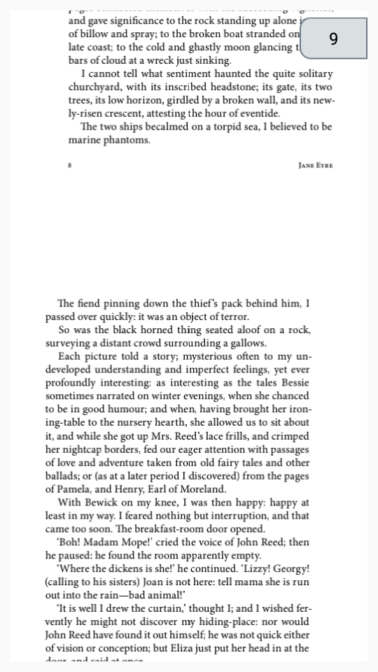
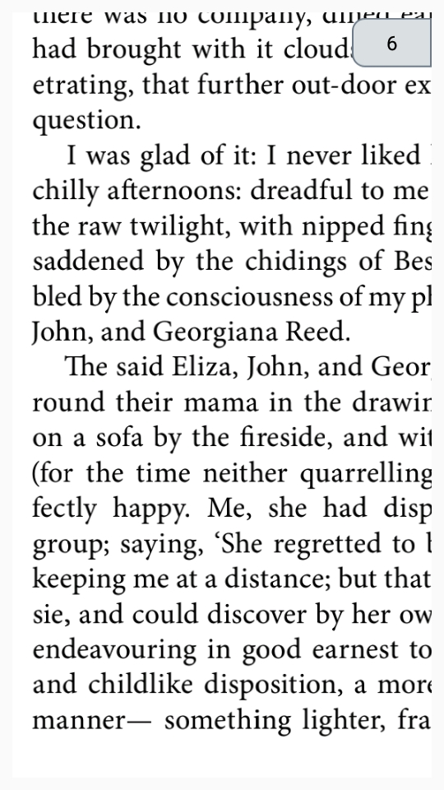
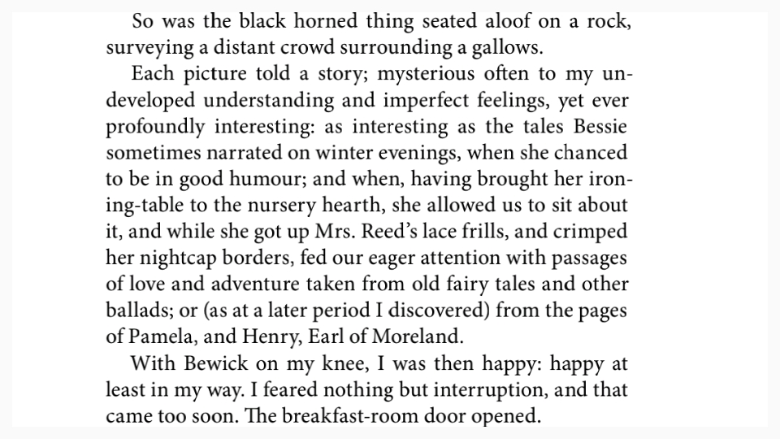
Continued
Landscape
Portrait
Zoom

Slide 9
GitHub Link
https://github.com/tazrianbillah/pdfReader1

Slide 10
Thank You

