Slide 1
CERN 2012 BSD Beam Test
Tyler Anderson

Slide 2
Notes
CAL not yet gain normalized
Don't have important conversion of PE/ncap
CAL was triggered by upstream tracker, not actual CAL trigger
For this analysis, used pion events with BSD centered on CAL and no BCD/TCD. There was another set of pion data where the BSD/TCD were in place (offset somewhat from main part of cal) and the BSD was offset from center.

Slide 3
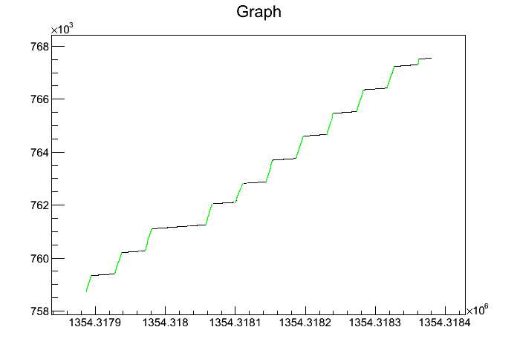
Aside: “IsWithCal” is good proxy for choosing in-spill events
Green is with cuts “IsWithCal”
Plot feventno vs. fcurtime

Slide 4
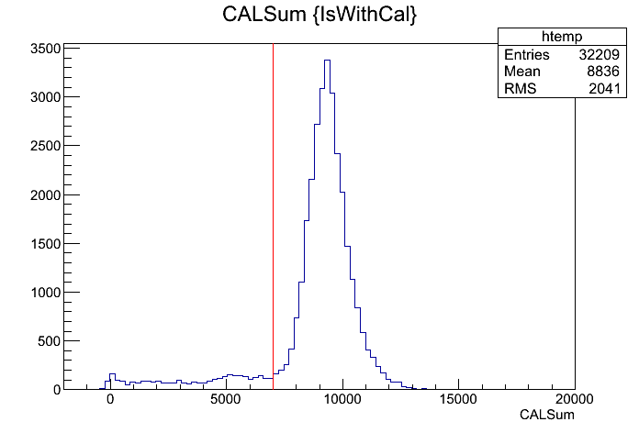
Electron Cut on CAL
Sasha says “electron beam is better than 75% pure”
Require CALSum > 7000 to get only electrons
Note: Turns out the 6 layers cut takes care of this automatically

Slide 5
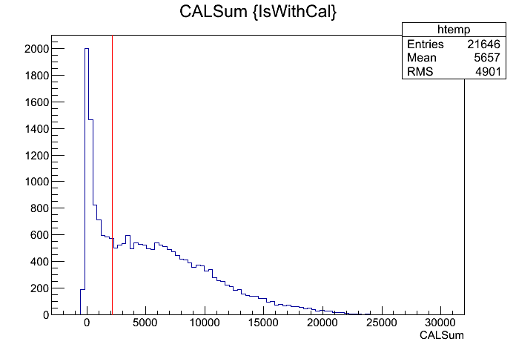
Pion Cut on CAL
Sasha says pion beam is ~95% pure
Should we cut on showering events only?
  Try with (showering) and without (everything) cut above to see difference
  Choose CALSum > 2160 because:
    It's a quick and dirty approximation to the CALtrigger condition (40 MeV x 6 Layers x 9 chan/MeV)
    You're clearly starting to get past pedestal and into peak

Slide 6
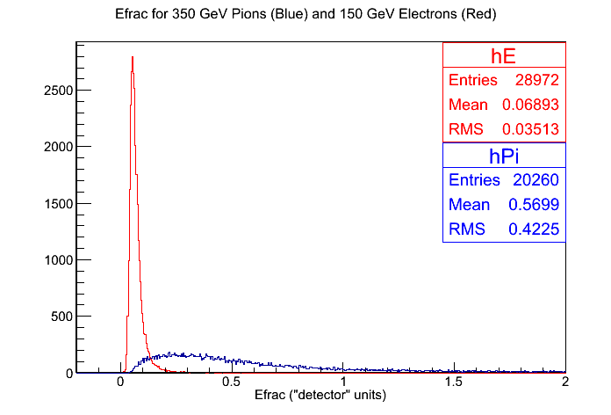
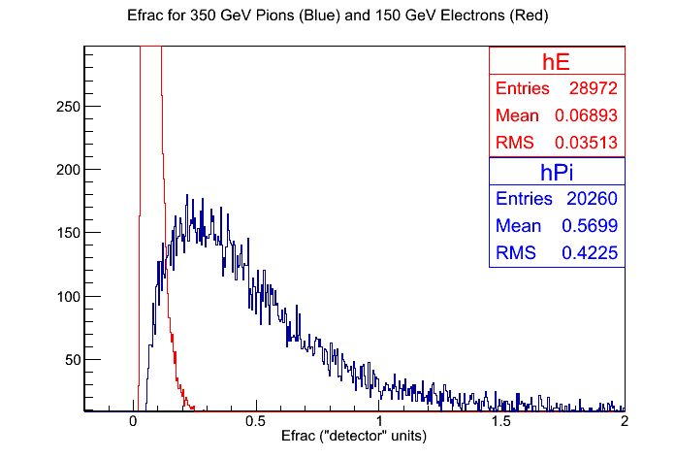
Efrac for All Pions

Slide 7
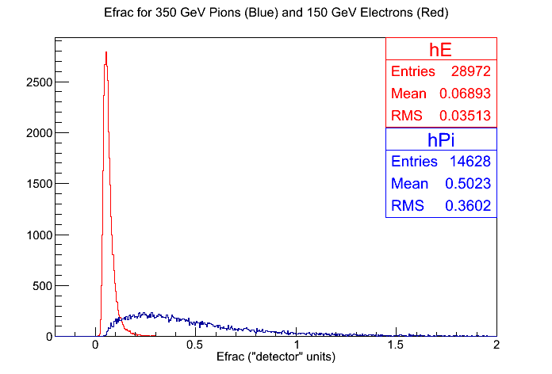
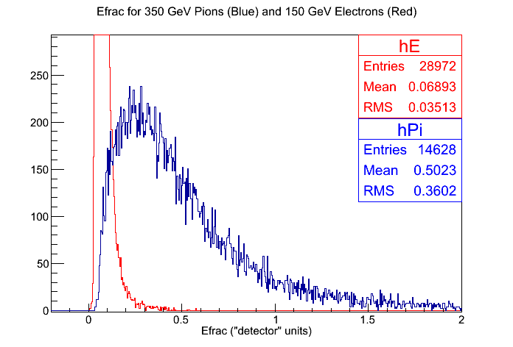
Efrac for Showering Pions
Cuts 28% of pion events

Slide 8
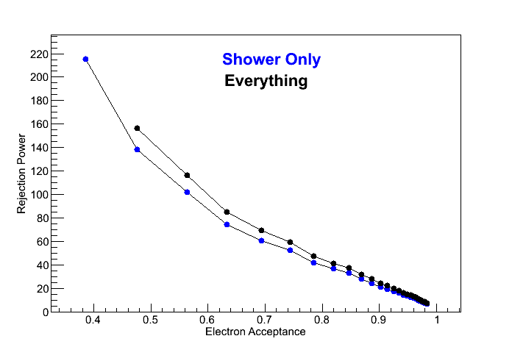
Rejection Power vs. Electron Acceptance

Slide 9
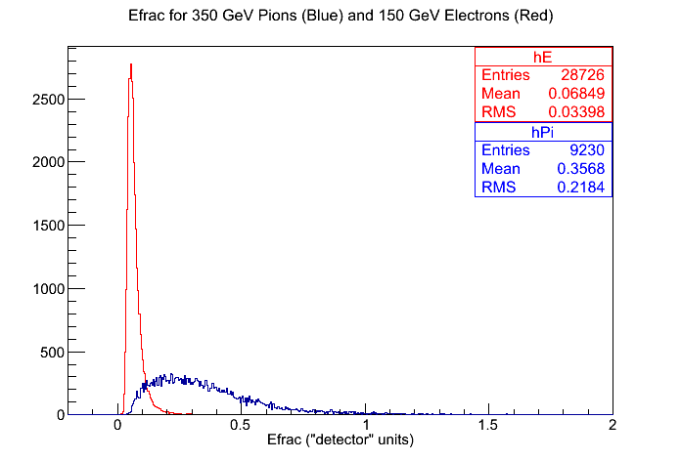
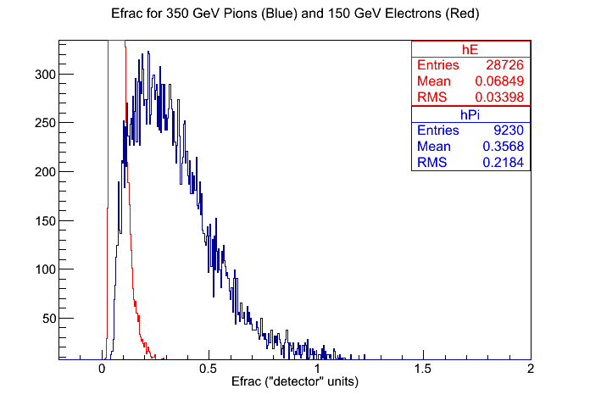
Better CAL Trigger Cut
>40 MeV in 6 consecutive layers instead of CALSum > 2160
Cuts 54% of pion events and ~1% of electron events (relative to “everything”)

Slide 10
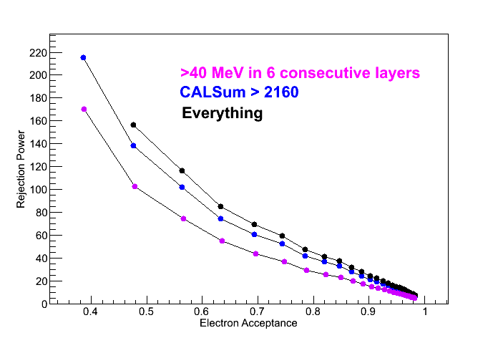
Rejection Power vs. Electron Acceptance

Slide 11
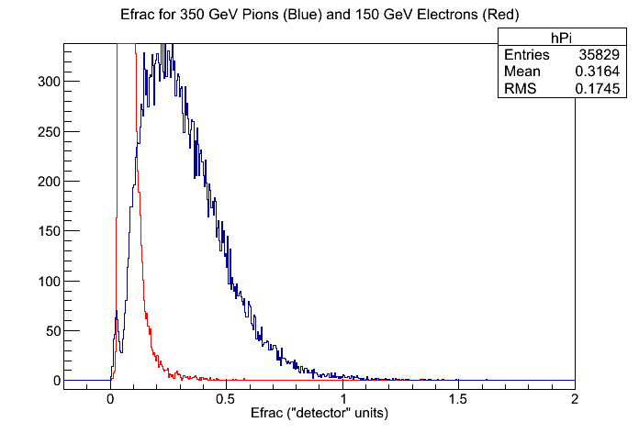
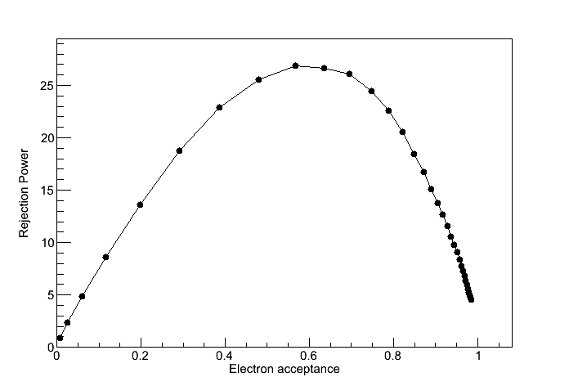
Same Analysis: 350 GeV Pions with BCD/TCD
Wow! Really different.
Strange second peak in Efrac pion distro messing things up. What is this?

Slide 12
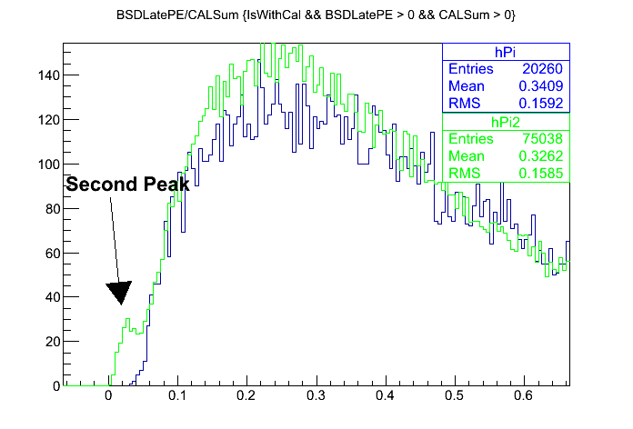
Understanding Small Efrac Peak in Second Pion Run
Second peak in pion data with BCD/TCD (hPi2) messes up Efrac distros
Could be large CALSum, small BSDLatePE, or intermediate combination of both...

Slide 13
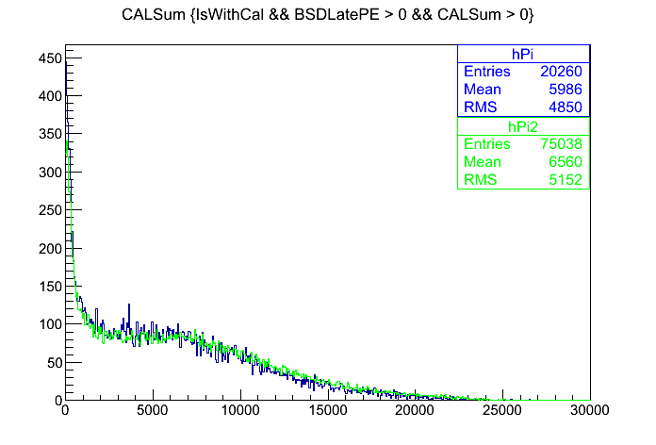
CALSum Comparison
Pretty similar

Slide 14
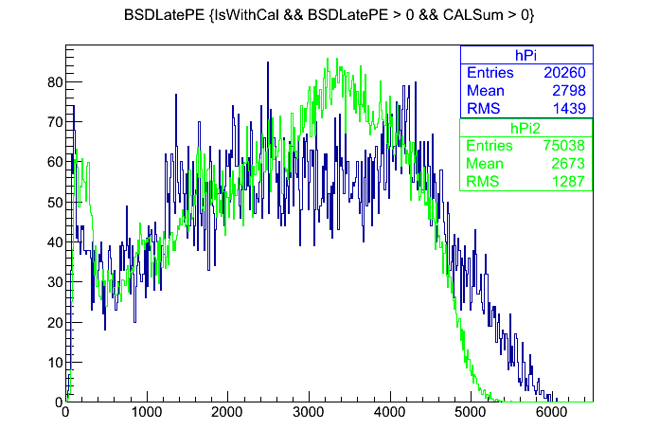
BSDLatePE Comparison
Somewhat different

Slide 15
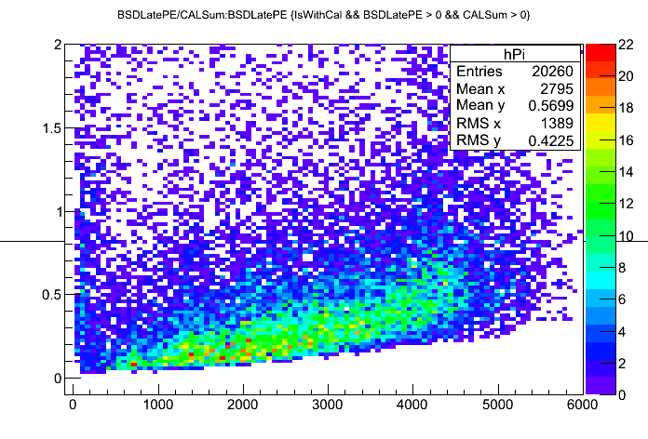
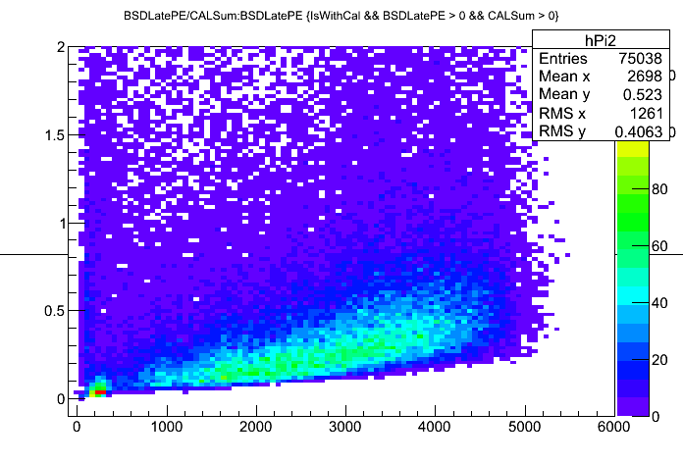
Efrac vs. BSDLatePE
Pi2 has two distros in BSDLatePE around ~240 PE

Slide 16
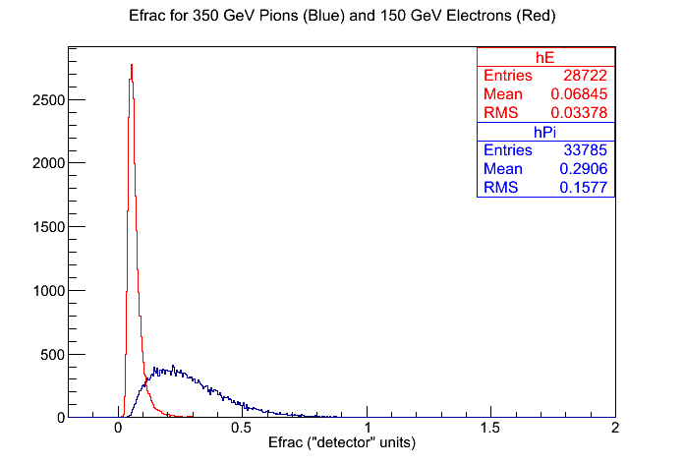
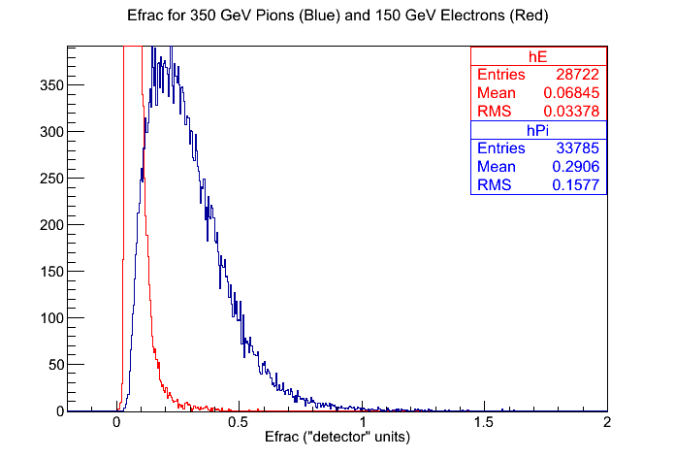
Solution
Found that I needed to add a check that all fCHA[1] thru fCHA[10] were >= 0. That removed the pathological events which were messing things up there. Above is with Pi and Pi2 datasets

Slide 17
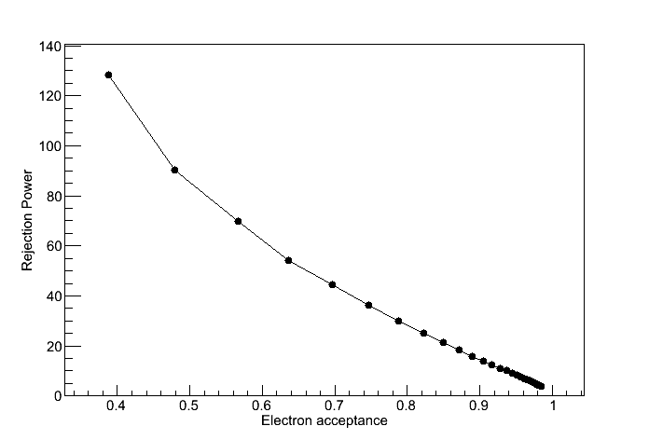
Solution (cont.)
Final rej vs accept plot for 150 GeV electrons and 350 GeV pions

Slide 18
All Cuts
“IsWithCal”
  CAL and BSD saw this event.
“BSDLatePE > 0”
  Sometimes you get saturating BSD events which wrap here
“CALSum > 0”
  Less than ped, clearly unphysical
“fCHA[n] > 0” for n = 1 through 10
  All PMTs participating in BSDLatePE sum see above pedestal events
CALS sees > 40 MeV in 6 consecutive layers
  This is flight version of CAL trigger

Slide 19
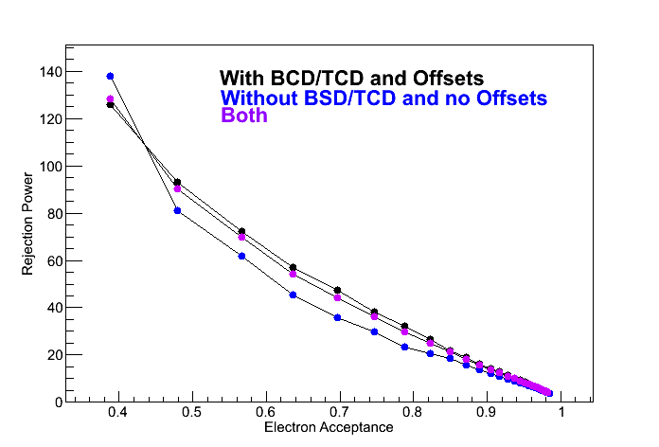
Comparison of Plot From Both Datasets + Combined
Combined datasets. Note that the final plot for this exercise is found in caltrig_cut

Slide 20
What now?
Look at efficiency of cuts you're applying in both e and pi.
Add error bars to everything you've done.
Make presentation style plots.
Look at other energies!
  Let's do this next because a.) it's the most fun b.) it will help us map out what we want/need to do next a little bit better.

Slide 21
CAL Response With Particle Energy
Note: 50 GeV electrons don't shower enough to meet the software”>40 MeV in 6 consecutive layers” cut. So this run doesn't make it into these plots.
Note: I'm noticing that the 6 layer cut seems to exclude a lot of the corruption in the electron beams. Revisit this!

Slide 22
BSDLatePE Response With Particle Energy
Note: BSDLatePE for 150 GeV and 175 GeV electrons are quite similar...

Slide 23
CALSum and BSDLatePE for 75-175 GeV Electron and 250-350 GeV Pions
Voila!

Slide 24
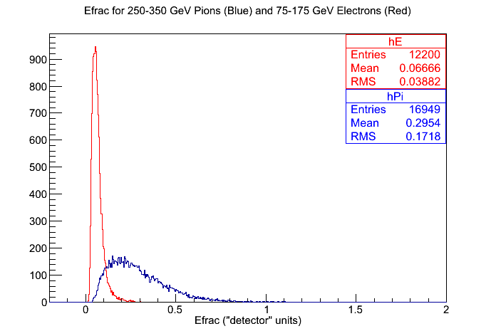
Efrac For All Energies
Voila!

Slide 25
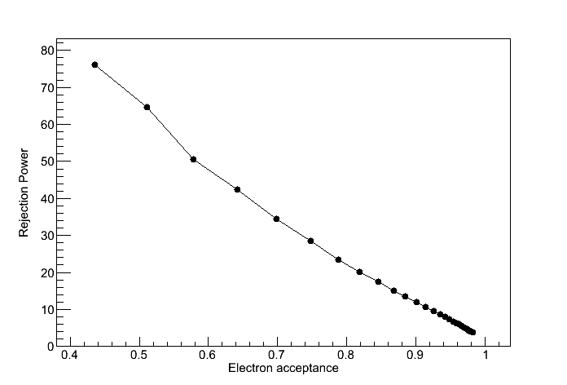
Rejection Power vs. Electron Acceptance
Voila!

Slide 26
CERN 2012 BSD Analysis Update
Tyler Anderson
December 12, 2012
BSD Group Meeting

Slide 27
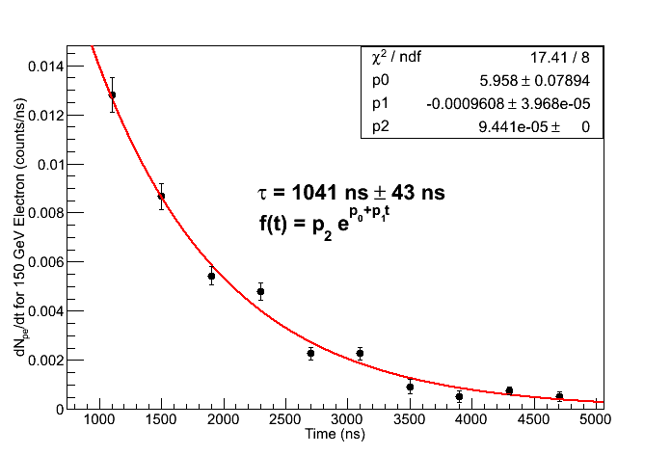
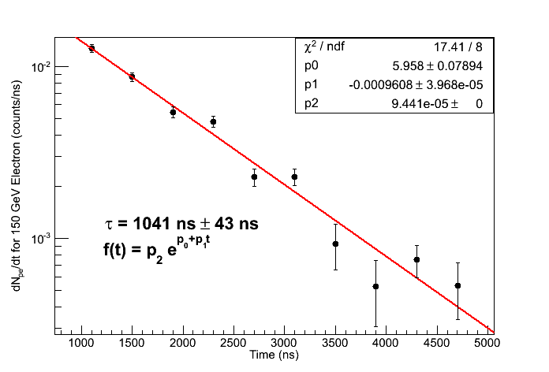
Scope Electron Data
Using PMT 1B, 150 GeV electron data
Error bars calculated as quadrature sum from three contributions:
  Error in center point approximation for derivative
  Standard error of mean in peak determination
  Standard error of mean in pedestal determination (small)
15 Pe between 900 ns to 4500 ns

Slide 28
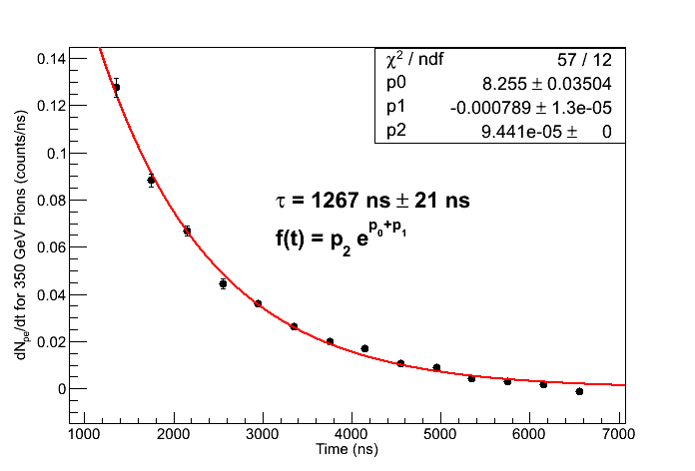
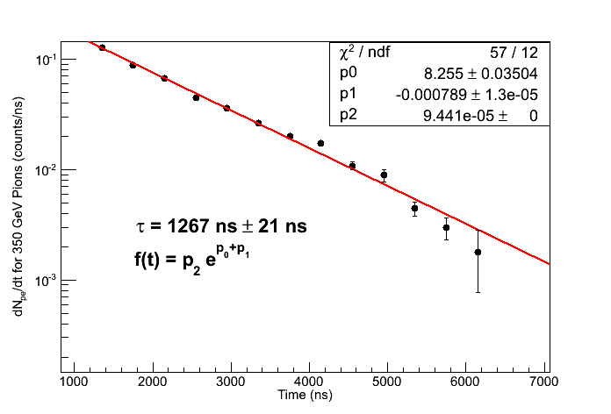
Scope Pion Data
Using PMT 1B, 350 GeV electron data
Error bars calculated as quadrature sum from three contributions:
  Error in center point approximation for derivative
  Standard error of mean in peak determination
213 PE between 900 ns to 450 ns

Slide 29
Initial Quality Cuts for 2249W Data
Note: Using pion and electron energy scan data from runs with BSD slightly offset and BCD + TCD in place
IsWithCal
  Cuts 64.7% of electrons, 67.1% of pions
  Requires that both BSD and CAL saw event (matched by event number)
  CDAQ has much more dead time (~20 ms) than CAMAC readout (~300 us), so this cuts a lot of data
fCHA[n] > 0 for n = 1 to 10
  Cuts 0.3% of remaining electrons, 24.2% of remaining pions
  Mostly from saturated channels (2249W puts out a “1” when saturated, so pedestal subtracted values are less than 0).
  Look at the 24.2% pions. This is large enough that it will affect Efrac distributions, since the cut is biased for large signal values.
CALSum > 0
  Cuts 0.4% of remaining electrons, 6.7% of remaining pions
  Below pedestal events caused by width of CAL pedestal
  Note that the next cut would clean these up anyway, so this cut is likely unnecessary.
>40 MeV in 6 consecutive CAL layers
  Cuts 9.4% of remaining electrons, 55.7% of remaining pions
  Use approximate conversion 9 chan = 1 MeV (from S. Nutter) as rough conversion. This needs to be redone when CAL is gain calibrated.
  Look at efficiency of this cut with energy
Out of 91174 electron events, 28991 remain
Out of 65748 pion events, 6768 remain

Slide 30
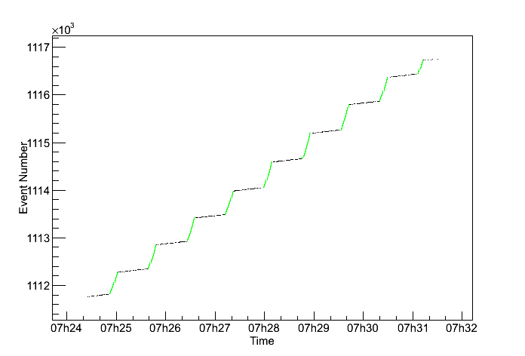
IsWithCal for In Spill Events
Choosing “IsWithCal” is a good proxy for in spill events.
  Black: All events in a particular run
  Green: Events with “IsWithCal” flag
Makes sense since this is the time window when the BSD and upstream scintillator counter triggers are well correlated.

Slide 31
fCHA[n] < 0
The 2249W puts out a number much less than pedestal (typically “1”) when it saturates
The fCHA branch is already pedestal subtracted, so these saturated values will show up as a large negative spike in channel histograms
These saturated events are significant (especially for pions) because:
  They represent large PE signals
  They are much common for pions (because of larger pion signal) than electrons
Hence, missing these events will through off Efrac significantly

Slide 32
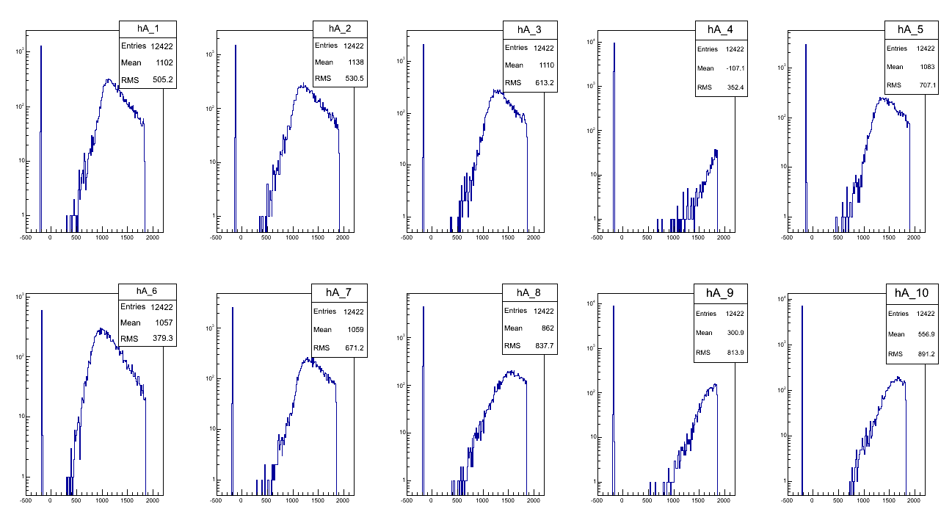
Looking at fCHA[n] < 0 Events
96.3% have fCHA[4] saturated.
99.1% have either fCHA[4] or fCHA[9] saturated.

Slide 33
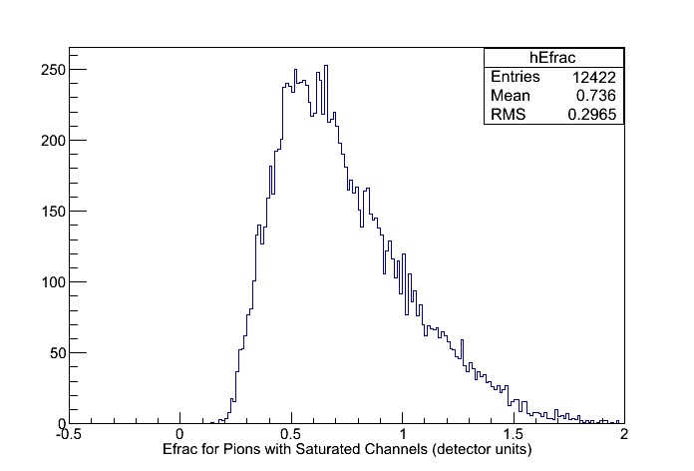
Saturated Event Solution
Solution: If a channel is saturated, give it max value, 2048 channels. This is a good approximation, though it under estimates the signal sum a little bit
All events with saturation (histogram above) then end up outside the electron Efrac range (Efrac < 0.1 in detector units). Thus, the slightly under estimated signal sum doesn't really matter in the end

Slide 34
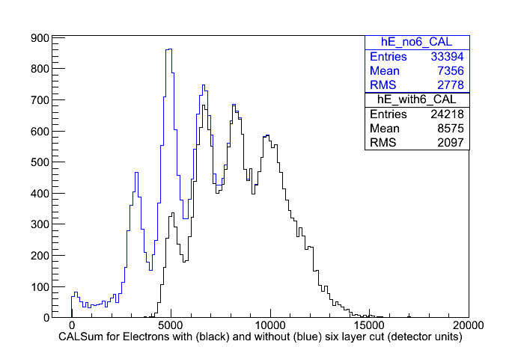
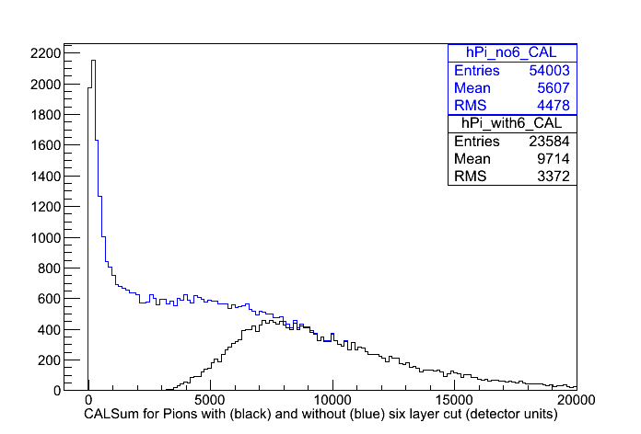
Effect of “Six Consecutive Layer >40MeV” Cut on CALSum
Note that the 6 layer cut removes much more of the low energy events than the high energy events
For analysis, must weight with equal amounts of all energies AFTER 6 layer cut
Note: Electron beam is only ~75% pure, but this cut removes most of the impurities. Pion beam is ~95% pure

Slide 35
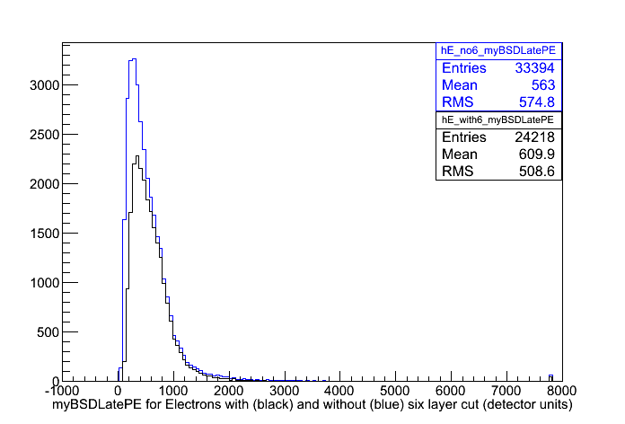
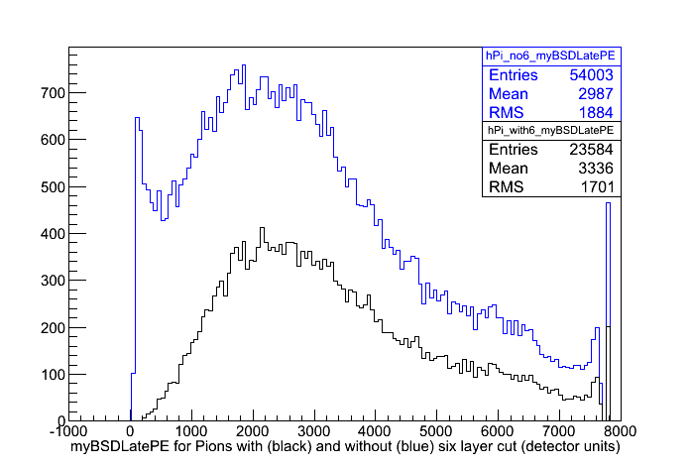
Effect of “Six Consecutive Layer >40MeV” Cut on myBSDLatePE
Note that the 6 layer cut removes much more of the low energy events than the high energy events
For analysis, must weight with equal amounts of all energies AFTER 6 layer cut

Slide 36
Revised Data Cuts and Conditioning
IsWithCal
  Cuts 64.7% of electrons, 64.1% of pions
Set any fCHA[n] < 0 for n = 1 to 10 to 2048 channels. Use myBSDLatePE as gain converted PE sum of these.
  Effects 0.3% of remaining electrons, 24.2% of remaining pions
Require >40 MeV in 6 consecutive CAL layers
  Cuts 9.9% of remaining electrons, 56.9% of remaining pions
Out of 91174 electron events, 29029 remain
Out of 65748 electron events, 9321 remain

Slide 37
Now what?
Cuts and data conditioning measures have been outlined/verified
Would like to make plots which are:
  1.) physically meaningful
  2.) can be compared with MC simulation data
Choose to do analysis of CALSum, myBSDLatePE, Efrac, and rejection power vs. electron acceptance for 75 GeV-175 GeV electron energies and 250 GeV-350 GeV pion energies.
Not all energy runs have the same amount of data, so we “mix” for equal fractions of all energies AFTER cuts and conditioning!

Slide 38
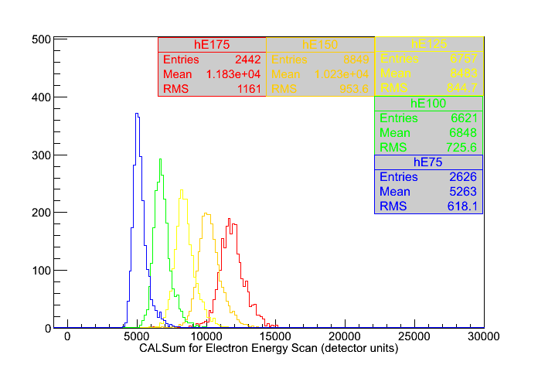
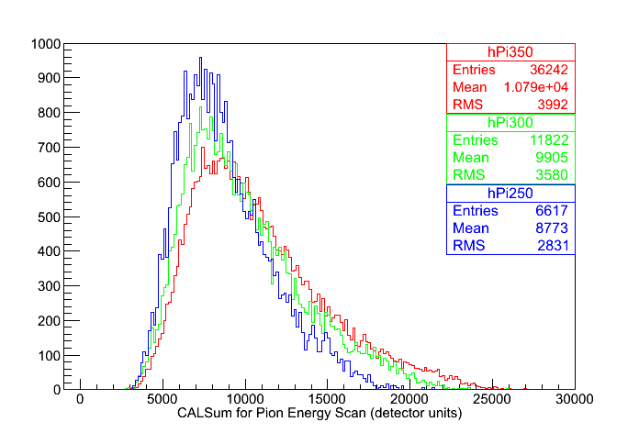
CAL Response With Particle Energy
Note: Histograms are scaled to similar heights by total number of events
Note: 50 GeV electrons don't shower enough to meet the software”>40 MeV in 6 consecutive layers” cut. So they aren't included in these plots even though we have data for them.

Slide 39
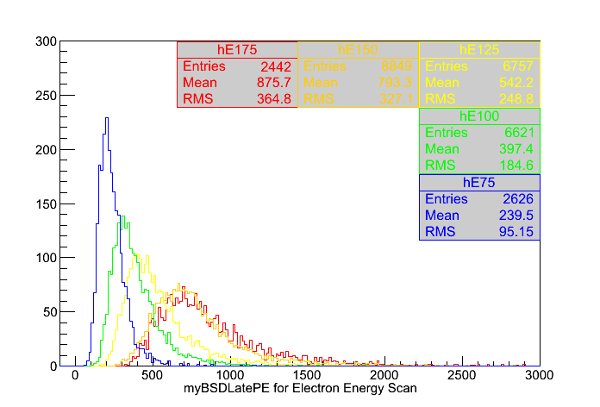
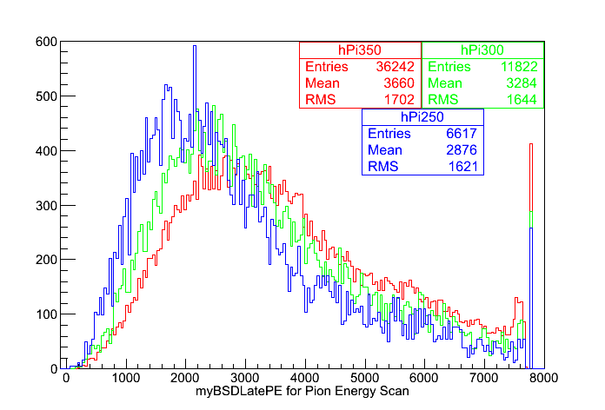
BSDLatePE Response With Particle Energy
Note: Histograms are scaled to similar height by total number of events
Note: BSDLatePE for 150 GeV and 175 GeV electrons are quite similar...

Slide 40
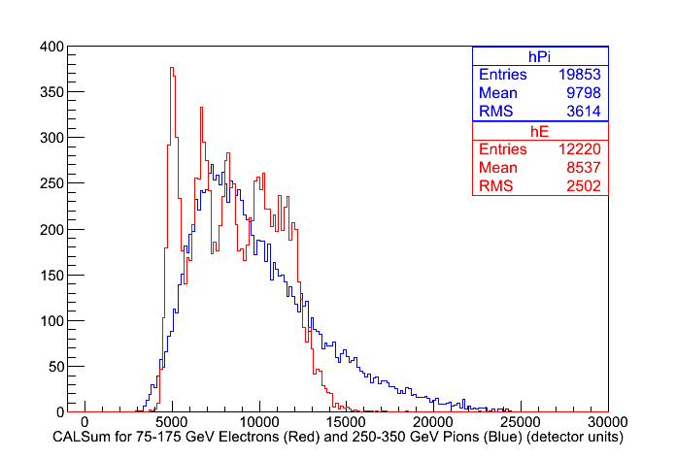
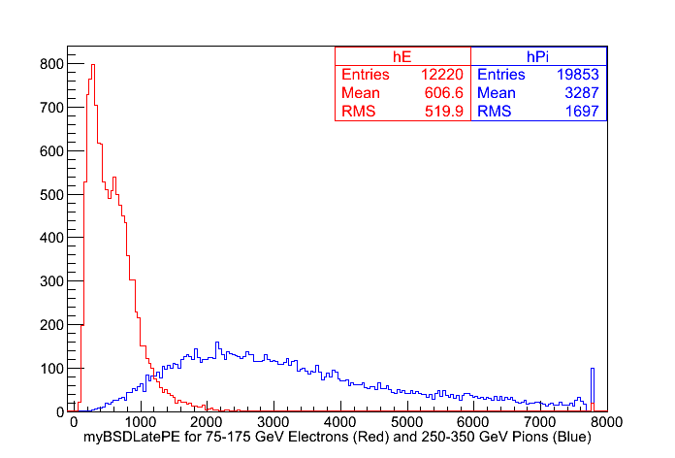
CALSum and BSDLatePE for 75-175 GeV Electron and 250-350 GeV Pions
Events have been selected from energy runs such that all are weighted equally

Slide 41
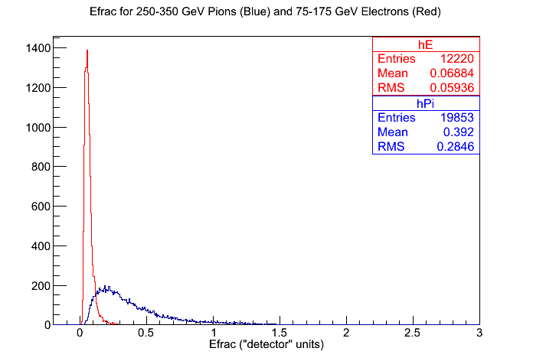
Efrac For All Energies

Slide 42
Rejection Power vs. Electron Acceptance
Voila!

Slide 43
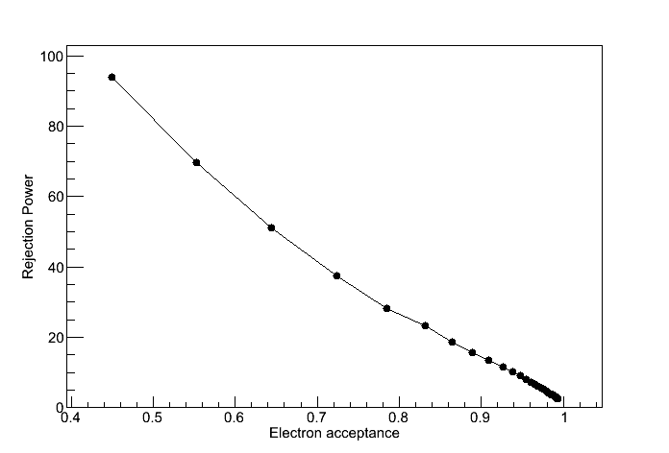
Rejection Power vs. Electron Acceptance
Note: Needs error bars! Work in progress!

Slide 44
Rejection Power vs. Electron Acceptance
150 GeV electrons and 350 GeV pions
Data from two different configurations:
  BSD centered directly on center of CAL, no BCD/TCD
  BSD offset somewhat, BCD/TCD in place
Why so different?
  The above was generated with “initial” cuts. Improved cuts may help (or hurt)?
  Different configuration. Maybe geometry makes a difference?
Plot needs error bars and needs to be re-run with improved cuts/data conditioning. Still a work in progress!

Slide 45
Closing Comments
Still some work in progress
Most of the analysis issues/plots can be addressed fairly easily now.
Need MC runs matching the event run conditions we got.
I'm taking suggestions on other plots/analysis tasks that can/should be tried out.

