Slide 1
CERN 2012 BSD Analysis Update
Tyler Anderson
December 12, 2012
BSD Group Meeting

Slide 2
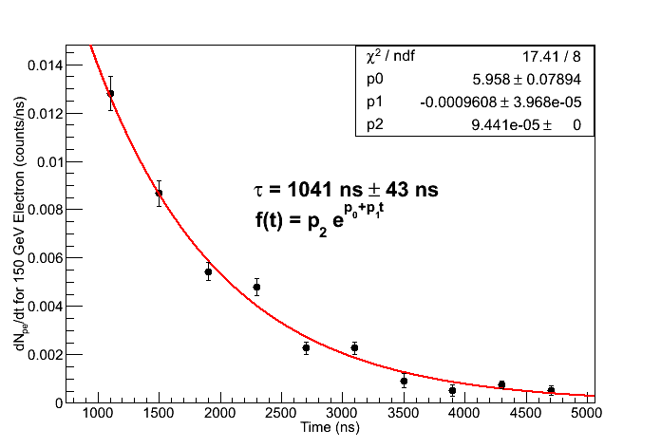
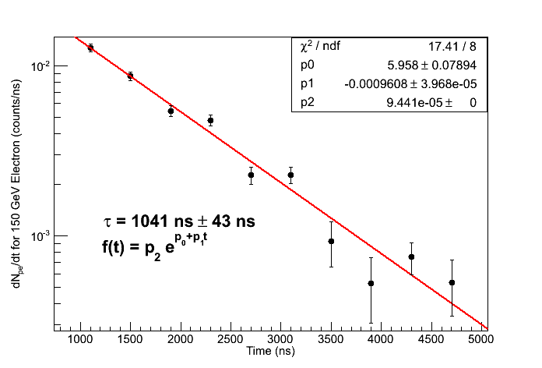
Scope Electron Data
Using PMT 1B, 150 GeV electron data
Error bars calculated as quadrature sum from three contributions:
  Error in center point approximation for derivative
  Standard error of mean in peak determination
  Standard error of mean in pedestal determination (small)
15 Pe between 900 ns to 4500 ns

Slide 3
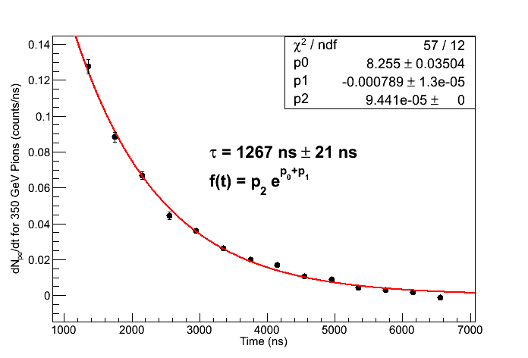
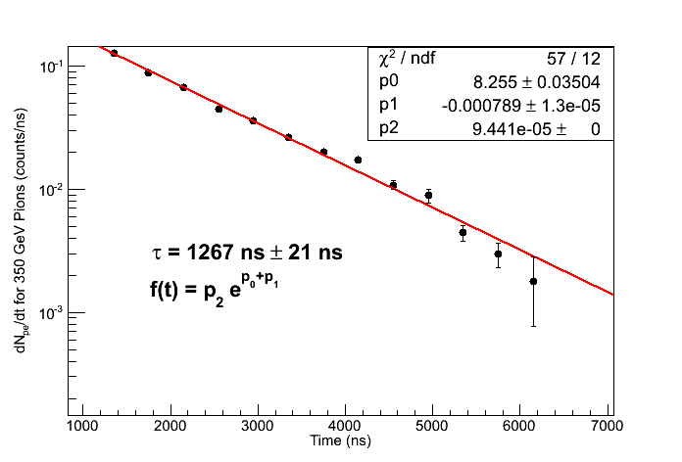
Scope Pion Data
Using PMT 1B, 350 GeV electron data
Error bars calculated as quadrature sum from three contributions:
  Error in center point approximation for derivative
  Standard error of mean in peak determination
213 PE between 900 ns to 450 ns

Slide 4
Initial Quality Cuts for 2249W Data
Note: Using pion and electron energy scan data from runs with BSD slightly offset and BCD + TCD in place
IsWithCal
  Cuts 64.7% of electrons, 67.1% of pions
  Requires that both BSD and CAL saw event (matched by event number)
  CDAQ has much more dead time (~20 ms) than CAMAC readout (~300 us), so this cuts a lot of data
fCHA[n] > 0 for n = 1 to 10
  Cuts 0.3% of remaining electrons, 24.2% of remaining pions
  Mostly from saturated channels (2249W puts out a “1” when saturated, so pedestal subtracted values are less than 0).
  Look at the 24.2% pions. This is large enough that it will affect Efrac distributions, since the cut is biased for large signal values.
CALSum > 0
  Cuts 0.4% of remaining electrons, 6.7% of remaining pions
  Below pedestal events caused by width of CAL pedestal
  Note that the next cut would clean these up anyway, so this cut is likely unnecessary.
>40 MeV in 6 consecutive CAL layers
  Cuts 9.4% of remaining electrons, 55.7% of remaining pions
  Use approximate conversion 9 chan = 1 MeV (from S. Nutter) as rough conversion. This needs to be redone when CAL is gain calibrated.
  Look at efficiency of this cut with energy
Out of 91174 electron events, 28991 remain
Out of 65748 pion events, 6768 remain

Slide 5
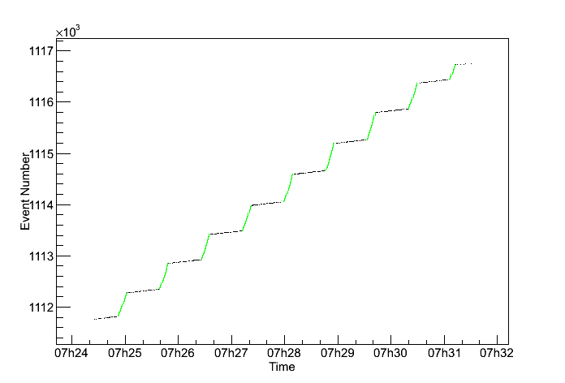
IsWithCal for In Spill Events
Choosing “IsWithCal” is a good proxy for in spill events.
  Black: All events in a particular run
  Green: Events with “IsWithCal” flag
Makes sense since this is the time window when the BSD and upstream scintillator counter triggers are well correlated.

Slide 6
fCHA[n] < 0
The 2249W puts out a number much less than pedestal (typically “1”) when it saturates
The fCHA branch is already pedestal subtracted, so these saturated values will show up as a large negative spike in channel histograms
These saturated events are significant (especially for pions) because:
  They represent large PE signals
  They are much common for pions (because of larger pion signal) than electrons
Hence, missing these events will through off Efrac significantly

Slide 7
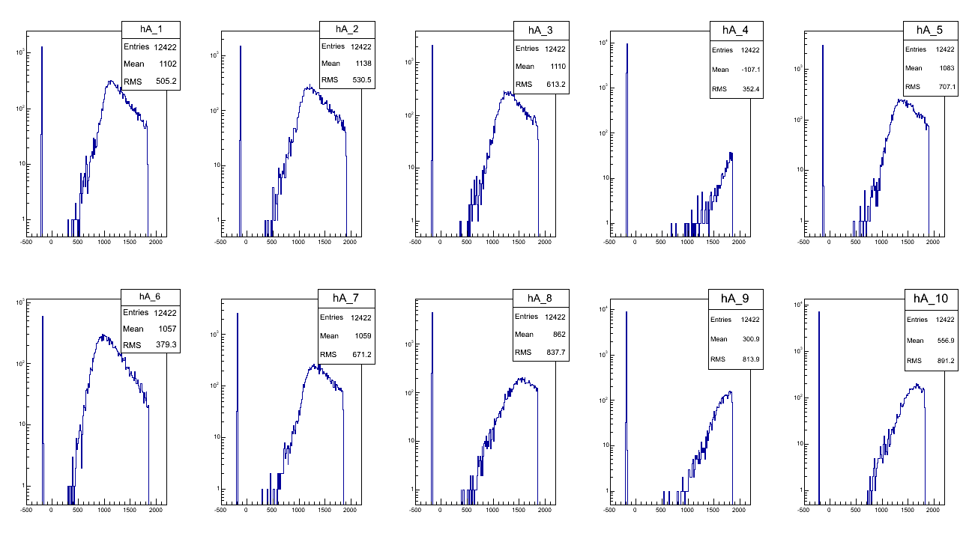
Looking at fCHA[n] < 0 Events
96.3% have fCHA[4] saturated.
99.1% have either fCHA[4] or fCHA[9] saturated.

Slide 8
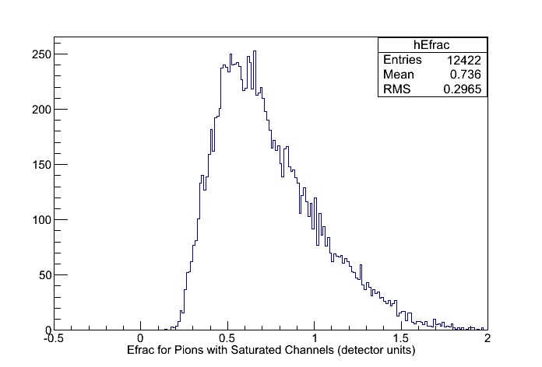
Saturated Event Solution
Solution: If a channel is saturated, give it max value, 2048 channels. This is a good approximation, though it under estimates the signal sum a little bit
All events with saturation (histogram above) then end up outside the electron Efrac range (Efrac < 0.1 in detector units). Thus, the slightly under estimated signal sum doesn't really matter in the end

Slide 9
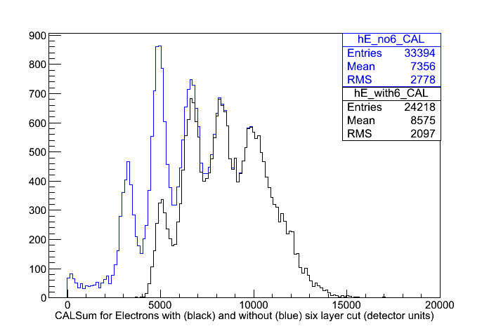
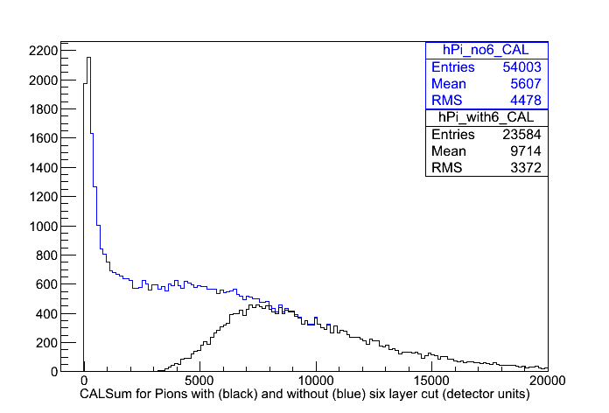
Effect of “Six Consecutive Layer >40MeV” Cut on CALSum
Note that the 6 layer cut removes much more of the low energy events than the high energy events
For analysis, must weight with equal amounts of all energies AFTER 6 layer cut
Note: Electron beam is only ~75% pure, but this cut removes most of the impurities. Pion beam is ~95% pure

Slide 10
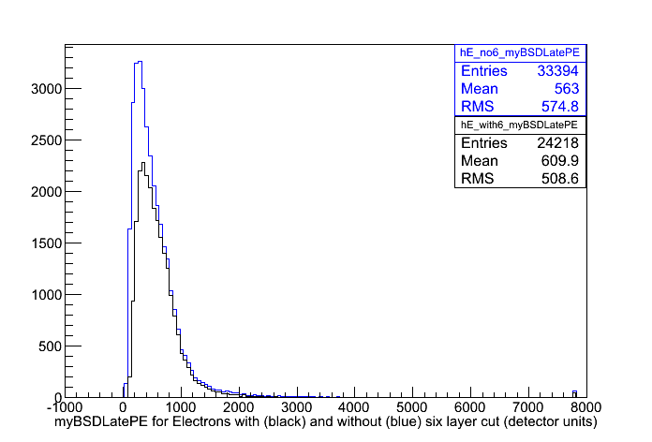
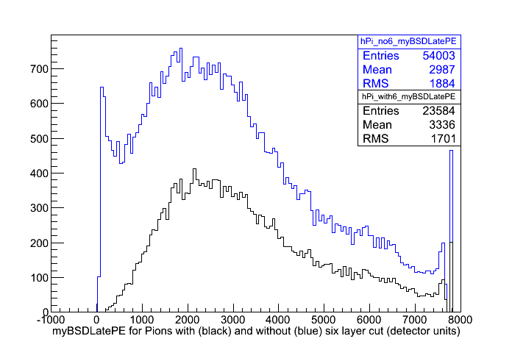
Effect of “Six Consecutive Layer >40MeV” Cut on myBSDLatePE
Note that the 6 layer cut removes much more of the low energy events than the high energy events
For analysis, must weight with equal amounts of all energies AFTER 6 layer cut

Slide 11
Revised Data Cuts and Conditioning
IsWithCal
  Cuts 64.7% of electrons, 64.1% of pions
Set any fCHA[n] < 0 for n = 1 to 10 to 2048 channels. Use myBSDLatePE as gain converted PE sum of these.
  Effects 0.3% of remaining electrons, 24.2% of remaining pions
Require >40 MeV in 6 consecutive CAL layers
  Cuts 9.9% of remaining electrons, 56.9% of remaining pions
Out of 91174 electron events, 29029 remain
Out of 65748 electron events, 9321 remain

Slide 12
Now what?
Cuts and data conditioning measures have been outlined/verified
Would like to make plots which are:
  1.) physically meaningful
  2.) can be compared with MC simulation data
Choose to do analysis of CALSum, myBSDLatePE, Efrac, and rejection power vs. electron acceptance for 75 GeV-175 GeV electron energies and 250 GeV-350 GeV pion energies.
Not all energy runs have the same amount of data, so we “mix” for equal fractions of all energies AFTER cuts and conditioning!

Slide 13
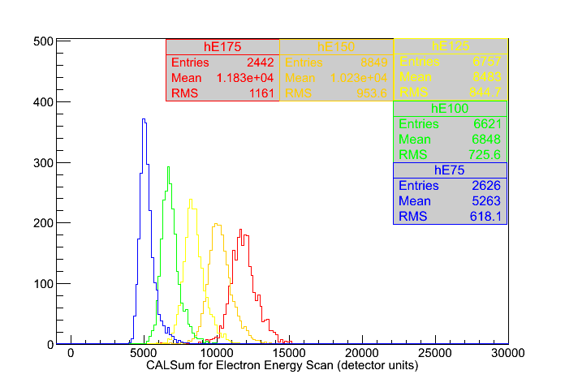
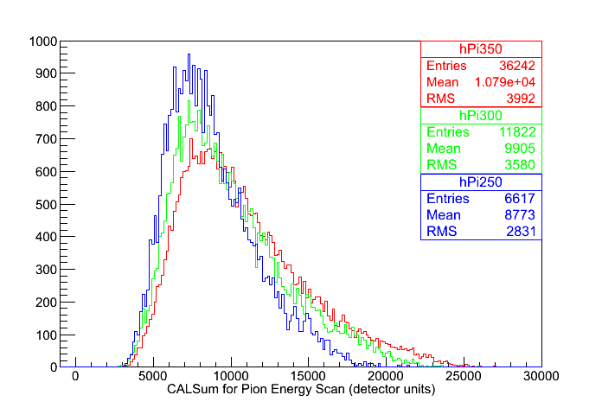
CAL Response With Particle Energy
Note: Histograms are scaled to similar heights by total number of events
Note: 50 GeV electrons don't shower enough to meet the software”>40 MeV in 6 consecutive layers” cut. So they aren't included in these plots even though we have data for them.

Slide 14
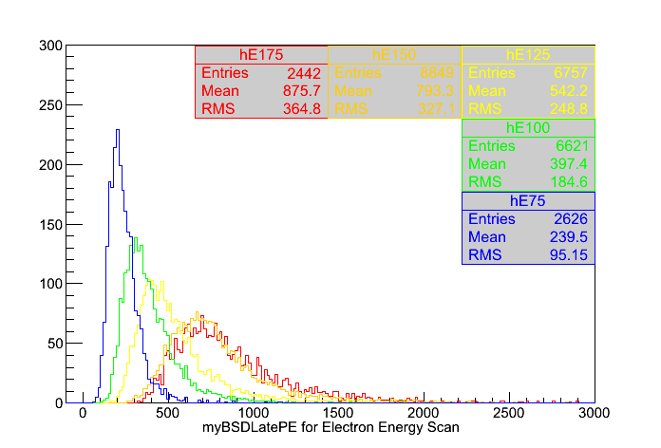
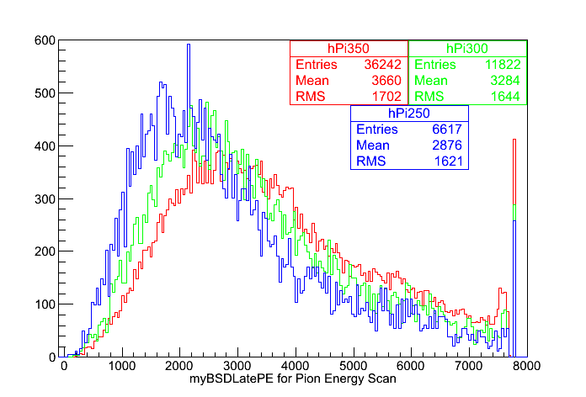
BSDLatePE Response With Particle Energy
Note: Histograms are scaled to similar height by total number of events
Note: BSDLatePE for 150 GeV and 175 GeV electrons are quite similar...

Slide 15
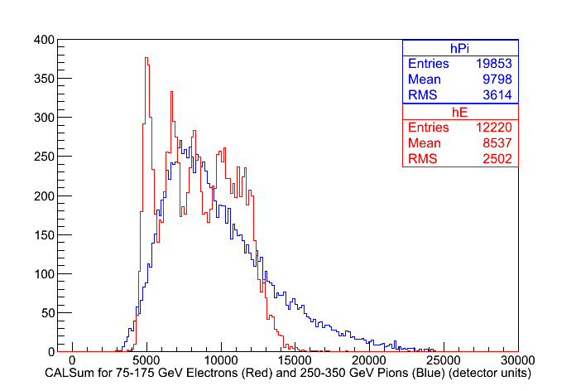
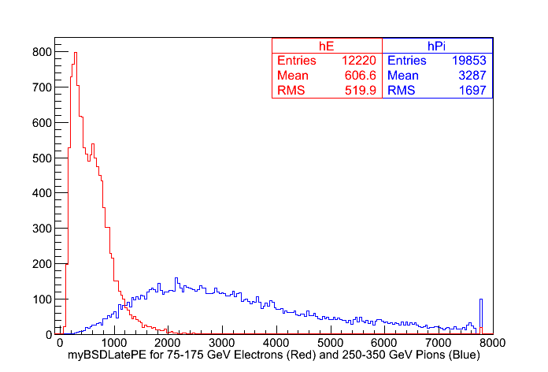
CALSum and BSDLatePE for 75-175 GeV Electron and 250-350 GeV Pions
Events have been selected from energy runs such that all are weighted equally

Slide 16
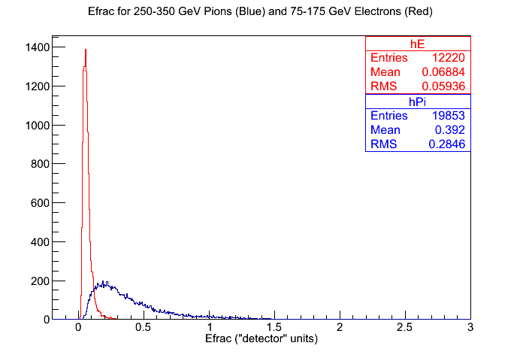
Efrac For All Energies

Slide 17
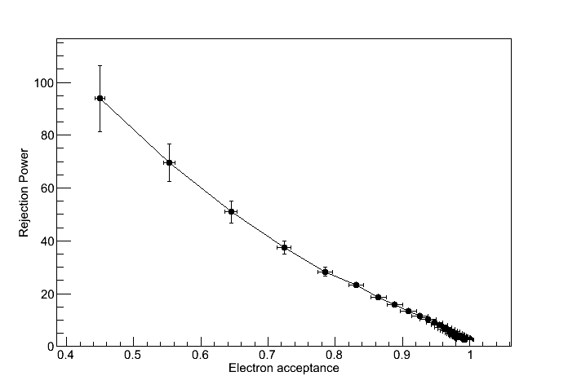
Rejection Power vs. Electron Acceptance
Error bars propagated from statistics of Efrac histogram.

Slide 18
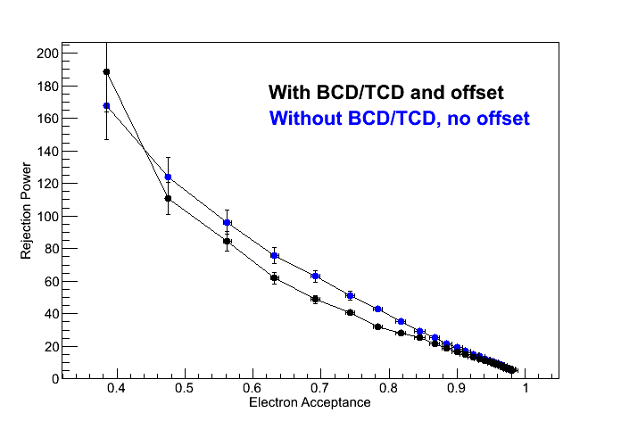
Rejection Power vs. Electron Acceptance
150 GeV electrons and 350 GeV pions
Data from two different configurations:
  BSD centered directly on center of CAL, no BCD/TCD
  BSD offset somewhat, BCD/TCD in place
Why so different?
  The above was generated with “initial” cuts. Improved cuts may help (or hurt)?
  Different configuration. Maybe geometry makes a difference?

Slide 19
Closing Comments
Still some work in progress
Most of the analysis issues/plots can be addressed fairly easily now.
Need MC runs matching the event run conditions we got.
I'm taking suggestions on other plots/analysis tasks that can/should be tried out.

