Slide 1
CERN 2012 BSD Analysis Update
Tyler Anderson
December 18, 2012
BSD Group Meeting

Slide 2
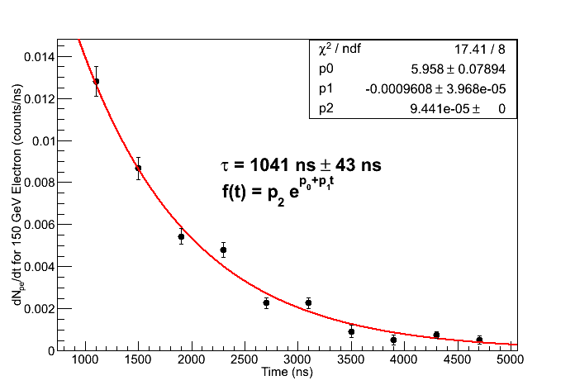
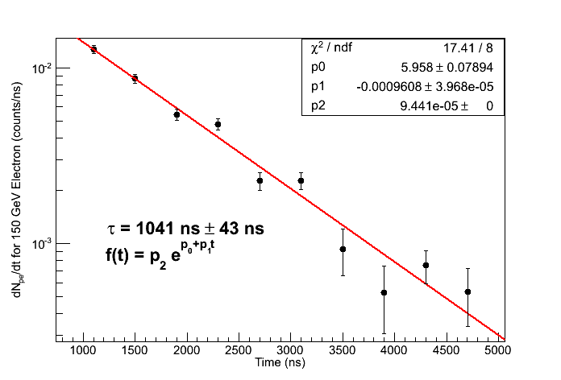
Scope Electron Data
Using PMT 1B, 150 GeV electron data from oscilloscope area measurements
Error bars calculated as quadrature sum from three contributions:
  Error in center point approximation for derivative
  Standard error of mean in peak determination
  Standard error of mean in pedestal determination (small)
Parameter p2 is “fixed” (i.e. not allowed to vary with fit) as part of conversion from ADC channel count to PE count.
15 PE between 900 ns to 4500 ns

Slide 3
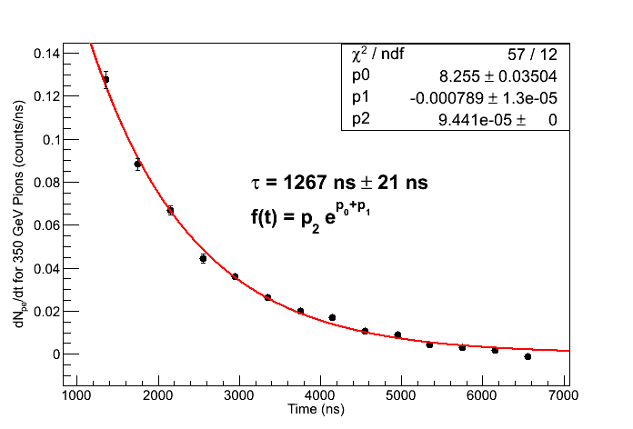
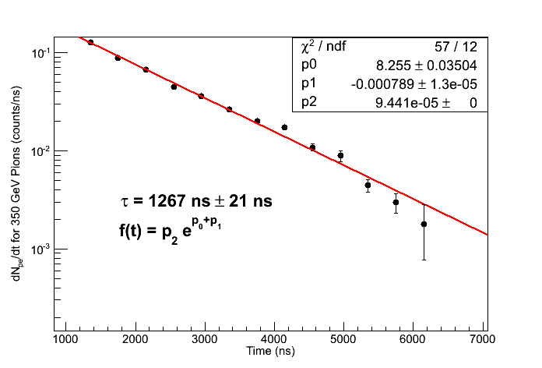
Scope Pion Data
Using PMT 1B, 350 GeV pion data from oscilloscope area measurements
Error bars calculated as quadrature sum from two contributions:
  Error in center point approximation for derivative
  Standard error of mean in peak determination
Parameter p2 is “fixed” (i.e. not allowed to vary with fit) as part of conversion from ADC channel count to PE count.
213 PE between 900 ns to 4500 ns

Slide 4
Initial Quality Cuts for 2249W Data
Note: Using pion and electron energy scan data from runs with BSD slightly offset and BCD + TCD in place
IsWithCal
  Cuts 64.7% of electrons, 67.1% of pions
  Requires that both BSD and CAL saw event (matched by event number)
  CDAQ has much more dead time (~20 ms) than CAMAC readout (~300 us), so this cuts a lot of data
fCHA[n] > 0 for n = 1 to 10
  Cuts 0.3% of remaining electrons, 24.2% of remaining pions
  Mostly from saturated channels (2249W puts out a “1” when saturated, so pedestal subtracted values are less than 0).
  Look at the 24.2% pions. This is large enough that it will affect Efrac distributions, since the cut is biased to remove large signal values.
CALSum > 0
  Cuts 0.4% of remaining electrons, 6.7% of remaining pions
  Below pedestal events caused by width of CAL pedestal
  Note that the next cut would clean these up anyway, so this cut is unnecessary.
>40 MeV in 6 consecutive CAL layers (flight CAL trigger)
  Cuts 9.4% of remaining electrons, 55.7% of remaining pions
  Use approximate conversion 9 chan = 1 MeV (from S. Nutter) as rough conversion. This needs to be redone when CAL is gain calibrated.
  Look at efficiency of this cut with energy
Out of 91174 electron events, 28991 remain
Out of 65748 pion events, 6768 remain

Slide 5
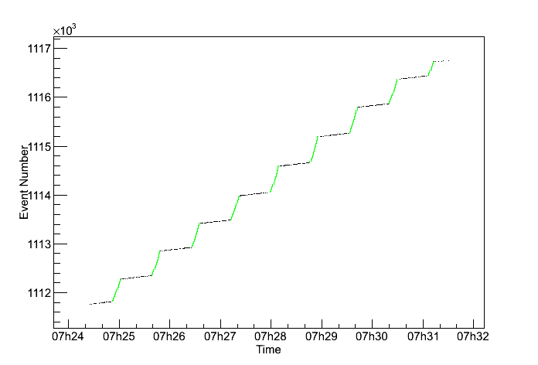
IsWithCal For In Spill Events
Choosing “IsWithCal” is a good proxy for in spill events.
Example plot for 150 GeV electron run BSDCALCombined_11-27-2012-13-24-15.root
  Black: All events in run
  Green: Events with “IsWithCal” flag
Makes sense since this is the time window when the BSD and upstream scintillator counter triggers are well correlated.

Slide 6
fCHA[n] < 0
The 2249W puts out a number much less than pedestal (typically “1”) when it saturates
The fCHA branch is already pedestal subtracted, so these saturated values will show up as a large negative spike in channel histograms
These saturated events are significant (especially for pions) because:
  They represent large PE signals
  They are much more common for pions (because of larger BSD late signal) than for electrons
Hence, missing these events will throw off Efrac significantly

Slide 7
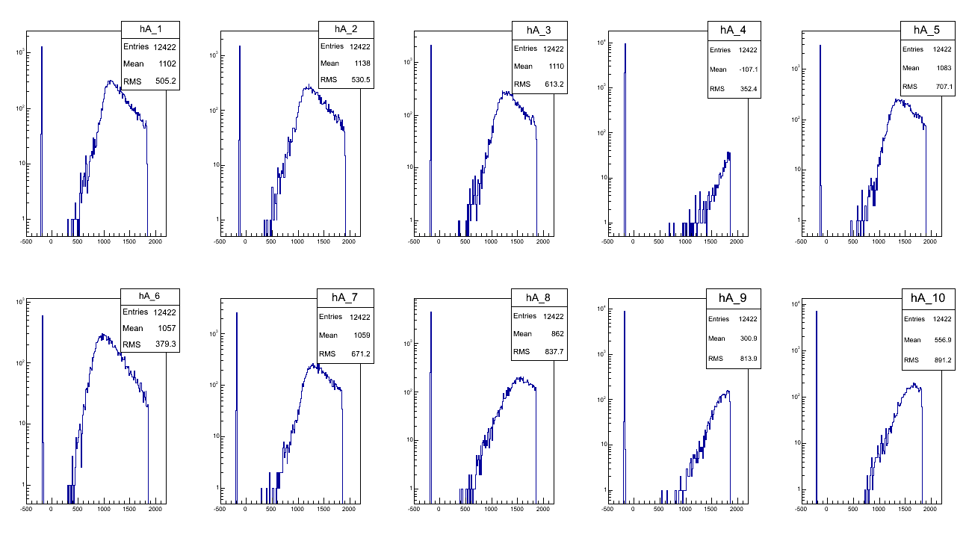
Looking at fCHA[n] < 0 Events
Clearly, these are saturated events
96.3% have fCHA[4] saturated.
99.1% have either fCHA[4] or fCHA[9] saturated.

Slide 8
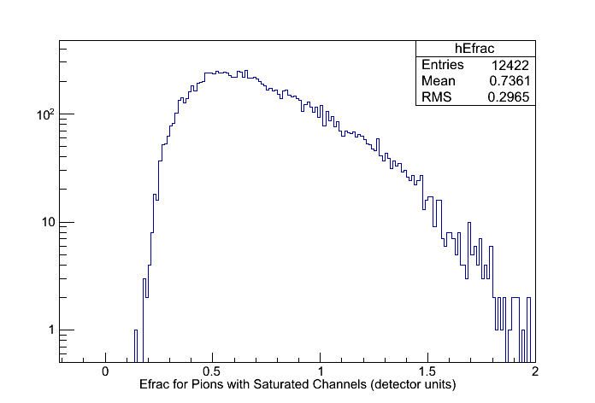
Saturated Event Solution
Solution: If a channel is saturated, give it max value, 2048 channels. This is a good approximation, though it under estimates the signal sum a little bit
All events with saturation (histogram above) then end up outside the electron Efrac range (Efrac < 0.1 in detector units). Thus, the slightly under estimated signal sum only influences the total histogram counts (a small effect), but not the counts for events in range of electron Efrac (a larger effect).

Slide 9
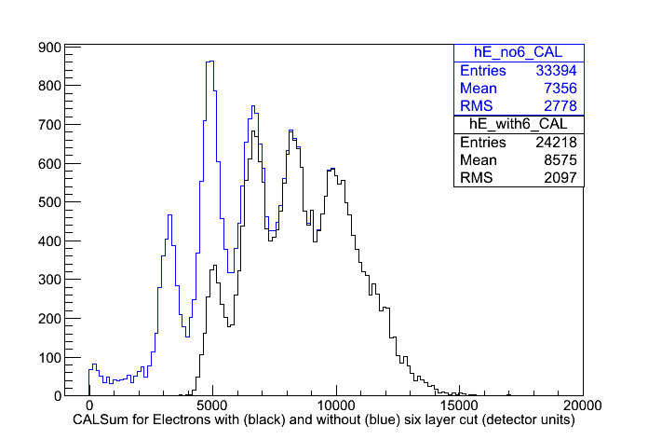
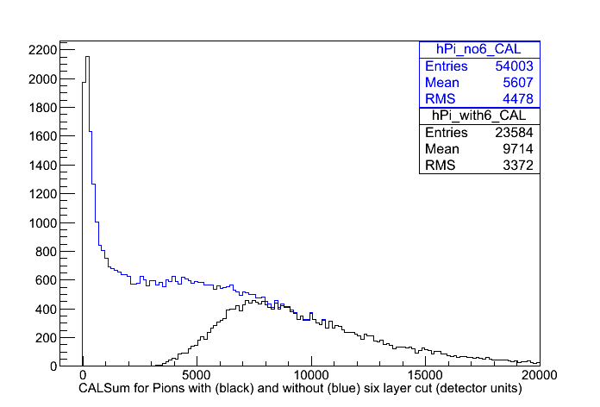
Effect of “Six Consecutive Layers >40 MeV” Cut on CALSum
Left histogram: Black is CALSum with equal numbers of events from electron runs at 50 GeV, 75 GeV, 100 GeV, 125 GeV, 150 GeV, and 175 GeV. Blue is remaining histogram after requiring CAL to have 6 consecutive layers with >40 MeV on this dataset.
Right histogram: Black is CALSum with equal numbers of events from pion runs at 250 GeV, 300 GeV, and 350 GeV. Blue is remaining histogram after requiring CAL to have 6 consecutive layers with >40 MeV on this dataset.
Note that the 6 layer cut removes many more low energy events than high energy events
For analysis, must weight with equal amounts of all energies AFTER 6 layer cut.

Slide 10
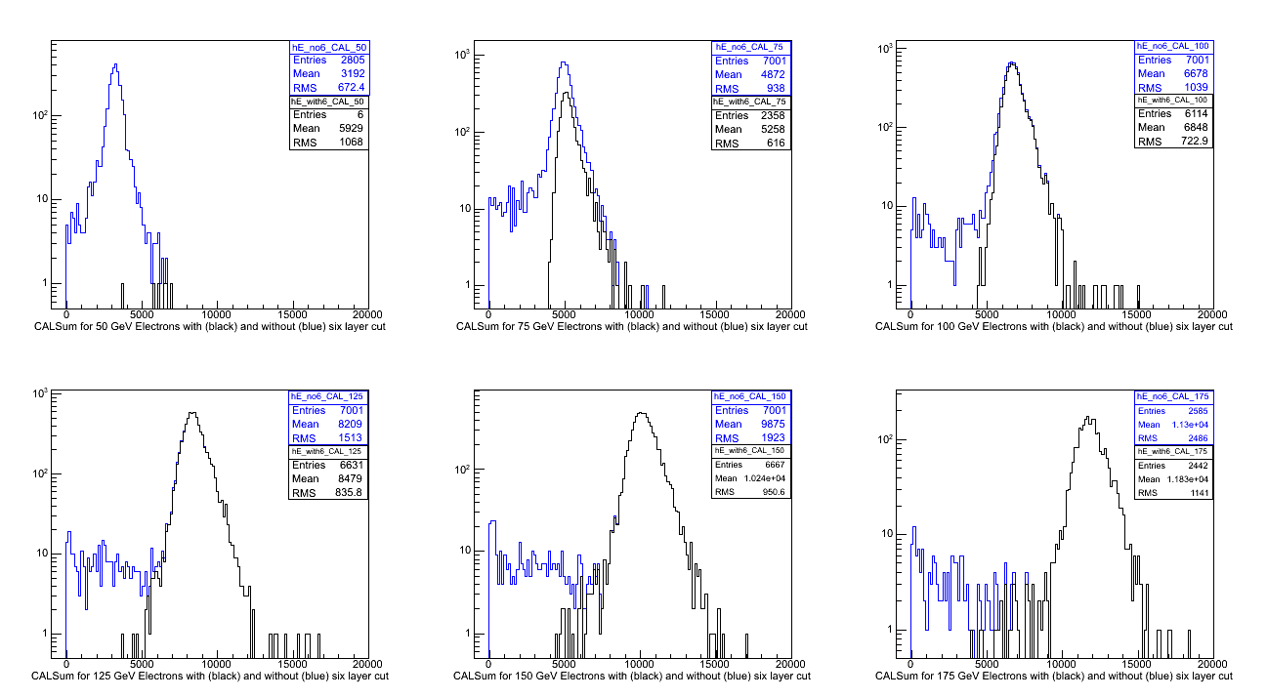
Another Effect of the 6 Layer Cut
Electron beam is only ~75% pure, but this cut removes most of the impurities. (Pion beam is ~95% pure.)
Only 6 events from the 50 GeV electron runs survive the 6 layer cut, so they will not be used in the remaining analysis.

Slide 11
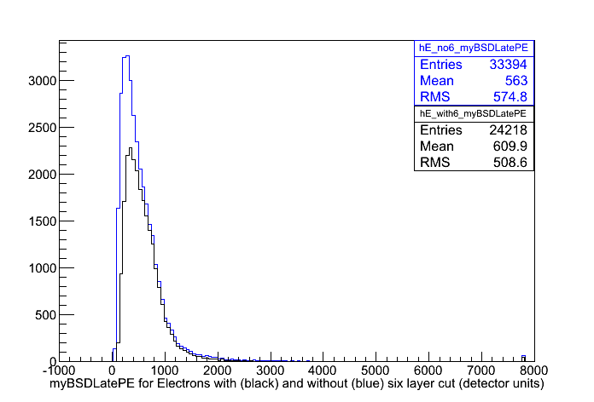
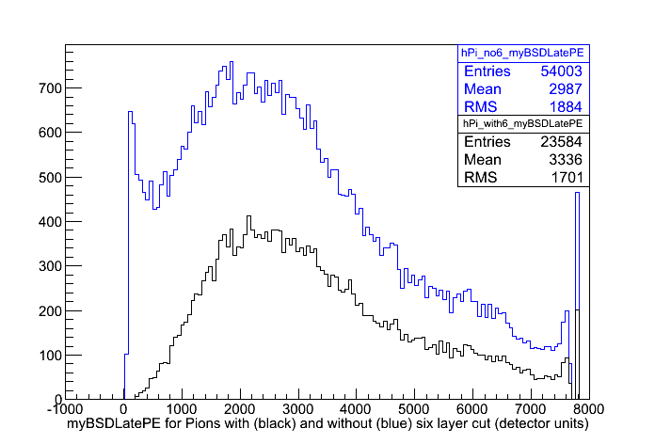
Effect of “Six Consecutive Layer >40MeV” Cut on myBSDLatePE
Note that the 6 layer cut removes much more of the low energy events than the high energy events
For analysis, must weight with equal amounts of all energies AFTER 6 layer cut

Slide 12
Revised Data Cuts and Conditioning
IsWithCal
  Cuts 64.7% of electrons, 64.1% of pions
Set any fCHA[n] < 0 for n = 1 to 10 to 2048 channels. Use myBSDLatePE as gain converted PE sum of these.
  Effects 0.3% of remaining electrons, 24.2% of remaining pions
Require >40 MeV in 6 consecutive CAL layers (flight CAL trigger)
  Cuts 9.9% of remaining electrons, 56.9% of remaining pions
Out of 91174 electron events, 29029 remain
Out of 65748 pion events, 9321 remain

Slide 13
Now what?
Cuts and data conditioning measures have been outlined/verified
Would like to make plots which are:
  1.) physically meaningful
  2.) can be compared with MC simulation data
Choose to do analysis of CALSum, myBSDLatePE, Efrac, and rejection power vs. electron acceptance for 75 GeV-175 GeV electron energies and 250 GeV-350 GeV pion energies.
Not all energy runs have the same amount of data, so we “mix” for equal fractions of all energies AFTER cuts and conditioning!

Slide 14
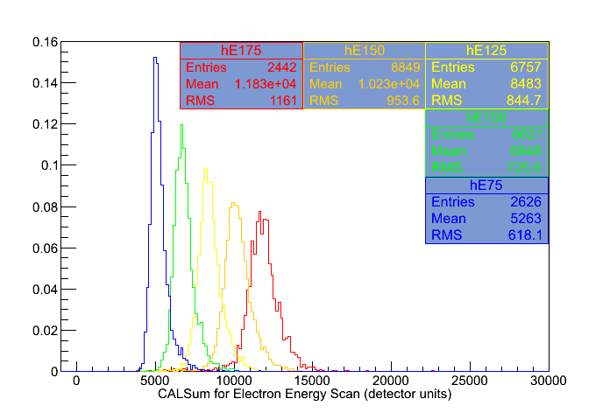
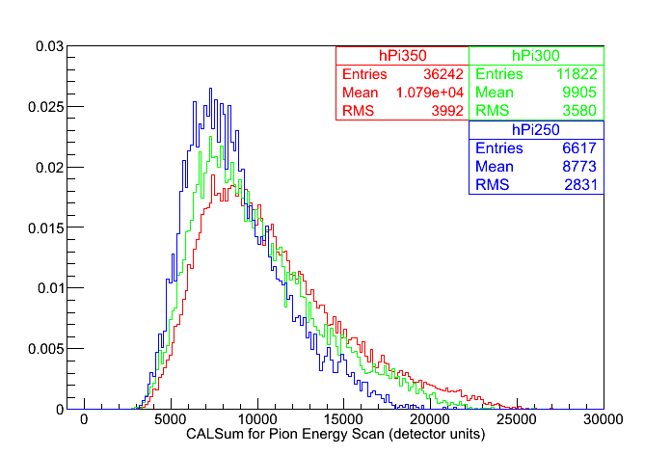
CAL Response With Particle Energy
Histograms are scaled to equal areas by total number of events and normalized such that total area is 1
Note: 50 GeV electrons don't shower enough to meet the software “>40 MeV in 6 consecutive layers” cut. So they aren't included in these plots even though we have data for them.

Slide 15
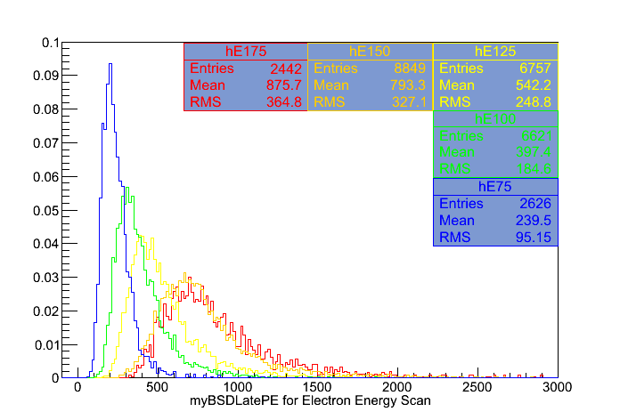
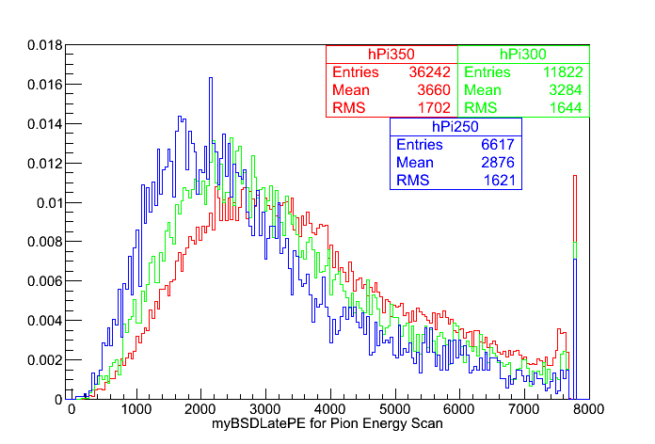
BSDLatePE Response With Particle Energy
Histograms are scaled to equal areas by total number of entries and normalized such that total area is 1
Note:150 and 175 GeV electrons are quite similar

Slide 16
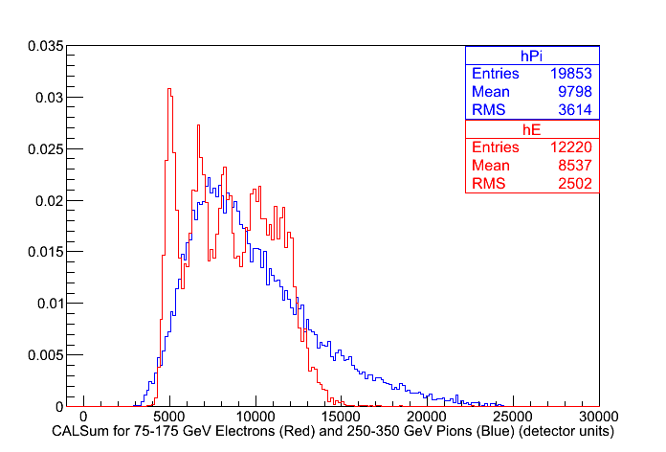
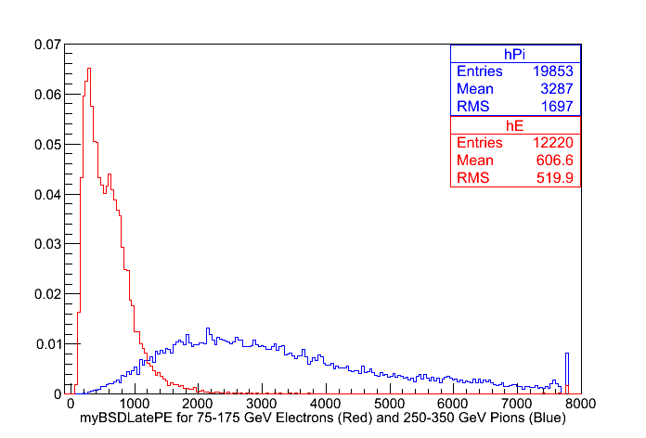
CALSum and BSDLatePE for 75-175 GeV Electron and 250-350 GeV Pions
Events have been selected from energy runs such that all energies are weighted equally
Histograms scaled to equal areas by total number of entries and normalized such that total area is 1

Slide 17
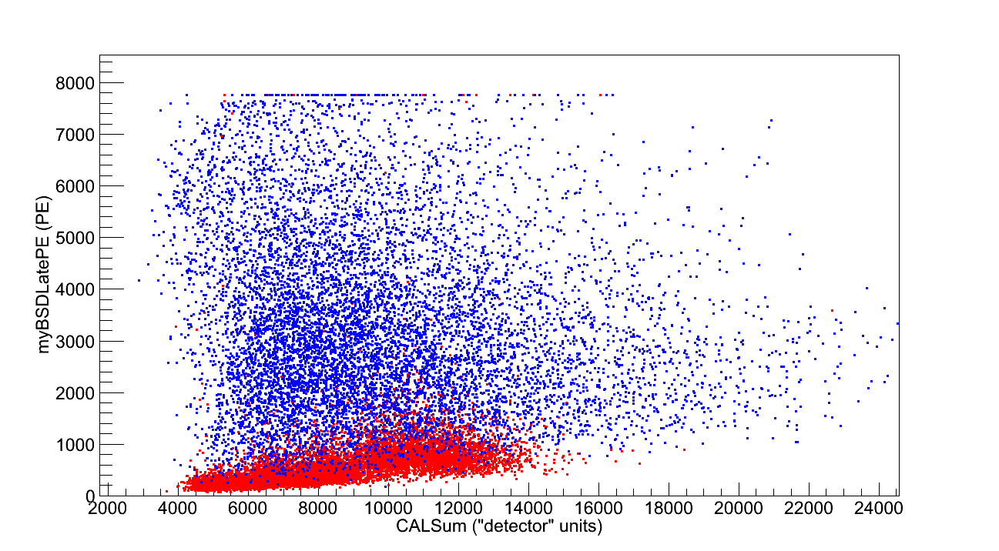
BSD Late vs. CAL
75-175 GeV electrons (red) and 250-350 GeV pions (blue)

Slide 18
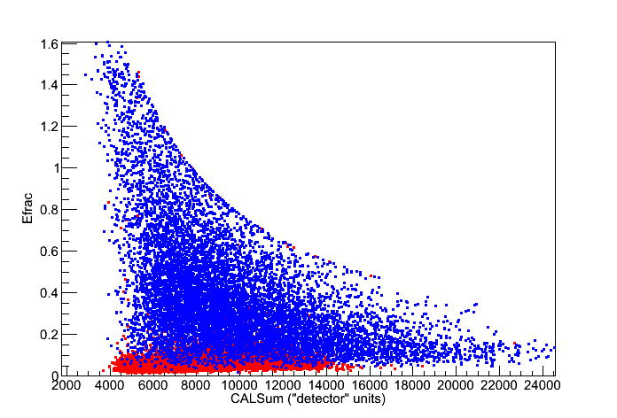
Efrac vs. CALSum
75-175 GeV electrons (red) and 250-350 GeV pions (blue)

Slide 19
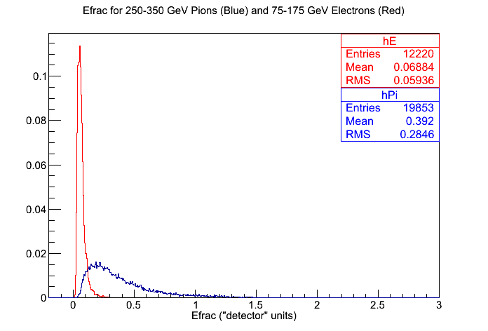
Efrac For All Energies
Electron and pion histograms scaled to equal area by total number of entries and normalized such that total area is 1

Slide 20
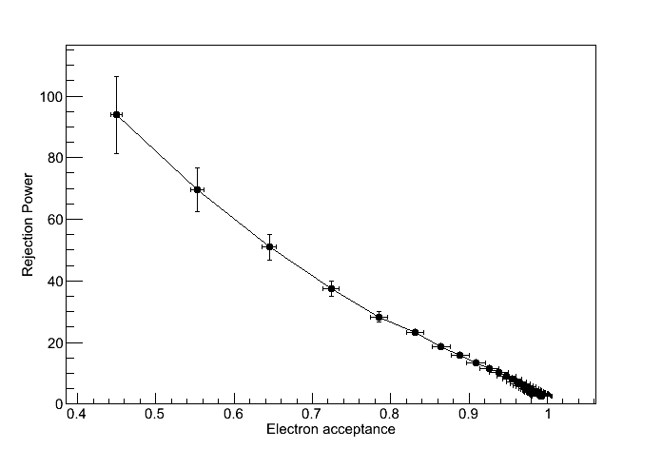
Rejection Power vs. Electron Acceptance
Error bars propagated from statistics of Efrac histogram.

Slide 21
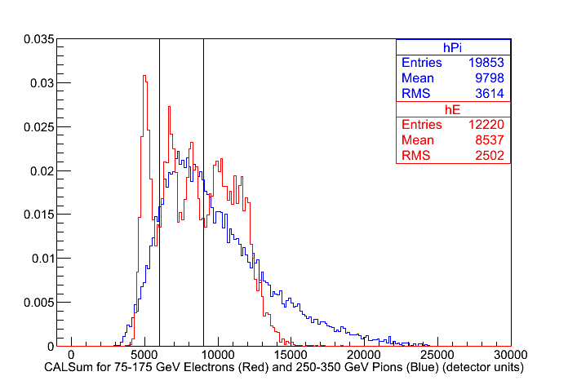
New Analysis: Cut on CALSum
Calculate Efrac, rejection ratio, and electron acceptance for CALSum between 6000 and 9000
This is mostly 100 to 125 GeV electrons and 250 to 350 GeV pions

Slide 22
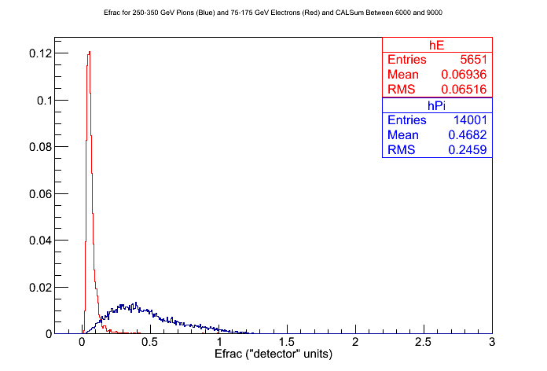
New Efrac
Efrac for CALSum between 6000 to 9000

Slide 23
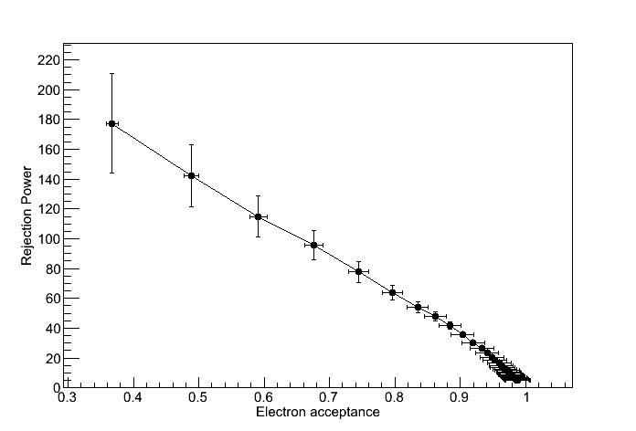
Rejection Power vs. Electron Acceptance
Rejection power vs. Electron Acceptance for CALSum between 6000 and 9000
Somewhat better than using all CALSum range

Slide 24
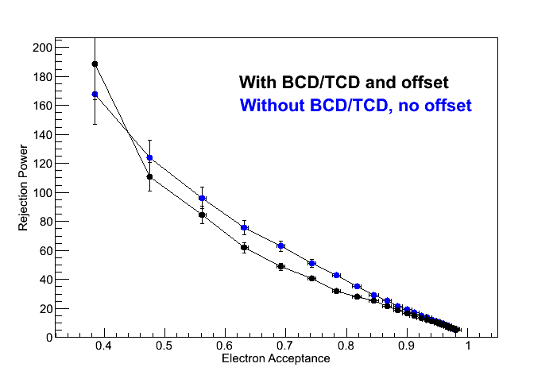
Rejection Power vs. Electron Acceptance
150 GeV electrons and 350 GeV pions
Data from two different configurations:
  BSD centered directly on center of CAL, no BCD/TCD
  BSD offset somewhat, BCD/TCD in place
Why so different?
  Different configuration. Maybe geometry makes a difference?

Slide 25
Closing Comments
Need MC runs matching the event run conditions we got.
I'm taking suggestions on other plots/analysis tasks that can/should be tried out.

