Slide 1
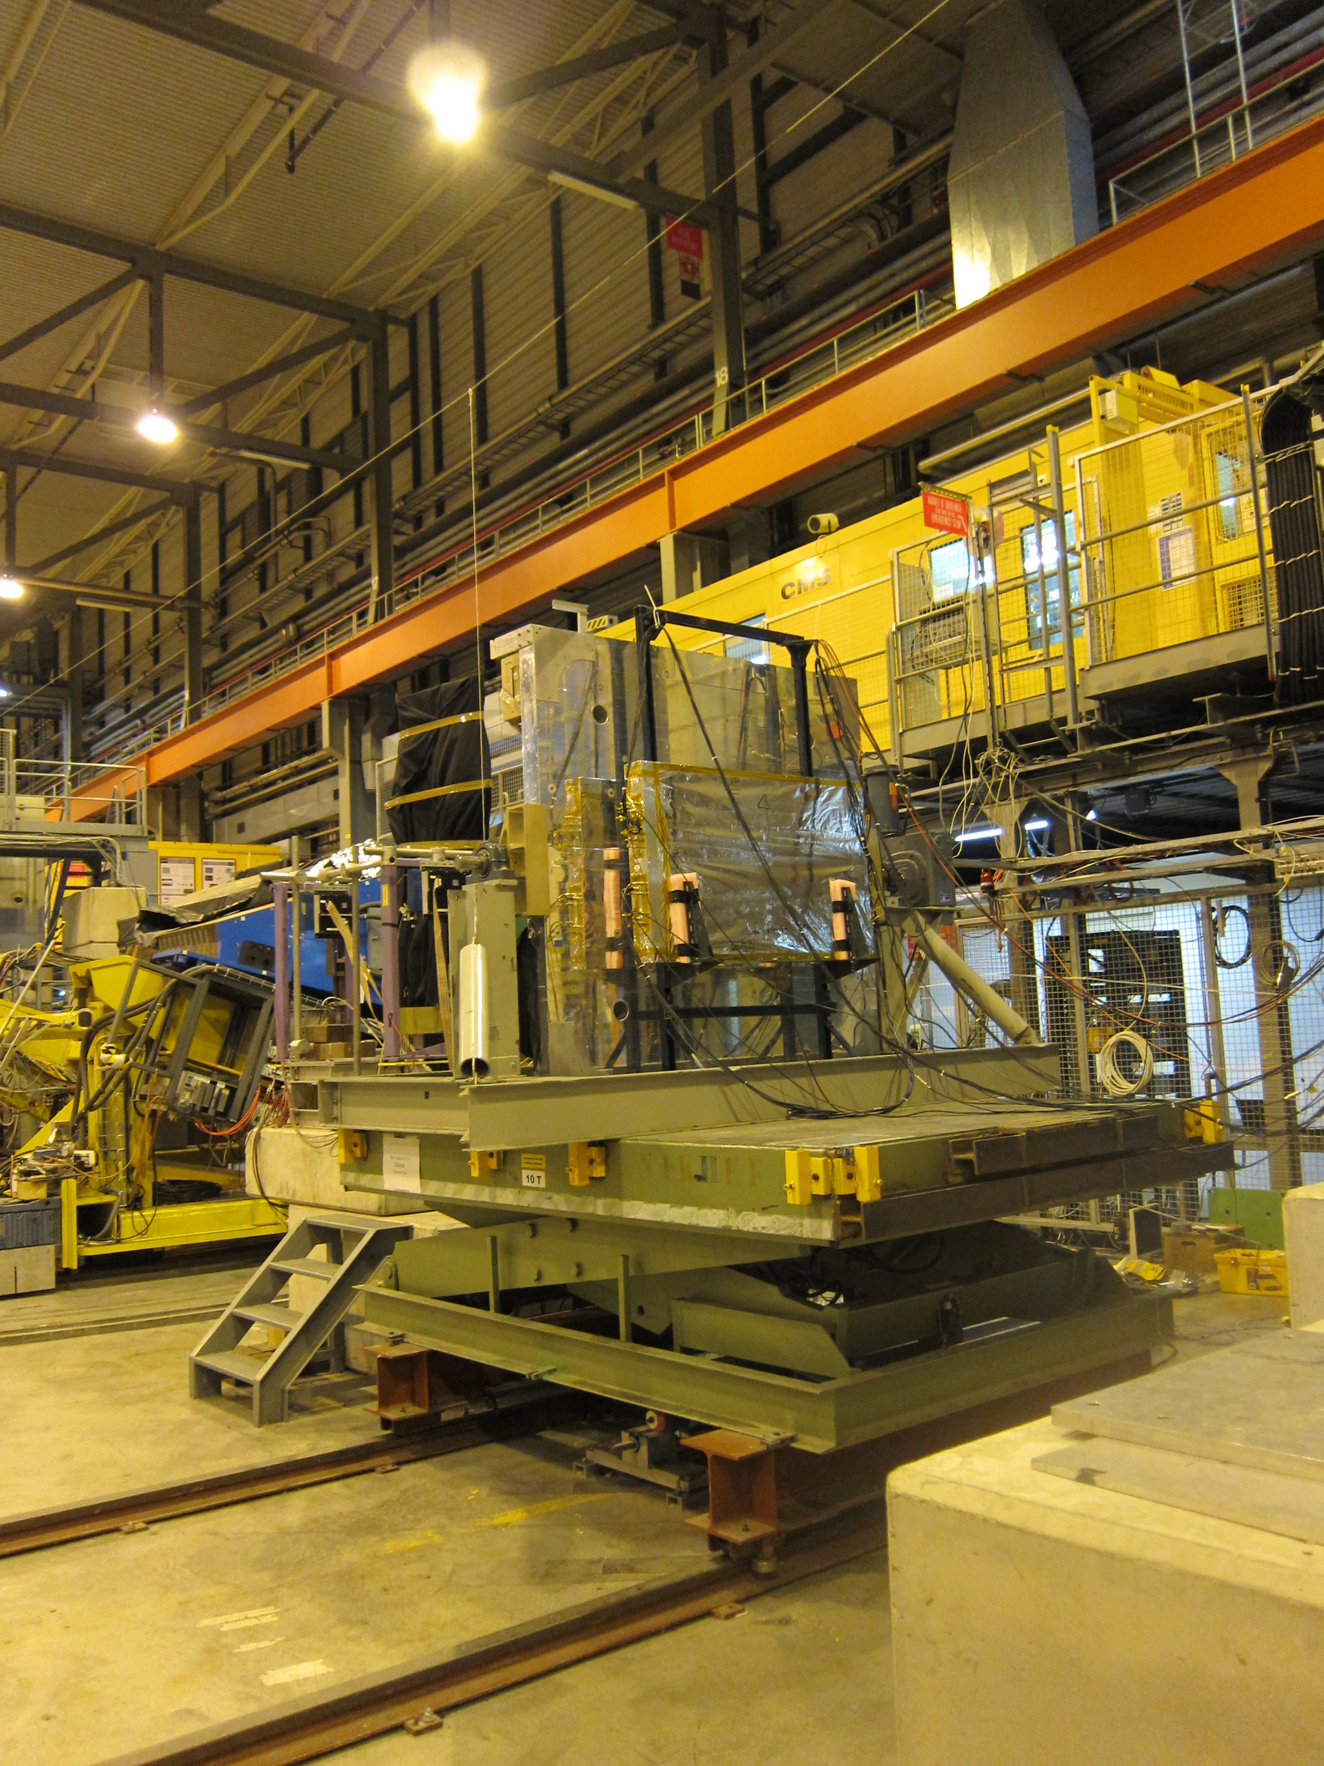
CERN 2012 BSD Analysis Update
Tyler Anderson
January 9, 2013
BSD Group Meeting

Slide 2
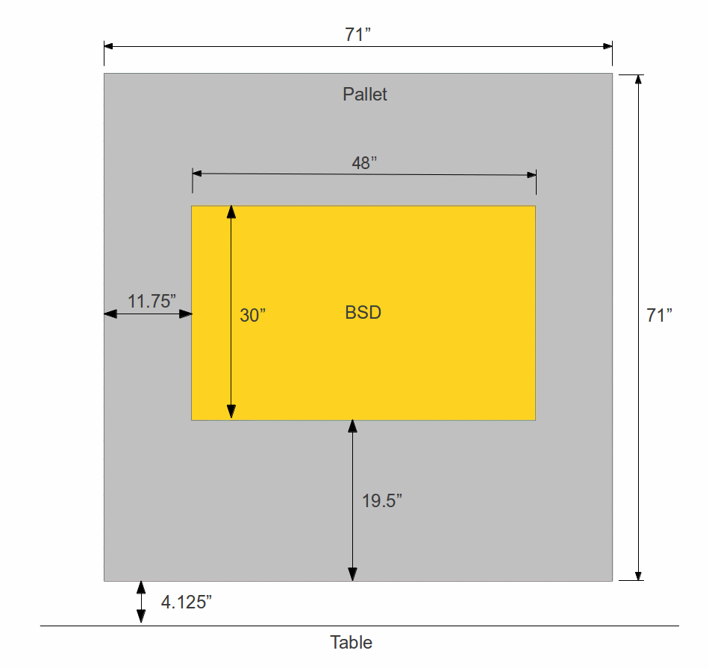
Configuration A
Looking upstream
No BCD or TCD
Upstream side of BSD is 5.5” from downstream surface of pallet

Slide 3
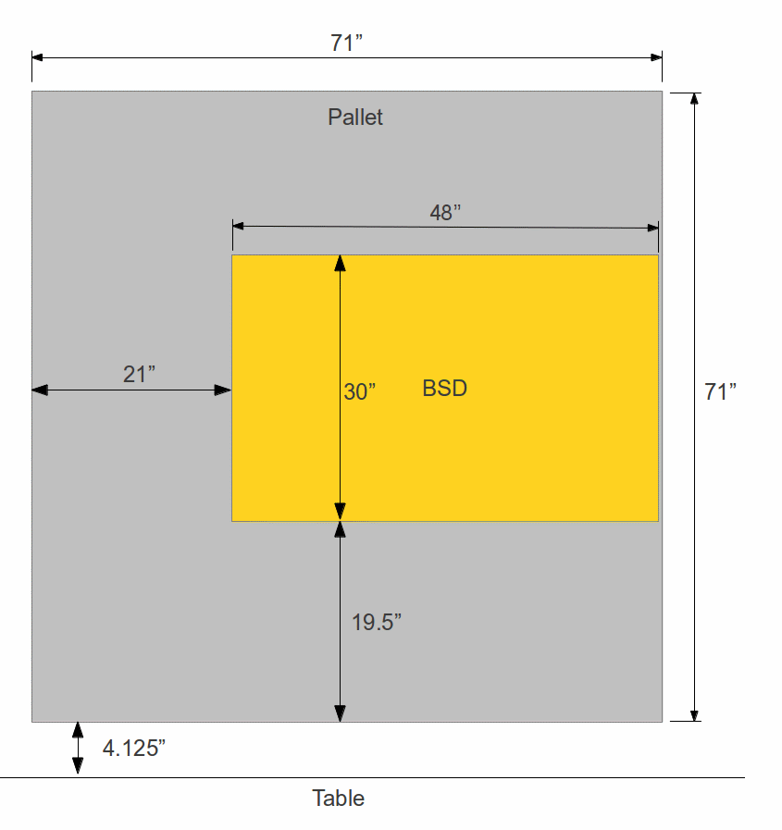
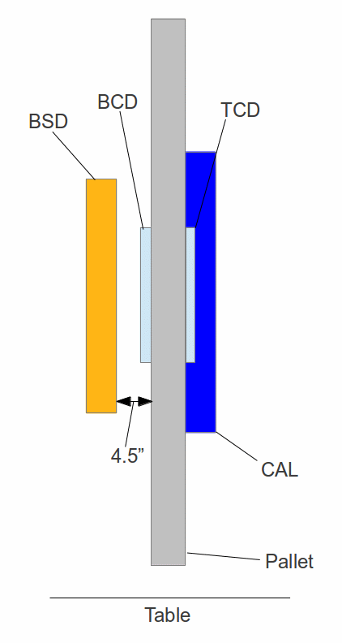
Configuration B
Looking upstream
Looking sideways
BCD and TCD in place

Slide 4
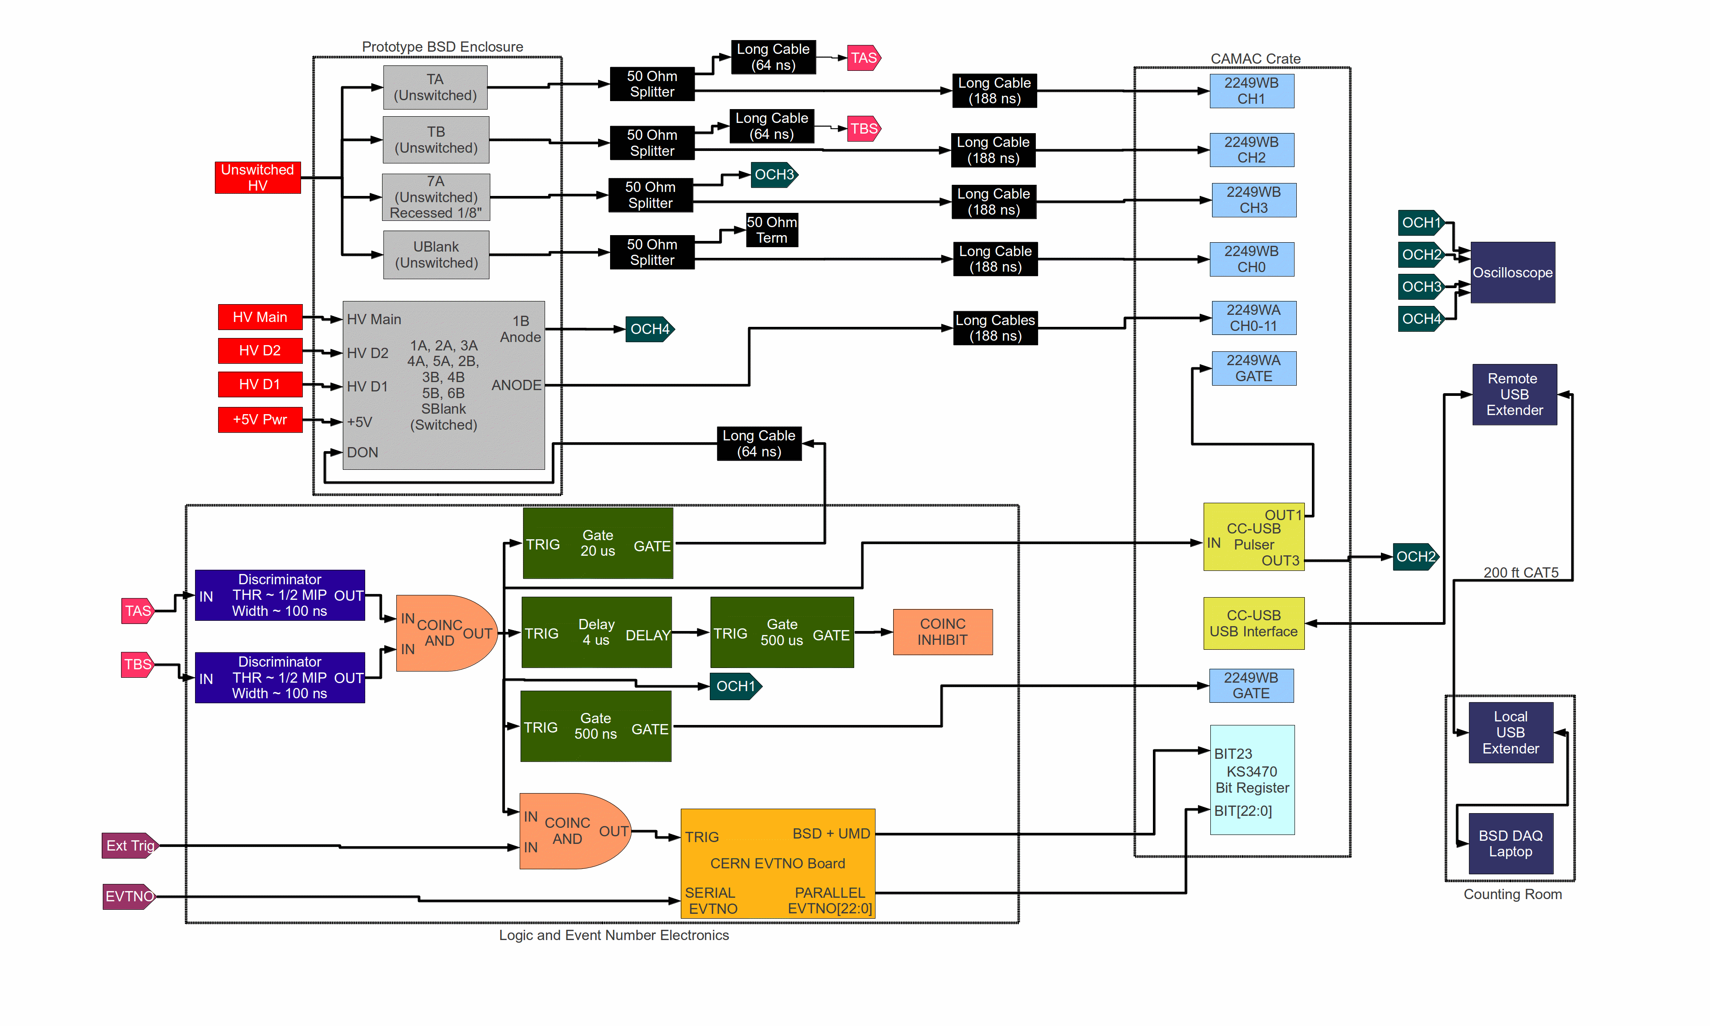
Equipment Setup
2249WA integrates switched tubes between 917 ns to 4517 ns from early shower
2249WB integrates unswitched tubes between -83 ns to 417 ns from early shower

Slide 5
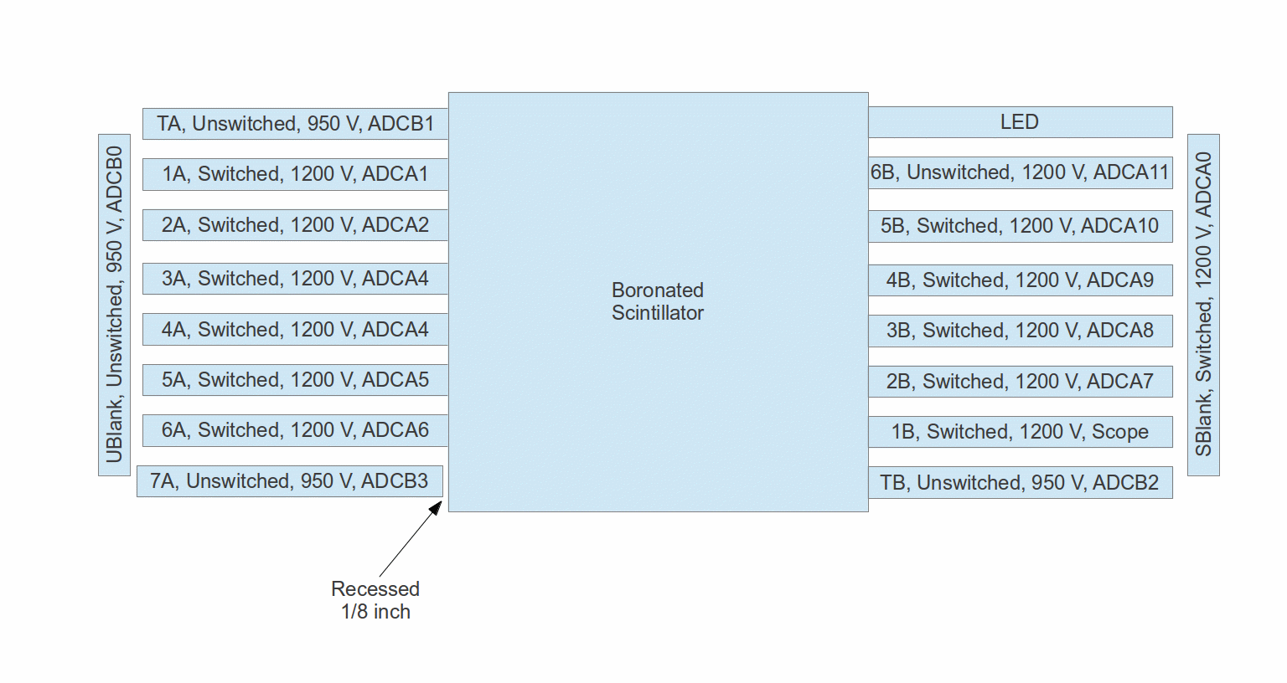
CERN BSD Tube Layout

Slide 6
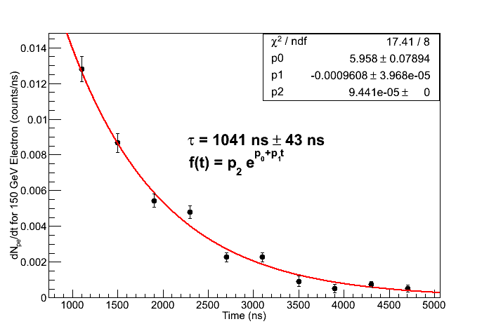
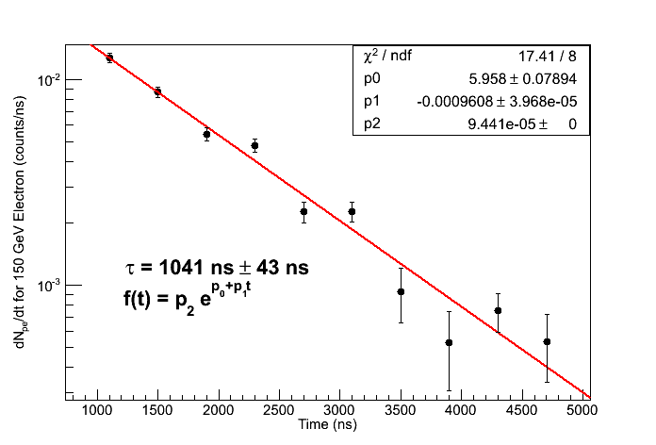
Scope Electron Data
Using PMT 1B, 150 GeV electron data from oscilloscope area measurements
Using ~1k events per data point
Error bars calculated as quadrature sum from three contributions:
  Error in center point approximation for derivative
  Standard error of mean in peak determination
  Standard error of mean in pedestal determination (small)
Parameter p2 is “fixed” (i.e. not allowed to vary with fit) as part of conversion from ADC channel count to PE count.
15 PE between 900 ns to 4500 ns (Note: Lead was in place for this run, but not for typical configuration B.)

Slide 7
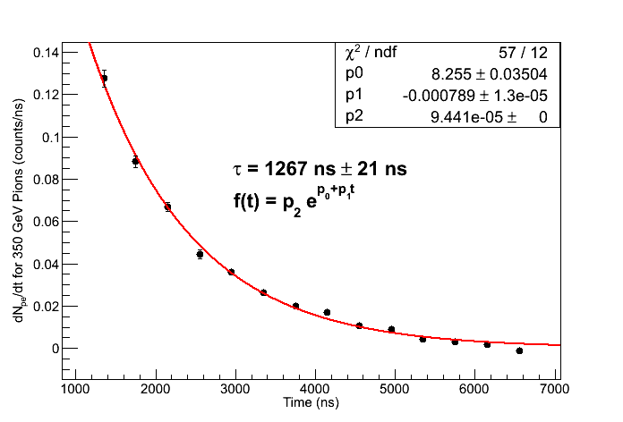
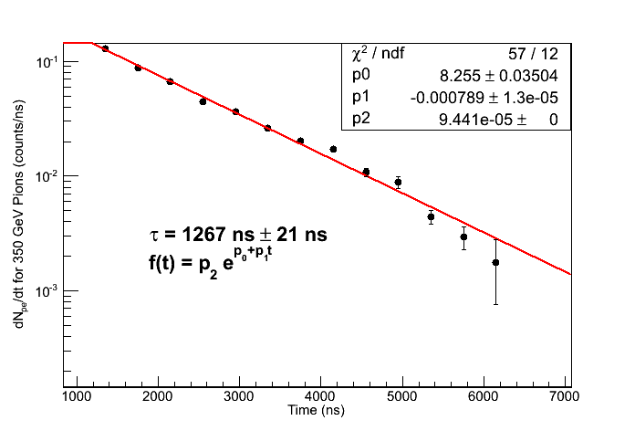
Scope Pion Data
Using PMT 1B, 350 GeV pion data from oscilloscope area measurements
Using ~1k events per data point
Error bars calculated as quadrature sum from two contributions:
  Error in center point approximation for derivative
  Standard error of mean in peak determination
Parameter p2 is “fixed” (i.e. not allowed to vary with fit) as part of conversion from ADC channel count to PE count.
213 PE between 900 ns to 4500 ns

Slide 8
2249W Mean PE Count by Tube
917 ns to 4517 ns (Configuration B)
Particle: | Electron | Electron | Electron | Electron | Electron | Pion | Pion | Pion
Energy: | 75 GeV | 100 GeV | 125 GeV | 150 GeV | 175 GeV | 250 GeV | 300 GeV | 350 GeV
1A | 23 PE | 35 PE | 47 PE | 60 PE | 74 PE | 230 PE | 266 PE | 299 PE
2A | 22 PE | 34 PE | 46 PE | 58 PE | 72 PE | 250 PE | 289 PE | 327 PE
3A | 29 PE | 47 PE | 64 PE | 78 PE | 104 PE | 330 PE | 377 PE | 417 PE
4A | 29 PE | 47 PE | 64 PE | 81 PE | 100 PE | 305 PE | 340 PE | 372 PE
5A | 20 PE | 31 PE | 43 PE | 54 PE | 67 PE | 234 PE | 265 PE | 297 PE
6A | 22 PE | 33 PE | 44 PE | 58 PE | 72 PE | 245 PE | 283 PE | 318 PE
2B | 21 PE | 32 PE | 43 PE | 55 PE | 68 PE | 217 PE | 247 PE | 274 PE
3B | 25 PE | 38 PE | 52 PE | 67 PE | 84 PE | 282 PE | 326 PE | 363 PE
4B | 41 PE | 66 PE | 90 PE | 115 PE | 143 PE | 411 PE | 466 PE | 510 PE
5B | 34 PE | 53 PE | 72 PE | 91 PE | 113 PE | 354 PE | 402 PE | 445 PE
Mean | 27 PE | 42 PE | 56 PE | 80 PE | 90 PE | 286 PE | 326 PE | 362 PE

Slide 9
Data Quality Cuts and Correction
Note: Using data from configuration B, since that's where energy scans were performed
“IsWithCal” Cut
  Requires that both BSD and CAL saw event (matched by event number)
  CDAQ has much more dead time (~20 ms) than BSD's CAMAC readout (~300 us), so this cuts a lot of data
Require >40 MeV in 6 consecutive CAL layers (flight CAL trigger)
  Use approximate conversion 9 chan = 1 MeV (from S. Nutter) as rough conversion.
  Note: This analysis should be redone when CAL is gain calibrated
Saturation Correction
  Set any fCHA[n] < 0 (2249W saturated) for n = 1 to 10 (switched tubes) to 2048 channels. Use “myBSDLatePE” variable as gain converted PE sum of these.

Slide 10
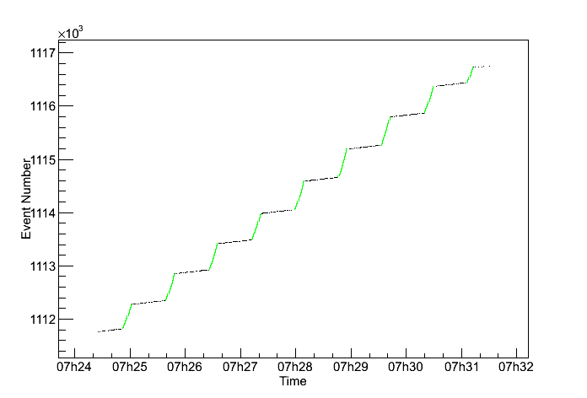
IsWithCal For In Spill Events
Choosing “IsWithCal” is a good proxy for in spill events.
Example plot for 150 GeV electron run BSDCALCombined_11-27-2012-13-24-15.root
  Black: All events in run
  Green: Events with “IsWithCal” flag
Makes sense since this is the time window when the BSD and upstream scintillator counter triggers are well correlated.

Slide 11
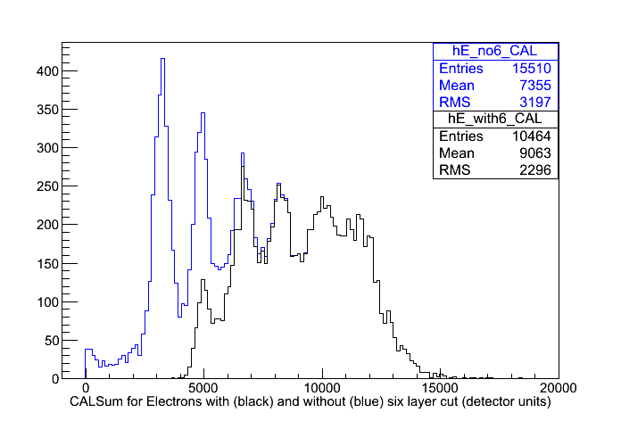
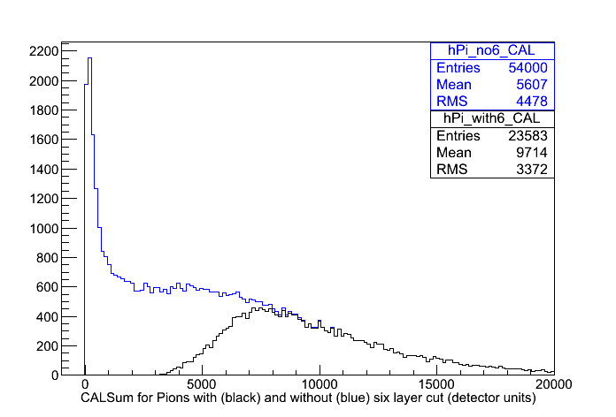
Effect of Six Layer Cut (i.e. “flight cut”) on CALSum
Left histogram: Black is CALSum with equal numbers of events from electron runs at 50 GeV, 75 GeV, 100 GeV, 125 GeV, 150 GeV, and 175 GeV. Blue is remaining histogram after requiring CAL to have 6 consecutive layers with >40 MeV on this dataset.
Right histogram: Black is CALSum with equal numbers of events from pion runs at 250 GeV, 300 GeV, and 350 GeV. Blue is remaining histogram after requiring CAL to have 6 consecutive layers with >40 MeV on this dataset.
Note that the 6 layer cut removes many more low energy events than high energy events
For analysis, must weight with equal amounts of all energies AFTER 6 layer cut.

Slide 12
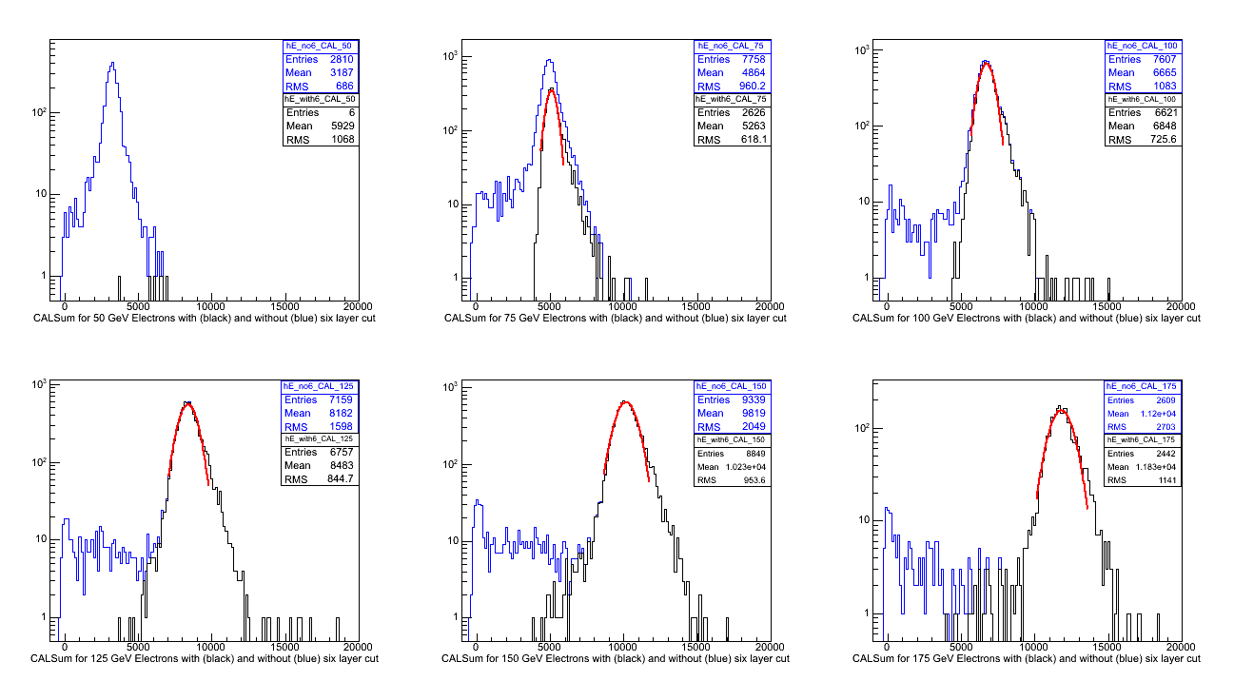
Another Effect of 6 Layer Cut
Electron beam is only ~75% pure, but this cut removes most of the impurities. (Pion beam is ~95% pure.)
Only 6 events from the 50 GeV electron runs survive the 6 layer cut, so they will not be used in the remaining analysis.

Slide 13
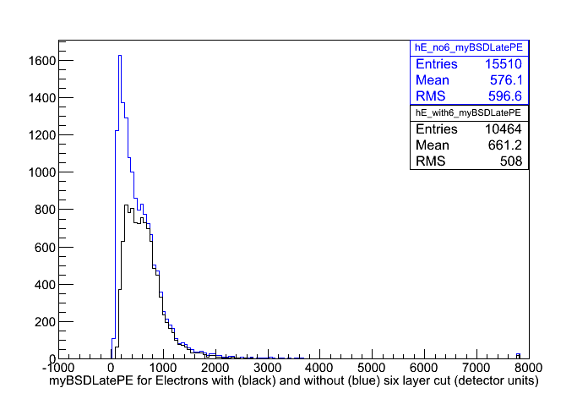
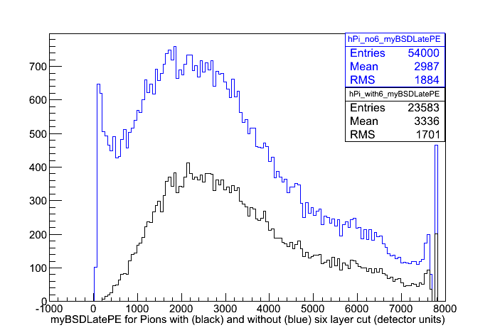
Effect of 6 Layer Cut on myBSDLatePE
Left histogram: Black is myBSDLatePE with equal numbers of events from electron runs at 50 GeV, 75 GeV, 100 GeV, 125 GeV, 150 GeV, and 175 GeV. Blue is remaining histogram after requiring CAL to have 6 consecutive layers with >40 MeV on this dataset.
Right histogram: Black is BSDLatePE with equal numbers of events from pion runs at 250 GeV, 300 GeV, and 350 GeV. Blue is remaining histogram after requiring CAL to have 6 consecutive layers with >40 MeV on this dataset.
For analysis, must weight with equal amounts of all energies AFTER 6 layer cut

Slide 14
Saturated Event Correction
The 2249W puts out a number much less than pedestal (typically “1”) when it saturates
The fCHA branch is already pedestal subtracted, so these saturated values will show up as a large negative spike in channel histograms
These saturated events are significant (especially for pions) because:
  They represent large PE signals
  They are much more common for pions (because of larger BSD late signal) than for electrons
Hence, missing these events will throw off Efrac significantly

Slide 15
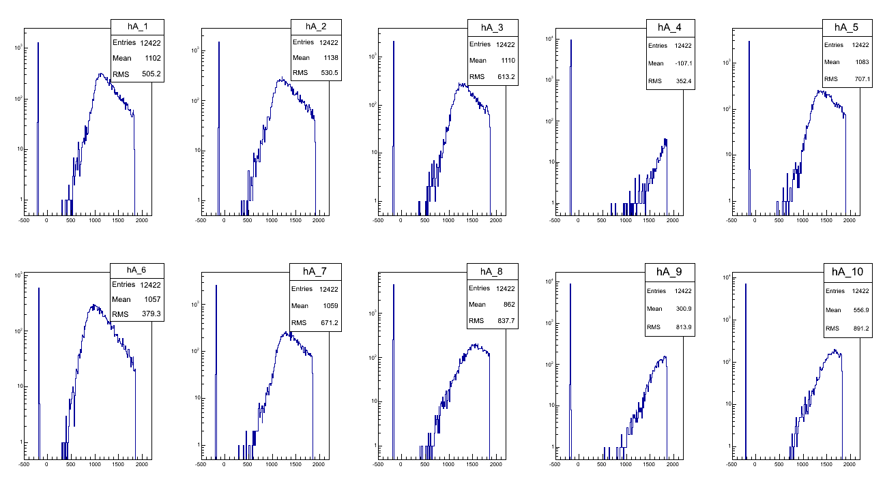
Looking at fCHA[n] < 0 Events
Clearly, these are saturated events
96.3% have fCHA[4] saturated.
99.1% have either fCHA[4] or fCHA[9] saturated.

Slide 16
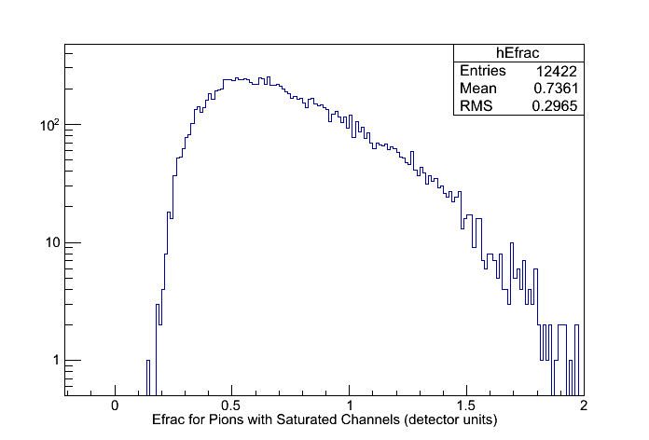
Saturated Event Solution
Solution: If a channel is saturated, give it max value, 2048 channels. This is a good approximation, though it under estimates the signal sum a little bit. Call this variable “myBSDLatePE”.
All events with saturation (histogram above) then end up outside the electron Efrac range (Efrac < 0.1 in detector units). Thus, the slightly under estimated signal sum only influences the total histogram counts (a small effect), but not the counts for events in range of electron Efrac (a larger effect).

Slide 17
Data Cuts and Conditioning Summary
Electron Energy (GeV): | 50 | 75 | 100 | 125 | 150 | 175 | Total
Starting Count | 37685 | 42175 | 37262 | 33997 | 30504 | 9942 | 191565
“IsWithCAL” (% cut of starting count) | 92.5% | 81.6% | 79.6% | 78.9% | 69.4% | 73.8% | 80.5%
“6 Layer Cut” (% cut of remaining) | 99.8% | 66.2% | 13.0% | 5.6% | 5.2% | 6.4% | 26.8%
Final Count | 6 | 2626 | 6621 | 6757 | 8849 | 2442 | 27301
Corrected For Saturation (% conditioned of remaining) | 0.0% | 0.5% | 0.4% | 0.3% | 0.1% | 0.2% | 0.3%
Pion Energy (GeV): | 250 | 300 | 350 | Total
Starting Count | 243938 | 85405 | 204650 | 533993
“IsWithCAL” (% cut of starting count) | 91.8% | 68.1% | 61.1% | 76.2%
“6 Layer Cut” (% cut of remaining) | 66.9% | 56.6% | 54.5% | 56.9%
Final Count | 6617 | 11822 | 36242 | 54681
Corrected For Saturation (% conditioned of remaining) | 14.6% | 18.9% | 25.5% | 22.7%

Slide 18
Now what?
Cuts and data conditioning measures have been outlined/verified
Would like to make plots which are:
  1.) physically meaningful
  2.) can be compared with MC simulation data
Choose to do analysis of CALSum, myBSDLatePE, Efrac, and rejection power vs. electron acceptance for 75 GeV-175 GeV electron energies and 250 GeV-350 GeV pion energies.
Not all energy runs have the same amount of data, so we “mix” for equal fractions of all energies AFTER cuts and conditioning!

Slide 19
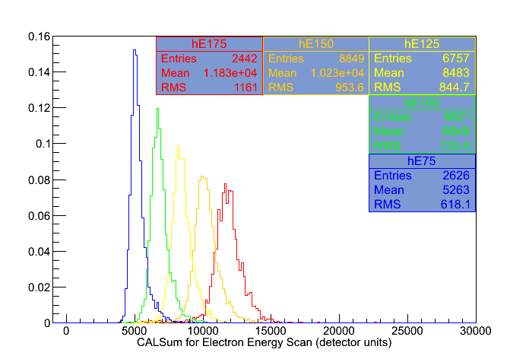
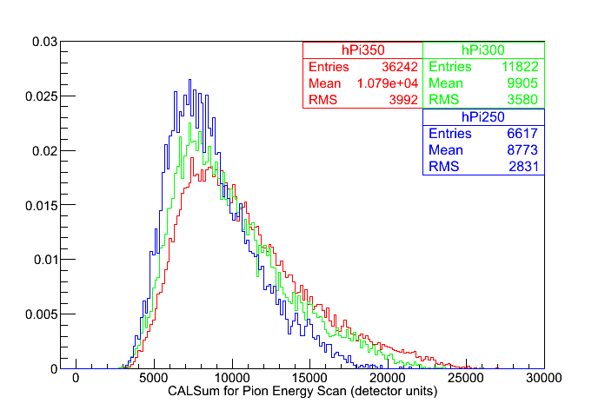
CAL Response With Particle Energy
Histograms are scaled to equal areas by total number of events and normalized such that total area is 1
Note: 50 GeV electrons don't shower enough to meet the software “>40 MeV in 6 consecutive layers” cut. So they aren't included in these plots even though we have data for them.

Slide 20
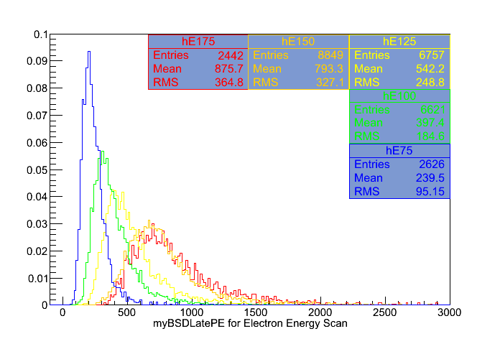
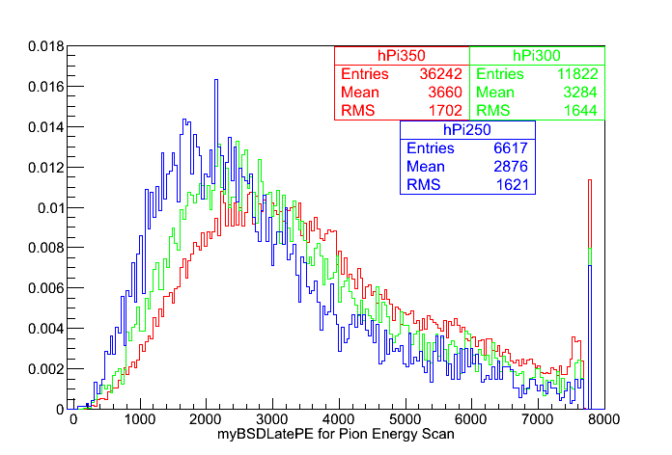
BSDLatePE Response With Particle Energy
Histograms are scaled to equal areas by total number of entries and normalized such that total area is 1
Note:150 and 175 GeV electrons are quite similar

Slide 21
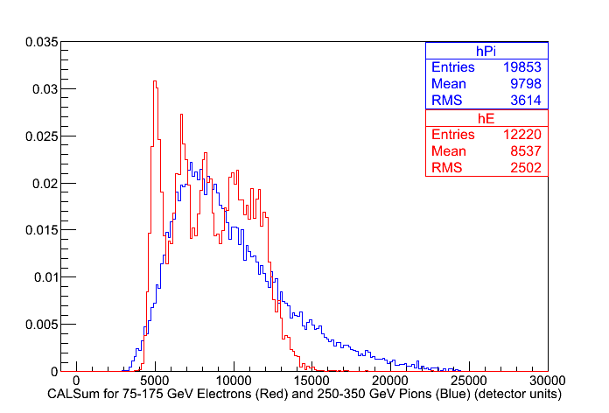
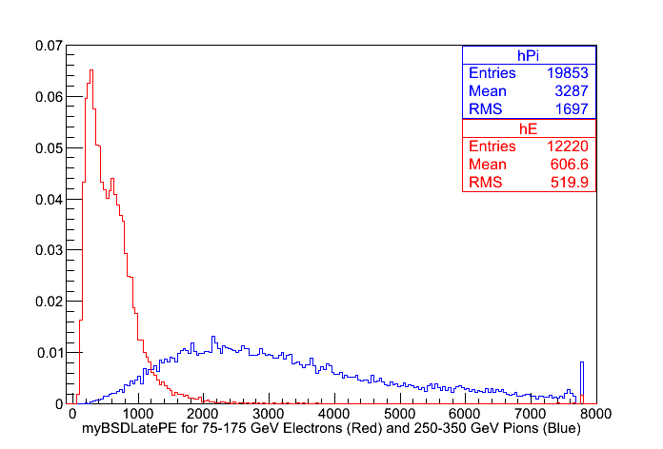
CALSum and BSDLatePE for 75-175 GeV Electron and 250-350 GeV Pions
Events have been selected from energy runs such that all energies are weighted equally
Histograms scaled to equal areas by total number of entries and normalized such that total area is 1

Slide 22
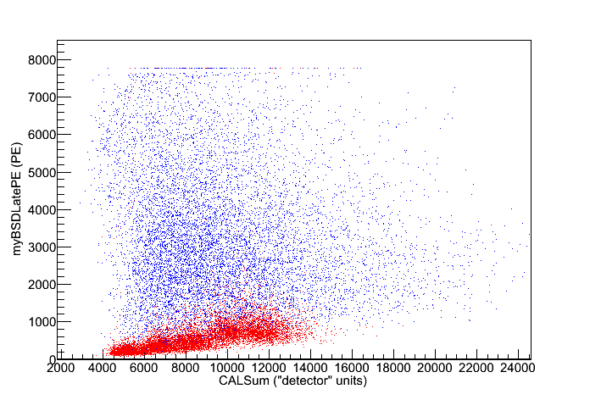
BSD Late vs. CAL
75-175 GeV electrons (red) and 250-350 GeV pions (blue)

Slide 23
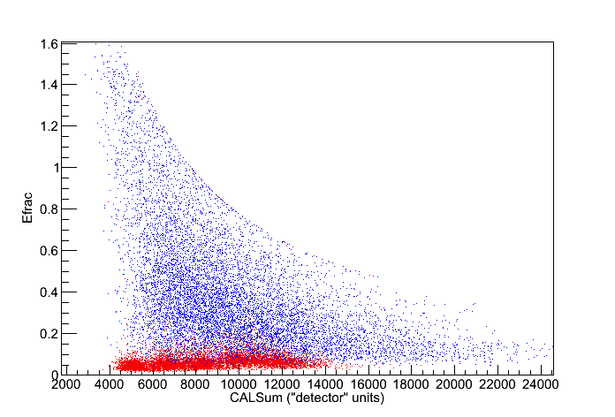
Efrac vs. CALSum
75-175 GeV electrons (red) and 250-350 GeV pions (blue)

Slide 24
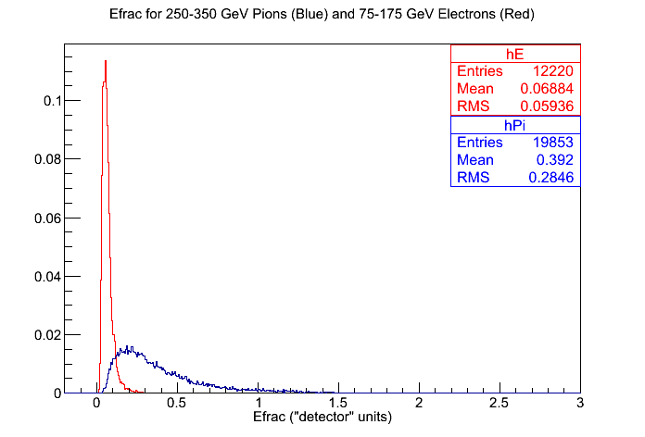
Efrac For All Energies
Electron and pion histograms scaled to equal area by total number of entries and normalized such that total area is 1

Slide 25
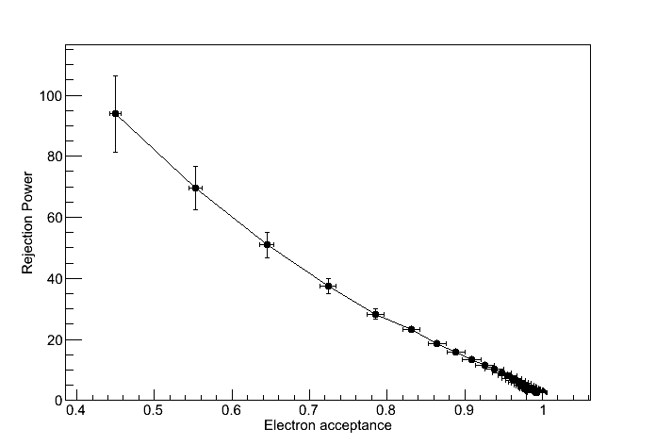
Rejection Power vs. Electron Acceptance
Error bars propagated from statistics of Efrac histogram

Slide 26
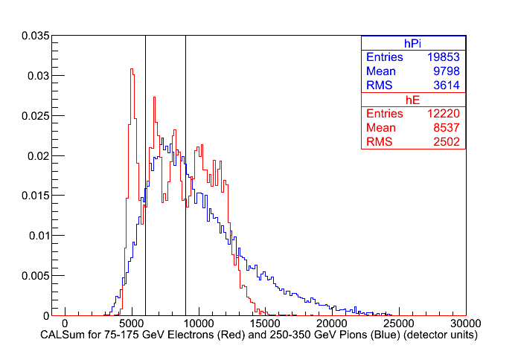
New Analysis: Cut on CALSum
Calculate Efrac, rejection ratio, and electron acceptance for CALSum between 6000 and 9000
This is mostly 100 to 125 GeV electrons and 250 to 350 GeV pions

Slide 27
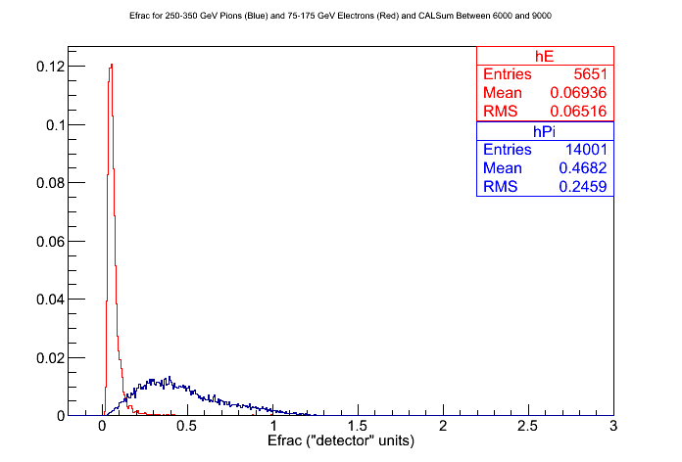
New Efrac
Efrac for CALSum between 6000 to 9000

Slide 28
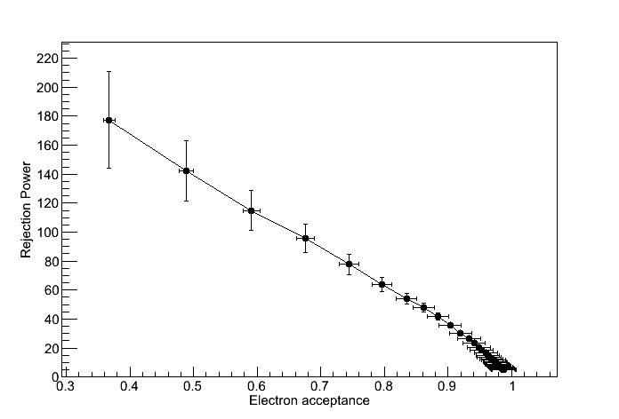
Rejection Power vs. Electron Acceptance
Rejection Power vs. Electron Acceptance for CALSum between 6000 and 9000
Somewhat better than using all CALSum range

Slide 29
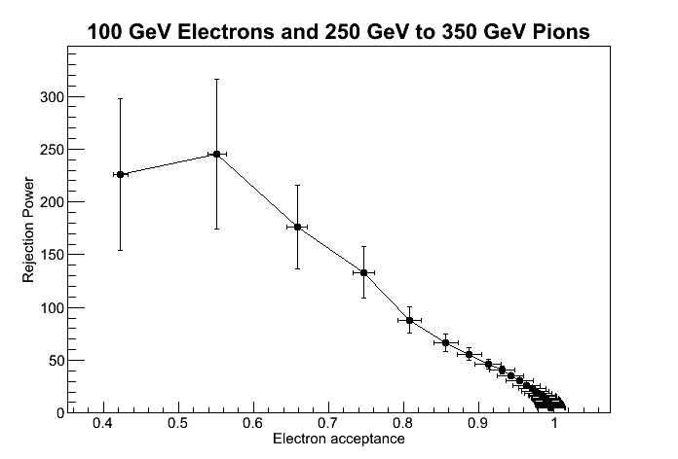
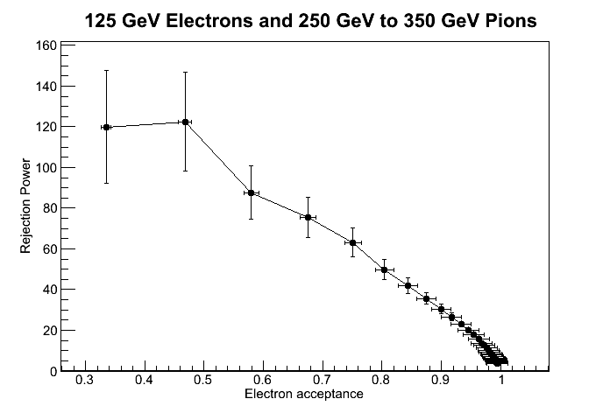
Different Approach to the Analysis
Restrict analysis to CALSum within 2σ of electron's CALSum peak. Analyze electron energies individually.
Make plots of rejection power vs. electron acceptance
Note: As the electron energy you're looking at gets farther away from the center of the pion peak, this analysis becomes less meaningful, so only did 100 GeV and 125 GeV electrons.

Slide 30
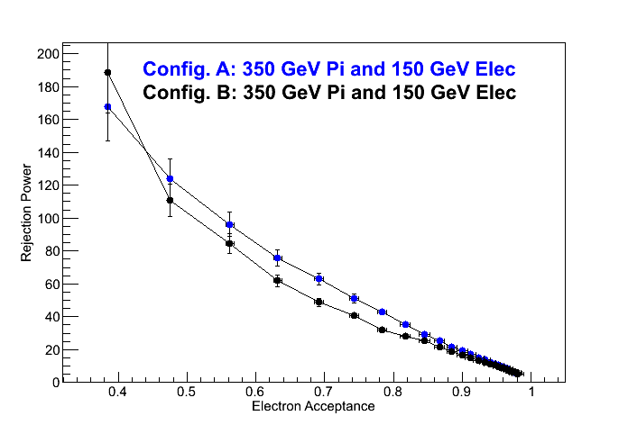
Rejection Power vs. Electron Acceptance
150 GeV electrons and 350 GeV pions
Data from two different configurations:
  Configuration A: BSD centered directly on center of CAL, no BCD/TCD
  Configuration B: Beam roughly centered on BSD, offset ~14 cm from CAL center. BCD/TCD in place.
Why the difference?
  Different configuration. Maybe geometry makes a difference?

Slide 31
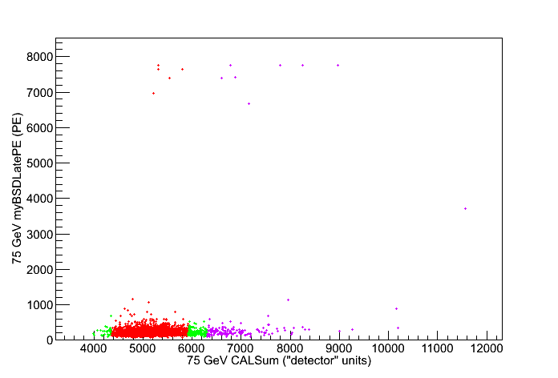
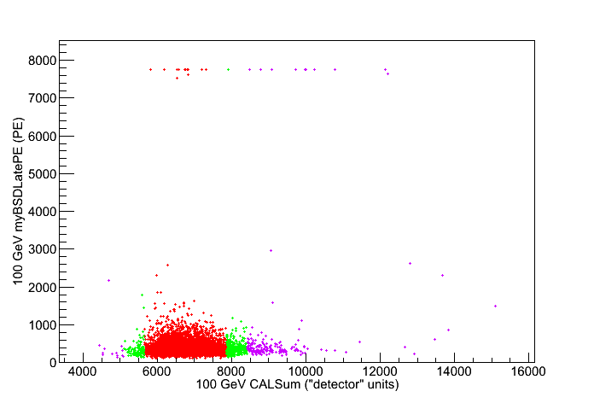
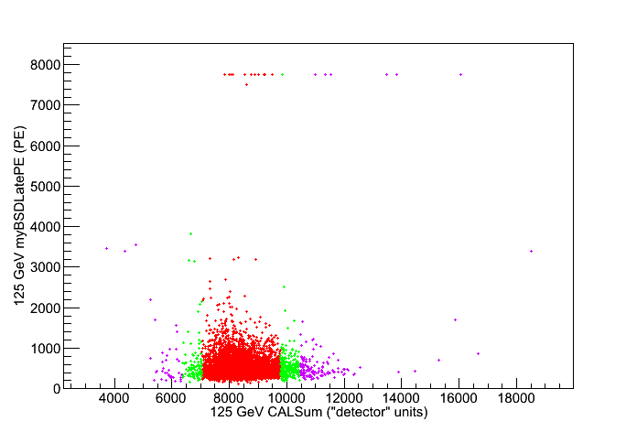
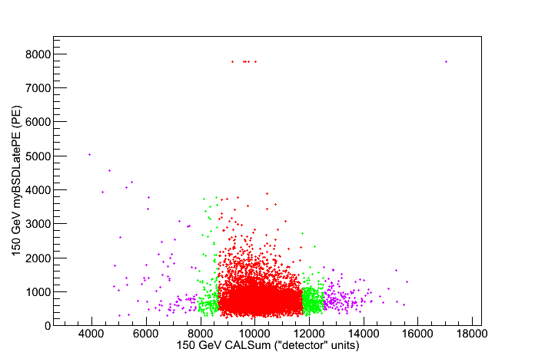
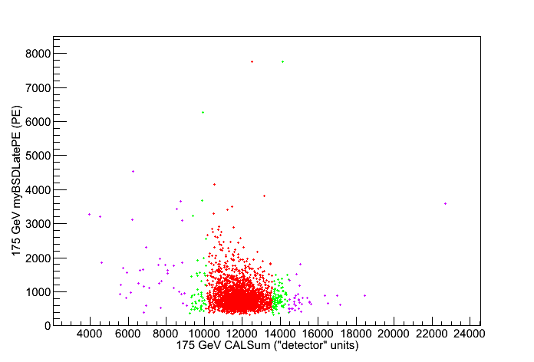
BSD Late vs. CALSum
Red: < 2 sigma
Green: 2-3 sigma
Violet: > 3 sigma

Slide 32
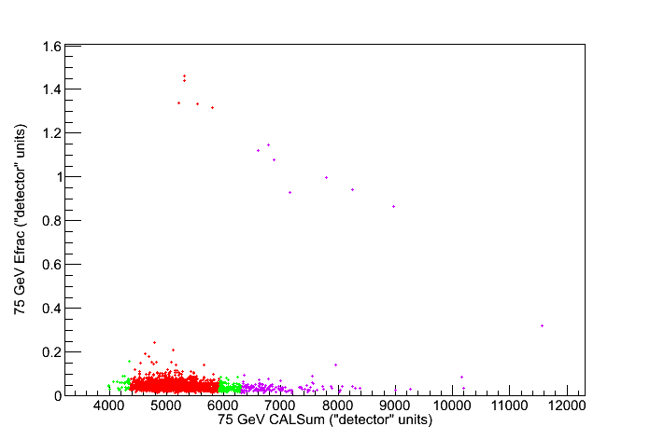
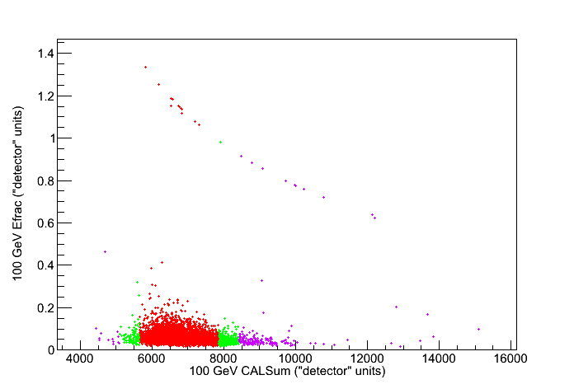
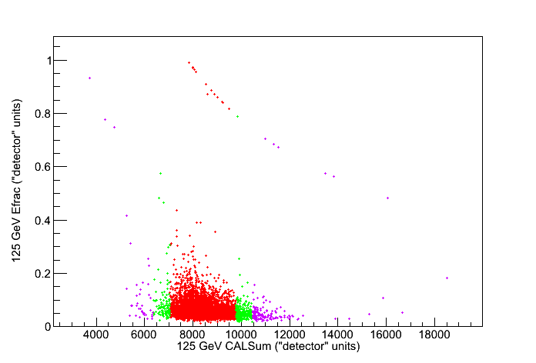
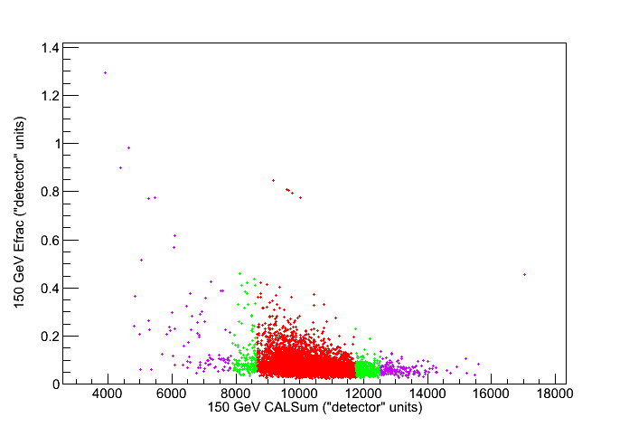
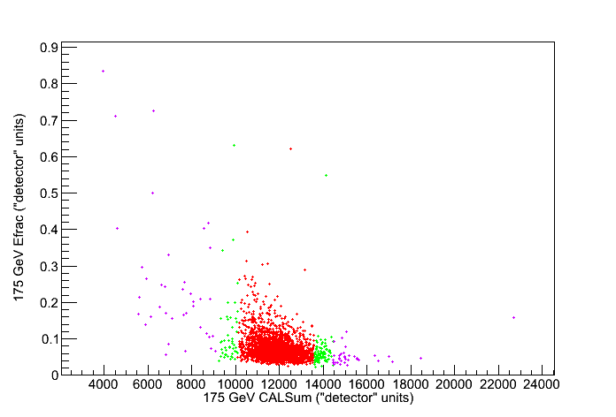
Efrac vs. CALSum
Red: < 2 sigma
Green: 2-3 sigma
Violet: > 3 sigma

