Slide 1
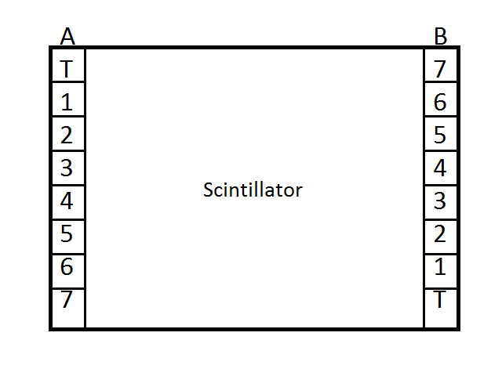
Layout of Instrument

Slide 2
Parameters from fitting landau distributions to muon signal histograms
PMT | Most Probable Value (# PE) | Sigma (# PE) | PMT | Most Probable Value (# PE) | Sigma (# PE)
TA | 62.8 | 10.8 | TB | 53.8 | 8.5
2A | 70.4 | 9.7 | 1B | 54.9 | 7.3
3A | 96.4 | 12.4 | 2B | 54.0 | 8.7
4A | 78.4 | 10.5 | 3B | 74.0 | 9.4
56 | 66.0 | 9.6 | 4B | 82.1 | 9.4
6A | 51.3 | 8.6 | 5B | 71.0 | 8.7
7A | 48.7 | 9.9 | 6B | 65.6 | 9.5

