Slide 1
Tracking Device – Altera Board Implementation
Tejaskumar Babel

Slide 2
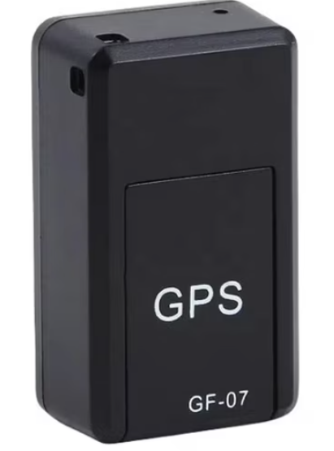
the objective of this tracking device to reduce the reoccurring cost of tracker, be smaller, and more power efficient
A special logic will allow lower power computation.
A special logic will allow the logic unit to be smaller.

Slide 3
State 1 – Idle
The device isn’t registered lost and isn’t conned to a peer through Bluetooth.
State 2 – Active with peer to peer
The device isn’t registered lost and is conned to a peer through Bluetooth.
State 3 – Active with self internet.
The device is marked lost, the device isn’t conned to a peer, and can connect to the network.
Step 4 – Active with self internet and peer to peer.
The device is marked lost and uses peer to peer to send.
1
4
2
3

Slide 4
GPS
UART
Formatter
SIM
Pooling
FSM
UART
Bluetooth
Phone
Application
UART
Account ID | SIM | Status | Location
00000001 | XXXXXXXXX | Inactive | (111.22,22.222)

Slide 5
Equipment
Bluetooth (BLE) module
GNSS (GPS) receiver module
SIM
NB-IoT Modem module
antennas
Timing
The location will only be update once per minute. So the actual ASIC will be idling for most of the time, but the trick is lower the power consumption of the prefinals.

Slide 6
Verification
Ultimate
Demonstrate the whole Tracking live. With P2P and independent capability.
Intermediate
Send test packets over the eSIM.
Send information to phone.
The send it from their to end server/computer.
Test the FSM.
Test the Formater

Slide 7
Timeline
Week | Task
Week 1 | Test bench for all the modules
Week 2 | Test data transfer over Bluetooth and SIM
Week 3 | Code the modules
Week 4 | Debug the integration issue and edge cases
Week 5 | Software, data bases, and basic website
Week 6 | Live test

Slide 8
Potential challenges
Antenna performance may be degraded due to small device size and enclosure constraints.
Mitigation: Prototype with external antennas first to validate RF performance before final miniaturized design.
Data security vulnerabilities could expose device location information
Mitigation: Use encrypted communication (TLS over MQTT/HTTPS), device authentication tokens, and secure key storage.

Slide 9
Final demo
I will take the FPGA to an unknow location and through the different tracking methods which I described I we will see if we can find it.

