Slide 1
Automation scripts

Slide 2
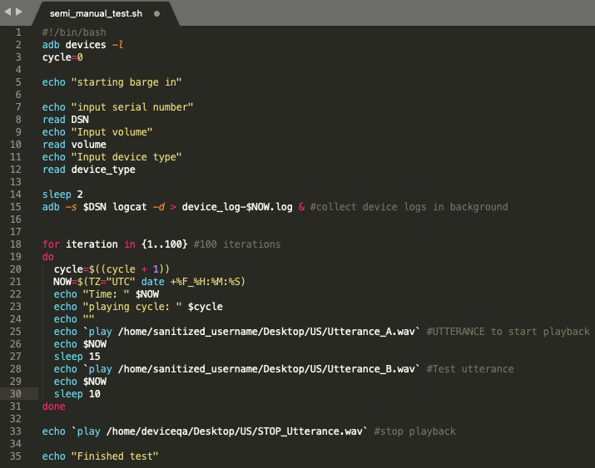
Automated playback of utterances

Slide 3
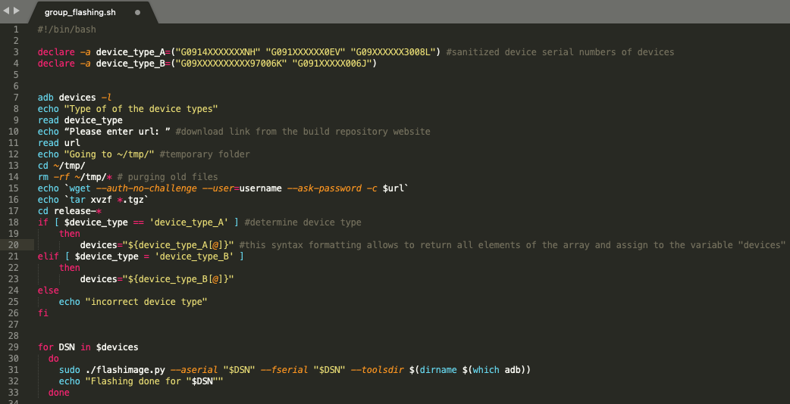
Automated rotation of flashing devices

