Slide 1


Our Project
Groupe Apple
Tarik Bacha, Florian Emery,
Nicolas Mauroux, Frédéric Spycher

Slide 2
The data base
370454 different projects after the first cleaning
What do we know?
The name;
The category;
The currency;
The date (launched and ended);
The number of backer;
The amount pledge
The statut
…

Slide 3
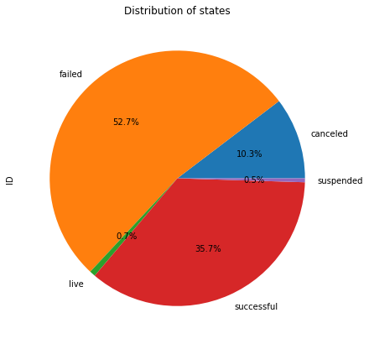
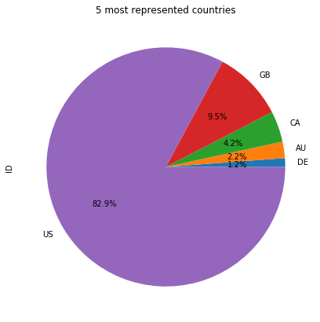
Exploratory Data Analysis

Slide 4
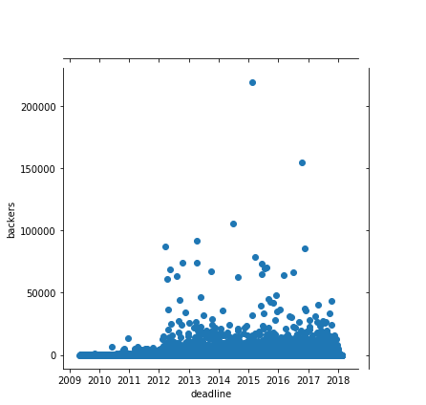
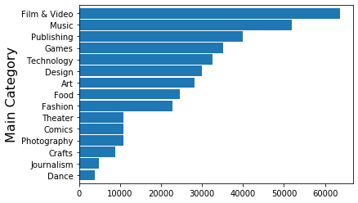
Exploratory Data Analysis (2)

Slide 5
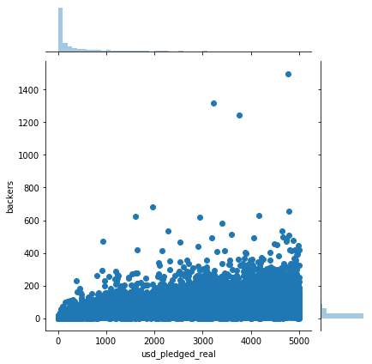
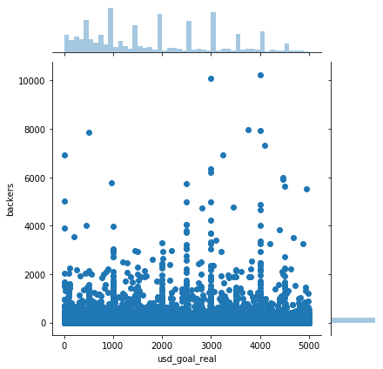
Exploratory Data Analysis (3)

Slide 6
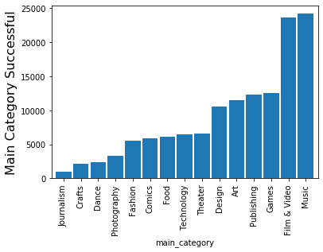
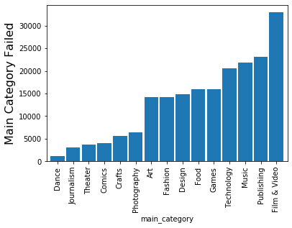
Exploratory Data Analysis (4)

