Slide 1
Kickstarter Gathering Insight Using Machine Learning
A project by Team Apple, HEC Lausanne, Fall 2019
Bacha, Tarik Emery, Florian Mauroux, Nicolas Spycher, Frédéric

Slide 2


1 Introduction
Focus: the crowdfunding platform
Dataset from
The set provides several features such as:
Name of the project
Main and specific categories
Launch date and deadline
Amount of money asked for and pledged
State
failed, successful, cancelled, suspended, or live

Slide 3
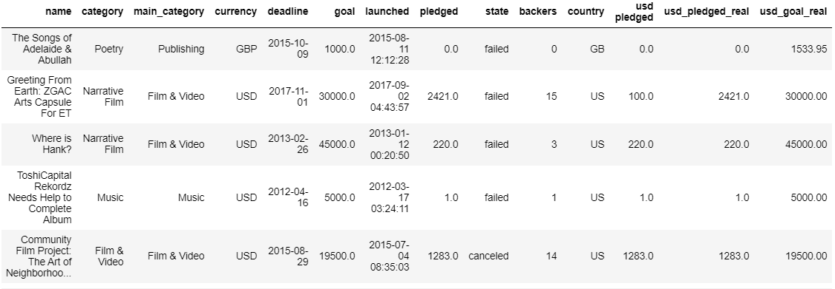

Slide 4
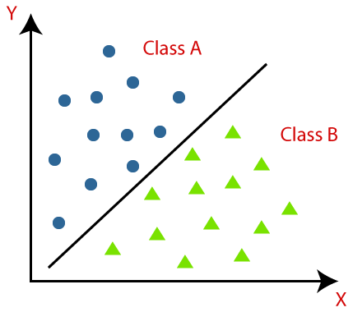
1 Introduction
Main research questions
Which features can predict with accuracy the success or failure of a Kickstarter project?
Which machine learning model performs the best at doing so?
→ Classification problem

Slide 5
2 Data Cleaning
Example
cancelled
failure
success
if (pct_reached < 1)
if (pct_reached ≥ 1)
$$\text{pct}\text{_}\text{reached}=\text{pledged} \text{/} \text{goal}$$

Slide 6
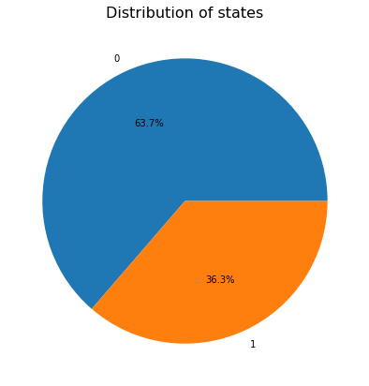
3 EDA
Base rate
0: Failed
1: Successful

Slide 7
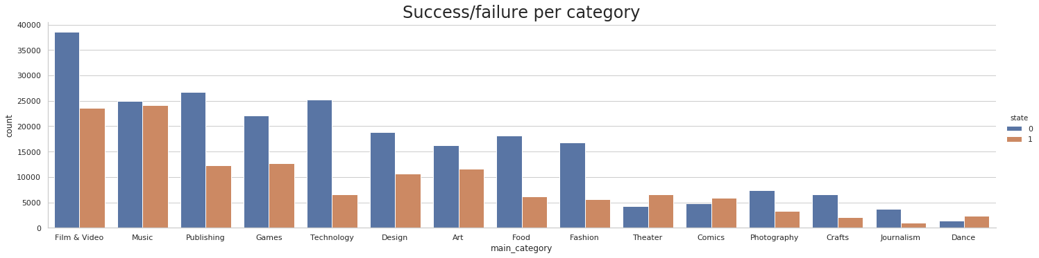
3 EDA
Insight

Slide 8


3 EDA
Insight

Slide 9
4 Machine Learning
Models
Models used
Logistic regression
k-nearest neighbors
Decision tree
Random forest
Neural network
Playing with many parameters
Features
usd_goal_real, elapsed_time, category, main_category, country
Scaling (min-max / z-score)
Encoding (label / one-hot)
Dimensionality reduction (PCA)

Slide 10
4 Machine Learning
Observations
Features
The specific category is the main contributor of accuracy
Pairs well with numerical variables
The country is irrelevant
Scaling
Most of the time, no significant difference
Encoding
Choice is crucial (depends on the model used)
PCA can help

Slide 11
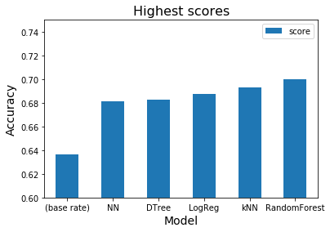
4 Machine Learning
Performance

Slide 12
To sum up
ML models close to the base rate (Δ 4-6%)
No significant score difference between models
Lack of relevant dimensions

Slide 13

Questions

