Slide 1
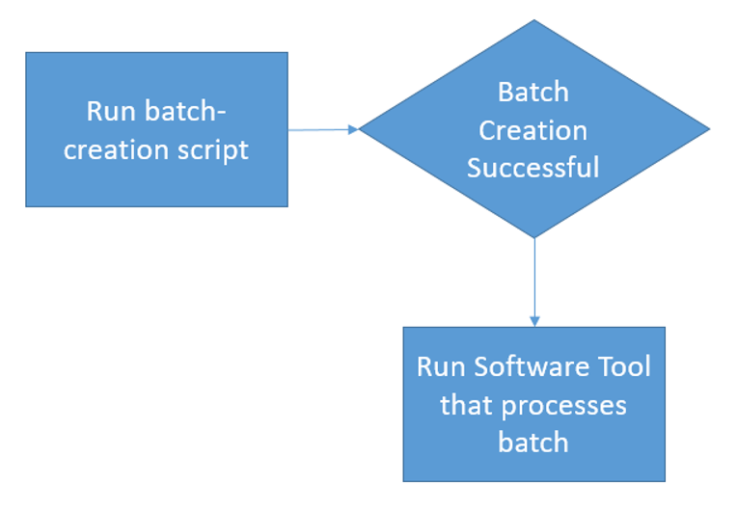
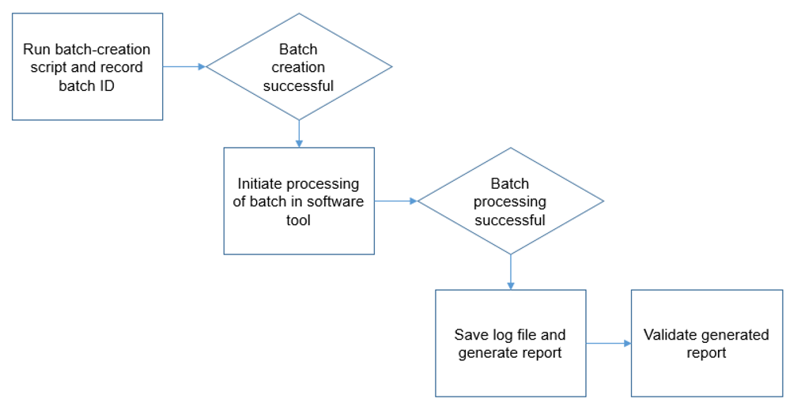
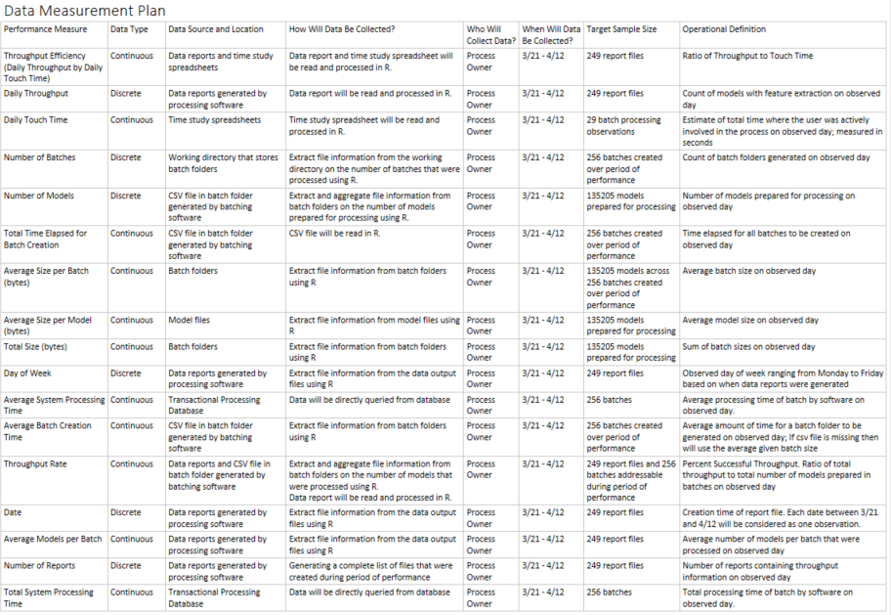
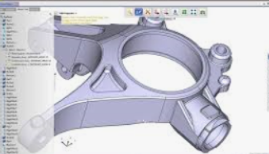


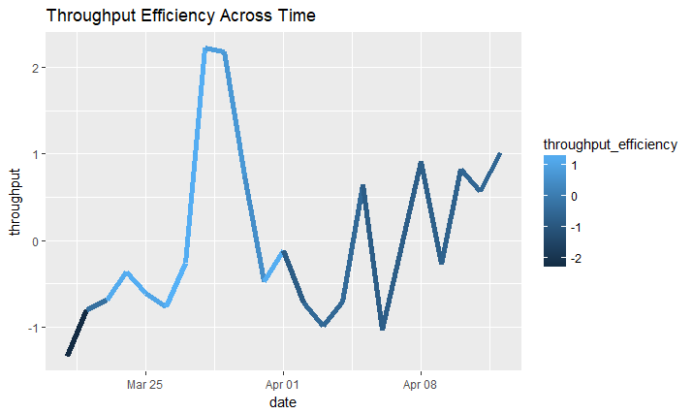
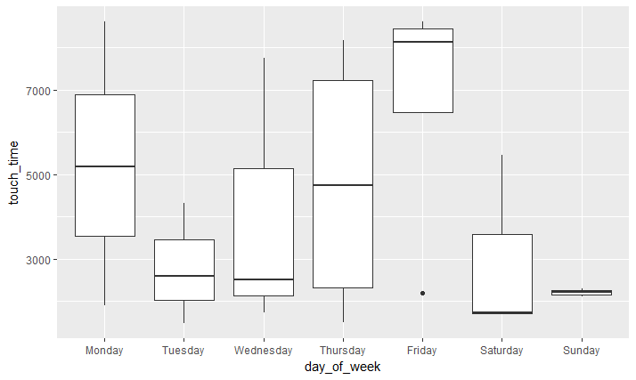





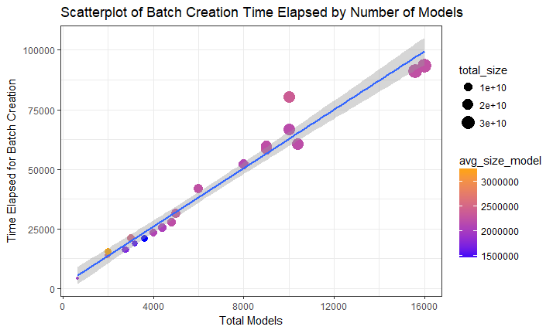
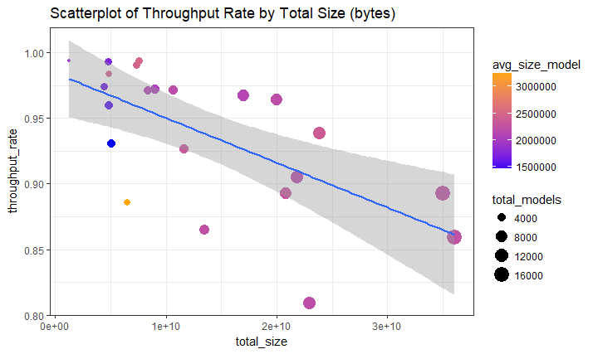

MBC 638
Geometry Feature Extraction Efficiency
Process owner: Thomas Bahng
Key Dates --->
Team Launch
April 8
Define
April 12
Measure
April 19
Analyze
May 17
Improve
May 24
Control
June 7
DEFINE
MEASURE
ANALYZE
IMPROVE
In 3 weeks, $2,500 of overhead labor will go towards a process to extract data from CAD models for downstream machine-learning apps.
Highly skilled engineers will spend 25 hours performing low-skill tasks in order to reach yield objectives.
Due to an inefficient process, other complex projects are impacted by capacity constraints.
Collected 22 daily observations of 17 variables from logs, time studies and Excel reports.
Too many touch-points in the end-to-end process.
Software Optimization
Parallel processing
Leverage 3rd party API
Increase batch size
Reduce touch-points
1988% increase in throughput efficiency
Can touch-times be reduced such that the same yield can be accomplished with less user involvement?
47,600
Defects per Million Opportunities
Sigma Quality Level
3.15
135,000 CAD models were processed during the performance period. Average daily yield (# models) and touch-times (seconds) exhibit a high margin of error.
High Variability
CONTROL
x̅̄ = 5629
Can software performance and backend integration be optimized to increase yield over time?
x̅̄ = 4344
Accessibility to technical documentation
Shareable / Executable / Compatible Software
Low risk / Minimal commitment required to sustain activity by a single user.
545,500
Defects per Million Opportunities
Sigma Quality Level
1.35
$$Throughput Efficiency=\frac{Throughput}{TouchTime}$$
TEAM MEMBERS
Thomas, Systems Engineer, Product Manager, Stakeholders

