Slide 1
Relevance Tuning with Genetic Algorithms
Tim Allison
Elastic Meetup
Arlington, VA
December 10, 2019
Approved for Public Release;
Distribution Unlimited.
Case Number 18-3138-12
© 2019 The MITRE Corporation. ALL RIGHTS RESERVED.

Slide 2
| 1 |
About me
Data Scientist at NASA’s Jet Propulsion Laboratory
Chair/V.P. Apache Tika
Committer/PMC Apache PDFBox
Committer/PMC Apache POI
Committer Apache Lucene/Solr
Member ASF
Ph.D. Classical Studies

Slide 3

| 1 |
Hat Tip – Simon Hughes
Simon Hughes “Evolving The Optimal Relevancy Scoring Model at Dice.com”
https://www.youtube.com/watch?v=z4c1xU7arhc
https://github.com/DiceTechJobs/RelevancyTuning
See also Zappo’s use of Genetic Algorithms:
https://www.modernretail.co/retailers/how-zappos-used-ai-to-rebuild-its-search-engine/

Slide 4
| 1 |
Some Open Source Relevance Tools
Quaerite (focus of this talk): https://github.com/tballison/quaerite
Quepid (Open Source Connections): https://github.com/o19s/quepid
Rated Ranking Evaluator RRE (Sease Ltd): https://github.com/SeaseLtd/rated-ranking-evaluator
Others?!

Slide 5
| 1 |
Outline
Introduction/Motivation
Evolution of methods
Generation 0
Generation 1
Generation 2
Findings
Next Steps

Slide 6

| 1 |
Search is easy!

Slide 7
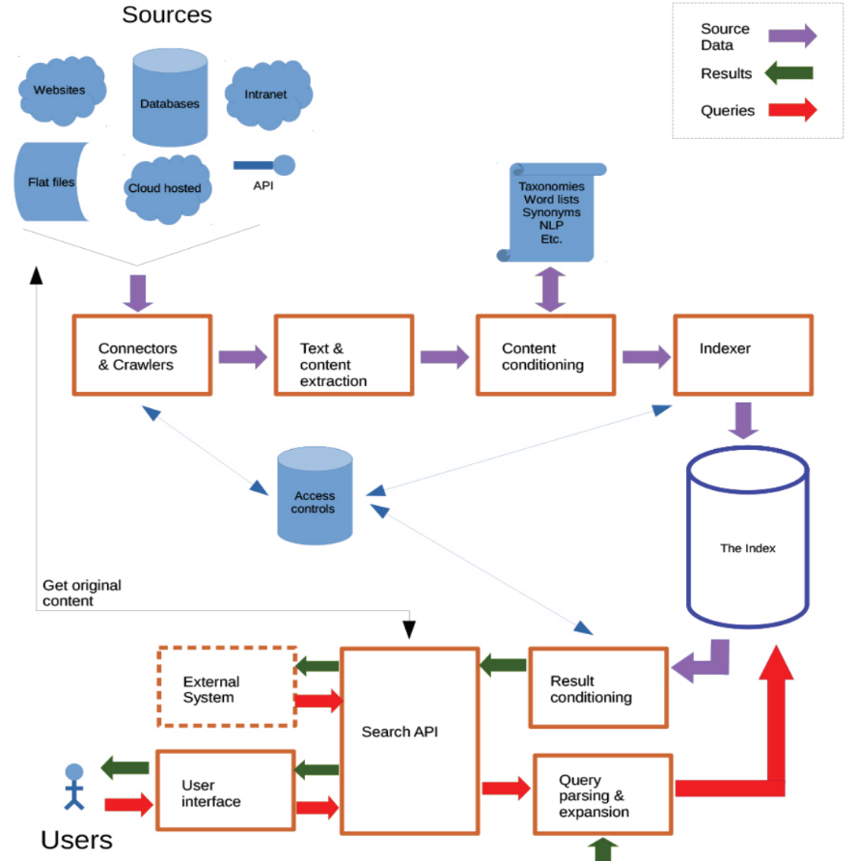
| 1 |
Search Engines – A Quick Overview
Udo Kruschwitz and Charlie Hull, “Searching the Enterprise”, Foundations and Trends® in Information Retrieval, 11, 2017.
https://www.researchgate.net/publication/318390198_Searching_the_Enterprise

Slide 8
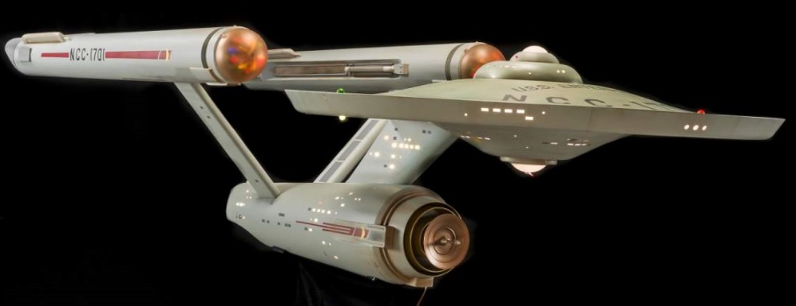
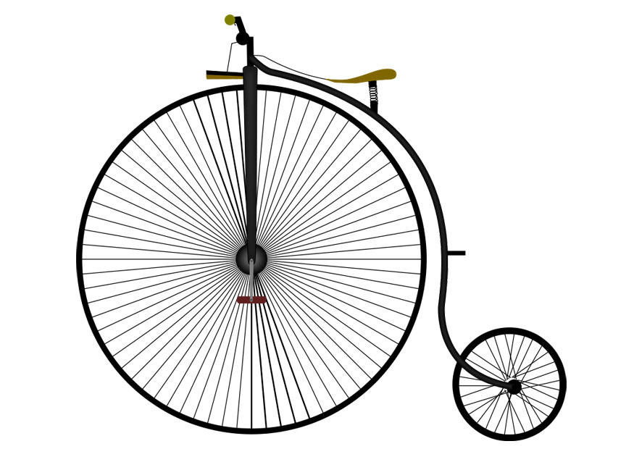

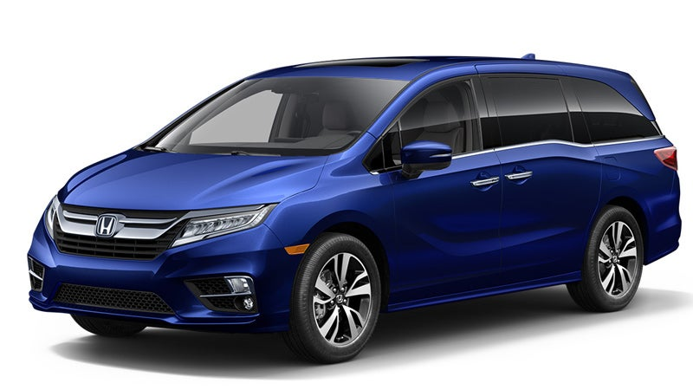

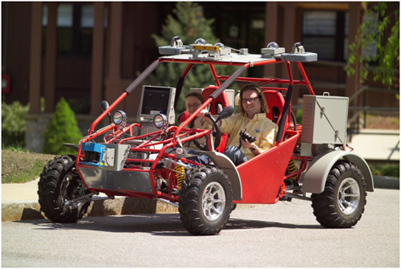
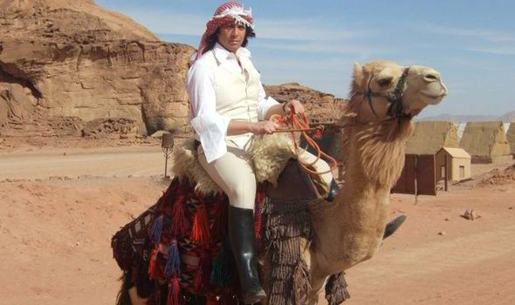
| 1 |
Search

Slide 9
| 9 |
A Few Different Types of Search
Web search/Standard Intranet Search – first N best pages are sufficient
E-commerce – same as above, slightly more complex with different fields
Patent examiners – must put eyes on every document
E-Discovery – relevance is important but recall is critical
Medical literature search – information foraging and serendipity
Even within related industries, e.g. real estate rentals, there will be completely different strategies for e.g. short term vacation (Airbnb) vs. long term (Long and Foster)

Slide 10
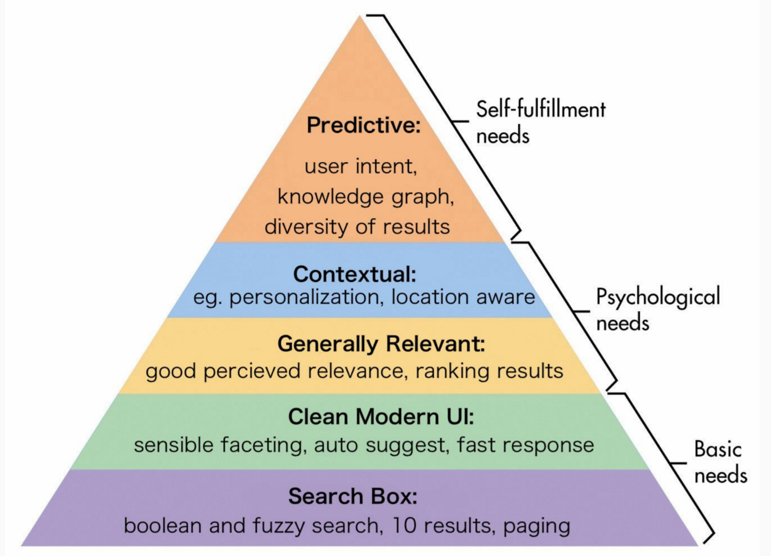
| 9 |
Search Maturity Hierarchy – Eric Pugh (Open Source Connections)
https://mices.co/mices2019/slides/pugh_search-organizational-maturity-model.pdf

Slide 11
Different Query Distributions

Slide 12
| 12 |
Available Parameters
14 tokenizers https://lucene.apache.org/solr/guide/7_1/tokenizers.html
~45 token filters (not including language-specific token filters – see next slide) https://lucene.apache.org/solr/guide/7_1/filter-descriptions.html
Query parsers
Boosting: fields, queries, functions
Phrasal boosting/shingling
Query operators, minimum should match, should, must, not
Token/field based scoring – best_fields, most_fields, cross_fields
Synonym lists, taxonomies
Similarity scoring parameters (with BM25)
Elevate
External signal enrichment
manual or automatic (NLP – entity extraction, categorization, etc.)
Reranking via machine learning (Learning to Rank)

Slide 13
| 13 |
Each Token Filter Can Have Many Parameters
<filter class="solr.WordDelimiterFilterFactory"
protected="protwords.txt"
generateWordParts="1"
generateNumberParts="1"
catenateWords="1"
catenateNumbers="1"
catenateAll="0"
splitOnCaseChange="0"
preserveOriginal="1"/>

Slide 14
| 14 |
If and only if...
Your search system is robust
You’ve made appropriate configuration decisions for your data
There is likely signal in user behavior/query logs
Your problem really is a relevance problem
Then...

Slide 15

| 14 |
What to do, what to do… First step!
“Relevant Search
With applications for Solr and Elasticsearch”
Doug Turnbull and John Berryman
https://www.manning.com/books/relevant-search
Thank you, Doug Turnbull and John Berryman
for permission to use the search engineer in this talk!

Slide 16
| 14 |
So much complexity...What do we do?!
One weird little acronym…
KPIs
Key Performance Indicators

Slide 17
| 14 |
Evaluation and Relevance tuning
Ground Truth Set(s) (Offline)
Queries and relevance judgments (or click history)
Different sets to test/tune different user stories/personas
User Behavior (Online)
Conversions (?!)
Paging depth
Query reformulation/refinement
A/B testing
User Feedback
Questionnaires
Interviews
Focus Groups
Experimental comparisons – task based/think aloud

Slide 18
| 14 |
Evaluation and Relevance Tuning in Practice
Triangulate!
Some Considerations for ground-truth based evaluation
Maturity of existing system
Homogeneity of queries and query types
Budget

Slide 19
| 14 |
Ground-truth based relevance tuning
Requires ground truth
Good ground truth
Overfitting…be careful!
Please use responsible train/test splits
LOL: https://www.gwern.net/Tanks

Slide 20
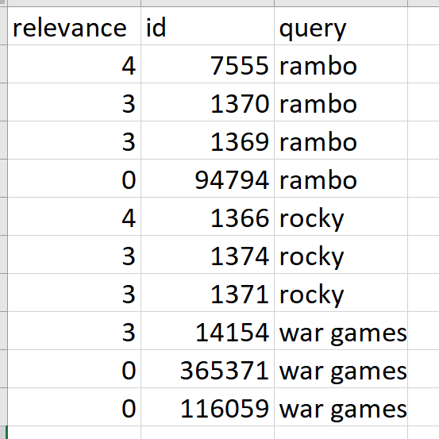
| 14 |
Example Ground Truth
Thank you, Doug Turnbull, John Berryman and “Open Source Connections” for the inspiration for using tmdb and for generating and sharing a ground truth set!

Slide 21
| 14 |
Generation 0: Run Some Experiments
Assuming a static corpus, results should be reproducible
Keep track of previous experiments
Allow standard output and flexibility of scoring metrics
Risk of overfitting

Slide 22
| 14 |
Key components for running experiments
{ "scorers": [ ], "experiments": { } }

Slide 23
| 14 |
Basic Experiment Configuration: Scorers and Experiments
{ "scorers": [ { "class": "NDCG", "atN": 10, "params": { "useForTrain": true, "useForTest": true, "exportPMatrix": true }, … ],
"experiments": { "title": { "searchServerUrl":"http://.../tmdb", "query": { "multi_match": {
"type": "best_fields", "qf": [ "title^10"
],
},},},}

Slide 24
| 14 |
Scorers – More Scorers
"scorers": [ { "class": "AtLeastOneAtN", "atN": 1 }, { "class": "AtLeastOneAtN", "atN": 5 }, { "class": "AtLeastOneAtN", "atN": 10 },
"class": "NDCG", "atN": 10, "params": { "useForTrain": true, "useForTest": true, "exportPMatrix": true } }, { "class": "TotalDocsReturned" }, { "class": "ZeroResults" } ]

Slide 25
| 14 |
Experiments – A Slightly More Interesting Experiment
"title_cast_pf_tie_0_8_mm2": { "searchServerUrl": "http://localhost:9200/tmdb", "query": { "multi_match": {
"type": "best_fields", "qf": [ "title^10", "cast^2" ], "tie" : 0.8, "q.op": { "mm": "2" }}}}

Slide 26
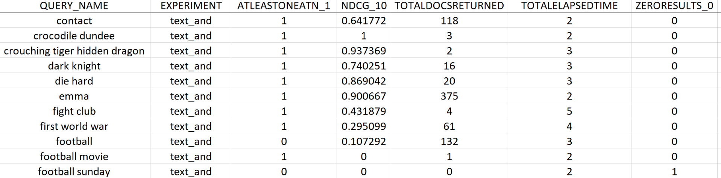
| 14 |
Output: Per Query/Per Experiment Scores

Slide 27
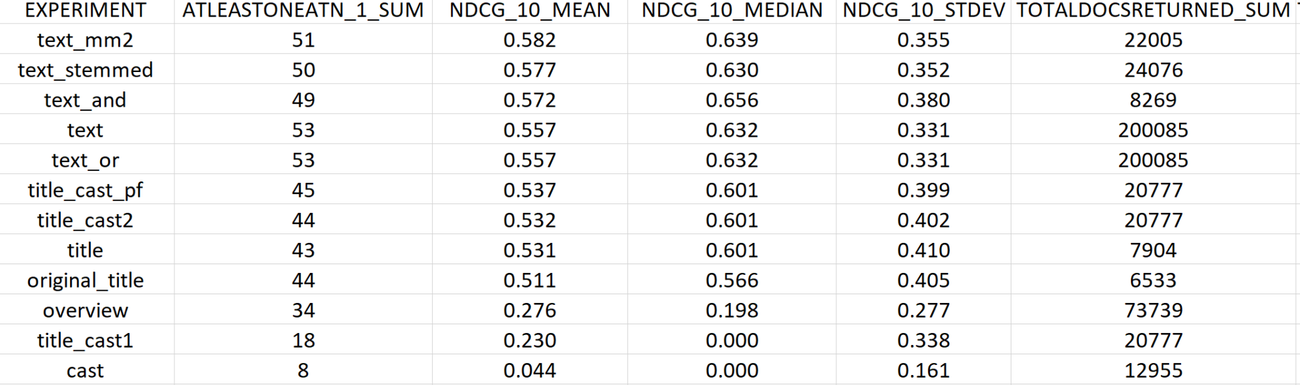
| 14 |
Output: Per Experiment Summary Analytics

Slide 28
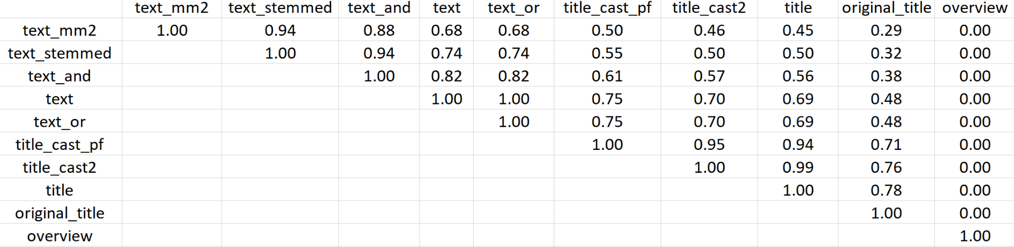
| 14 |
Output: Pairwise P-Value for Diffs in NDCG@10

Slide 29

| 14 |
Generation 1: Automatically Generate Experiments
If I know the parameters I want to experiment with, why should I have to specify the combinations?!
Different analyzer chains
Stubb’s
Risk of overfitting

Slide 30
| 14 |
Generation 1: Automatically Generate Experiments
If I know the parameters I want to experiment with, why should I have to specify the combinations?!
Different analyzer chains
field boosts and ranges
Stubb’s
Stubb’s
Stubb’s
Risk of overfitting

Slide 31

| 31 |
Generation 1a: Automatically Generate All Experiments (Brute Force/Grid Search)
If I know the parameters I want to experiment with, why should I have to specify the combinations?!
Different analyzer chains
field boosts and ranges
boolean/min should match
tie
best_fields, most_fields,
cross_fields, phrase
boost
Stubb’s
Stubb’s
Stubb’s
Stubb’s
Stubb’s
Stubb’s
Stubb’s
Stubb’s
Stubb’s
Risk of overfitting

Slide 32
| 31 |
Experiment Features – Scorers and FeatureFactories
{"scorers": [ { "class": "NDCG", "atN": 10
} ], "featureFactories": { "urls": [ "http://localhost:9200/tmdb" ], "query": { "multi_match": { …
} } }

Slide 33
| 31 |
Query Features – A Bit More Interesting
"query": { "edismax": { "qf": { "fields": [ "title", "overview", "cast" ], "defaultWeights": [ 0.0, 2.0, 10.0 ], "minSetSize": 1, "maxSetSize": 3 }, "tie": [0.0, 0.2, 0.8], "q.op": { "operators" : ["or", "and"], "mmInts" : [1,2,3] } } }
Generates
390 experiments!

Slide 34
| 31 |
Parameterizable Strings
"boost": [ "max(recip(ms(NOW/DAY, ds_field_last_modified), 3.16e-11,[1,2,3],[$1]),
[0.1, 0.9])" ],
"max(recip(ms(NOW/DAY, ds_field_last_modified), 3.16e-11,1,1), 0.1)"
"max(recip(ms(NOW/DAY, ds_field_last_modified), 3.16e-11,2,2), 0.1)"
…

Slide 35
| 31 |
Permutation explosion – Beware!
Number of Fields | Number of Experiments No Weights* | Number of Experiments Two Weights*
2 | 3 | 8
3 | 7 | 26
4 | 15 | 80
5 | 31 | 242
6 | 63 | 728
7 | 127 | 2,186
And, that’s just field weights!!!
The following are held constant: tie, operator, multi_match type, boost
*No Weights: a given field may or may not exist
*Two Weights: a given field may not be used or have one of two weights, e.g. text^2, text^10

Slide 36
| 36 |
Generation 1b: Automatically Generate Random Experiments (Random Search)
If I know the parameters I want to experiment with, how about running only SOME combinations?!
Different analyzer chains
field boosts and ranges
boolean/min should match
tie
best_fields, most_fields,
cross_fields, phrase
boost
Stubb’s
Stubb’s
Stubb’s
Stubb’s
Risk of overfitting

Slide 37

| 36 |
Generation 2: Genetic Algorithm
Perhaps I could improve on random search? At each generation, only let the top experiments into the next generation – mutate, crossover, random…repeat…
Different analyzer chains
field boosts and ranges
boolean/min should match
tie
best_fields, most_fields,
cross_fields, phrase
boost
Risk of overfitting

Slide 38
| 36 |
Genetic Algorithm Terms
Population
Generations
Operations
Random
Crossover
Mutate

Slide 39

| 36 |
Genetic Algorithm Basics
Generation 0
0.4
0.3
0.5
0.4
0.1
NDCG@10
Generation 1
0.25
0.4
0.5
0.4
0.3
Crossover
Mutate
Random
…
Generation X

Slide 40
| 36 |
Interlude: How Does this Differ from Learning to Rank (LTR)
Still need:
All the sound search engineering decisions (sane analysis chain, etc.)
Ground truth; good ground truth
Difference:
Learns settings for overall initial search, not a reranking function on (typically) a subset

Slide 41

| 36 |
Generation 2: Genetic Algorithm – Cross-fold Validation Built-in
Perhaps I could improve on random search? At each generation, only let the top experiments into the next generation – mutate, crossover, random…repeat…
Different analyzer chains
field boosts and ranges
boolean/min should match
tie
best_fields, most_fields,
cross_fields, phrase
boost
Cross-fold Validation
Risk of overfitting

Slide 42
| 36 |
N-Fold Cross-Validation
Fold 0
Fold 1
Fold 2
Fold 3
Testing
NDCG@10 0.45
Testing
NDCG@10 0.50
Testing
NDCG@10 0.47
Testing
NDCG@10 0.42
NDCG@10 Average Testing : 0.46
Training
Testing

Slide 43
| 36 |
Results Per Fold
FOLD 0 TRAINING
experiment 'train_fold_0_gen_4_exp_2': .678
experiment 'train_fold_0_gen_4_exp_7': .678
experiment 'train_fold_0_gen_0_exp_13': .662
experiment 'train_fold_0_gen_2_exp_13': .640
experiment 'train_fold_0_gen_2_exp_12': .640
experiment 'train_fold_0_gen_1_exp_3': .640
experiment 'train_fold_0_gen_3_exp_4': .640
experiment 'train_fold_0_gen_3_exp_7': .640
experiment 'train_fold_0_gen_3_exp_3': .640
experiment 'train_fold_0_gen_3_exp_2': .640
FOLD 0 TESTING
experiment 'test_fold_0_gen_4_exp_2': .552

Slide 44
| 36 |
Results: Overall, across folds
FINAL RESULTS ON TESTING:
experiment 'test_fold_2_gen_4_exp_1': .790
experiment 'test_fold_0_gen_4_exp_2': .552
experiment 'test_fold_1_gen_3_exp_6': .540
mean: .627
median: .552
stdev:.141

Slide 45
| 36 |
Initial Findings
The Good:
Boosted NDCG@10 from 0.25->0.3
The Bad:
Worse than baseline on huge parameter set with insufficient(?) generations
The Great:
I can spend more time on feature engineering/signal enrichment.

Slide 46
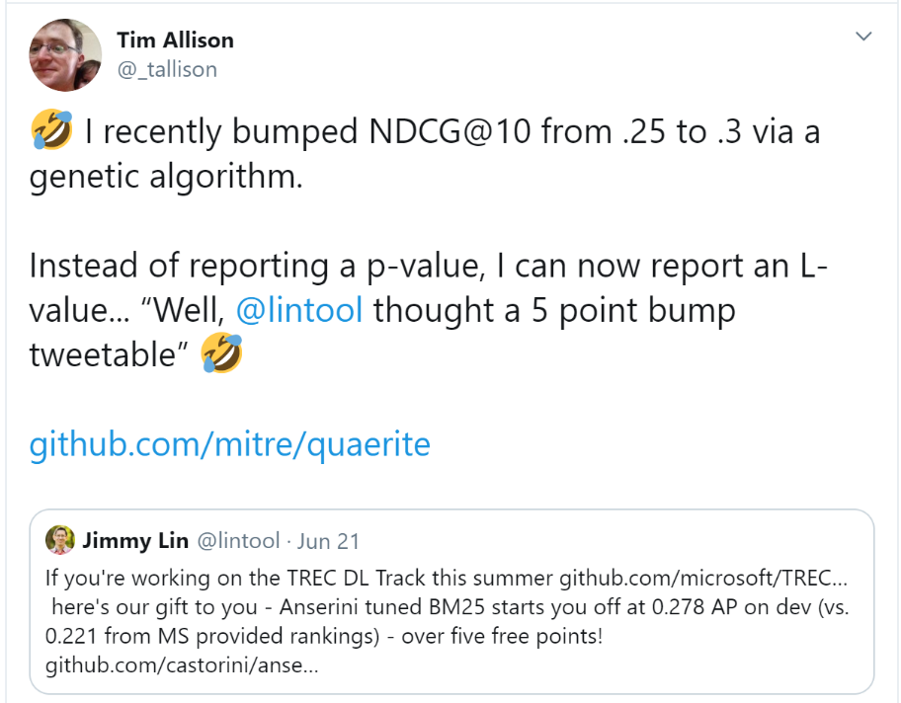

| <number> |
Initial Findings – L-Value

Slide 47
| 47 |
Next Steps
Documentation
Documentation
Documentation
Documentation
Documentation
Documentation
Documentation
Documentation
Documentation
Documentation
Documentation
Documentation

Slide 48
| 47 |
Next Steps
Documentation
Finalize (ish) API for 1.0.0 release
Add ground truth-free measures (overlap, rank correlation)
Add descriptors for features so that the results are somewhat interpretable
Bayesian optimization?!

Slide 49
| 47 |
Questions?
Quaerite
https://github.com/tballison/quaerite
https://github.com/tballison/quaerite/tree/master/quaerite-examples
Contact:
tallison@apache.org
@_tallison

Slide 50
| 47 |
Extras

Slide 51
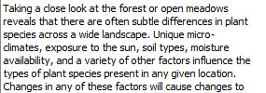
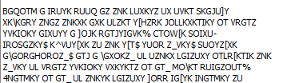
| <number> |
Corrupt Text (Upgrade from PDFBox 1.8.6->1.8.7)
Notes:
<number>

