Slide 1
Search Relevance Tuning Apache Roadshow DC – George Mason University
Tim Allison
25 March 2019
Approved for Public Release; Distribution Unlimited. Case Number 18-3138-4

Slide 2
Overview
About MITRE
About me
Open Source Projects
Enterprise Search Overview
Case Study – U.S. Courts intranet

Slide 3
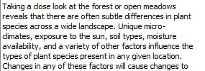
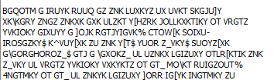
About Me
Chair Apache Tika
Committer/PMC Apache POI, Apache PDFBox
Committer Apache Lucene/Solr
Member Apache Software Foundation
Projects
SpanQueryParser
Concordance
Rhapsode
Quaerite
Upgrade from PDFBox 1.8.6->1.8.7

Slide 4

Magnifying Impact via Open Source
Open Source Code
Sponsor’s IT System
Sponsor’s Shop

Slide 5

Open Source: Land of the Free
http://www.writeonnewjersey.com/2011/03/if-its-free-its-for-me/

Slide 6
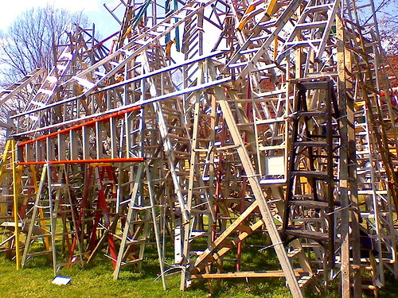
Home of the Brave
http://www.contractortalk.com/f59/ladder-safety-has-come-along-way-71332/

Slide 7
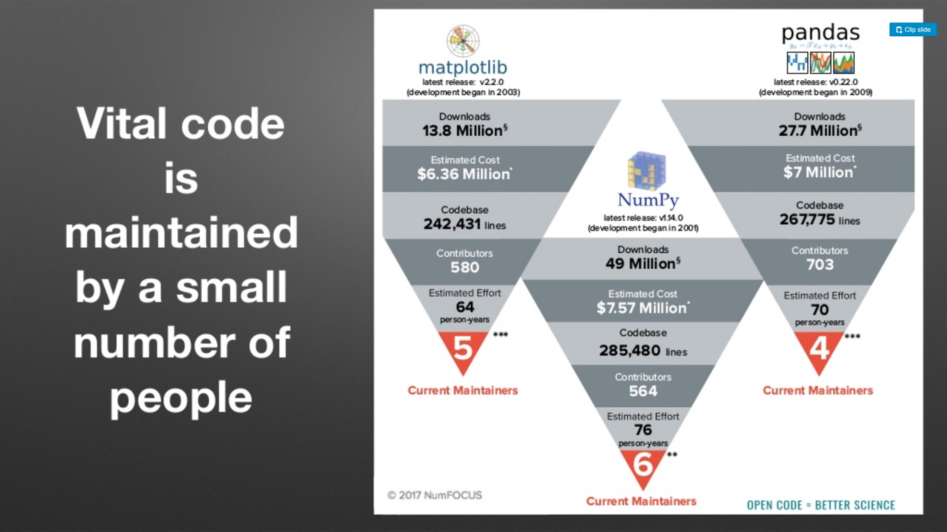
Grim Numeric Realities
Kelle Cruz. “Collaborations in the Extreme: The rise of open code development in the scientific community.” https://www.slideshare.net/KelleCruz/collaborations-in-the-extreme-the-rise-of-open-code-development-in-the-scientific-community

Slide 8
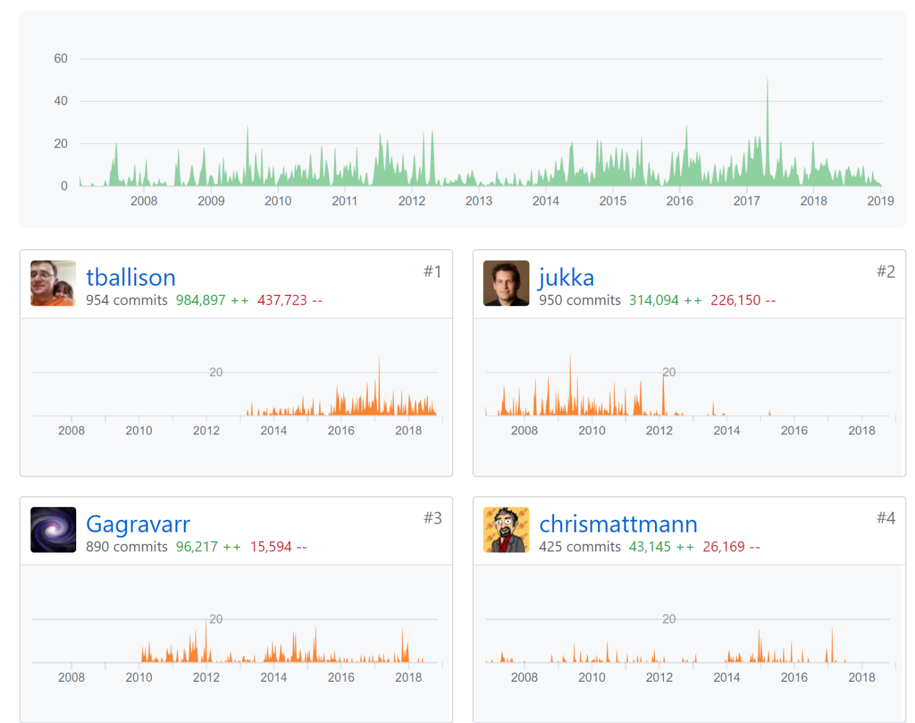
Apache Tika – Commits

Slide 9
How You Can Help – Not Just Code!
Identifying problems
Requesting new features
Code
Patches
Unit tests
New projects via incubator
Answering questions on user@, stackoverflow
Documentation – user’s guides, example code
Community – conference talks, conferences, meetups, training
Legal
Graphic Design – logos, etc.

Slide 10
Enterprise Search – How to Improve it
Google-level Expectations
The What
The How

Slide 11
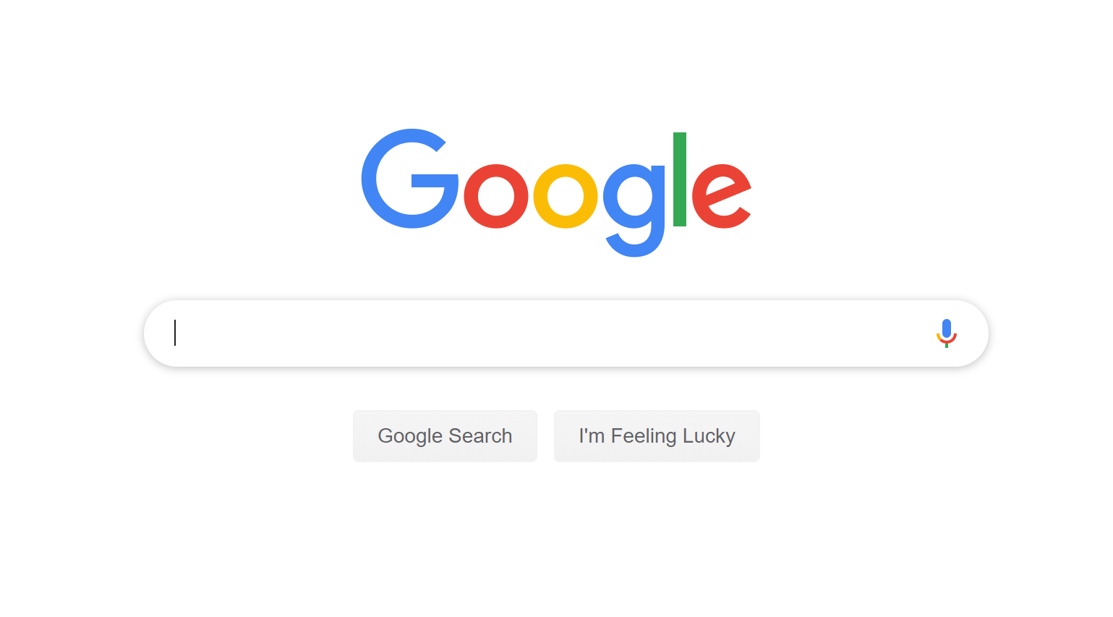
Search? That’s easy!

Slide 12
Enterprise/Intranet Search – Why Can’t it be like Google?!
Hyperlink structure (PageRank)
Web pages are carefully crafted by expert content producers to be found (Search Engine Optimization (SEO))
Higher proportion of Office/PDF documents
Sometimes profoundly different use cases – find the one document that answers my need vs. more exploratory types of search
Google’s revenue is $136 billion and they have ~20,000 engineers (White, 2015)
Notes:
*Need a reference

Slide 13
The What
Brief Technical Deep Dive on Search

Slide 14
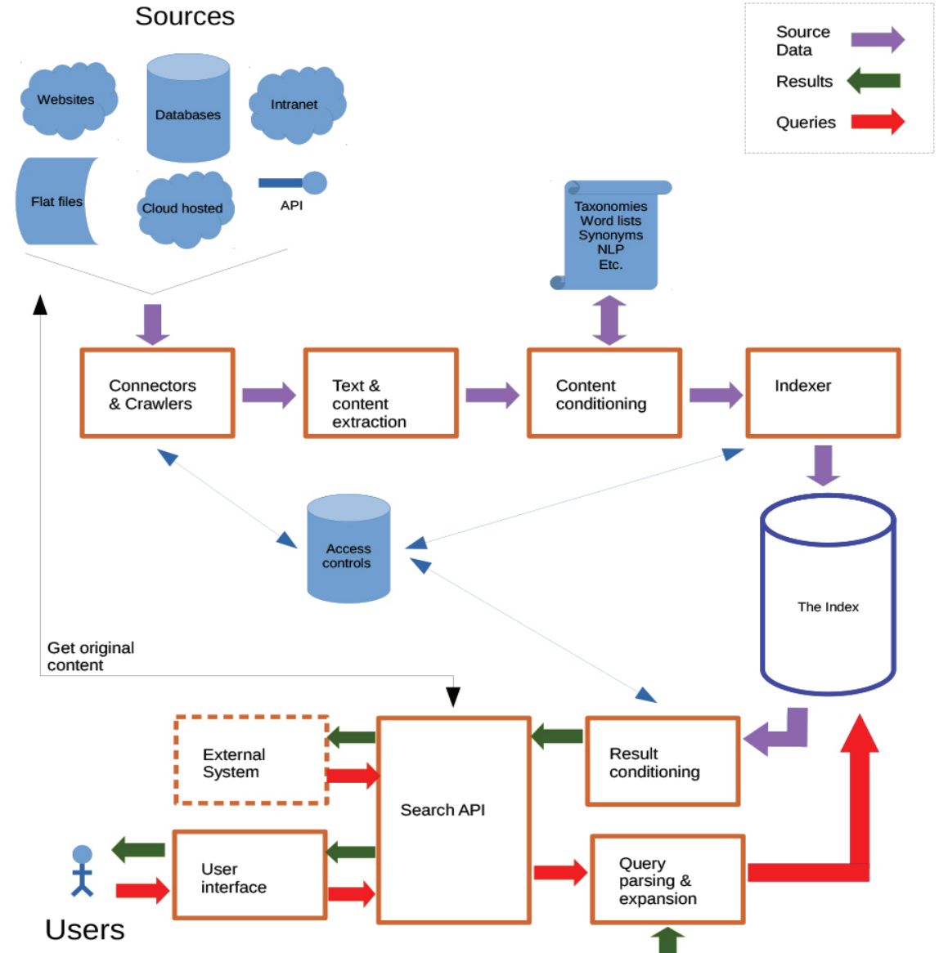
Search Engines – A Quick Overview
Martin White “The Technology of Search. Search Insights 2018, The Search Network. p. 9.
http://www.flax.co.uk/blog/2018/03/26/search-insights-2018-free-independent-report-search
Figure originally published in “Searching the Enterprise”, Foundations and Trends® in Information Retrieval

Slide 15
Example of Normalization for Search
Input Documents
Index
Queries
doc1
…nino…
…
Nino
nine: doc5, doc6
nino
nino: doc1, doc2,
doc3, doc4
nino
Niño
doc2
…Nino…
nintendo: doc7
nino
doc3
…niño…
…
niño
doc4
…Niño…

Slide 16
Example of Failure to Normalize for Search
Input Documents
Index
Queries
doc1
…nino…
Nino: doc2
Niño: doc4
Nino
…
Niño
doc2
…Nino…
nine: doc5, doc6
nino: doc1
nino
doc3
…niño…
nintendo: doc7
niño
…
doc4
…Niño…
niño : doc3
…

Slide 17
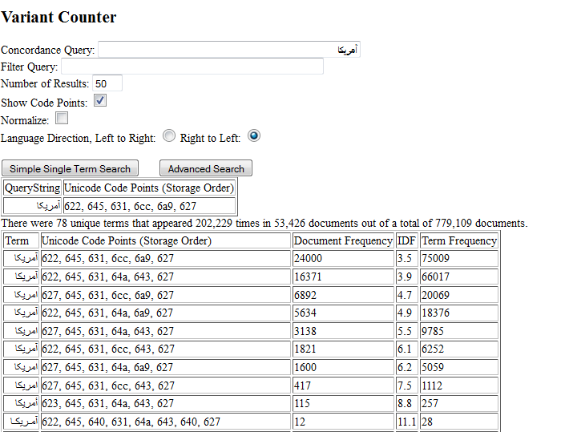
ICUFoldingFilter – Don’t leave خانه Without it!

Slide 18
When Search Goes Wrong
You don’t know what you can’t find

Slide 19
Available Parameters
14 tokenizers https://lucene.apache.org/solr/guide/7_1/tokenizers.html
~45 token filters (not including language-specific token filters – see next slide) https://lucene.apache.org/solr/guide/7_1/filter-descriptions.html
Query parsers
Field boosting
Phrasal boosting/shingling
Query operators, minimum should match, should, must, not
Token/field based scoring – best_fields, most_fields, cross_fields
Synonym lists, taxonomies
Similarity scoring parameters (with BM25)
Elevate
External signal enrichment
manual or automatic (NLP – entity extraction, categorization, etc.)
Reranking via machine learning (Learning to Rank)

Slide 20
Each Token Filter Can Have Many Parameters
<filter class="solr.WordDelimiterFilterFactory"
protected="protwords.txt"
generateWordParts="1"
generateNumberParts="1"
catenateWords="1"
catenateNumbers="1"
catenateAll="0"
splitOnCaseChange="0"
preserveOriginal="1"/>

Slide 21
On the one hand…on the other
On the one hand
This amount of precise control is great
On the other
Permutations are mind-boggling
Defaults were typically abysmal, but they are getting slightly better
On the third hand
The communities are amazingly responsive and helpful

Slide 22
In practice…
Open Source Search engines are toolkits, not a turn-key, finished product
Out-of-the-box settings may/may not be well suited for your use case…how many types of search are there?

Slide 23
The How

Slide 24
How to improve it?
One weird little acronym…
KPIs
Key Performance Indicators

Slide 25
But seriously…
Ground Truth Set(s) (Offline)
Queries and relevance judgments
Different sets to test/tune different user stories/personas
User Behavior (Online)
Conversions (?!)
Paging depth
Query reformulation
A/B testing
User Feedback
Questionnaires
Interviews
Focus Groups
Experimental comparisons – task based/think aloud protocol

Slide 26
Evaluation, in short…
Each point on the previous slide has entire academic departments/fields of studies/journals/books’ worth of research
Each point on the previous slide has costs and limitations
The answer:
Triangulate

Slide 27
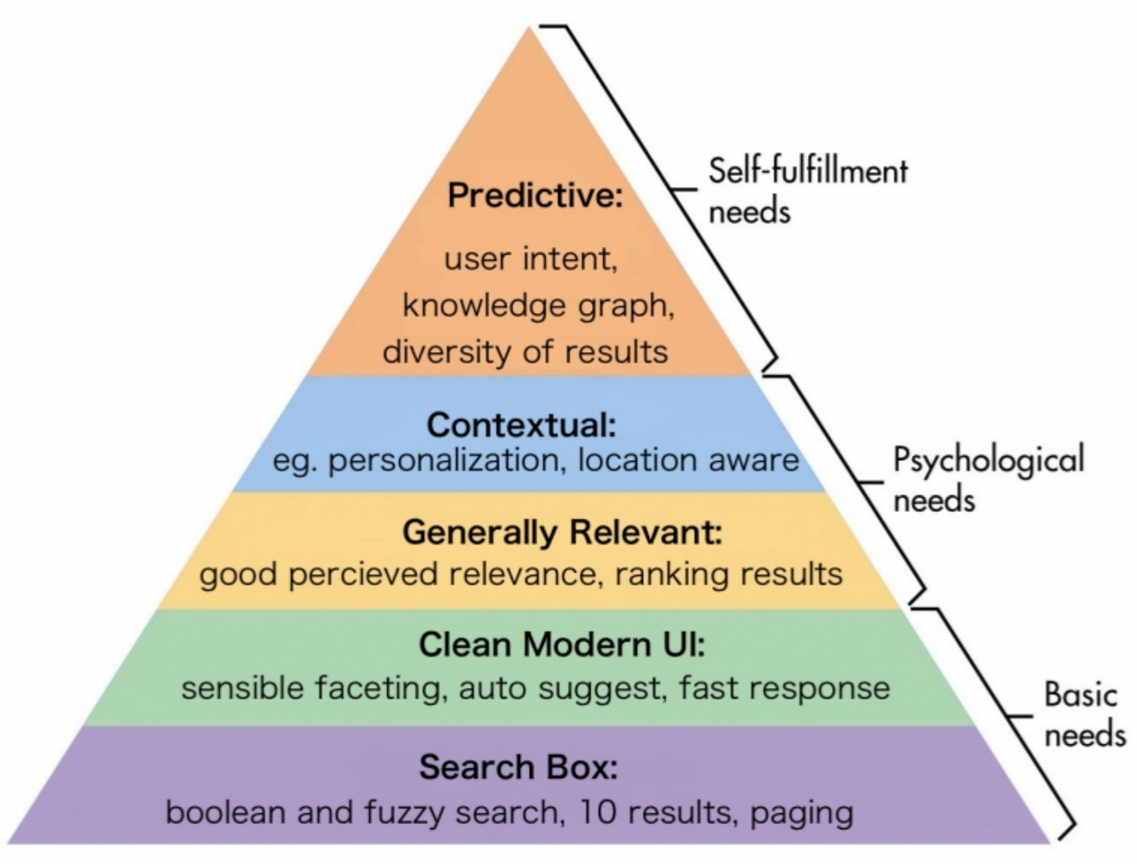
Eric Pugh’s Search Relevance Maturity Model
Ingest and Content and Metadata Extraction***:
Reliable text for searching
Eric Pugh, “Search Relevance Organizational Maturity Model” https://www.slideshare.net/lucidworks/search-relevance-organizational-maturity-model-eric-pugh-opensource-connections

Slide 28
Case Study

Slide 29
Case Study – Assessment, phase 1
Content Extraction (tika-eval)
Query log analysis
Technical analysis of configuration
Interviews
Client developed ground truth relevance set ~500 queries with relevance judgments

Slide 30
Case Study – Phase 1 Findings
Content extraction was working well
PDFs had mostly reliable text – no need for Optical Character Recognition (OCR)
50% failure rate on xls within zip files
Query log analysis
Limited use of facets, advanced query operators
Paging infrequent past first page of results
Technical analysis of search configuration – Tokenizer Chain
Drops single character tokens
Applies aggressive stemming
Does not strip out HTML markup
Analysis of metadata – numerous dates for older documents were inaccurate

Slide 31
Analyzer Chain Issues – Details
Dropping single character tokens
I 9
8 USC
September 6 2010
HTML Markup
One of the most common queries “pay tables” – any document with a version of “pay” and an HTML table – returning 4,540 pages instead of the correct 813
Aggressive Stemming
Query Counts officer ->
office 2669 | officer 2098 | officers 348 | offices 69 | officer's 10 | offic 5 | offical 3 | officers' 3
Document Counts
20,671 currently returned for any one of the above
10,372 documents that actually contain “officer” or “officers”
8,115 documents that actually contain “officers”
6,053 documents that actually contain “officer”

Slide 32
User feedback
Across numerous survey instruments:
Search is awful – too many irrelevant results, too many out of date results
Dates and recency emerged as a very common theme, after “too many irrelevant documents”

Slide 33
Phase 2
Fix basics and set up second/dev search system with new configurations
Develop ground truth set for offline experimentation
Create a new field “quick_hits” for content managers to add popular queries into documents’ metadata
Boost on popular document types
Fold in recency with relevance rankings
And going forward:
Continued experimentation
Outreach for feedback on new system
Establish a plan, policies and practice around the content lifecycle
Enlarging truth set with GoogleAnalytics data about user behavior

Slide 34
Evaluation Toolkit for Offline Experiments -- Quaerite
Run Experiments
Generate Experiments
Genetic Algorithm – to find best settings via xfold cross-validation given ground truth
Feature Finder
v1.0.0-ALPHA Available
https://github.com/mitre/quaerite
Releases
https://github.com/mitre/quaerite/releases
Examples:
https://github.com/mitre/quaerite/blob/master/quaerite-examples/README.md

Slide 35
Takeaways
Intranet/site search is not easy, but there are processes and tools – “relevance engineer” is a job/area of expertise
Open source is amazingly powerful, please join our communities and contribute!

Slide 36
References*
Relevance tools
RRE (Sease.io) -- https://github.com/SeaseLtd/rated-ranking-evaluator/wiki/Maven-Plugin
Quepid, splainer – https://quepid.com/
Quaerite – https://github.com/mitre/quaerite
Open Source Projects
Apache Lucene/Solr
Elasticsearch
Apache PDFBox
Apache POI
Apache Tika
Notes:
Need to add links

Slide 37
References
Personal Projects
Rhapsode – https://github.com/mitre/rhapsode
SpanQueryParser/Concordance – https://github.com/tballison/lucene-addons
Books
Kruschwitz, Udo and Charlie Hull. 2017. “Searching the Enterprise.”
Turnbull, Doug and John Berryman. 2016. “Relevant Search.”
White, Martin. 2015. “Enterprise Search: Enhancing Business Performance.”
Talks
Hostetter, Chris. “Hidden Gems of Apache Solr” https://www.youtube.com/watch?v=qTVi7eMGe1A
Ingersoll, Grant. “BM-25 is so Yesterday”: https://www.youtube.com/watch?v=nA8dqw03m48

Slide 38
Contact Info
tallison@mitre.org
tallison@apache.org
@_tallison
https://github.com/tballison

