Slide 1
(R)Evolving Relevance Tuning with Genetic Algorithms
Tim Allison
Activate Conference 2019
Washington, DC
September 12, 2019
Approved for Public Release;
Distribution Unlimited.
Case Number 18-3138-12
© 2019 The MITRE Corporation. ALL RIGHTS RESERVED.

Slide 2
About me
Chair/V.P. Apache Tika
Committer/PMC Apache PDFBox
Committer/PMC Apache POI
Committer Apache Lucene/Solr
Member ASF
Ph.D. Classical Studies

Slide 3
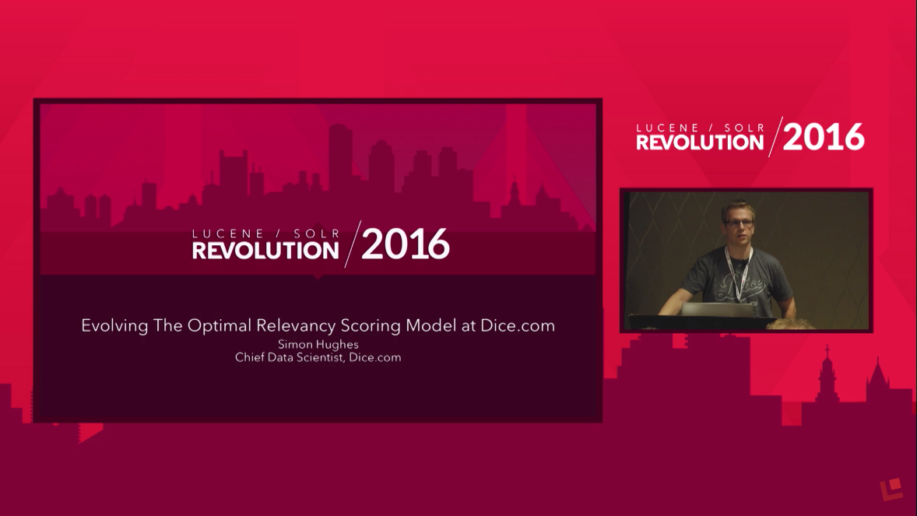
Hat Tip – Simon Hughes
Simon Hughes “Evolving The Optimal Relevancy Scoring Model at Dice.com”
https://www.youtube.com/watch?v=z4c1xU7arhc
https://github.com/DiceTechJobs/RelevancyTuning

Slide 4
Some Open Source Relevance Tools
Quaerite (focus of this talk): https://github.com/mitre/quaerite
Quepid (Open Source Connections): https://github.com/o19s/quepid
Rated Ranking Evaluator RRE (Sease Ltd): https://github.com/SeaseLtd/rated-ranking-evaluator
Others?!

Slide 5
Outline
Introduction/Motivation
Evolution of methods
Generation 0
Generation 1
Generation 2
Findings
Next Steps

Slide 6
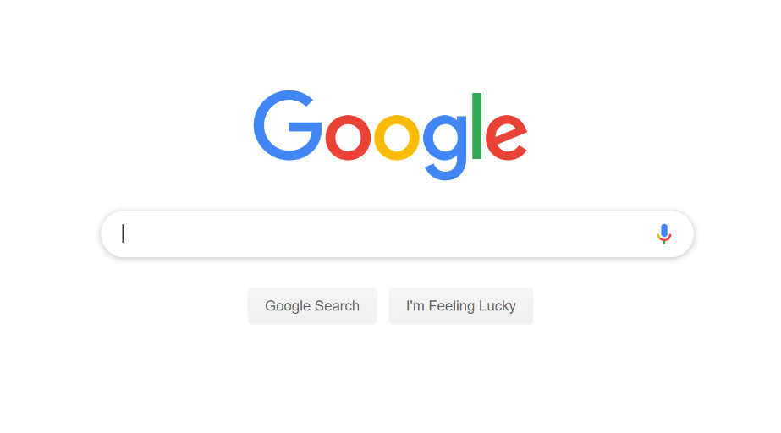
Search is easy!

Slide 7
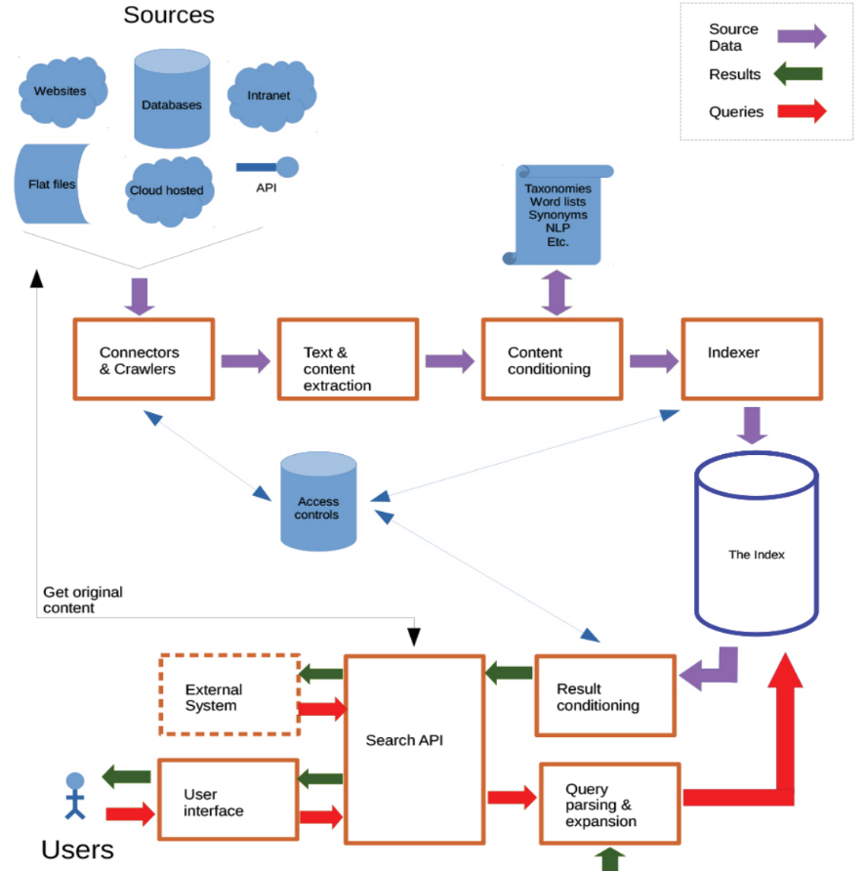
Search Engines – A Quick Overview
Martin White “The Technology of Search. Search Insights 2018, The Search Network. p. 9.
http://www.flax.co.uk/blog/2018/03/26/search-insights-2018-free-independent-report-search
Figure originally published in “Searching the Enterprise”, Foundations and Trends® in Information Retrieval

Slide 8
Available Parameters
14 tokenizers https://lucene.apache.org/solr/guide/7_1/tokenizers.html
~45 token filters (not including language-specific token filters – see next slide) https://lucene.apache.org/solr/guide/7_1/filter-descriptions.html
Query parsers
Boosting: fields, queries, functions
Phrasal boosting/shingling
Query operators, minimum should match, should, must, not
Token/field based scoring – best_fields, most_fields, cross_fields
Synonym lists, taxonomies
Similarity scoring parameters (with BM25)
Elevate
External signal enrichment
manual or automatic (NLP – entity extraction, categorization, etc.)
Reranking via machine learning (Learning to Rank)

Slide 9
Each Token Filter Can Have Many Parameters
<filter class="solr.WordDelimiterFilterFactory"
protected="protwords.txt"
generateWordParts="1"
generateNumberParts="1"
catenateWords="1"
catenateNumbers="1"
catenateAll="0"
splitOnCaseChange="0"
preserveOriginal="1"/>

Slide 10
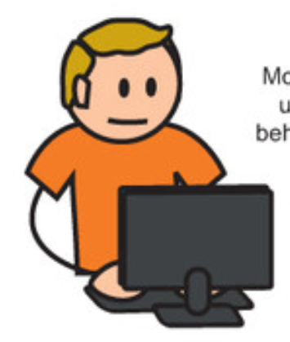
What to do, what to do…
“Relevant Search
With applications for Solr and Elasticsearch”
Doug Turnbull and John Berryman
https://www.manning.com/books/relevant-search
Thank you, Doug Turnbull and John Berryman
for permission to use the search engineer in this talk!

Slide 11
Ground-truth based relevance tuning
Requires ground truth
Good ground truth
Overfitting…be careful!
Please use responsible train/test splits
LOL: https://www.gwern.net/Tanks

Slide 12
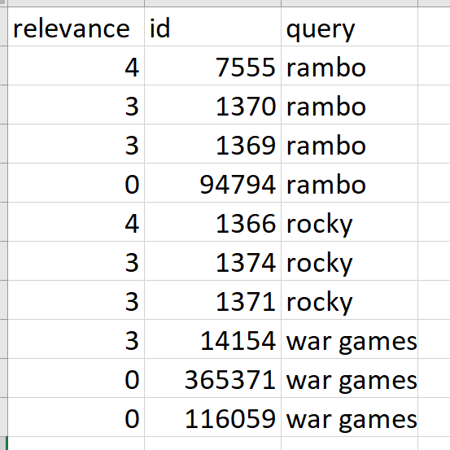
Example Ground Truth
Thank you, Doug Turnbull, John Berryman and “Open Source Connections” for the inspiration for using tmdb and for generating and sharing a ground truth set!

Slide 13
Generation 0: Run Some Experiments
Assuming a static corpus, results should be reproducible
Keep track of previous experiments
Allow standard output and flexibility of scoring metrics
Risk of overfitting

Slide 14
Key components for running experiments
{ "scorers": [ ], "experiments": { } }

Slide 15
Basic Experiment Configuration: Scorers and Experiments
{ "scorers": [ { "class": "NDCG", "atN": 10, "params": { "useForTrain": true, "useForTest": true, "exportPMatrix": true }, … ],
"experiments": { "title": { "searchServerUrl": "http://.../solr/tmdb", "query": { "edismax": { "qf": [ "title" ] } } }, …
}
}

Slide 16
Scorers – More Scorers
"class": "NDCG", "atN": 10, "params": { "useForTrain": true, "useForTest": true, "exportPMatrix": true } }, { "class": "TotalDocsReturned" }, { "class": "ZeroResults" } ]
"scorers": [ { "class": "AtLeastOneAtN", "atN": 1 }, { "class": "AtLeastOneAtN", "atN": 5 }, { "class": "AtLeastOneAtN", "atN": 10 },

Slide 17
Experiments – A Slightly More Interesting Experiment
"title_cast_pf_tie_0_8_mm2": { "searchServerUrl": "http://localhost:8983/solr/tmdb", "query": { "edismax": { "qf": [ "title^10", "cast^2" ], "tie" : 0.8, "pf": [ "title^10", "cast^2" ], "q.op": { "mm": "2" }}}}

Slide 18
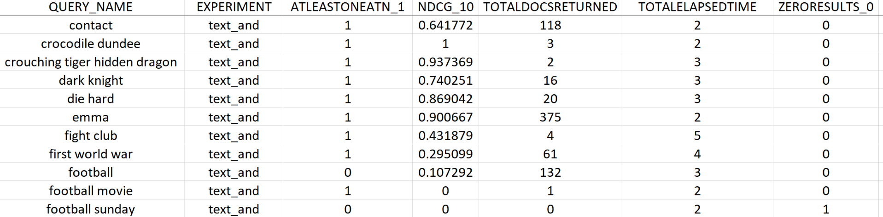
Output: Per Query/Per Experiment Scores

Slide 19
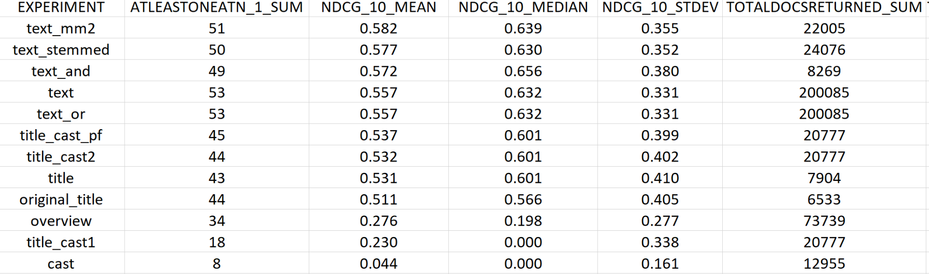
Output: Per Experiment Summary Analytics

Slide 20
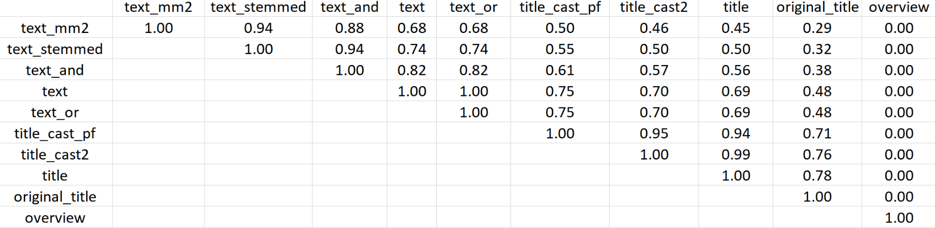
Output: Pairwise P-Value for Diffs in NDCG@10

Slide 21
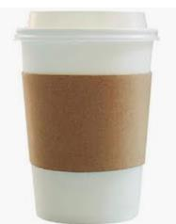
Generation 1: Automatically Generate Experiments
If I know the parameters I want to experiment with, why should I have to specify the combinations?!
Different analyzer chains
Stubb’s
Risk of overfitting

Slide 22
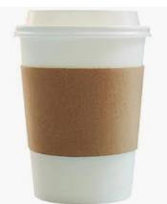
Generation 1: Automatically Generate Experiments
If I know the parameters I want to experiment with, why should I have to specify the combinations?!
Different analyzer chains
field boosts and ranges
Stubb’s
Stubb’s
Stubb’s
Risk of overfitting

Slide 23

Generation 1a: Automatically Generate All Experiments (Brute Force/Grid Search)
If I know the parameters I want to experiment with, why should I have to specify the combinations?!
Different analyzer chains
field boosts and ranges
boolean/min should match
tie
pf, pf2, pf3, ps, ps2, ps3
bq, boost
Stubb’s
Stubb’s
Stubb’s
Stubb’s
Stubb’s
Stubb’s
Stubb’s
Stubb’s
Stubb’s
Risk of overfitting

Slide 24
Experiment Features – Scorers and FeatureFactories
{"scorers": [ { "class": "NDCG", "atN": 10
} ], "featureFactories": { "urls": [ "http://localhost:8983/solr/tmdb" ], "query": { "edismax": { …
} } }

Slide 25
Query Features – A Bit More Interesting
"query": { "edismax": { "qf": { "fields": [ "title", "overview", "cast" ], "defaultWeights": [ 0.0, 2.0, 10.0 ], "minSetSize": 1, "maxSetSize": 3 }, "tie": [0.0, 0.2, 0.8], "q.op": { "operators" : ["or", "and"], "mmInts" : [1,2,3] } } }
Generates
390 experiments!

Slide 26
Parameterizable Strings
"boost": [ "max(recip(ms(NOW/DAY, ds_field_last_modified), 3.16e-11,[1,2,3],[$1]),
[0.1, 0.9])" ],
"max(recip(ms(NOW/DAY, ds_field_last_modified), 3.16e-11,1,1), 0.1)"
"max(recip(ms(NOW/DAY, ds_field_last_modified), 3.16e-11,2,2), 0.1)"
…

Slide 27
Permutation explosion – Beware!
Number of Fields | Number of Experiments No Weights* | Number of Experiments Two Weights*
2 | 3 | 8
3 | 7 | 26
4 | 15 | 80
5 | 31 | 242
6 | 63 | 728
7 | 127 | 2,186
And, that’s just field weights!!!
The following are held constant: tie, operator, pf, pf2, ps, ps2, bq, boost
*No Weights: a given field may or may not exist
*Two Weights: a given field may not be used or have one of two weights, e.g. text^2, text^10

Slide 28
Generation 1b: Automatically Generate Random Experiments (Random Search)
If I know the parameters I want to experiment with, how about running only SOME combinations?!
Different analyzer chains
field boosts and ranges
boolean/min should match
tie
pf, pf2, pf3, ps, ps2, ps3
bq, boost
Stubb’s
Stubb’s
Stubb’s
Stubb’s
Stubb’s
Risk of overfitting

Slide 29
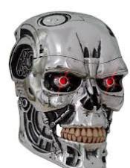
Generation 2: Genetic Algorithm
Perhaps I could improve on random search? At each generation, only let the top experiments into the next generation – mutate, crossover, random…repeat…
Different analyzer chains
field boosts and ranges
boolean/min should match
tie
pf, pf2, pf3, ps, ps2, ps3
bq, boost
Risk of overfitting

Slide 30
Genetic Algorithm Terms
Population
Generations
Operations
Random
Crossover
Mutate

Slide 31

Genetic Algorithm Basics
Generation 0
0.4
0.3
0.5
0.4
0.1
NDCG@10
Generation 1
0.25
0.4
0.5
0.4
0.3
Crossover
Mutate
Random
…
Generation X

Slide 32
Interlude: How Does this Differ from Learning to Rank (LTR)
Still need:
All the sound search engineering decisions (sane analysis chain, etc.)
Ground truth; good ground truth
Difference:
Learns settings for overall initial search, not a reranking function on (typically) a subset

Slide 33

Generation 2: Genetic Algorithm – Cross-fold Validation Built-in
Perhaps I could improve on random search? At each generation, only let the top experiments into the next generation – mutate, crossover, random…repeat…
Different analyzer chains
field boosts and ranges
boolean/min should match
tie
pf, pf2, pf3, ps, ps2, ps3
bq, boost
Cross-fold Validation
Risk of overfitting

Slide 34
N-Fold Cross-Validation
Fold 0
Fold 1
Fold 2
Fold 3
Testing
NDCG@10 0.45
Testing
NDCG@10 0.50
Testing
NDCG@10 0.47
Testing
NDCG@10 0.42
NDCG@10 Average Testing : 0.46
Training
Testing

Slide 35
Results Per Fold
FOLD 0 TRAINING
experiment 'train_fold_0_gen_4_exp_2': .678
experiment 'train_fold_0_gen_4_exp_7': .678
experiment 'train_fold_0_gen_0_exp_13': .662
experiment 'train_fold_0_gen_2_exp_13': .640
experiment 'train_fold_0_gen_2_exp_12': .640
experiment 'train_fold_0_gen_1_exp_3': .640
experiment 'train_fold_0_gen_3_exp_4': .640
experiment 'train_fold_0_gen_3_exp_7': .640
experiment 'train_fold_0_gen_3_exp_3': .640
experiment 'train_fold_0_gen_3_exp_2': .640
FOLD 0 TESTING
experiment 'test_fold_0_gen_4_exp_2': .552

Slide 36
Results: Overall, across folds
FINAL RESULTS ON TESTING:
experiment 'test_fold_2_gen_4_exp_1': .790
experiment 'test_fold_0_gen_4_exp_2': .552
experiment 'test_fold_1_gen_3_exp_6': .540
mean: .627
median: .552
stdev:.141

Slide 37
Initial Findings
The Good:
Boosted NDCG@10 from 0.25->0.3
The Bad:
Worse than baseline on huge parameter set with insufficient(?) generations
The Great:
I can spend more time on feature engineering/signal enrichment.

Slide 38
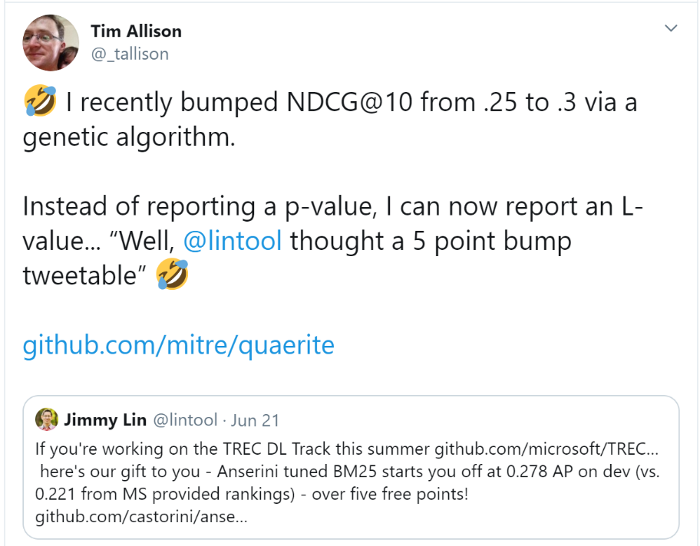

Initial Findings – L-Value

Slide 39
Next Steps
Documentation
Documentation
Documentation
Documentation
Documentation
Documentation
Documentation
Documentation
Documentation
Documentation
Documentation
Documentation

Slide 40
Next Steps
Documentation
Finalize (ish) API for 1.0.0 release
Add ground truth-free measures (overlap, rank correlation)
Add descriptors for features so that the results are somewhat interpretable
Bayesian optimization?!

Slide 41
Questions?
Quaerite
https://github.com/mitre/quaerite
https://github.com/mitre/quaerite/blob/master/quaerite-examples/README.md
Contact:
tallison@apache.org
@_tallison

Slide 42
Stubb’s

Slide 43
On the one hand…on the other
On the one hand
This amount of precise control is great
On the other
Permutations are mind-boggling
Defaults used to be abysmal, but they are much better now…generally
On the third hand
The lists and commercial support are amazingly responsive and helpful

Slide 44
Debts of Gratitude
David Smiley
Nick Burch
Chris Mattmann
Tilman Hausherr
Dominik Stadler
Fellow devs:
Apache Lucene/Solr, Apache Commons, Apache POI, Apache PDFBox, Apache Tika
ASF Community and users!
Common Crawl and govdocs1
Rackspace
© 2019 The MITRE Corporation. ALL RIGHTS RESERVED.

Slide 45
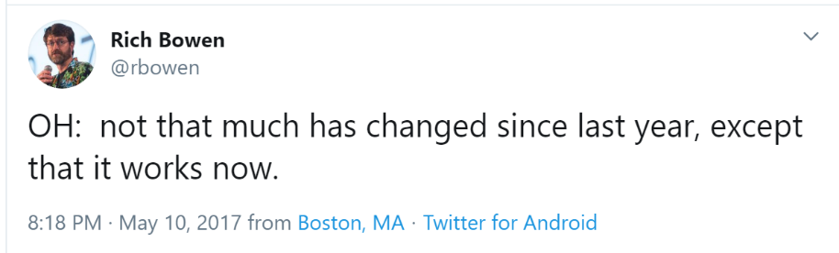

Overview
Intro to Tika: content and metadata extraction in the ETL stack
Motivation for tika-eval: what can go wrong?
tika-eval overview and workflow – single vm
tika-eval at scale
ApacheCon 2017
ApacheCon 2019

Slide 46



Content Extraction and HLT
Search:
“Arnold Schwarzenegger”~2
Entity Extraction:
أرنولد ألويس شوارزنيجر
(ولد في 8 أغسطس 1947، في ستيريا، النمسا)
Traditional Human Language Technologies
Machine Translation: Arnold Alois Schwarzenegger (born August 8, 1947, in Styria, Austria)
Search:
2~“أرنولد شوارزنيجر”
Text
أرنولد ألويس شوارزنيجر (ولد في 8 أغسطس 1947، في ستيريا، النمسا)
Content Extraction
=
1001010010010010001001010100101001101011111101010101011011011101101110110101110110110111011011110110110110110111111000000110101000000110010000011010010010
Bytes
Notes:
Machine translation via Google translate
Text retrieved from https://ar.wikipedia.org/wiki/%D8%A3%D8%B1%D9%86%D9%88%D9%84%D8%AF_%D8%B4%D9%88%D8%A7%D8%B1%D8%B2%D9%86%D9%8A%D8%AC%D8%B1 on 2/1/2017

Slide 47
High Level Components of a Media Processing Stack
User Interface
Search/Entity Extraction/MT, etc.
Text Extraction and Metadata Extraction
Files
Structured
Data-store
Forensics:
Carving and Advanced Methods

Slide 48
Let’s not forget Metadata!
Various formats store useful information
Who: author (first, last, commenters, editors), digital signature, company, from/to/cc/bcc (emails)
What: hardware version/name, software version/name, globally unique file/heritage id (XMP), title, keywords, description
Where: geo (latitude, longitude), file location (file paths embedded inside documents)
When: created, last modified, last printed
Beyond the standard types…custom metadata

Slide 49
When Things Go Wrong with Text Extraction
Example Application: Search
© 2019 The MITRE Corporation. ALL RIGHTS RESERVED.

Slide 50
What the User Sees in a Search System
User Interface
Indexer/ Search System
Content/ Metadata Extraction
Structured
Data-store

Slide 51
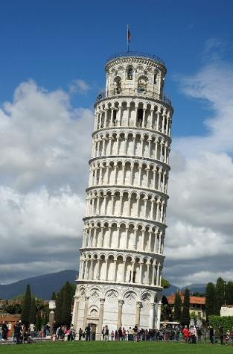
When Things Go Wrong with a Foundation
W. Lloyd MacKenzie, via Flickr @http://www.flickr.com/photos/saffron_blaze/
Notes:
Image from: http://upload.wikimedia.org/wikipedia/commons/6/66/The_Leaning_Tower_of_Pisa_SB.jpeg
Permission details
Outside of Wikimedia Foundation projects, attribution is to be made to: W. Lloyd MacKenzie, via Flickr @http://www.flickr.com/photos/saffron_blaze/

Slide 52
What can go wrong? Basic problems: thrown exceptions
Parser has a problem with non-corrupt file (and admits it…thank you!!!)
Password/access protected files
Format version not handled (add new parser?)
Corrupt files – can’t be opened by primary application or parsed by other parsers
Corrupt files – slight variant from spec/other parsers can handle it
Truncated files
Note: some text/metadata may or may not be extracted before the exception is thrown

Slide 53
What can go wrong? Catastrophic problems
OutOfMemoryError – potentially corrupting the JVM
Inefficient parsers DOM vs SAX on rare docx (TIKA-2170) and pptx (TIKA-2201). NOTE: with multithreaded garbage collection, a single thread running Tika can cause a quad-core system to grind to a snail’s pace before hitting OOM.
Four bytes of a compressed file (TIKA-2330)
Slowly building memory leak
See above on quad-core, gc and snails (TIKA-2180?)
Permanent Hang
TIKA-1132
Security Vulnerabilities
XXE (CVE-2016-4334), arbitrary code execution (CVE-2016-6809)
These are extremely rare, and we try to fix them when we’re aware of them!

Slide 54
What can go wrong? Hidden problems (no exceptions!)…
Garbled text
From slightly to…fully
Missing text/metadata
From missing some text to … no text at all
Missing attachments
Silently swallowed exceptions of embedded documents
Classic Tika xhtml silently swallows embedded exceptions!!!

Slide 55
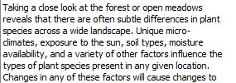
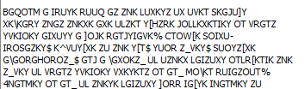
Corrupt Text (Upgrade from PDFBox 1.8.6->1.8.7)

Slide 56

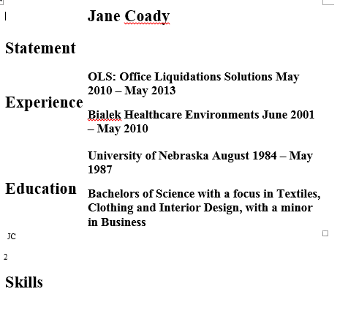
Missing Text (TIKA-1130)
Document available: https://issues.apache.org/jira/browse/TIKA-1130

Slide 57
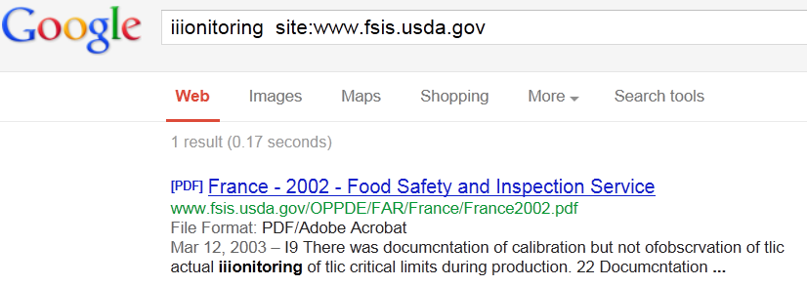
When Things Go Not as Well as They Might with Content Extraction – OCR
Image:
Text Extracted:
I9 There was documcntation of calibration but not ofobscrvation of tlic actual iiionitoring of tlic critical limits during production.
Search Results:

Slide 58
Take-away #1
If you don’t evaluate content extraction…
You don’t know what you can’t find

Slide 59
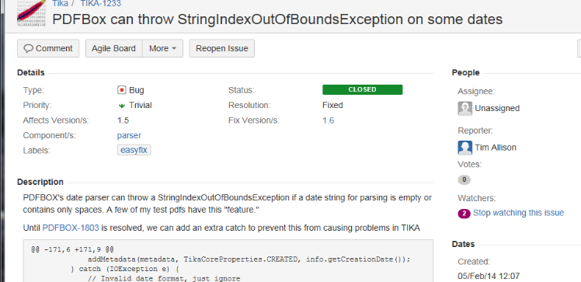

Take-away #2
A small problem for me can be a big problem for you!

Slide 60
TIKA-1302: The Dream
Motivation
All of the above
We have only roughly 1,000 test files in unit tests in Apache POI, Apache PDFBox and Apache Tika
Apache POI/PDFBox/Tika mistakenly made me a committer
Run Tika on much larger corpus nightly/weekly
Automatically recognize regressions

Slide 61
tika-eval
Available since Apache Tika 1.15
© 2019 The MITRE Corporation. ALL RIGHTS RESERVED.

Slide 62
High-level overview
tika-eval’s scope
Single vm, file share to file share (with embedded H2 db), ~few million files is a reasonable size
Not currently cloud-scale
Random sampling – should be good enough
Our Jira is open and committers are standing by!
tika-eval’s two modes
Profile single extraction run
Compare two extraction runs
Ground truth vs. particular tool
Tool A vs. tool B
Tool A with settings X vs. Tool A with settings Y

Slide 63
Definitions
“original documents” or “container documents” – the original binary documents from which you’d like to extract text, whether or not they actually have attachments.
“embedded documents” – any document contained within another document, including those that only ever exist as embedded docs: emf/wmf/xmp/xfa.
“extract” – .txt or .json representation of the extracted text/metadata.
tika-eval was designed for .json
RecursiveParserWrapper via API
(-J) for tika-app
/rmeta for tika-server
tika-eval can handle .txt files – details on our wiki

Slide 64
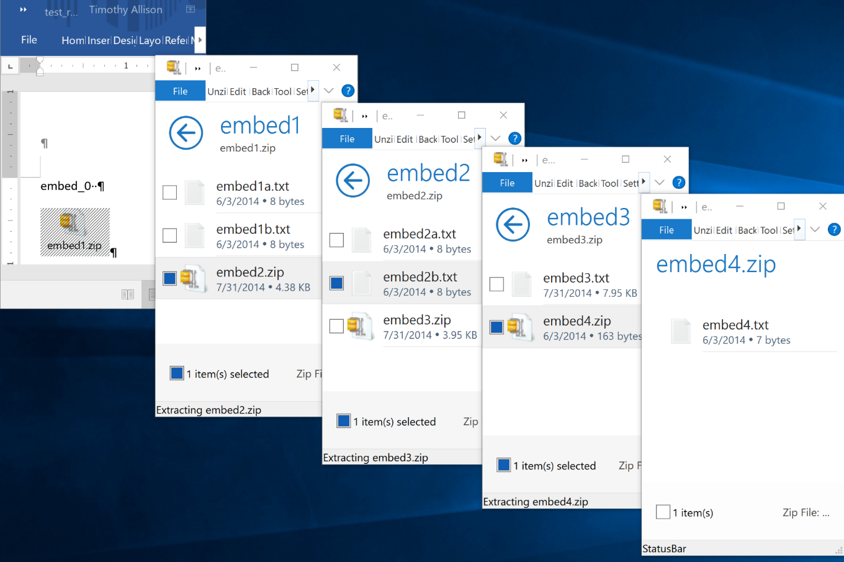
Why the RecursiveParserWrapper?

Slide 65
Classic XHTML
<?xml version="1.0" encoding="UTF-8"?>
<meta name="Content-Type" .../>
…
<p>embed_0 </p>
<p><div class="embedded" id="rId7"/>
<p>embed1.zip</p>
<div class="embedded" id="embed1/embed1a.txt"/>
<div class="package-entry">
<p>embed_1a</p>
</div>
...
Metadata from embedded docs is lost
Exceptions from embedded docs are swallowed
Metadata from the container document may be incomplete

Slide 66
RecursiveParserWrapper
[
{
"Application-Name": "Microsoft Office Word",
"Content-Length": "27082",
"Content-Type": "application/....wordprocessingml.document",
"X-TIKA:content": "embed_0 ",
...
},
{
"Content-Type": "text/plain; charset=ISO-8859-1",
"Last-Modified": "2014-06-04T04:08:28Z",
"X-TIKA:content": "embed_1a",
"X-TIKA:embedded_resource_path": "/embed1.zip/embed1a.txt",
...
},
{
"Content-Type": "application/zip",
"Last-Modified": "2014-06-04T04:09:40Z",
"X-TIKA:content": "embed4.txt",
"X-TIKA:embedded_resource_path": "/embed1.zip/embed2.zip/embed3.zip/embed4.zip"
...
}, ...]
Embedded metadata (e.g. mime/author/lat-long, etc.) are retained
Embedded exceptions are stored in a metadata key
All metadata is extracted stored

Slide 67
Workflow – Profile
Generate extracts with parallel directory structure to original documents, append “.txt” or “.json” into, say my_extracts directory
Run profiler to populate in-process H2 DB
java –jar tika-eval.jar Profile
–extracts my_extracts
–db my_db
Dump reports
java –jar tika-eval.jar Report –db my_db
Excel reports will be dumped to the reports directory

Slide 68
Workflow – Compare
Generate extracts with parallel directory structure to original documents, append “.txt” or “.json” into, say my_extractsA and my_extractsB directories
Run profiler to populate in-process H2 DB
java –jar tika-eval.jar Compare
–extractsA my_extractsA
–extractsB my_extractsB
–db my_db
Dump reports
java –jar tika-eval.jar Report –db my_db
Excel reports will be dumped to the reports directory

Slide 69
Workflow – StartDB
Start db:
java –jar tika-eval.jar StartDB
Open browser to localhost:8082
Select db (full path!):
jdbc:h2:/C:/data/my_db
Notes on db structure: https://wiki.apache.org/tika/TikaEvalDbDesign

Slide 70
Reports (Profile)
Metadata – count of metadata values
Attachments – counts
Mimes – mime counts for containers and embedded docs
Exceptions
Counts by type (e.g. password vs. actual exception)
Counts by mime
Counts by normalized stacktrace
All stack traces
Content
Language id
Word count
Common words count
Word length stats
Page count

Slide 71
Reports (Compare)*
Metadata – comparison counts A to B
Attachments – comparison counts A to B
Mimes
Comparison mime counts for containers and embedded docs
Counts of mime changes mimeA->mimeB
Exceptions
Comparisons of counts by mime
Counts by mime
Counts by normalized stacktrace
All stack traces
Content
Language id
Word count
Word length stats
Page count
Includes Profile data for both A and B and then also some comparison reports

Slide 72
Content – “Common words” and their Utility in Profile
Top 30k most common words per language* in Leipzig Corpus**
To find PDFs that are mostly image only:
number of words/number of pages
To find very corrupt text***:
“In vocabulary %”:(number of common words/number of alphabetic words)
“Out of vocabulary (OOV)%”: 1-“in vocabulary %”
* Many thanks, Apache Lucene!
** http://wortschatz.uni-leipzig.de/en/download/ and Apache OpenNLP’s: https://svn.apache.org/repos/bigdata/opennlp/
*** Metric was recommended by Tilman Hausherr

Slide 73
Content comparisons
Similarity metrics between A and B
how many words in common/total number of words (with counts normalized to 0/1 per doc)
how many words in common/total number of words (with actual counts)
Improvement in “common words”
number of Common Words in B – number of Common Words in A
Per mime

Slide 74
Content Comparison Example – Junk -> Better
 | Tika 1.14 | Tika 1.15-SNAPSHOT
Unique Tokens | 786 | 156
Total Tokens | 1603 | 272
LangId | zh-ch | de
Common Words | 0 | 116
Alphabetic Tokens | 1603 | 250
Top N Tokens | 捳敨: 18 | 獴档: 14 | 略獴: 14 | m: 11 | 杮湥: 11 | 瑵捳: 11 | 畬杮: 11 | 档湥: 10 | 搠敩: 9 | 敮浨: 9 | die: 11 | und: 8 | von: 8 | deutschen: 7 | deutsche: 6 | 1: 5 | das: 5 | der: 5 | finanzministerium: 5 | oder: 5
OOV% | 1-(0/1603) = 100% | 1-(116/250) = 54%
Overlap: 0%
Increase in Common Words: 116

Slide 75
Content Comparison Example – Small Regression
 | Tika 1.14 | Tika 1.15-SNAPSHOT
Unique Tokens | 1916 | 1995
Total Tokens | 14187 | 14302
LangId | en | en
Common Words | 7498 | 7409
Alphabetic Tokens | 13472 | 13587
Top 10 Unique Tokens | applicant's: 8 | 1.69: 1 | arbitrary: 1 | collecting: 1 | constitution: 1 | e112: 1 | ei.b: 1 | equating: 1 | magnetically: 1 | o: 1 | ss: 106 | applicantis: 8 | ssss: 7 | iactsi: 4 | ithe: 4 | imeansi: 3 | iprocessi: 3 | calculations.i: 2 | iabstract: 2 | idata: 2
OOV% | 1-(7498/13472) = 44% | 1-(7409/13587) = 45%
Overlap: 95.5%
Increase in Common Words: -89

Slide 76
Taking tika-eval public
Rackspace kindly hosts a vm for ongoing evals (TIKA-1302)
1 TB (~3 million files) from Common Crawl and govdocs1
Collaborating with Apache PDFBox and Apache POI to run evals as part of the release process
Critical to identifying regressions and building new parsers
Stacktraces created by public documents are critical for the hey-I’m-getting-this parse-exception-but-can’t-share-the-document-with-you problem
See Dominik Stadler’s Common Crawl download tool: https://github.com/centic9/CommonCrawlDocumentDownload

Slide 77
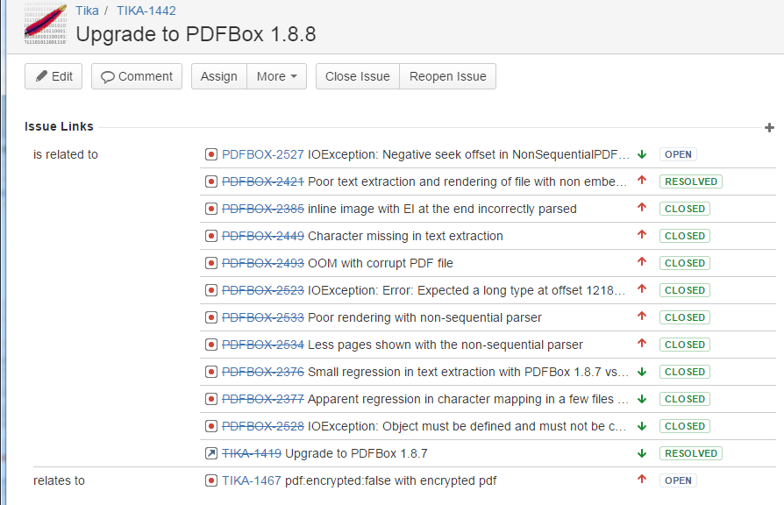
Community collaboration
Thank you, Tilman Hausherr!

Slide 78
Limits of Automated Metrics without Ground Truth
More exceptions – We have a problem! Wait…
New parser, we were entirely skipping those file types before
Parser was yielding junk before on this file, now it is letting us know there’s a problem
Fewer exceptions – Great! Wait…
Mime detection not working – skipping files that we used to parse (theoretical)
Now we’re getting junk
More Common Words – Great! Wait…
Serious bug that duplicates worksheets in some xlsx files (TIKA-2356…my fault…ugh!)
More non-html markup/xml tags incorrectly getting through
Fewer Common Words – Problem! Wait…
More attachments, fewer attachments (Your turn!)

Slide 79
TIKA-1302: The Ticket is Grown; the Dream is Gone
Without ground truth, humans need to interpret differences
This only makes building a gui more important!!! (TIKA-1334)
Collaborative tagging? As a human reviews diffs, flag document as “hopeless” or a given extract as “great” or “awful” (Again, thanks to Tilman Hausherr)
Dream of TIKA-1302 ran into reality, but we’re far better than where we were

Slide 80
Scaling tika-eval

Slide 81
tika-eval at Scale (with tika-eval >= 1.22)
Motivation
Running into unacceptably long processing times for analysis on ~3 million documents in H2. Current work around: Postgres…still not speedy (~40 minutes)
Big data frameworks are built for analysis and scale! Use them!
General Process – two steps
Calculating content statistics (as of Tika 1.22: decoupled tika-eval text stats calculator)
Rollups/aggregations
Limitations
Moving beyond the file share leads to an explosion of big data frameworks…no single solution
There is no one answer…must be customized per framework…

Slide 82
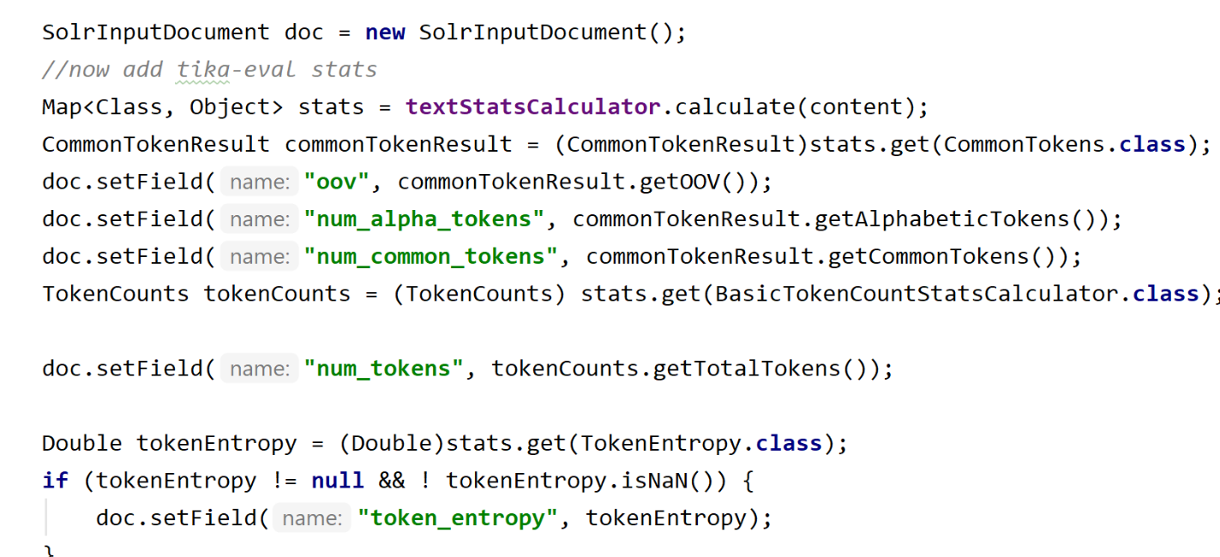
Step 1: Calculating Content Statistics – An Example with SolrJ
https://github.com/tballison/tika-addons/tree/master/tika-eval-solrj

Slide 83
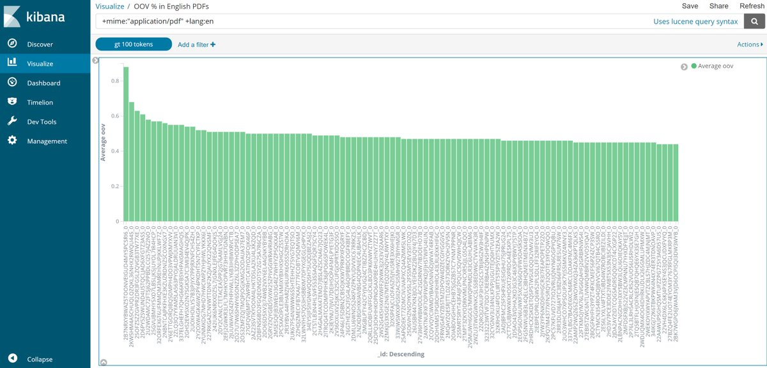
Average OOV% in English PDFs

Slide 84
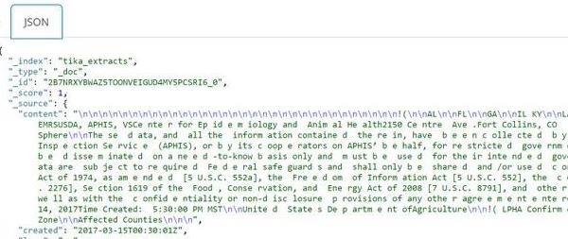
That document all the way on the left in the previous slide

Slide 85
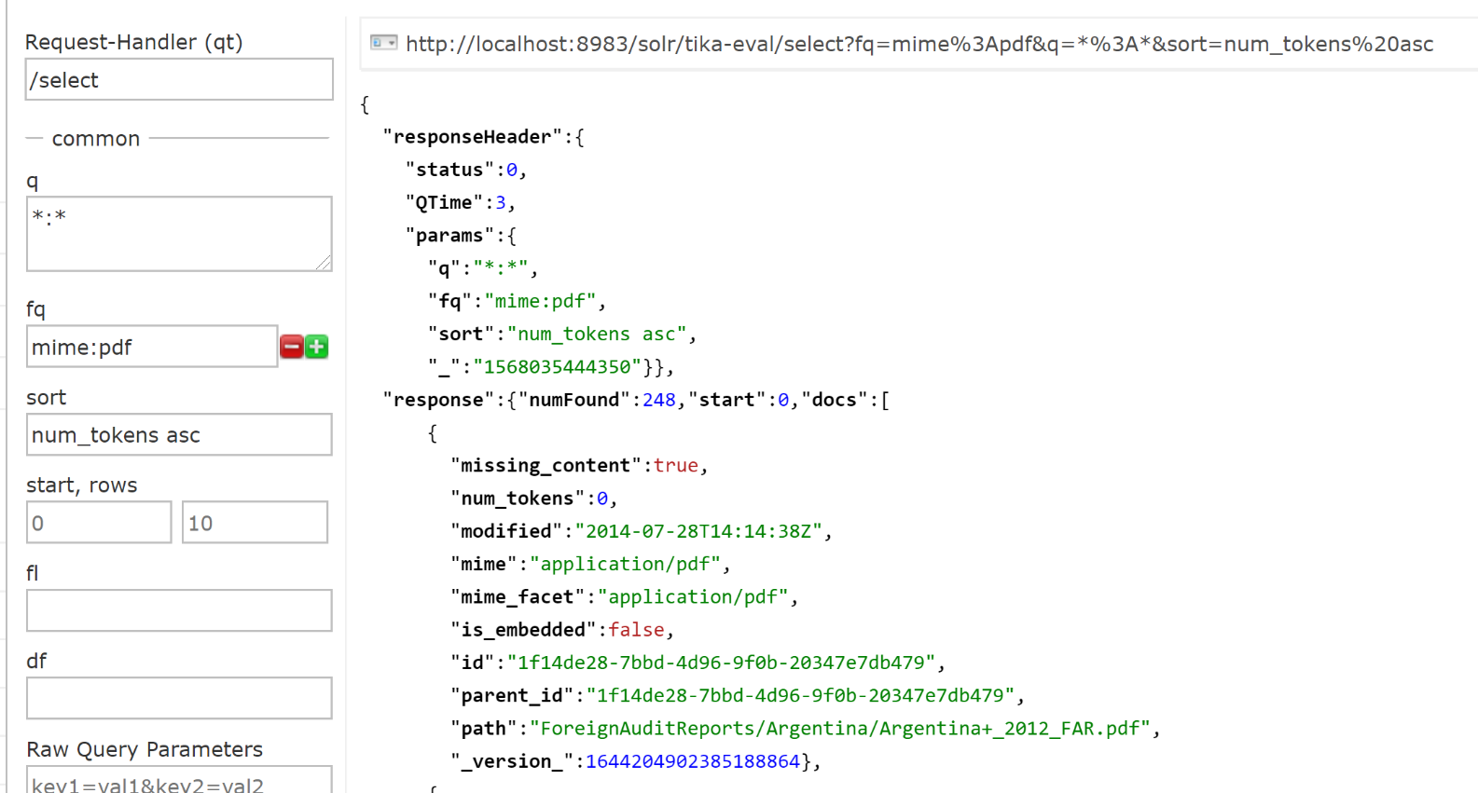
Which PDFs had little to no content?

Slide 86
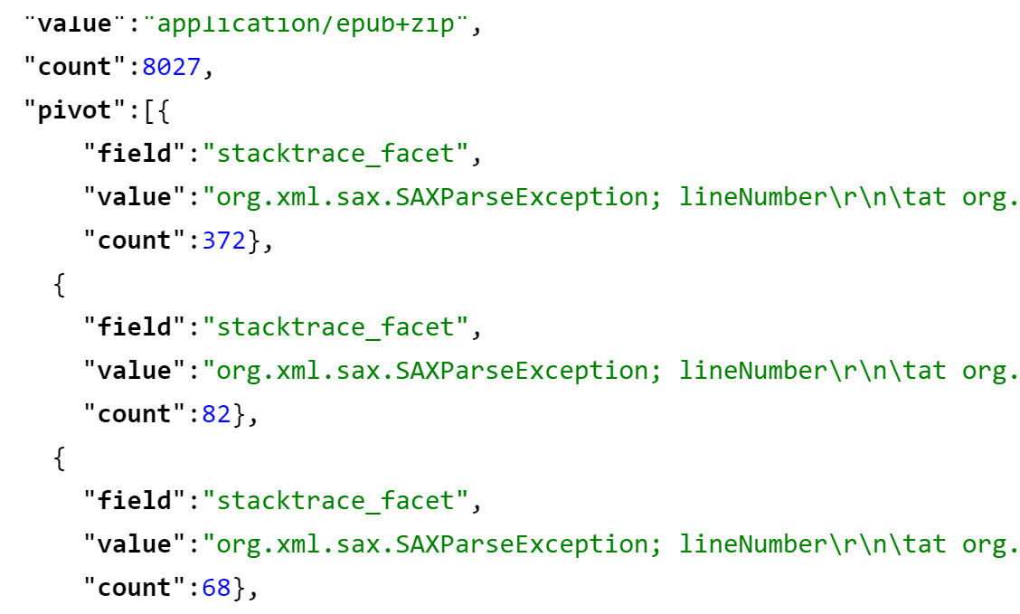
Most Common Stacktraces for Epubs?
http://localhost:8983/solr/tika-eval/select?facet.pivot=mime_facet,stacktrace_facet&facet=on
&fq=mime:epub&q=*:*

Slide 87
From Analytics to Action
PDFs – when to run OCR
Charset detection – which detector to trust…building a better charset detector

Slide 88
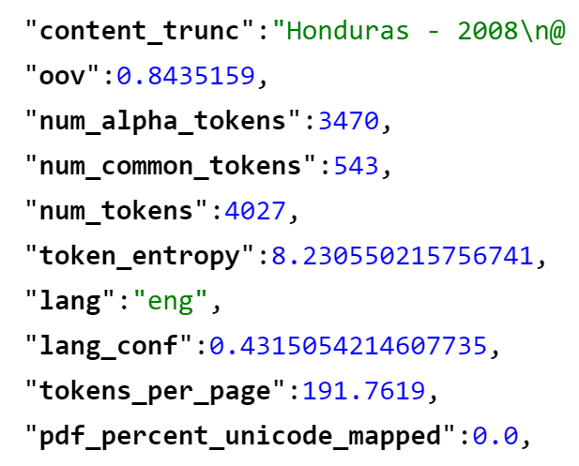
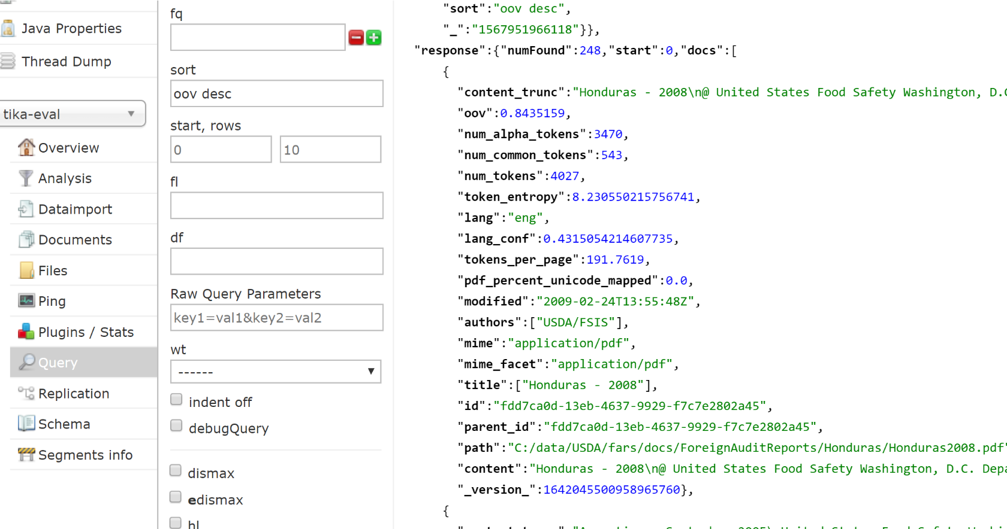
Prioritizing OCR via “sort oov desc”

Slide 89
Stored text vs. OCR’d text
Text as stored in PDF (OOV 84%)
GO Obpermtmn of the Establishment
I : S I . 11.Itmpacudo~+r~ A pn~ccssing1C:ontinent:tl. San l'edro S~tla.I-Iondurus; April 7, 2UO8 ( h ~ c l ' s l a t ~ g h ~ ~ r Ilurillg optraticlnol sanitation insprutiol~in tlre slaughter rrjom, carcuss i ; ~ 5icr.c c~l~scl-isl1~1t1k3 r'd
contacting visccrri cart wllecls. 'I'his \\.as cc&gt;rrcctcc[immcdiiiiuly by tllc csli~blishnicn~I T C . I S I ~ H I I ~ ~ . 1Kcgu1atc11.yrulirencc: 9CIf:li 41 (1.1 3(c)(
51 NAME OF AUDlTOR
Text extracted from Tesseract (OOV 30%)
60 Observation of the Establishment
Est. 12. Empacadora Continental. San Pedro Sula, Honduras; April 7, 2008 (beet aughter & processing) 10 During operational sanitation inspection in the slaughter room, carcass fore shanks were observed contacting viscera cart wheels. This was corrected immediately by the establishment personne! [Regulatory reference: 9CFR 416.13(¢)|
AND DATE 51 NAME OF AUDITOR

Slide 90
WWGD*?
Text in Google’s Cache
60 Observation of the Establishment Est. 12. Empacadora Continental, San Pedro Sula, Honduras; April 7, 2008 (heel slaughter & processing) 10 During operational sanitation inspection in the slaughter room, carcass fore shanks Tiere observedcontacung viscera cart wheels. This was corrected immediately by the establishment personnel.Regulatory reference: 9CFR 416.13(0
See also:
Popat, Ashok. (2009). A panlingual anomalous text detector. 201-204. 10.1145/1600193.1600237.
*WWGD: “What would Google Do?” (h/t Grant Ingersoll)

Slide 91
Charset detection – HTML meta charset (HTMLDefault) vs. Mozilla’s chardet (Universal)
HTMLDefault | Universal | HTMLDefault Sum Common Tokens | Universal Sum Common Tokens | Difference in Sums
UTF-8 | EUC-JP | 4,437 | 481,919 | 477,482
EUC-JP | Shift_JIS | 1,512 | 391,126 | 389,614
UTF-16 | windows-1252 | 1,240 | 368,496 | 367,256
UTF-16 | UTF-8 | 2,563 | 321,717 | 319,154
EUC-JP | UTF-8 | 764,957 | 1,047,029 | 282,072
windows-1255 | UTF-8 | 17,450 | 246,271 | 228,821
windows-1256 | UTF-8 | 52,185 | 249,105 | 196,920
EUC-KR | UTF-8 | 1,081,986 | 1,274,249 | 192,263
UTF-8 | Shift_JIS | 2,040 | 191,757 | 189,717
windows-1252 | UTF-8 | 427,997 | 554,311 | 126,314
See initial charset study draft: https://github.com/tballison/share/blob/master/slides/Tika_charset_detector_study_201909.docx

Slide 92
Next Steps
Streaming expressions: histograms and ?
Visualizations…please help!
Zeppelin?
“Compare” mode at scale?
Community feedback – please help!

Slide 93
To conclude
Text extraction is critical
A small problem for us could be a big problem for you…please evaluate!
Seriously, please evaluate – you don’t know what you can’t find!
Join the Apache Tika community and its evaluation efforts!
Email: tallison@apache.org
Twitter: @_tallison

Slide 94
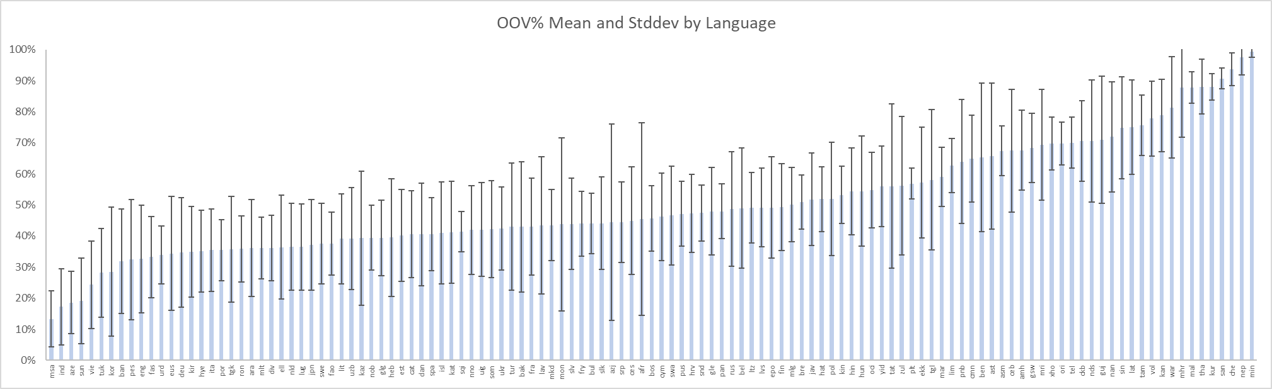
OOV% by Language, Mean and 1 StdDev on 1.5 million text-based files

Slide 95
Some Resources
Nick Burch’s talk on Tika: http://events.linuxfoundation.org/sites/events/files/slides/WhatsNewWithApacheTika_2.pdf
tika-eval wiki:https://cwiki.apache.org/confluence/display/tika/TikaEval
Fellow traveler Ryan Bauman’s “Automatic evaluation of OCR”: https://ryanfb.github.io/etc/2015/03/16/automatic_evaluation_of_ocr_quality.html
Ted Underwood’s earlier post: https://tedunderwood.com/2012/04/26/the-obvious-thing-were-lacking/

Slide 96
Extras

Slide 97

Apache Tika
File Type Identification
PDF
MSOffice
HTML
JPEG
MP3
WAV
…
Metadata and Text Content
Uniform Metadata and Text Content for text processing and/or ingestion into search engine

Slide 98
