Slide 1
Evaluating Content/Text Extraction at Scale with Apache Tika
Approved for Public Release;
Distribution Unlimited.
Case Number 18-3138-11
Tim Allison
Activate Conference 2019
Washington, DC
September 11, 2019
© 2019 The MITRE Corporation. ALL RIGHTS RESERVED.

Slide 2
Announcement
There’s a deep learning talk in Columbia 3/4
This talk will focus on content extraction and evaluation. Sorry.

Slide 3
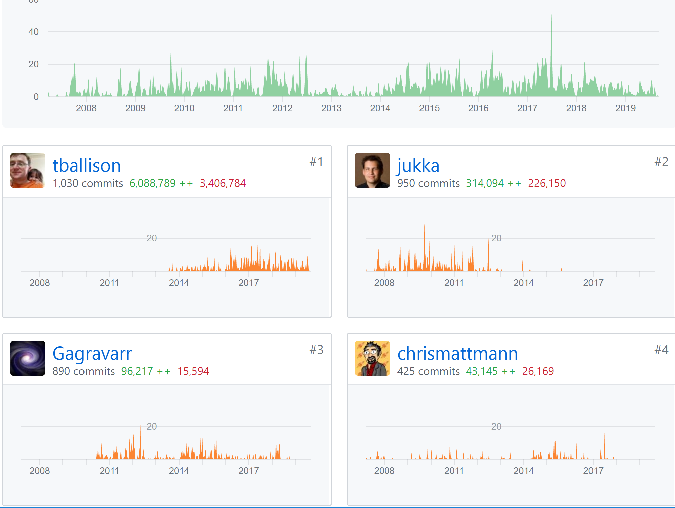
About me
Chair/V.P. Apache Tika
Committer/PMC Apache PDFBox
Committer/PMC Apache POI
Committer Apache Lucene/Solr
Member ASF

Slide 4
Debts of Gratitude
David Smiley
Nick Burch
Chris Mattmann
Tilman Hausherr
Dominik Stadler
Fellow devs:
Apache Lucene/Solr, Apache Commons, Apache POI, Apache PDFBox, Apache Tika
ASF Community and users!
Common Crawl and govdocs1
Rackspace
© 2019 The MITRE Corporation. ALL RIGHTS RESERVED.

Slide 5
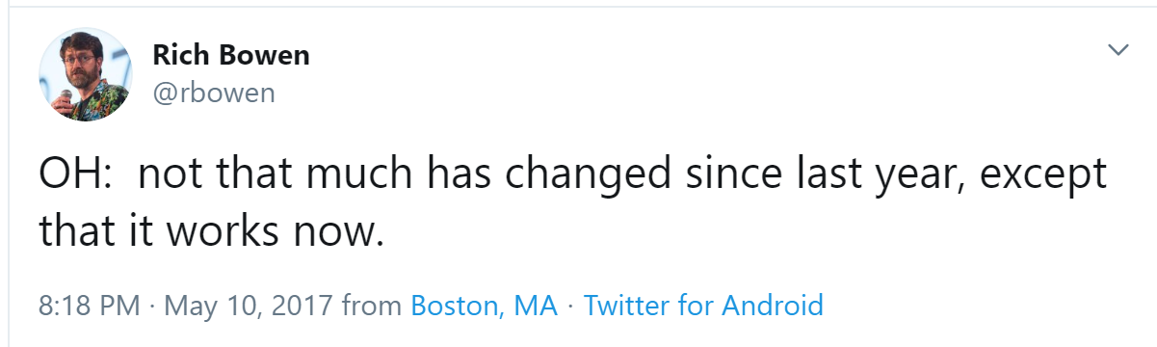

Overview
Intro to Tika: content and metadata extraction in the ETL stack
Motivation for tika-eval: what can go wrong?
tika-eval overview and workflow – single vm
tika-eval at scale
ApacheCon 2017
ApacheCon 2019

Slide 6



Content Extraction and HLT
Search:
“Arnold Schwarzenegger”~2
Entity Extraction:
أرنولد ألويس شوارزنيجر
(ولد في 8 أغسطس 1947، في ستيريا، النمسا)
Traditional Human Language Technologies
Machine Translation: Arnold Alois Schwarzenegger (born August 8, 1947, in Styria, Austria)
Search:
2~“أرنولد شوارزنيجر”
Text
أرنولد ألويس شوارزنيجر (ولد في 8 أغسطس 1947، في ستيريا، النمسا)
Content Extraction
=
1001010010010010001001010100101001101011111101010101011011011101101110110101110110110111011011110110110110110111111000000110101000000110010000011010010010
Bytes
Notes:
Machine translation via Google translate
Text retrieved from https://ar.wikipedia.org/wiki/%D8%A3%D8%B1%D9%86%D9%88%D9%84%D8%AF_%D8%B4%D9%88%D8%A7%D8%B1%D8%B2%D9%86%D9%8A%D8%AC%D8%B1 on 2/1/2017

Slide 7
High Level Components of a Media Processing Stack
User Interface
Search/Entity Extraction/MT, etc.
Text Extraction and Metadata Extraction
Files
Structured
Data-store
Forensics:
Carving and Advanced Methods

Slide 8
Let’s not forget Metadata!
Various formats store useful information
Who: author (first, last, commenters, editors), digital signature, company, from/to/cc/bcc (emails)
What: hardware version/name, software version/name, globally unique file/heritage id (XMP), title, keywords, description
Where: geo (latitude, longitude), file location (file paths embedded inside documents)
When: created, last modified, last printed
Beyond the standard types…custom metadata

Slide 9
When Things Go Wrong with Text Extraction
Example Application: Search
© 2019 The MITRE Corporation. ALL RIGHTS RESERVED.

Slide 10
What the User Sees in a Search System
User Interface
Indexer/ Search System
Content/ Metadata Extraction
Structured
Data-store

Slide 11
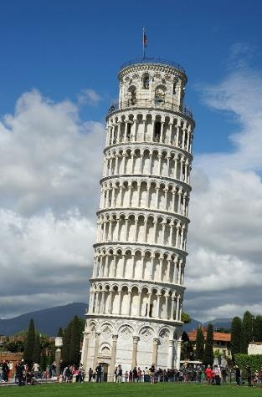
When Things Go Wrong with a Foundation
W. Lloyd MacKenzie, via Flickr @http://www.flickr.com/photos/saffron_blaze/
Notes:
Image from: http://upload.wikimedia.org/wikipedia/commons/6/66/The_Leaning_Tower_of_Pisa_SB.jpeg
Permission details
Outside of Wikimedia Foundation projects, attribution is to be made to: W. Lloyd MacKenzie, via Flickr @http://www.flickr.com/photos/saffron_blaze/

Slide 12
What can go wrong? Basic problems: thrown exceptions
Parser has a problem with non-corrupt file (and admits it…thank you!!!)
Password/access protected files
Format version not handled (add new parser?)
Corrupt files – can’t be opened by primary application or parsed by other parsers
Corrupt files – slight variant from spec/other parsers can handle it
Truncated files
Note: some text/metadata may or may not be extracted before the exception is thrown

Slide 13
What can go wrong? Catastrophic problems
OutOfMemoryError – potentially corrupting the JVM
Inefficient parsers DOM vs SAX on rare docx (TIKA-2170) and pptx (TIKA-2201). NOTE: with multithreaded garbage collection, a single thread running Tika can cause a quad-core system to grind to a snail’s pace before hitting OOM.
Four bytes of a compressed file (TIKA-2330)
Slowly building memory leak
See above on quad-core, gc and snails (TIKA-2180?)
Permanent Hang
TIKA-1132
Security Vulnerabilities
XXE (CVE-2016-4334), arbitrary code execution (CVE-2016-6809)
These are extremely rare, and we try to fix them when we’re aware of them!

Slide 14
What can go wrong? Hidden problems (no exceptions!)…
Garbled text
From slightly to…fully
Missing text/metadata
From missing some text to … no text at all
Missing attachments
Silently swallowed exceptions of embedded documents
Classic Tika xhtml silently swallows embedded exceptions!!!

Slide 15
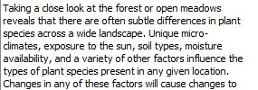
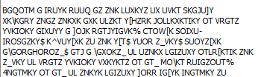
Corrupt Text (Upgrade from PDFBox 1.8.6->1.8.7)

Slide 16

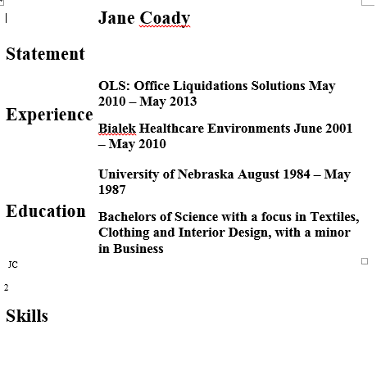
Missing Text (TIKA-1130)
Document available: https://issues.apache.org/jira/browse/TIKA-1130

Slide 17
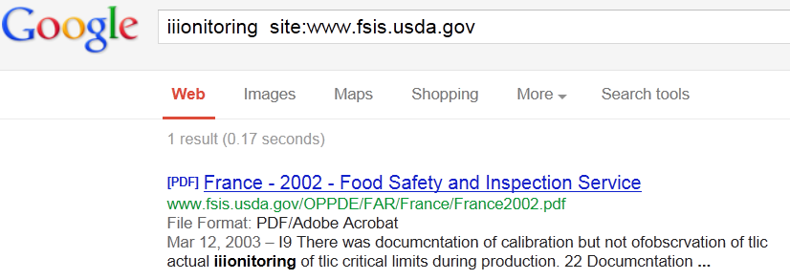
When Things Go Not as Well as They Might with Content Extraction – OCR
Image:
Text Extracted:
I9 There was documcntation of calibration but not ofobscrvation of tlic actual iiionitoring of tlic critical limits during production.
Search Results:

Slide 18
Take-away #1
If you don’t evaluate content extraction…
You don’t know what you can’t find

Slide 19
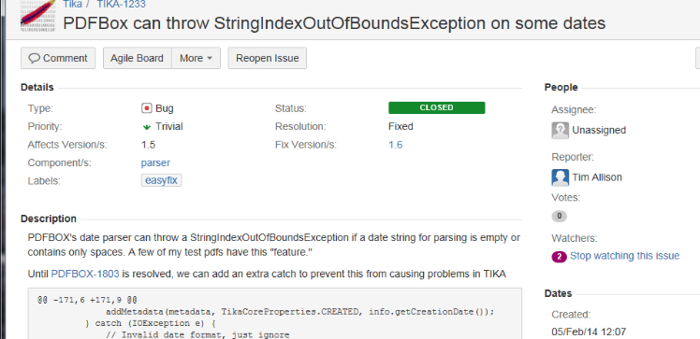

Take-away #2
A small problem for me can be a big problem for you!

Slide 20
TIKA-1302: The Dream
Motivation
All of the above
We have only roughly 1,000 test files in unit tests in Apache POI, Apache PDFBox and Apache Tika
Apache POI/PDFBox/Tika mistakenly made me a committer
Run Tika on much larger corpus nightly/weekly
Automatically recognize regressions

Slide 21
tika-eval
Available since Apache Tika 1.15
© 2019 The MITRE Corporation. ALL RIGHTS RESERVED.

Slide 22
High-level overview
tika-eval’s scope
Single vm, file share to file share (with embedded H2 db), ~few million files is a reasonable size
Not currently cloud-scale
Random sampling – should be good enough
Our Jira is open and committers are standing by!
tika-eval’s two modes
Profile single extraction run
Compare two extraction runs
Ground truth vs. particular tool
Tool A vs. tool B
Tool A with settings X vs. Tool A with settings Y

Slide 23
Definitions
“original documents” or “container documents” – the original binary documents from which you’d like to extract text, whether or not they actually have attachments.
“embedded documents” – any document contained within another document, including those that only ever exist as embedded docs: emf/wmf/xmp/xfa.
“extract” – .txt or .json representation of the extracted text/metadata.
tika-eval was designed for .json
RecursiveParserWrapper via API
(-J) for tika-app
/rmeta for tika-server
tika-eval can handle .txt files – details on our wiki

Slide 24
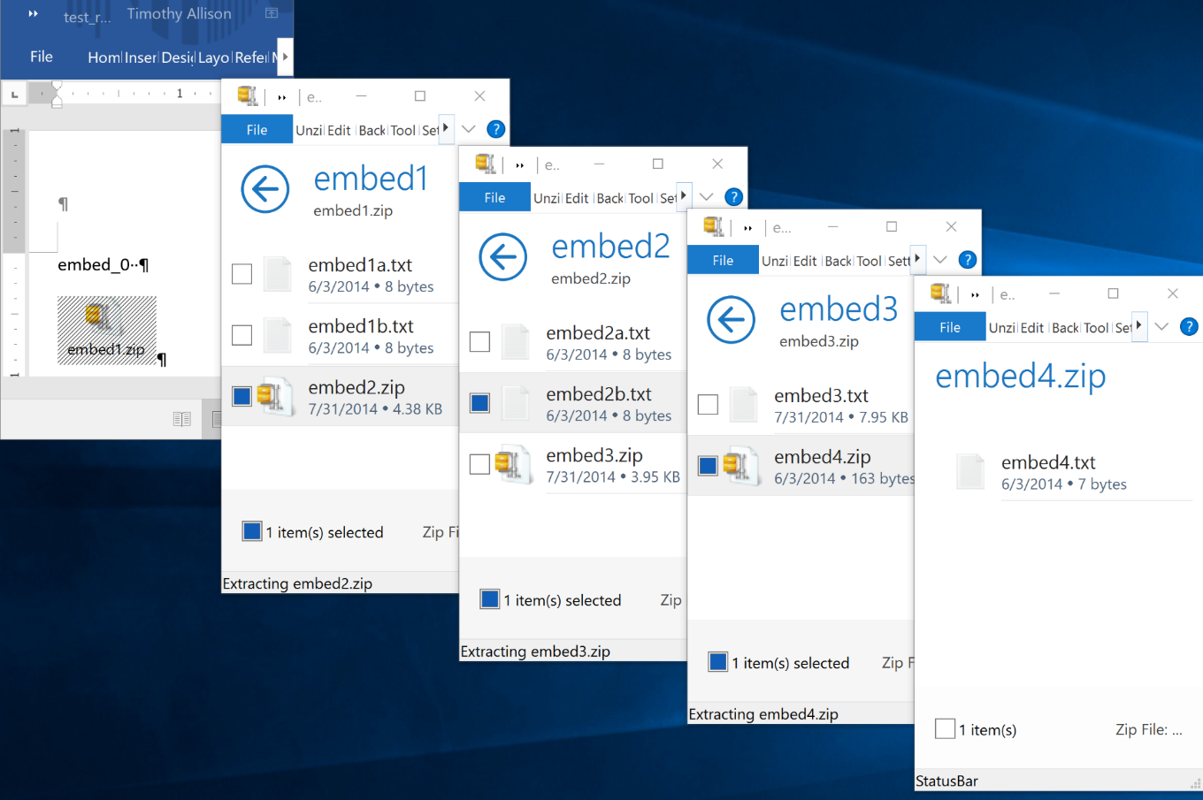
Why the RecursiveParserWrapper?

Slide 25
Classic XHTML
<?xml version="1.0" encoding="UTF-8"?>
<meta name="Content-Type" .../>
…
<p>embed_0 </p>
<p><div class="embedded" id="rId7"/>
<p>embed1.zip</p>
<div class="embedded" id="embed1/embed1a.txt"/>
<div class="package-entry">
<p>embed_1a</p>
</div>
...
Metadata from embedded docs is lost
Exceptions from embedded docs are swallowed
Metadata from the container document may be incomplete

Slide 26
RecursiveParserWrapper
[
{
"Application-Name": "Microsoft Office Word",
"Content-Length": "27082",
"Content-Type": "application/....wordprocessingml.document",
"X-TIKA:content": "embed_0 ",
...
},
{
"Content-Type": "text/plain; charset=ISO-8859-1",
"Last-Modified": "2014-06-04T04:08:28Z",
"X-TIKA:content": "embed_1a",
"X-TIKA:embedded_resource_path": "/embed1.zip/embed1a.txt",
...
},
{
"Content-Type": "application/zip",
"Last-Modified": "2014-06-04T04:09:40Z",
"X-TIKA:content": "embed4.txt",
"X-TIKA:embedded_resource_path": "/embed1.zip/embed2.zip/embed3.zip/embed4.zip"
...
}, ...]
Embedded metadata (e.g. mime/author/lat-long, etc.) are retained
Embedded exceptions are stored in a metadata key
All metadata is extracted stored

Slide 27
Workflow – Profile
Generate extracts with parallel directory structure to original documents, append “.txt” or “.json” into, say my_extracts directory
Run profiler to populate in-process H2 DB
java –jar tika-eval.jar Profile
–extracts my_extracts
–db my_db
Dump reports
java –jar tika-eval.jar Report –db my_db
Excel reports will be dumped to the reports directory

Slide 28
Workflow – Compare
Generate extracts with parallel directory structure to original documents, append “.txt” or “.json” into, say my_extractsA and my_extractsB directories
Run profiler to populate in-process H2 DB
java –jar tika-eval.jar Compare
–extractsA my_extractsA
–extractsB my_extractsB
–db my_db
Dump reports
java –jar tika-eval.jar Report –db my_db
Excel reports will be dumped to the reports directory

Slide 29
Workflow – StartDB
Start db:
java –jar tika-eval.jar StartDB
Open browser to localhost:8082
Select db (full path!):
jdbc:h2:/C:/data/my_db
Notes on db structure: https://wiki.apache.org/tika/TikaEvalDbDesign

Slide 30
Reports (Profile)
Metadata – count of metadata values
Attachments – counts
Mimes – mime counts for containers and embedded docs
Exceptions
Counts by type (e.g. password vs. actual exception)
Counts by mime
Counts by normalized stacktrace
All stack traces
Content
Language id
Word count
Common words count
Word length stats
Page count

Slide 31
Reports (Compare)*
Metadata – comparison counts A to B
Attachments – comparison counts A to B
Mimes
Comparison mime counts for containers and embedded docs
Counts of mime changes mimeA->mimeB
Exceptions
Comparisons of counts by mime
Counts by mime
Counts by normalized stacktrace
All stack traces
Content
Language id
Word count
Word length stats
Page count
Includes Profile data for both A and B and then also some comparison reports

Slide 32
Content – “Common words” and their Utility in Profile
Top 30k most common words per language* in Leipzig Corpus**
To find PDFs that are mostly image only:
number of words/number of pages
To find very corrupt text***:
“In vocabulary %”:(number of common words/number of alphabetic words)
“Out of vocabulary (OOV)%”: 1-“in vocabulary %”
* Many thanks, Apache Lucene!
** http://wortschatz.uni-leipzig.de/en/download/ and Apache OpenNLP’s: https://svn.apache.org/repos/bigdata/opennlp/
*** Metric was recommended by Tilman Hausherr

Slide 33
Content comparisons
Similarity metrics between A and B
how many words in common/total number of words (with counts normalized to 0/1 per doc)
how many words in common/total number of words (with actual counts)
Improvement in “common words”
number of Common Words in B – number of Common Words in A
Per mime

Slide 34
Content Comparison Example – Junk -> Better
 | Tika 1.14 | Tika 1.15-SNAPSHOT
Unique Tokens | 786 | 156
Total Tokens | 1603 | 272
LangId | zh-ch | de
Common Words | 0 | 116
Alphabetic Tokens | 1603 | 250
Top N Tokens | 捳敨: 18 | 獴档: 14 | 略獴: 14 | m: 11 | 杮湥: 11 | 瑵捳: 11 | 畬杮: 11 | 档湥: 10 | 搠敩: 9 | 敮浨: 9 | die: 11 | und: 8 | von: 8 | deutschen: 7 | deutsche: 6 | 1: 5 | das: 5 | der: 5 | finanzministerium: 5 | oder: 5
OOV% | 1-(0/1603) = 100% | 1-(116/250) = 54%
Overlap: 0%
Increase in Common Words: 116

Slide 35
Content Comparison Example – Small Regression
 | Tika 1.14 | Tika 1.15-SNAPSHOT
Unique Tokens | 1916 | 1995
Total Tokens | 14187 | 14302
LangId | en | en
Common Words | 7498 | 7409
Alphabetic Tokens | 13472 | 13587
Top 10 Unique Tokens | applicant's: 8 | 1.69: 1 | arbitrary: 1 | collecting: 1 | constitution: 1 | e112: 1 | ei.b: 1 | equating: 1 | magnetically: 1 | o: 1 | ss: 106 | applicantis: 8 | ssss: 7 | iactsi: 4 | ithe: 4 | imeansi: 3 | iprocessi: 3 | calculations.i: 2 | iabstract: 2 | idata: 2
OOV% | 1-(7498/13472) = 44% | 1-(7409/13587) = 45%
Overlap: 95.5%
Increase in Common Words: -89

Slide 36
Taking tika-eval public
Rackspace kindly hosts a vm for ongoing evals (TIKA-1302)
1 TB (~3 million files) from Common Crawl and govdocs1
Collaborating with Apache PDFBox and Apache POI to run evals as part of the release process
Critical to identifying regressions and building new parsers
Stacktraces created by public documents are critical for the hey-I’m-getting-this parse-exception-but-can’t-share-the-document-with-you problem
See Dominik Stadler’s Common Crawl download tool: https://github.com/centic9/CommonCrawlDocumentDownload

Slide 37
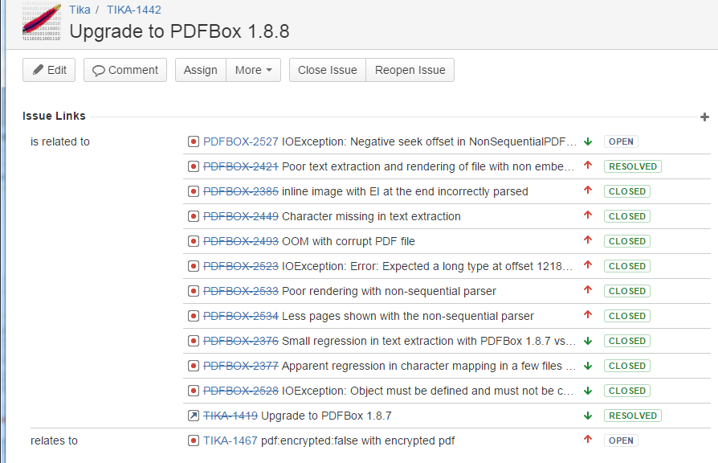
Community collaboration
Thank you, Tilman Hausherr!

Slide 38
Limits of Automated Metrics without Ground Truth
More exceptions – We have a problem! Wait…
New parser, we were entirely skipping those file types before
Parser was yielding junk before on this file, now it is letting us know there’s a problem
Fewer exceptions – Great! Wait…
Mime detection not working – skipping files that we used to parse (theoretical)
Now we’re getting junk
More Common Words – Great! Wait…
Serious bug that duplicates worksheets in some xlsx files (TIKA-2356…my fault…ugh!)
More non-html markup/xml tags incorrectly getting through
Fewer Common Words – Problem! Wait…
More attachments, fewer attachments (Your turn!)

Slide 39
TIKA-1302: The Ticket is Grown; the Dream is Gone
Without ground truth, humans need to interpret differences
This only makes building a gui more important!!! (TIKA-1334)
Collaborative tagging? As a human reviews diffs, flag document as “hopeless” or a given extract as “great” or “awful” (Again, thanks to Tilman Hausherr)
Dream of TIKA-1302 ran into reality, but we’re far better than where we were

Slide 40
Scaling tika-eval

Slide 41
tika-eval at Scale (with tika-eval >= 1.22)
Motivation
Running into unacceptably long processing times for analysis on ~3 million documents in H2. Current work around: Postgres…still not speedy (~40 minutes)
Big data frameworks are built for analysis and scale! Use them!
General Process – two steps
Calculating content statistics (as of Tika 1.22: decoupled tika-eval text stats calculator)
Rollups/aggregations
Limitations
Moving beyond the file share leads to an explosion of big data frameworks…no single solution
There is no one answer…must be customized per framework…

Slide 42
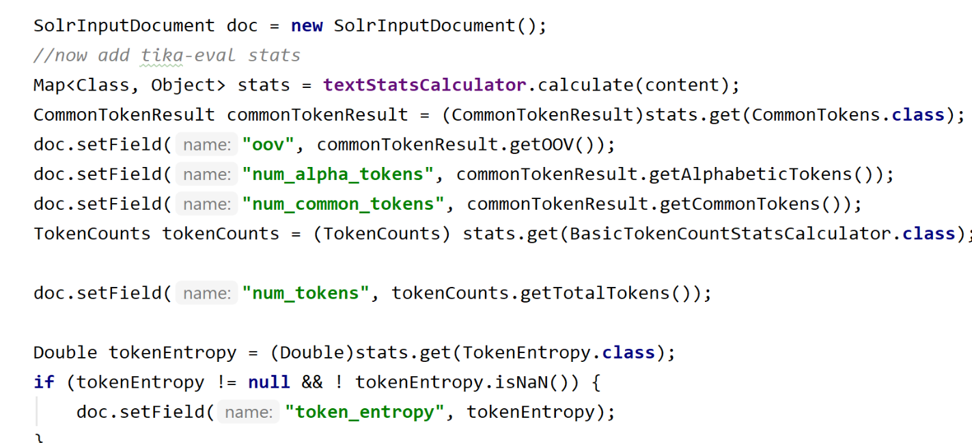
Step 1: Calculating Content Statistics – An Example with SolrJ
https://github.com/tballison/tika-addons/tree/master/tika-eval-solrj

Slide 43
Interlude before Step 2: Tika-eval analytics for Search Relevance
OOV%
Token entropy
Num alphabetic tokens
Num pages
Other stats?
Depending on your documents, these can be used as signals in relevance!!!

Slide 44
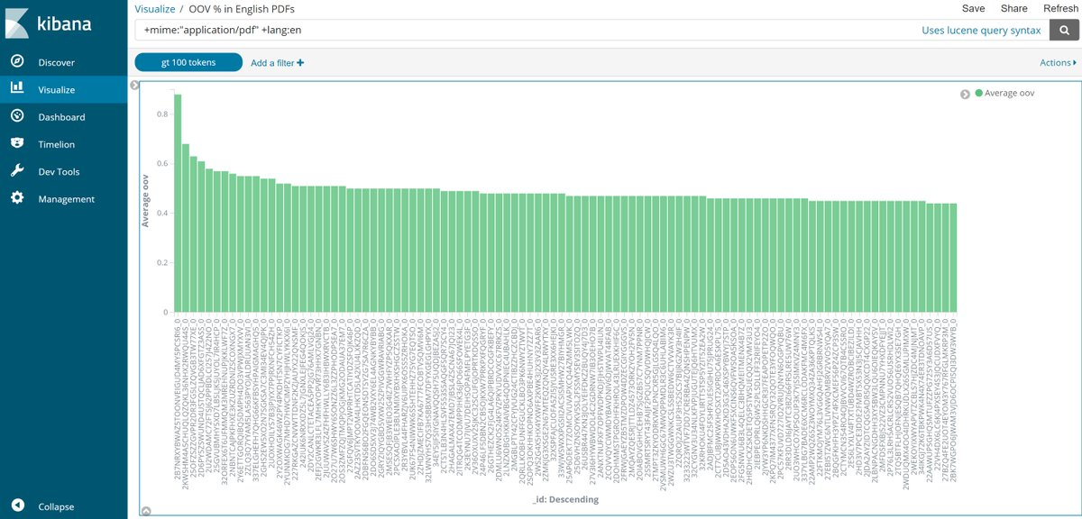
Average OOV% in English PDFs

Slide 45
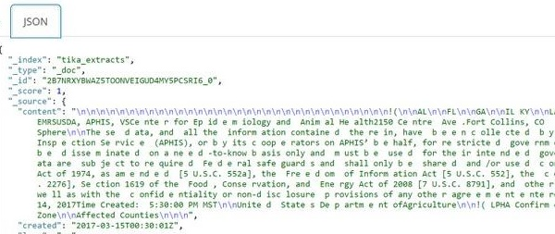
That document all the way on the left in the previous slide

Slide 46
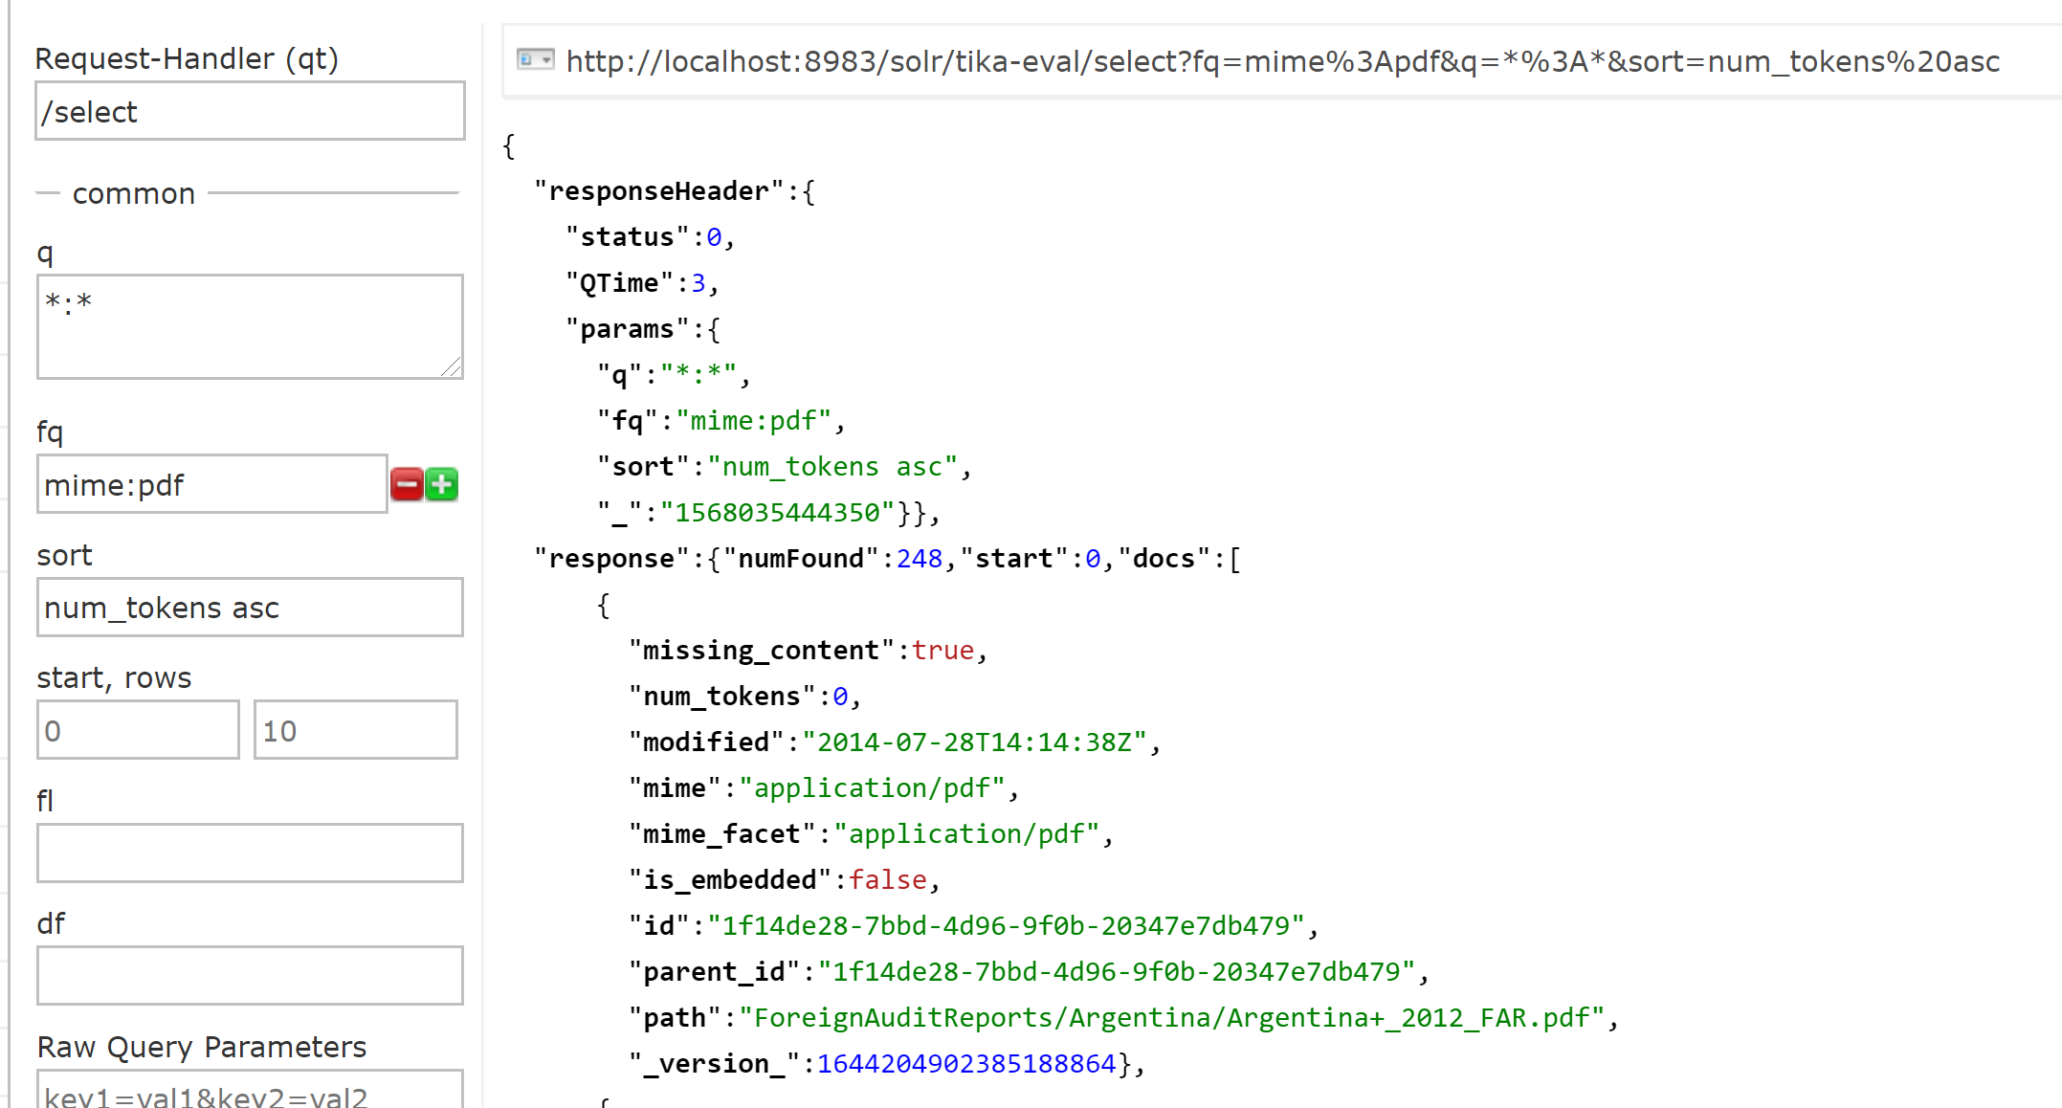
Which PDFs had little to no content?

Slide 47
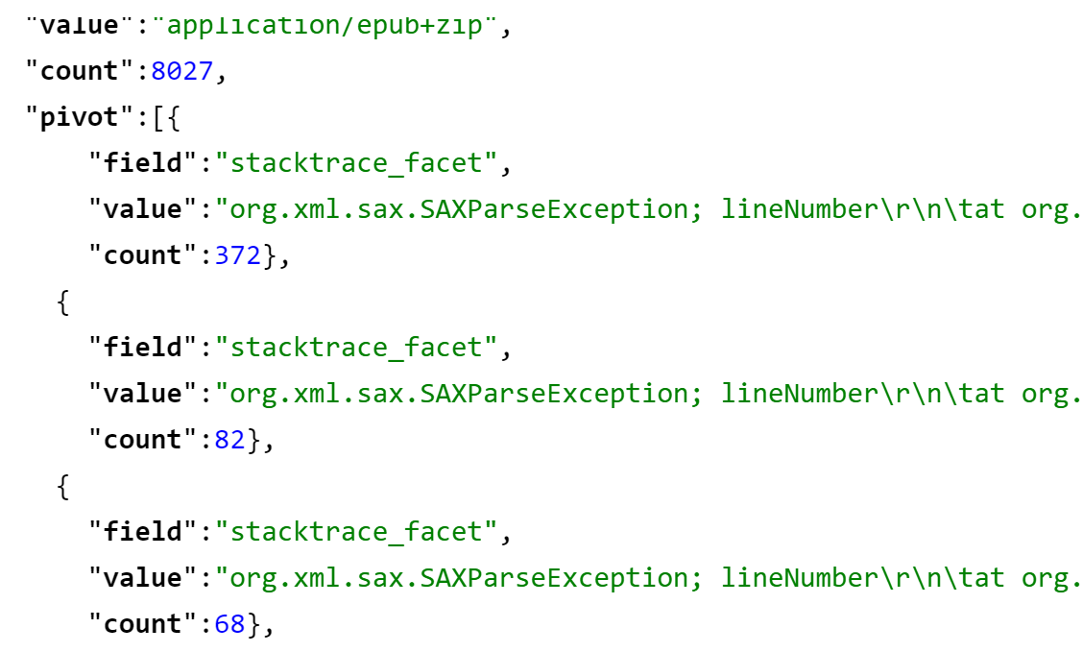
Most Common Stacktraces for Epubs?
http://localhost:8983/solr/tika-eval/select?facet.pivot=mime_facet,stacktrace_facet&facet=on
&fq=mime:epub&q=*:*

Slide 48
From Analytics to Action
PDFs – when to run OCR
Charset detection – which detector to trust…building a better charset detector

Slide 49
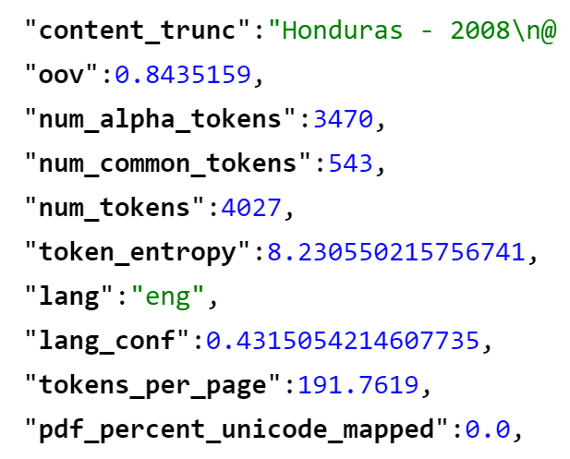
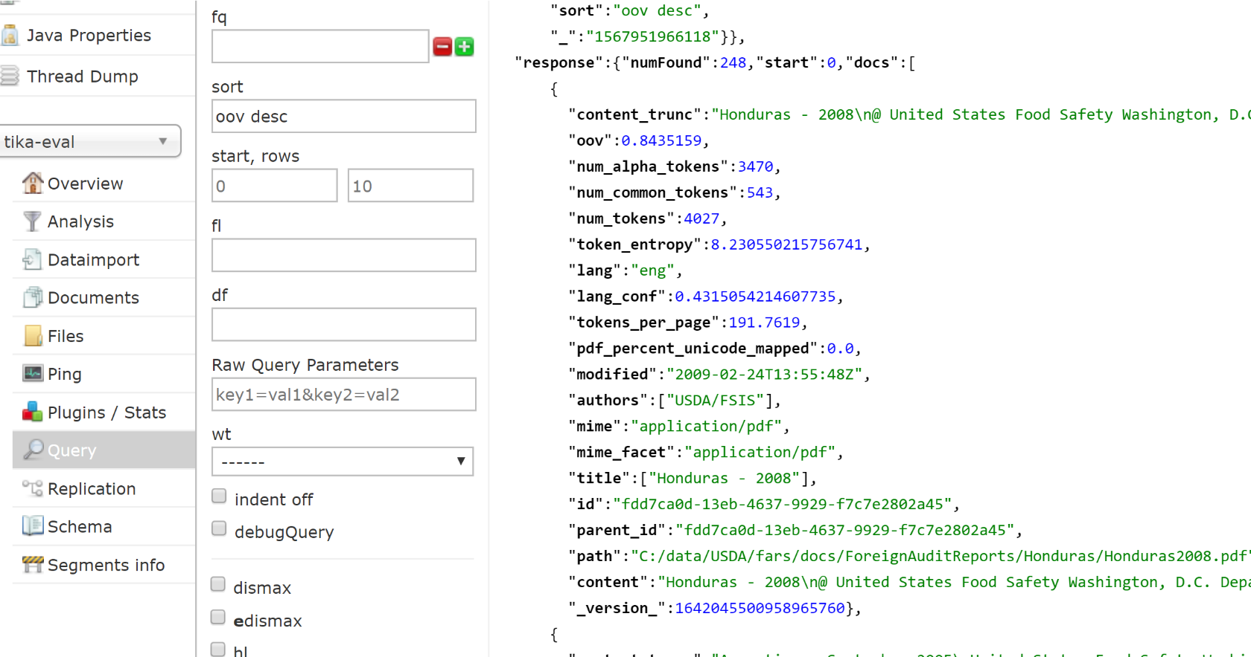
Prioritizing OCR via “sort oov desc”

Slide 50
Stored text vs. OCR’d text
Text as stored in PDF (OOV 84%)
GO Obpermtmn of the Establishment
I : S I . 11.Itmpacudo~+r~ A pn~ccssing1C:ontinent:tl. San l'edro S~tla.I-Iondurus; April 7, 2UO8 ( h ~ c l ' s l a t ~ g h ~ ~ r Ilurillg optraticlnol sanitation insprutiol~in tlre slaughter rrjom, carcuss i ; ~ 5icr.c c~l~scl-isl1~1t1k3 r'd
contacting visccrri cart wllecls. 'I'his \\.as cc&gt;rrcctcc[immcdiiiiuly by tllc csli~blishnicn~I T C . I S I ~ H I I ~ ~ . 1Kcgu1atc11.yrulirencc: 9CIf:li 41 (1.1 3(c)(
51 NAME OF AUDlTOR
Text extracted from Tesseract (OOV 30%)
60 Observation of the Establishment
Est. 12. Empacadora Continental. San Pedro Sula, Honduras; April 7, 2008 (beet aughter & processing) 10 During operational sanitation inspection in the slaughter room, carcass fore shanks were observed contacting viscera cart wheels. This was corrected immediately by the establishment personne! [Regulatory reference: 9CFR 416.13(¢)|
AND DATE 51 NAME OF AUDITOR

Slide 51
WWGD*?
Text in Google’s Cache
60 Observation of the Establishment Est. 12. Empacadora Continental, San Pedro Sula, Honduras; April 7, 2008 (heel slaughter & processing) 10 During operational sanitation inspection in the slaughter room, carcass fore shanks Tiere observedcontacung viscera cart wheels. This was corrected immediately by the establishment personnel.Regulatory reference: 9CFR 416.13(0
See also:
Popat, Ashok. (2009). A panlingual anomalous text detector. 201-204. 10.1145/1600193.1600237.
*WWGD: “What would Google Do?” (h/t Grant Ingersoll)

Slide 52
Charset detection – HTML meta charset (HTMLDefault) vs. Mozilla’s chardet (Universal)
HTMLDefault | Universal | HTMLDefault Sum Common Tokens | Universal Sum Common Tokens | Difference in Sums
UTF-8 | EUC-JP | 4,437 | 481,919 | 477,482
EUC-JP | Shift_JIS | 1,512 | 391,126 | 389,614
UTF-16 | windows-1252 | 1,240 | 368,496 | 367,256
UTF-16 | UTF-8 | 2,563 | 321,717 | 319,154
EUC-JP | UTF-8 | 764,957 | 1,047,029 | 282,072
windows-1255 | UTF-8 | 17,450 | 246,271 | 228,821
windows-1256 | UTF-8 | 52,185 | 249,105 | 196,920
EUC-KR | UTF-8 | 1,081,986 | 1,274,249 | 192,263
UTF-8 | Shift_JIS | 2,040 | 191,757 | 189,717
windows-1252 | UTF-8 | 427,997 | 554,311 | 126,314
See initial charset study draft: https://github.com/tballison/share/blob/master/slides/Tika_charset_detector_study_201909.docx

Slide 53
Next Steps
Streaming expressions: histograms and ?
Visualizations…please help!
Zeppelin, Superset, Grafana
“Compare” mode at scale

Slide 54
To conclude – Please evaluate!
Text extraction is critical
You don’t know what you can’t find
A small problem for me could be a big problem for you
Please evaluate!

Slide 55
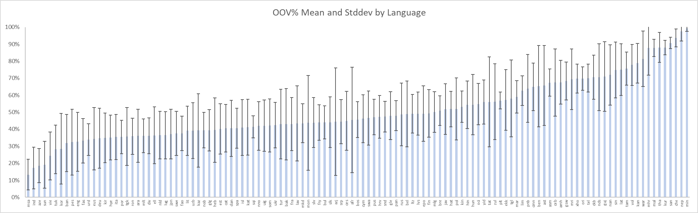
Join the Apache Tika community and its evaluation efforts!
OOV% by Language; Mean and 1 StdDev on 1.5 million text-based files
Personal Contact
Email: tallison@apache.org
Twitter: @_tallison
Lists
user@tika.apache.org
dev@tika.apache.org

Slide 56
Some Resources
Nick Burch’s talk on Tika: http://events.linuxfoundation.org/sites/events/files/slides/WhatsNewWithApacheTika_2.pdf
tika-eval wiki:https://cwiki.apache.org/confluence/display/tika/TikaEval
Fellow traveler Ryan Bauman’s “Automatic evaluation of OCR”: https://ryanfb.github.io/etc/2015/03/16/automatic_evaluation_of_ocr_quality.html
Ted Underwood’s earlier post: https://tedunderwood.com/2012/04/26/the-obvious-thing-were-lacking/

Slide 57
Extras

Slide 58

Apache Tika
File Type Identification
PDF
MSOffice
HTML
JPEG
MP3
WAV
…
Metadata and Text Content
Uniform Metadata and Text Content for text processing and/or ingestion into search engine

Slide 59
