Slide 1
AMIA 2021 Urea Cycle Disorder (UCD) App Example
Tremor SNOMED CT Concepts with UCD and Hyperammonemia (HA) diagnoses
Steps to construct graph

Slide 2
TOM – pick any queries that make sense to you.
Your video can have audio (preferred) or can just be video and I can add audio on top. In either case, I can provide the set-up (background) and the conclusions.
The next 2 slides are screen shots that I have in the paper (I scraped them from our Zoom calls); you do not have to be compelled to use them.
I thought it would be interesting to do one query that shows all the different UCD sub-types and a SNOMED code. Then we can add the HA events / no HA events variable. (Hovering over the nodes and edges to show the counts.)
Then we could focus in on ALD as one type of UCD. And show the ALD + no-HA + intentional tremors node with the talking point.
A final talking point could be the fact that the edge thickness can be difficult to interpret when there are fewer observations.
  “We found that the size connected vertices must be considered when assessing significance of relative relationships. For instance, due to its heavier connecting edge, the relationship of proximal-UCD disorders to Attention Deficit Hyperactivity Disorder appeared more significant than that to Mood Disorder in our visualization. However, the heavier edge was explained by a greater number of observations in the first relationship than in the second, when in fact, the proportions of different UCD subtypes for each SNOMED concept were similar. “

Slide 3
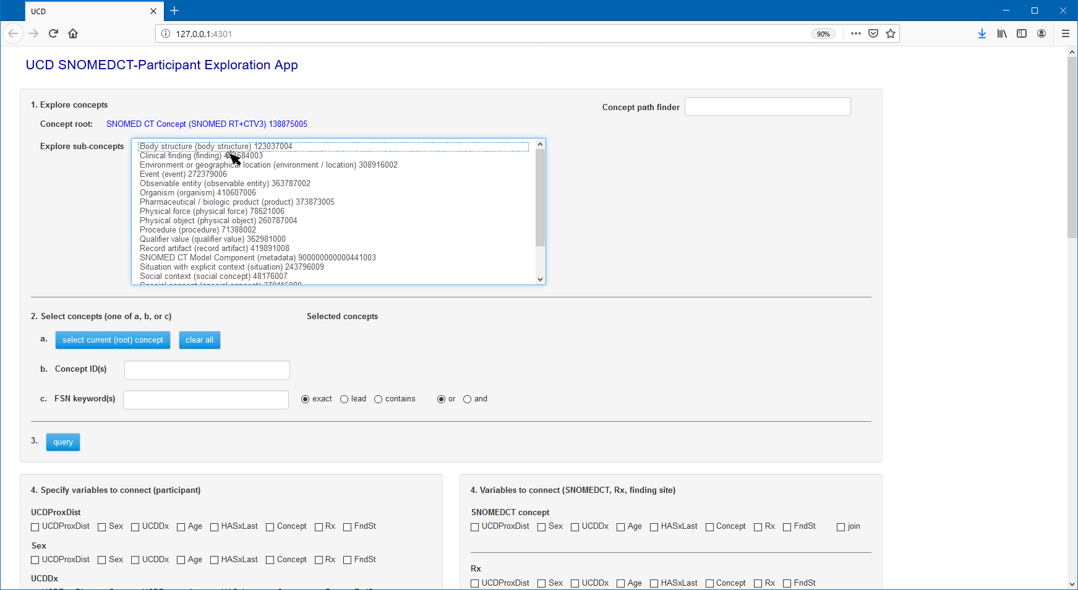
Explore concepts by descending through SNOMED CT tree and locate a concept of interest
Clinical finding

Slide 4
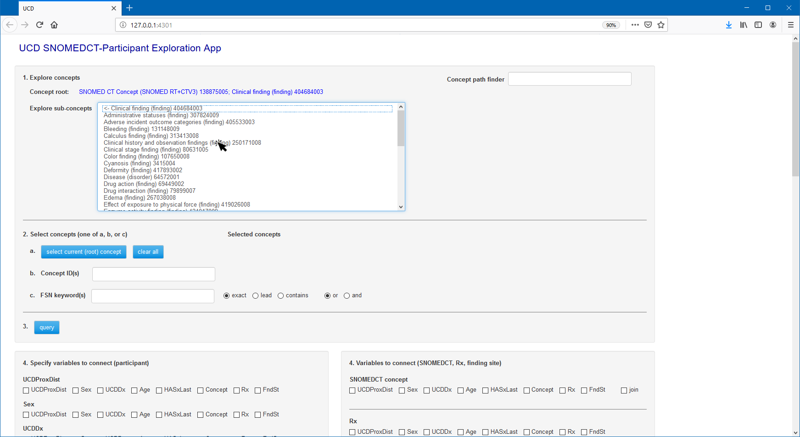
Clinical history and observation findings

Slide 5
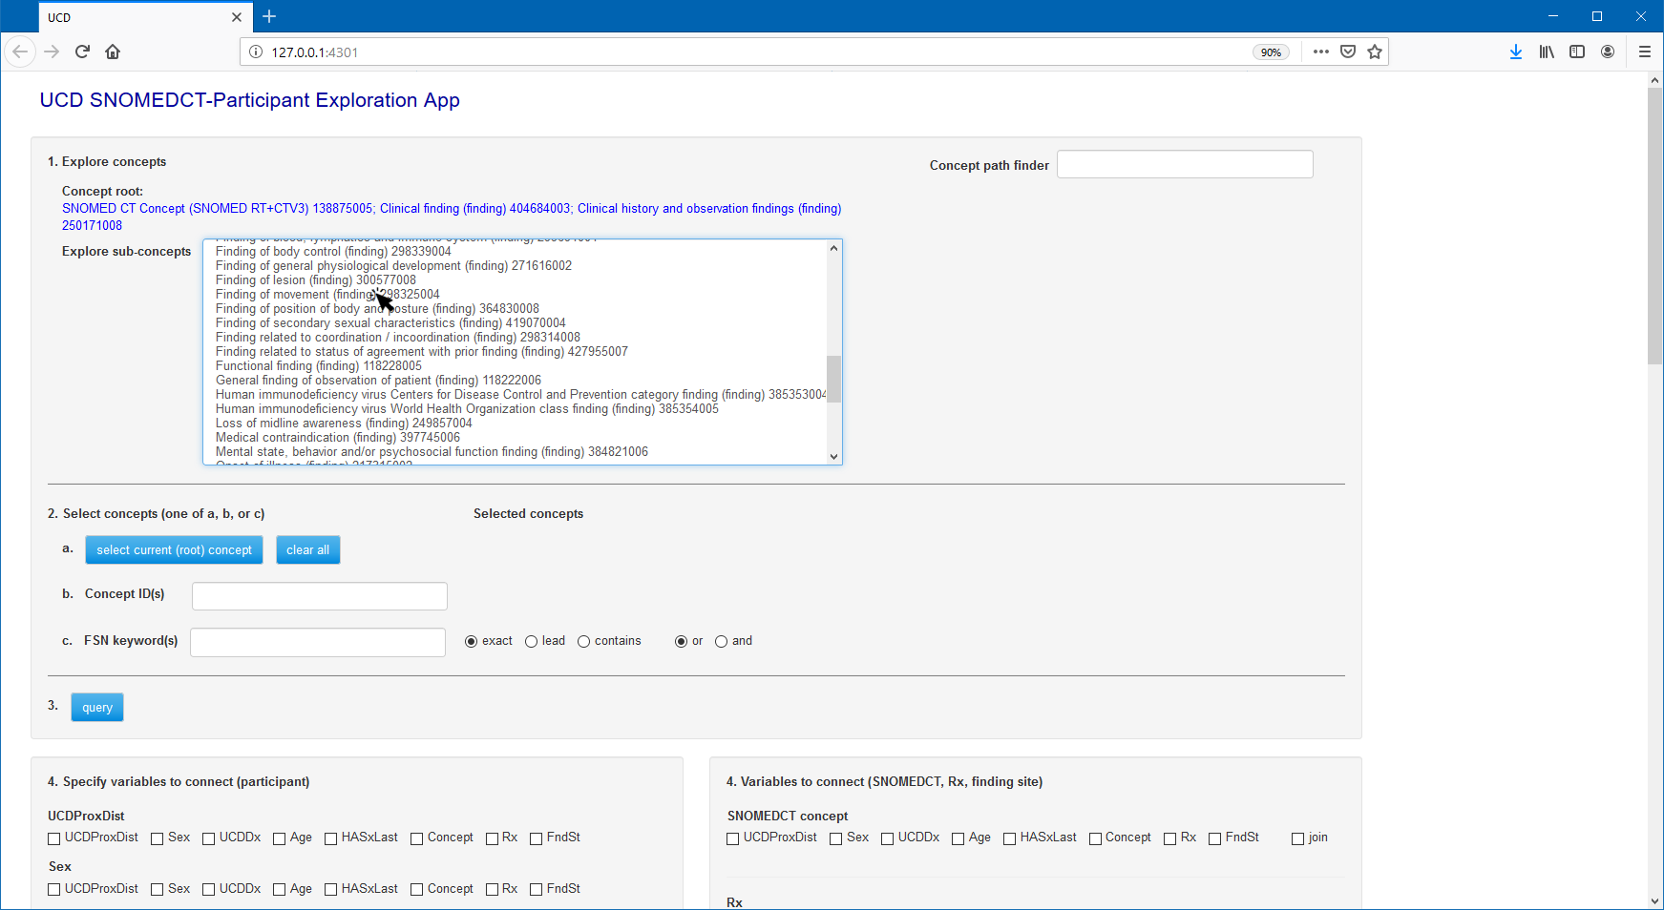
Finding of movement

Slide 6
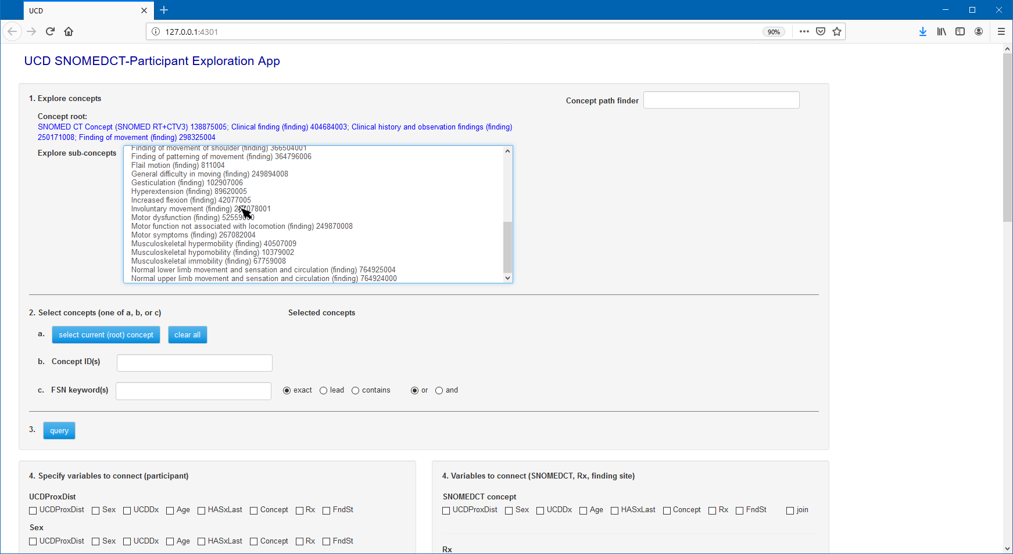
Involuntary movement

Slide 7
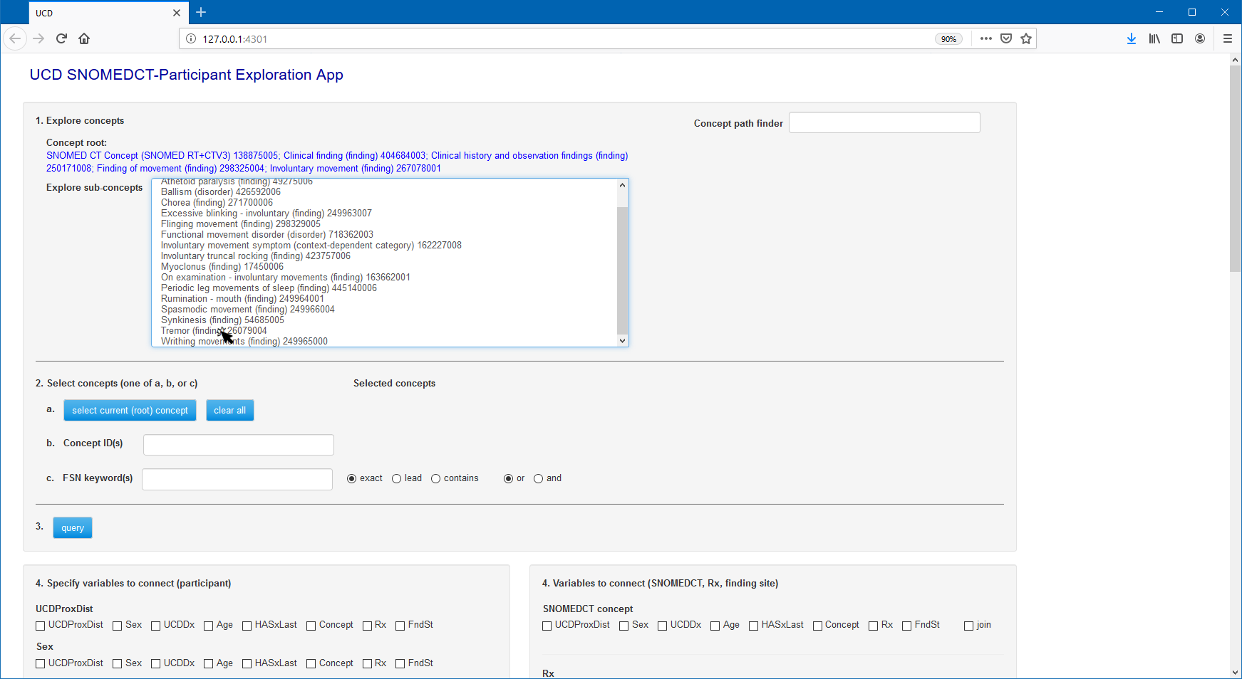
Tremor

Slide 8
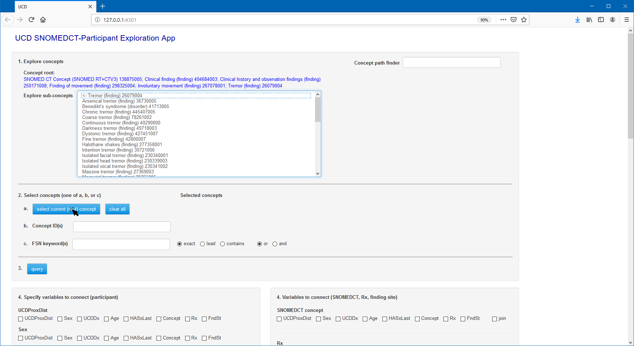
Select current concept (Tremor)

Slide 9
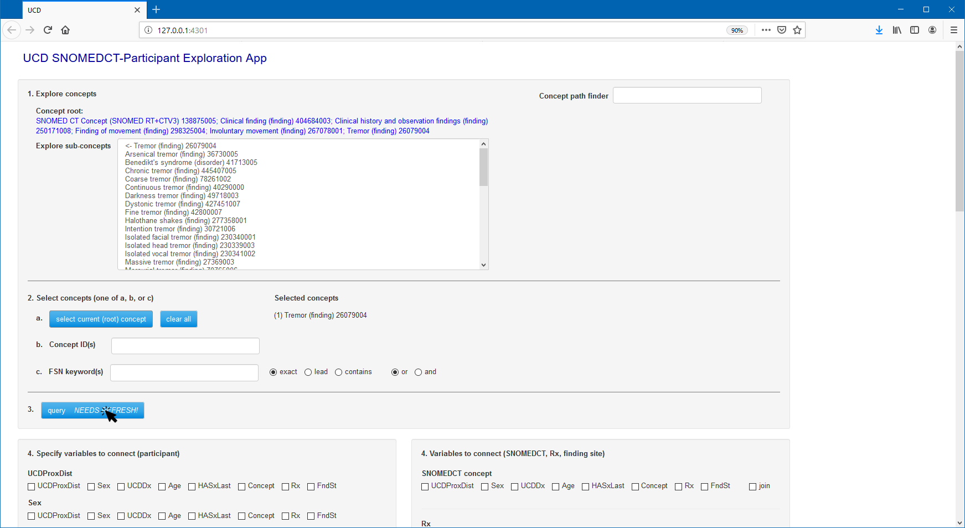
Query participant data

Slide 10
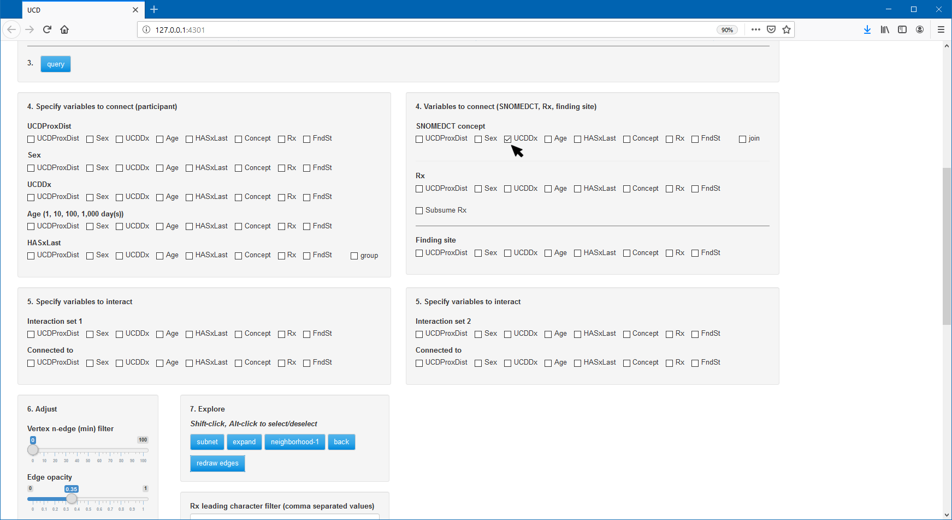
Select variables to be graphed and connected (SNOMED CT concept and UCD diagnosis)

Slide 11
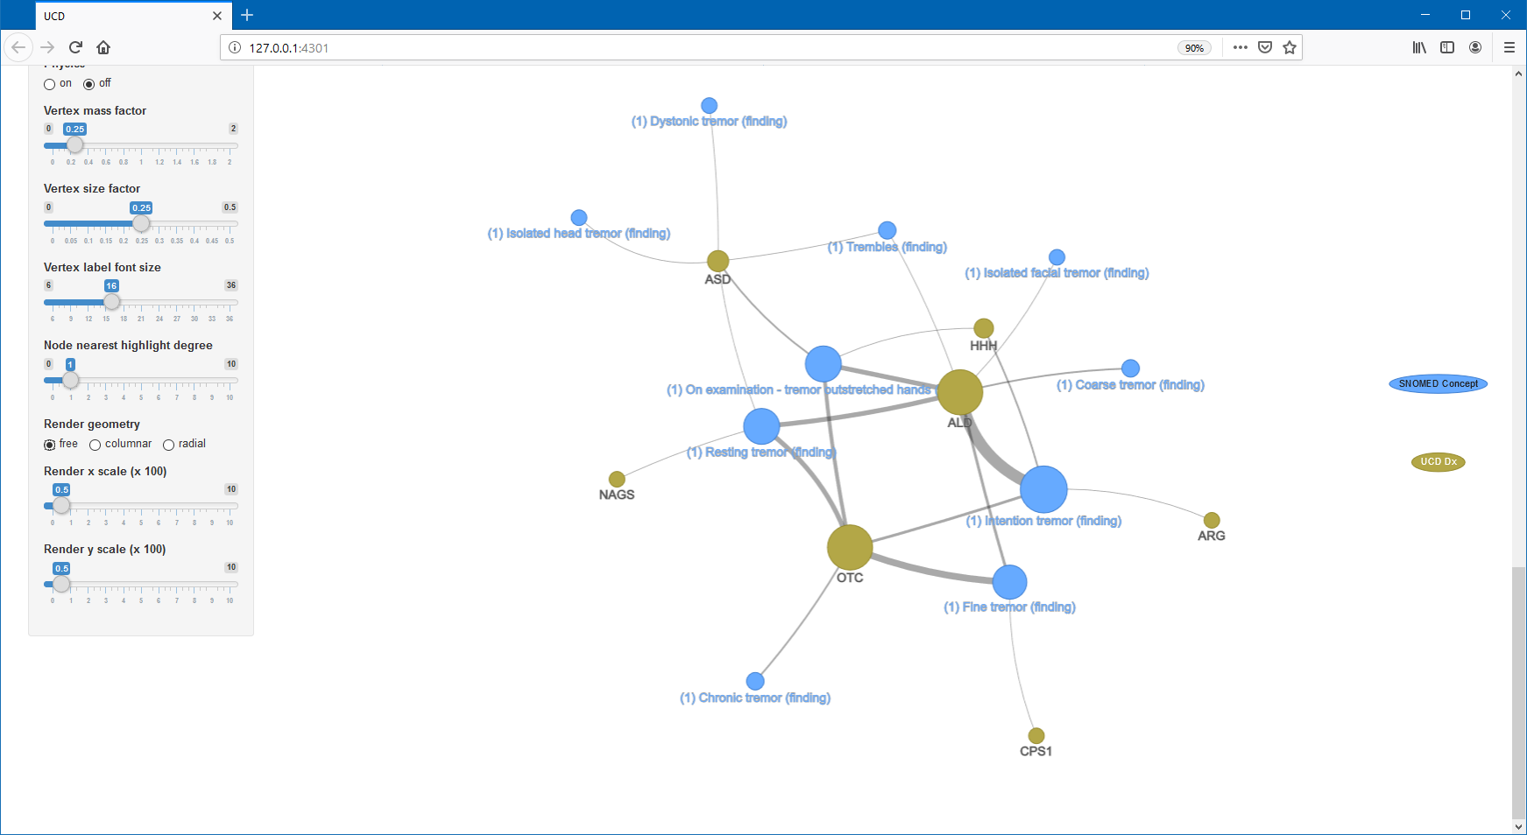
Default (free-form) graph
(1) Indicates the first concept (Tremor) specified (multiple concepts can be selected)

Slide 12
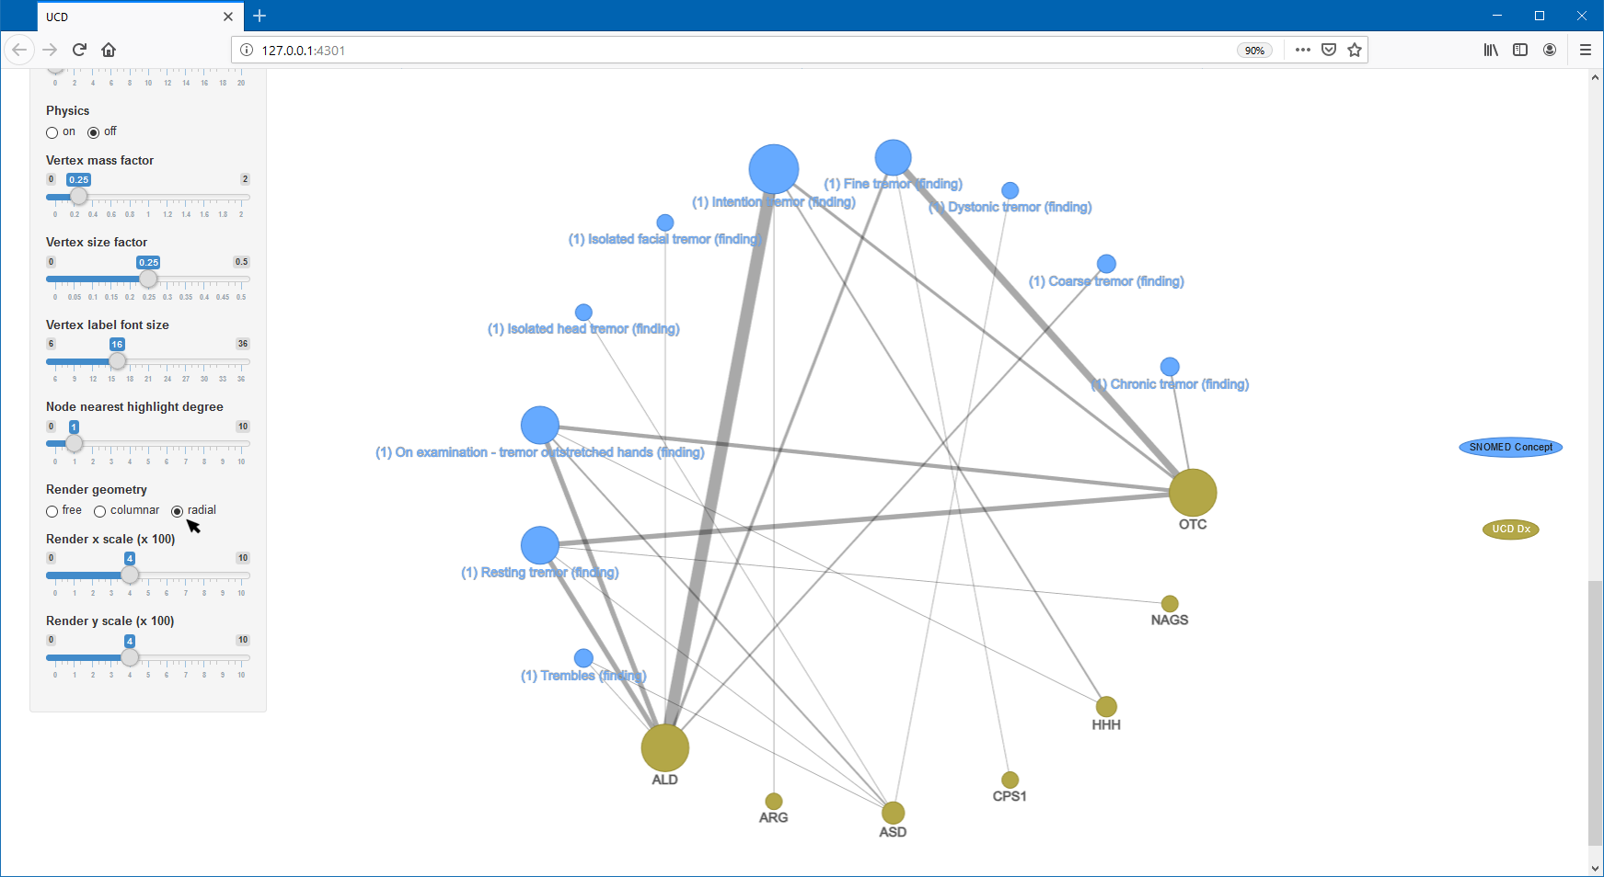
Convert to radial graph

Slide 13
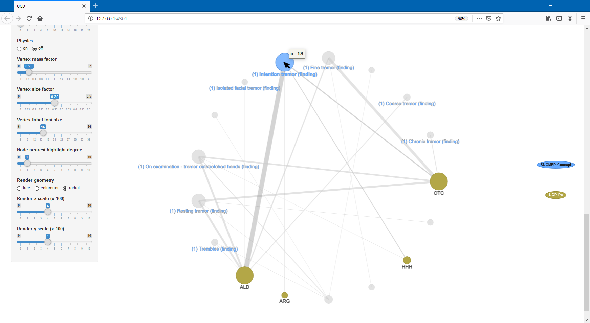
Node hover labels, SNOMED CT concept Intention tremor has 18 distinct participants

Slide 14
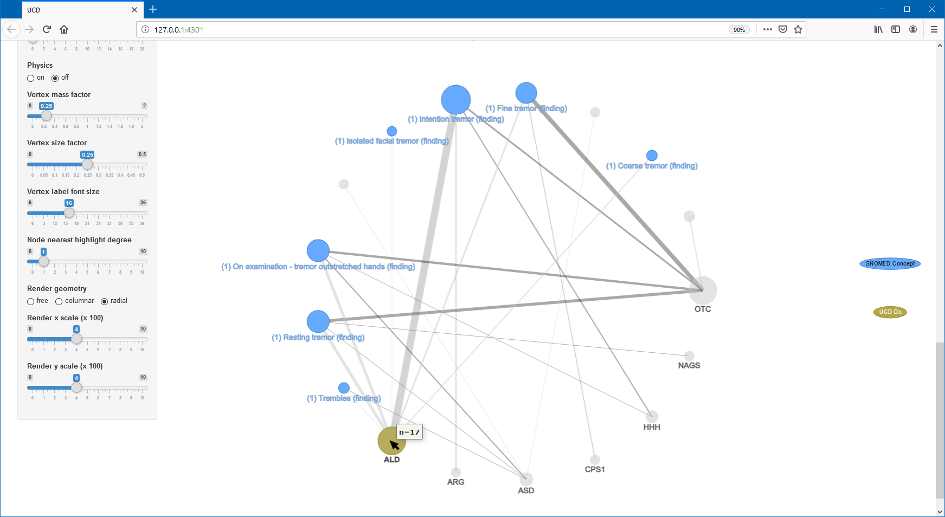
Node hover labels, UCD diagnosis ALD has 17 distinct participants

Slide 15
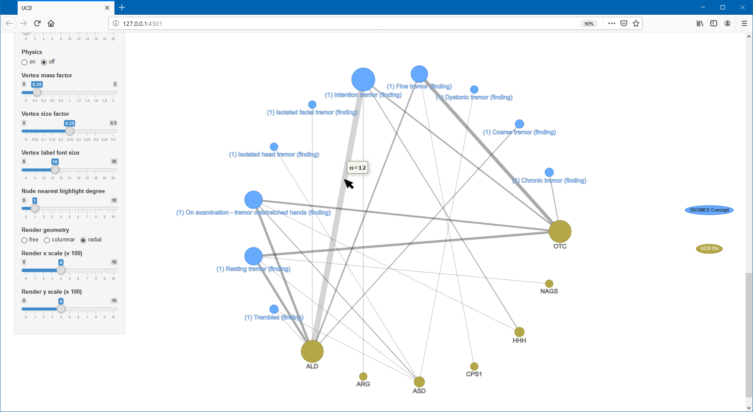
Edge hover labels, 12 distinct participants are associated with both Intention tremor and UCD diagnosis of ALD

Slide 16
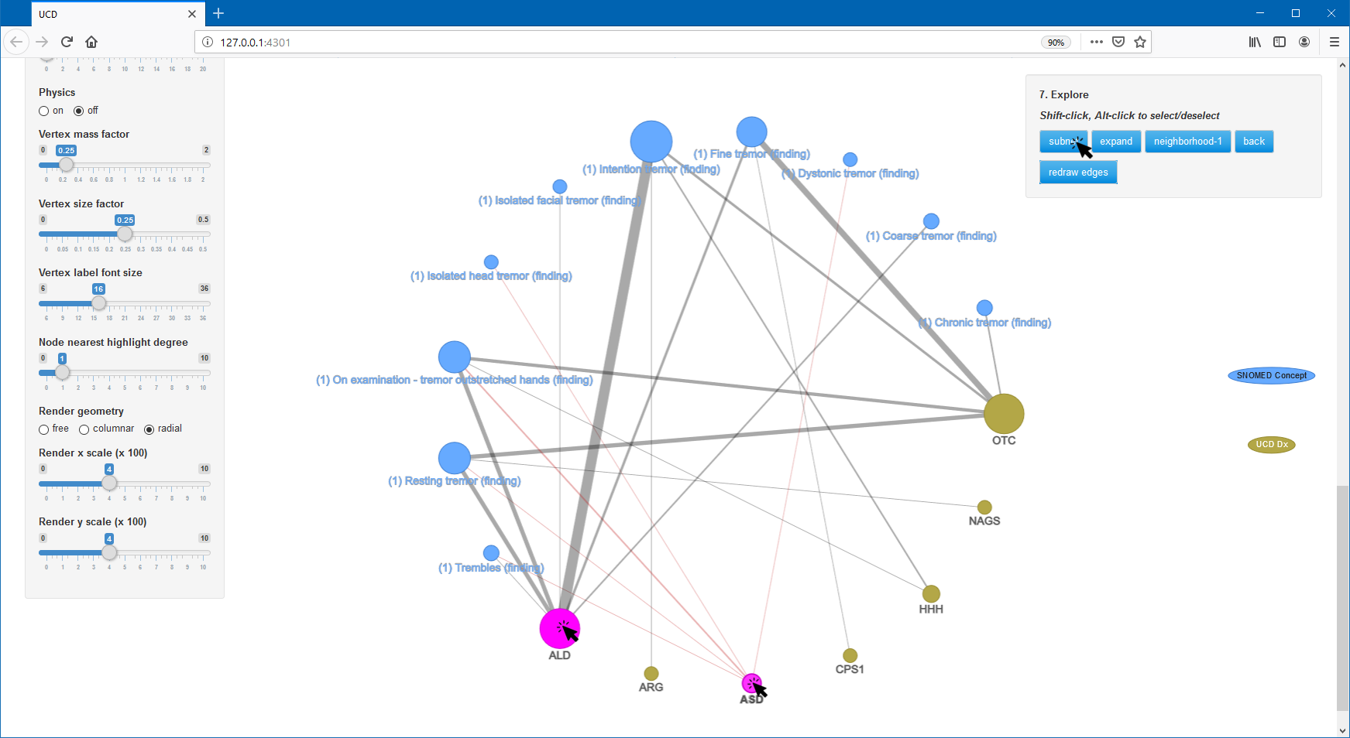
Subnet to include ALD and ASD only (shift-click nodes to select)

Slide 17
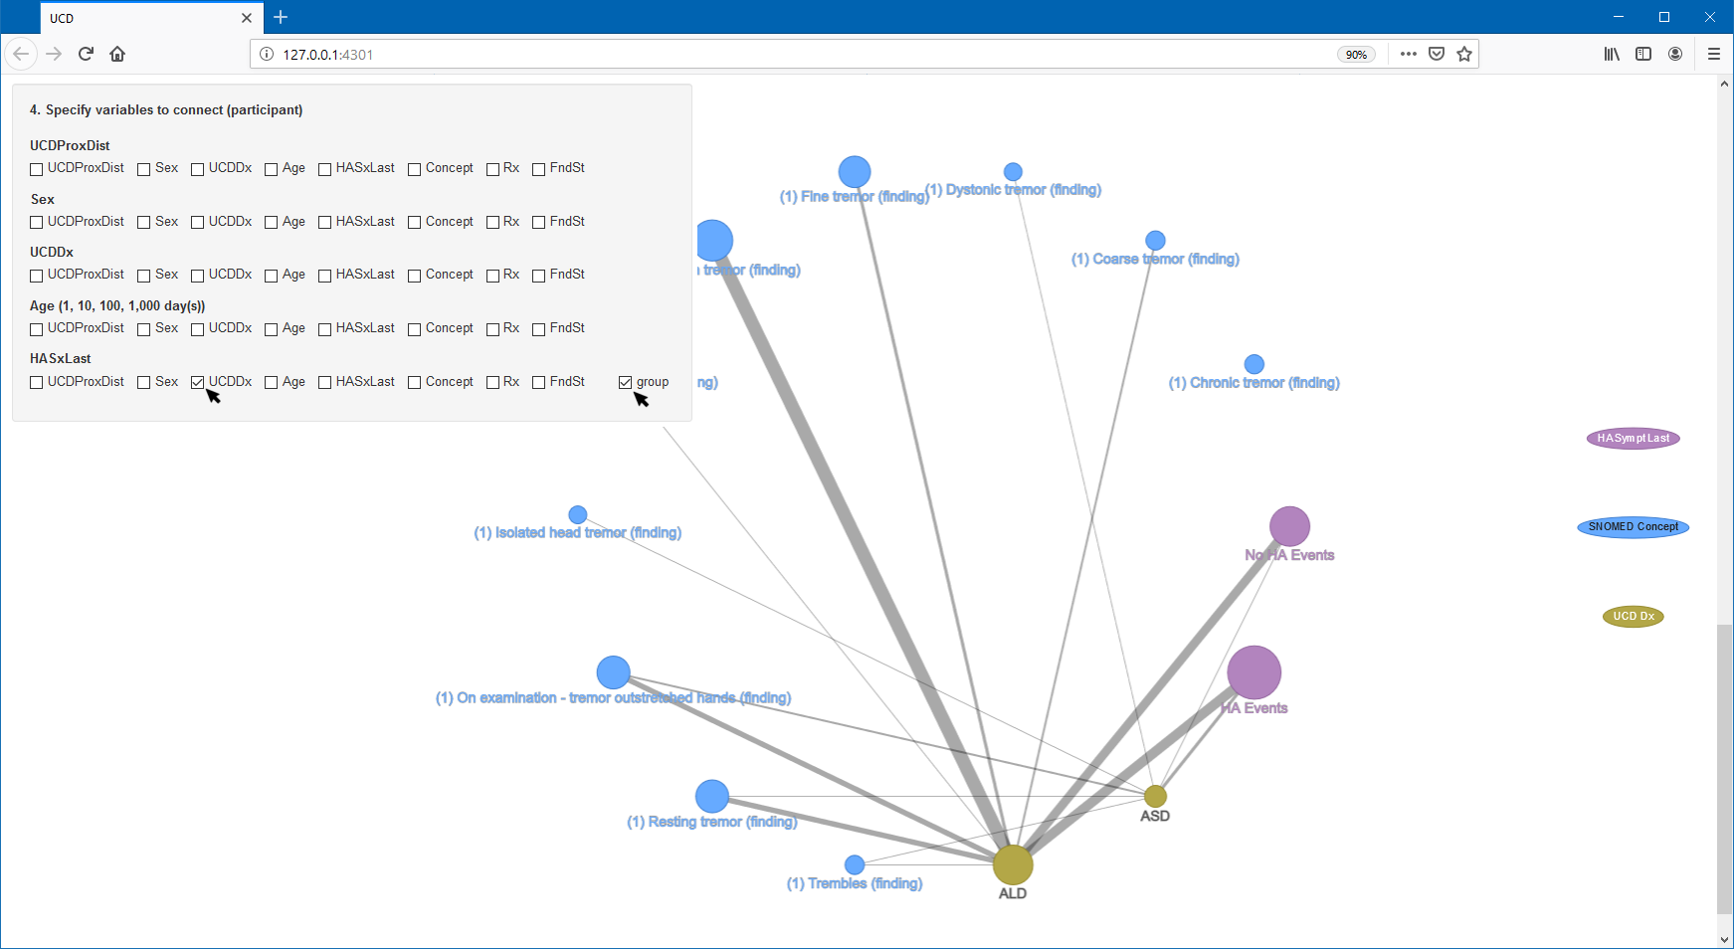
Include nodes for HA and group levels into either with or without HA, specify edges between UCDDx and HA

Slide 18
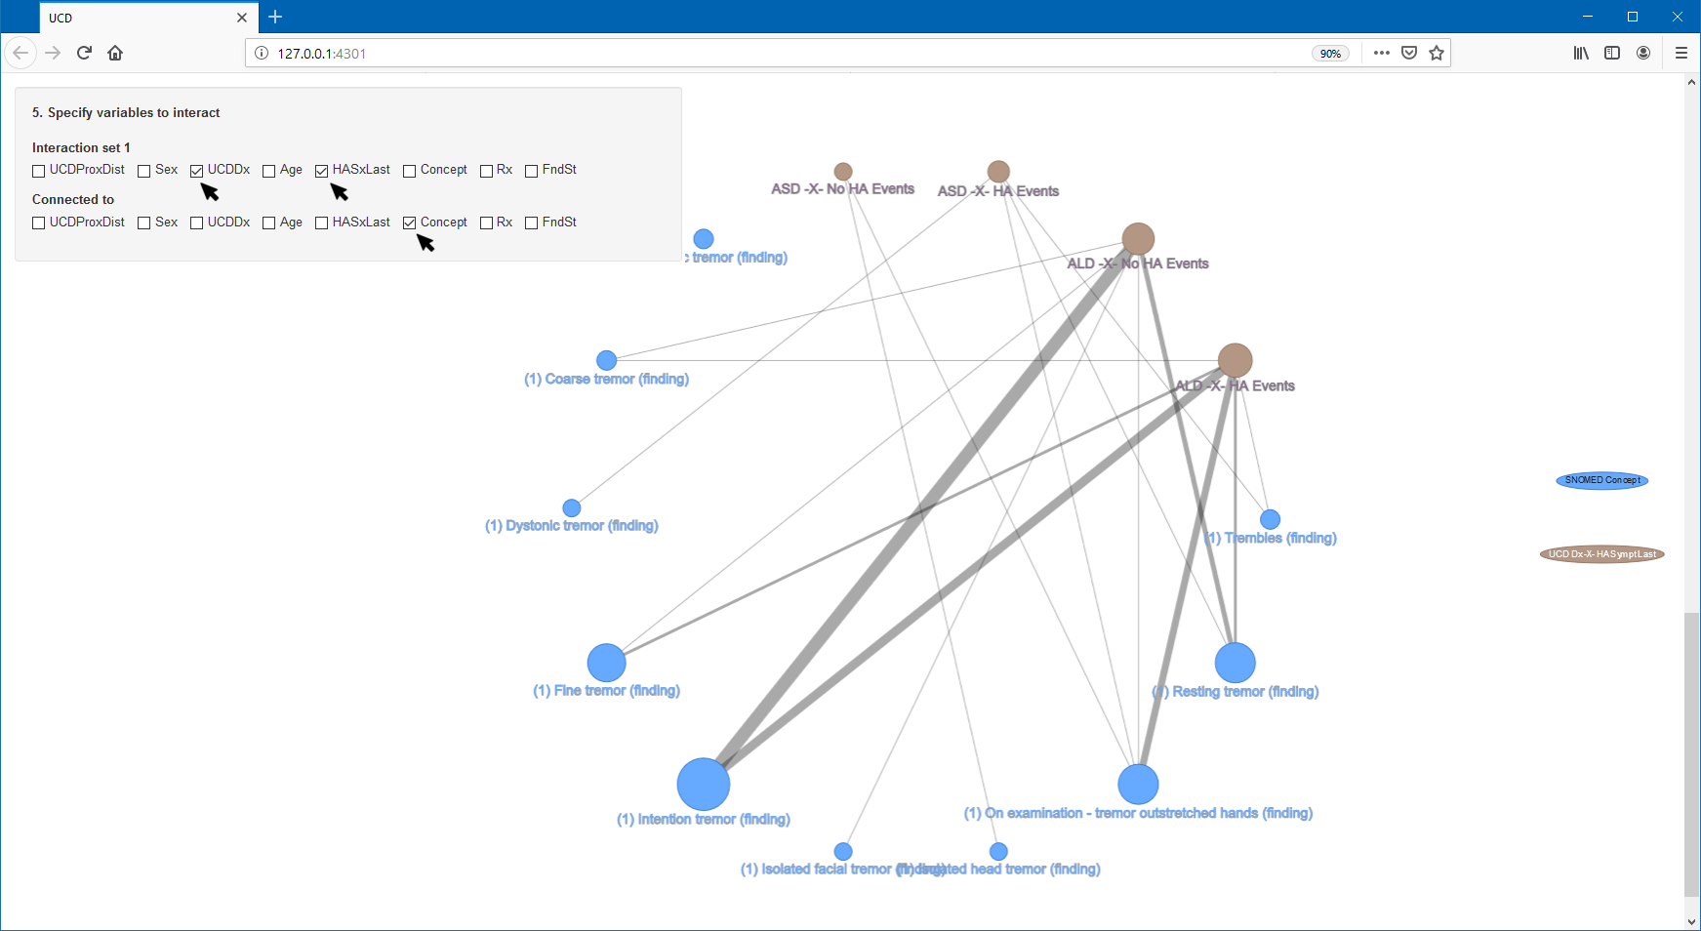
Specify interaction between UCDDx and HA, edges to SNOMED CT concept

Slide 19
Talking point:
“The fact that ALD have no HA events but have resting and intentional tremors… this is a great visualization. Help us decide which of these neurological phenotypes are due to hyperammonemia (as a result of UCD and impacting the brain) versus a loss of other enzymatic function due to the specific disease/failure of the urea cycle metabolism.” (Sandesh quote)

Slide 20
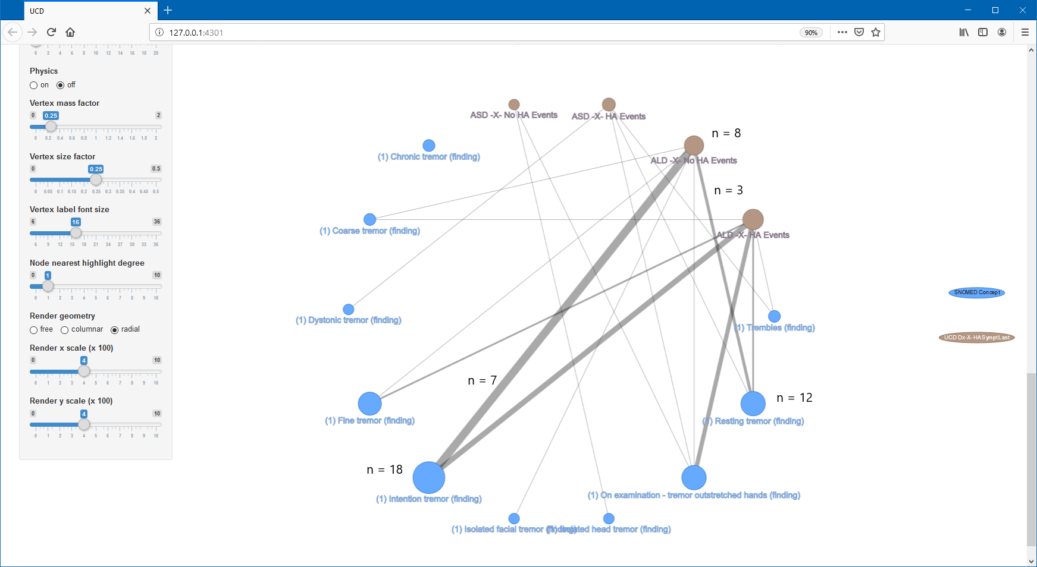
ALD-No-HA participants associated with Intention tremor and/or Resting tremor

Slide 21
CONCLUSIONS - can be part of your video or I can cover in my section after the demonstration.
“The fact that ALD have no HA events but have resting and intentional tremors… this is a great visualization. Help us decide which of these neurological phenotypes are due to hyperammonemia (as a result of UCD and impacting the brain) versus a loss of other enzymatic function due to the specific disease/failure of the urea cycle metabolism.”
In other words, this visualization helps us understand that some patients are showing neurological symptoms (e.g., tremor) - not because of accumulated ammonia neurotoxin (as a sequalae of UCD) - but because of loss of specific enzymes (due to the UCD defect) within the neurons (i.,e., patients with ALD + tremors and NO HA Events)
Specifically, the visualization shows that patients with ALD with no hyperammonemic events have resting tremors, which is interesting and unexpected. Also, if you look at resting tremors, there seem to be more people without HA events than with them.
Confirms a hypothesis/line of investigation that his research team is currently exploring, but also gives us insight into the mechanics of disease for different UCD subtypes, and potentially in the future, targets for intervention.

