Slide 1
Duke University OPM Synthetic data project
Comparing Synthetic Human Capital Data to OPM Source Data
U.S. Office of Personnel Management | Duke University Human Capital and Statistical Sciences | August 31, 2016

Slide 2
comparison data
CPDF: Non-DOD status observations supplied by OPM to Duke University as a result of John de Figueiredo’s 2012 FOIA request (referred to as JdF-2012) n = 28,257,629
Synthetic data: Duke generated version 0.6 (referred to as DIBBS-2016) n = 28,412,573
Variables in study:
OPM Synthetic Data Project | Duke University Human Capital and Statistical Sciences
Pseudo ID
Fiscal Year
Agency
Sex
Race
ERI Bridge
Education Level
Age Range
Occupational Category
Occupation
Pay Plan
Grade
Step Rate
Pay Basis
Work Schedule
Basic Pay

Slide 3
Additional comparison data
FedScope 1998-2011 September CPDF data (source: www.opm.gov/data)
Pseudo ID unavailable (needed for longitudinal studies, promotion, etc.)
Education Level unavailable for 1998-2003
Race unavailable
FedScope Salary = CPDF Adjusted Basic Pay (not synthesized)
OPM Synthetic Data Project | Duke University Human Capital and Statistical Sciences

Slide 4
john: Fed-Scope data are included in time series plots only since data are available for 1998-2011 only combining fed-scope with total period proportion tables or bar plots would exhibit differences due to different periods covered also, race is not available in the fed-scope data Nor are pseudo IDs, so year of entry (age of new employee) is unavailable
OPM Synthetic Data Project | Duke University Human Capital and Statistical Sciences

Slide 5
1988 – 2011 Total Observation Count
 | Observations
CPDF | 28,257,629
Synthetic | 28,512,573
OPM Synthetic Data Project | Duke University Human Capital and Statistical Sciences

Slide 6
1988 – 2011 observation Count BY SEX
 | CPDF |  | Synthetic
Female | 13,782,762 | 48.78% | 13,920,912 | 48.82%
Male | 14,474,840 | 51.22% | 14,591,661 | 51.18%
OPM Synthetic Data Project | Duke University Human Capital and Statistical Sciences

Slide 7
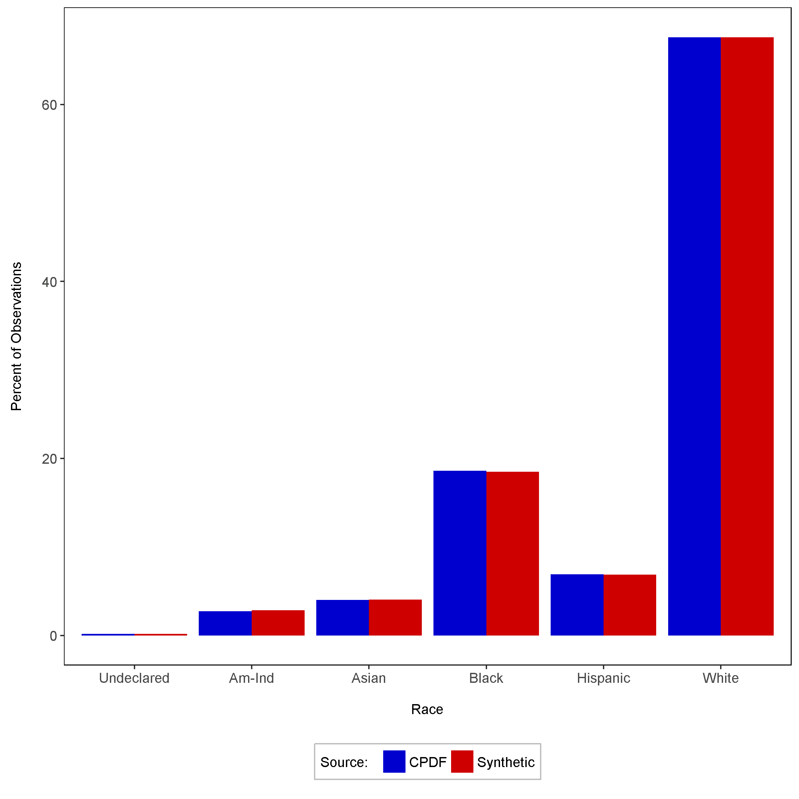
1988 – 2011 observations - percent BY rACE
OPM Synthetic Data Project | Duke University Human Capital and Statistical Sciences

Slide 8
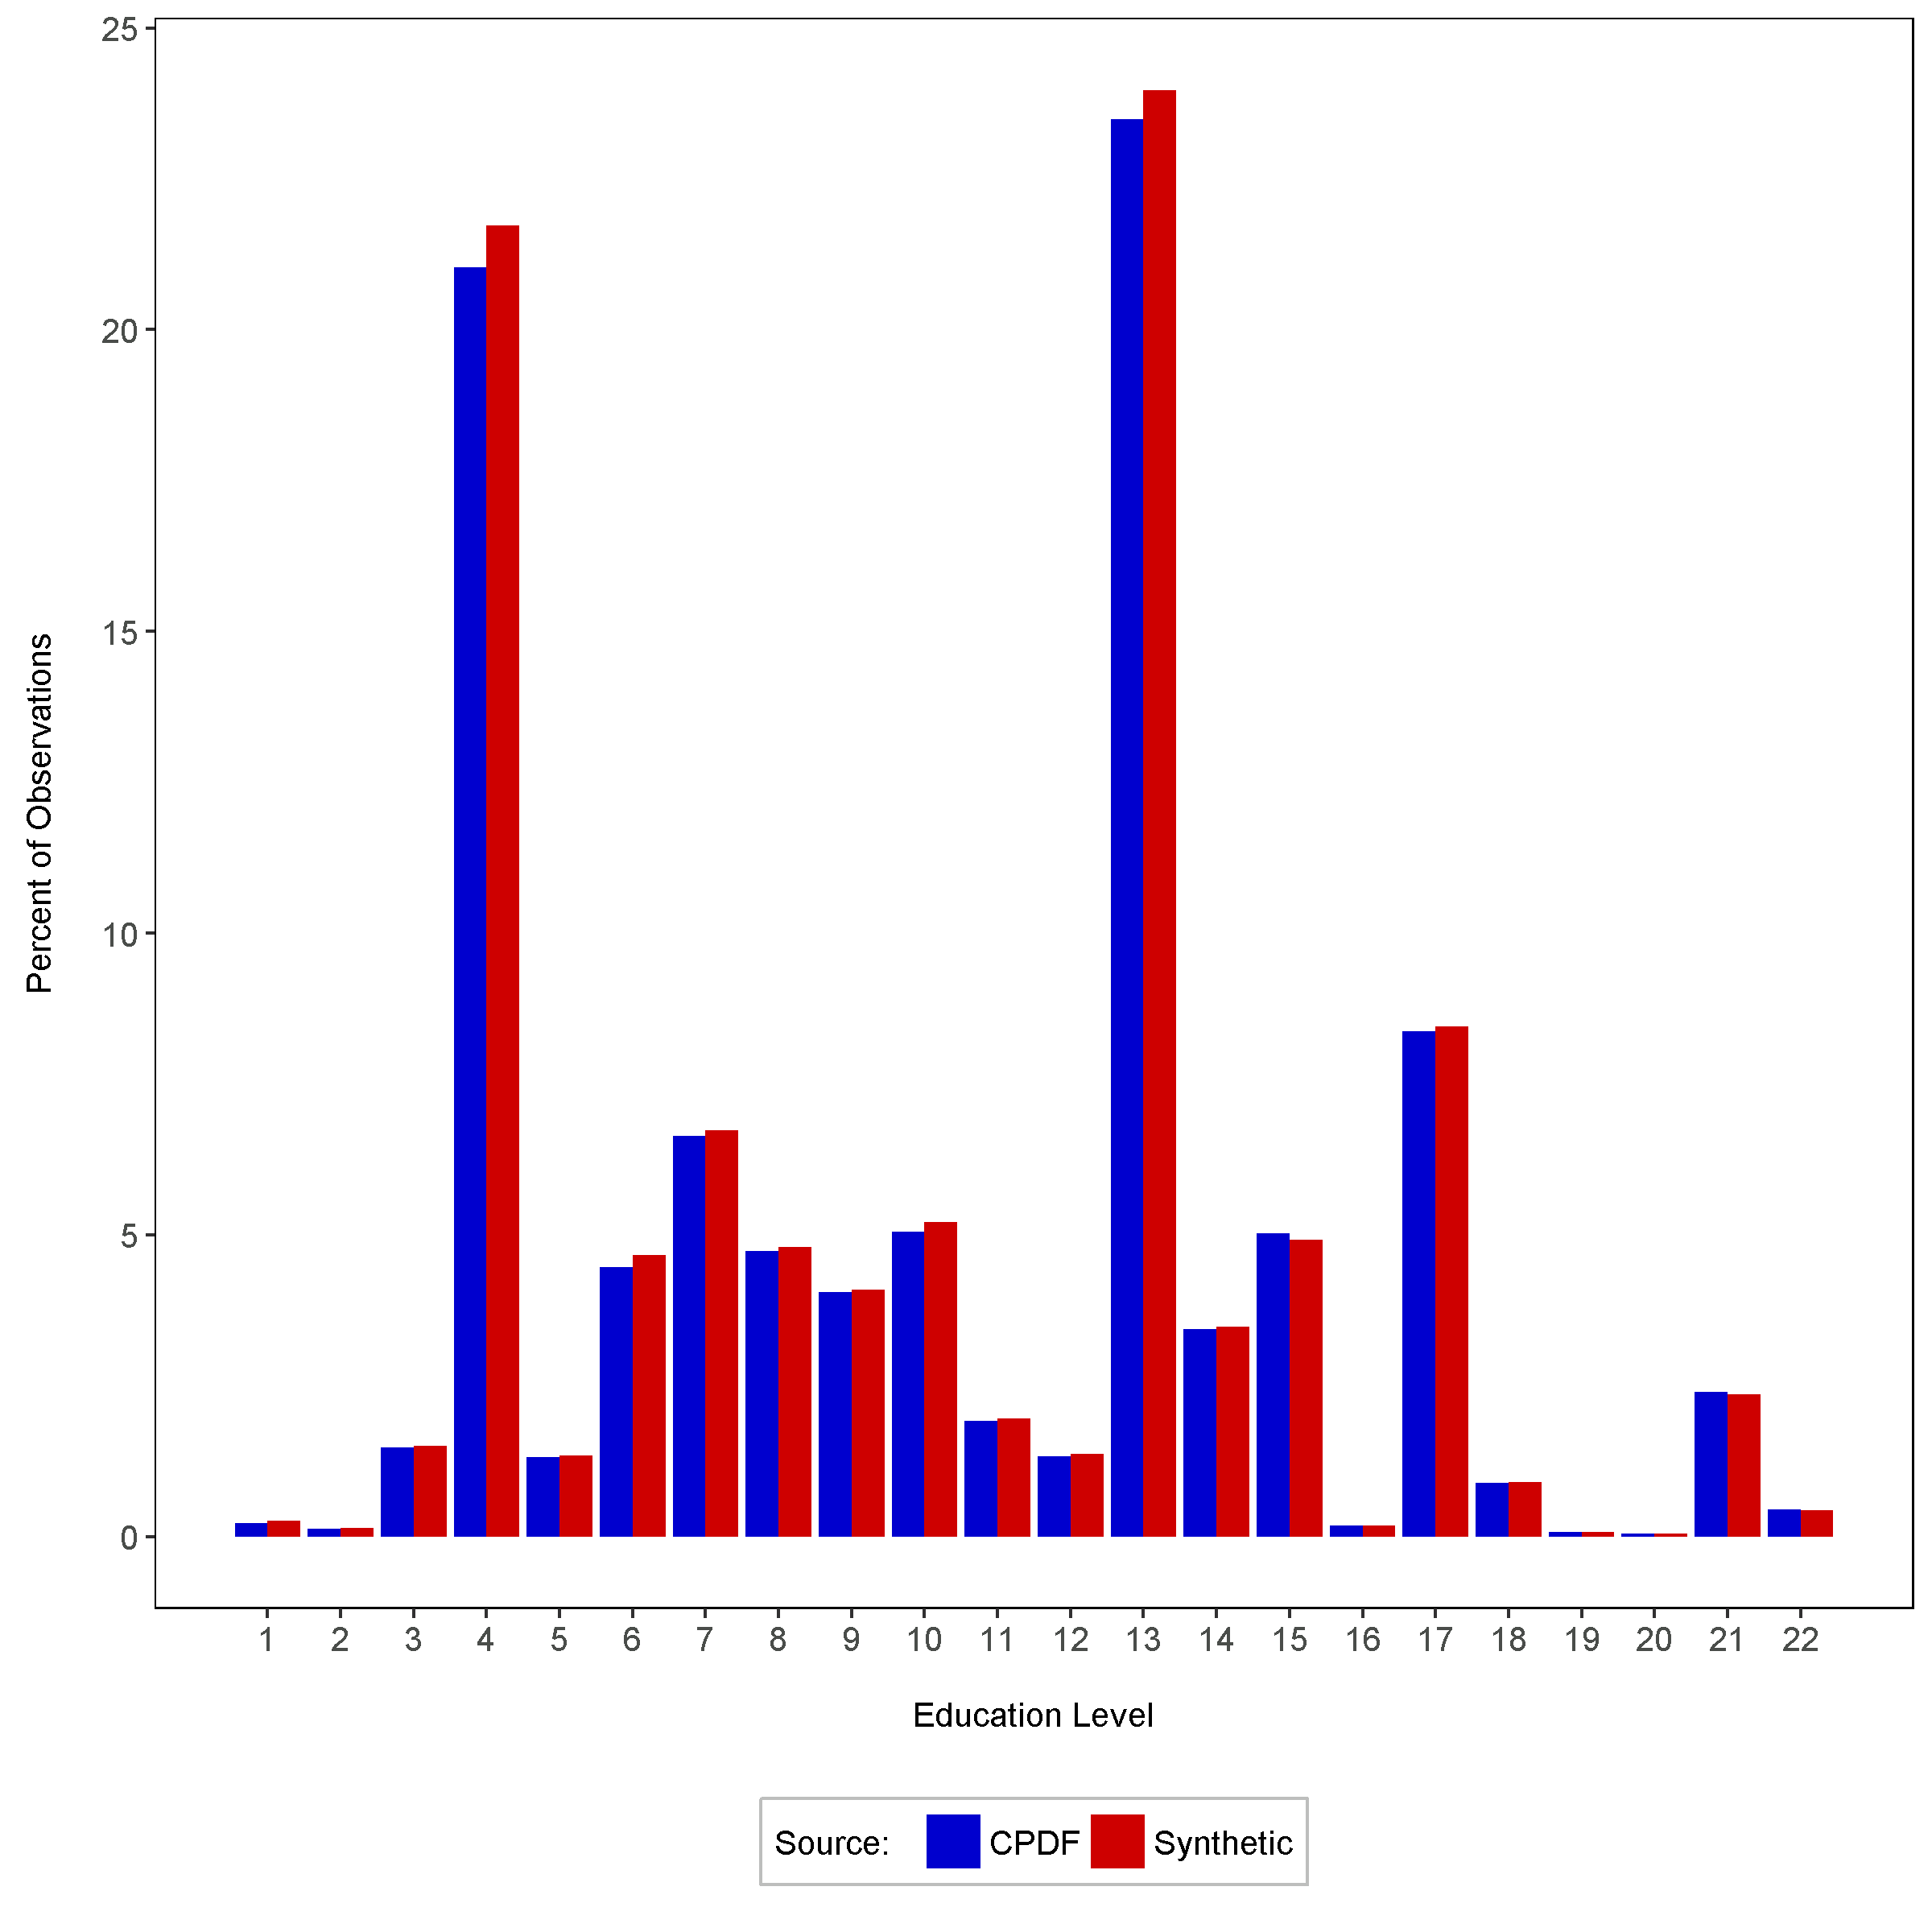
1988 – 2011 observations - percent BY Education
OPM Synthetic Data Project | Duke University Human Capital and Statistical Sciences

Slide 9
CPDF education code definitions
0 | NOT APPLICABLE
1 | NO FORMAL EDUCATION OR SOME ELEM SCHOOL
2 | ELEMENTARY SCHOOL COMPLETED - NO HIGH SC
3 | SOME HIGH SCHOOL - DID NOT COMPLETE
4 | HIGH SCHOOL GRADUATE OR CERTIFICATE OF E
5 | TERMINAL OCCUPATIONAL PROGRAM - DID NOT
6 | TERMINAL OCCUPATIONAL PROGRAM - CERTIFIC
7 | SOME COLLEGE - LESS THAN ONE YEAR
8 | ONE YEAR COLLEGE
9 | TWO YEARS COLLEGE
10 | ASSOCIATE DEGREE
11 | THREE YEARS COLLEGE
12 | FOUR YEARS COLLEGE
13 | BACHELOR'S DEGREE
14 | POST-BACHELOR'S
15 | FIRST PROFESSIONAL
16 | POST-FIRST PROFESSIONAL
17 | MASTER'S DEGREE
18 | POST-MASTER'S
19 | SIXTH-YEAR DEGREE
20 | POST-SIXTH YEAR
21 | DOCTORATE DEGREE
22 | POST-DOCTORATE
OPM Synthetic Data Project | Duke University Human Capital and Statistical Sciences

Slide 10
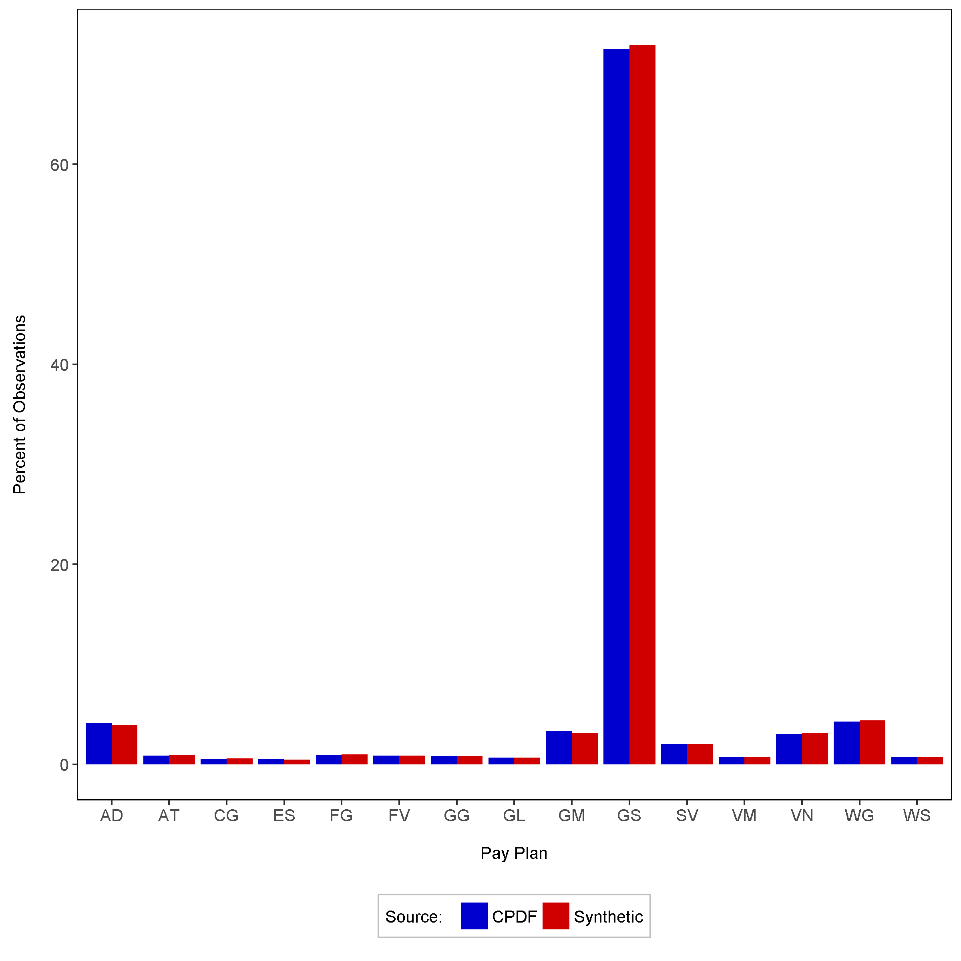
1988 – 2011 observations - percent BY Pay Plan
OPM Synthetic Data Project | Duke University Human Capital and Statistical Sciences

Slide 11
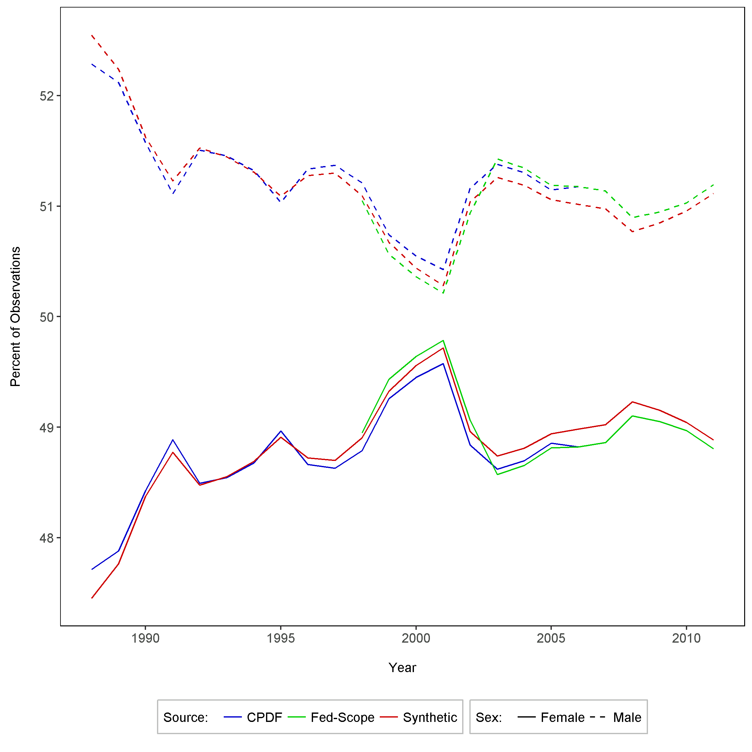
Time series – percent observations by sex
OPM Synthetic Data Project | Duke University Human Capital and Statistical Sciences

Slide 12
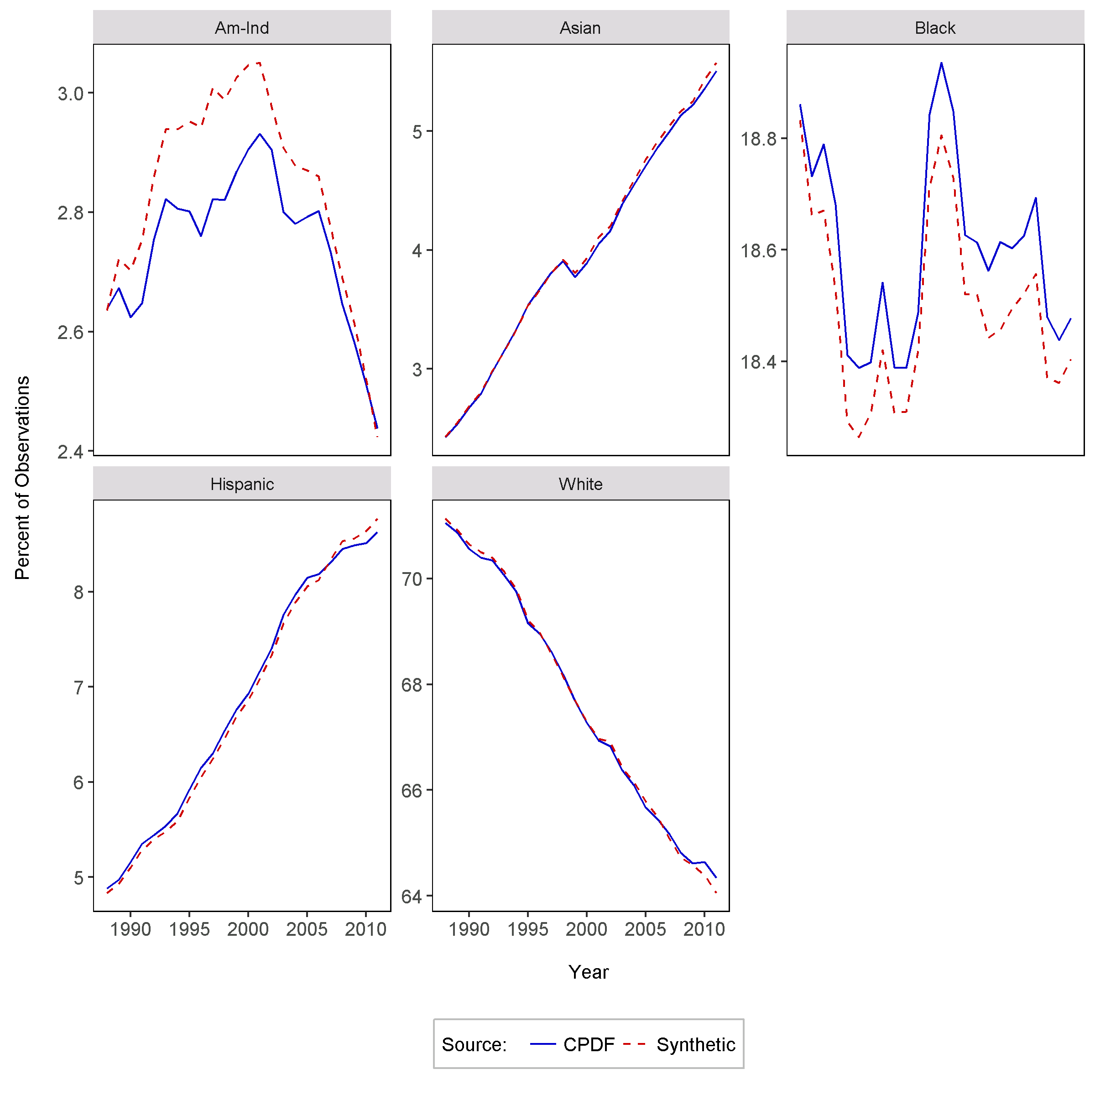
Time series – percent observations by race
OPM Synthetic Data Project | Duke University Human Capital and Statistical Sciences

Slide 13
Summary comparisons
From Grade Inflation Research
OPM Synthetic Data Project | Duke University Human Capital and Statistical Sciences

Slide 14
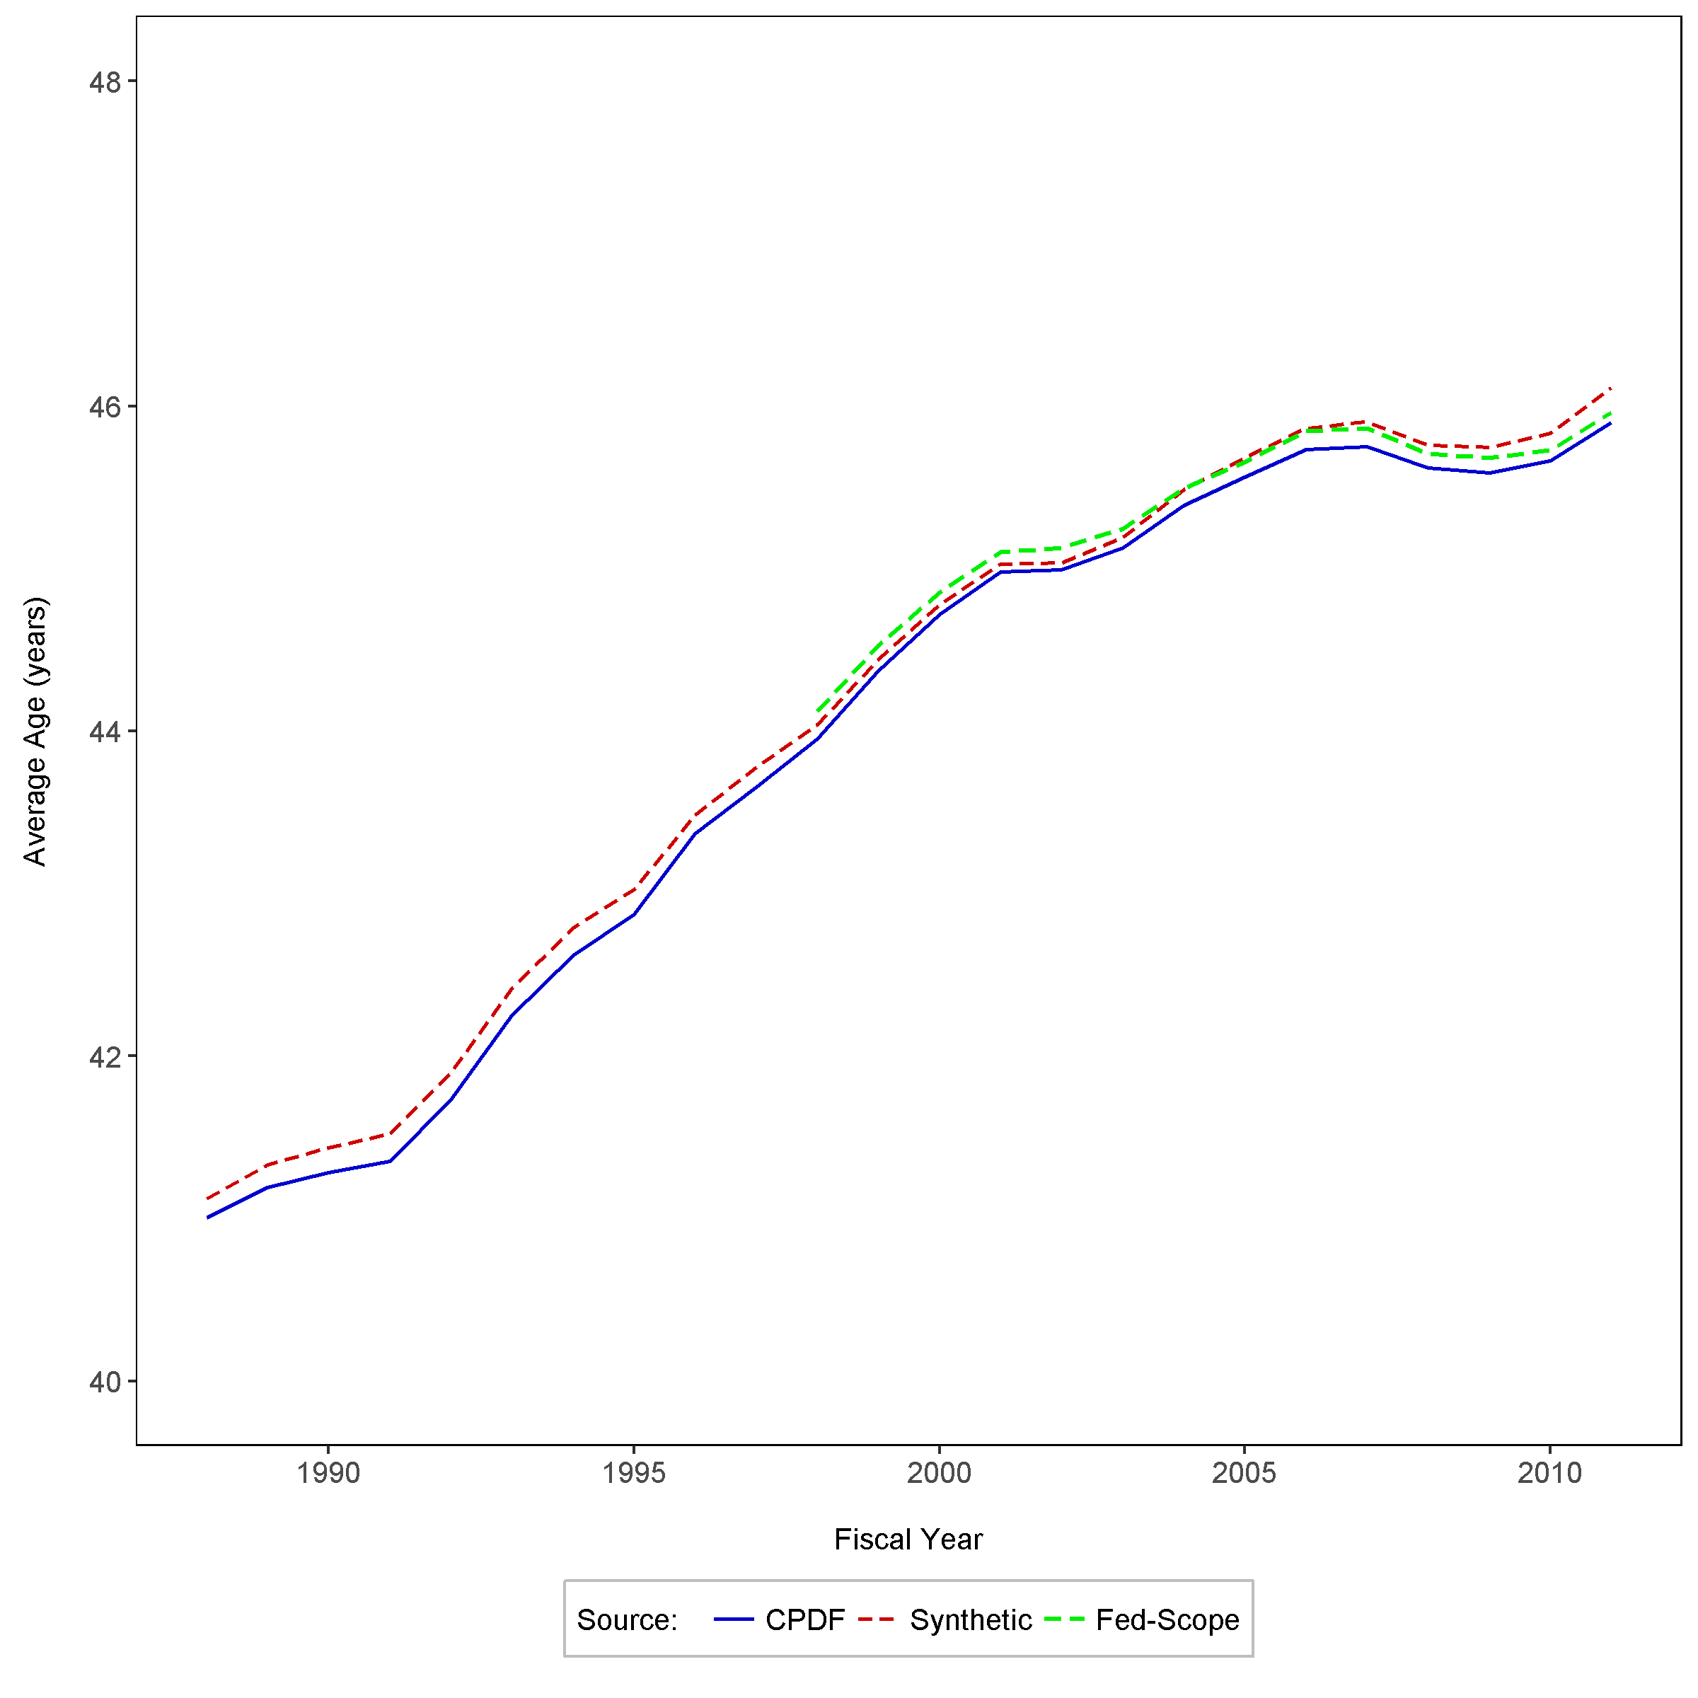
Average federal employee age 1988-2011, FT employees
OPM Synthetic Data Project | Duke University Human Capital and Statistical Sciences

Slide 15
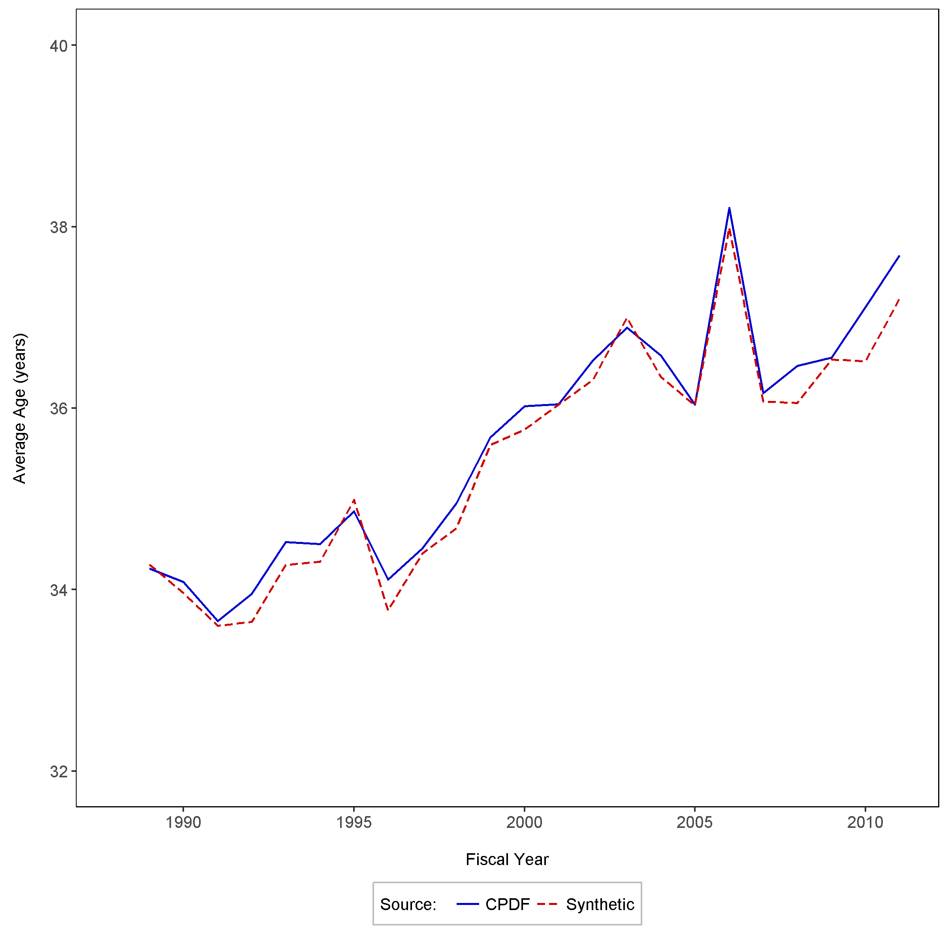
Average federal employee age 1988-2011, new FT employees
OPM Synthetic Data Project | Duke University Human Capital and Statistical Sciences

Slide 16
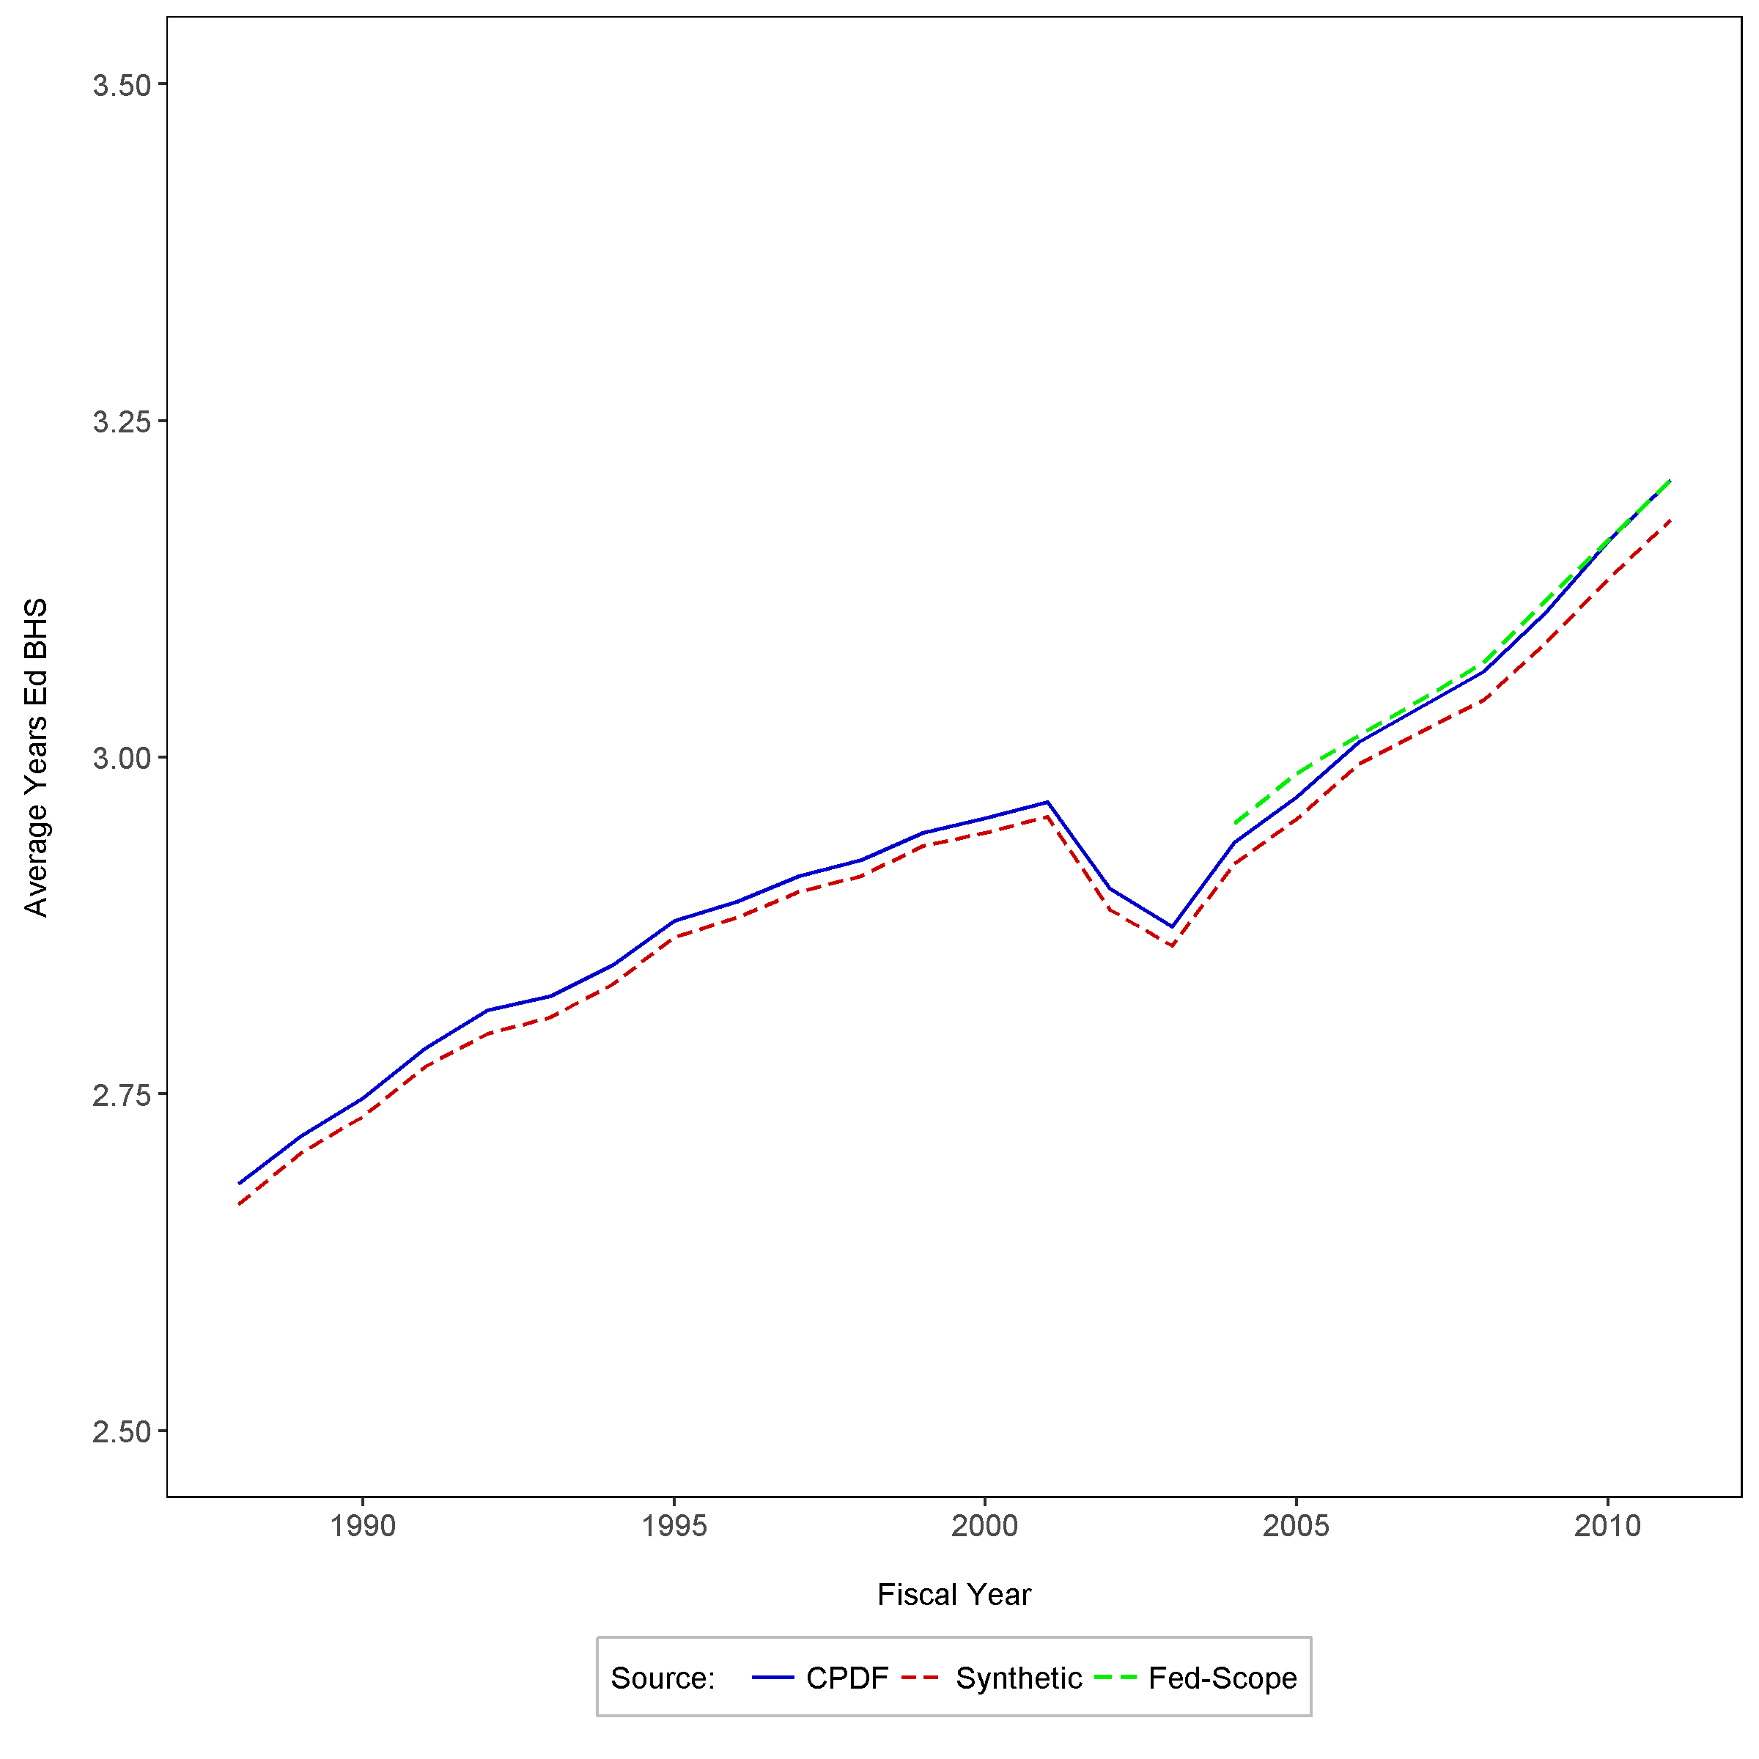
Average federal employee education, FT employees
OPM Synthetic Data Project | Duke University Human Capital and Statistical Sciences

Slide 17
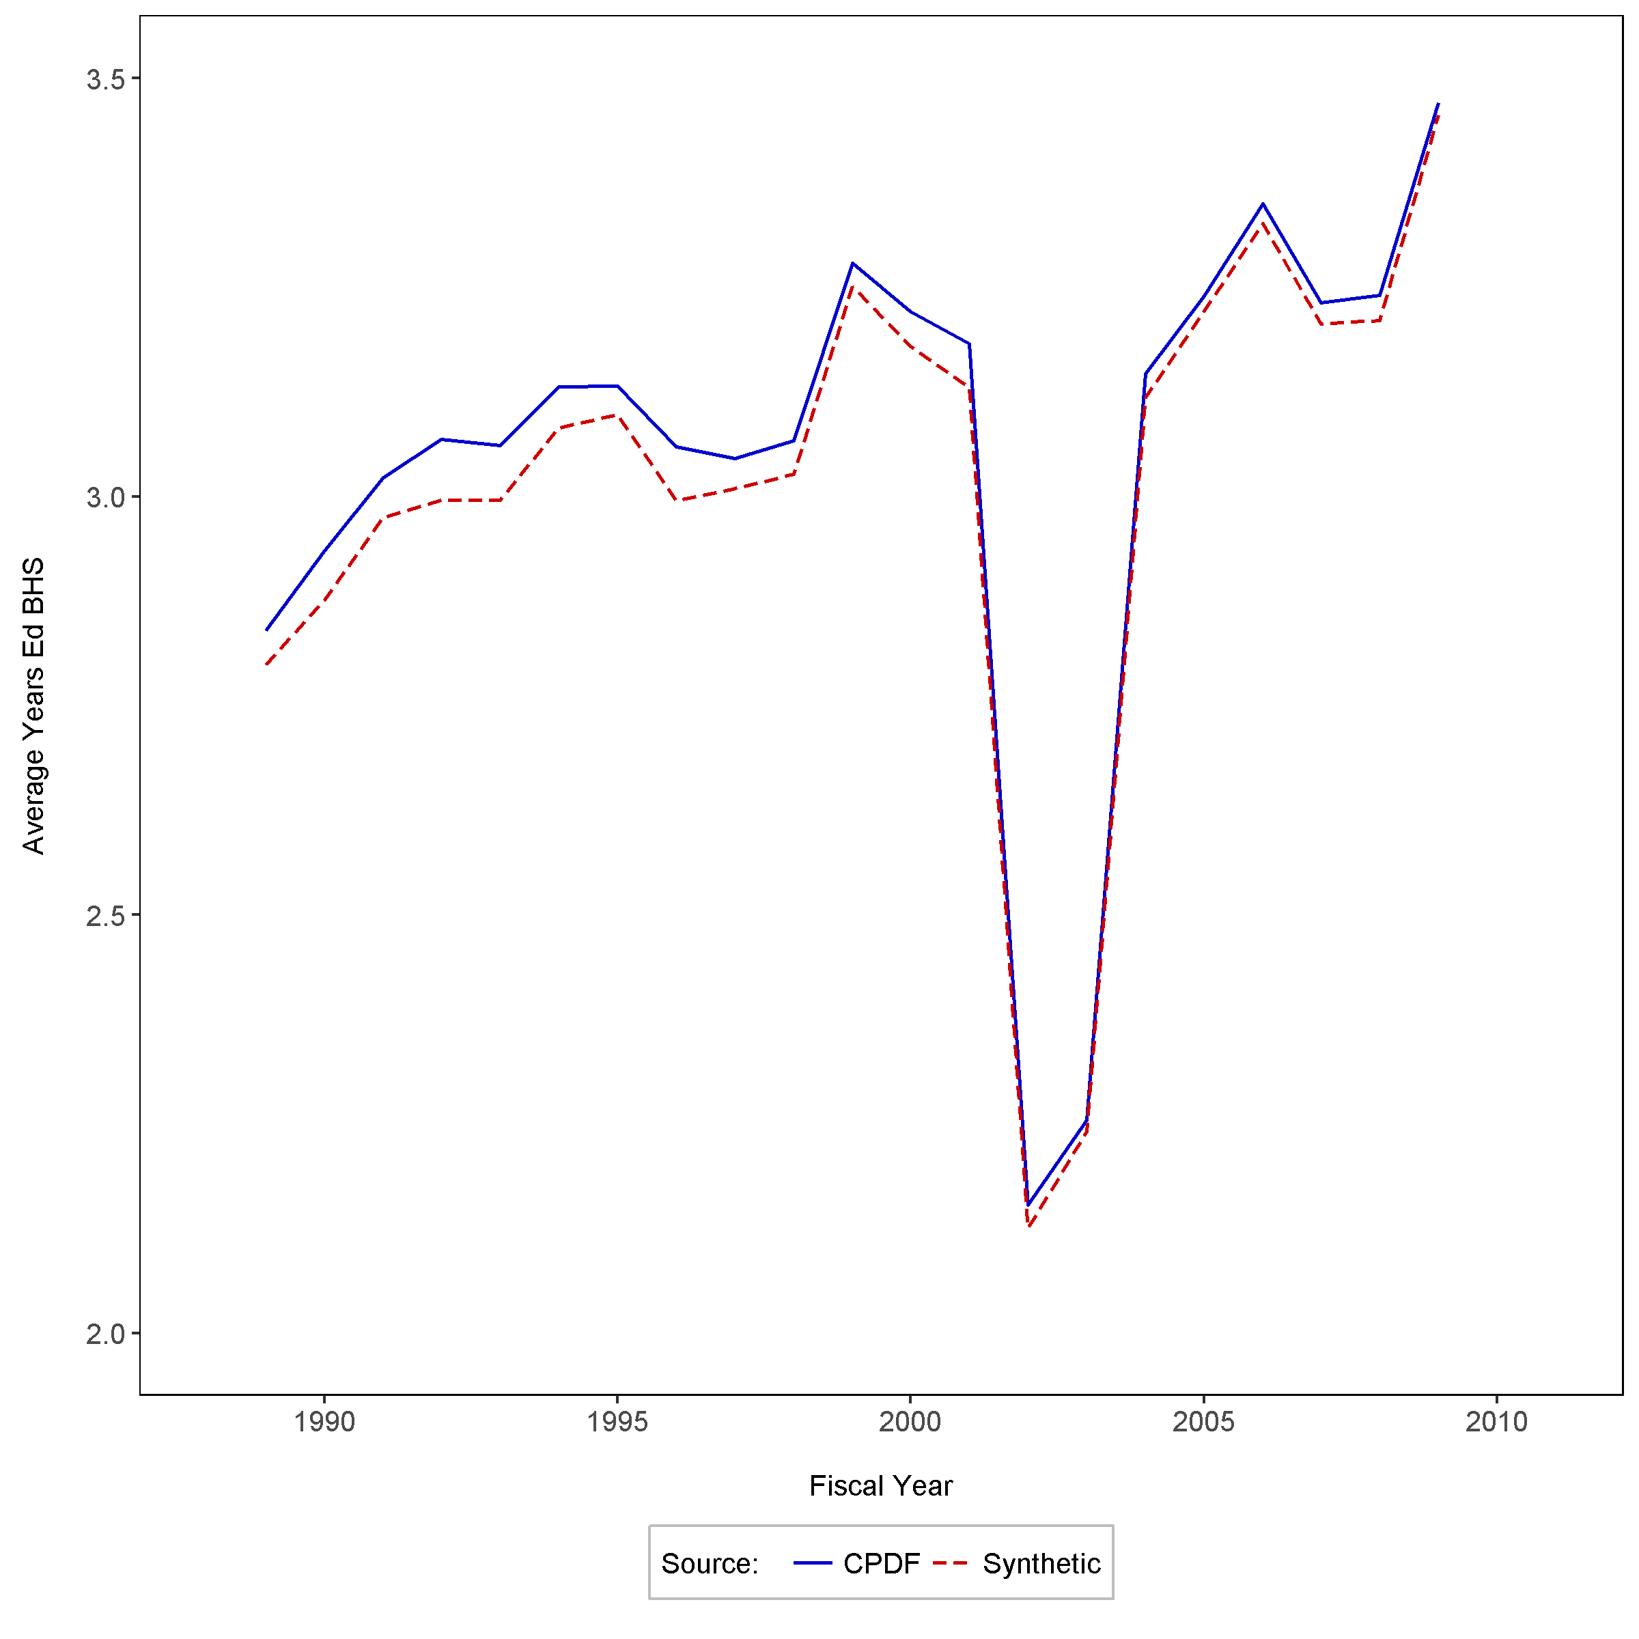
Average federal employee education, new FT employees
OPM Synthetic Data Project | Duke University Human Capital and Statistical Sciences

Slide 18
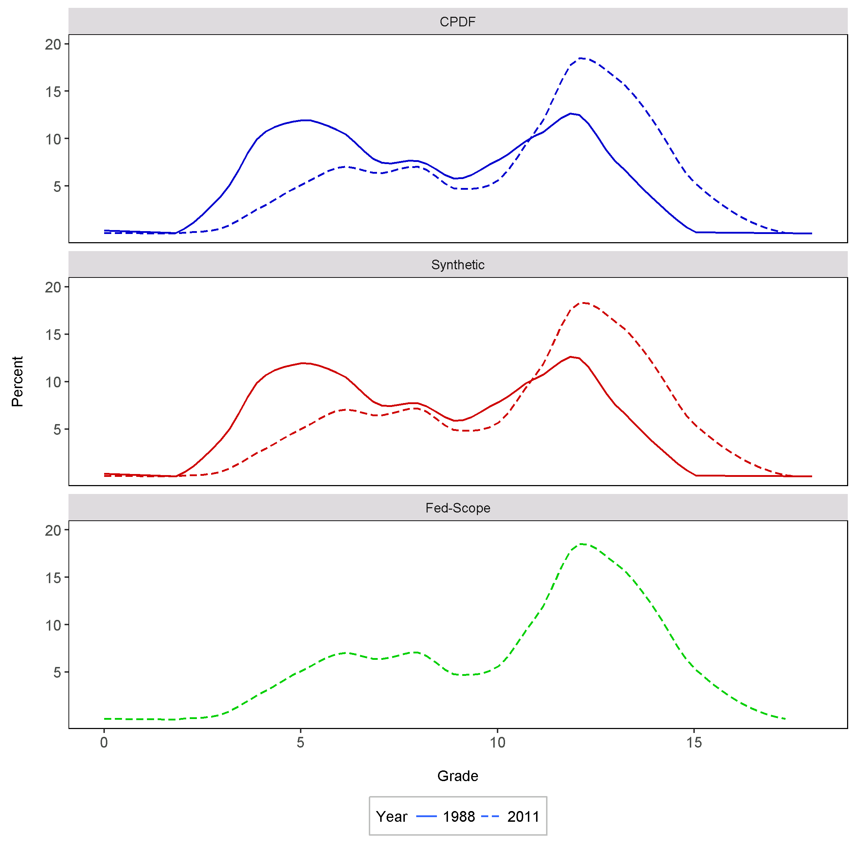
Distribution of gs employees by grade, 2011 vs. 1998
OPM Synthetic Data Project | Duke University Human Capital and Statistical Sciences

Slide 19
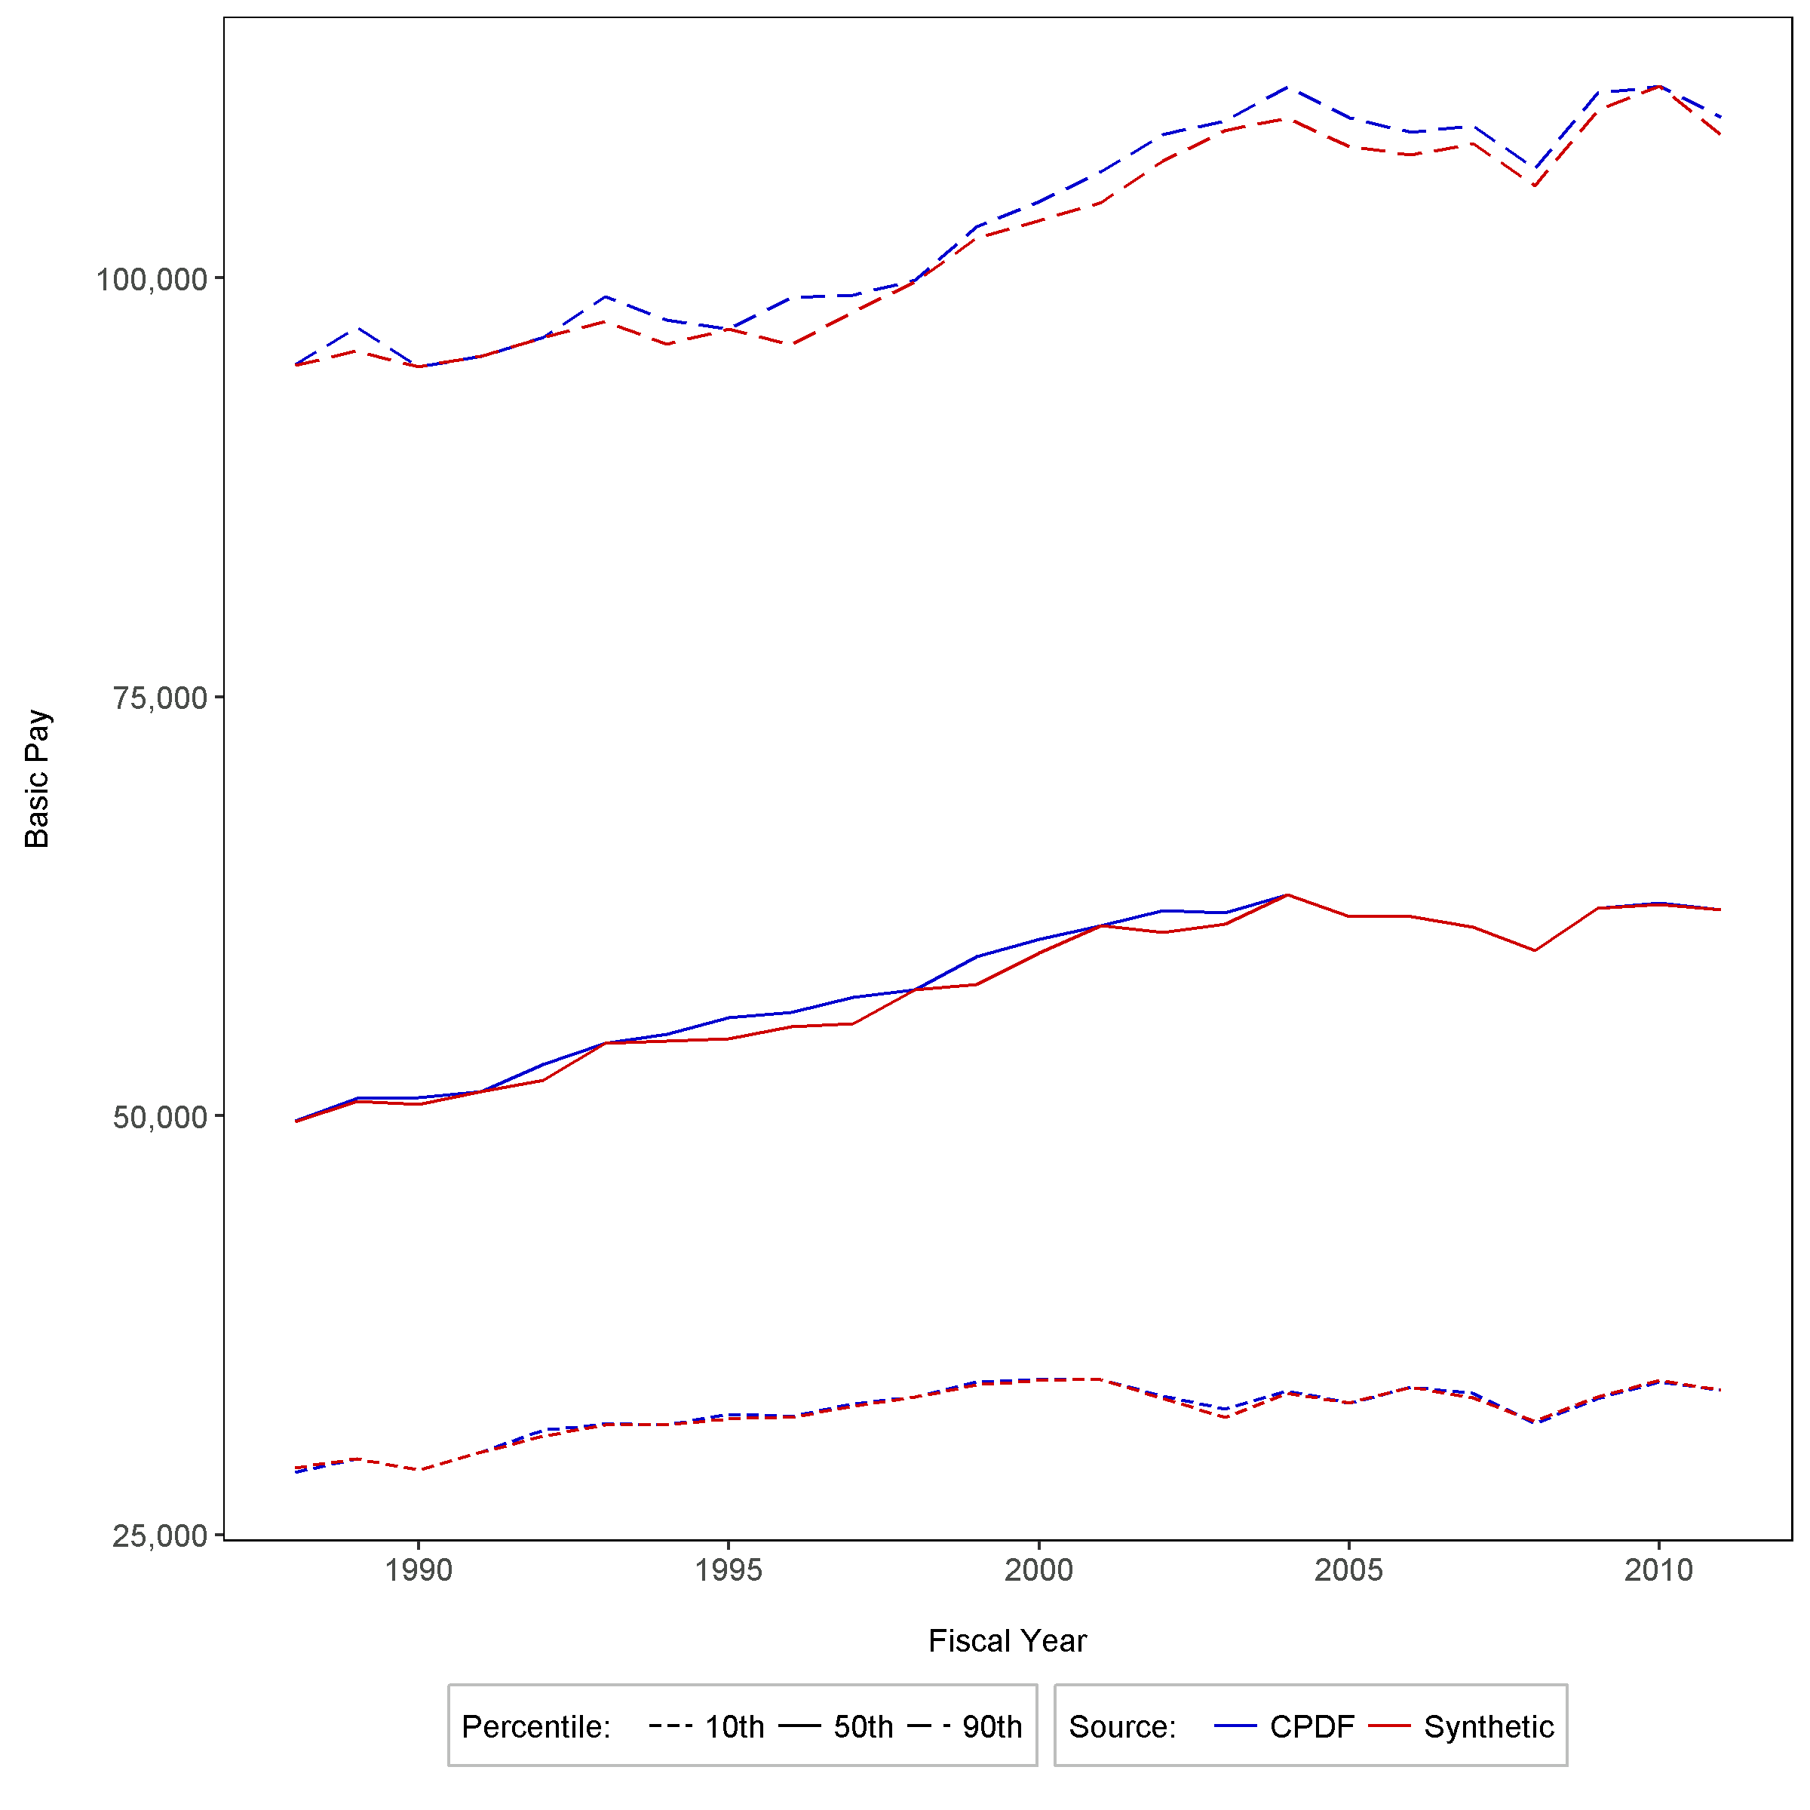
Federal basic pay percentiles by year, all pay plans
OPM Synthetic Data Project | Duke University Human Capital and Statistical Sciences

Slide 20
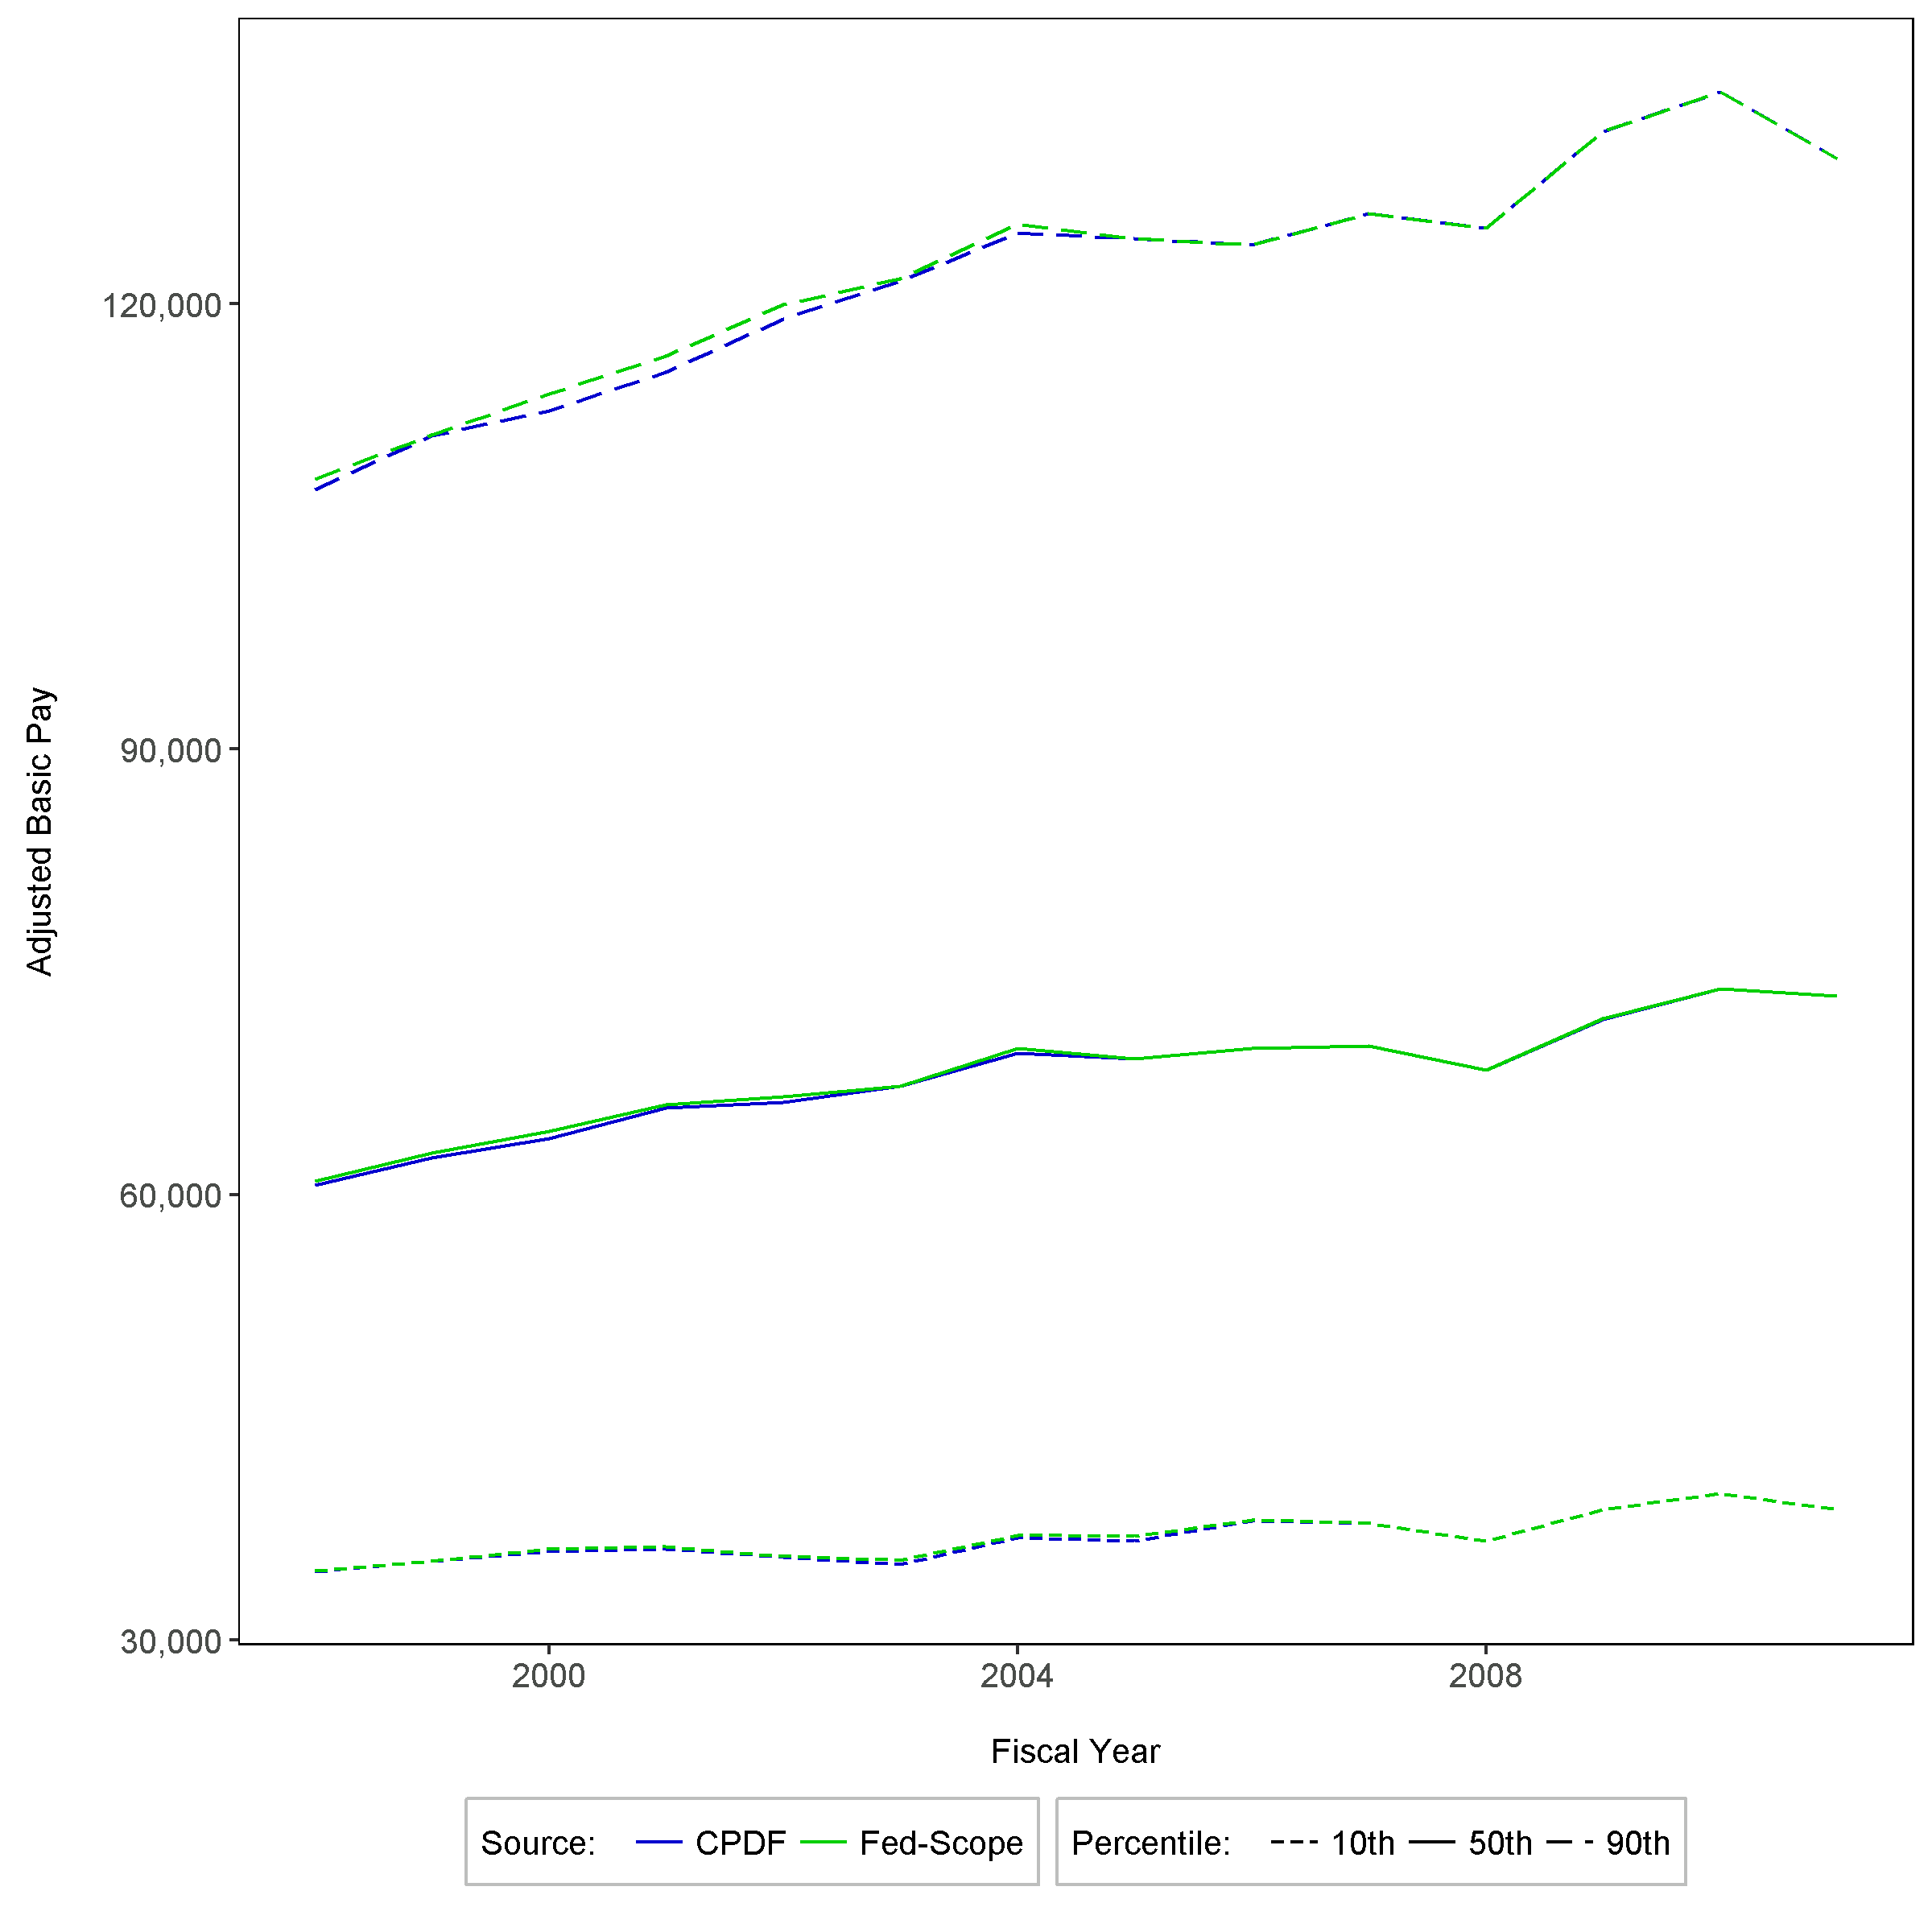
Federal adjusted basic pay percentiles by year, all pay plans
OPM Synthetic Data Project | Duke University Human Capital and Statistical Sciences

Slide 21
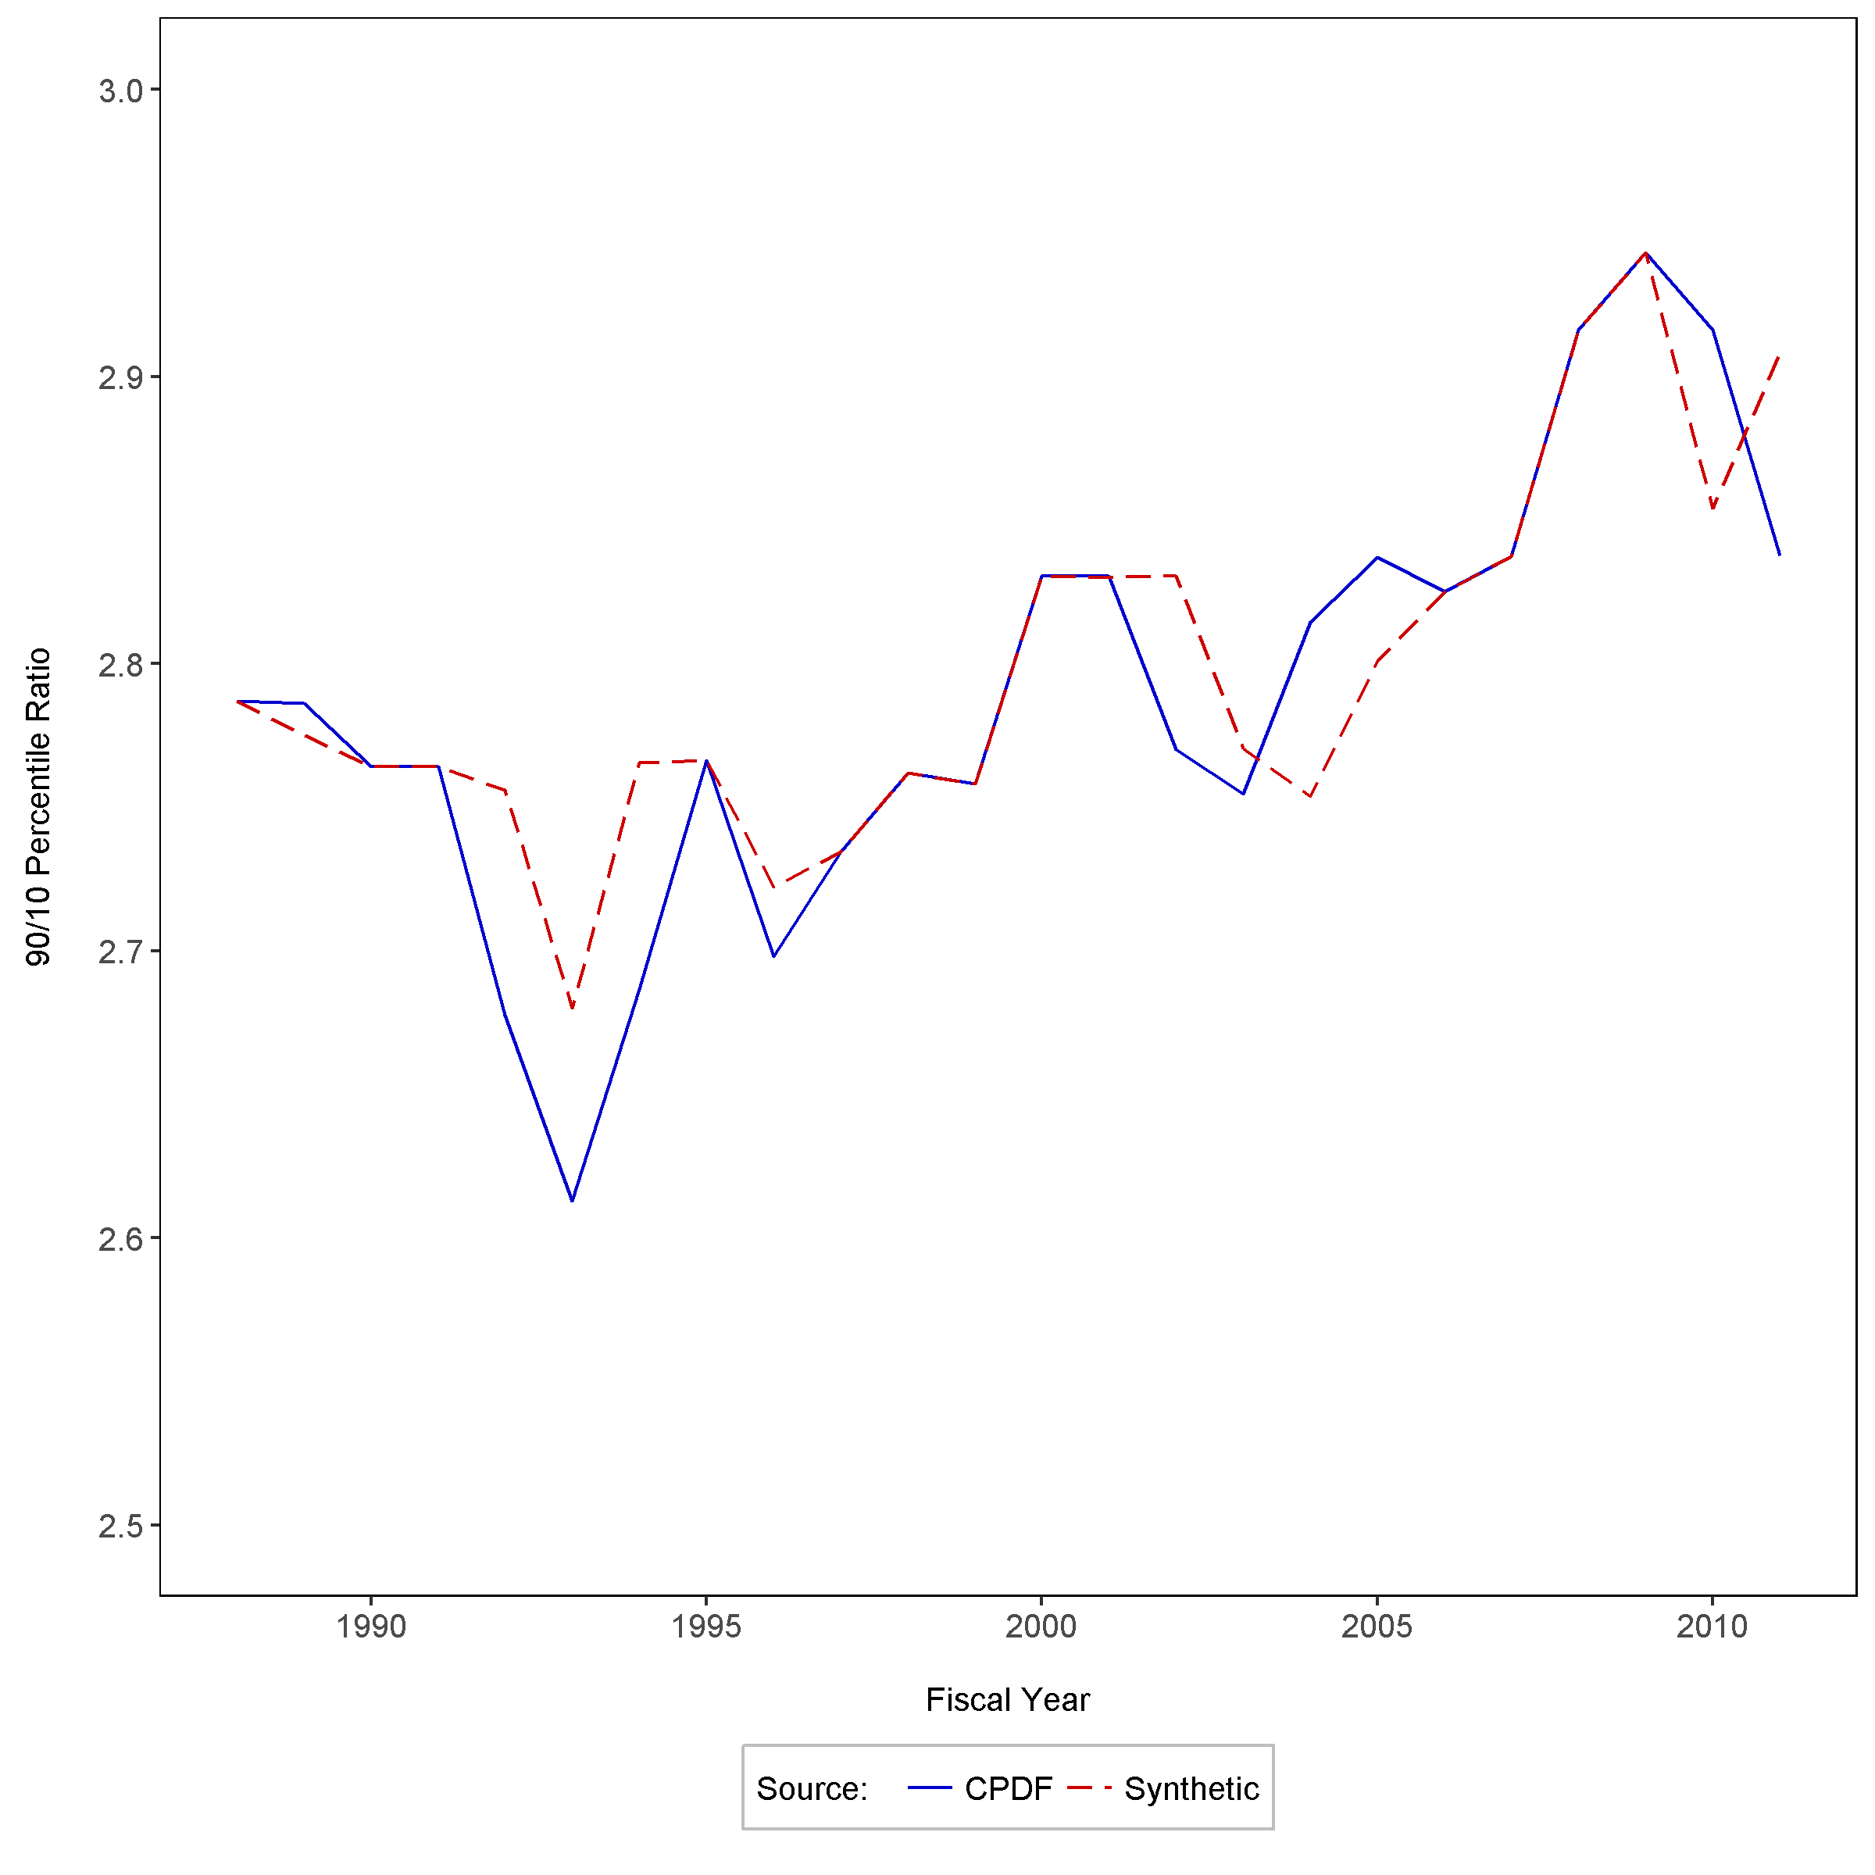
ratio of 90th to 10th basic pay percentiles, GS pay plan
OPM Synthetic Data Project | Duke University Human Capital and Statistical Sciences

Slide 22
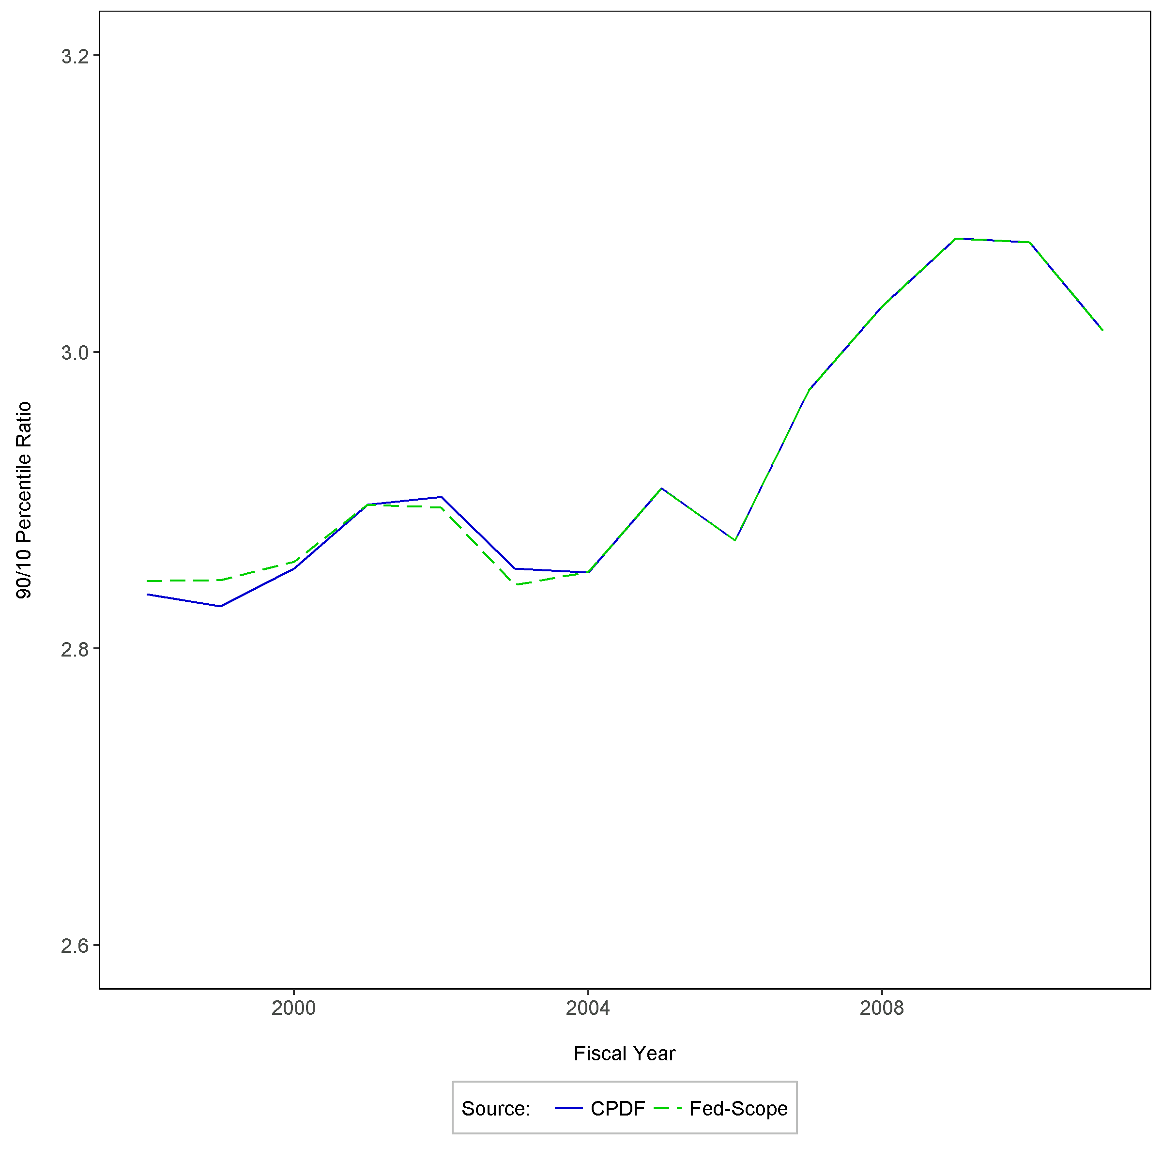
ratio of 90th to 10th Adj-basic pay percentiles, GS pay plan
OPM Synthetic Data Project | Duke University Human Capital and Statistical Sciences

Slide 23
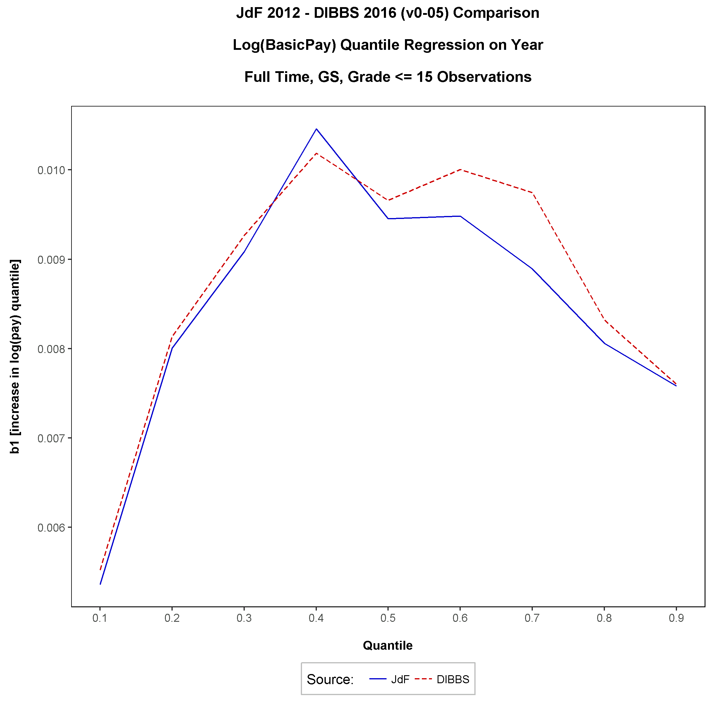
Annual rate of change in pay percentiles, gs pay plan, 1988-2011
OPM Synthetic Data Project | Duke University Human Capital and Statistical Sciences

Slide 24
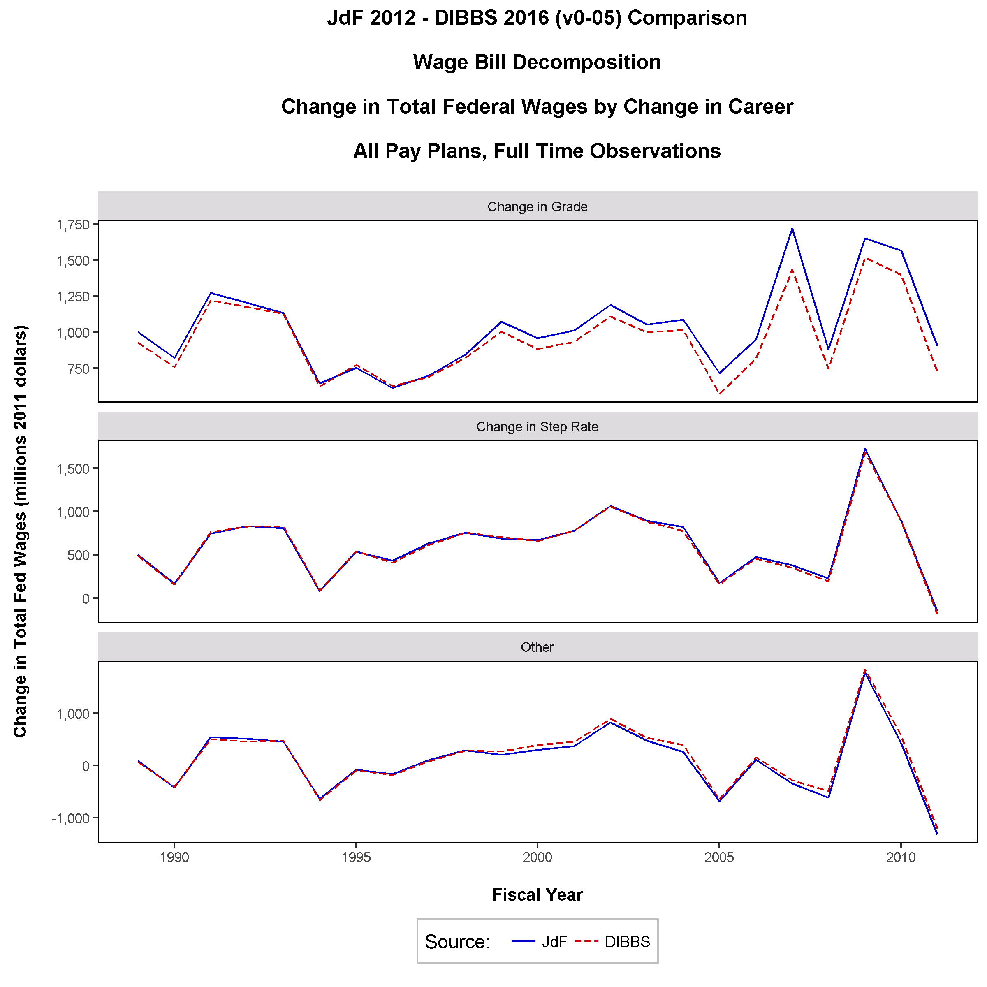
Annual change in federal payroll due to increases, 1989-2011
OPM Synthetic Data Project | Duke University Human Capital and Statistical Sciences

Slide 25
regression models
From Gender Pay Differential Research
OPM Synthetic Data Project | Duke University Human Capital and Statistical Sciences

Slide 26
OLS Gender pay model
Models 4 and 5: Sex + Race + Age² + Age + Education + (Year, Bureau, Occupational Category, Occupation Fixed Effects)
 | Model 4 |  |  |  | Model 5
Parameter | InModel | Estimate.CPDF | Estimate.Synthetic |  | InModel | Estimate.CPDF | Estimate.Synthetic
b0 | √ | 9.9129 | 10.2067 |  | √ | 9.3479 | 9.6130
 |  | (0.000757) | (0.000776) |  |  | (0.000690) | (0.000731)
Female | √ | -0.0595 | -0.0570 |  | √ | -0.0430 | -0.0369
 |  | (0.000111) | (0.000121) |  |  | (0.000105) | (0.000118)
Age | √ | 0.0386 | 0.0283 |  | √ | 0.0371 | 0.0275
 |  | (0.000031) | (0.000031) |  |  | (0.000028) | (0.000028)
Age**2 | √ | -0.0003 | -0.0002 |  | √ | -0.0003 | -0.0002
 |  | 0.000000 | 0.000000 |  |  | 0.000000 | 0.000000
Ed | √ | 0.0339 | 0.0252 |  | √ | 0.0241 | 0.0150
 |  | (0.000027) | (0.000029) |  |  | (0.000026) | (0.000028)
Race | √ |  |  |  | √
Year | √ |  |  |  | √
Bureau | √ |  |  |  | √
Occ-Cat | √
Occ |  |  |  |  | √
n |  | 24,574,478 | 25,241,263 |  |  | 24,574,478 | 25,241,263
nID |  | 2,761,841 | 2,852,216 |  |  | 2,761,841 | 2,852,216
OPM Synthetic Data Project | Duke University Human Capital and Statistical Sciences

Slide 27
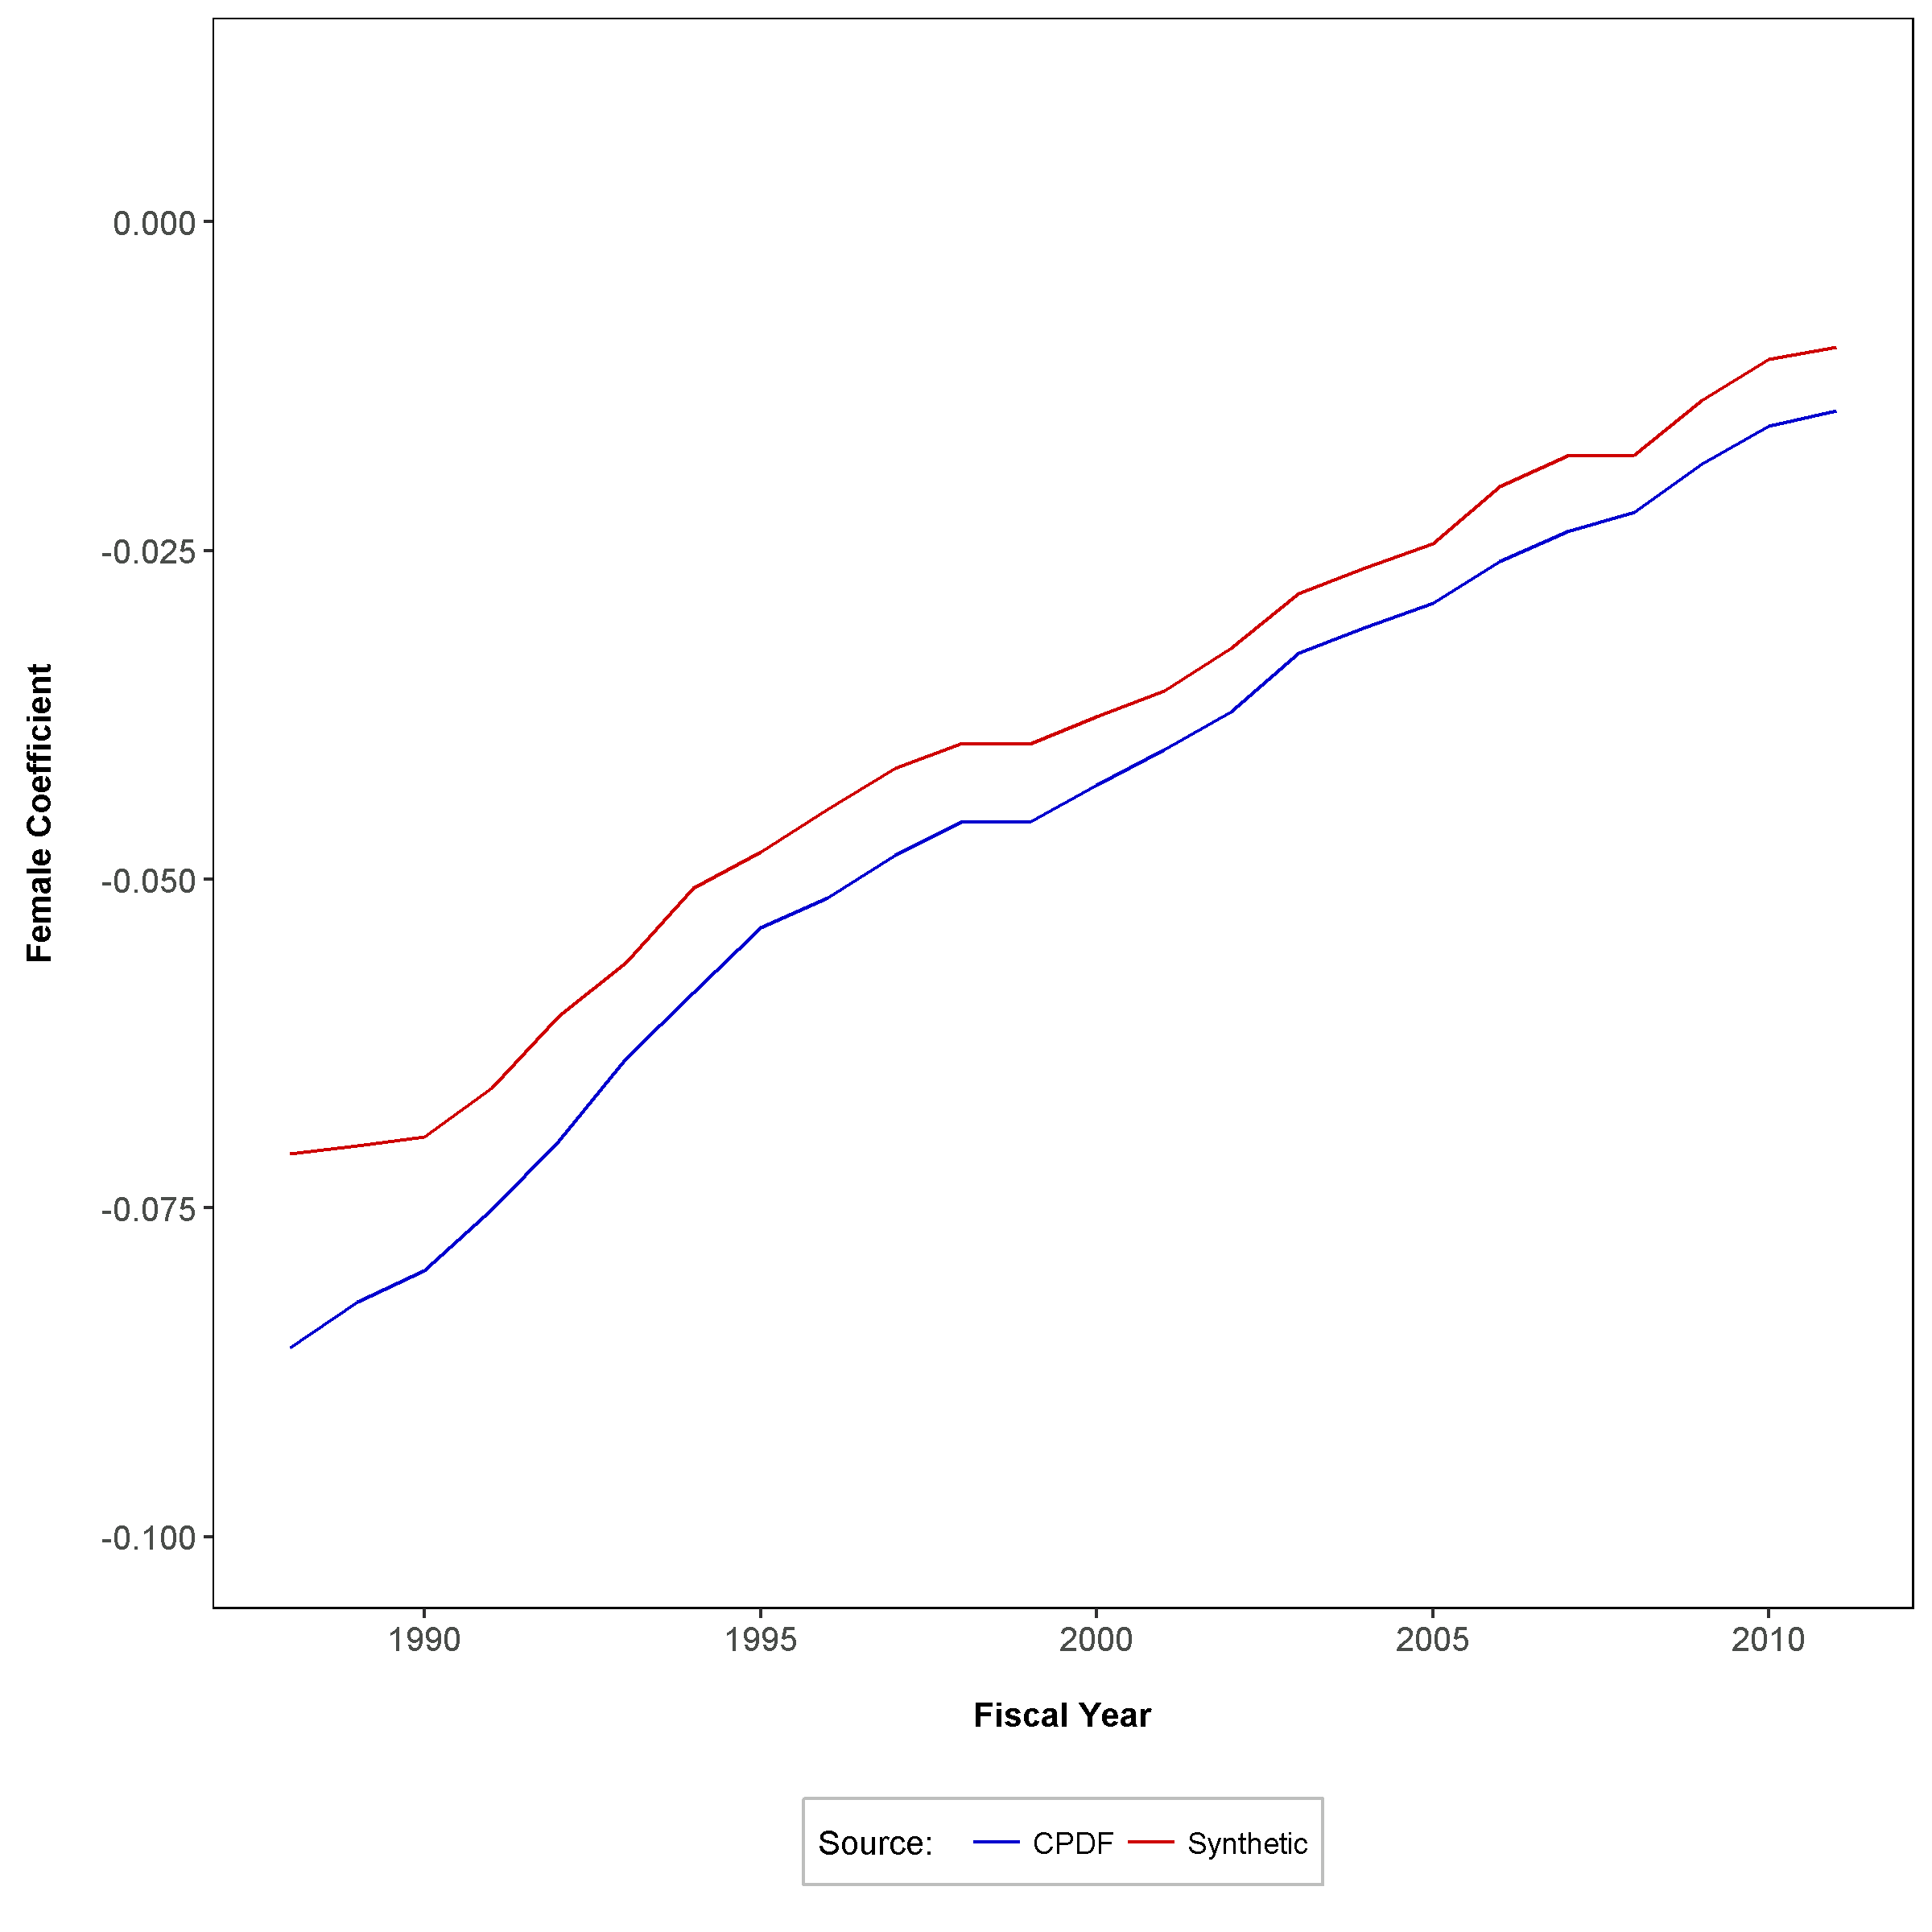
time series - Gender pay differential
Mode 5: Sex + Race + Age² + Age + Education + (Year, Bureau, Occupation Fixed Effects)
OPM Synthetic Data Project | Duke University Human Capital and Statistical Sciences

Slide 28
regression models
From Race Pay Differential Research
OPM Synthetic Data Project | Duke University Human Capital and Statistical Sciences

Slide 29
OLS Race pay model
Model 1: Race Fixed Effects Only
Parameter | InModel | Estimate.CPDF | Estimate.Synthetic
b0 | √ | 11.0258 | 11.0065
 |  | (0.000106) | (0.000106)
RaceAmInd | √ | -0.2989 | -0.2471
 |  | (0.000565) | (0.000552)
RaceAsian | √ | 0.0601 | 0.05
 |  | (0.000453) | (0.000451)
RaceBlack | √ | -0.2305 | -0.1863
 |  | (0.000225) | (0.000226)
RaceHisp | √ | -0.1676 | -0.1276
 |  | (0.000347) | (0.000347)
Female
Age
Age²
Ed
Year
Bureau
Occ-Cat
Occ
n |  | 25,036,646 | 25,442,002
nID |  | 2,883,417 | 2,964,226
OPM Synthetic Data Project | Duke University Human Capital and Statistical Sciences

Slide 30
OLS Race pay model
Model 2: Race + Sex + Age² + Age + Education
Parameter | InModel | Estimate.CPDF | Estimate.Synthetic
b0 | √ | 9.4311 | 9.7639
 |  | (0.00094) | (0.000918)
RaceAmInd | √ | -0.1522 | -0.1265
 |  | (0.000453) | (0.000466)
RaceAsian | √ | -0.0112 | 0.0011
 |  | (0.000358) | (0.000378)
RaceBlack | √ | -0.0862 | -0.0615
 |  | (0.000183) | (0.000195)
RaceHisp | √ | -0.0587 | -0.0375
 |  | (0.000275) | (0.000292)
Female | √ | -0.1112 | -0.1087
 |  | (0.000142) | (0.00015)
Age | √ | 0.0498 | 0.0362
 |  | (0.000043) | (0.000042)
Age² | √ | -0.0004 | -0.0003
 |  | (0) | (0)
Ed | √ | 0.0856 | 0.0777
 |  | (0.000029) | (0.00003)
Year
Bureau
Occ-Cat
Occ
n |  | 24,579,468 | 25,246,713
nID |  | 2,762,109 | 2,852,503
OPM Synthetic Data Project | Duke University Human Capital and Statistical Sciences

Slide 31
OLS Race pay model
Model 3: Race + Sex + Age² + Age + Education + (Year, Bureau Fixed Effects)
Parameter | InModel | Estimate.CPDF | Estimate.Synthetic
b0 | √ | 9.5152 | 9.1012
 |  | (0.08399) | (0.049372)
RaceAmInd | √ | -0.0976 | -0.0565
 |  | (0.000661) | (0.000622)
RaceAsian | √ | -0.0075 | 0.0008
 |  | (0.000387) | (0.000381)
RaceBlack | √ | -0.0901 | -0.0663
 |  | (0.000201) | (0.000199)
RaceHisp | √ | -0.0532 | -0.0331
 |  | (0.000301) | (0.000297)
Female | √ | -0.0859 | -0.0866
 |  | (0.000159) | (0.000156)
Age | √ | 0.0503 | 0.0371
 |  | (0.000046) | (0.000042)
Age² | √ | -0.0004 | -0.0003
 |  | (0.000001) | (0)
Ed | √ | 0.0802 | 0.0715
 |  | (0.000033) | (0.000032)
Year | √
Bureau | √
Occ-Cat
Occ
n |  | 24,579,468 | 25,246,713
nID |  | 2,762,109 | 2,852,503
OPM Synthetic Data Project | Duke University Human Capital and Statistical Sciences

Slide 32
OLS Race pay model
Model 4: Race + Sex + Age² + Age + Education + (Year, Bureau, Occupational Category Fixed Effects)
Parameter | InModel | Estimate.CPDF | Estimate.Synthetic
b0 | √ | 9.9129 | 10.2067
 |  | (0.001136) | (0.001048)
RaceAmInd | √ | -0.0404 | -0.0177
 |  | (0.000661) | (0.000622)
RaceAsian | √ | -0.0134 | -0.0069
 |  | (0.000388) | (0.000382)
RaceBlack | √ | -0.042 | -0.0286
 |  | (0.000202) | (0.0002)
RaceHisp | √ | -0.0312 | -0.0164
 |  | (0.000301) | (0.000298)
Female | √ | -0.0595 | -0.057
 |  | (0.000167) | (0.000164)
Age | √ | 0.0386 | 0.0283
 |  | (0.000047) | (0.000042)
Age² | √ | -0.0003 | -0.0002
 |  | (0.000001) | (0)
Ed | √ | 0.0339 | 0.0252
 |  | (0.00004) | (0.000039)
Year | √
Bureau | √
Occ-Cat | √
Occ
n |  | 24,574,478 | 25,241,263
nID |  | 2,761,841 | 2,852,216
OPM Synthetic Data Project | Duke University Human Capital and Statistical Sciences

Slide 33
OLS Race pay model
Model 5: Race + Sex + Age² + Age + Education + (Year, Bureau, Occupation Fixed Effects)
Parameter | InModel | Estimate.CPDF | Estimate.Synthetic
b0 | √ | 9.3479 | 9.613
 |  | (0.001184) | (0.001095)
RaceAmInd | √ | -0.0226 | -0.007
 |  | (0.000663) | (0.000623)
RaceAsian | √ | -0.0276 | -0.0204
 |  | (0.000391) | (0.000383)
RaceBlack | √ | -0.0147 | -0.0078
 |  | (0.000206) | (0.000202)
RaceHisp | √ | -0.0257 | -0.0143
 |  | (0.000303) | (0.000299)
Female | √ | -0.043 | -0.0369
 |  | (0.00018) | (0.000176)
Age | √ | 0.0371 | 0.0275
 |  | (0.000047) | (0.000042)
Age² | √ | -0.0003 | -0.0002
 |  | (0.000001) | (0)
Ed | √ | 0.0241 | 0.015
 |  | (0.000044) | (0.000042)
Year | √
Bureau | √
Occ-Cat
Occ | √
n |  | 24,574,480 | 25,241,583
nID |  | 2,761,841 | 2,852,256
OPM Synthetic Data Project | Duke University Human Capital and Statistical Sciences

Slide 34
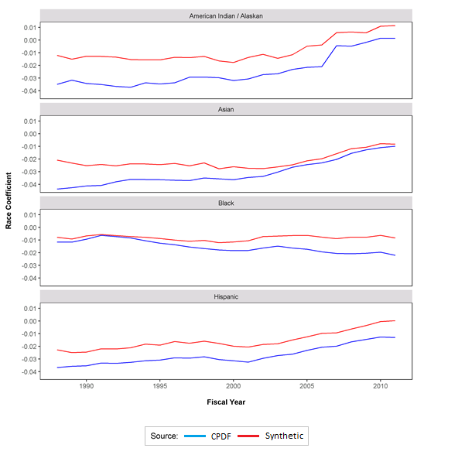
Race Pay Differential
OLS Regression
Model 5
All Races
OPM Synthetic Data Project | Duke University Human Capital and Statistical Sciences

Slide 35
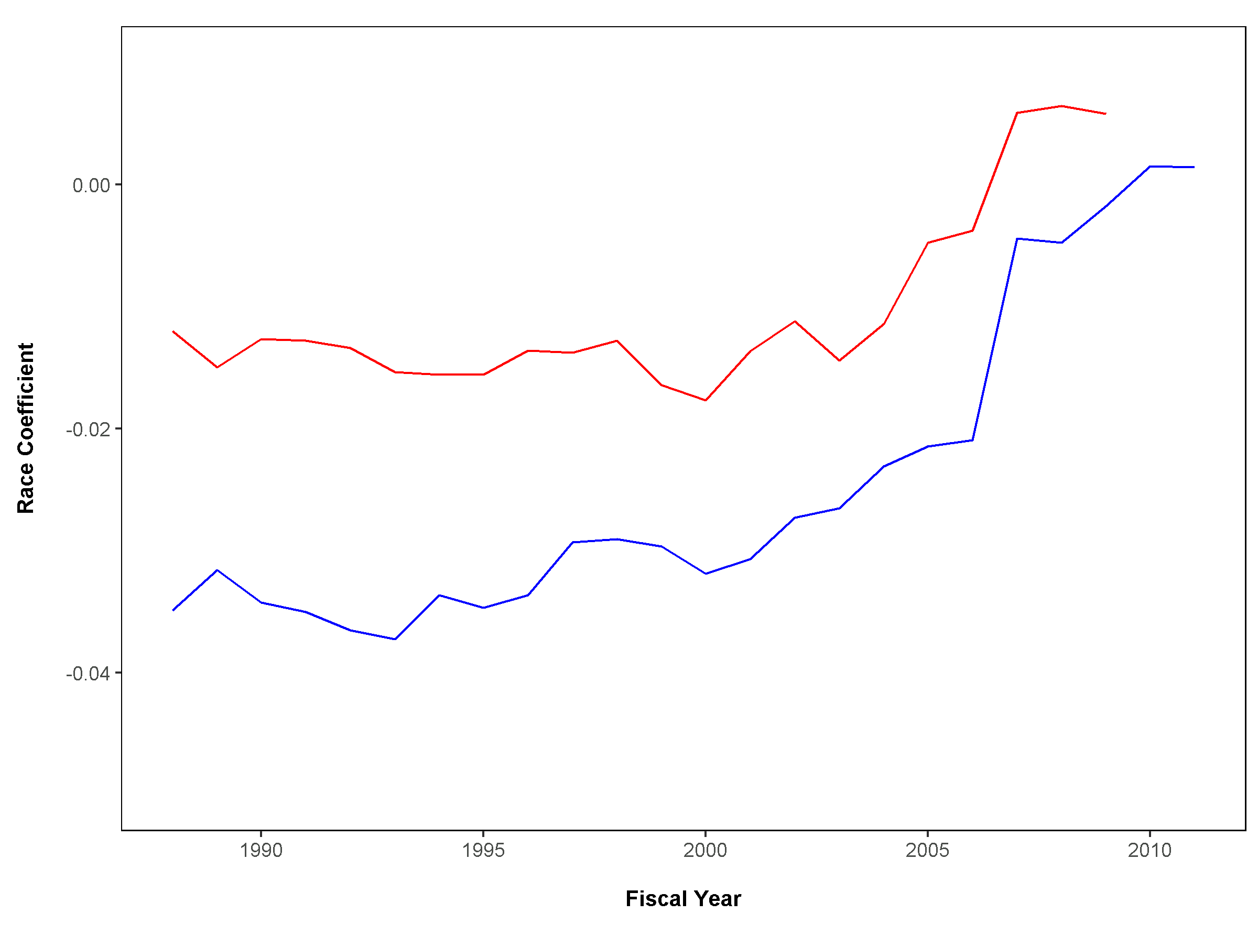

Race Pay Differential
OLS Regression
Model 5
Race Am-Ind
OPM Synthetic Data Project | Duke University Human Capital and Statistical Sciences

Slide 36
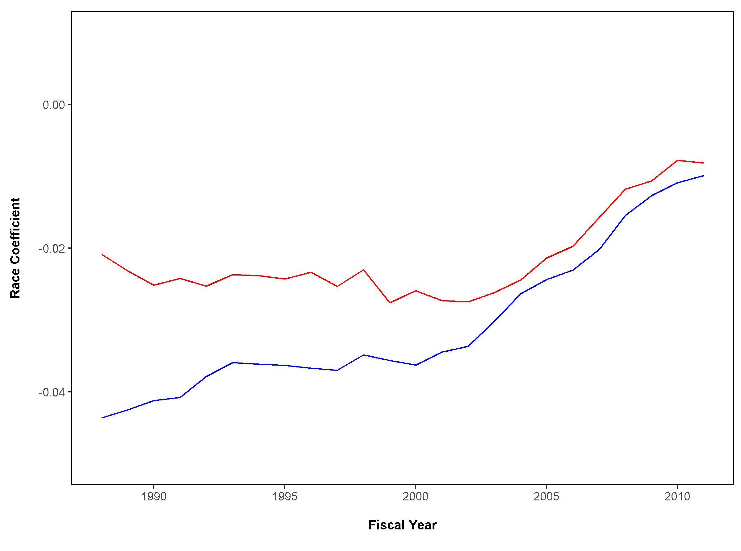
Race Pay Differential
OLS Regression
Model 5
Race Asian
OPM Synthetic Data Project | Duke University Human Capital and Statistical Sciences

Slide 37
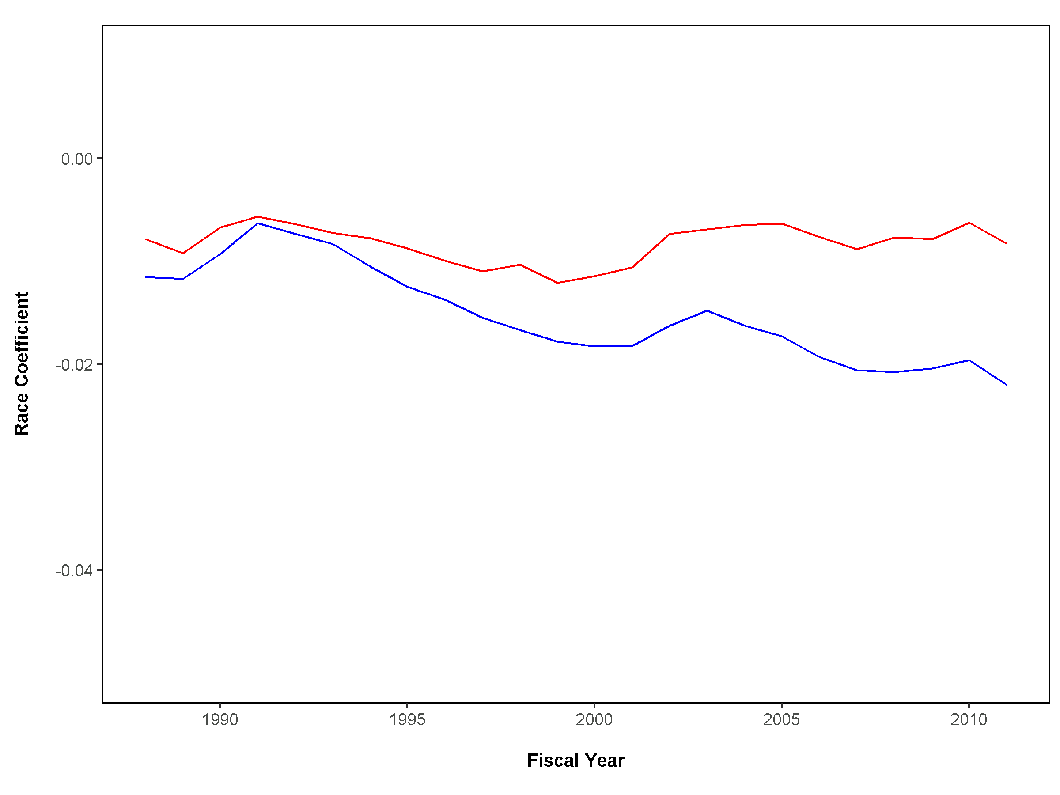
Race Pay Differential
OLS Regression
Model 5
Race Black
OPM Synthetic Data Project | Duke University Human Capital and Statistical Sciences

Slide 38
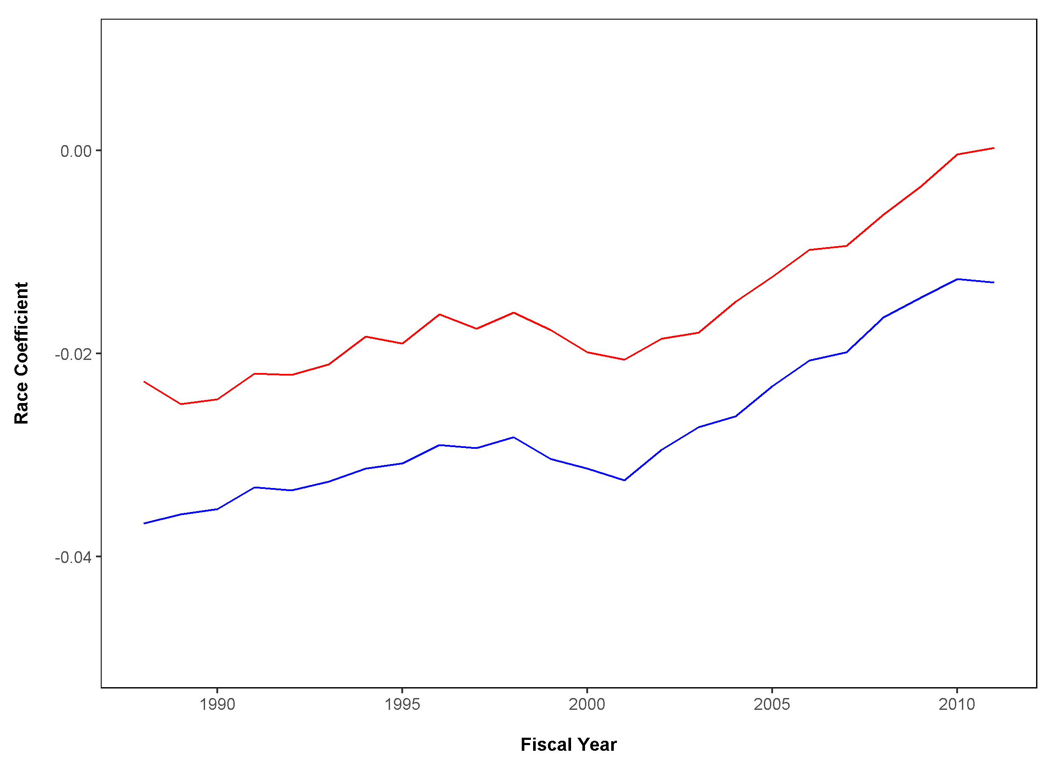
Race Pay Differential
OLS Regression
Model 5
Race Hispanic
OPM Synthetic Data Project | Duke University Human Capital and Statistical Sciences

Slide 39
Race pay Differential Quantile Regression modelS
Model 5: Race + Sex + Age² + Age + Education + (Year, Bureau, Occupation Fixed Effects)
Quantile | 0.1 |  |  | 0.5 |  |  | 0.9
Parameter | JdF | DIBBS |  | JdF | DIBBS |  | JdF | DIBBS
b0 | 9.7357 | 9.8585 |  | 10.0671 | 10.0745 |  | 10.8643 | 10.5568
Female | -0.0252 | -0.0203 |  | -0.0351 | -0.0318 |  | -0.0427 | -0.0366
RaceAmInd | -0.0240 | -0.0072 |  | -0.0210 | -0.0079 |  | -0.0209 | -0.0053
RaceAsian | -0.0226 | -0.0213 |  | -0.0223 | -0.0184 |  | -0.0195 | -0.0158
RaceBlack | 0.0000 | -0.0005 |  | -0.0110 | -0.0062 |  | -0.0188 | -0.0083
RaceHisp | -0.0205 | -0.0109 |  | -0.0209 | -0.0135 |  | -0.0227 | -0.0139
Age | 0.0454 | 0.0332 |  | 0.0393 | 0.0289 |  | 0.0352 | 0.0232
Age² | -0.0004 | -0.0003 |  | -0.0003 | -0.0002 |  | -0.0003 | -0.0002
Education | 0.0162 | 0.0084 |  | 0.0216 | 0.0142 |  | 0.0243 | 0.0160
Year | √ | √ |  | √ | √ |  | √ | √
Bureau | √ | √ |  | √ | √ |  | √ | √
Occupation | √ | √ |  | √ | √ |  | √ | √
OPM Synthetic Data Project | Duke University Human Capital and Statistical Sciences

Slide 40
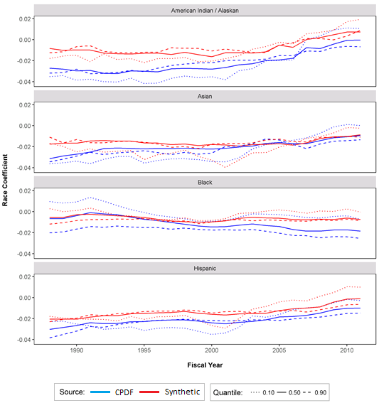
Race Pay Differential
Quantile Regression
Model 5
All Races
OPM Synthetic Data Project | Duke University Human Capital and Statistical Sciences

Slide 41
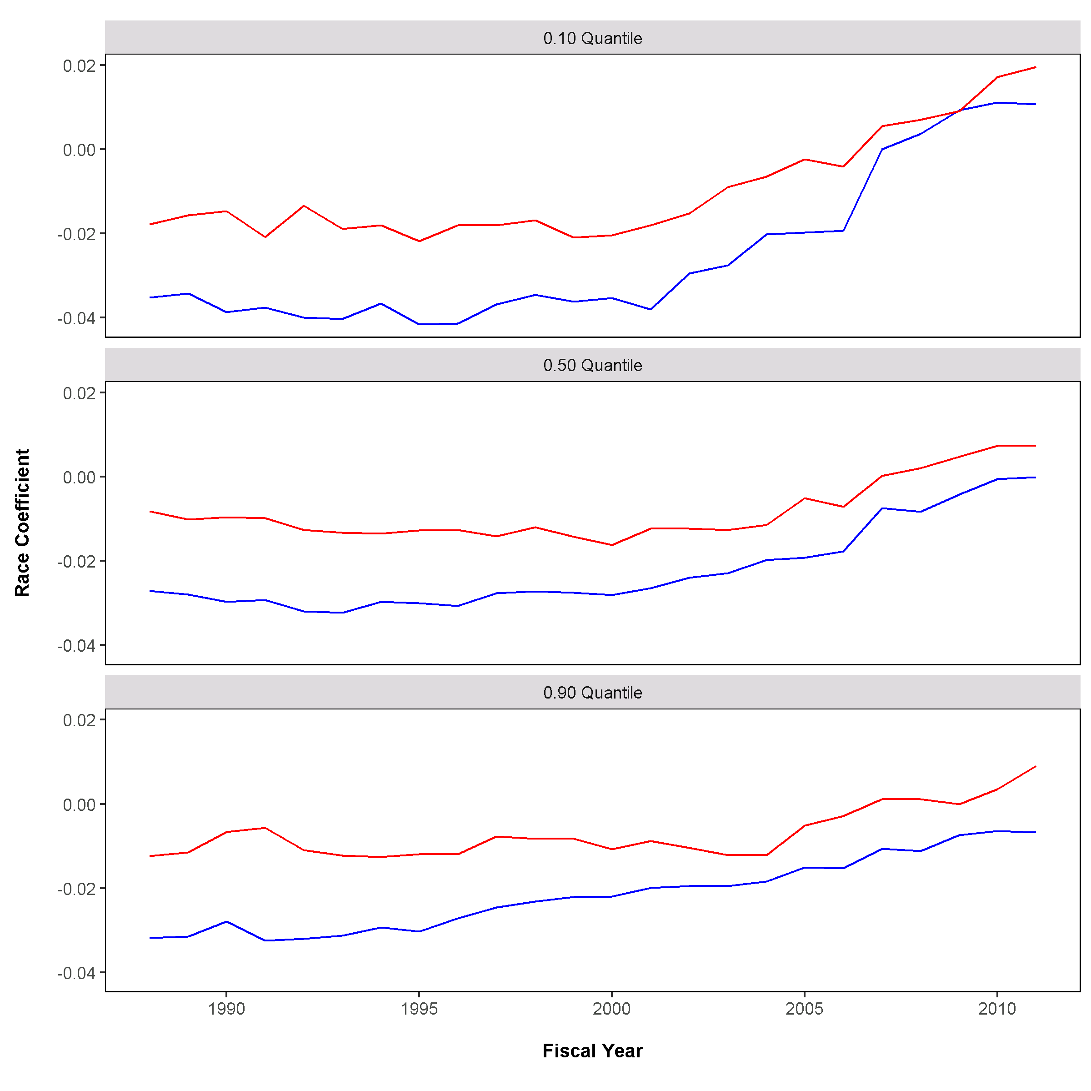
Race Pay Differential
Quantile Regression
Model 5
Race Am-Ind
OPM Synthetic Data Project | Duke University Human Capital and Statistical Sciences

Slide 42
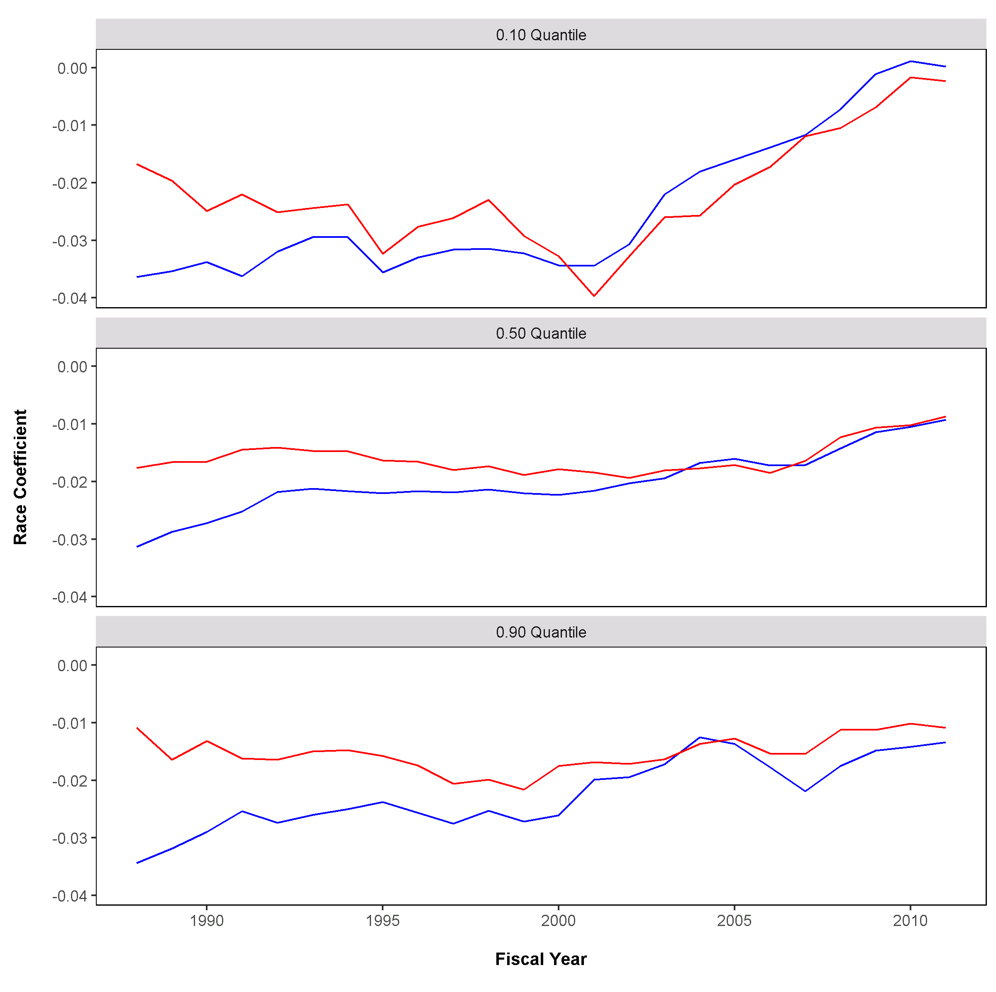
Race Pay Differential
Quantile Regression
Model 5
Race Asian
OPM Synthetic Data Project | Duke University Human Capital and Statistical Sciences

Slide 43
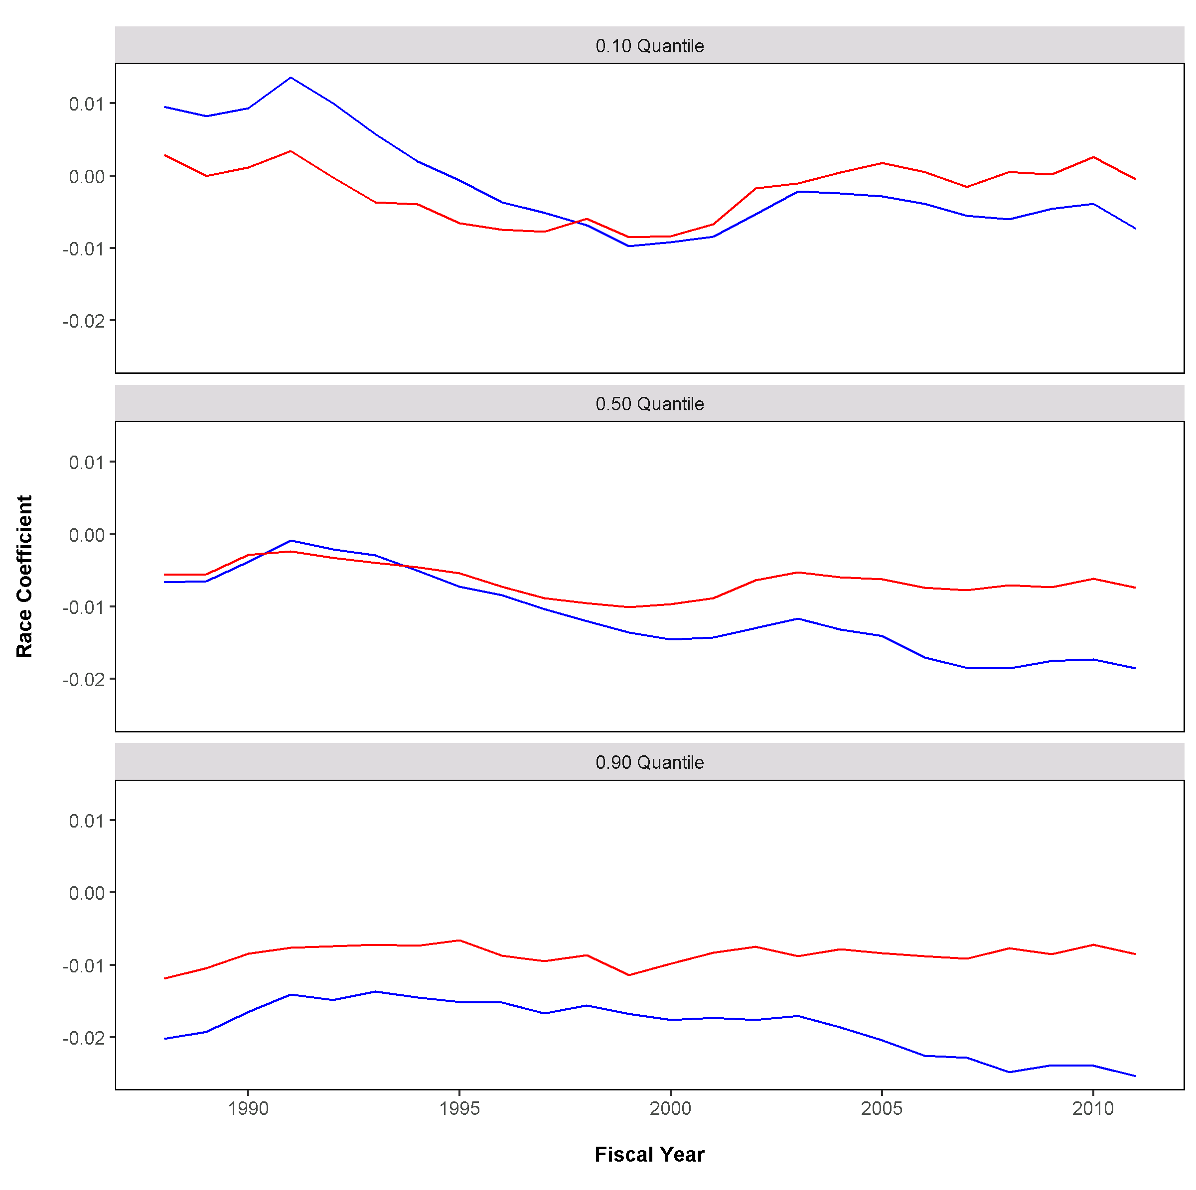
Race Pay Differential
Quantile Regression
Model 5
Race Black
OPM Synthetic Data Project | Duke University Human Capital and Statistical Sciences

Slide 44
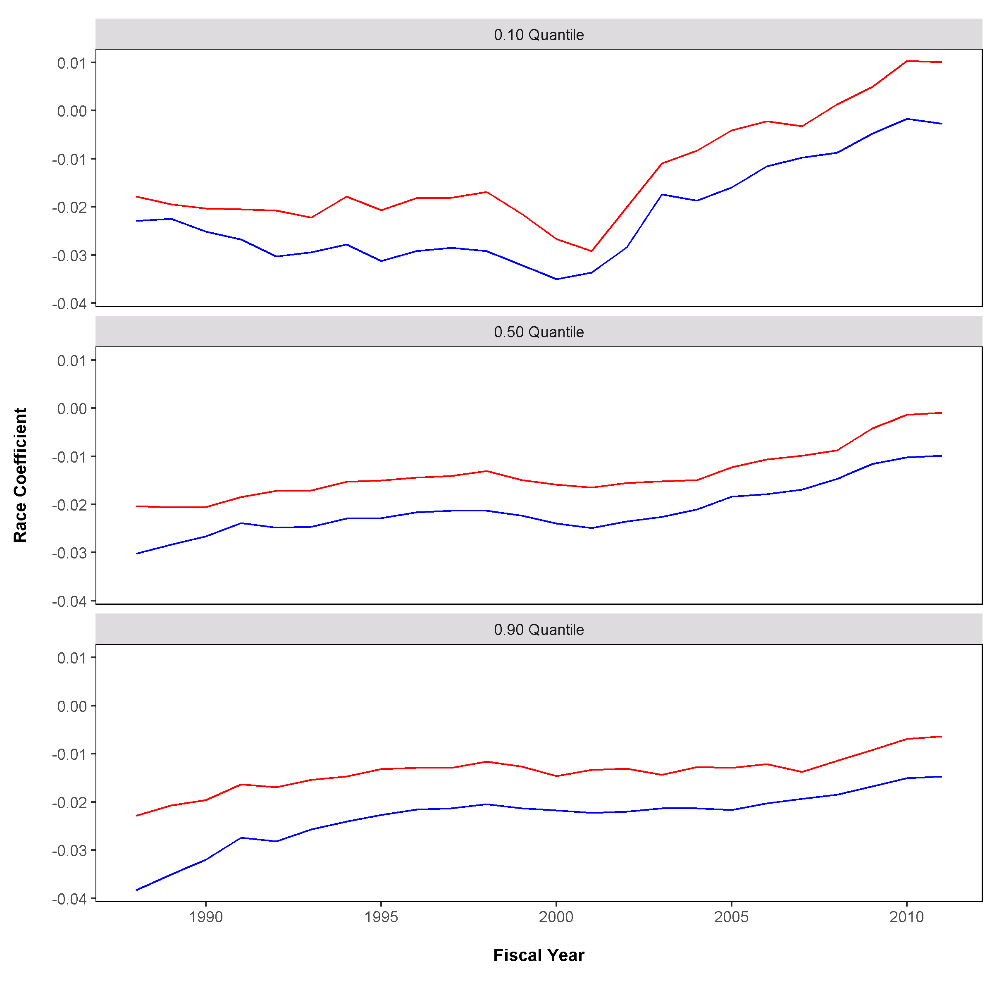
Race Pay Differential
Quantile Regression
Model 5
Race Hispanic
OPM Synthetic Data Project | Duke University Human Capital and Statistical Sciences

Slide 45
Promotion models
From Gender Pay Differential Research
OPM Synthetic Data Project | Duke University Human Capital and Statistical Sciences

Slide 46
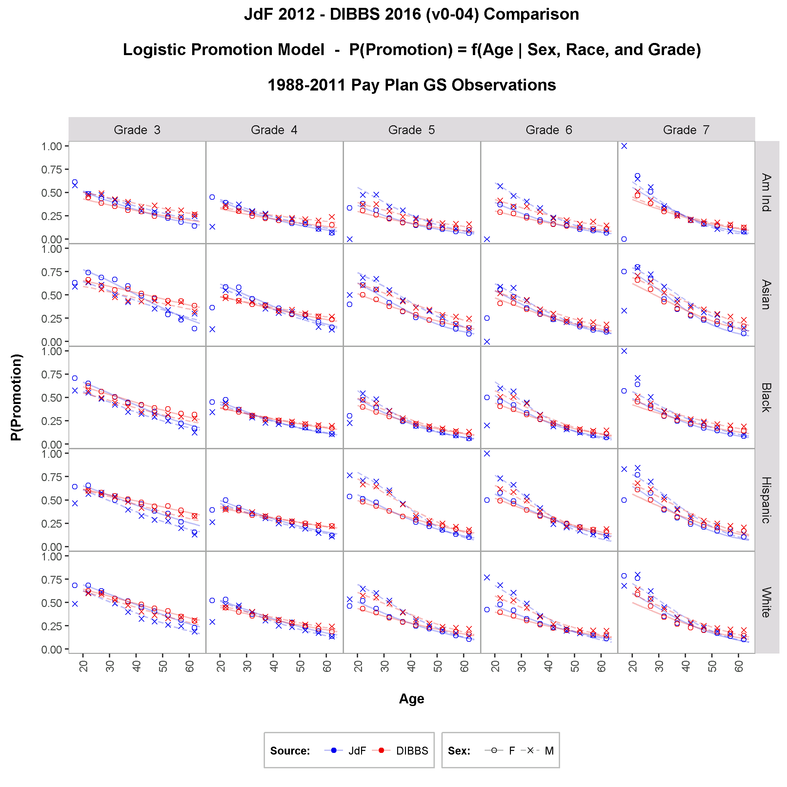
proportion employees promoted with logistic regression model
Probability of Promotion = f(Sex, Race, Age, Grade)
OPM Synthetic Data Project | Duke University Human Capital and Statistical Sciences

Slide 47
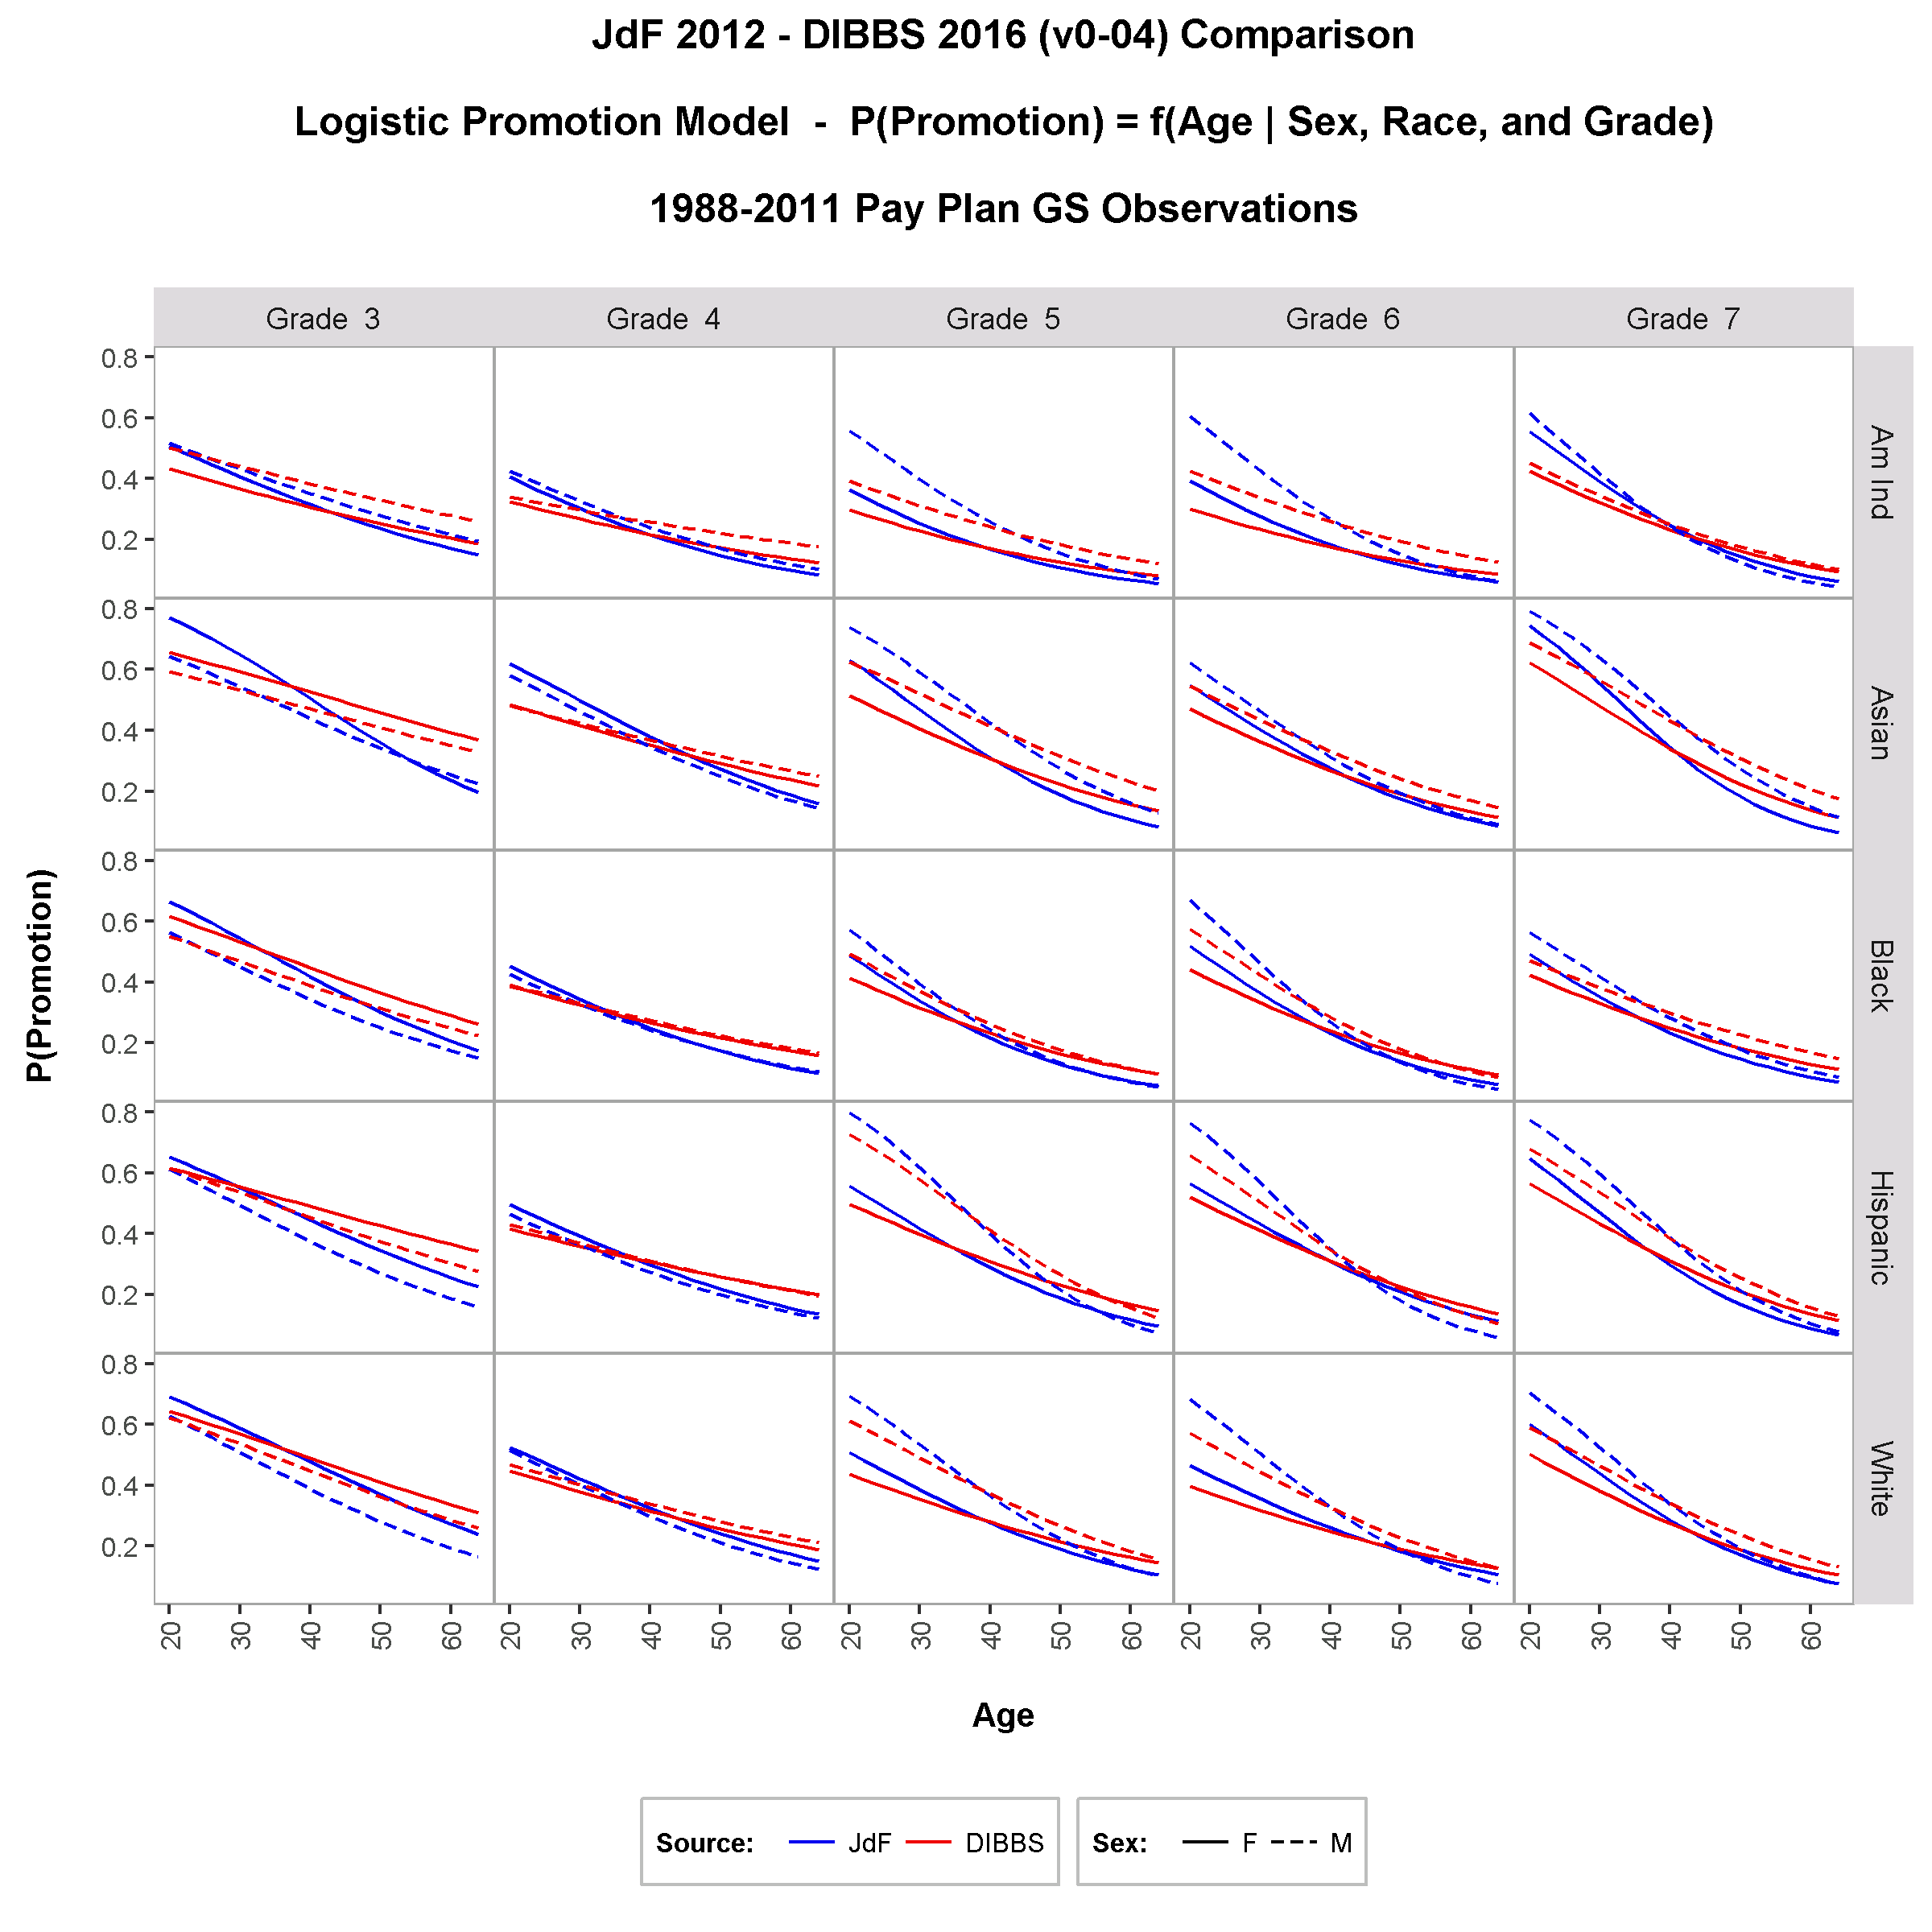
comparison of models derived from synthetic and actual data
Probability of Promotion = f(Sex, Race, Age, Grade)
OPM Synthetic Data Project | Duke University Human Capital and Statistical Sciences

