Slide 1
Duke University OPM Synthetic data project
Comparing Synthetic Human Capital Data to OPM Source Data
Conference on Analyzing Federal Personnel Data | June 2-3, 2016
Center for Institutional and Organizational Performance
Duke University | Durham, North Carolina
thomas.balmat@duke.edu

Slide 2
Purpose
Develop systematic procedures for assessing homogeneity of synthesized CPDF data to source OPM data
Emphasis on utility assessment (does a researcher reach the same conclusions using synthetic data as she would using source OPM data?)

Slide 3
example research questions used in comparison
What is the distribution of federal employees by sex, agency, occupation?
Are sex, race, age, and education functional predictors of federal employee pay?
Is probability of promotion a function of sex, race, age, and education?
Do gender proportions by occupation change through time?

Slide 4
Human Capital CPDF Data assets
Requestor | Req Type | Req Year | Contents |  | Period | Files | Records | Code Tables
de Fig | FOIA | 2012 | DOD | Dynamic | 1988-2011 | 92 | 58,996,920 | OPM GDS 1999-2014
de Fig | FOIA | 2012 | DOD | Status | 1988-2011 | 24 | 18,732,308 | OPM GDS 1999-2014
de Fig | FOIA | 2012 | Non-DOD | Dynamic | 1988-2011 | 92 | 84,108,247 | OPM GDS 1999-2014
de Fig | FOIA | 2012 | Non-DOD | Status | 1988-2011 | 24 | 28,257,629 | OPM GDS 1999-2014
de Fig | FOIA | 2014 | DOD | Status | 1988-2011 | 24 | 18,732,308 | OPM GDS 1999-2014
de Fig | FOIA | 2014 | Non-DOD | Status | 1988-2011 | 24 | 28,257,629 | OPM GDS 1999-2014
Tim J | FOIA | 2008 | Non-DOD | Status | 1973-2007 | 35 | 39,317,925 | OPM SCT 1973-2007
Tim J | NARA | 2009 | DOD Non-DOD | Status | 1973-1997 | 25 | 52,532,129 | NAR SCT 1973-1982
Tim J | NARA | 2009 | Non-DOD | Survey | 1979-1981 1983 1986 1988-1989 1991-1993 1996-1997 1999-2000 2005 | 26 | 683,326 | Individual by Survey
Tim J | NARA | 2009 | TVA | HRIS | 1992-1995 2000 | 5 | 222,644 | TVA HR Codes 1992-2003
Tim J | FOIA | 2012 | Non-DOD | Dynamic | Mar-Sep 1979-2013 | 152 | 135,067,802 | OPM SCT 1973-2013
 |  |  |  |  | Jan-Jun 1973-2013
Tim J | FOIA | 2012 | Non-DOD | Status | 1973-2013 | 41 | 47,333,165 | OPM SCT 1973-2013
de Fig | FedScope | 2016 | DOD Non-DOD | Status | Sep 1998 – Sep 2015 | 18 | 34,720,487
 |  |  |  |  |  | 582 | 546,962,519

Slide 5
synthetic data assets
Current version 5, May 2016
28,412,573 non-DOD status observations
Variables synthesized:
Pseudo ID
Fiscal Year
Agency
Sex
Race
ERI Bridge
Education Level
Age Range
Years Since Degree Range
Instructional Program
Occupational Category
Occupation
Functional Class
FLSA
Type Appointment
Political Appointee Type
Position Occupied
Tenure
Supervisory Status
Pay Plan
Grade
Step Rate
Pay Basis
Pay Rate Determinant
Work Schedule
Basic Pay

Slide 6
comparison data
CPDF: Non-DOD status observations supplied by OPM to Duke University as a result of John de Figueiredo’s 2012 FOIA request (referred to as JdF-2012) n = 28,257,629
Synthetic data: Duke generated version 0.5 (referred to as DIBBS-2016) n = 28,412,573
Variables in study:
Pseudo ID
Fiscal Year
Agency
Sex
Race
ERI Bridge
Education Level
Age Range
Occupational Category
Occupation
Pay Plan
Grade
Step Rate
Pay Basis
Work Schedule
Basic Pay

Slide 7
Additional comparison data
FedScope 1998-2011 September CPDF data (source: www.opm.gov/data)
Pseudo ID unavailable (needed for longitudinal studies, promotion, etc.)
Education Level unavailable for 1998-2003
Race unavailable
FedScope Salary = CPDF Adjusted Basic Pay (not synthesized)

Slide 8
Data analysis technologies and methods
SQL for synthetic data versioning and comparative data set generation
R for statistical, graphical, and numerical operations
Observation frequency, proportion, cumulative density comparison, χ² tests
Regression: ordinary least squares, logistic regression, quantile regression
Parallel processing: X’X indicator parsing, sparse matrix solutions
n

Slide 9
Questions?

Slide 10
Summary comparisons
From Grade Inflation Research

Slide 11
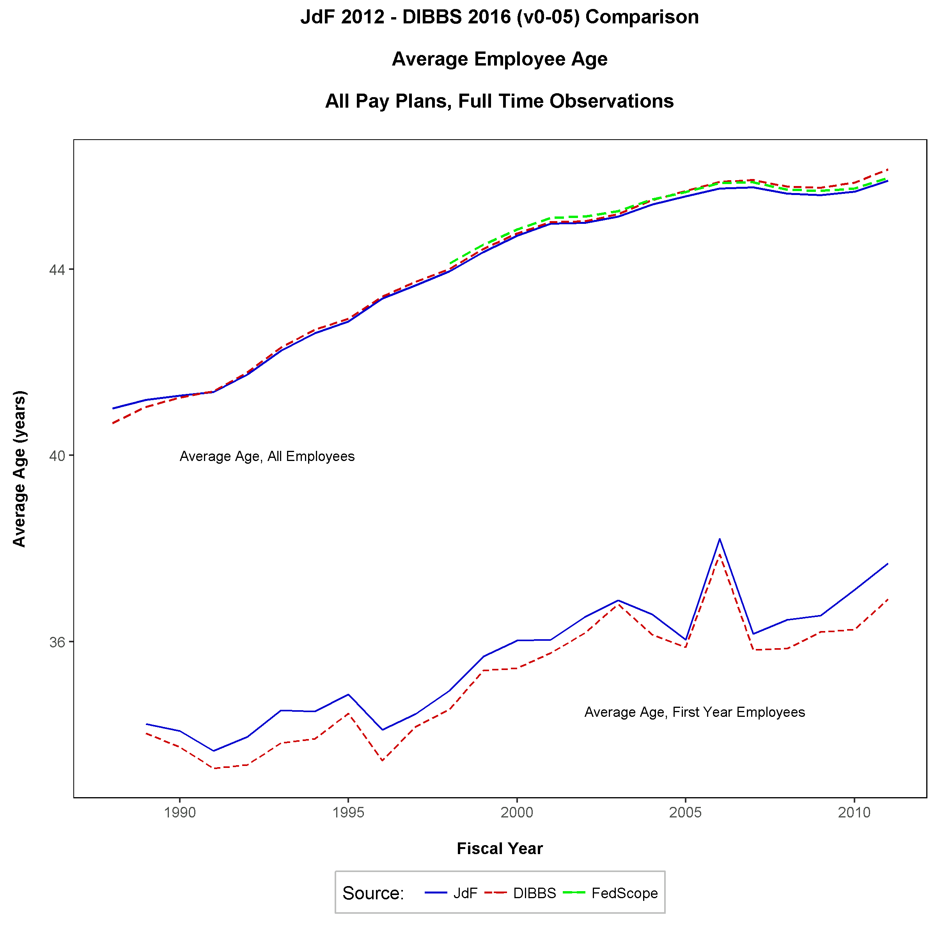
Average federal employee age, 1988-2011

Slide 12
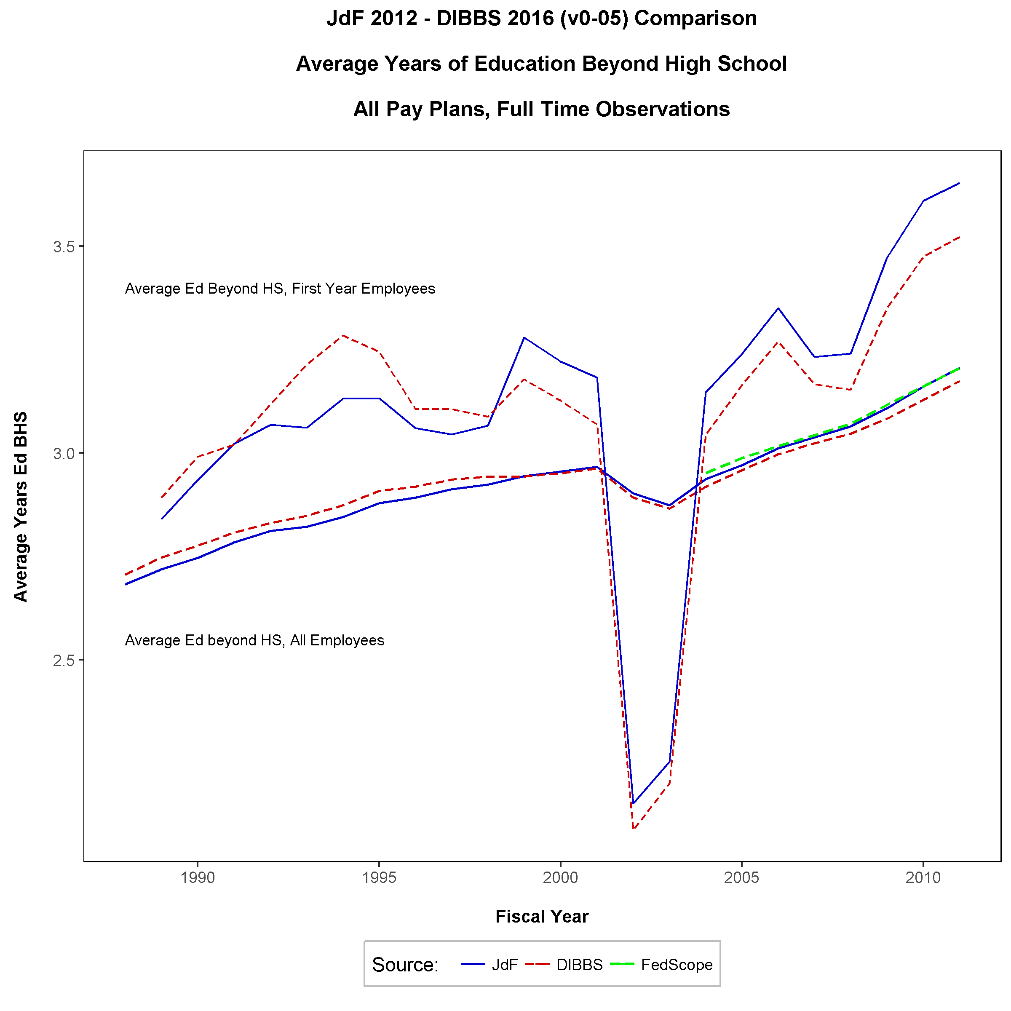
Average federal employee Education, 1988-2011

Slide 13
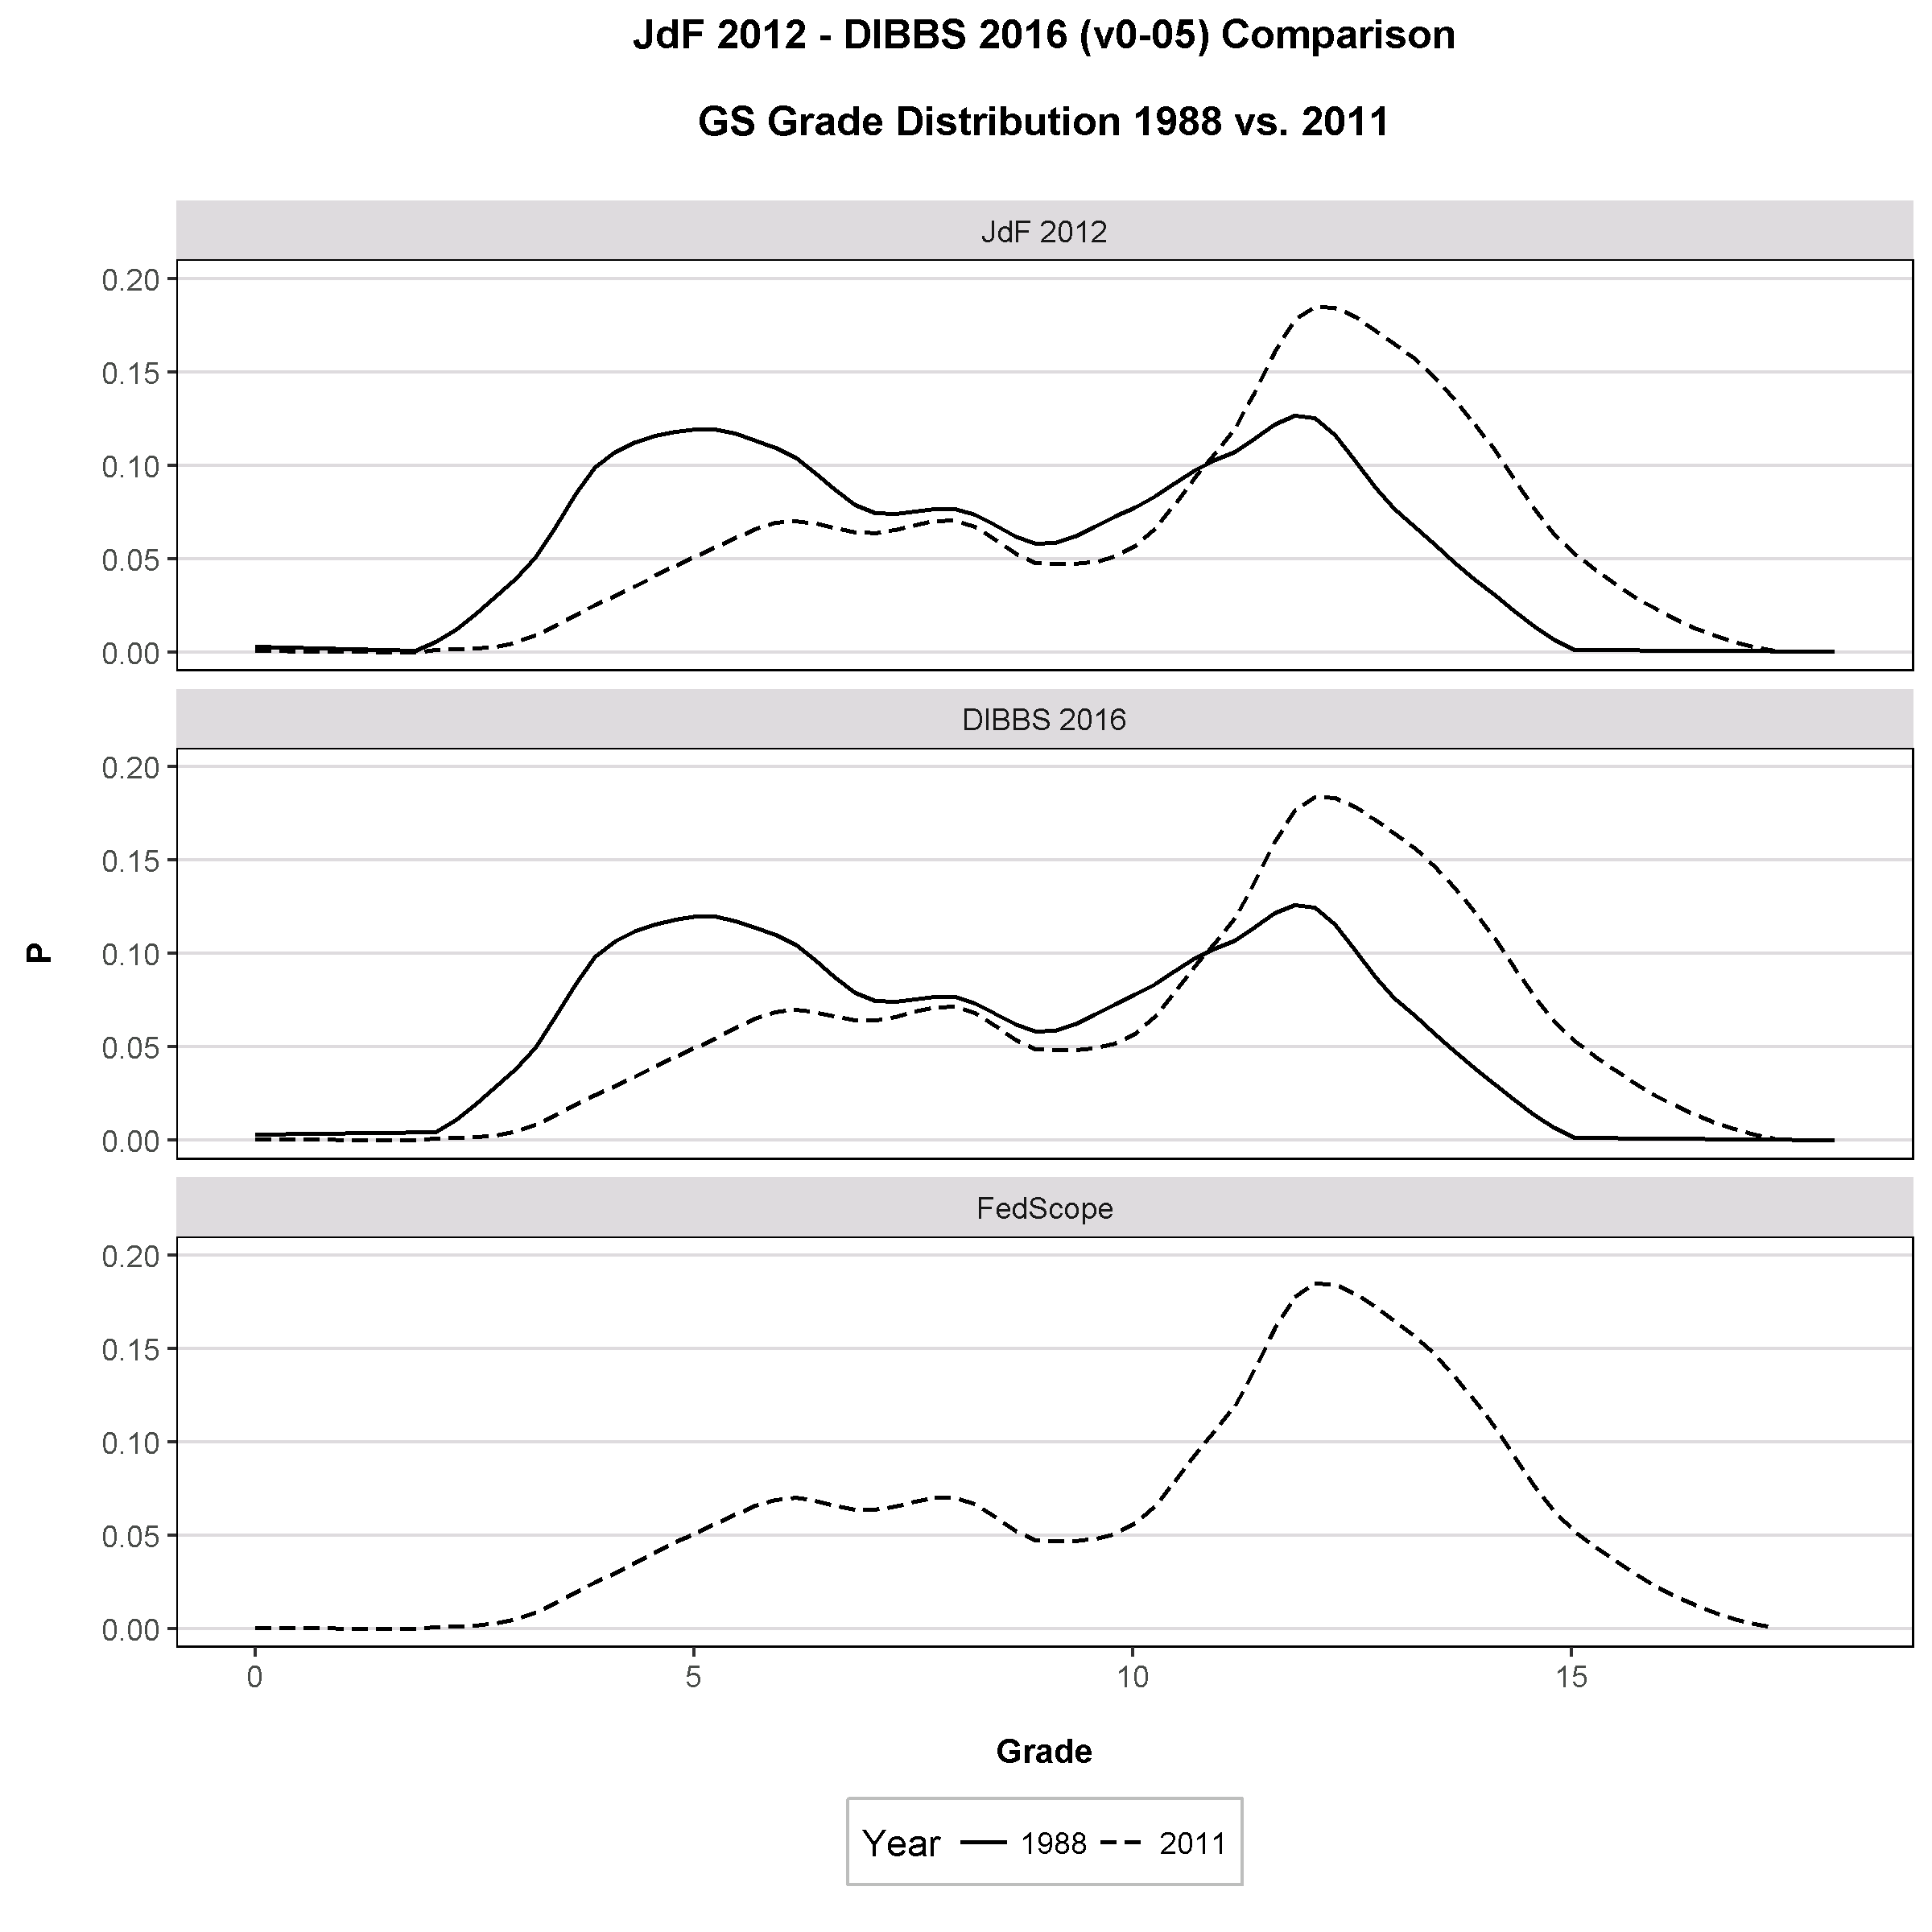
Distribution of gs employees by grade, 2011 vs. 1998

Slide 14
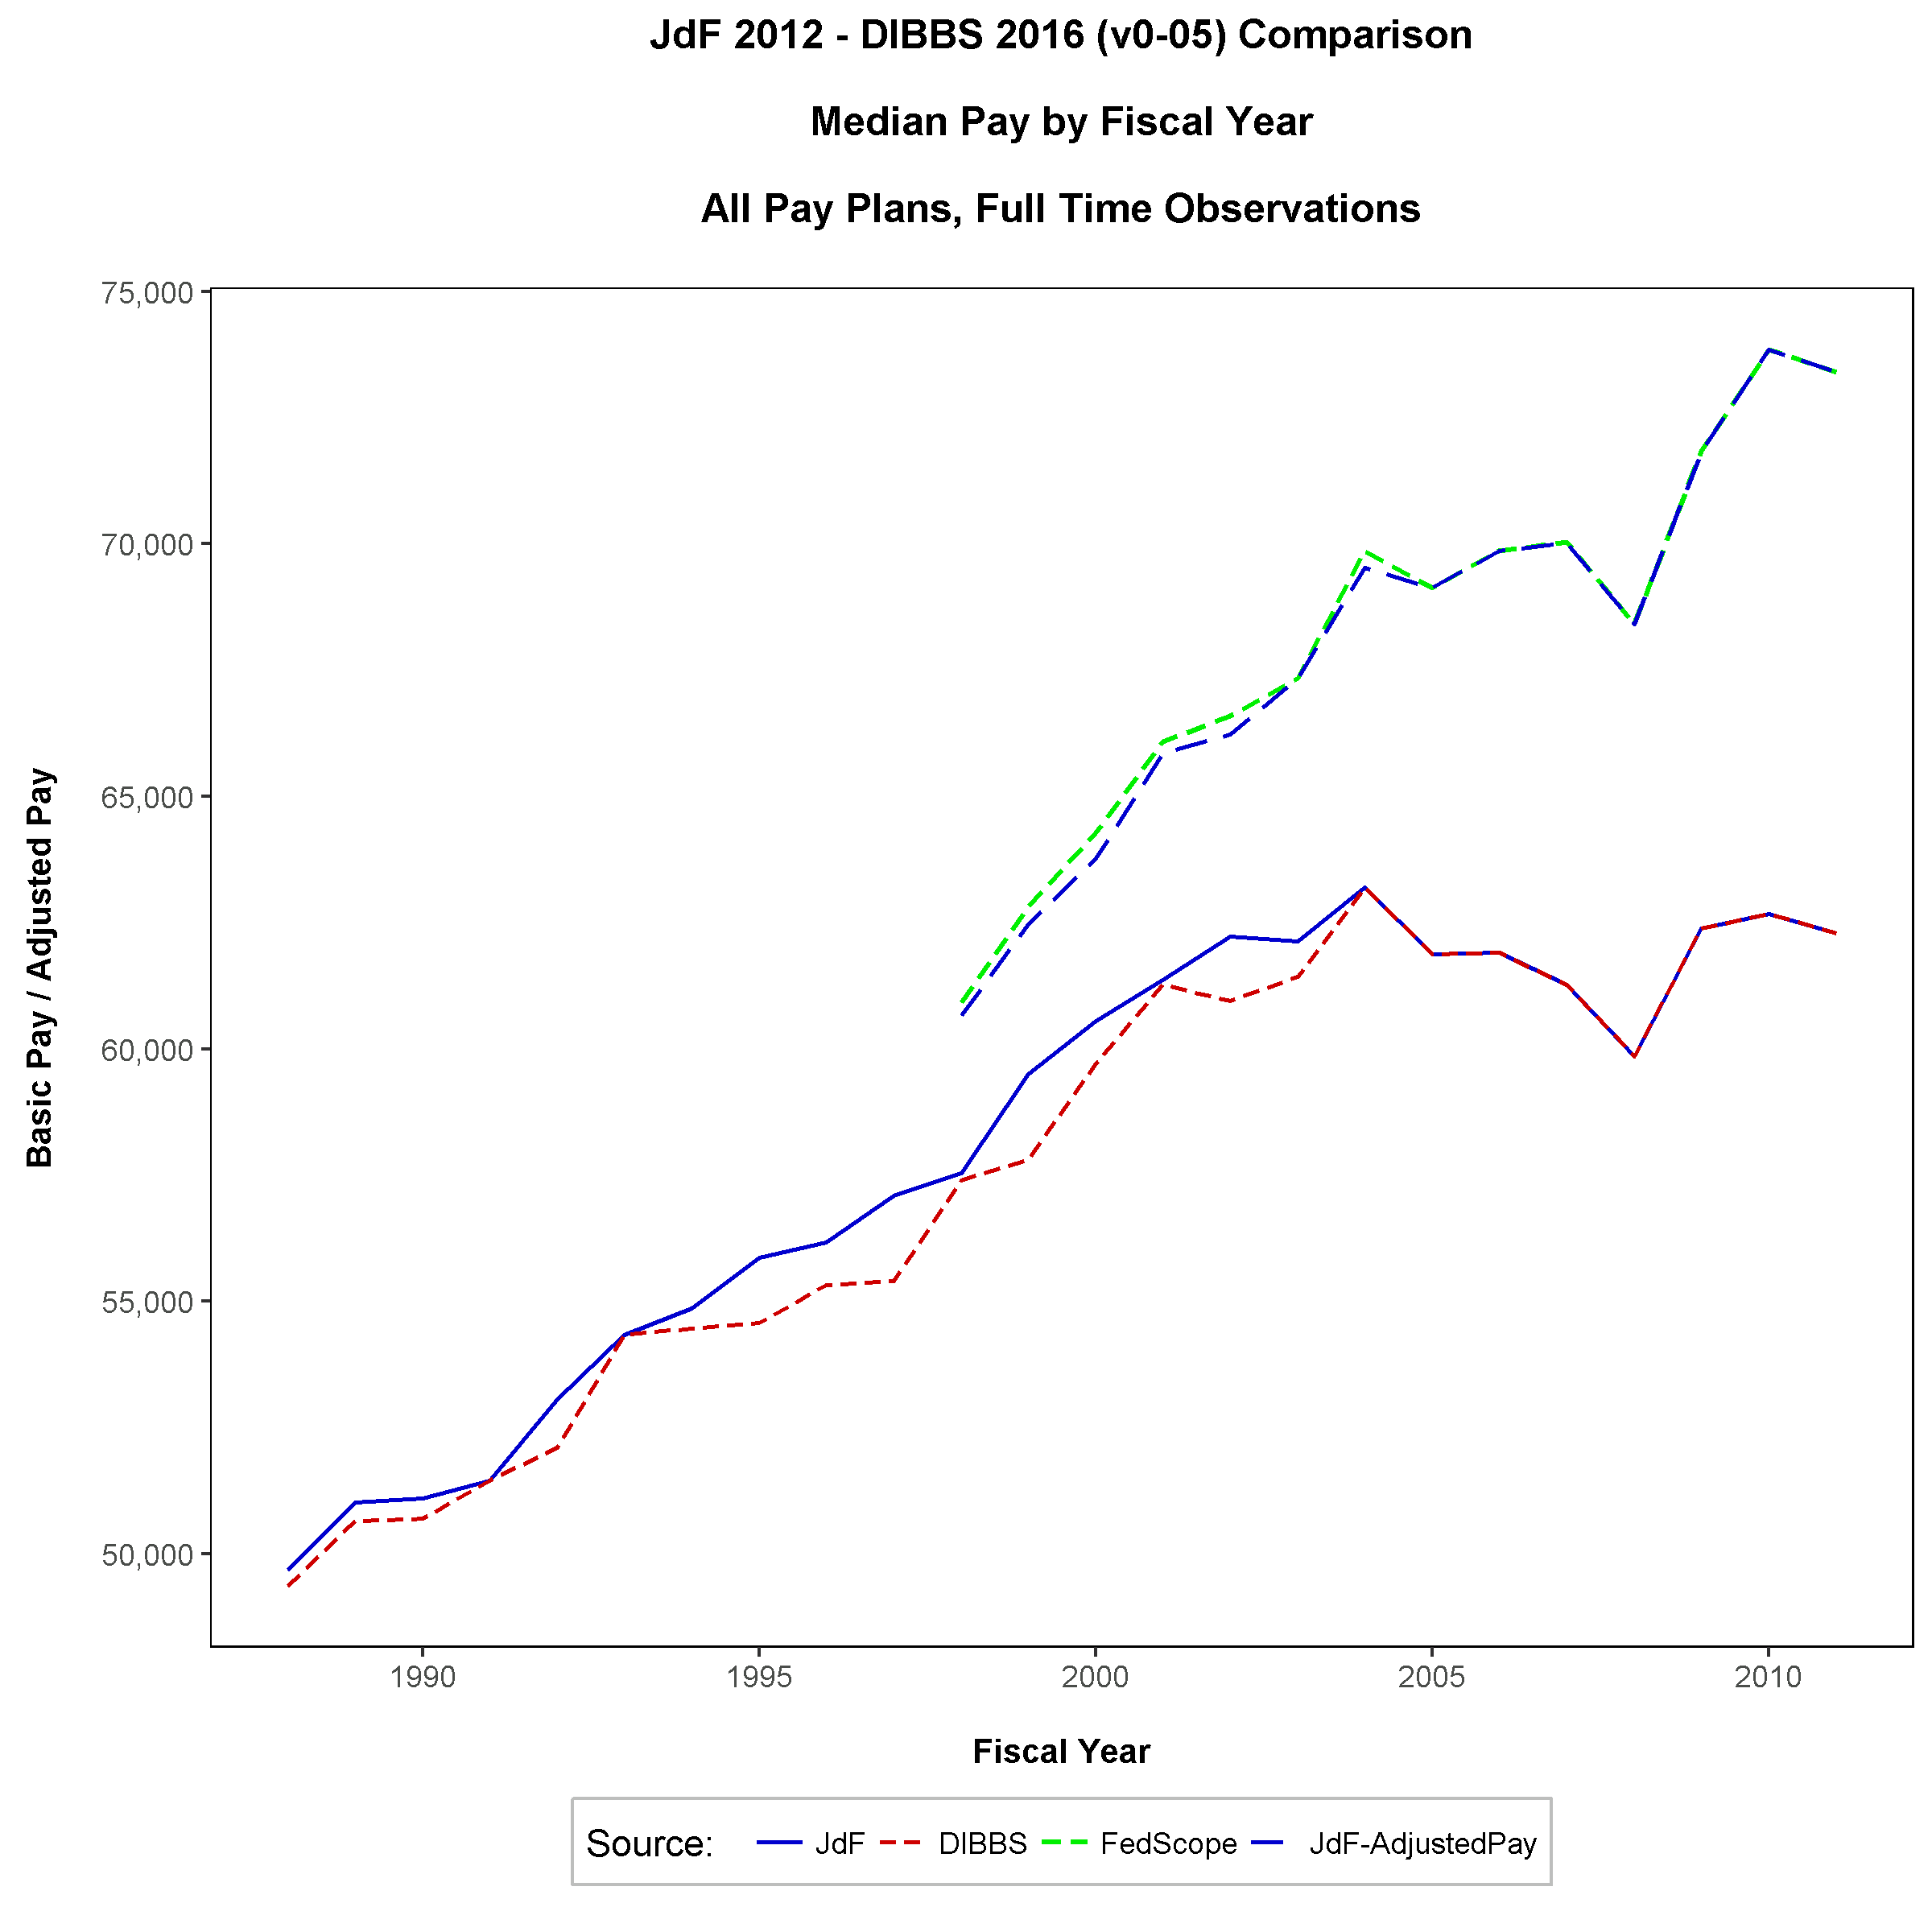
median Federal employee pay, 1988-2011

Slide 15
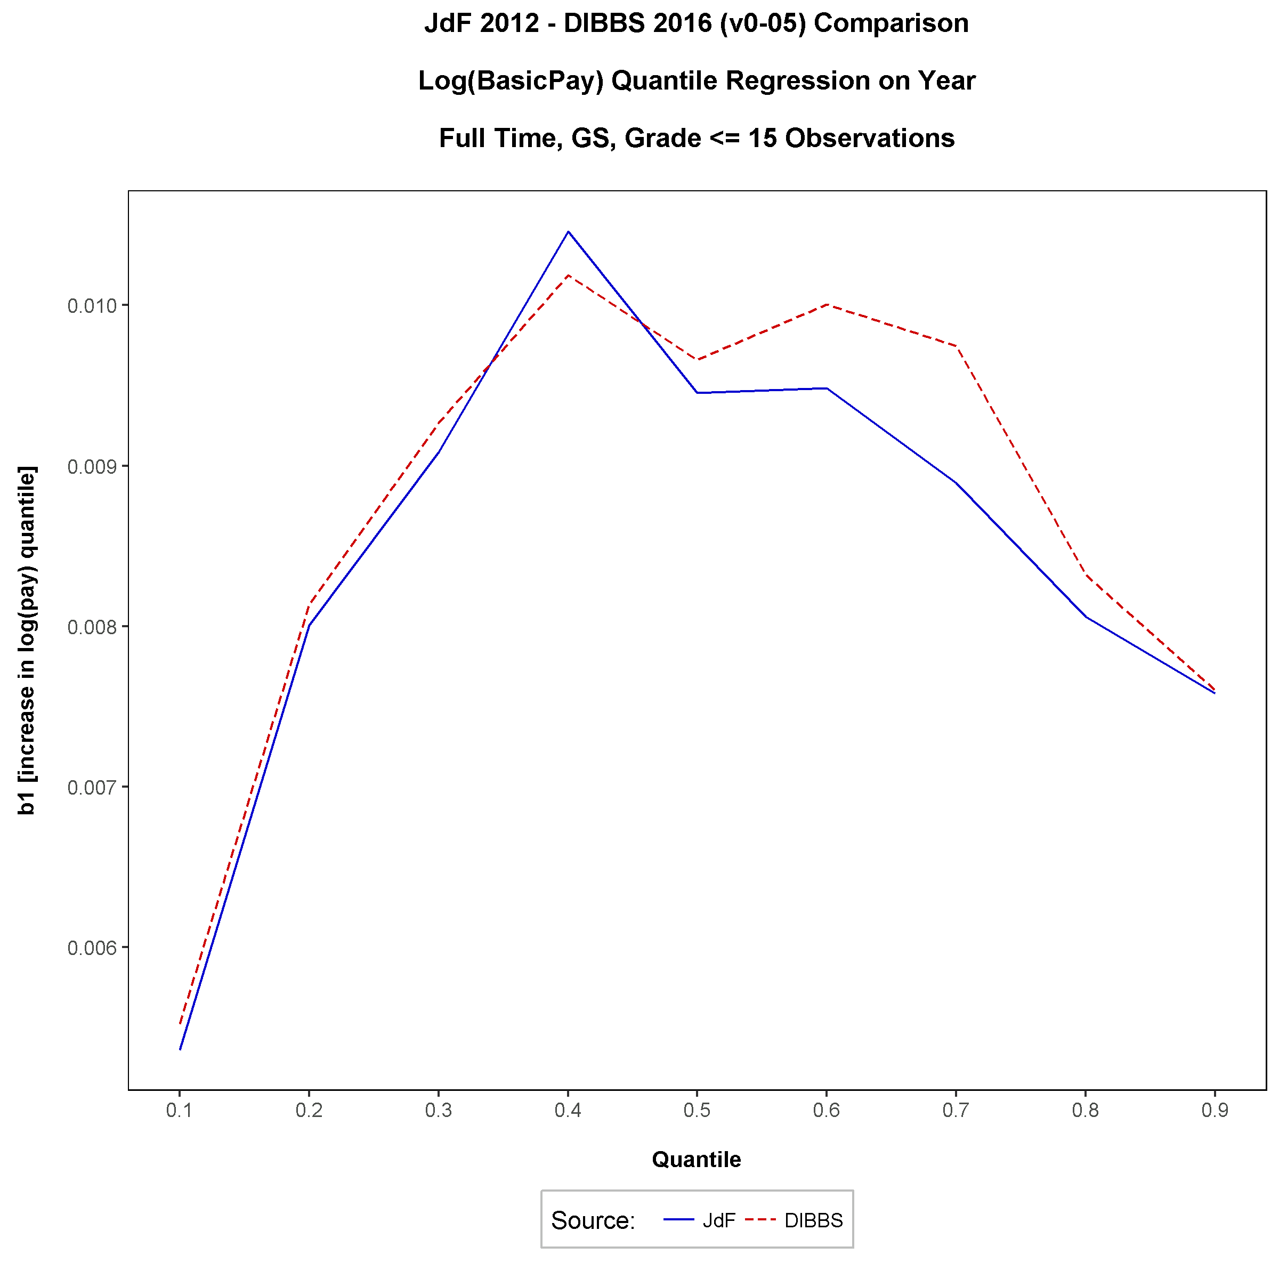
Annual rate of change in pay percentiles, gs pay plan, 1988-2011

Slide 16
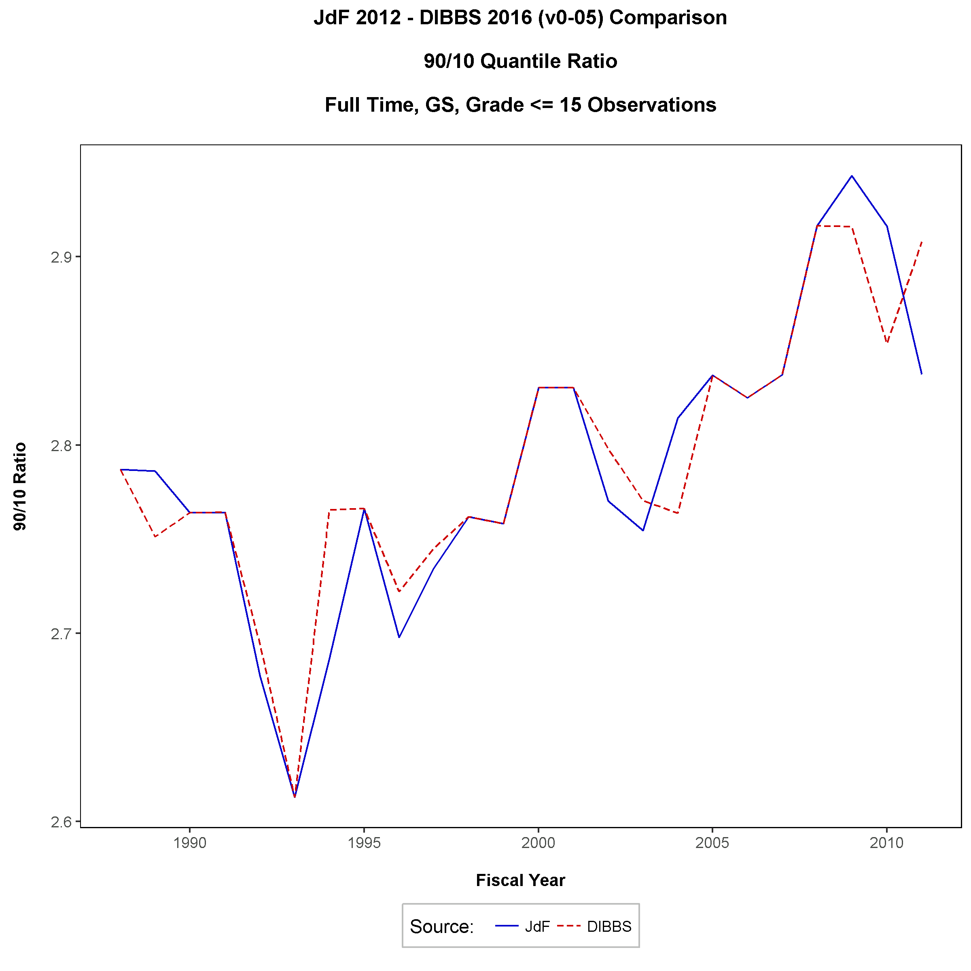
ratio of 90th to 10th pay percentiles, GS pay plan, 1988-2011

Slide 17
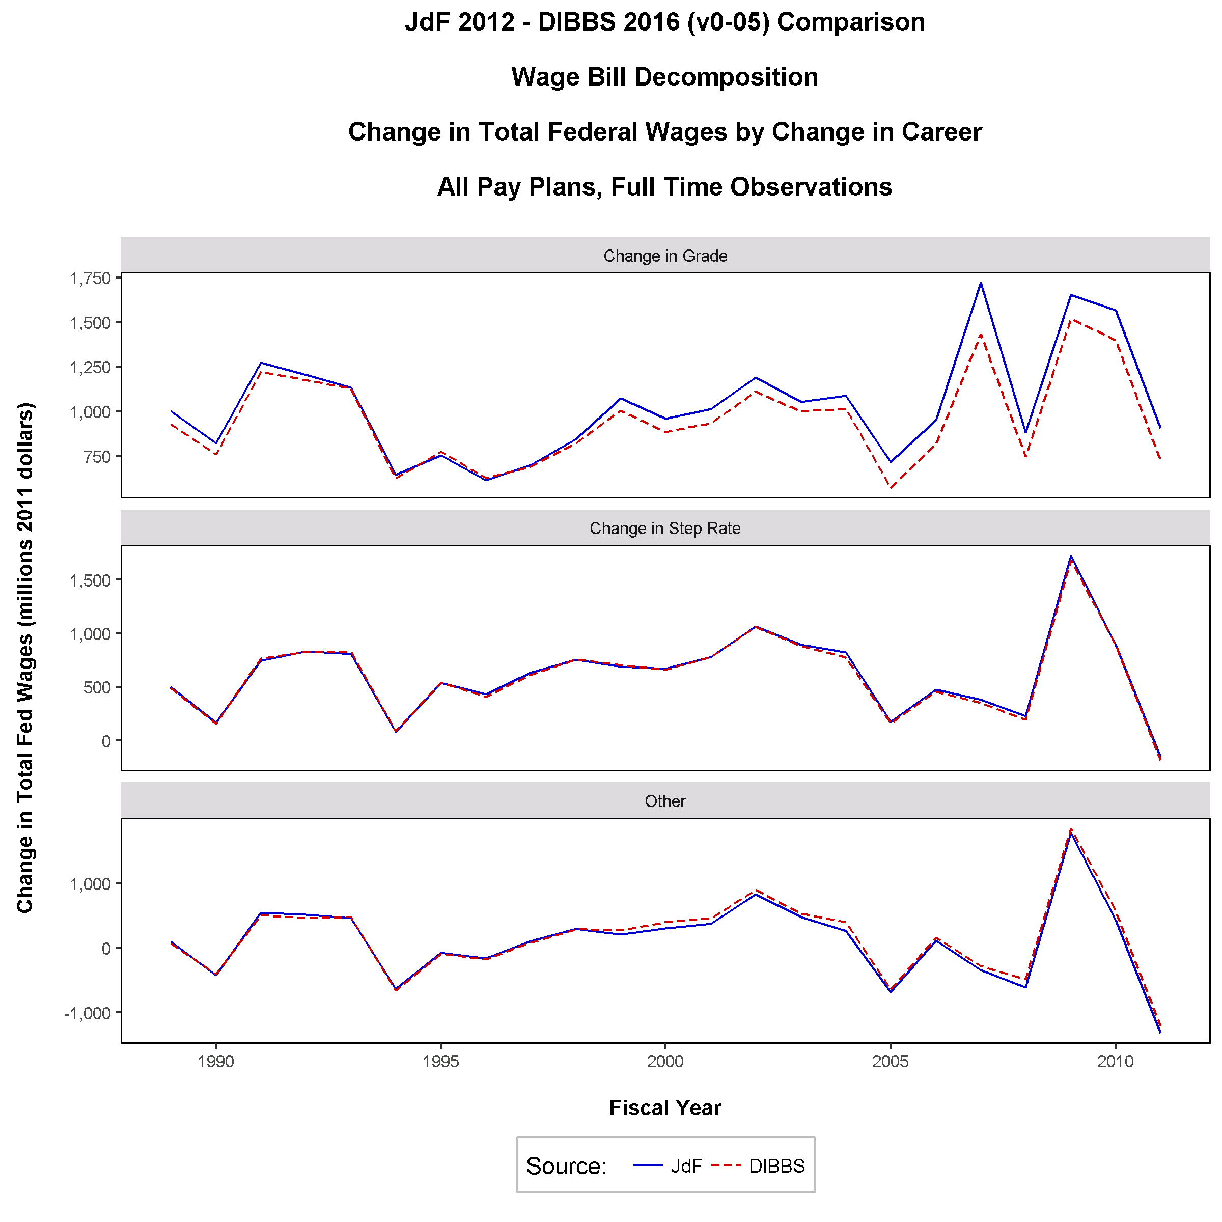
Annual change in federal payroll due to increases, 1989-2011

Slide 18
distribution models
From Gender Pay Differential Research

Slide 19
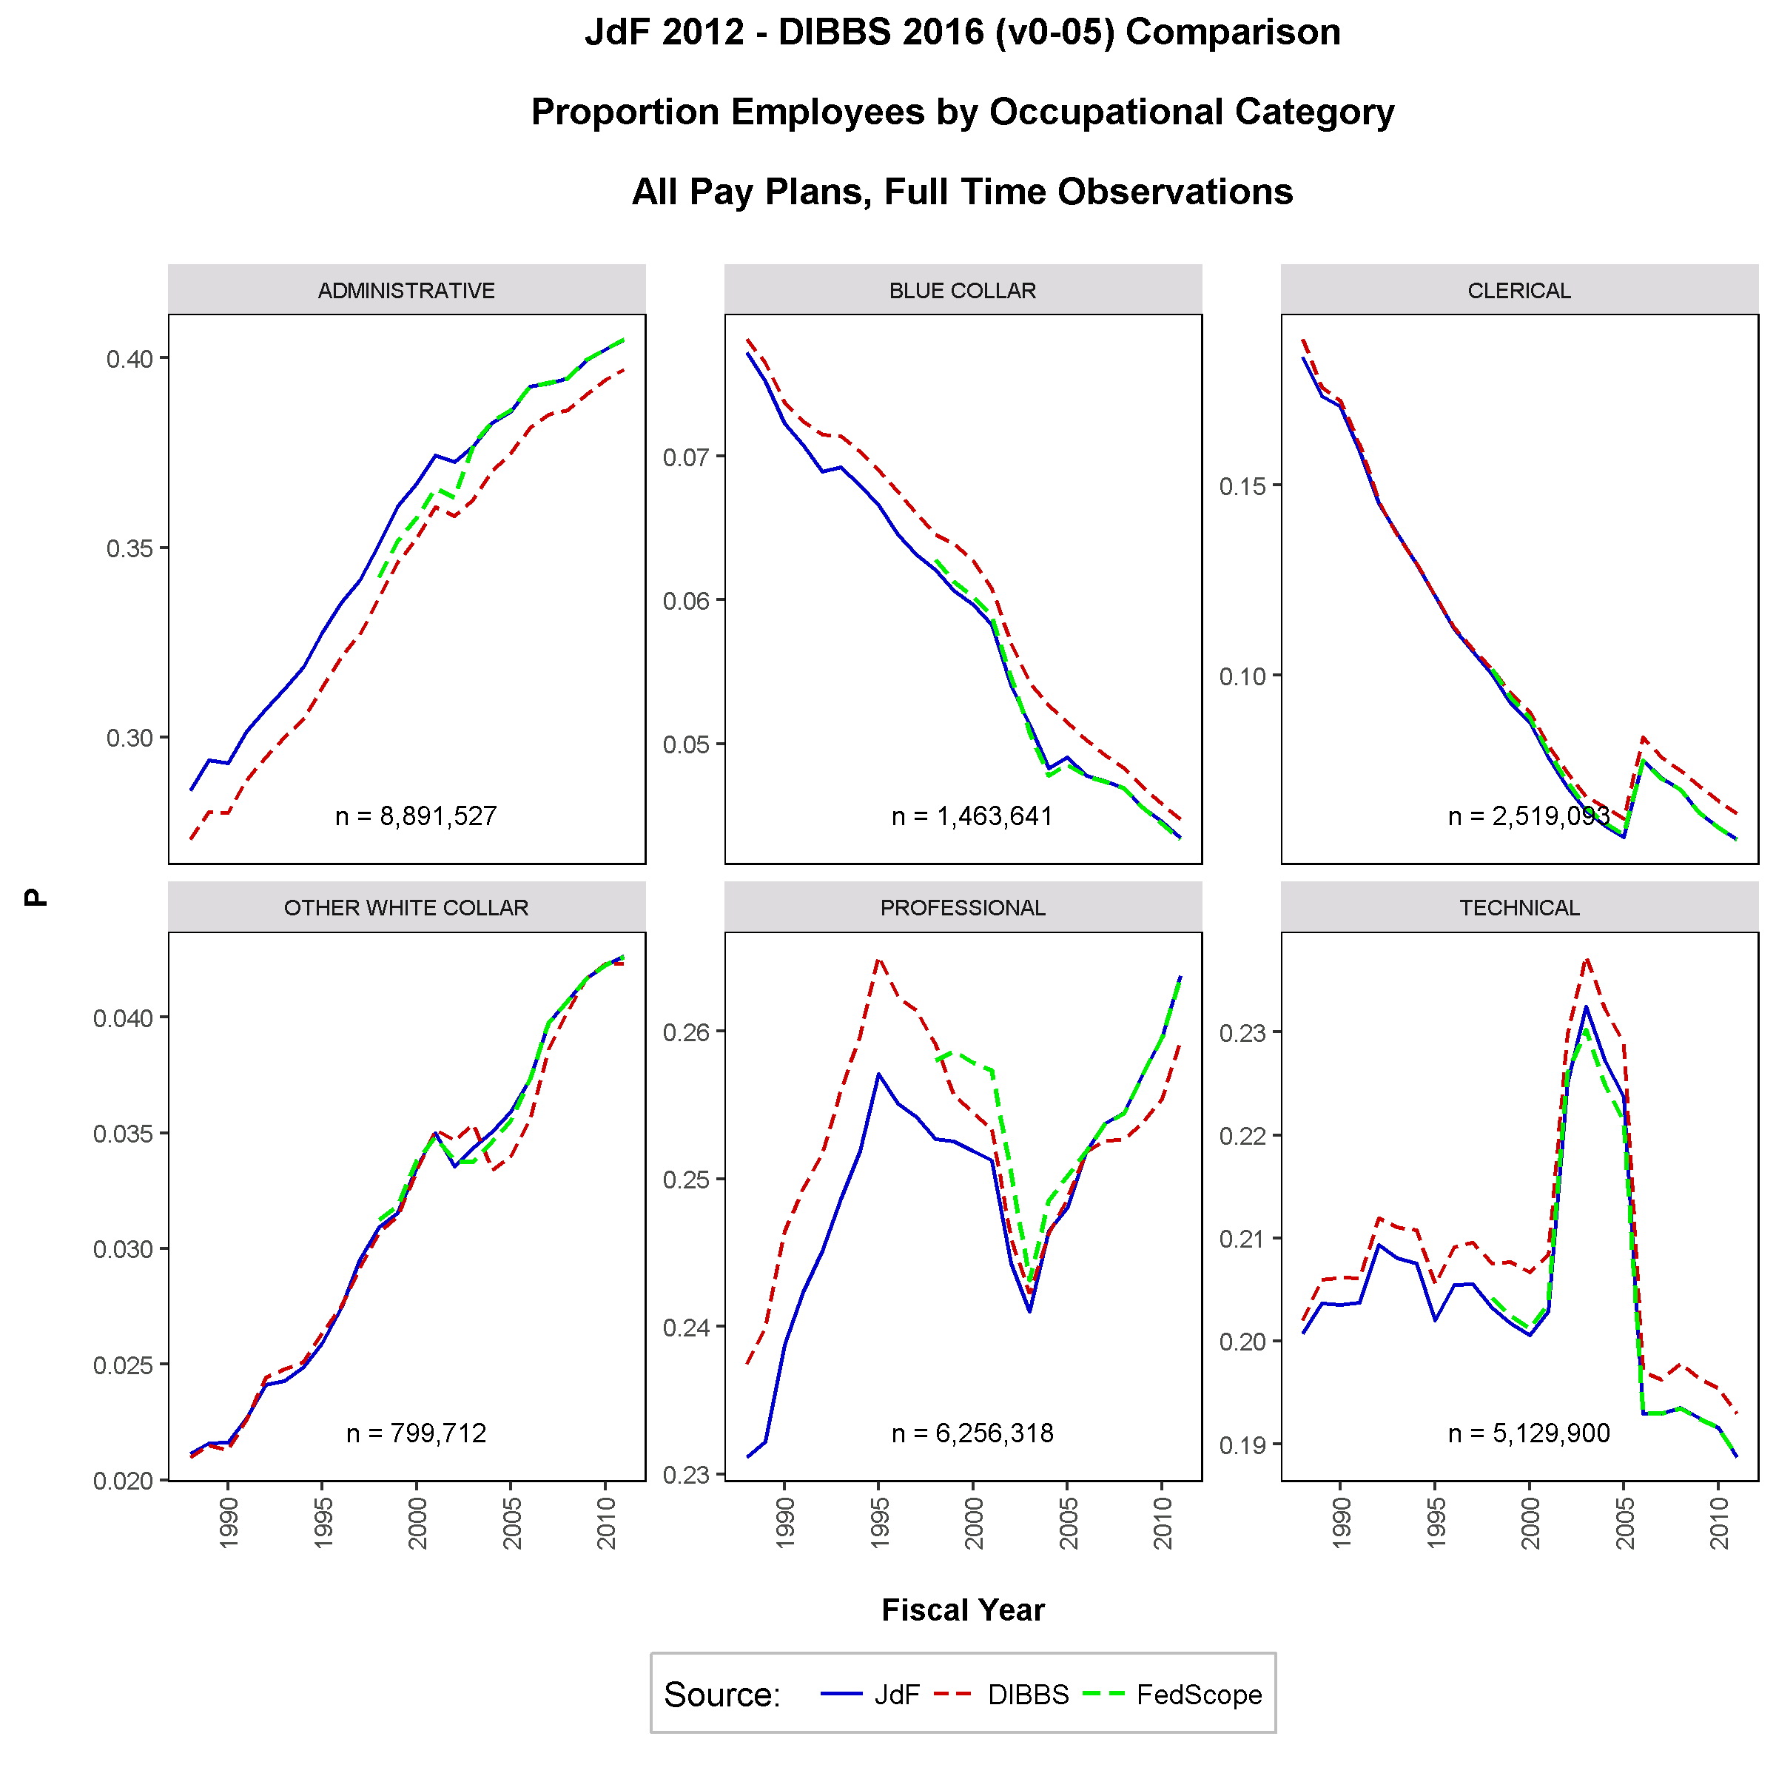
distribution of Federal employees by occupational category, 1988-2011

Slide 20
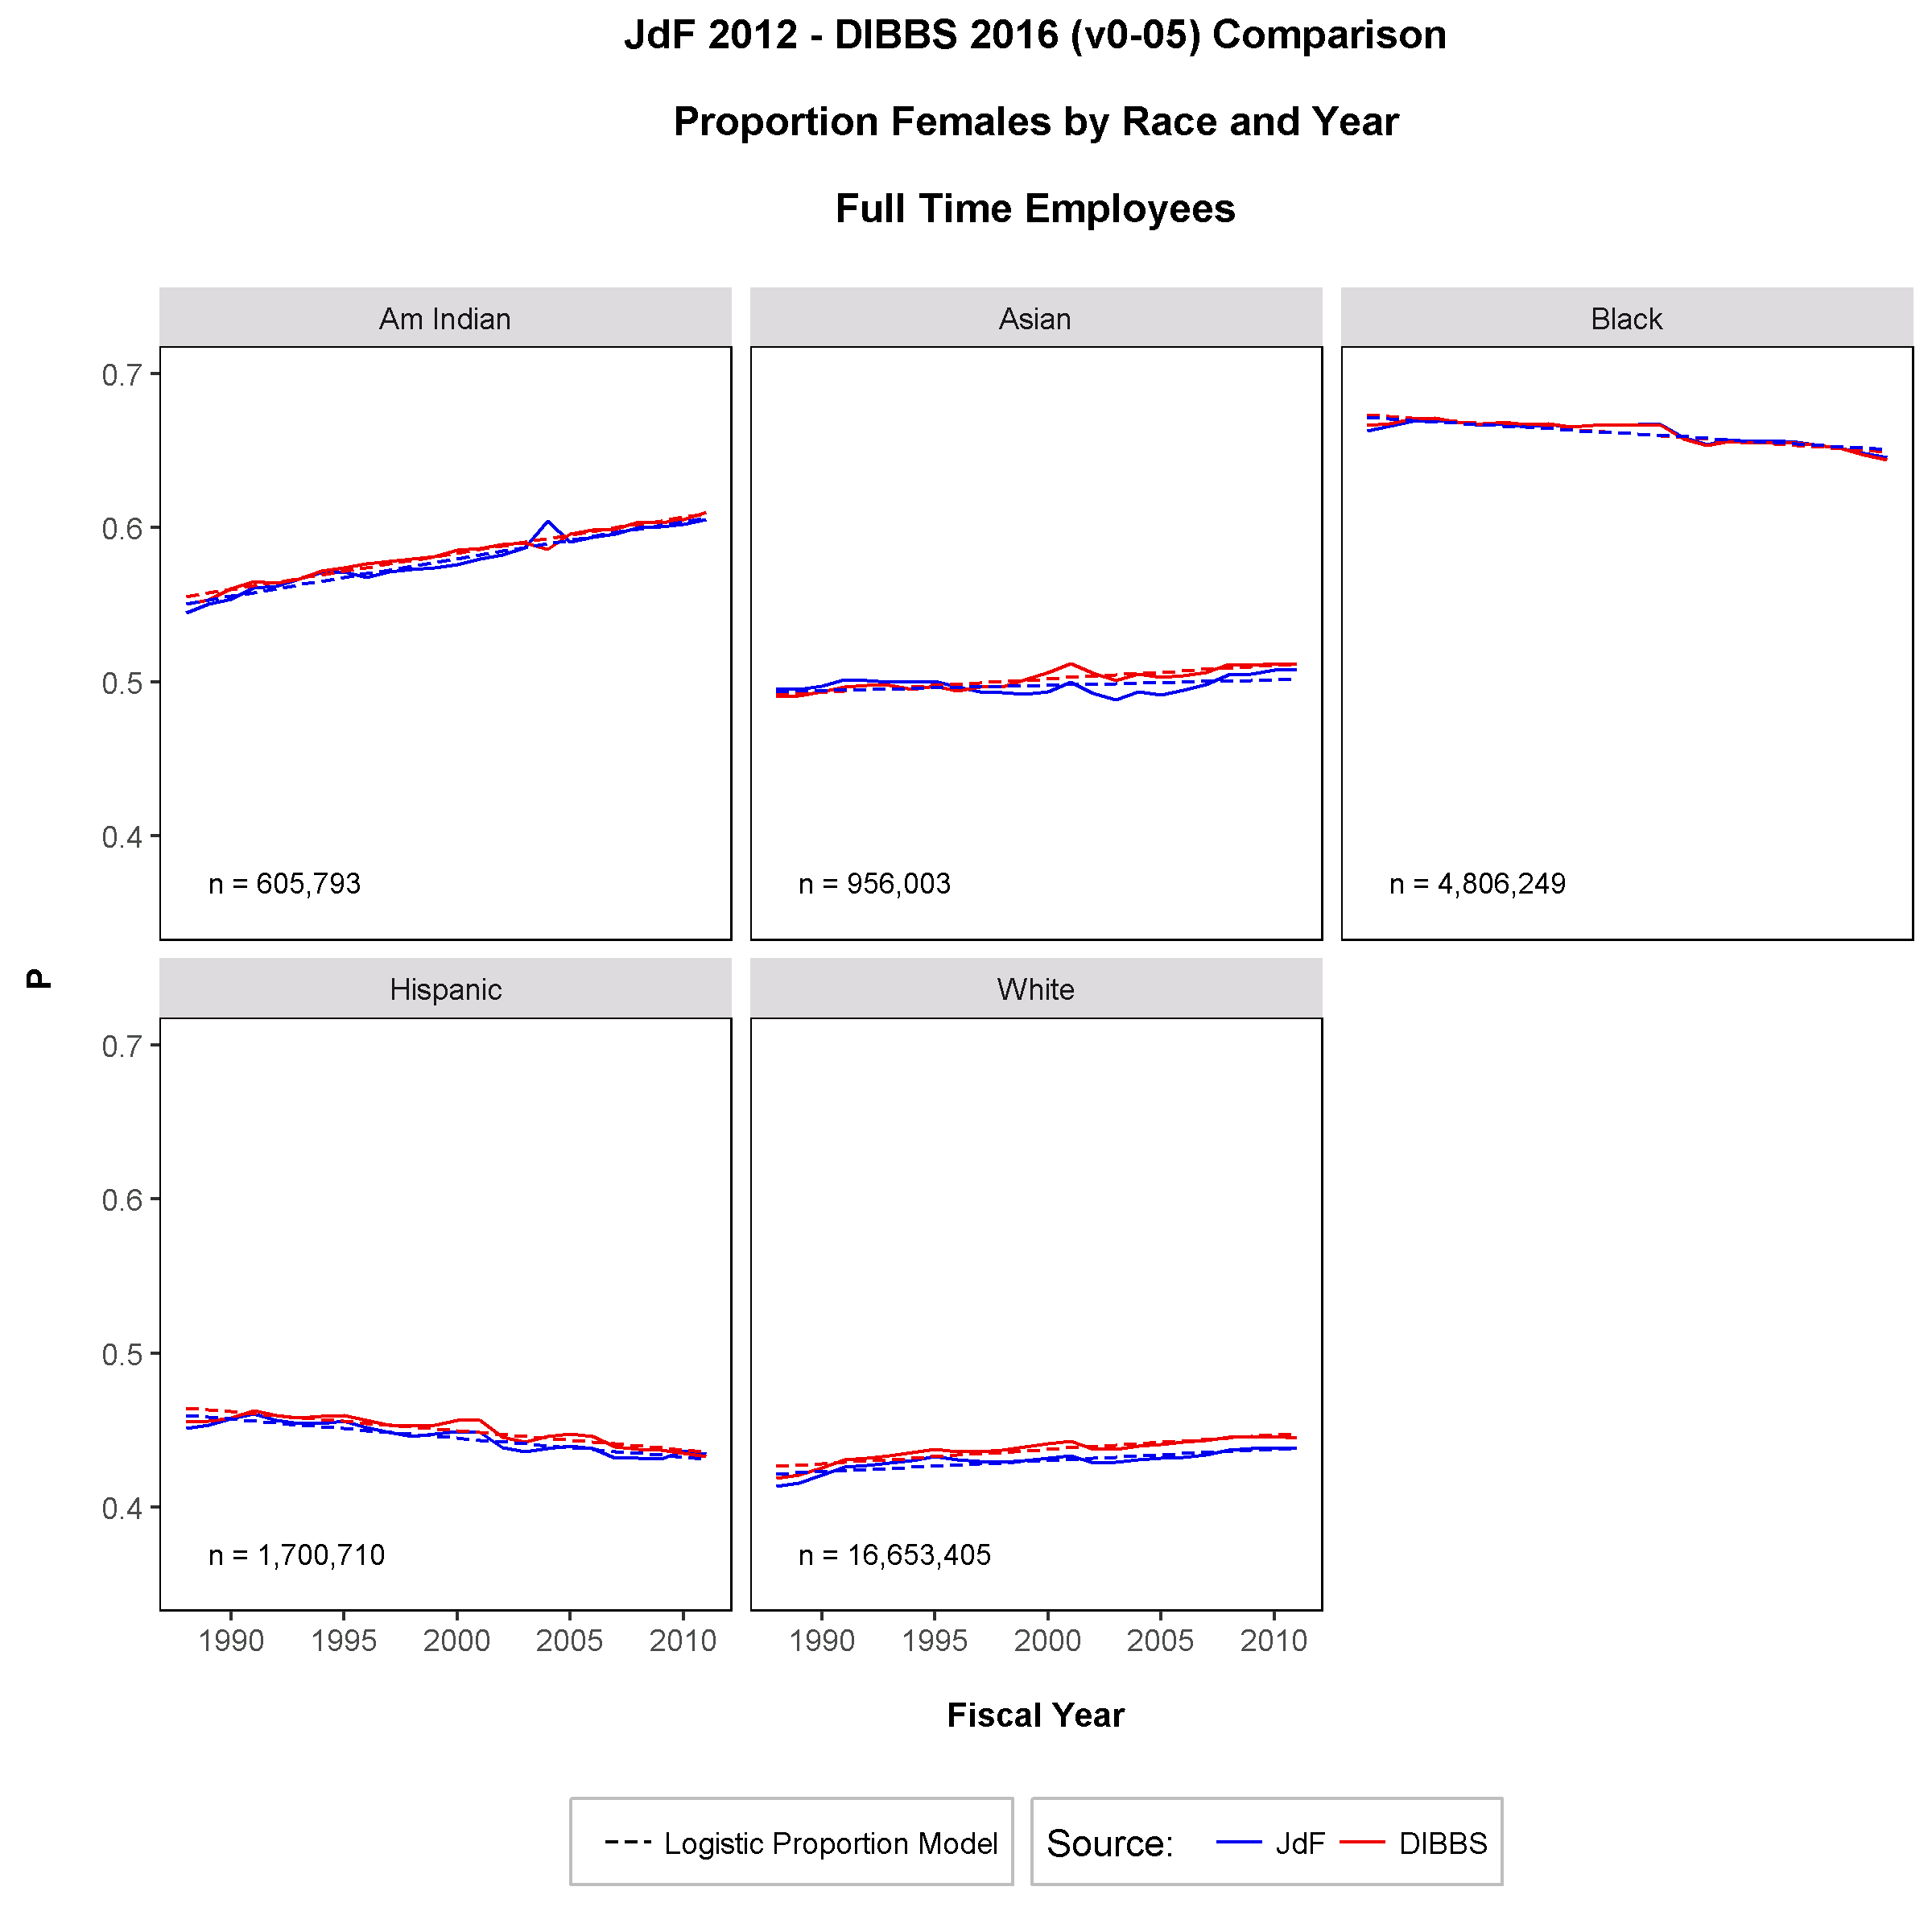
proportion females by race, 1988-2011

Slide 21
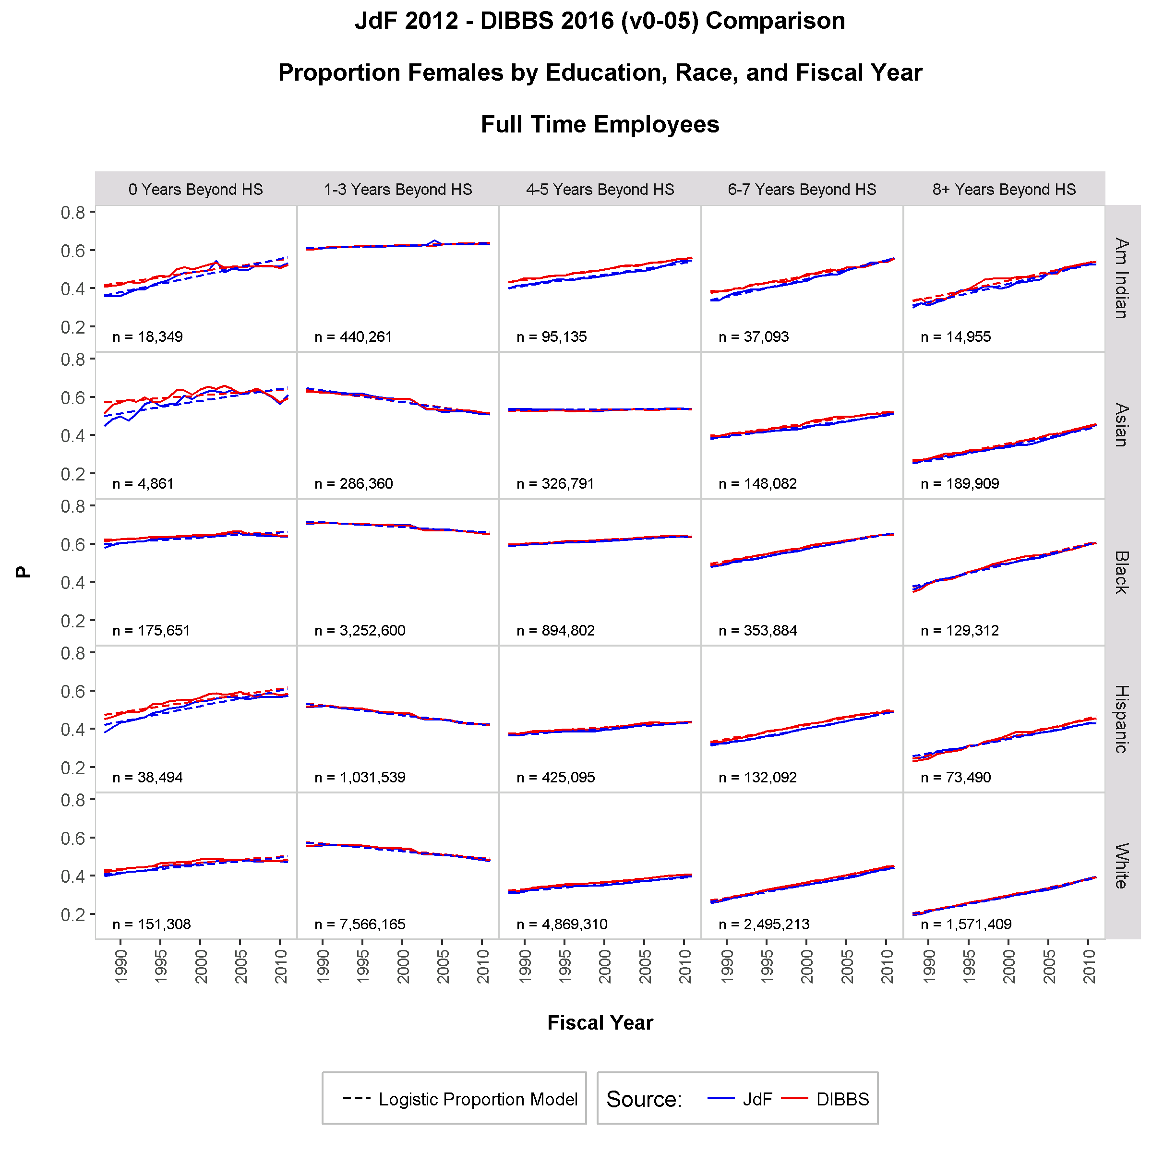
proportion females by race and education, 1988-2011

Slide 22
regression models
From Grade Inflation and Gender Pay Differential Research

Slide 23
simple OLS pay model
Age and Education Predictors
Duke OPM Synthetic OLS Model 1 Analysis
Model: ln(BasicPay) = Age + Age² + Education
 | JdF |  | DIBBS
Coefficient | Estimate | SE | Estimate | SE
Intercept | 9.3700 | 0.0010 | 9.6951 | 0.0010
Age | 0.0481 | 4.0E-05 | 0.0348 | 4.0E-05
Age² | -0.0004 | 5.0E-07 | -0.0003 | 5.0E-05
Education | 0.0819 | 3.0E-05 | 0.0753 | 3.0E-05

Slide 24
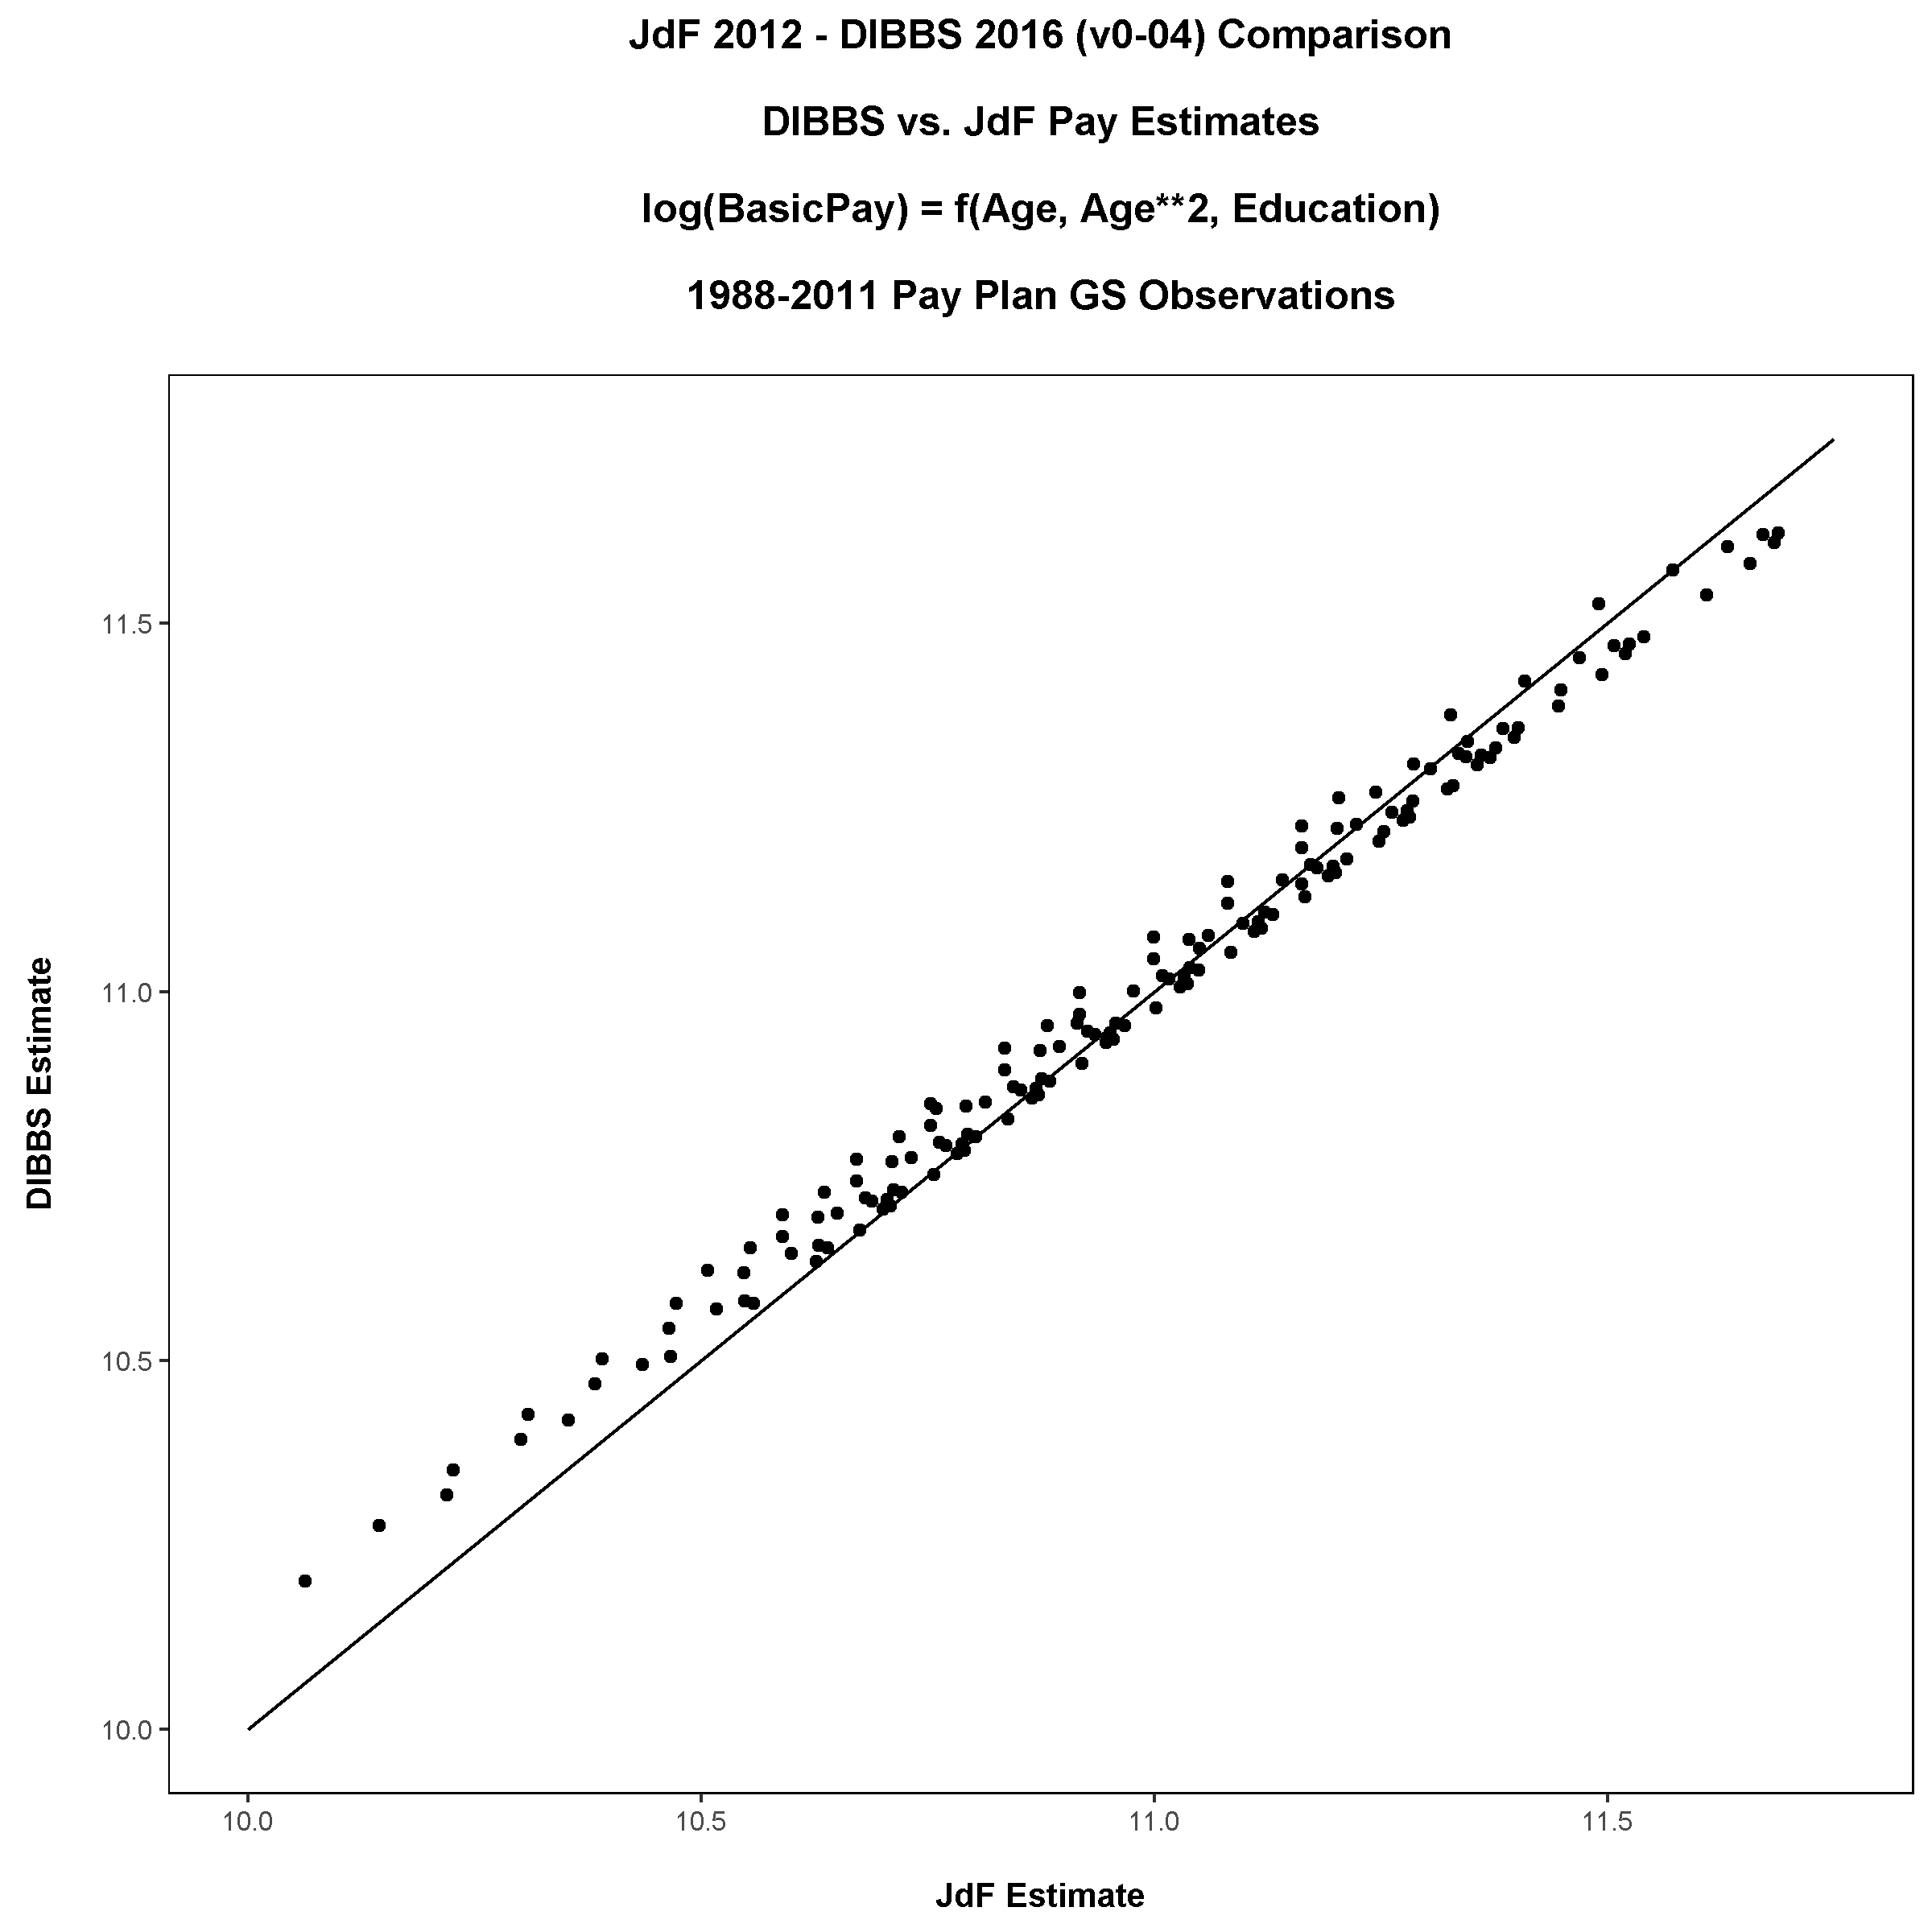
simple OLS pay model
Synthetic Predicted Pay vs. Predicted Pay from JdF Model

Slide 25
fixed effects OLS pay model
Age and Education Predictors; Sex, Race, Agency, and Year Fixed Effects
Duke OPM Synthetic OLS Model 2 Analysis
Model: ln(BasicPay) = Age + Age² + Education + Agency + Year
 | JdF |  | DIBBS
Coefficient | Estimate | SE | Estimate | SE
Intercept | 9.5025 | 0.0734 | 9.119 | 0.0414
Age | 0.0489 | 4.1E-05 | 0.0365 | 3.9E-05
Age² | -0.0004 | 4.6E-07 | -0.0003 | 4.4E-07
Education | 0.0661 | 3.0E-05 | 0.0617 | 3.1E-05
Sex | -0.0910 | 0.0001 | -0.0723 | 0.0001
Race | √ |  | √
Agency | √ |  | √
Year | √ |  | √

Slide 26
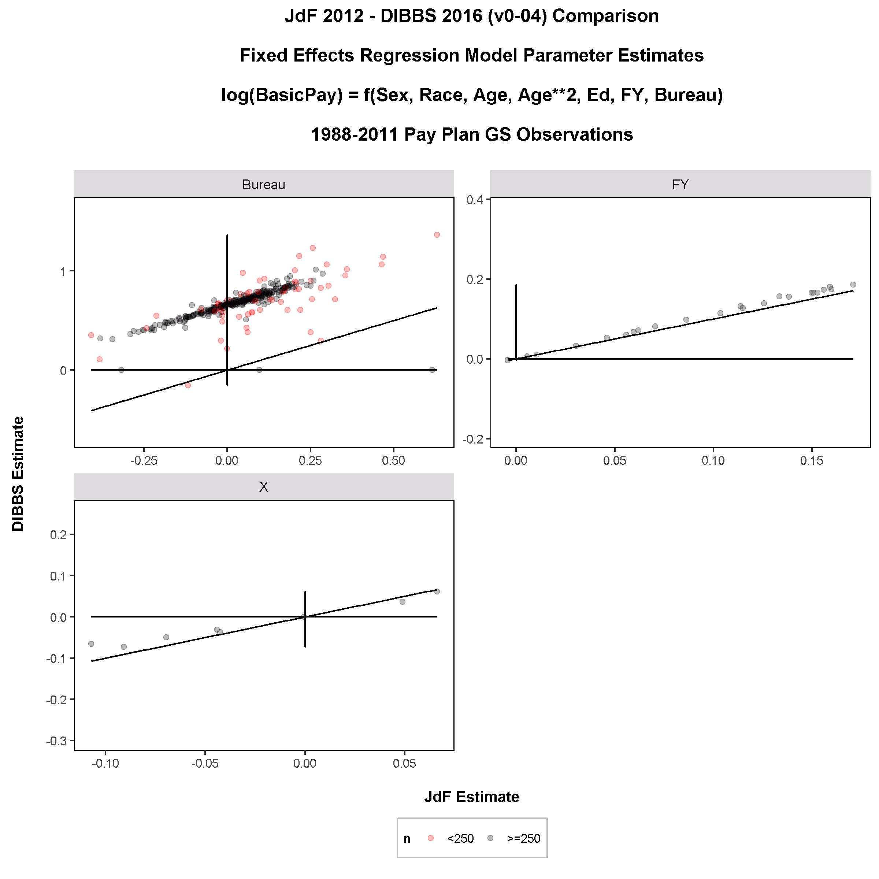
OLS pay model with Sex, agency, and year fixed effects
Parameter Estimate Homogeneity

Slide 27
fixed effects OLS pay model
Age and Education Predictors; Sex, Race, Agency, Year, and Occupation Fixed Effects
Duke OPM Synthetic OLS Model 3 Analysis
Model: ln(BasicPay) = Age + Age² + Education + Agency + Year + Occupation
 | JdF |  | DIBBS
Coefficient | Estimate | SE | Estimate | SE
Intercept | 10.2621 | 0.0520 | 10.2127 | 0.0298
Age | 0.0352 | 2.9E-05 | 0.0266 | 2.9E-05
Age² | -0.0003 | 3.3E-07 | -0.0002 | 3.3E-07
Education | 0.0186 | 2.7E-05 | 0.0125 | 2.8E-05
Sex | -0.0320 | 0.00011 | -0.0234 | 0.0001
Race | √ |  | √
Agency | √ |  | √
Year | √ |  | √
Occupation | √ |  | √

Slide 28
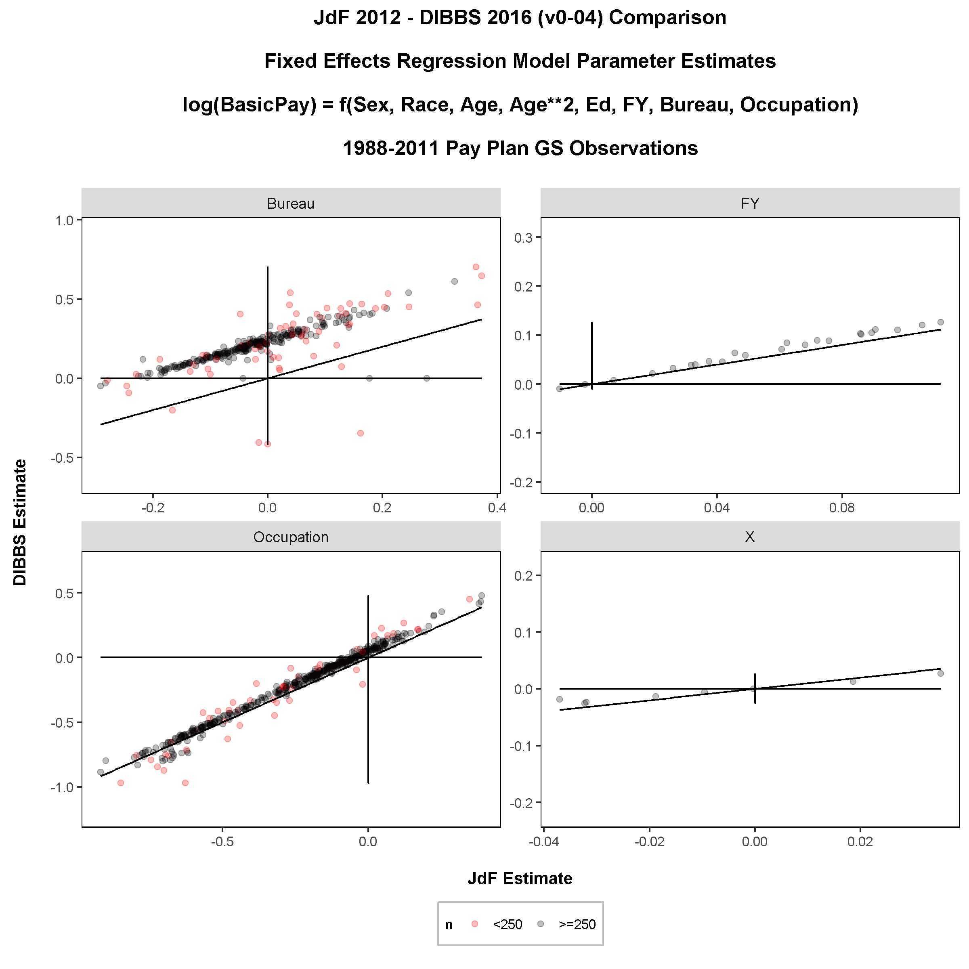
OLS pay model with Sex, Race, Agency, Year, and occupation fixed effects
Parameter Estimate Homogeneity

Slide 29
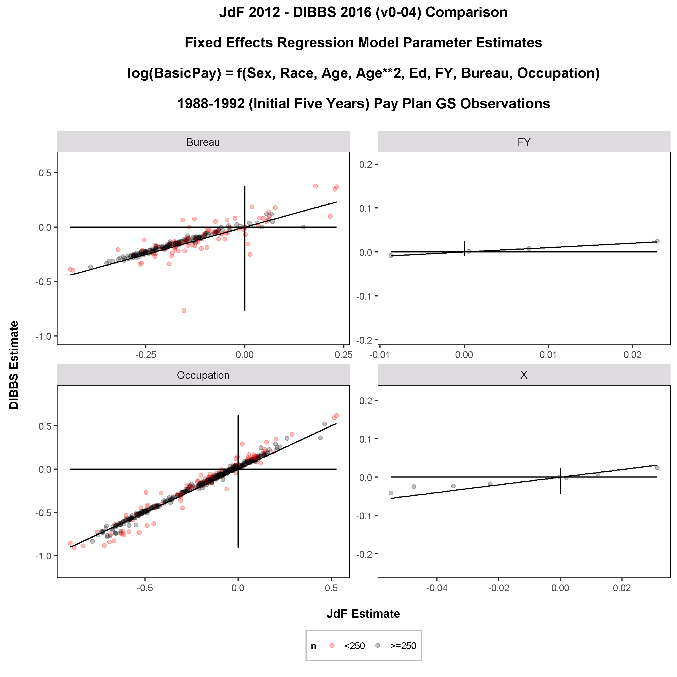
OLS pay model with Sex, race, agency, year, and occupation fixed effects
Initial Five Years of Study Data

Slide 30
Promotion models
From Gender Pay Differential Research

Slide 31
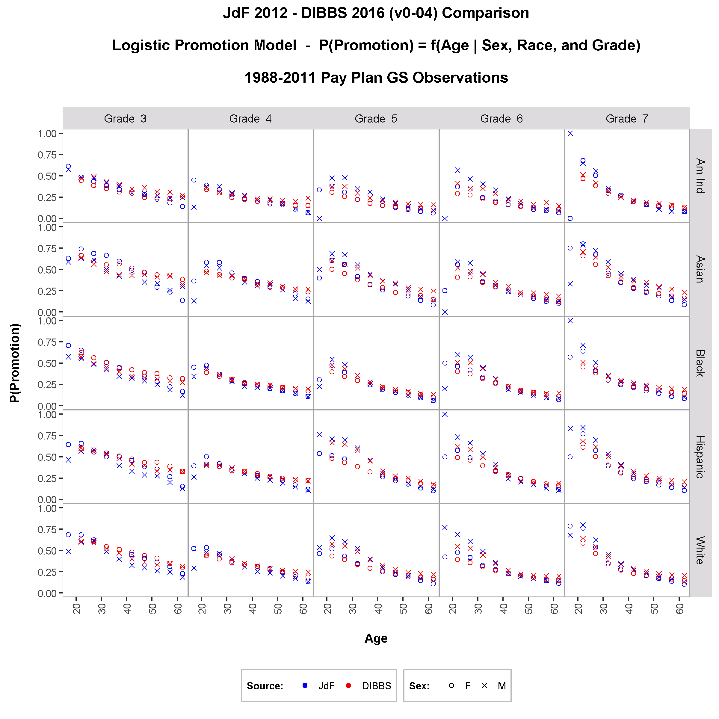
proportion employees promoted by sex, race, age, and grade
Synthetic Proportions Compared to Actual

Slide 32
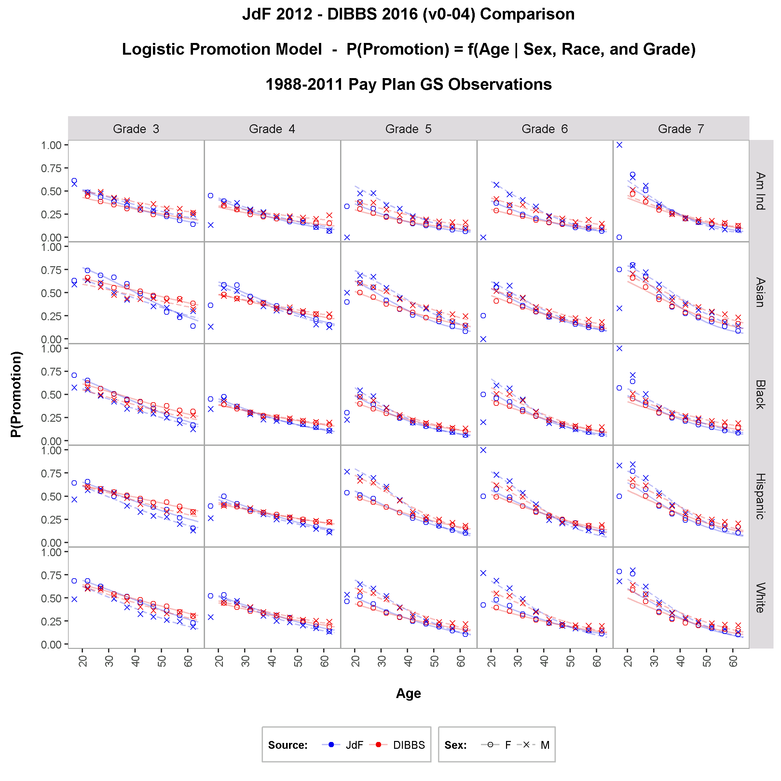
proportion employees promoted with logistic regression model
Probability of Promotion = f(Sex, Race, Age, Grade)

Slide 33
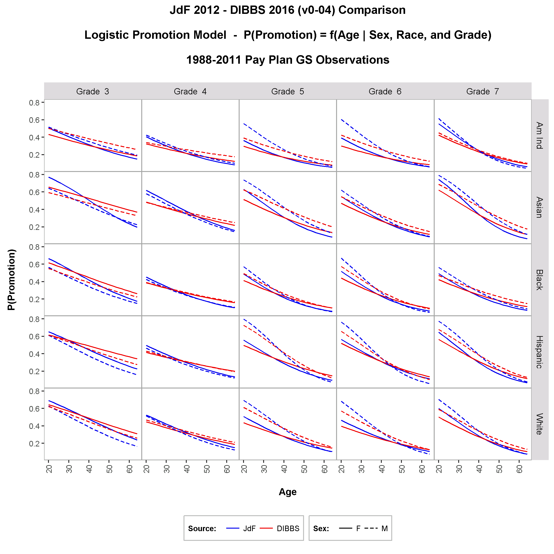
comparison of models derived from synthetic and actual data
Probability of Promotion = f(Sex, Race, Age, Grade)

Slide 34
Coming attractions
Gender pay quantile regression model
GS -> SES promotion proportional hazards regression model

Slide 35
conclusion
Key summary statistics and distributions (mean age by year, grade distribution, gender proportions) derived from synthetic data strongly agree with those observed in the source OPM data
Important research models (pay, promotion, OLS, logistic regression) based on synthetic data provide meaningful estimates with strong to moderate agreement with those derived from source OPM data
Demanding models (gender differential pay quantile regression, occupational category switching by age/education regression) are being assessed
The iterative process of data synthesis → model and fit analysis → synthesis model adjustment → data synthesis yields improved utility with each iteration (currently at version 5)

Slide 36
Questions?

Slide 37
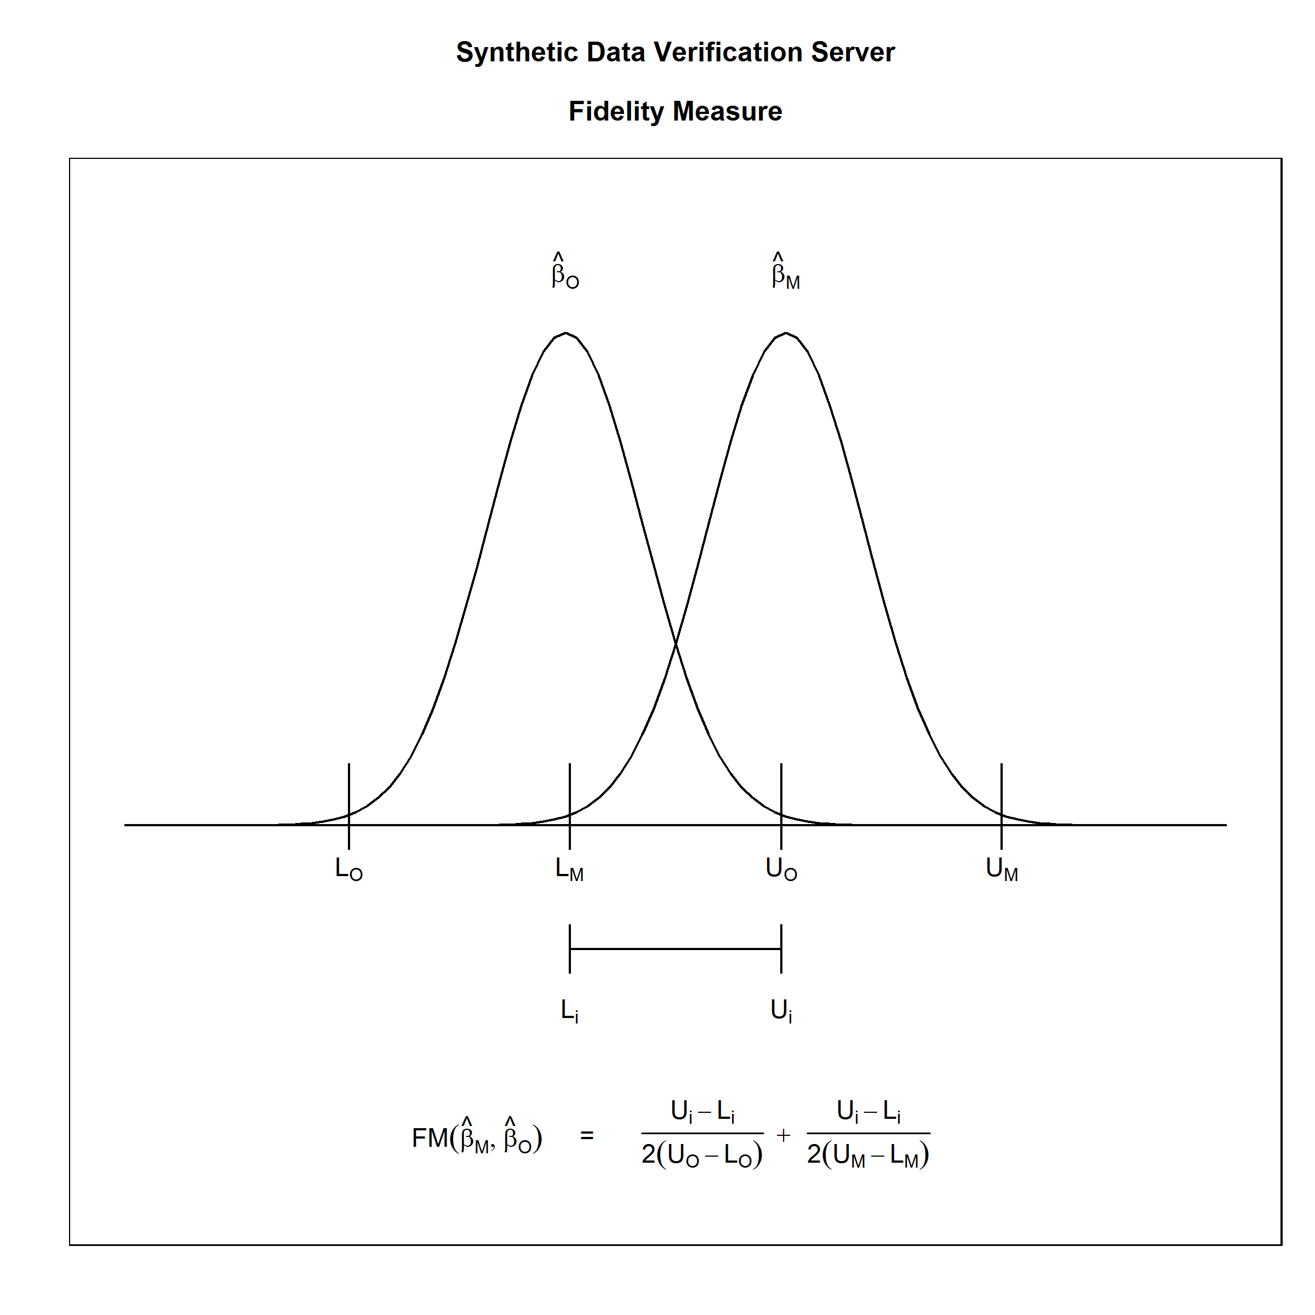
Addendum: Verification server fidelity measure example
Comparing Estimates from Synthetic (M, or masked) and Original (O) Data (taken from Reiter, 2009)

