Slide 1
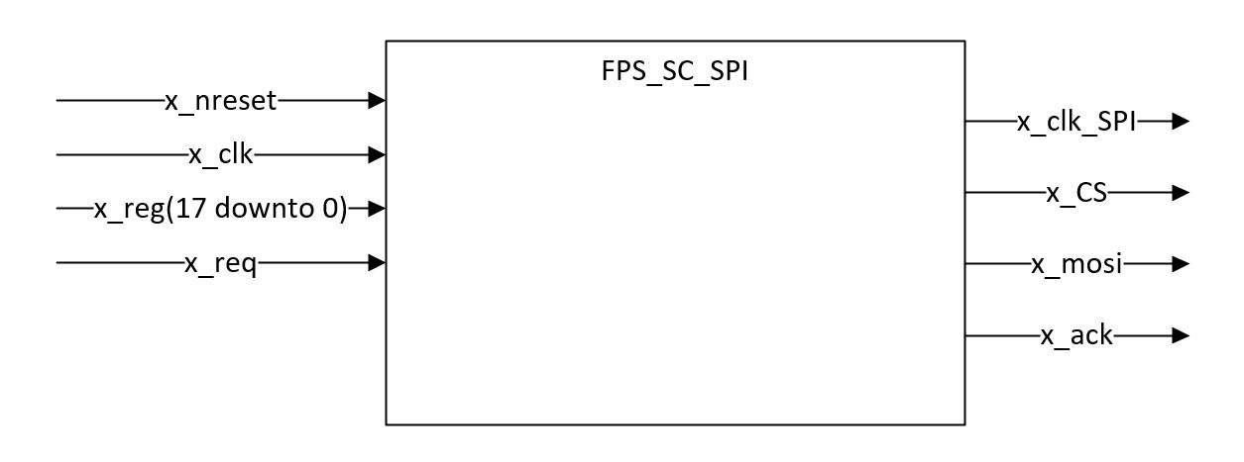
FPS_SC_SPI_PRE_PROD_ASIC
Slow control FASER chip
Important point : FPS_SC_SPI works similarily to FPS_SC_SPI_PRE_PROD_ASIC except :
- The length of spi commands is 20 bits instead of 19
18

Slide 2
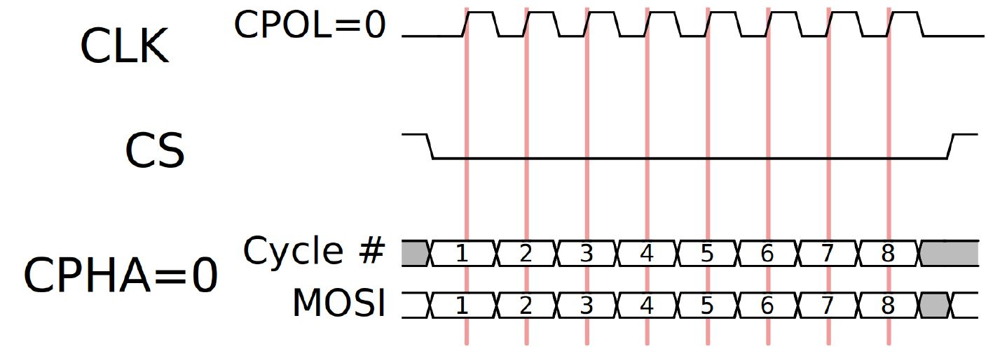
Timing Protocol (over 19 bits instead of 8, MSB first, 8.33MHz):
FPS_SC_SPI_PRE_PROD_ASIC
- FASER_MAIN - Online LaTeX Editor Overleaf
- FASER Preshower Upgrade - Readout Specifications - Online LaTeX Editor Overleaf

Slide 3
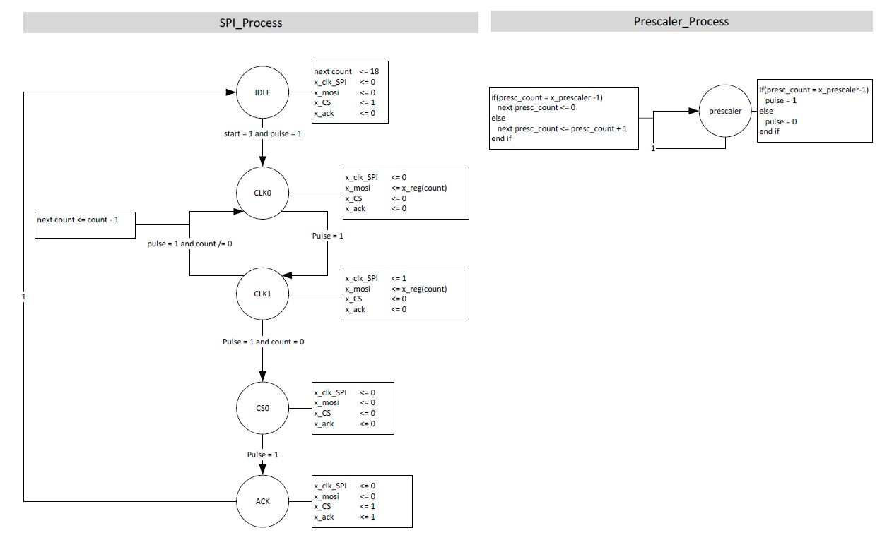
Finite State Machine
FPS_SC_SPI_PRE_PROD_ASIC

Slide 4
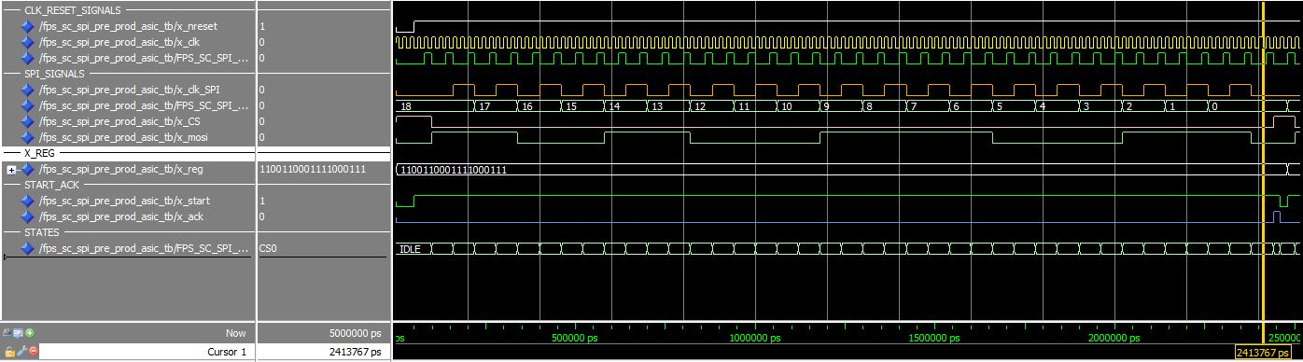
Timing
FPS_SC_SPI_PRE_PROD_ASIC

