Slide 1
FPS_SC_FEEDER_PRE_PROD_ASIC
Important point : FPS_SC_FEEDER works similarily to FPS_SC_FEEDER_PRE_PROD_ASIC except :
- The length of spi commands is 20 bits instead of 19
- The command is constructed in a slightly different way. Please refer to the FASER production chip specification document for details

Slide 2
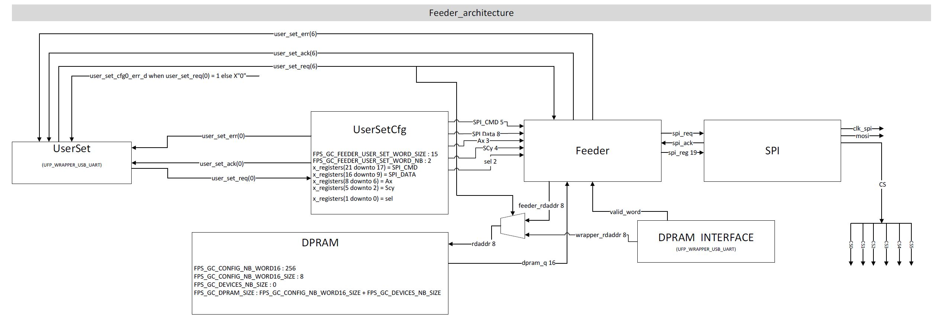
Interfaces
FPS_SC_FEEDER_PRE_PROD_ASIC

Slide 3
FPS_SC_FEEDER_PRE_PROD_ASIC

Slide 4
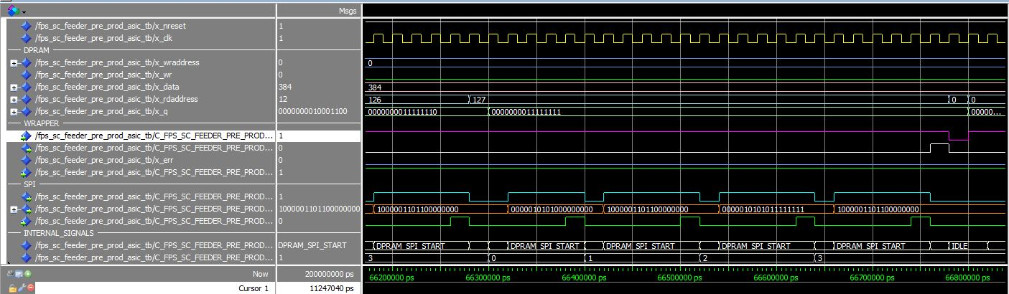
Timing examples x_sel = 00
FPS_SC_FEEDER_PRE_PROD_ASIC
FPS_SC_FEEDER_PRE_PROD_ASIC_tb.vhd

Slide 5
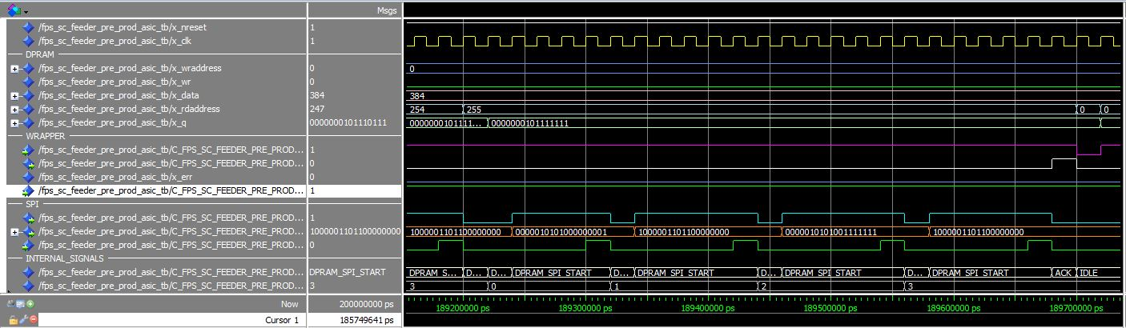
Timing examples x_sel = 01
FPS_SC_FEEDER_PRE_PROD_ASIC
FPS_SC_FEEDER_PRE_PROD_ASIC_tb.vhd

Slide 6
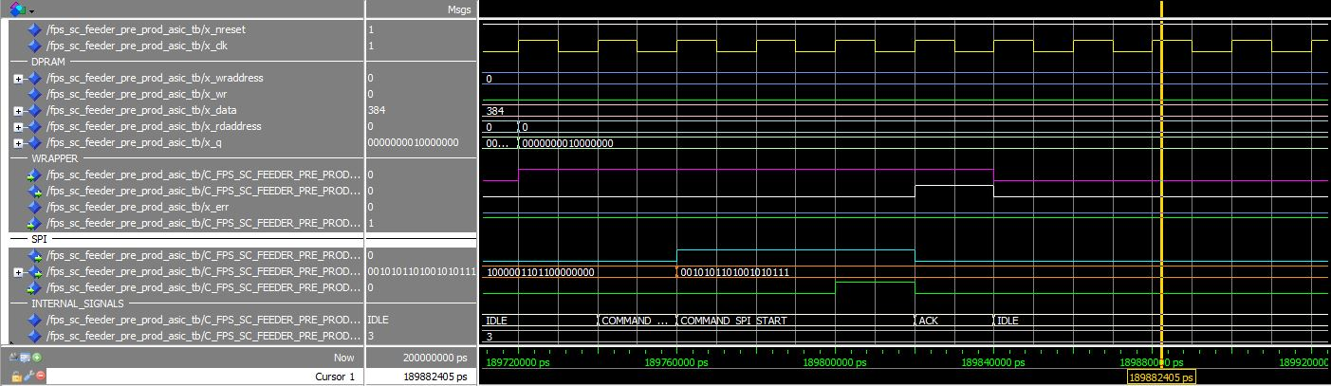
Timing examples x_sel = 10
FPS_SC_FEEDER_PRE_PROD_ASIC
FPS_SC_FEEDER_PRE_PROD_ASIC_tb.vhd

