Slide 1
Retrieval Engine for The University of Memphis
Tara Baniya

Slide 2
Overview
Crawler
12,026 pages indexed
Search Engine
Implemented in python
Web based search interface
Hosted in XAMP Apache server

Slide 3
Components
Crawler
12,026 pages from University of Memphis’ website
Indexer
Preprocessing
inverted index of word to document pointers
Retrieval Engine
retrieves documents containing at least one of the keyword
cosine similarity between query vector and document vector is calculated to rank the retrieved documents

Slide 4
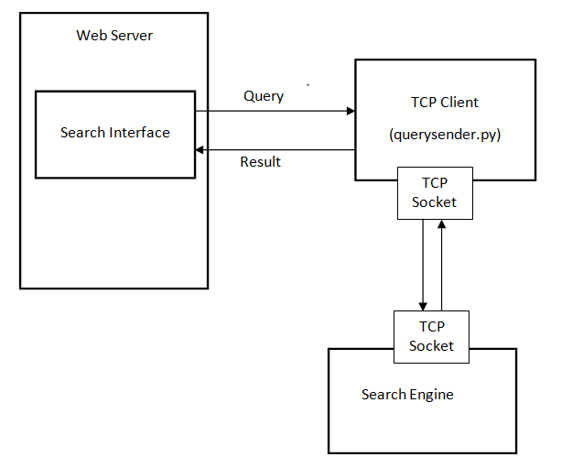
Architecture
CGI
CGI
Notes:
The search interface (HTML page) and TCP client program are hosted in web server
Search Engine is independent program
It indexes the pages, opens a socket and waits for client for query indefinitely
Client is web browser
Web browser sends POST request and CGI sends the query to theTCP client (querysender.py) residing in the web server.
The TCP client opens socket and sends query to the search engine
Search engine receives the query and send back the result to TCP client.
CGI sends result from TCP client to browser.

Slide 5
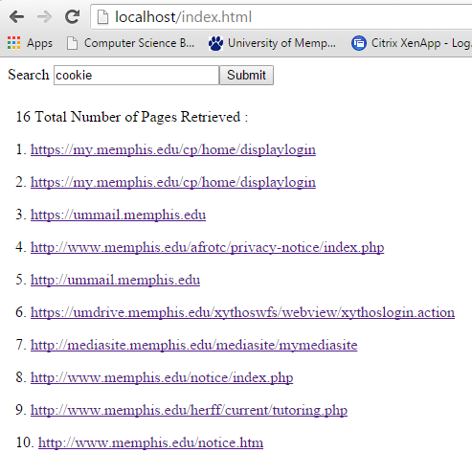
Output

Slide 6
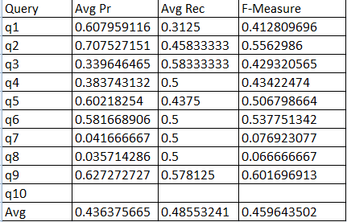
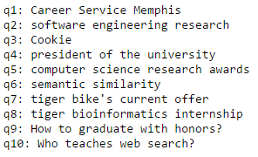
Performance Evaluation

Slide 7
Demo Time !!

