Slide 1
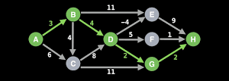
NP-Complete – Longest Path
By: Kiavash Seraj & Trevor Nicholas

