Slide 1
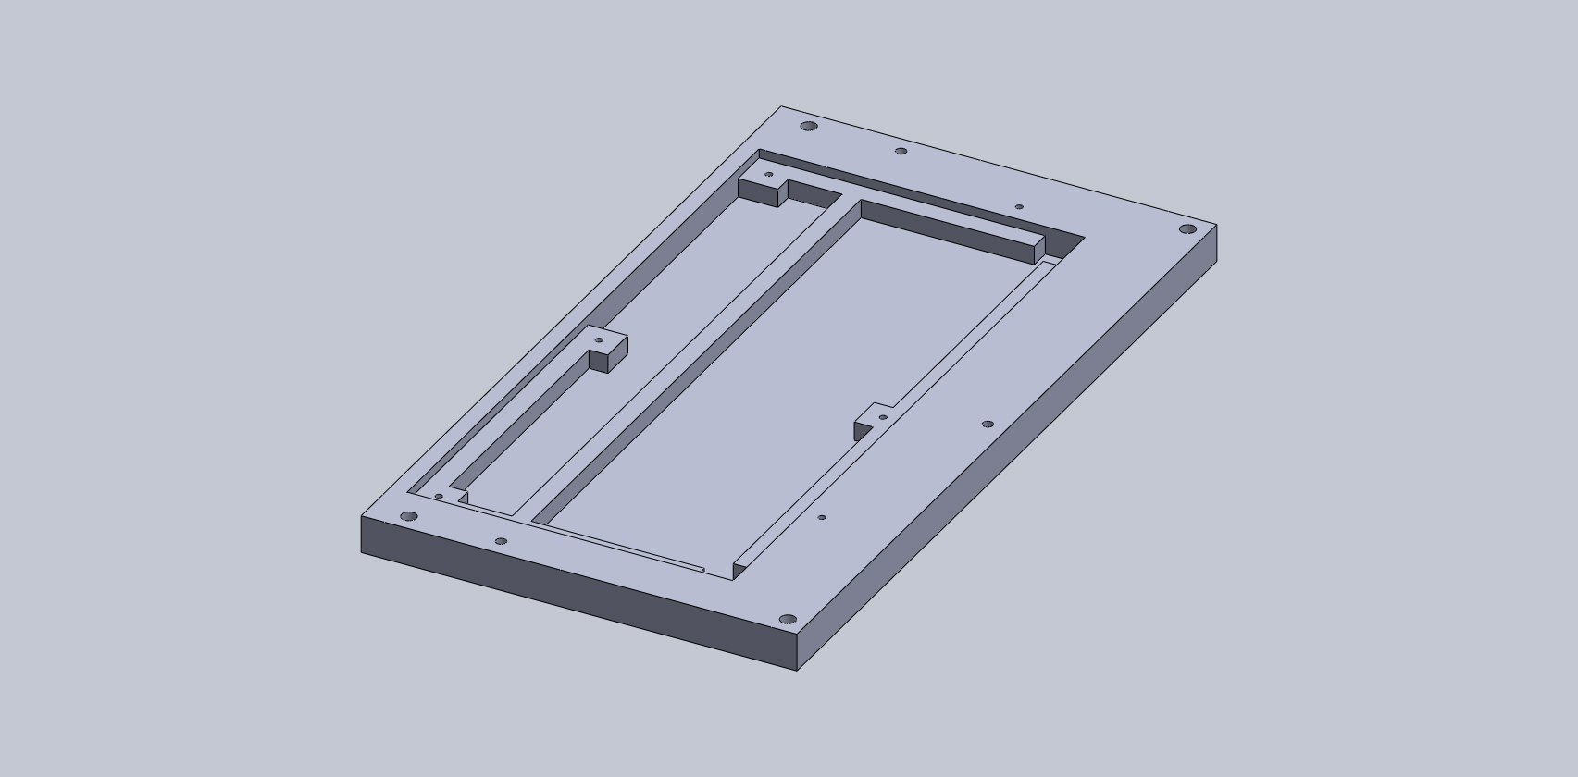
Base

Slide 2
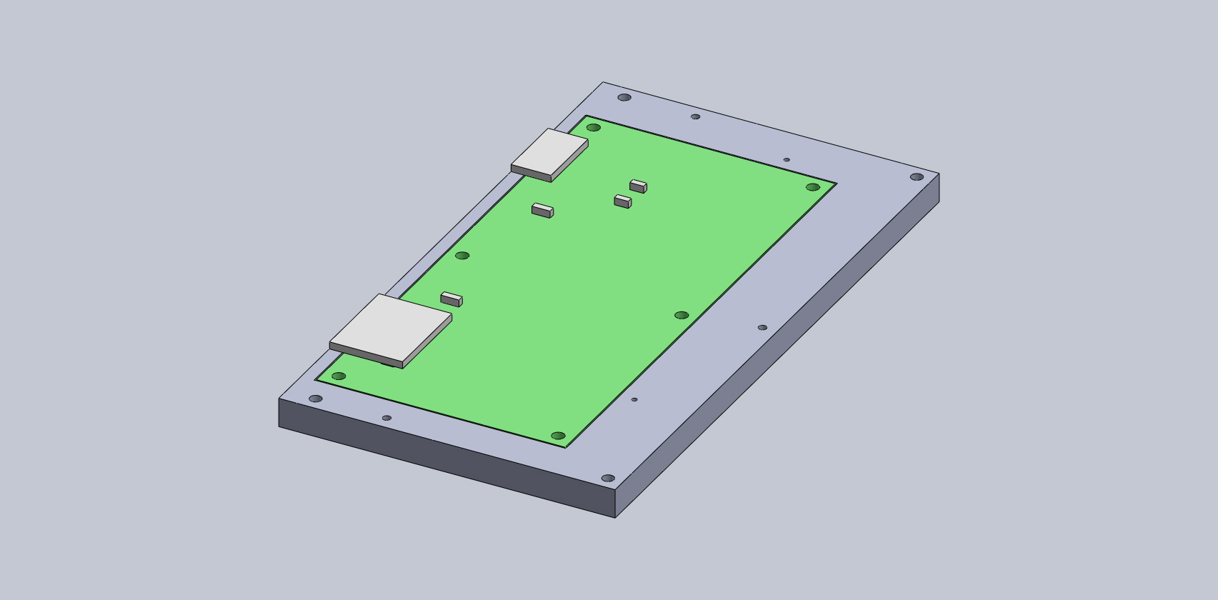
Add Motherboard
Sits on the base’s shelf

Slide 3
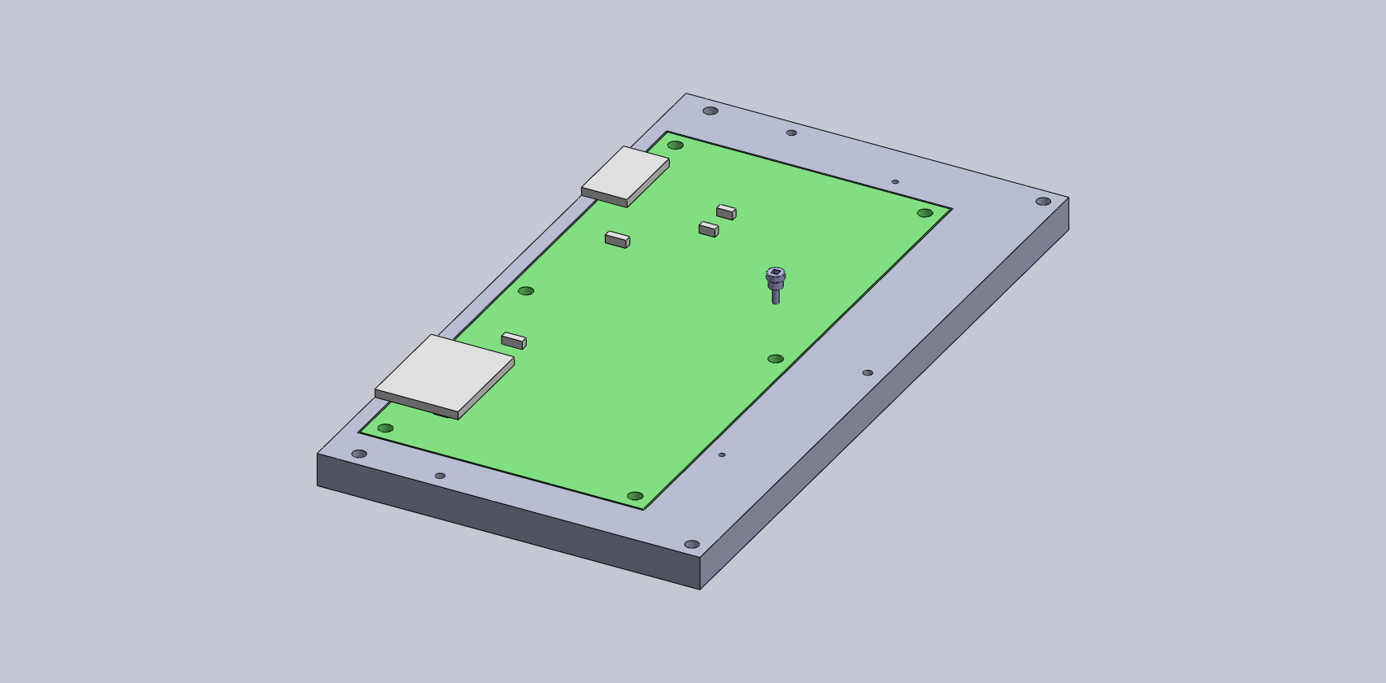
Add Motherboard
Sits on the base’s shelf
Attached with a single screw
Using Belleville washer

Slide 4

Add Motherboard
Sits on the base’s shelf
Attached with a single screw
Using Belleville washer

Slide 5
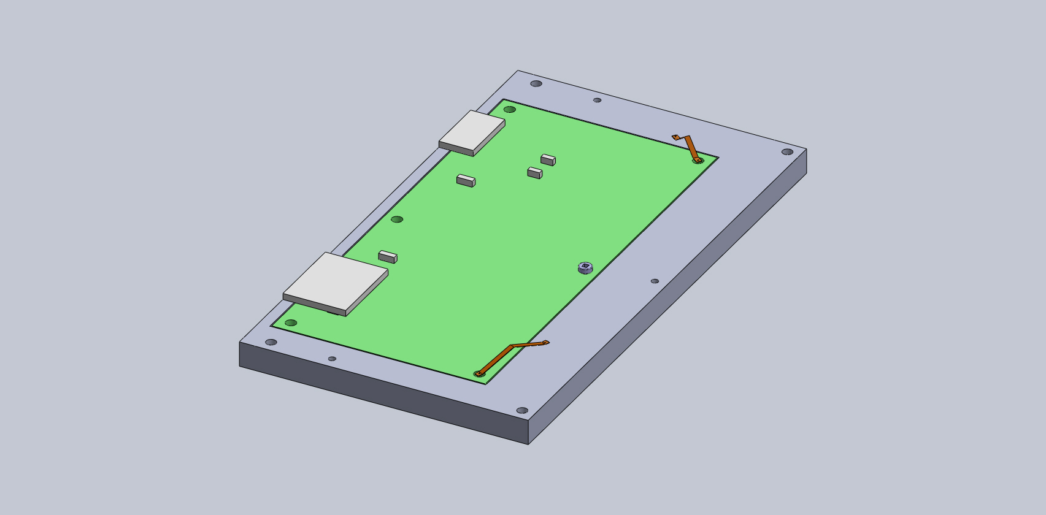
Add Thermal Straps
Between the base and 2 unused holes on the Motherboard
Possibly add these for the other 3 unused holes as well

Slide 6
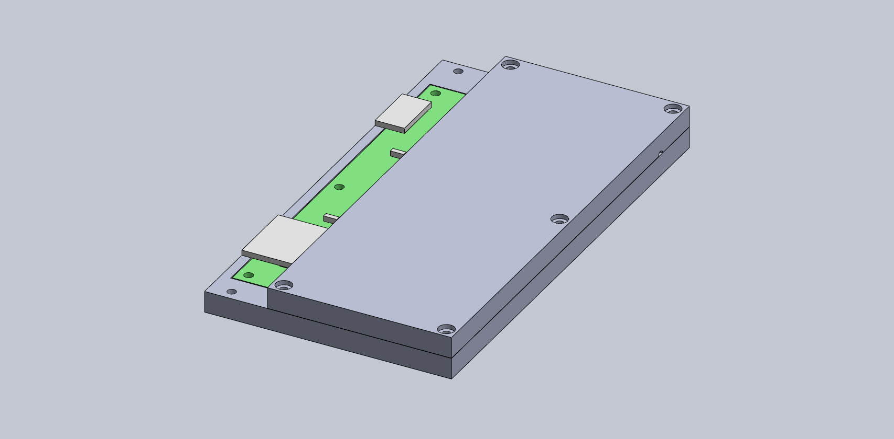
Add Lid
Covers the half of the Motherboard that carries the Carrier/Mezzanine boards
Outlet for the air pump out port

Slide 7
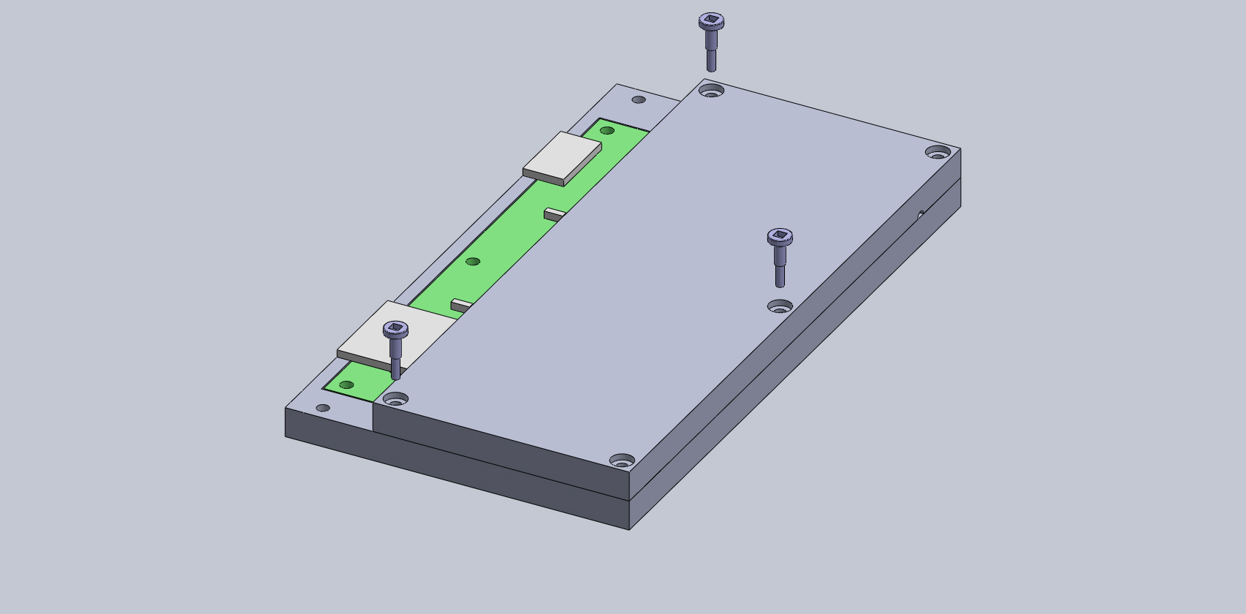
Add Lid
Covers the half of the Motherboard that carries the Carrier/Mezzanine boards
Attached to the base in 3 spots
Untapped holes through the lid and tapped on the base

Slide 8

Add Lid
Covers the half of the Motherboard that carries the Carrier/Mezzanine boards
Attached to the base in 3 spots
Untapped holes through the lid and tapped on the base

Slide 9

Connect to Dewar
4 screws, 1 in each corner
Untapped holes through lid and base
Dewar 4K plate has tapped holes
Screws are 5x10”

Slide 10

Connect to Dewar
4 screws, 1 in each corner
Untapped holes through lid and base
Dewar 4K plate has tapped holes
Screws are 5x10”

