Slide 1
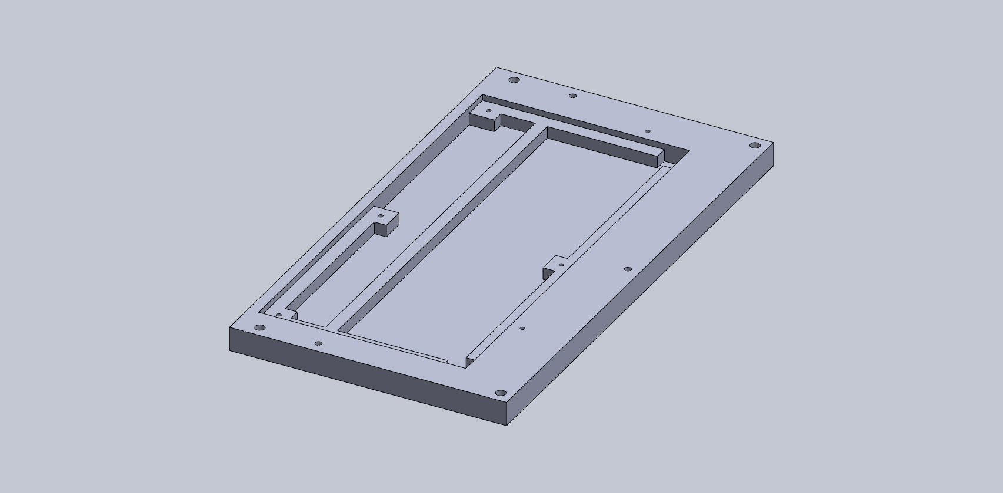
Base

Slide 2
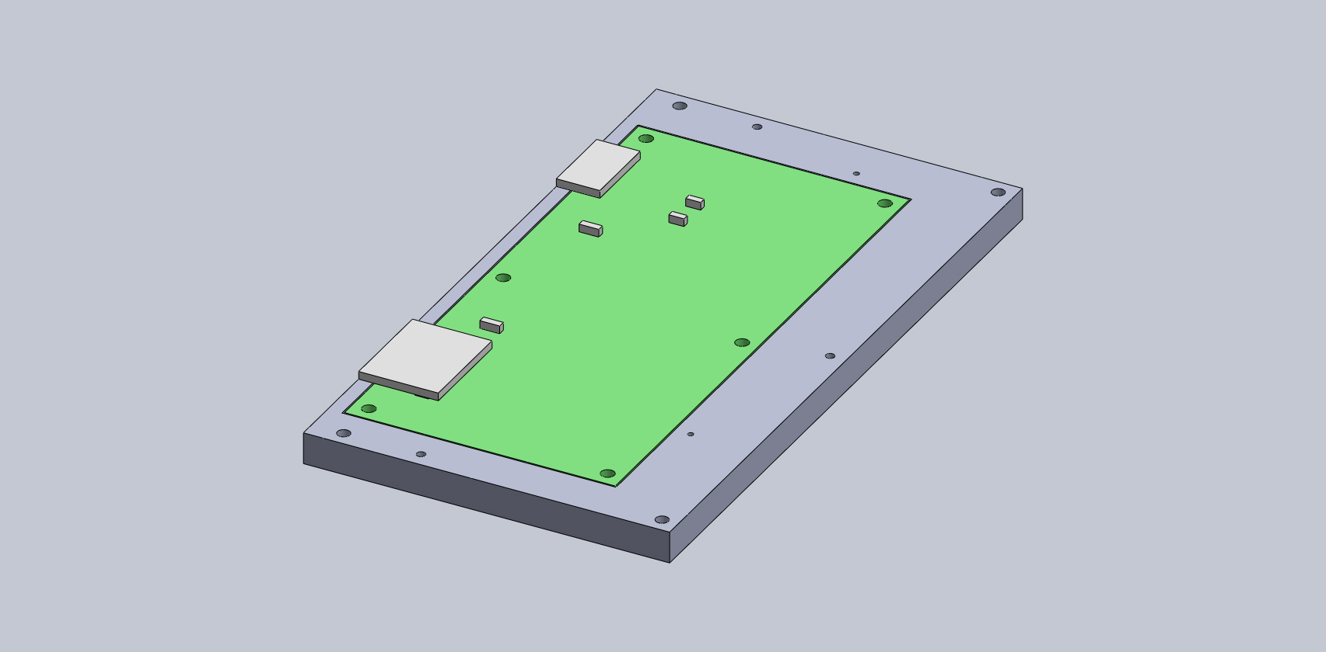
Add Motherboard
Sits on the base’s shelf

Slide 3
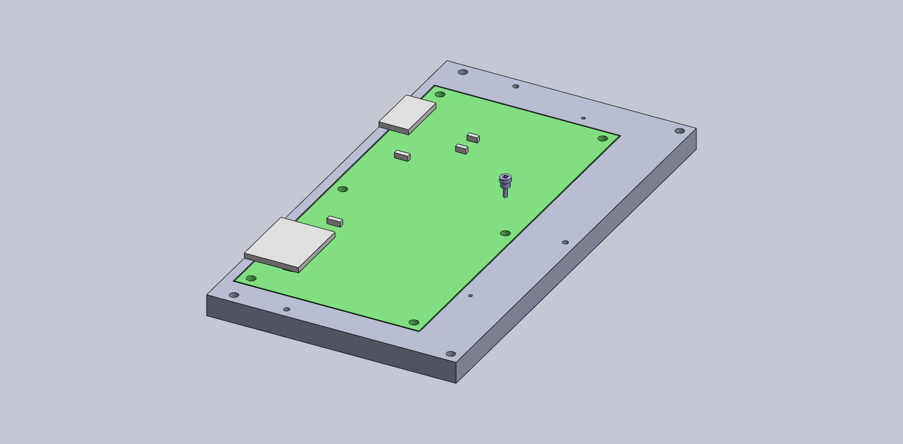
Add Motherboard
Sits on the base’s shelf
Attached with a single screw
Using Belleville washer

Slide 4

Add Motherboard
Sits on the base’s shelf
Attached with a single screw
Using Belleville washer

Slide 5
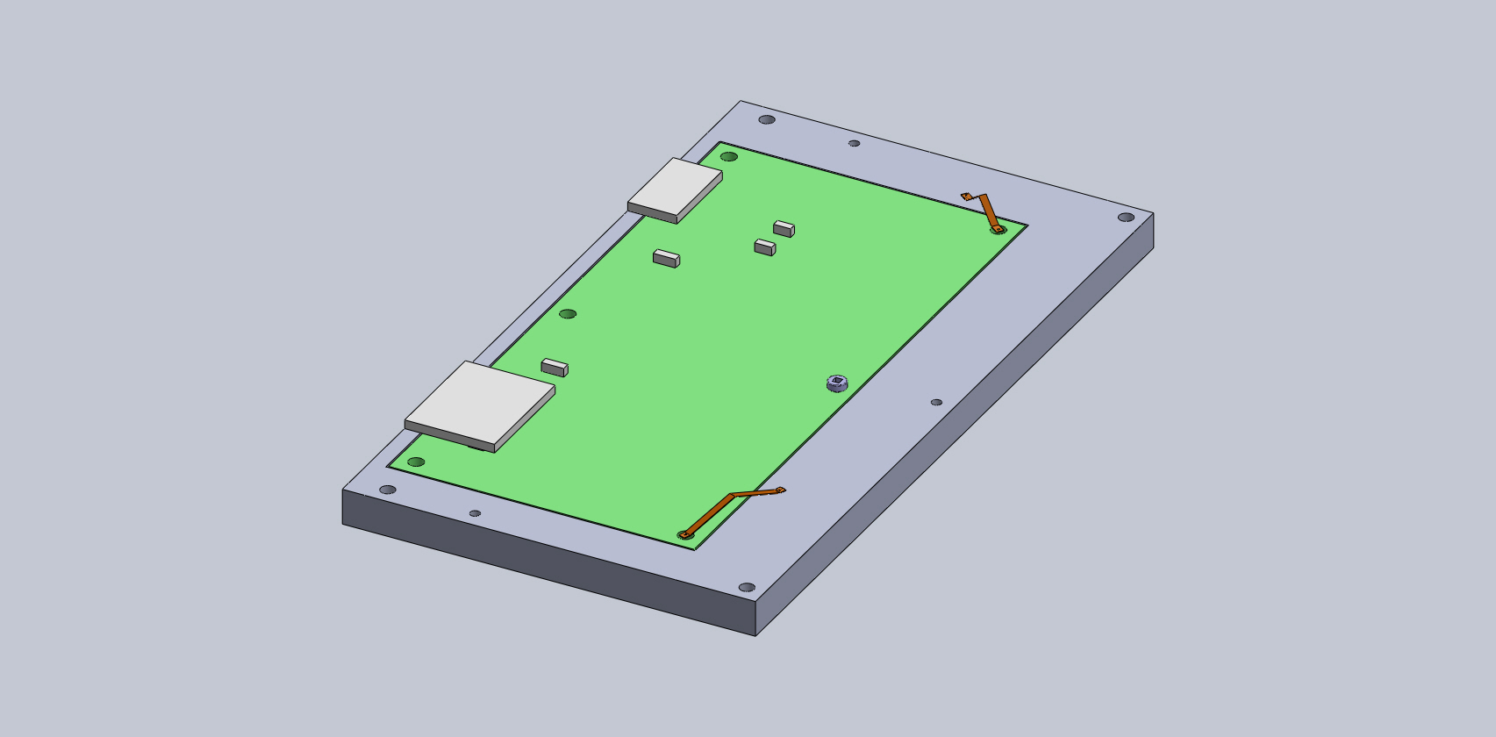
Add Thermal Straps
Between the base and 2 unused holes on the Motherboard
Possibly add these for the other 3 unused holes as well

Slide 6
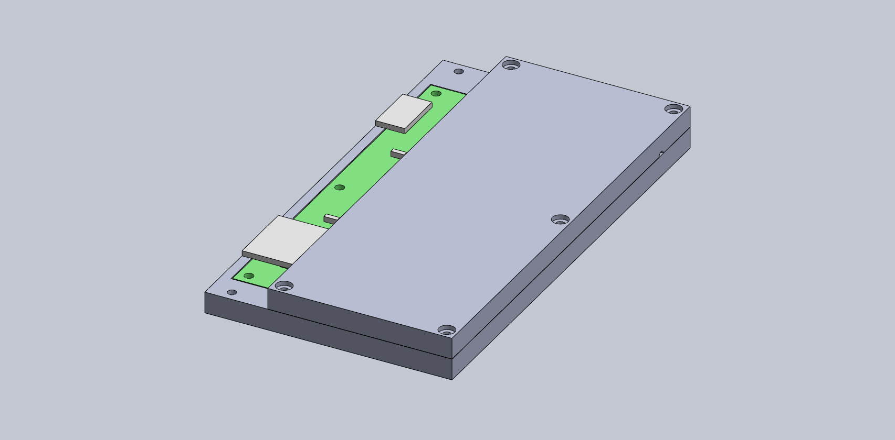
Add Lid
Covers the half of the Motherboard that carries the Carrier/Mezzanine boards
Outlet for the air pump out port

Slide 7
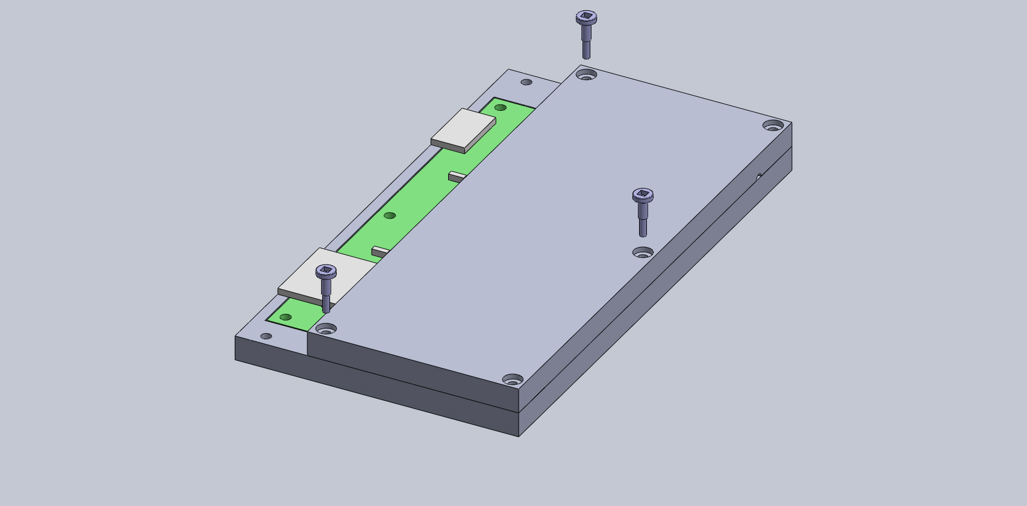
Add Lid
Covers the half of the Motherboard that carries the Carrier/Mezzanine boards
Attached to the base in 3 spots
Untapped holes through the lid and tapped on the base

Slide 8

Add Lid
Covers the half of the Motherboard that carries the Carrier/Mezzanine boards
Attached to the base in 3 spots
Untapped holes through the lid and tapped on the base

Slide 9

Connect to Dewar
4 screws, 1 in each corner
Untapped holes through lid and base
Dewar 4K plate has tapped holes
Screws are 5x10”

Slide 10

Connect to Dewar
4 screws, 1 in each corner
Untapped holes through lid and base
Dewar 4K plate has tapped holes
Screws are 5x10”

Slide 11
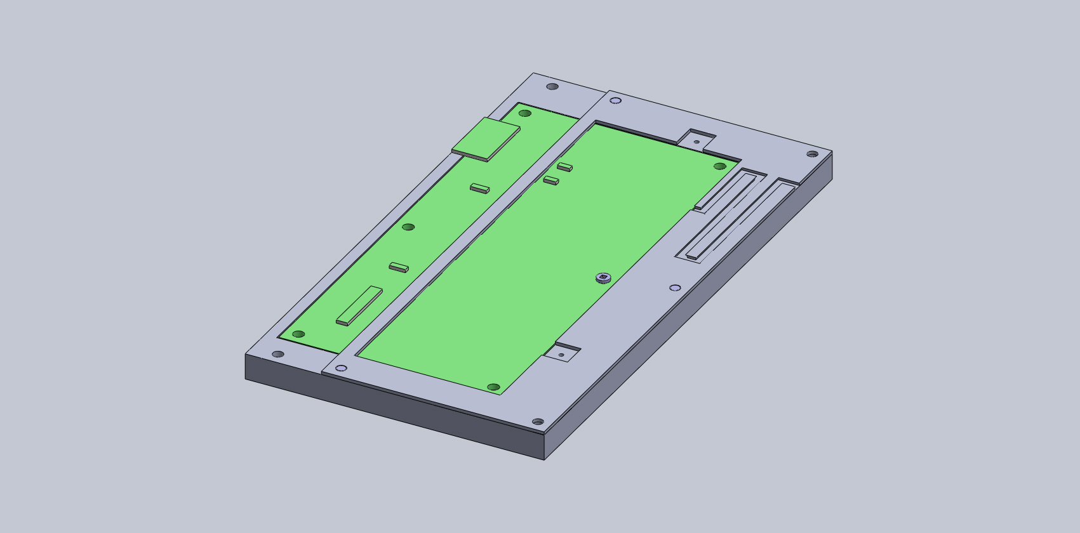
Cutout
Meander for escaping air during pump down and limiting radon passage during transport
Tapped holes for connecting thermal straps
Outlet for the air pump out port

Slide 12
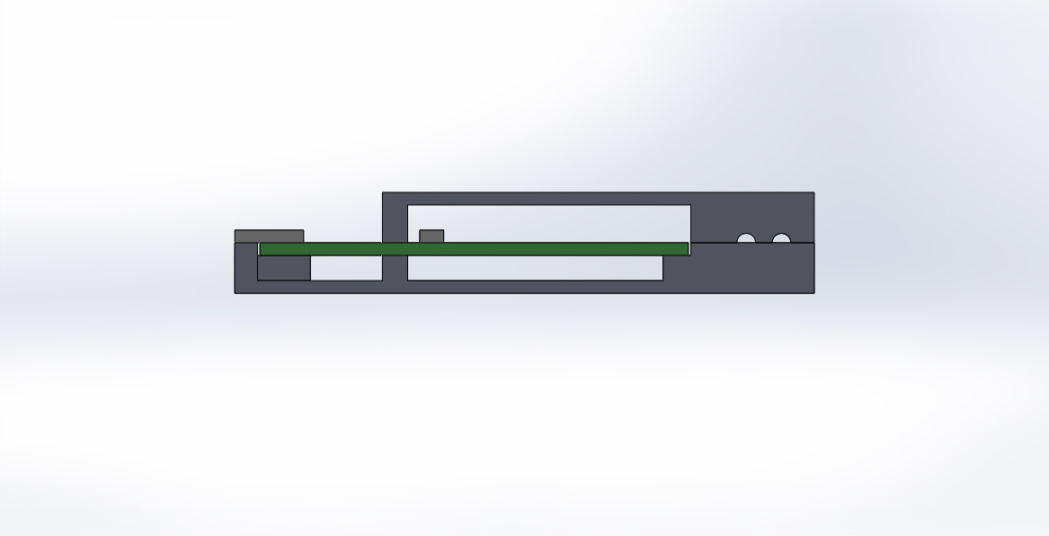
Questions:
How much clearance do we need above the board?
Do we know exactly how thick the PCB will be?
How much clearance do we need below the board?

