Slide 1

An Analysis of the Relationships Between Educational Outcomes and Economic Performance
Gredel Lynch, Sanita Gurung, Tim Barger, Mike Kozar

Slide 2
Summary
Objective: analyze relationships between educational/social outcomes and key economic indicators across countries
Key Questions: Do gender equity or investment in education relate to macroeconomic performance?

Slide 3
Summary
Hypotheses:
If a country sees high level of gender equity in employment rates, that country will have a higher GDP per capita
If a country invests more heavily in primary education, the country will have a higher GDP per capita

Slide 4
Summary
Outcomes:
Teammates will follow data journey from indicator to visualization
Gain insights into which development indicators may be more or less important to driving economic growth

Slide 5
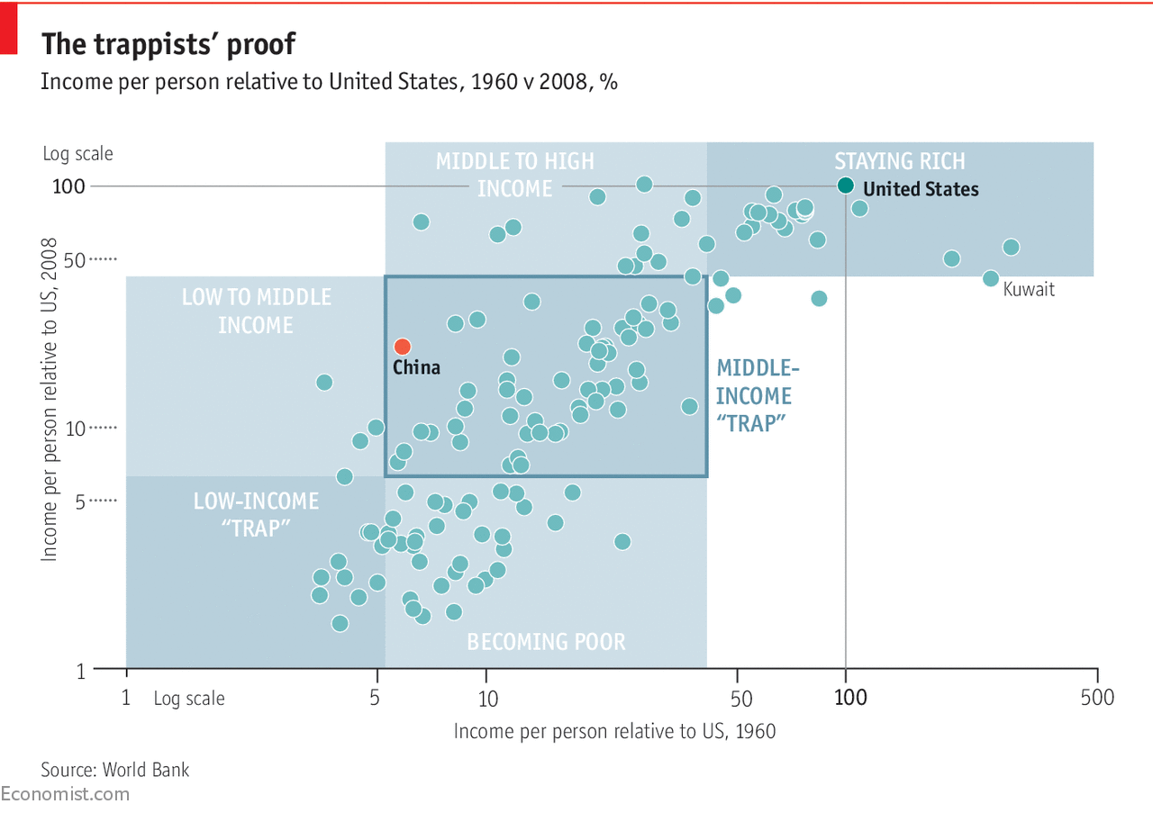
But why?
Billions invested over decades in “international development”
Yet there is a middle income trap
So how can we isolate the factors at play?

Slide 6

Data Source - World Bank Data
Over 10,000 indicators across more than 250 countries
Highly structured data available through API and/or CSV
Breakdown of indicators of interest by gender and level of education

Slide 7
Our Approach
Each team member choose two indicators and a country
Perform linear regression of indicator values against GDP per capita by year
Limitations
Only analyzed 8 indicators
Only compared 4 countries, each at different income levels
More than one measure of economic performance
Absence of Control Variables

Slide 8
Our Data Journey
Step 1) Identify Indicators and Countries
Step 2) Pull data from World Bank API
Step 3) Clean and explore the data
Step 4) Perform regression analysis
Step 5) Visualize data

Slide 9
Countries and Indicators
Brazil
Labor Force, Total
Population, Total Ages 15-64
Tanzania
Population, Total Ages 0-14
Primary School Enrollment, Female
Colombia
Government expenditure per student primary, % of GDP per Capita
Literacy Rate, Age 15 +
United States
Unemployment Male (% male labor force)
Unemployment Female (% female labor force)

Slide 10
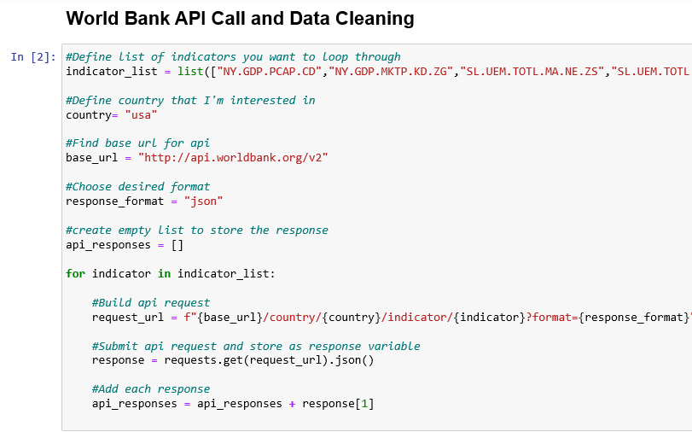
Data Collection
World Bank API – unexpected simple, but complicated

Slide 11
Data Exploration
Clean Up
Different countries had different years worth of data
Ran into a lot NaN’s
Thinking through how to approach merging data sets
Figures
Scientific notation
Syntax for using matplotlib outside of class exercises

Slide 12
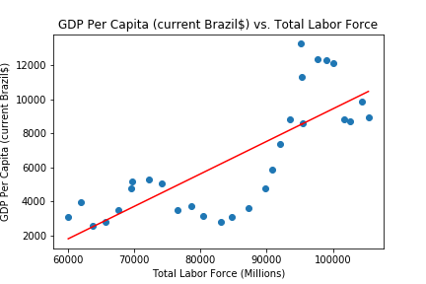
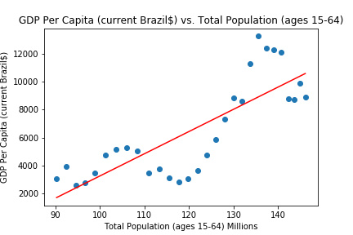
Brazil
R = 0.78
R = 0.80

Slide 13
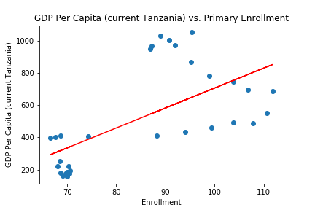
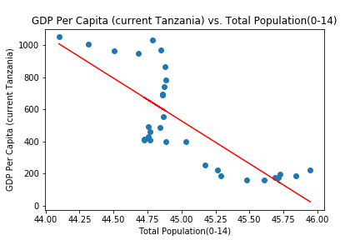
Tanzania
R = 0.63
R = -0.78

Slide 14
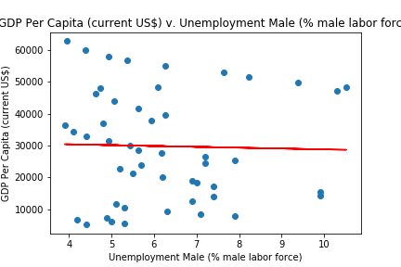
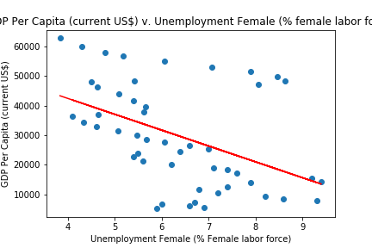
United States
GDP Per Capita (current US$) v. Unemployment Male (% male labor force)
GDP Per Capita (current US$) v. Unemployment Female (% female labor force)
R = -0.31
R = -0.46

Slide 15
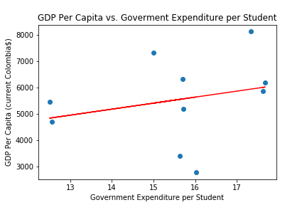
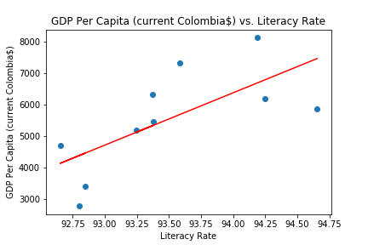
Colombia
R = 0.26
R = 0.69

Slide 16
Summary
Outcomes:
Each member of the team improved competencies in matplotlib, regression analysis, git commands, merging, etc.
Improved personal relations, collaboration, and teamwork among group members.
Actual application of skills we’ve learned as they would be applied in real world situations.

