Slide 1
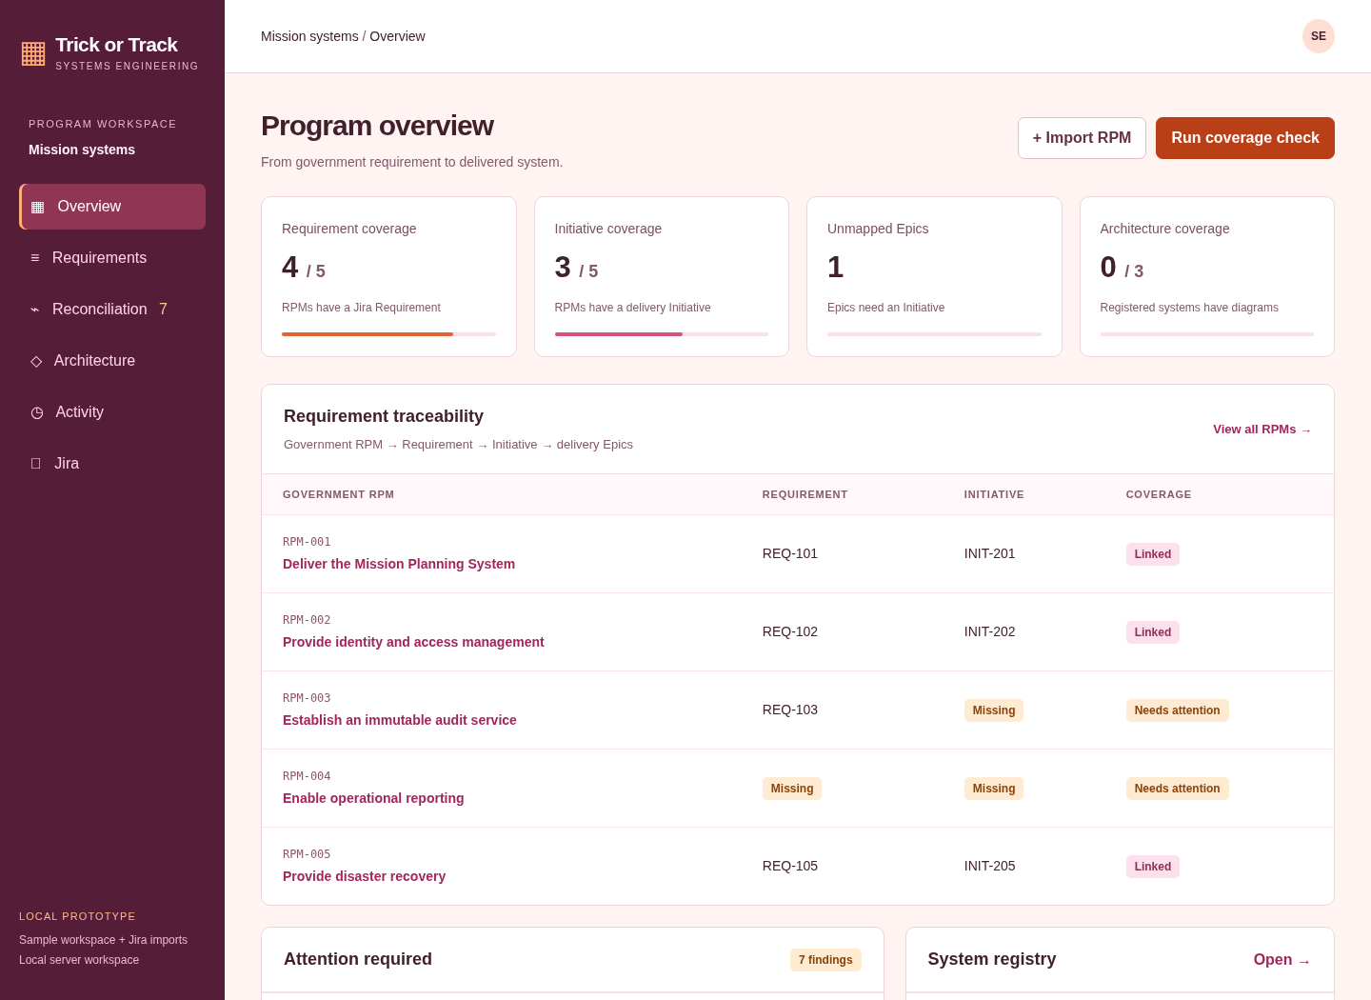
Trick or Track · v2
Requirements gathering, implementation readiness, and reviewed Trellis task export
From requirement
to delivery.
Gather requirements.
Reveal coverage gaps.
Connect delivery context.
Actual app screenshots • Sample workspace
TRICK OR TRACK • SYSTEMS ENGINEERING • LOCAL PROTOTYPE
1

Slide 2
01 Program overview
Spot missing coverage before it becomes a delivery gap.
One view of program health
• Requirement and Initiative coverage
• Unmapped Epics and architecture coverage
• Attention items and system registry
Metrics shown belong to the built-in sample dataset.
TRICK OR TRACK • SYSTEMS ENGINEERING • LOCAL PROTOTYPE
2
Notes:
01 Program overview
Spot missing coverage before it becomes a delivery gap.
Requirement and Initiative coverage
Unmapped Epics and architecture coverage
Attention items and system registry
Metrics shown belong to the built-in sample dataset.
Screenshot captured from the actual local application, using sample data. No live Jira account was connected.

Slide 3
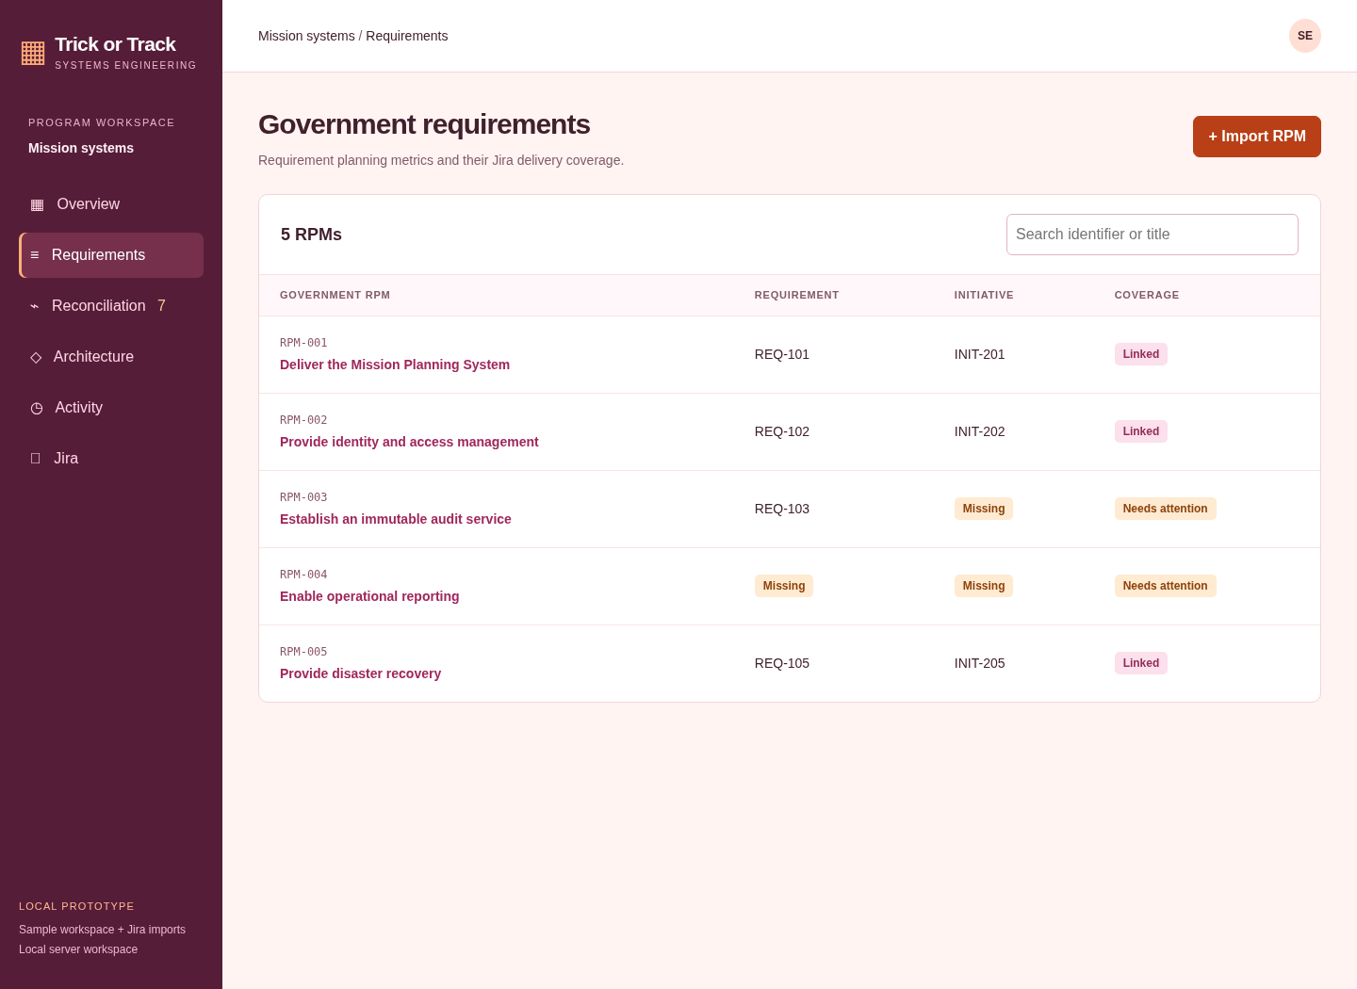
02 Requirements inventory
Organize government RPMs and see their delivery relationships.
Find the gaps quickly
• Search by identifier or title
• Compare Requirement and Initiative links
• Open a requirement for delivery context
RPMs are manually captured; automated document parsing is not implemented.
TRICK OR TRACK • SYSTEMS ENGINEERING • LOCAL PROTOTYPE
3
Notes:
02 Requirements inventory
Organize government RPMs and see their delivery relationships.
Search by identifier or title
Compare Requirement and Initiative links
Open a requirement for delivery context
RPMs are manually captured; automated document parsing is not implemented.
Screenshot captured from the actual local application, using sample data. No live Jira account was connected.

Slide 4
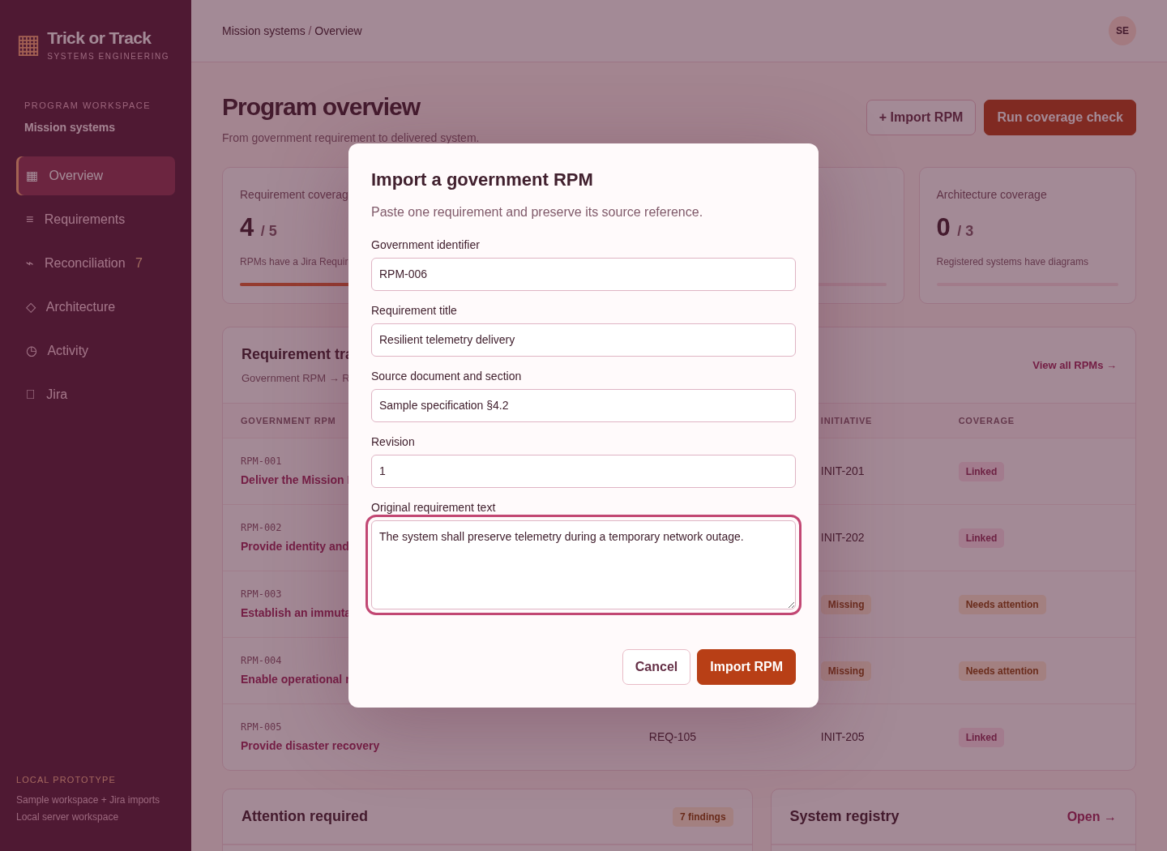
03 Gather a requirement
Capture the original requirement and preserve its source.
Keep source context
• Identifier, title, and revision
• Source document and section
• Original requirement text
The screenshot shows a prepared example form; no new record was submitted.
TRICK OR TRACK • SYSTEMS ENGINEERING • LOCAL PROTOTYPE
4
Notes:
03 Gather a requirement
Capture the original requirement and preserve its source.
Identifier, title, and revision
Source document and section
Original requirement text
The screenshot shows a prepared example form; no new record was submitted.
Screenshot captured from the actual local application, using sample data. No live Jira account was connected.

Slide 5
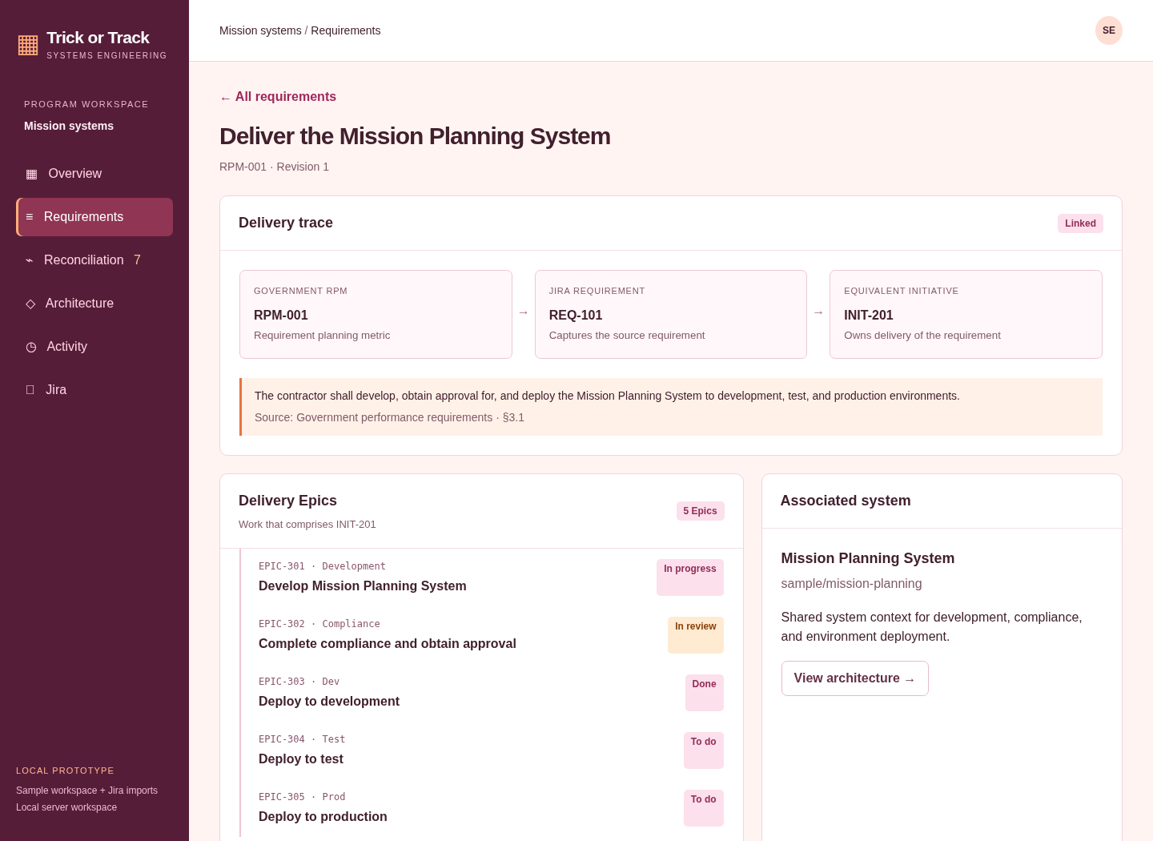
04 End-to-end traceability
Follow an RPM through its Requirement, Initiative, and delivery Epics.
Connect intent to work
• Visual delivery chain
• Source text and reference
• Associated Epics and system context
Relationships displayed here are sample workspace data.
TRICK OR TRACK • SYSTEMS ENGINEERING • LOCAL PROTOTYPE
5
Notes:
04 End-to-end traceability
Follow an RPM through its Requirement, Initiative, and delivery Epics.
Visual delivery chain
Source text and reference
Associated Epics and system context
Relationships displayed here are sample workspace data.
Screenshot captured from the actual local application, using sample data. No live Jira account was connected.

Slide 6
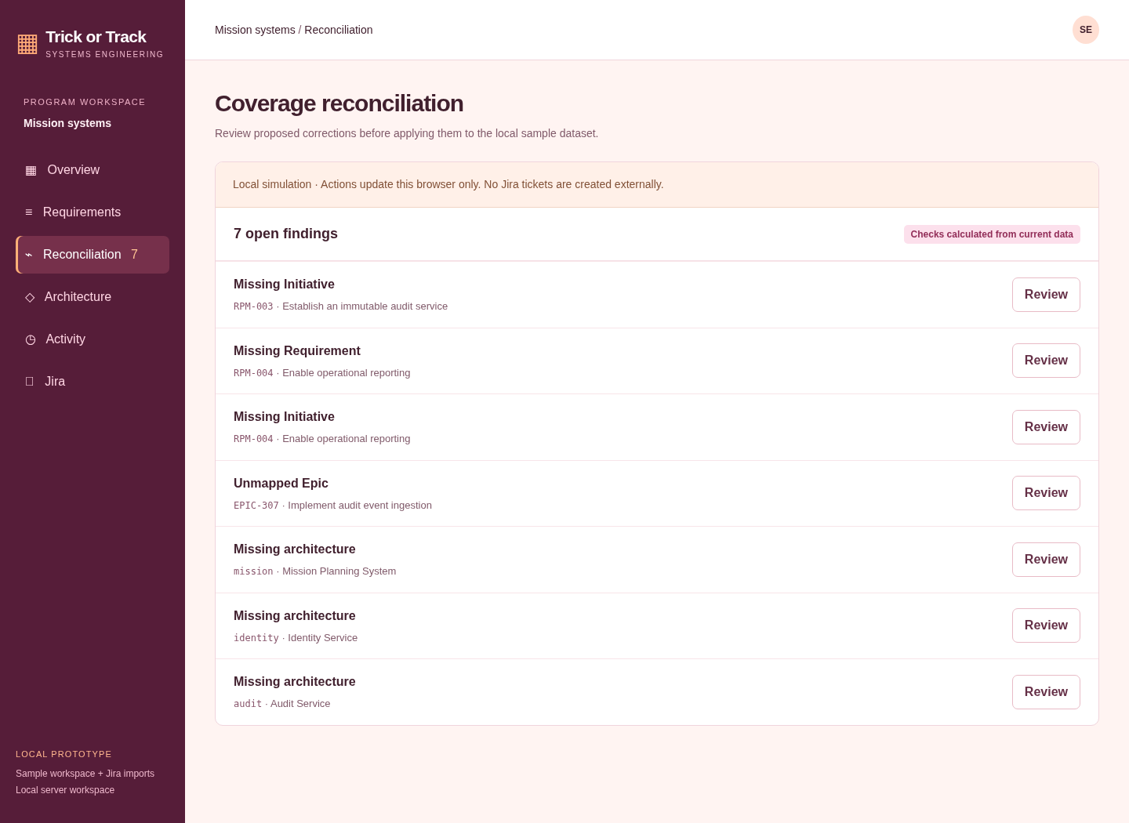
05 Coverage reconciliation
Turn missing relationships into a reviewable worklist.
Make gaps actionable
• Identify missing records
• Find unmapped Epics
• Flag missing or stale architecture
Local coverage checks update the browser dataset; they do not create Jira issues.
TRICK OR TRACK • SYSTEMS ENGINEERING • LOCAL PROTOTYPE
6
Notes:
05 Coverage reconciliation
Turn missing relationships into a reviewable worklist.
Identify missing records
Find unmapped Epics
Flag missing or stale architecture
Local coverage checks update the browser dataset; they do not create Jira issues.
Screenshot captured from the actual local application, using sample data. No live Jira account was connected.

Slide 7
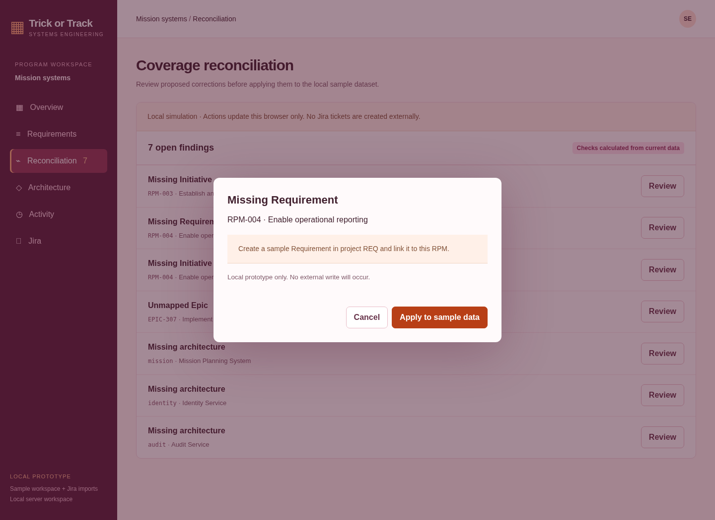
06 Review before correction
Inspect a proposed change before applying it.
Keep the user in control
• Explain the proposed correction
• Review prerequisites before proceeding
• Apply changes to sample data
This example creates a local sample Requirement for RPM-004.
TRICK OR TRACK • SYSTEMS ENGINEERING • LOCAL PROTOTYPE
7
Notes:
06 Review before correction
Inspect a proposed change before applying it.
Explain the proposed correction
Review prerequisites before proceeding
Apply changes to sample data
This example creates a local sample Requirement for RPM-004.
Screenshot captured from the actual local application, using sample data. No live Jira account was connected.

Slide 8
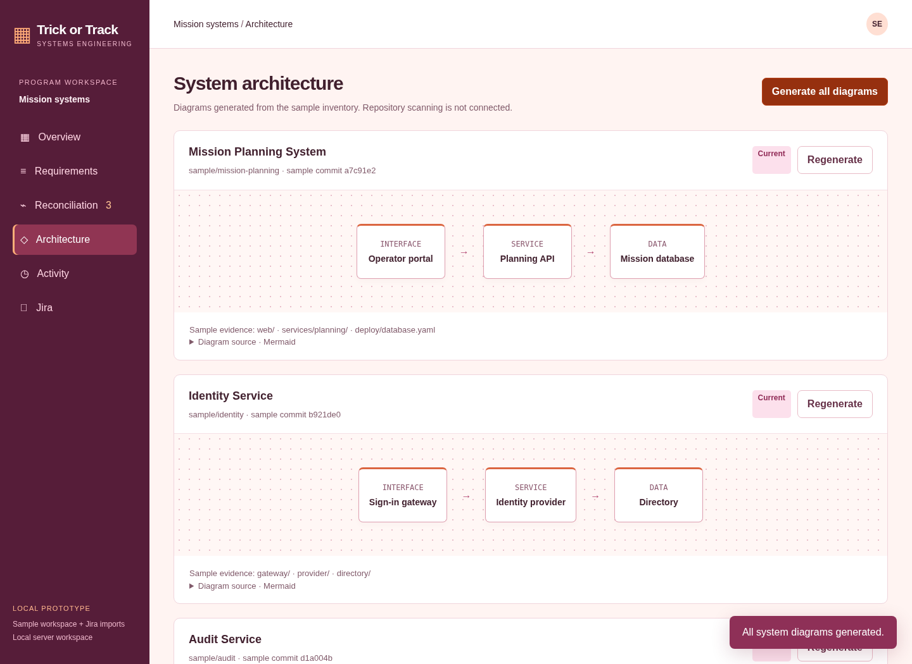
07 System architecture
Generate component diagrams and connect them to system context.
Make system context visible
• Component and data-flow view
• Sample repository evidence
• Mermaid source and .mmd download
Generated from sample manifests; real repository scanning is not connected.
TRICK OR TRACK • SYSTEMS ENGINEERING • LOCAL PROTOTYPE
8
Notes:
07 System architecture
Generate component diagrams and connect them to system context.
Component and data-flow view
Sample repository evidence
Mermaid source and .mmd download
Generated from sample manifests; real repository scanning is not connected.
Screenshot captured from the actual local application, using sample data. No live Jira account was connected.

Slide 9
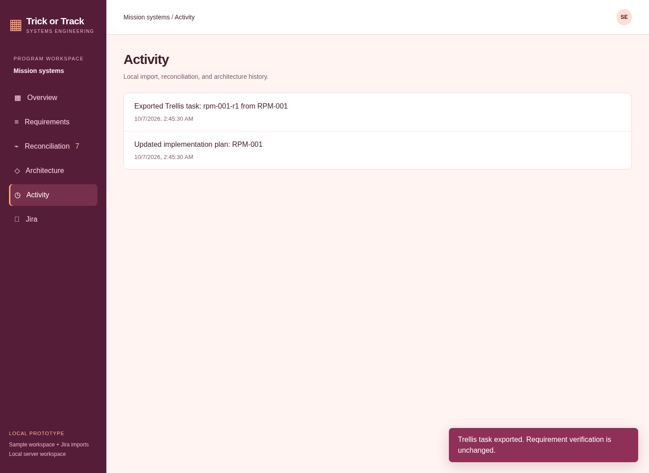
08 Activity history
Review the changes made within the local workspace.
See what changed
• Local import and correction history
• Architecture generation events
• Timestamped workspace activity
This is local history, not a centralized enterprise audit log.
TRICK OR TRACK • SYSTEMS ENGINEERING • LOCAL PROTOTYPE
9
Notes:
08 Activity history
Review the changes made within the local workspace.
Local import and correction history
Architecture generation events
Timestamped workspace activity
This is local history, not a centralized enterprise audit log.
Screenshot captured from the actual local application, using sample data. No live Jira account was connected.

Slide 10
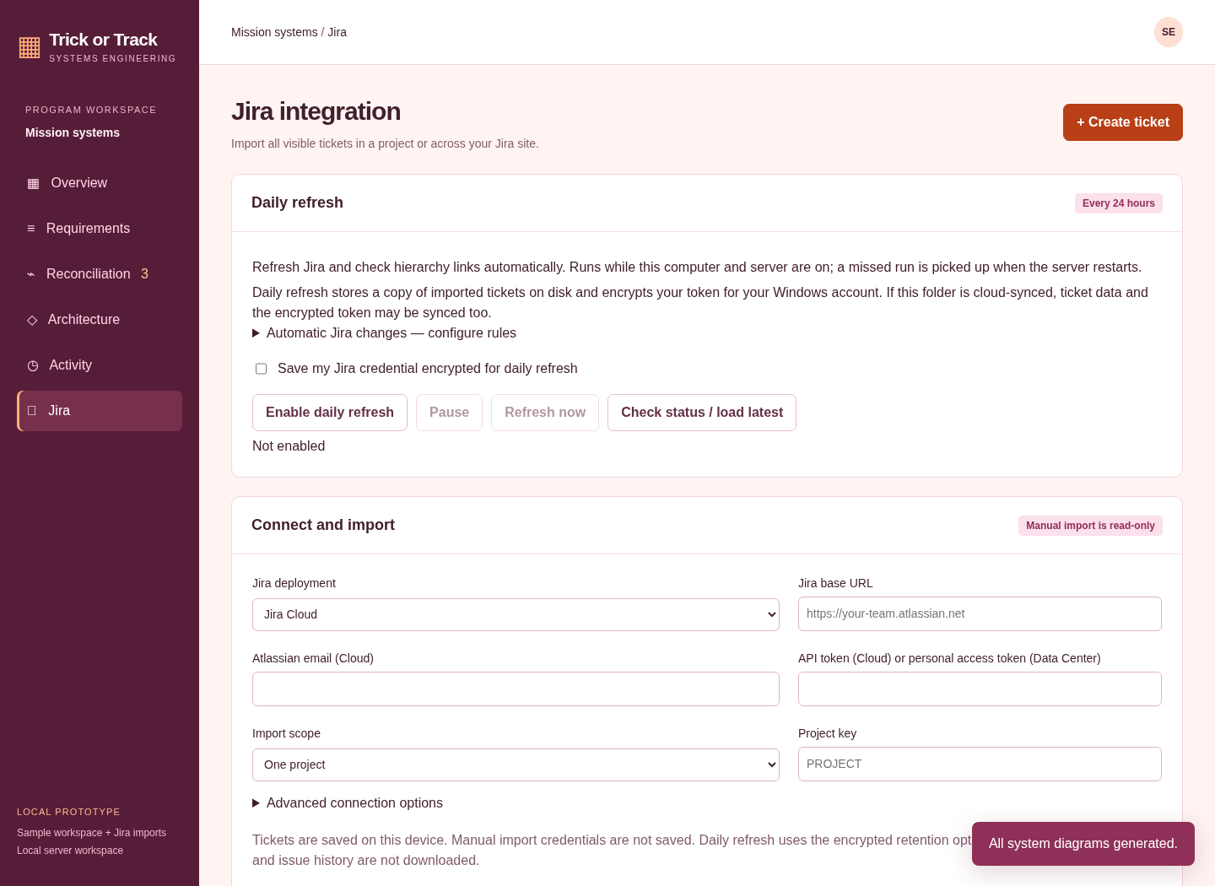
09 Jira integration
Connect the requirements workflow to Jira Cloud or Data Center.
Bring real tickets into view
• Project or site-wide ticket imports
• Separate imported inventory
• Prepare and review ticket creation
Screenshot shows the real connection UI. No live Jira import or write was performed.
TRICK OR TRACK • SYSTEMS ENGINEERING • LOCAL PROTOTYPE
10
Notes:
09 Jira integration
Connect the requirements workflow to Jira Cloud or Data Center.
Project or site-wide ticket imports
Separate imported inventory
Prepare and review ticket creation
Screenshot shows the real connection UI. No live Jira import or write was performed.
Screenshot captured from the actual local application, using sample data. No live Jira account was connected.

Slide 11
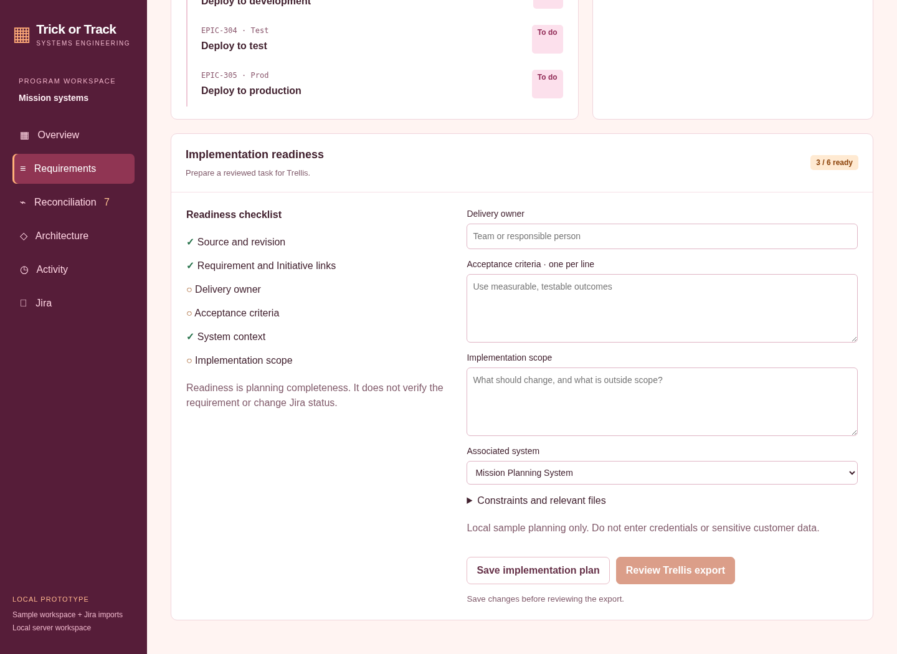
10 Implementation readiness
See what is missing before handing a requirement to a coding agent.
A clear planning gate
• Source and delivery links
• Owner, criteria, and system context
• Scope must be recorded before export
Existing saved requirements remain compatible. Readiness does not establish verification.
TRICK OR TRACK • SYSTEMS ENGINEERING • LOCAL PROTOTYPE
11
Notes:
10 Implementation readiness
See what is missing before handing a requirement to a coding agent.
Source and delivery links
Owner, criteria, and system context
Scope must be recorded before export
Existing saved requirements remain compatible. Readiness does not establish verification.
Screenshot captured from the actual local application, using sample data. No live Jira account was connected.

Slide 12
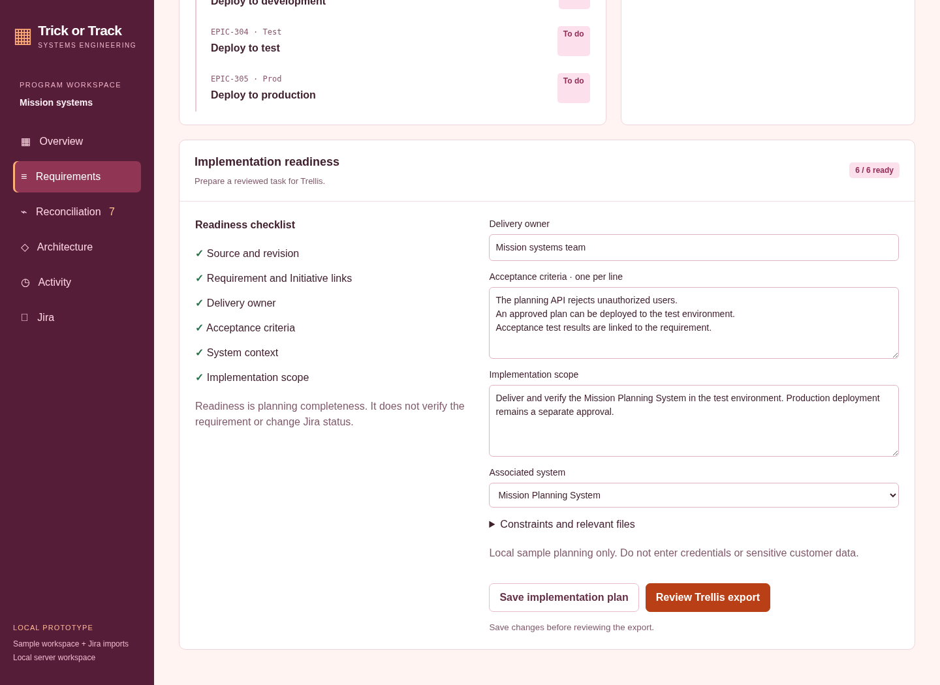
11 Acceptance criteria and scope
Record measurable outcomes and a responsible delivery owner.
Prepare a useful handoff
• One acceptance criterion per line
• Save owner, scope, and system
• Optional constraints and repository paths
Plans persist in browser storage. The screenshot shows an illustrative sample plan.
TRICK OR TRACK • SYSTEMS ENGINEERING • LOCAL PROTOTYPE
12
Notes:
11 Acceptance criteria and scope
Record measurable outcomes and a responsible delivery owner.
One acceptance criterion per line
Save owner, scope, and system
Optional constraints and repository paths
Plans persist in browser storage. The screenshot shows an illustrative sample plan.
Screenshot captured from the actual local application, using sample data. No live Jira account was connected.

Slide 13
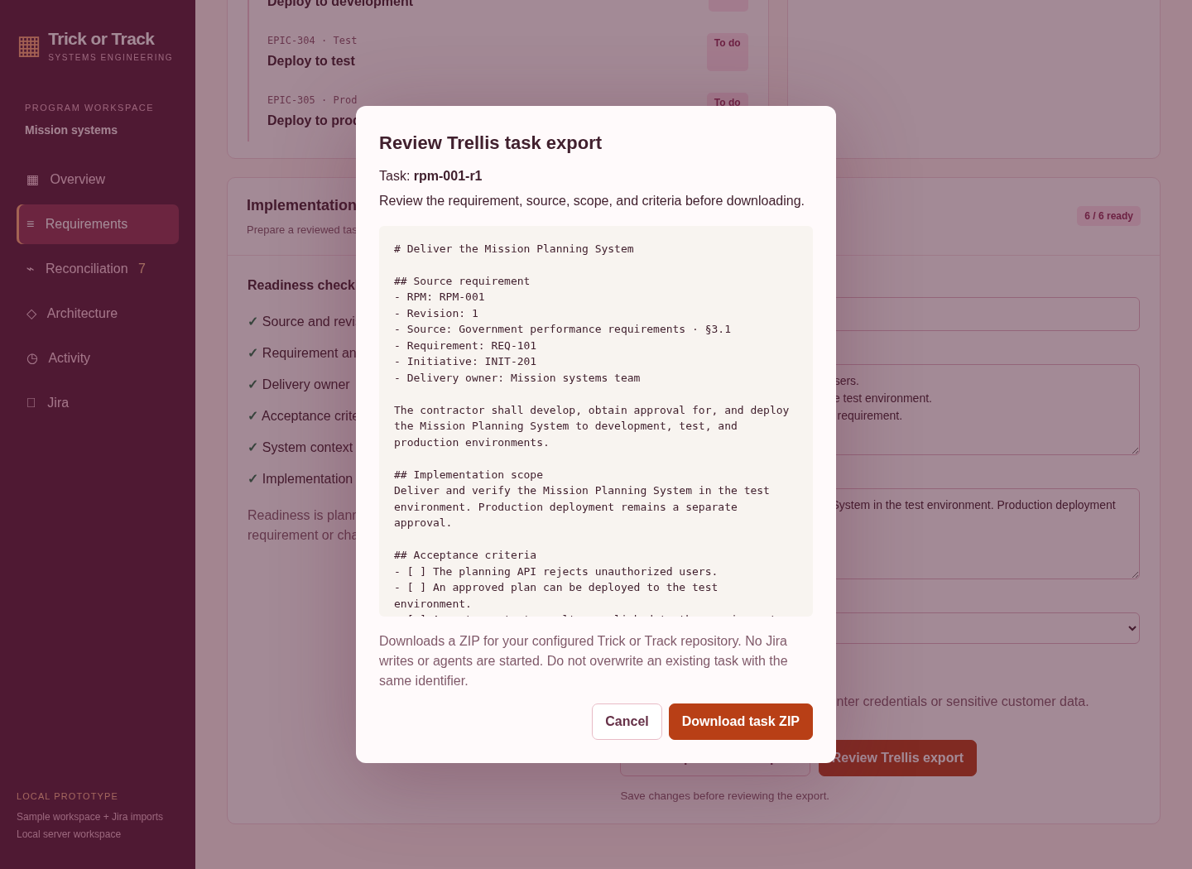
12 Reviewed Trellis task export
Inspect the task package before downloading it.
From requirement to task
• PRD with source and acceptance criteria
• Task metadata and trace identifiers
• Implementation and check contexts
ZIP extraction and Trellis context validation passed. No agents or Jira writes are triggered.
TRICK OR TRACK • SYSTEMS ENGINEERING • LOCAL PROTOTYPE
13
Notes:
12 Reviewed Trellis task export
Inspect the task package before downloading it.
PRD with source and acceptance criteria
Task metadata and trace identifiers
Implementation and check contexts
ZIP extraction and Trellis context validation passed. No agents or Jira writes are triggered.
Screenshot captured from the actual local application, using sample data. No live Jira account was connected.

Slide 14
Prototype capabilities and next steps
A working local prototype, with clear boundaries for real-world use.
WORKS TODAY
NEEDS YOUR CONFIGURATION
FUTURE EXTENSIONS
Sample requirements and traceability
Coverage review and corrections
Sample architecture generation
Readiness and task ZIP export
23 automated tests passing
Live Jira site and credentials
Project and issue-type mappings
Explicit review for ticket creation
Network access to your Jira site
Windows for encrypted daily refresh
Real repository scanning
Government document parsing
Shared multi-user workspace
Production deployment design
Run locally: Node.js 22+ → npm start → open 127.0.0.1:4173 on the same computer.
TRICK OR TRACK • SYSTEMS ENGINEERING • LOCAL PROTOTYPE
14

