Slide 1
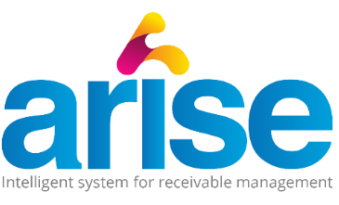
Product Road Map
Q 1
UAT, Code and Tool Optimisation by Mynd IT
Q2
Q3
Q4
Mobile App Development
Synchronizing customer AP systems with Arise
Mynd Finance Deployment Stabilisation
Customer Self Serve Portal
Credit Module
Collection Report syncing for SAP and Oracle
Incorporate 3rd party data from Credit Agencies, Government and Courier Agencies
Explore the option for Product level information to be available to client, useful in retail, distribution, FMCG etc.
Dispatch module linkages with Courier sites, auto validation and updation of couriers tracking
Separate login and details for legal/Dispute cases
Reconciliation Module - Cash Application, Bank to Cash, Customer Account Recon
Sync M1 Exchange for discounting of invoices - Should be an optional feature
Mynd Finance on ground deployment
Review internal customer feedback and requirements for further capability development
Finalise feature list for phase 2 developments
Develop feature to Sync and share payment trends for customer user base across Arise users
Email Exchange Server Synchronization
Email ticketing system - single ticket to multiple users, tracking and reporting
Data Gathering exercise for Mynd Finance Deployment
Digital Signature
PAN /TAN /GSTIN auto validation through government sites
Whatsapp/ SMS functionality
Best possible solution for server to be assessed

Slide 2
Opportunities
- Credit Rating and Approval mechanism
- Reconciliation Tools
- Sync with email exchange, M1 exchange, Credit Agencies and AP tools
- Need for Mobile App exists
- Capability to raise invoices from the tool
- Cash Application
Threat
- Existing and more expensive tools that exist in the market might limit Arise to the Low-Mid Size Business
- Optimal product pricing/upselling needed initially to gain market share and ward off competition from in-house developments or vertical integrations.
Weakness
- As the product is in the nascent stage of its life cycle, considerable marketing would be needed to create a funnel
- Deployment timeline of 2.5 months is currently hypothetical, would be accurately determined after Mynd Finance deployment
Strength
- Highly Modularised tool
- Simple and Easy UI
- Highly Scalable and Customisable
- Easy Integration and Compatibility
- Customisable Collection Strategies
- Provides the customer benefits in terms of cash flow, cost of borrowing and manpower efficiencies
- Speed of doing customisation

