Slide 1
Cross-Site Scripting Attack (XSS)

Slide 2
Outline
The Cross-Site Scripting attack
Reflected XSS
Persistent XSS
Damage done by XSS attacks
XSS attacks to befriend with others
XSS attacks to change other people’s profiles
Self-propagation
Countermeasures

Slide 3
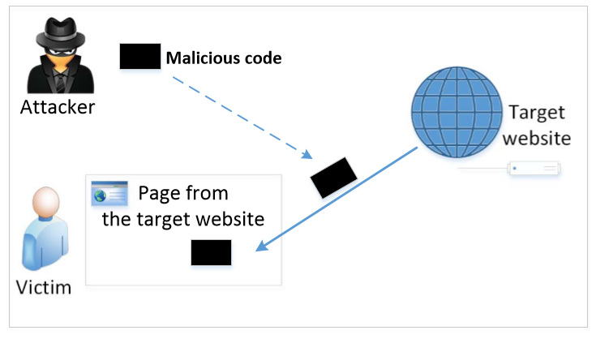
The Cross-Site Scripting Attack
In XSS, an attacker injects his/her malicious code to the victim’s browser via the target website.
When code comes from a website, it is considered as trusted with respect to the website, so it can access and change the content on the pages, read cookies belonging to the website and sending out requests on behalf of the user.
Basically, code can do whatever the user can do inside the session.

Slide 4
Types of XSS Attacks
Non-persistent (Reflected) XSS Attack
Persistent (Stored) XSS Attack

Slide 5
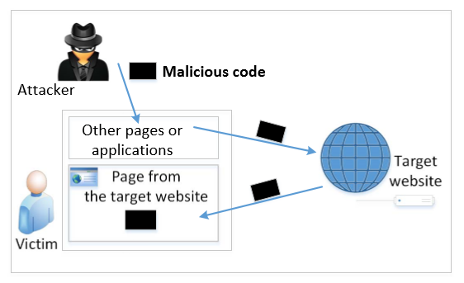
Non-persistent (Reflected) XSS Attack
If a website with a reflective behavior takes user inputs, then :
Attackers can put JavaScript code in the input, so when the input is reflected back, the JavaScript code will be injected into the web page from the website.
Notes:
Many websites take input from the user,conduct some activities and then send response to the user in a web page, with the original user input included on the response (i.e the user input is reflected back)

Slide 6
Non-persistent (Reflected) XSS Attack
Assume a vulnerable service on website : http://www.exame.com/search?input=word, where word is provided by the users.
Now the attacker sends the following URL to the victim and tricks him to click the link: http://www.example.com/search?input=<script>alert(“attack”);</script>
Once the victim clicks on this link, an HTTP GET request will be sent to the www.example.com web server, which returns a page containing the search result, with the original input in the page. The input here is a JavaScript code which runs and gives a pop-up message on the victim’s browser.

Slide 7
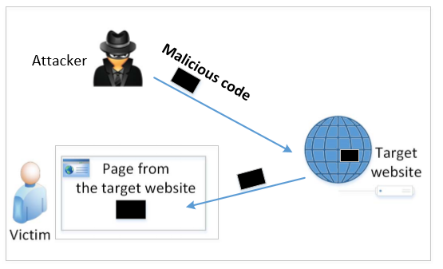
Persistent (Stored) XSS Attack
Attackers directly send their data to a target website/server which stores the data in a persistent storage.
If the website later sends the stored data to other users, it creates a channel between the users and the attackers.
Example : User profile in a social network is a channel as it is set by one user and viewed by another.

Slide 8
Persistent (Stored) XSS Attack
These channels are supposed to be data channels.
But data provided by users can contain HTML markups and JavaScript code.
If the input is not sanitized properly by the website, it is sent to other users’ browsers through the channel and gets executed by the browsers.
Browsers consider it like any other code coming from the website. Therefore, the code is given the same privileges as that from the website.

Slide 9
Damage Caused by XSS
Web defacing: JavaScript code can use DOM APIs to access the DOM nodes inside the hosting page. Therefore, the injected JavaScript code can make arbitrary changes to the page. Example: JavaScript code can change a news article page to something fake or change some pictures on the page.
Spoofing requests: The injected JavaScript code can send HTTP requests to the server on behalf of the user. (Discussed in later slides)
Stealing information: The injected JavaScript code can also steal victim’s private data including the session cookies, personal data displayed on the web page, data stored locally by the web application.

Slide 10
XSS Lab

Slide 11
Countermeasures: the Filter Approach
Removes code from user inputs.
It is difficult to implement as there are many ways to embed code other than <script> tag.
Use of open-source libraries that can filter out JavaScript code.
Example : jsoup

Slide 12
Countermeasures: The Encoding Approach
Replaces HTML markups with alternate representations.
If data containing JavaScript code is encoded before being sent to the browsers, the embedded JavaScript code will be displayed by browsers, not executed by them.
Converts <script> alert(‘XSS’) </script> to &lt;script&gt;alert(‘XSS’)

Slide 13
Countermeasures: Elgg’s Approach
PHP module HTMLawed:
Highly customizable PHP script to sanitize HTML against XSS attacks.
PHP function htmlspecialchars:
Encode data provided by users, s.t., JavaScript code in user’s inputs will be interpreted by browsers only as strings and not as code.

Slide 14
Discussion Questions
Question 1: What are the main differences of CSRF and XSS attacks? They both have “cross site” in their names.
Question 2: Can we use the countermeasures against CSRF attacks to defend against XSS attacks, including the secret token and same-site cookie approaches?

Slide 15
Summary
Two types of XSS attacks
How to launch XSS attacks
Create a self-propagating XSS worm
Countermeasures against XSS attacks

