Slide 1
David M. Kroenke’s
Database Processing:
Fundamentals, Design, and Implementation
Chapter Two:
Introduction to
Structured Query Language

Slide 2
Structured Query Language
Structured Query Language (SQL) was developed by the IBM Corporation in the late 1970s.
SQL was endorsed as a United States national standard by the American National Standards Institute (ANSI) in 1992 [SQL-92].
A newer version [SQL3] exists and incorporates some object-oriented concepts, but is not widely used in commercial DBMS products.
For analytics, people should learn SQL-99

Slide 3
SQL as a Data Sublanguage
SQL is not a fully featured programming language as are C, C#, and Java.
SQL is a data sublanguage for creating and processing database data and metadata.
SQL is ubiquitous in enterprise-class DBMS products.
SQL programming is a critical skill. This is why it is an important in CS364

Slide 4
SQL DDL and DML
SQL statements can be divided into two categories:
Data definition language (DDL) statements
Used for creating tables, relationships, and other structures.
Covered in Chapter Seven.
Data manipulation language (DML) statements.
This is the main topic of this chapter!
Used for queries and data modification
Covered in this chapter (Chapter Two)

Slide 5
Cape Codd Outdoor Sports
Cape Codd Outdoor Sports is a fictitious company based on an actual outdoor retail equipment vendor.
Cape Codd Outdoor Sports:
Has 15 retail stores in the United States and Canada.
Has an on-line Internet store.
Has a (postal) mail order department.
All retail sales recorded in an Oracle database.

Slide 6
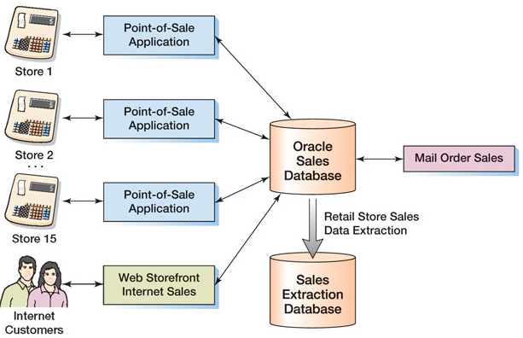
Cape Codd Retail Sales Structure

Slide 7
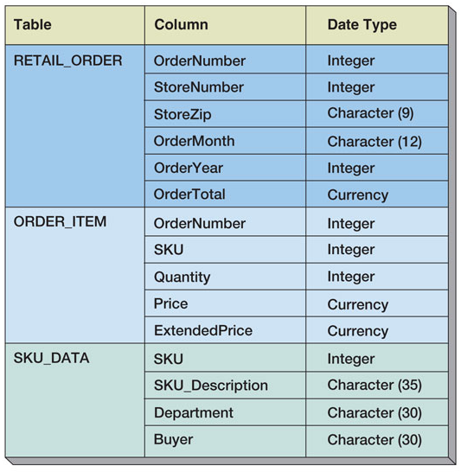
Extracted Retail Sales Data Format

Slide 8
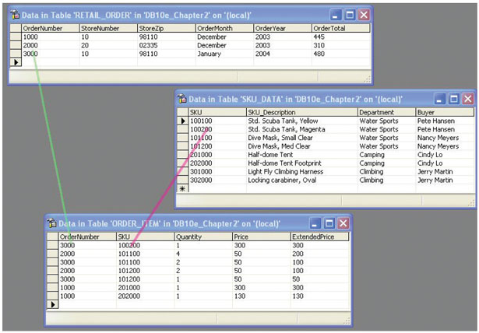
Retail Sales Extract Tables [in MS SQL Server]

Slide 9
The SQL SELECT Statement
The fundamental framework for SQL query states is the SQL SELECT statement:
SELECT {ColumnName(s)}
FROM {TableName(s)}
WHERE {Conditions}
All SQL statements end with a semi-colon (;).

Slide 10
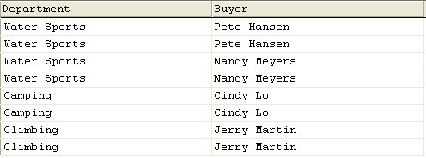
Specific Columns on One Table
SELECT Department, Buyer
FROM SKU_DATA;
Getting all buyers and their department, with duplication, who have an SKU

Slide 11
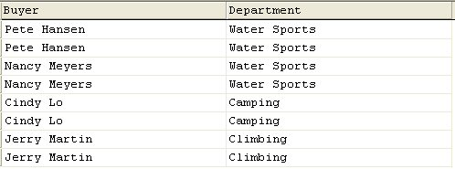
Specifying Column Order
SELECT Buyer, Department
FROM SKU_DATA;

Slide 12
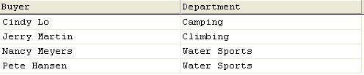
The DISTINCT Keyword
SELECT DISTINCT Buyer, Department
FROM SKU_DATA;
Getting all buyers and their department, without duplication, who have an SKU

Slide 13
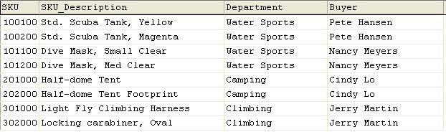
Selecting All Columns: The Asterisk (*) Keyword
SELECT *
FROM SKU_DATA;

Slide 14
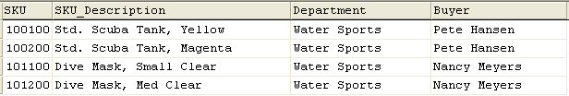
Specific Rows from One Table
SELECT *
FROM SKU_DATA
WHERE Department = 'Water Sports';
NOTE: SQL wants a plain ASCII single quote: ' NOT ‘ !

Slide 15
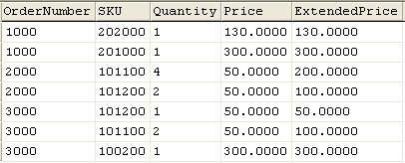
Sorting the Results: ORDER BY
SELECT *
FROM ORDER_ITEM
ORDER BY OrderNumber, Price;

Slide 16
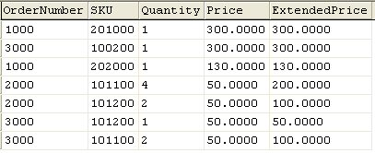
Sort Order: Ascending and Descending
SELECT *
FROM ORDER_ITEM
ORDER BY Price DESC, OrderNumber ASC;
NOTE: The default sort order is ASC – does not have to be specified.

Slide 17

WHERE Clause Options: AND
SELECT *
FROM SKU_DATA
WHERE Department = 'Water Sports'
AND Buyer = 'Nancy Meyers';
Jie’s comment, we are assuming that one buyer services several department. Otherwise, just use the second condition.

Slide 18
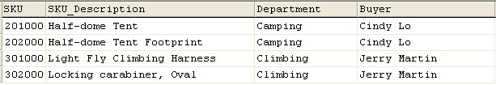
WHERE Clause Options: OR
SELECT *
FROM SKU_DATA
WHERE Department = 'Camping'
OR Department = 'Climbing';

Slide 19
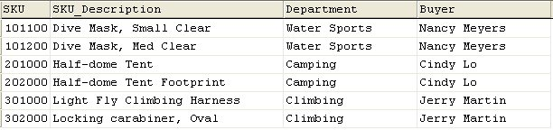
**WHERE Clause Options:- IN
SELECT *
FROM SKU_DATA
WHERE Buyer IN ('Nancy Meyers',
'Cindy Lo', 'Jerry Martin');

Slide 20

**WHERE Clause Options: NOT IN
SELECT *
FROM SKU_DATA
WHERE Buyer NOT IN ('Nancy Meyers',
'Cindy Lo', 'Jerry Martin');

Slide 21
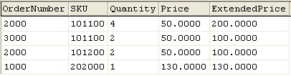
WHERE Clause Options: Ranges with BETWEEN
SELECT *
FROM ORDER_ITEM
WHERE ExtendedPrice
BETWEEN 100 AND 200;
SELECT *
FROM ORDER_ITEM
WHERE ExtendedPrice >= 100
AND ExtendedPrice <= 200;

Slide 22
WHERE Clause Options: LIKE and Wildcards
The SQL keyword LIKE can be combined with wildcard symbols:
SQL 92 Standard (SQL Server, Oracle, etc.):
_ = Exactly one character
% = Any set of one or more characters
MS Access (based on MS DOS)
? = Exactly one character
* = Any set of one or more characters

Slide 23

***WHERE Clause Options: LIKE and Wildcards (Continued)
SELECT *
FROM SKU_DATA
WHERE Buyer LIKE 'Pete%';
SELECT *
FROM SKU_DATA
WHERE Buyer LIKE 'Pete*';

Slide 24

WHERE Clause Options: LIKE and Wildcards (Continued)
SELECT *
FROM SKU_DATA
WHERE SKU_Description LIKE '%Tent%';

Slide 25

WHERE Clause Options: LIKE and Wildcards
SELECT *
FROM SKU_DATA
WHERE SKU LIKE '%2__';

Slide 26
SQL Built-in Functions
There are five SQL Built-in Functions:
COUNT
SUM
AVG
MIN
MAX
Without GROUP BY, the result can and always be just one line!!!
We will talk about GROUP BY later

Slide 27

SQL Built-in Functions (Continued)
SELECT SUM (ExtendedPrice)
AS Order3000Sum
FROM ORDER_ITEM
WHERE OrderNumber = 3000;

Slide 28

SQL Built-in Functions (Continued)
SELECT SUM (ExtendedPrice) AS OrderItemSum,
AVG (ExtendedPrice) AS OrderItemAvg,
MIN (ExtendedPrice) AS OrderItemMin,
MAX (ExtendedPrice) AS OrderItemMax
FROM ORDER_ITEM;

Slide 29

SQL Built-in Functions (Continued)
SELECT COUNT(*) AS NumRows
FROM ORDER_ITEM;

Slide 30

SQL Built-in Functions (Continued)
SELECT COUNT
(DISTINCT Department)
AS DeptCount
FROM SKU_DATA;
May not work for Access

Slide 31
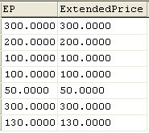
Arithmetic in SELECT Statements
SELECT Quantity * Price AS EP,
ExtendedPrice
FROM ORDER_ITEM;

Slide 32
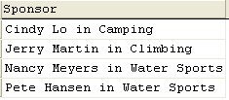
String Functions in SELECT Statements
SELECT DISTINCT RTRIM (Buyer)
+ ' in ' + RTRIM (Department) AS Sponsor
FROM SKU_DATA;

Slide 33
The starting of GROUP BY
What if I need to know for each department, the number of items the department has?

Slide 34
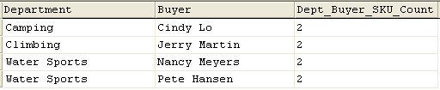
The SQL keyword GROUP BY
SELECT Department, Buyer,
COUNT(*) AS
Dept_Buyer_SKU_Count
FROM SKU_DATA
GROUP BY Department, Buyer;
For each Department and Buyer, how many SKUs does the combination have?

Slide 35
The SQL keyword GROUP BY (Continued)
In general, place WHERE before GROUP BY. Some DBMS products do not require that placement, but to be safe, always put WHERE before GROUP BY.
The HAVING operator restricts the groups that are presented in the result.
There is an ambiguity in statements that include both WHERE and HAVING clauses. The results can vary, so to eliminate this ambiguity SQL always applies WHERE before HAVING.
Where – conditions for records; Having – conditions for group

Slide 36

The SQL keyword GROUP BY (Continued)
SELECT Department, COUNT(*) AS
Dept_SKU_Count
FROM SKU_DATA
WHERE SKU <> 302000
GROUP BY Department
ORDER BY Dept_SKU_Count;

Slide 37

The SQL keyword GROUP BY (Continued)
SELECT Department, COUNT(*) AS
Dept_SKU_Count
FROM SKU_DATA
WHERE SKU <> 302000
GROUP BY Department
HAVING COUNT (*) > 1
ORDER BY Dept_SKU_Count;

Slide 38
Start dealing with more than one table
How to utilize the fact that tables in a database are integrated?
Sub-query
Join

Slide 39

Querying Multiple Tables: Subqueries
SELECT SUM (ExtendedPrice) AS Revenue
FROM ORDER_ITEM
WHERE SKU IN
(SELECT SKU
FROM SKU_DATA
WHERE Department = 'Water Sports');
Note: The second SELECT statement is a subquery.
This one gives the revenue of Water Sports

Slide 40

Querying Multiple Tables: Subqueries (Continued)
SELECT Buyer
FROM SKU_DATA
WHERE SKU IN
(SELECT SKU
FROM ORDER_ITEM
WHERE OrderNumber IN
(SELECT OrderNumber
FROM RETAIL_ORDER
WHERE OrderMonth = 'January'
AND OrderYear = 2004));

Slide 41
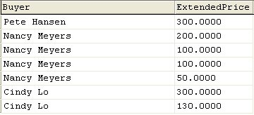
Querying Multiple Tables: Joins
SELECT Buyer, ExtendedPrice
FROM SKU_DATA, ORDER_ITEM
WHERE SKU_DATA.SKU = ORDER_ITEM.SKU;

Slide 42

Querying Multiple Tables: Joins (Continued)
SELECT Buyer, SUM(ExtendedPrice)
AS BuyerRevenue
FROM SKU_DATA, ORDER_ITEM
WHERE SKU_DATA.SKU = ORDER_ITEM.SKU
GROUP BY Buyer
ORDER BY BuyerRevenue DESC;

Slide 43
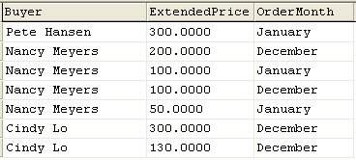
Querying Multiple Tables: Joins (Continued)
SELECT Buyer, ExtendedPrice, OrderMonth
FROM SKU_DATA, ORDER_ITEM, RETAIL_ORDER
WHERE SKU_DATA.SKU = ORDER_ITEM.SKU
AND ORDER_ITEM.OrderNumber =
RETAIL_ORDER.OrderNumber;

Slide 44
Subqueries versus Joins
Subqueries and joins both process multiple tables.
A subquery can only be used to retrieve data from the top table.
A join can be used to obtain data from any number of tables, including the “top table” of the subquery.
In Chapter 8, we will study the correlated subquery. That kind of subquery can do work that is not possible with joins.

Slide 45
Getting you to think using EXISTS and NOT EXIST
Correlated Sub-queries can answer questions such as finding students who are taking all classes takes place in ITC305. That is, we want to list names of every student for whom there does not exist a class in ITC305 the student is not taking.

