Slide 1
Chapter 6
Database Design

Slide 2
The Database Design Process
Create tables and columns from entities and attributes
Select primary keys
  Examine normalization criteria
Represent relationships
Specify constraints (business rules), if any
  Re-examine normalization criteria

Slide 3
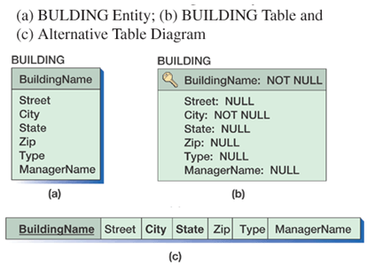
Transforming an Entity to a Table
For this class, we are looking for result like (c)
Notes:
To transform an entity-relationship model into a relational database design, each entity is represented as a table.
All attributes of the entity become columns of that table.
By default, the identifier of the entity will become the primary key of the new table.

Slide 4
Selecting the Primary Key
An ideal primary key is short, numeric, and seldom changing
If there are more than one candidate keys (alternate identifiers), they should be evaluated and the best one chosen as the table’s primary key
If the entity has no identifier, an attribute needs to be selected as the identifier
In some situations, a surrogate key should be defined

Slide 5
Representing Relationships
Relationships are expressed by placing the primary key of one table into a second table
The new column in the second table is referred to as a foreign key

Slide 6
Representing 1:1 and 1:N Relationships
General rule: the key of a parent table (the 1 side of a 1:N relationship) is always placed into the child
  For 1:1 relationship, either entity could be considered the parent or the child
  For 1:N relationship, the parent entity is always the entity on the one side
  We can also represent either a 1:1 or a 1:N relationship with a separate table.
    For 1:1, use one of the key as the key
    For 1:N, use the child’s key as the key

Slide 7
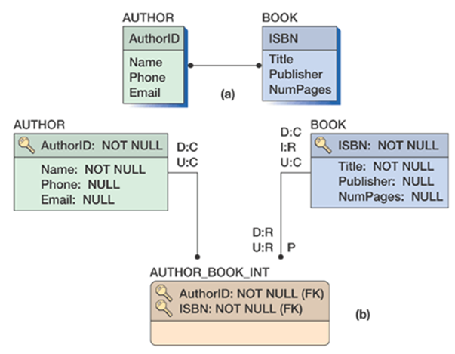
Representing N:M Relationships
Using a third table, ALWAYS!!!

Slide 8
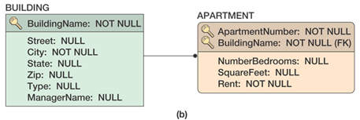
Example: ID-Dependent Relationship
The ID-Dependent or not makes no difference in converting the entity into a table

Slide 9
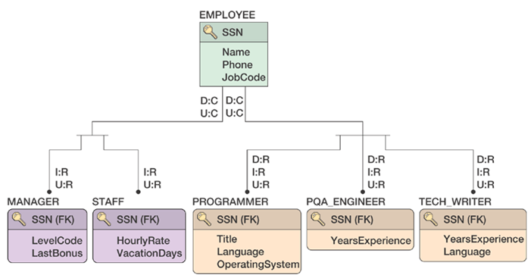
Representing Subtype Relationships (IS-A)
Primary key of the supertype (or generic) entity is placed into the subtype (or category entity)

Slide 10
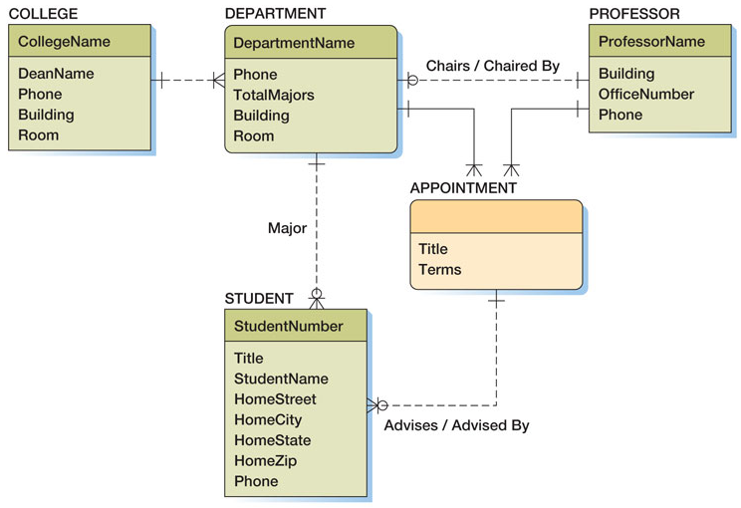
Final Highline University Data Model
The database design is given next
5-<number>

Slide 11
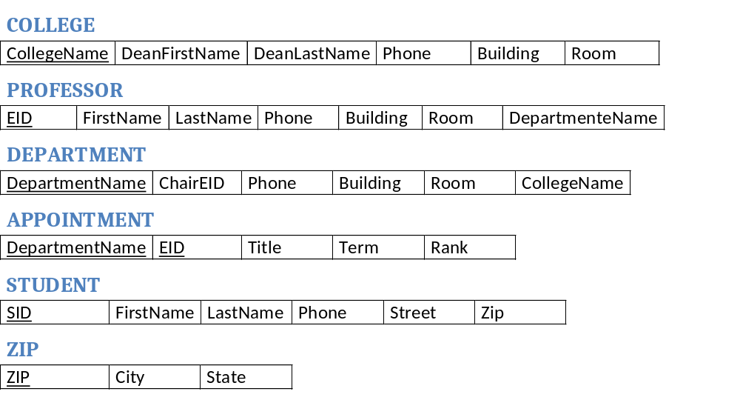
Logical Database – table structure
5-<number>

