Slide 1
What is Machine Learning?
Aspect of AI: creates knowledge
Definition:
“changes in [a] system that ... enable [it] to do the same task or tasks drawn from the same population more efficiently and more effectively the next time.'' (Simon 1983)
There are two ways that a system can improve:
1. By acquiring new knowledge
  acquiring new facts
  acquiring new skills
2. By adapting its behavior
  solving problems more accurately
  solving problems more efficiently

Slide 2
What is Learning?
Herbert Simon: “Learning is any process by which a system improves performance from experience.”
What is the task?
  Classification
  Categorization/clustering
  Problem solving / planning / control
  Prediction
  others

Slide 3
Why Study Machine Learning?
Developing Better Computing Systems
Develop systems that are too difficult/expensive to construct manually because they require specific detailed skills or knowledge tuned to a specific task (knowledge engineering bottleneck).
Develop systems that can automatically adapt and customize themselves to individual users.
  Personalized news or mail filter
  Personalized tutoring
Discover new knowledge from large databases (data mining).
  Market basket analysis (e.g. diapers and beer)
  Medical text mining (e.g. migraines to calcium channel blockers to magnesium)

Slide 4
Related Disciplines
Artificial Intelligence
Data Mining
Probability and Statistics
Information theory
Numerical optimization
Computational complexity theory
Control theory (adaptive)
Psychology (developmental, cognitive)
Neurobiology
Linguistics
Philosophy

Slide 5
Human vs machine learning
Cognitive science vs computational science
  Animal learning vs machine learning
    Don’t fly like birds
  Many ML models are based on human types of learning
Evolution vs machine learning
  Adaptation vs learning

Slide 6
Adaptive vs machine learning
An adaptive system is a set of interacting or interdependent entities, real or abstract, forming an integrated whole that together are able to respond to environmental changes or changes in the interacting parts. Feedback loops represent a key feature of adaptive systems, allowing the response to changes; examples of adaptive systems include: natural ecosystems, individual organisms, human communities, human organizations, and human families.
Some artificial systems can be adaptive as well; for instance, robots employ control systems that utilize feedback loops to sense new conditions in their environment and adapt accordingly.

Slide 7
Types of Learning
Induction vs deduction
Rote learning (memorization)
Advice or instructional learning
Learning by example or practice
  Most popular; many applications
Learning by analogy; transfer learning
Discovery learning
Others?

Slide 8
Levels of Learning
Training
Many learning methods involve training
Training is the acquisition of knowledge, skills, and competencies as a result of the teaching of vocational or practical skills and knowledge that relate to specific useful competencies (wikipedia).
Training requires scenarios or examples (data)

Slide 9
Types of training experience
Direct or indirect
With a teacher or without a teacher
An eternal problem:
  Make the training experience representative of the performance goal

Slide 10
Types of training
Supervised learning: uses a series of labelled examples with direct feedback
Reinforcement learning: indirect feedback, after many examples
Unsupervised/clustering learning: no feedback
Semisupervised

Slide 11
Types of testing
Evaluate performance by testing on data NOT used for testing (both should be randomly sampled)
Cross validation methods for small data sets
The more (relevant) data the better.

Slide 12
Testing
How well the learned system work?
Generalization
  Performance on unseen or unknown scenarios or data
  Brittle vs robust performance

Slide 13


Which of these things is NOT like the others?

Slide 14




Which of these things is like the others? And how?

Slide 15
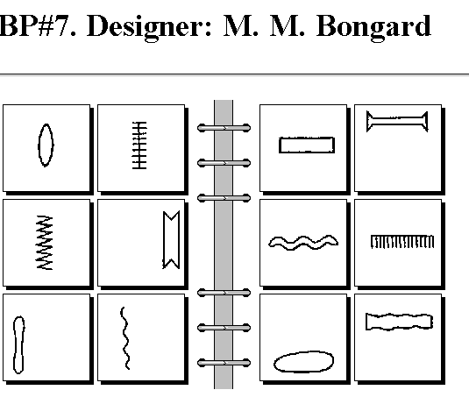
Bongard problems
- visual pattern rule induction
Index of Bongard Problems

Slide 16
Usual ML stages
Hypothesis, data
Training or learning
Testing or generalization

Slide 17
Why is machine learning necessary?
learning is a hallmark of intelligence; many would argue that a system that cannot learn is not intelligent.
without learning, everything is new; a system that cannot learn is not efficient because it rederives each solution and repeatedly makes the same mistakes.
Why is learning possible?
Because there are regularities in the world.

Slide 18
Different Varieties of Machine Learning
Concept Learning
Clustering Algorithms
Connectionist Algorithms
Genetic Algorithms
Explanation-based Learning
Transformation-based Learning
Reinforcement Learning
Case-based Learning
Macro Learning
Evaluation Functions
Cognitive Learning Architectures
Constructive Induction
Discovery Systems
Knowledge capture

Slide 19
Defining the Learning Task
Improve on task, T, with respect to
performance metric, P, based on experience, E.
T: Playing checkers
P: Percentage of games won against an arbitrary opponent
E: Playing practice games against itself
T: Recognizing hand-written words
P: Percentage of words correctly classified
E: Database of human-labeled images of handwritten words
T: Driving on four-lane highways using vision sensors
P: Average distance traveled before a human-judged error
E: A sequence of images and steering commands recorded while
observing a human driver.
T: Categorize email messages as spam or legitimate.
P: Percentage of email messages correctly classified.
E: Database of emails, some with human-given labels

Slide 20
Designing a Learning System
Choose the training experience
Choose exactly what is too be learned, i.e. the target function.
Choose how to represent the target function.
Choose a learning algorithm to infer the target function from the experience.
Learner
Environment/
Experience
Knowledge
Performance
Element

Slide 21
Sample Learning Problem
Learn to play checkers from self-play
Develop an approach analogous to that used in the first machine learning system developed by Arthur Samuels at IBM in 1959.

Slide 22
Training Experience
Direct experience: Given sample input and output pairs for a useful target function.
  Checker boards labeled with the correct move, e.g. extracted from record of expert play
Indirect experience: Given feedback which is not direct I/O pairs for a useful target function.
  Potentially arbitrary sequences of game moves and their final game results.
Credit/Blame Assignment Problem: How to assign credit blame to individual moves given only indirect feedback?

Slide 23
Source of Training Data
Provided random examples outside of the learner’s control.
  Negative examples available or only positive?
Good training examples selected by a “benevolent teacher.”
  “Near miss” examples
Learner can query an oracle about class of an unlabeled example in the environment.
Learner can construct an arbitrary example and query an oracle for its label.
Learner can design and run experiments directly in the environment without any human guidance.

Slide 24
Training vs. Test Distribution
Generally assume that the training and test examples are independently drawn from the same overall distribution of data.
  IID: Independently and identically distributed
If examples are not independent, requires collective classification.
If test distribution is different, requires transfer learning.

Slide 25
Choosing a Target Function
What function is to be learned and how will it be used by the performance system?
For checkers, assume we are given a function for generating the legal moves for a given board position and want to decide the best move.
  Could learn a function:
  ChooseMove(board, legal-moves) → best-move
  Or could learn an evaluation function, V(board) → R, that gives each board position a score for how favorable it is. V can be used to pick a move by applying each legal move, scoring the resulting board position, and choosing the move that results in the highest scoring board position.

Slide 26
Ideal Definition of V(b)
If b is a final winning board, then V(b) = 100
If b is a final losing board, then V(b) = –100
If b is a final draw board, then V(b) = 0
Otherwise, then V(b) = V(b´), where b´ is the highest scoring final board position that is achieved starting from b and playing optimally until the end of the game (assuming the opponent plays optimally as well).
  Can be computed using complete mini-max search of the finite game tree.

Slide 27
Approximating V(b)
Computing V(b) is intractable since it involves searching the complete exponential game tree.
Therefore, this definition is said to be non-operational.
An operational definition can be computed in reasonable (polynomial) time.
Need to learn an operational approximation to the ideal evaluation function.

Slide 28
Representing the Target Function
Target function can be represented in many ways: lookup table, symbolic rules, numerical function, neural network.
There is a trade-off between the expressiveness of a representation and the ease of learning.
The more expressive a representation, the better it will be at approximating an arbitrary function; however, the more examples will be needed to learn an accurate function.

Slide 29
Linear Function for Representing V(b)
In checkers, use a linear approximation of the evaluation function.
  bp(b): number of black pieces on board b
  rp(b): number of red pieces on board b
  bk(b): number of black kings on board b
  rk(b): number of red kings on board b
  bt(b): number of black pieces threatened (i.e. which can be immediately taken by red on its next turn)
  rt(b): number of red pieces threatened

Slide 30
Obtaining Training Values
Direct supervision may be available for the target function.
  < <bp=3,rp=0,bk=1,rk=0,bt=0,rt=0>, 100> (win for black)
With indirect feedback, training values can be estimated using temporal difference learning (used in reinforcement learning where supervision is delayed reward).

Slide 31
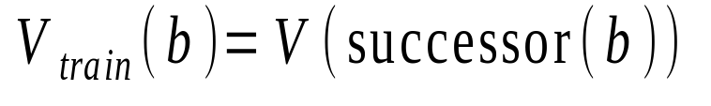
Temporal Difference Learning
Estimate training values for intermediate (non-terminal) board positions by the estimated value of their successor in an actual game trace.
where successor(b) is the next board position where it is the program’s move in actual play.
Values towards the end of the game are initially more accurate and continued training slowly “backs up” accurate values to earlier board positions.

Slide 32
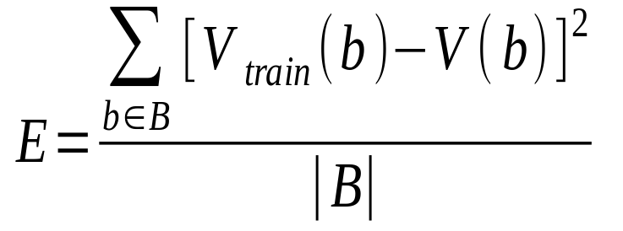
Learning Algorithm
Uses training values for the target function to induce a hypothesized definition that fits these examples and hopefully generalizes to unseen examples.
In statistics, learning to approximate a continuous function is called regression.
Attempts to minimize some measure of error (loss function) such as mean squared error:

Slide 33
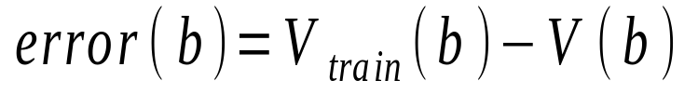
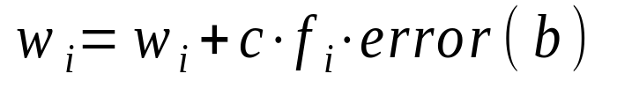
Least Mean Squares (LMS) Algorithm
A gradient descent algorithm that incrementally updates the weights of a linear function in an attempt to minimize the mean squared error
Until weights converge :
For each training example b do :
1) Compute the absolute error :
2) For each board feature, f_{i}, update its weight, w_{i} :
for some small constant (learning rate) c

Slide 34
LMS Discussion
Intuitively, LMS executes the following rules:
  If the output for an example is correct, make no change.
  If the output is too high, lower the weights proportional to the values of their corresponding features, so the overall output decreases
  If the output is too low, increase the weights proportional to the values of their corresponding features, so the overall output increases.
Under the proper weak assumptions, LMS can be proven to eventetually converge to a set of weights that minimizes the mean squared error.

Slide 35
Lessons Learned about Learning
Learning can be viewed as using direct or indirect experience to approximate a chosen target function.
Function approximation can be viewed as a search through a space of hypotheses (representations of functions) for one that best fits a set of training data.
Different learning methods assume different hypothesis spaces (representation languages) and/or employ different search techniques.

Slide 36
Various Function Representations
Numerical functions
  Linear regression
  Neural networks
  Support vector machines
Symbolic functions
  Decision trees
  Rules in propositional logic
  Rules in first-order predicate logic
Instance-based functions
  Nearest-neighbor
  Case-based
Probabilistic Graphical Models
  Naïve Bayes
  Bayesian networks
  Hidden-Markov Models (HMMs)
  Probabilistic Context Free Grammars (PCFGs)
  Markov networks

Slide 37
Various Search Algorithms
Gradient descent
  Perceptron
  Backpropagation
Dynamic Programming
  HMM Learning
  PCFG Learning
Divide and Conquer
  Decision tree induction
  Rule learning
Evolutionary Computation
  Genetic Algorithms (GAs)
  Genetic Programming (GP)
  Neuro-evolution

Slide 38
Evaluation of Learning Systems
Experimental
  Conduct controlled cross-validation experiments to compare various methods on a variety of benchmark datasets.
  Gather data on their performance, e.g. test accuracy, training-time, testing-time.
  Analyze differences for statistical significance.
Theoretical
  Analyze algorithms mathematically and prove theorems about their:
    Computational complexity
    Ability to fit training data
    Sample complexity (number of training examples needed to learn an accurate function)

Slide 39
History of Machine Learning
1950s
  Samuel’s checker player
  Selfridge’s Pandemonium
1960s:
  Neural networks: Perceptron
  Pattern recognition
  Learning in the limit theory
  Minsky and Papert prove limitations of Perceptron
1970s:
  Symbolic concept induction
  Winston’s arch learner
  Expert systems and the knowledge acquisition bottleneck
  Quinlan’s ID3
  Michalski’s AQ and soybean diagnosis
  Scientific discovery with BACON
  Mathematical discovery with AM

Slide 40
History of Machine Learning (cont.)
1980s:
  Advanced decision tree and rule learning
  Explanation-based Learning (EBL)
  Learning and planning and problem solving
  Utility problem
  Analogy
  Cognitive architectures
  Resurgence of neural networks (connectionism, backpropagation)
  Valiant’s PAC Learning Theory
  Focus on experimental methodology
1990s
  Data mining
  Adaptive software agents and web applications
  Text learning
  Reinforcement learning (RL)
  Inductive Logic Programming (ILP)
  Ensembles: Bagging, Boosting, and Stacking
  Bayes Net learning

Slide 41
History of Machine Learning (cont.)
2000s
  Support vector machines
  Kernel methods
  Graphical models
  Statistical relational learning
  Transfer learning
  Sequence labeling
  Collective classification and structured outputs
  Computer Systems Applications
    Compilers
    Debugging
    Graphics
    Security (intrusion, virus, and worm detection)
  E mail management
  Personalized assistants that learn
  Learning in robotics and vision

Slide 42
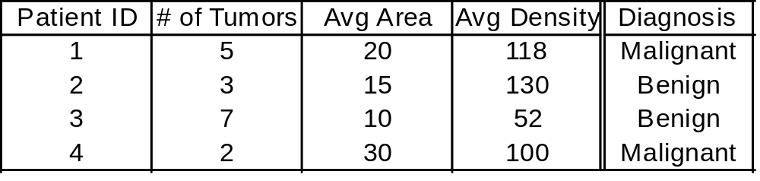
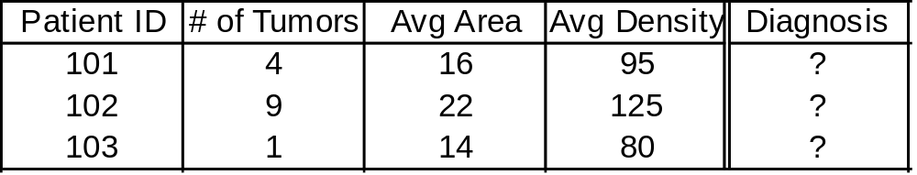
Supervised Learning Classification
Example: Cancer diagnosis
Training Set
Use this training set to learn how to classify patients where diagnosis is not known:
Test Set
Input Data
Classification
The input data is often easily obtained, whereas the classification is not.

Slide 43
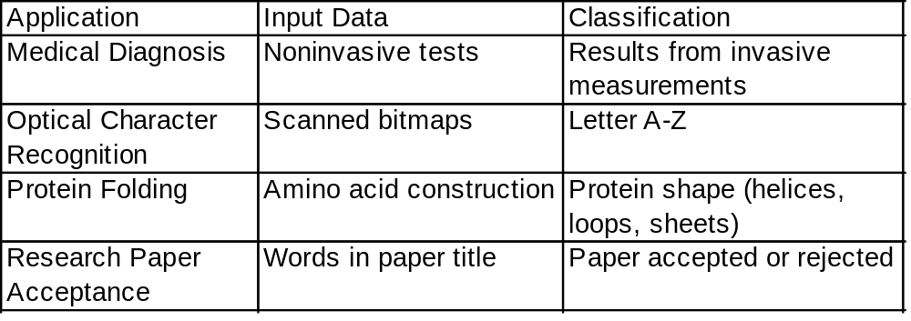
Classification Problem
Goal: Use training set + some learning method to produce a predictive model.
Use this predictive model to classify new data.
Sample applications:

Slide 44
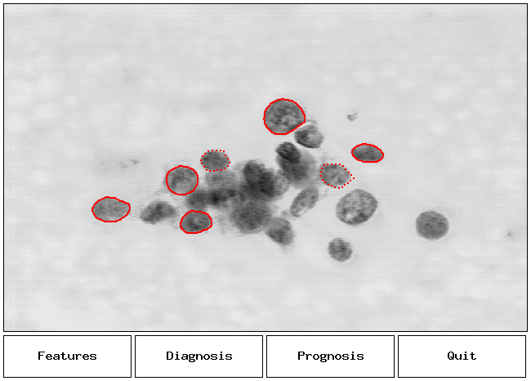
Application: Breast Cancer Diagnosis
Research by Mangasarian,Street, Wolberg

Slide 45
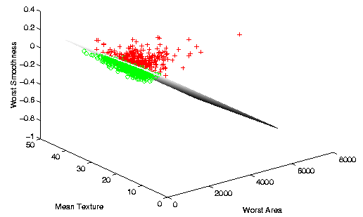
Breast Cancer Diagnosis Separation
Research by Mangasarian,Street, Wolberg

Slide 46

Robotics and ML
Areas that robots are used:
  Industrial robots
  Military, government and space robots
  Service robots for home, healthcare, laboratory
Why are robots used?
  Dangerous tasks or in hazardous environments
  Repetitive tasks
  High precision tasks or those requiring high quality
  Labor savings
Control technologies:
  Autonomous (self-controlled), tele-operated (remote control)

Slide 47
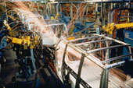
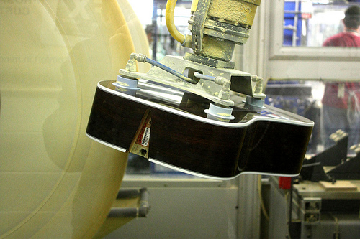
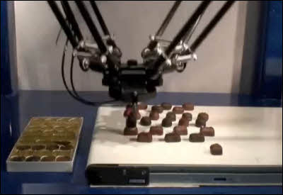
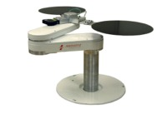
Industrial Robots
Uses for robots in manufacturing:
  Welding
  Painting
  Cutting
  Dispensing
  Assembly
  Polishing/Finishing
  Material Handling
    Packaging, Palletizing
    Machine loading

Slide 48
Industrial Robots
Uses for robots in Industry/Manufacturing
  Automotive:
    Video - Welding and handling of fuel tanks from TV show “How It’s Made” on Discovery Channel. This is a system I worked on in 2003.
  Packaging:
    Video - Robots in food manufacturing.

Slide 49
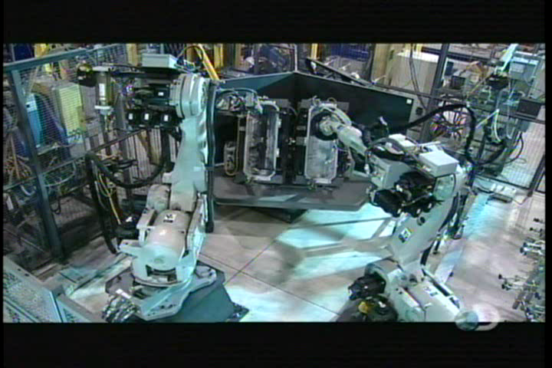
Industrial Robots - Automotive

Slide 50
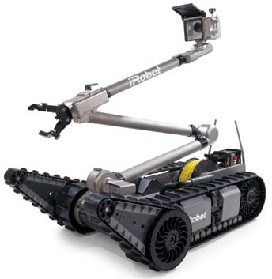
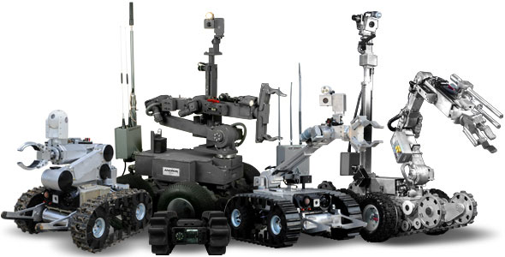
Military/Government Robots
iRobot PackBot
Remotec Andros

Slide 51
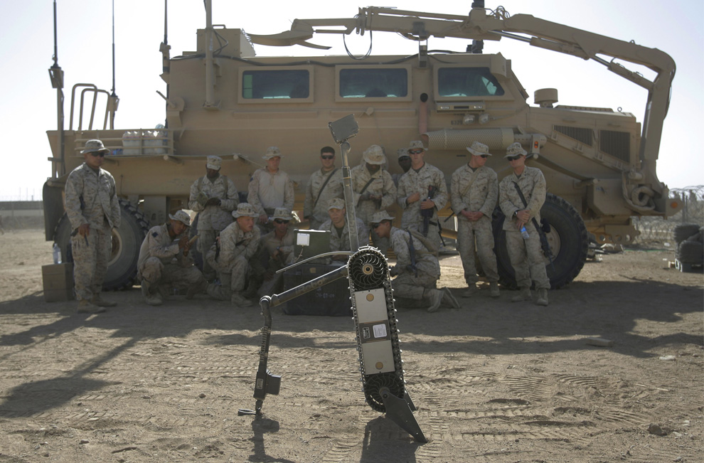
Military/Government Robots
Soldiers are being trained how to defuse a landmine using a PackBot.

Slide 52
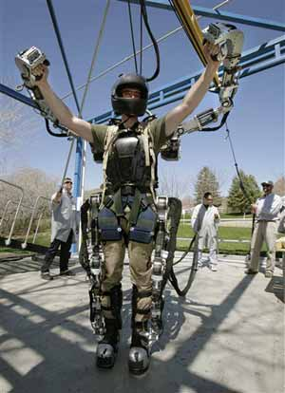

Military Robots
Aerial drones (UAV)
Military suit

Slide 53
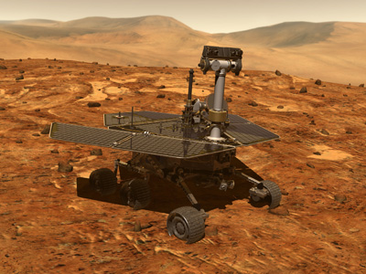
Space Robots
Mars Rovers – Spirit and Opportunity
  Autonomous navigation features with human remote control and oversight

Slide 54
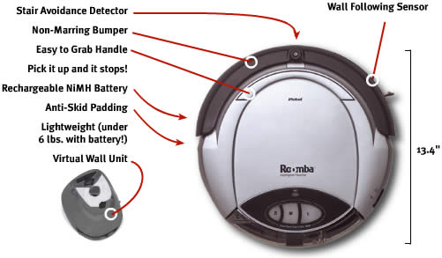
Service Robots
Many uses…
  Cleaning & Housekeeping
  Humanitarian Demining
  Rehabilitation
  Inspection
  Agriculture & Harvesting
  Lawn Mowers
  Surveillance
  Mining Applications
  Construction
  Automatic Refilling
  Fire Fighters
  Search & Rescue
iRobot Roomba vacuum cleaner robot

Slide 55
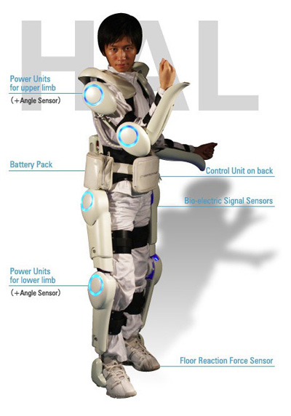
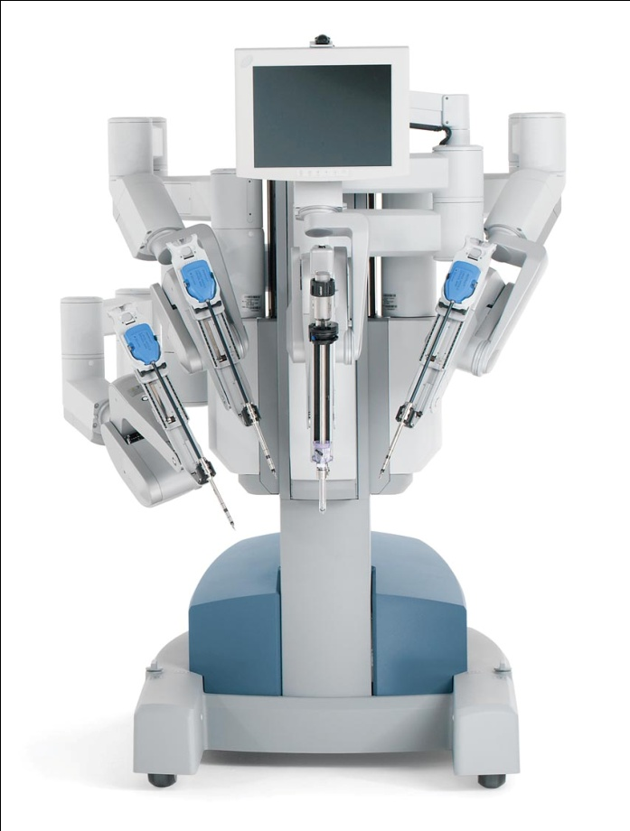
Medical/Healthcare Applications
  DaVinci surgical robot by Intuitive Surgical.
  St. Elizabeth Hospital is one of the local hospitals using this robot. You can see this robot in person during an open house (website).
  Japanese health care assistant suit (HAL - Hybrid Assistive Limb)
Also… Mind-controlled wheelchair using NI LabVIEW

Slide 56
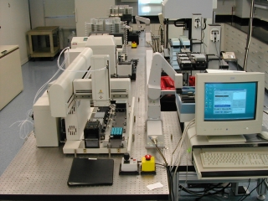
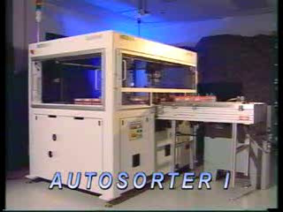
Laboratory Applications
  Drug discovery
  Test tube sorting

Slide 57
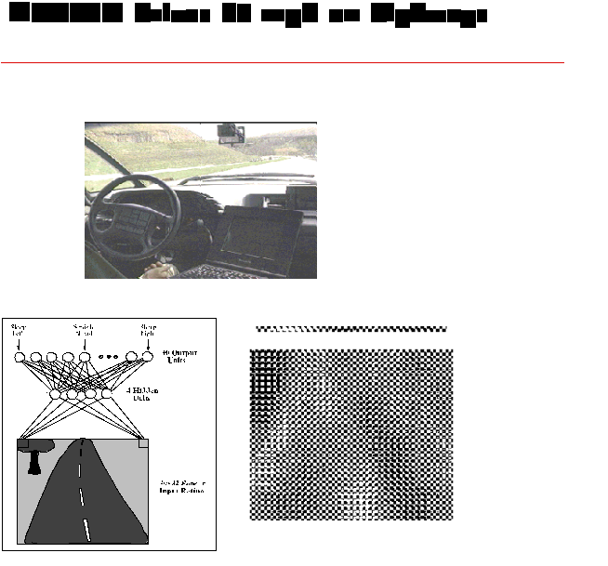
ALVINN
Drives 70 mph on a public highway
Predecessor of the Google car
Camera
image
30 outputs
for steering
30x32 weights
into one out of
four hidden
unit
4 hidden
units
30x32 pixels
as inputs

Slide 58
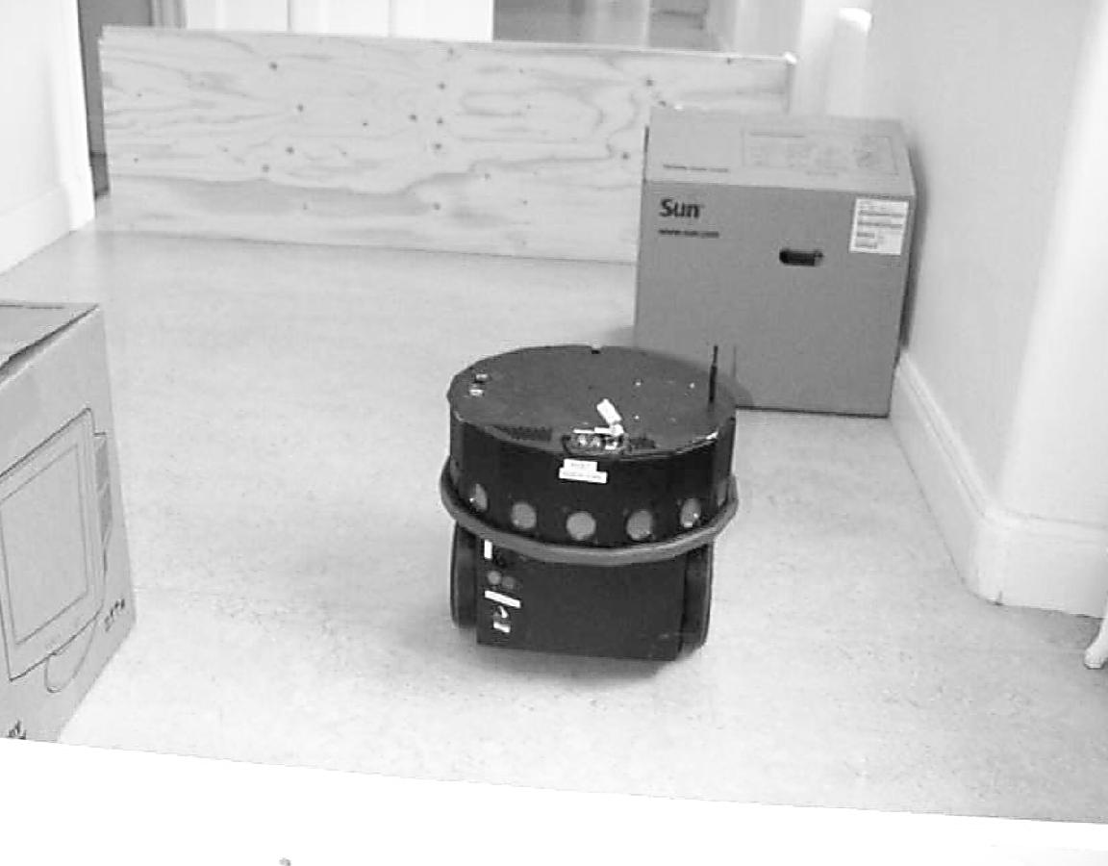
Scout Robots
16 Sonar sensors
Laser range
scanner
Odometry
Differential drive
Simulator
API in C

Slide 59
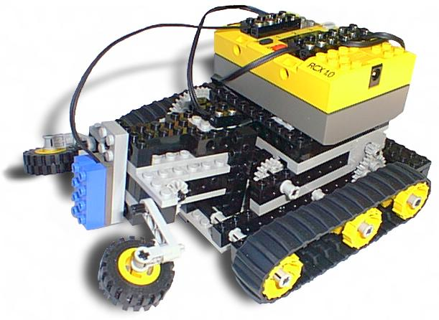
LEGO Mindstorms
Touch sensor
Light sensor
Rotation sensor
Video cam
Motors

Slide 60
Learning vs Adaptation
”Modification of a behavioral tendency by expertise.”
(Webster 1984)
”A learning machine, broadly defined is any device whose
actions are influenced by past experiences.” (Nilsson 1965)
”Any change in a system that allows it to perform better
the second time on repetition of the same task or on another
task drawn from the same population.” (Simon 1983)
”An improvement in information processing ability that results
from information processing activity.” (Tanimoto 1990)

Slide 61
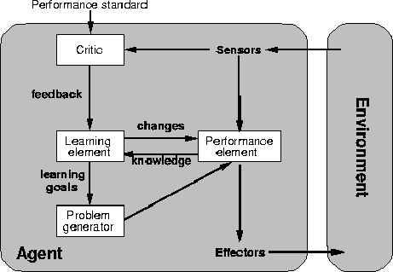
A general model of learning agents

Slide 62
Disciplines relevant to ML
Artificial intelligence
Bayesian methods
Control theory
Information theory
Computational complexity theory
Philosophy
Psychology and neurobiology
Statistics
Many practical problems in engineering and business

Slide 63
Machine Learning as
Function approximation (mapping)
  Regression
Classification
Categorization (clustering)
Prediction
Pattern recognition

Slide 64
ML in the real world
Real World Applications Panel: Machine Learning and Decision Support
Google
Orbitz
Astronomy

Slide 65
Working Applications of ML
Classification of mortgages
Predicting portfolio performance
Electrical power control
Chemical process control
Character recognition
Face recognition
DNA classification
Credit card fraud detection
Cancer cell detection

Slide 66
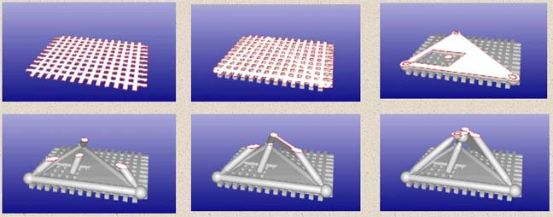
Artificial Life
GOLEM Project (Nature: Lipson, Pollack 2000)
http://www.demo.cs.brandeis.edu/golem/
Evolve simple electromechanical locomotion machines from basic building blocks (bars, acuators, artificial neurons) in a simulation of the physical world (gravity, friction).
The individuals that demonstrate the best locomotion ability are fabricated through rapid prototyping technology.

Slide 67
Issues in Machine Learning
What algorithms can approximate functions well and when
  How does the number of training examples influence accuracy
Problem representation / feature extraction
Intention/independent learning
Integrating learning with systems
What are the theoretical limits of learnability
Transfer learning
Continuous learning

Slide 68
Measuring Performance
Generalization accuracy
Solution correctness
Solution quality (length, efficiency)
Speed of performance

Slide 69
Scaling issues in ML
Number of
  Inputs
  Outputs
  Batch vs realtime
  Training vs testing

Slide 70
Machine Learning versus Human Learning
  Some ML behavior can challenge the performance of human experts (e.g., playing chess)
  Although ML sometimes matches human learning capabilities, it is not able to learn as well as humans or in the same way that humans do
  There is no claim that machine learning can be applied in a truly creative way
  Formal theories of ML systems exist but are often lacking (why a method succeeds or fails is not clear)
  ML success is often attributed to manipulation of symbols (rather than mere numeric information)

