Slide 1
What is machine learning?
A branch of artificial intelligence, concerned with the design and development of algorithms that allow computers to evolve behaviors based on empirical data.
As intelligence requires knowledge, it is necessary for the computers to acquire knowledge.

Slide 2
Learning system model
Testing
Input Samples
Learning Method
System
Training

Slide 3
Training and testing
Data acquisition
Practical usage
Universal set
(unobserved)
Training set (observed)
Testing set
(unobserved)

Slide 4
Training and testing
Training is the process of making the system able to learn.
No free lunch rule:
  Training set and testing set come from the same distribution
  Need to make some assumptions or bias

Slide 5
Performance
There are several factors affecting the performance:
  Types of training provided
  The form and extent of any initial background knowledge
  The type of feedback provided
  The learning algorithms used
Two important factors:
  Modeling
  Optimization

Slide 6
Algorithms
The success of machine learning system also depends on the algorithms.
The algorithms control the search to find and build the knowledge structures.
The learning algorithms should extract useful information from training examples.

Slide 7


Algorithms
Supervised learning ( )
  Prediction
  Classification (discrete labels), Regression (real values)
Unsupervised learning ( )
  Clustering
  Probability distribution estimation
  Finding association (in features)
  Dimension reduction
Semi-supervised learning
Reinforcement learning
  Decision making (robot, chess machine)

Slide 8
Algorithms
Supervised learning
Unsupervised learning
Semi-supervised learning

Slide 9
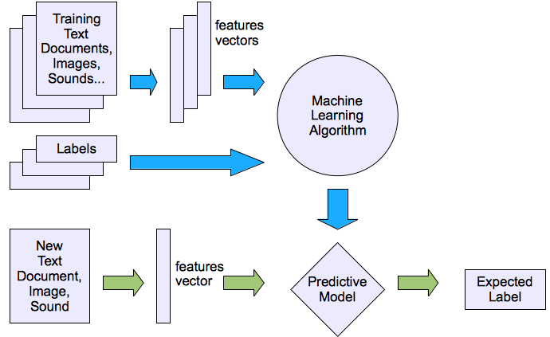
Machine learning structure
Supervised learning

Slide 10
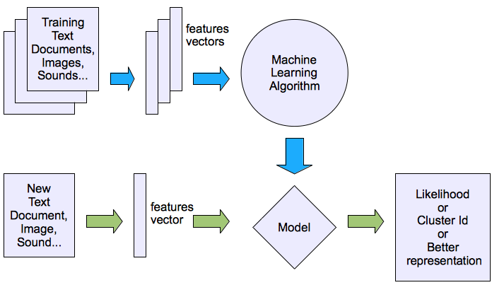
Machine learning structure
Unsupervised learning

Slide 11
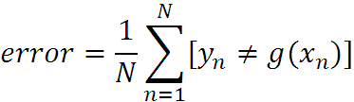
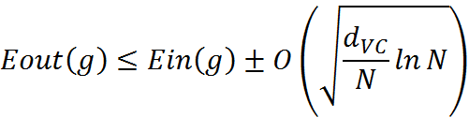
What are we seeking?
Supervised: Low E-out or maximize probabilistic terms
Unsupervised: Minimum quantization error, Minimum distance, MAP, MLE(maximum likelihood estimation)
E-in: for training set
E-out: for testing set

Slide 12




What are we seeking?
Under-fitting VS. Over-fitting (fixed N)
error
(model = hypothesis + loss functions)

Slide 13
Learning techniques
Supervised learning categories and techniques
  Linear classifier (numerical functions)
  Parametric (Probabilistic functions)
    Naïve Bayes, Gaussian discriminant analysis (GDA), Hidden Markov models (HMM), Probabilistic graphical models
  Non-parametric (Instance-based functions)
    K-nearest neighbors, Kernel regression, Kernel density estimation, Local regression
  Non-metric (Symbolic functions)
    Classification and regression tree (CART), decision tree
  Aggregation
    Bagging (bootstrap + aggregation), Adaboost, Random forest

Slide 14

Learning techniques
Linear classifier
Techniques:
  Perceptron
  Logistic regression
  Support vector machine (SVM)
  Ada-line
  Multi-layer perceptron (MLP)
, where w is an d-dim vector (learned)

Slide 15
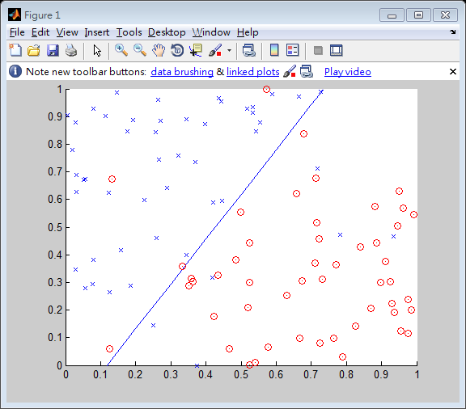
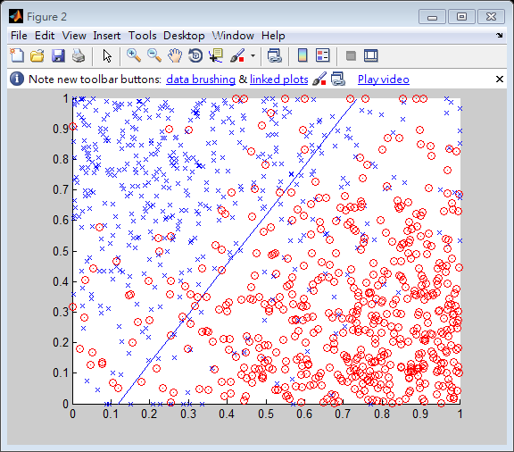
Learning techniques
Using perceptron learning algorithm(PLA)
Training
Testing
Error rate: 0.10
Error rate: 0.156

Slide 16
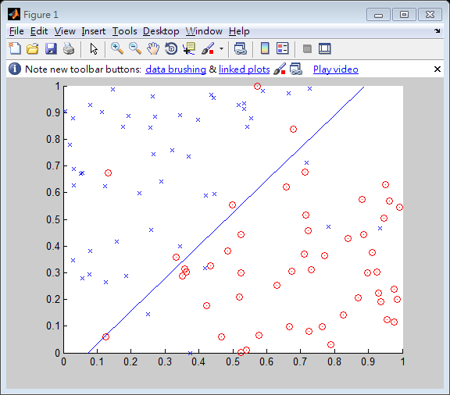
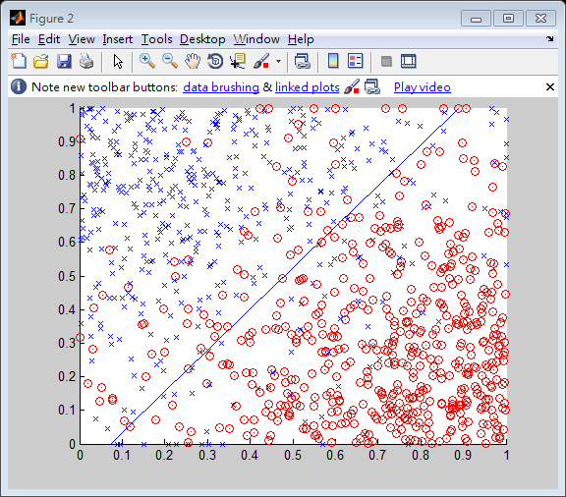
Learning techniques
Using logistic regression
Training
Testing
Error rate: 0.11
Error rate: 0.145

Slide 17



Learning techniques
Non-linear case
Support vector machine (SVM):
  Linear to nonlinear: Feature transform and kernel function

Slide 18
Learning techniques
Unsupervised learning categories and techniques
  Clustering
    K-means clustering
    Spectral clustering
  Density Estimation
    Gaussian mixture model (GMM)
    Graphical models
  Dimensionality reduction
    Principal component analysis (PCA)
    Factor analysis

Slide 19
Applications
Face detection
Object detection and recognition
Image segmentation
Multimedia event detection
Economical and commercial usage

