Slide 1
4 Major Versions of Python
“Python” or “CPython” is written in C/C++
- Version 2.7 came out in mid-2010
- Version 3.1.2 came out in early 2010
“Jython” is written in Java for the JVM
“IronPython” is written in C# for the .Net environment
Go To Website

Slide 2
Development Environments what IDE to use? http://stackoverflow.com/questions/81584
1. PyDev with Eclipse
2. Komodo
3. Emacs
4. Vim
5. TextMate
6. Gedit
7. Idle
8. PIDA (Linux)(VIM Based)
9. NotePad++ (Windows)
10.BlueFish (Linux)

Slide 3
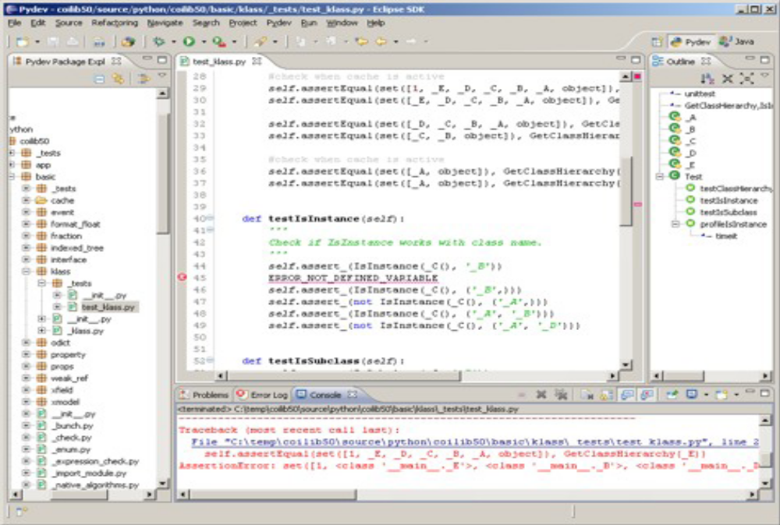
Pydev with Eclipse

Slide 4
Python Interactive Shell
% python
Python 2.6.1 (r261:67515, Feb 11 2010, 00:51:29)
[GCC 4.2.1 (Apple Inc. build 5646)] on darwin
Type "help", "copyright", "credits" or "license" for more information.
>>>
You can type things directly into a running Python session
>>> 2+3*4
14
>>> name = "Andrew"
>>> name
'Andrew'
>>> print "Hello", name
Hello Andrew
>>>

Slide 5
Background
Data Types/Structure
Control flow
File I/O
Modules
Class
NLTK

Slide 6
List
A compound data type:
[0]
[2.3, 4.5]
[5, "Hello", "there", 9.8]
[]
Use len() to get the length of a list
>>> names = [“Ben", “Chen", “Yaqin"]
>>> len(names)
3

Slide 7
Use [ ] to index items in the list
>>> names[0]
‘Ben'
>>> names[1]
‘Chen'
>>> names[2]
‘Yaqin'
>>> names[3]
Traceback (most recent call last):
File "<stdin>", line 1, in <module>
IndexError: list index out of range
>>> names[-1]
‘Yaqin'
>>> names[-2]
‘Chen'
>>> names[-3]
‘Ben'
[0] is the first item.
[1] is the second item
...
Out of range values
raise an exception
Negative values
go backwards from
the last element.

Slide 8
Strings share many features with lists
>>> smiles = "C(=N)(N)N.C(=O)(O)O"
>>> smiles[0]
'C'
>>> smiles[1]
'('
>>> smiles[-1]
'O'
>>> smiles[1:5]
'(=N)'
>>> smiles[10:-4]
'C(=O)'
Use “slice” notation to
get a substring

Slide 9
String Methods: find, split
smiles = "C(=N)(N)N.C(=O)(O)O"
>>> smiles.find("(O)")
15
>>> smiles.find(".")
9
>>> smiles.find(".", 10)
-1
>>> smiles.split(".")
['C(=N)(N)N', 'C(=O)(O)O']
>>>
Use “find” to find the
start of a substring.
Start looking at position 10.
Find returns -1 if it couldn’t
find a match.
Split the string into parts
with “.” as the delimiter

Slide 10
String operators: in, not in
if "Br" in “Brother”:
print "contains brother“
email_address = “clin”
if "@" not in email_address:
email_address += "@brandeis.edu“

Slide 11
String Method: “strip”, “rstrip”, “lstrip” are ways to remove whitespace or selected characters
>>> line = " # This is a comment line \n"
>>> line.strip()
'# This is a comment line'
>>> line.rstrip()
' # This is a comment line'
>>> line.rstrip("\n")
' # This is a comment line '
>>>

Slide 12
More String methods
email.startswith(“c") endswith(“u”)
True/False
>>> "%s@brandeis.edu" % "clin"
'clin@brandeis.edu'
>>> names = [“Ben", “Chen", “Yaqin"]
>>> ", ".join(names)
‘Ben, Chen, Yaqin‘
>>> “chen".upper()
‘CHEN'

Slide 13
Unexpected things about strings
>>> s = "andrew"
>>> s[0] = "A"
Traceback (most recent call last):
File "<stdin>", line 1, in <module>
TypeError: 'str' object does not support item assignment
>>> s = "A" + s[1:]
>>> s
'Andrew‘
Strings are read only

Slide 14
“\” is for special characters
\n -> newline
\t -> tab
\\ -> backslash
...
But Windows uses backslash for directories!
filename = "M:\nickel_project\reactive.smi" # DANGER!
filename = "M:\\nickel_project\\reactive.smi" # Better!
filename = "M:/nickel_project/reactive.smi" # Usually works

Slide 15
Lists are mutable - some useful methods
append an element
remove an element
sort by default order
reverse the elements in a list
insert an element at some
specified position.
(Slower than .append())
>>> ids = ["9pti", "2plv", "1crn"]
>>> ids.append("1alm")
>>> ids
['9pti', '2plv', '1crn', '1alm']
>>>ids.extend(L)
Extend the list by appending all the items in the given list; equivalent to a[len(a):] = L.
>>> del ids[0]
>>> ids
['2plv', '1crn', '1alm']
>>> ids.sort()
>>> ids
['1alm', '1crn', '2plv']
>>> ids.reverse()
>>> ids
['2plv', '1crn', '1alm']
>>> ids.insert(0, "9pti")
>>> ids
['9pti', '2plv', '1crn', '1alm']

Slide 16
Tuples: sort of an immutable list
>>> yellow = (255, 255, 0) # r, g, b
>>> one = (1,)
>>> yellow[0]
>>> yellow[1:]
(255, 0)
>>> yellow[0] = 0
Traceback (most recent call last):
File "<stdin>", line 1, in <module>
TypeError: 'tuple' object does not support item assignment
Very common in string interpolation:
>>> "%s lives in %s at latitude %.1f" % ("Andrew", "Sweden", 57.7056)
'Andrew lives in Sweden at latitude 57.7'

Slide 17
zipping lists together
>>> names
['ben', 'chen', 'yaqin']
>>> gender = [0, 0, 1]
>>> zip(names, gender)
[('ben', 0), ('chen', 0), ('yaqin', 1)]

Slide 18
Dictionaries
Dictionaries are lookup tables.
They map from a “key” to a “value”.
symbol_to_name = {
"H": "hydrogen",
"He": "helium",
"Li": "lithium",
"C": "carbon",
"O": "oxygen",
"N": "nitrogen"
}
Duplicate keys are not allowed
Duplicate values are just fine

Slide 19
Keys can be any immutable value numbers, strings, tuples, frozenset, not list, dictionary, set, ...
atomic_number_to_name = {
1: "hydrogen"
6: "carbon",
7: "nitrogen"
8: "oxygen",
}
nobel_prize_winners = {
(1979, "physics"): ["Glashow", "Salam", "Weinberg"],
(1962, "chemistry"): ["Hodgkin"],
(1984, "biology"): ["McClintock"],
}
A set is an unordered collection
with no duplicate elements.

Slide 20
Dictionary
Get the value for a given key
Test if the key exists
(“in” only checks the keys,
not the values.)
[] lookup failures raise an exception.
Use “.get()” if you want
to return a default value.
>>> symbol_to_name["C"]
'carbon'
>>> "O" in symbol_to_name, "U" in symbol_to_name
(True, False)
>>> "oxygen" in symbol_to_name
False
>>> symbol_to_name["P"]
Traceback (most recent call last):
File "<stdin>", line 1, in <module>
KeyError: 'P'
>>> symbol_to_name.get("P", "unknown")
'unknown'
>>> symbol_to_name.get("C", "unknown")
'carbon'

Slide 21
Some useful dictionary methods
>>> symbol_to_name.keys()
['C', 'H', 'O', 'N', 'Li', 'He']
>>> symbol_to_name.values()
['carbon', 'hydrogen', 'oxygen', 'nitrogen', 'lithium', 'helium']
>>> symbol_to_name.update( {"P": "phosphorous", "S": "sulfur"} )
>>> symbol_to_name.items()
[('C', 'carbon'), ('H', 'hydrogen'), ('O', 'oxygen'), ('N', 'nitrogen'), ('P', 'phosphorous'), ('S', 'sulfur'), ('Li', 'lithium'), ('He', 'helium')]
>>> del symbol_to_name['C']
>>> symbol_to_name
{'H': 'hydrogen', 'O': 'oxygen', 'N': 'nitrogen', 'Li': 'lithium', 'He': 'helium'}

Slide 22
Background
Data Types/Structure
list, string, tuple, dictionary
Control flow
File I/O
Modules
Class
NLTK

Slide 23
Control Flow
Things that are False
The boolean value False
The numbers 0 (integer), 0.0 (float) and 0j (complex).
The empty string "".
The empty list [], empty dictionary {} and empty set set().
Things that are True
The boolean value True
All non-zero numbers.
Any string containing at least one character.
A non-empty data structure.

Slide 24
If
>>> smiles = "BrC1=CC=C(C=C1)NN.Cl"
>>> bool(smiles)
True
>>> not bool(smiles)
False
>>> if not smiles:
... print "The SMILES string is empty"
...
The “else” case is always optional

Slide 25
Use “elif” to chain subsequent tests
>>> mode = "absolute"
>>> if mode == "canonical":
... smiles = "canonical"
... elif mode == "isomeric":
... smiles = "isomeric”
... elif mode == "absolute":
... smiles = "absolute"
... else:
... raise TypeError("unknown mode")
...
>>> smiles
' absolute '
>>>
“raise” is the Python way to raise exceptions

Slide 26
Boolean logic
Python expressions can have “and”s and “or”s:
if (ben <= 5 and chen >= 10 or
chen == 500 and ben != 5):
print “Ben and Chen“

Slide 27
Range Test
if (3 <= Time <= 5):
print “Office Hour"

Slide 28
For
>>> names = [“Ben", “Chen", “Yaqin"]
>>> for name in names:
... print smiles
...
Ben
Chen
Yaqin

Slide 29
Tuple assignment in for loops
data = [ ("C20H20O3", 308.371),
("C22H20O2", 316.393),
("C24H40N4O2", 416.6),
("C14H25N5O3", 311.38),
("C15H20O2", 232.3181)]
for (formula, mw) in data:
print "The molecular weight of %s is %s" % (formula, mw)
The molecular weight of C20H20O3 is 308.371
The molecular weight of C22H20O2 is 316.393
The molecular weight of C24H40N4O2 is 416.6
The molecular weight of C14H25N5O3 is 311.38
The molecular weight of C15H20O2 is 232.3181

Slide 30
Break, continue
Checking 3
The square is 9
Checking 1
Ignoring
Checking 4
The square is 16
Checking 1
Ignoring
Checking 5
The square is 25
Checking 9
Exiting for loop
>>>
>>> for value in [3, 1, 4, 1, 5, 9, 2]:
... print "Checking", value
... if value > 8:
... print "Exiting for loop"
... break
... elif value < 3:
... print "Ignoring"
... continue
... print "The square is", value**2
...
Use “break” to stop
the for loop
Use “continue” to stop
processing the current item

Slide 31
Range()
“range” creates a list of numbers in a specified range
range([start,] stop[, step]) -> list of integers
When step is given, it specifies the increment (or decrement).
>>> range(5)
[0, 1, 2, 3, 4]
>>> range(5, 10)
[5, 6, 7, 8, 9]
>>> range(0, 10, 2)
[0, 2, 4, 6, 8]
How to get every second element in a list?
for i in range(0, len(data), 2):
print data[i]

Slide 32
Background
Data Types/Structure
Control flow
File I/O
Modules
Class
NLTK

Slide 33
Reading files
>>> f = open(“names.txt")
>>> f.readline()
'Yaqin\n'

Slide 34
Quick Way
>>> lst= [ x for x in open("text.txt","r").readlines() ]
>>> lst
['Chen Lin\n', 'clin@brandeis.edu\n', 'Volen 110\n', 'Office Hour: Thurs. 3-5\n', '\n', 'Yaqin Yang\n', 'yaqin@brandeis.edu\n', 'Volen 110\n', 'Offiche Hour: Tues. 3-5\n']
Ignore the header?
for (i,line) in enumerate(open(‘text.txt’,"r").readlines()):
if i == 0: continue
print line

Slide 35
Using dictionaries to count occurrences
>>> for line in open('names.txt'):
... name = line.strip()
... name_count[name] = name_count.get(name,0)+ 1
...
>>> for (name, count) in name_count.items():
... print name, count
...
Chen 3
Ben 3
Yaqin 3

Slide 36
File Output
input_file = open(“in.txt")
output_file = open(“out.txt", "w")
for line in input_file:
output_file.write(line)
“w” = “write mode”
“a” = “append mode”
“wb” = “write in binary”
“r” = “read mode” (default)
“rb” = “read in binary”
“U” = “read files with Unix
or Windows line endings”

Slide 37
Background
Data Types/Structure
Control flow
File I/O
Modules
Class
NLTK

Slide 38
Modules
When a Python program starts it only has access to a basic functions and classes.
(“int”, “dict”, “len”, “sum”, “range”, ...)
“Modules” contain additional functionality.
Use “import” to tell Python to load a module.
>>> import math
>>> import nltk

Slide 39
import the math module
>>> import math
>>> math.pi
3.1415926535897931
>>> math.cos(0)
1.0
>>> math.cos(math.pi)
-1.0
>>> dir(math)
['__doc__', '__file__', '__name__', '__package__', 'acos', 'acosh',
'asin', 'asinh', 'atan', 'atan2', 'atanh', 'ceil', 'copysign', 'cos',
'cosh', 'degrees', 'e', 'exp', 'fabs', 'factorial', 'floor', 'fmod',
'frexp', 'fsum', 'hypot', 'isinf', 'isnan', 'ldexp', 'log', 'log10',
'log1p', 'modf', 'pi', 'pow', 'radians', 'sin', 'sinh', 'sqrt', 'tan',
'tanh', 'trunc']
>>> help(math)
>>> help(math.cos)

Slide 40
“import” and “from ... import ...”
>>> import math
math.cos
>>> from math import cos, pi
cos
>>> from math import *

Slide 41
Background
Data Types/Structure
Control flow
File I/O
Modules
Class
NLTK

Slide 42
Classes
class ClassName(object):
<statement-1>
. . .
<statement-N>
class MyClass(object):
"""A simple example class"""
i = 12345
def f(self):
return self.i
class DerivedClassName(BaseClassName):
<statement-1>
. . .
<statement-N>

Slide 43
Background
Data Types/Structure
Control flow
File I/O
Modules
Class
NLTK

Slide 44
http://www.nltk.org/book
NLTK is on berry patch machines!
>>>from nltk.book import *
>>> text1
<Text: Moby Dick by Herman Melville 1851>
>>> text1.name
'Moby Dick by Herman Melville 1851'
>>> text1.concordance("monstrous")
>>> dir(text1)
>>> text1.tokens
>>> text1.index("my")
4647
>>> sent2
['The', 'family', 'of', 'Dashwood', 'had', 'long', 'been', 'settled', 'in', 'Sussex', '.']

Slide 45
Classify Text
>>> def gender_features(word):
... return {'last_letter': word[-1]}
>>> gender_features('Shrek')
{'last_letter': 'k'}
>>> from nltk.corpus import names
>>> import random
>>> names = ([(name, 'male') for name in names.words('male.txt')] +
... [(name, 'female') for name in names.words('female.txt')])
>>> random.shuffle(names)

Slide 46
Featurize, train, test, predict
>>> featuresets = [(gender_features(n), g) for (n,g) in names]
>>> train_set, test_set = featuresets[500:], featuresets[:500]
>>> classifier = nltk.NaiveBayesClassifier.train(train_set)
>>> print nltk.classify.accuracy(classifier, test_set)
0.726
>>> classifier.classify(gender_features('Neo'))
'male'

Slide 47
from nltk.corpus import reuters
Reuters Corpus:10,788 news
1.3 million words.
Been classified into 90 topics
Grouped into 2 sets, "training" and "test“
Categories overlap with each other
http://nltk.googlecode.com/svn/trunk/doc/book/ch02.html

Slide 48
Reuters
>>> from nltk.corpus import reuters
>>> reuters.fileids()
['test/14826', 'test/14828', 'test/14829', 'test/14832', ...]
>>> reuters.categories()
['acq', 'alum', 'barley', 'bop', 'carcass', 'castor-oil', 'cocoa', 'coconut', 'coconut-oil', 'coffee', 'copper', 'copra-cake', 'corn', 'cotton', 'cotton-oil', 'cpi', 'cpu', 'crude', 'dfl', 'dlr', ...]

