Slide 1
Layout

Slide 2
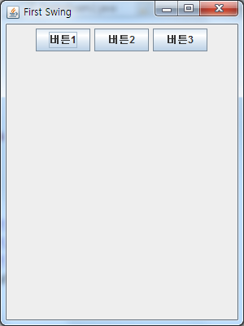
Flowlayout

Slide 3
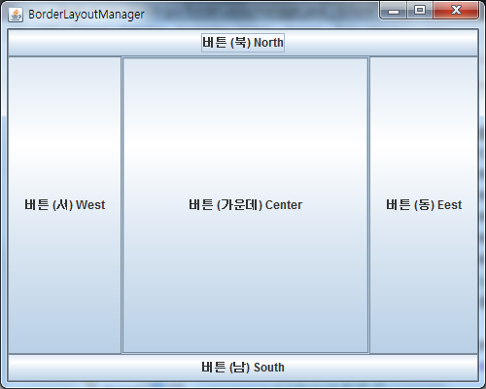
Borderlayout

Slide 4
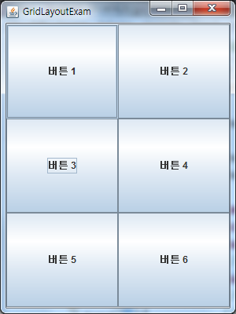
Gridlayout

Slide 5
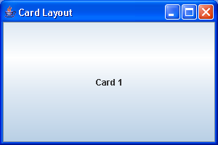
Cardlayout

