Slide 1
Efficient Stereo Depth Estimation using PatchMatch
Tyler Baumgartner
Notes:
In an era of starships, drones, and self-driving cars, the demand for real-time image processing is at an all time high. A lot of the current focus within the field of image processing has been object detection and classification, but equally important to detecting objects is being able to estimate their distance. Currently a lot of autonomous vehicles are utilizing LiDAR, radar, and other waveform technologies to estimate distance, but these technologies are usually very costly. For my paper I focused on implementing a real-time algorithm for estimating depth using stereo imaging and a famous image processing tool called PatchMatch.

Slide 2
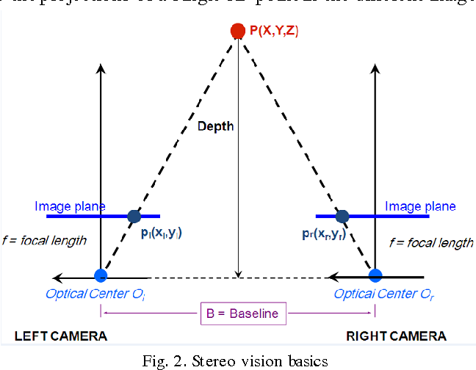
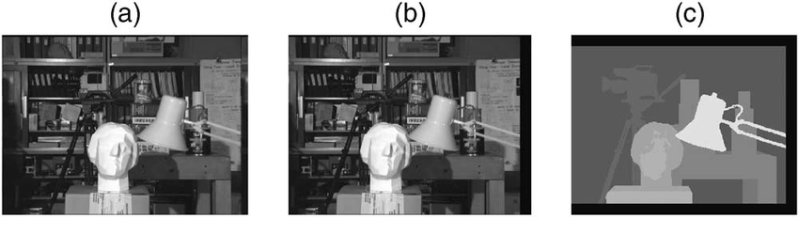
Stereo Image Depth Estimation
Similar to how we estimate depth based on disparities between our left and right eyes.
Pixels can be mapped between left and right images
Open Questions:
How do we properly match pixels?
What if a pixel in the left is obstructed in the right (or vice versa)?
How do we discriminate between identical pixels?
How do minor shifts in lighting alter output?
Notes:
So stereo image depth estimation is actually one of the ways that we as humans perceive distance. As an experiment try shutting one eye, and then the other. You’ll notice that the objects in your field of view jump from left to right. This movement, or disparity, can help us, and stereo cameras, perceive distance. So when trying to apply this theory to stereo cameras, there are a lot of open questions about how to accurately match pixels between images.

Slide 3
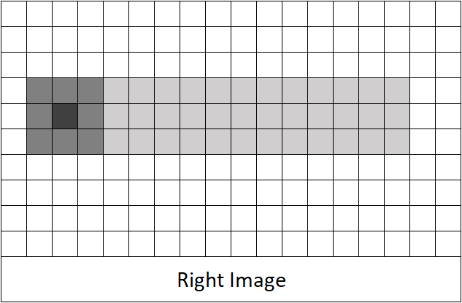
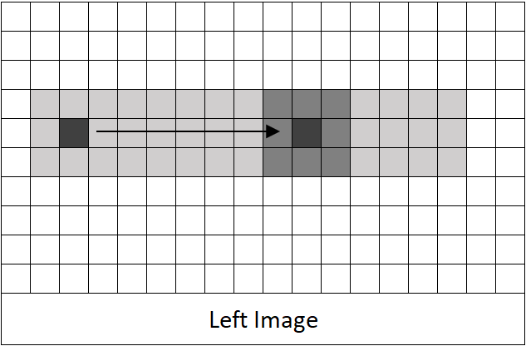
Basic Block Matching
Advantages:
Quick
Low memory usage
Disadvantages:
No global scope
No refining process
Can be used to “prune” search space
Notes:
One of the most rudimentary forms of estimating distance is to use basic block matching. “Blocks” of pixels, such as this three by three block shown on the right image are compared to similar blocks in the left image. Some cost function, usually a sum of squared errors, is used to identify the nearest neighboring block. The advantages of this method are that it’s quick and it uses little memory besides the images themselves. However, by just matching blocks of pixels, the algorithm cannot take into account the context of each pixel within the global scope resulting in discontinuous estimations across what are obviously continuous surfaces.

Slide 4
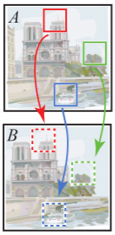
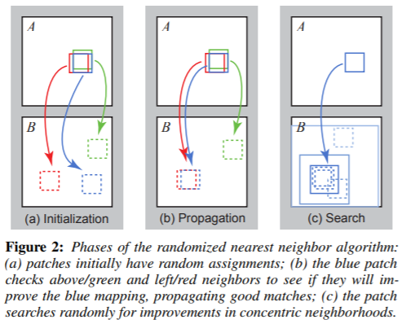
PatchMatch
Notes:
Switching gears, PatchMatch is a famous algorithm that was introduced in 2006 by a team at Princeton in order to find approximate near neighbor patches between two images or within a given image. This was very important for image editing tools that utilized these features to resize images, fill-patches, much more. The algorithm works in three phases, the latter two repeated in as many iterations as desired. The first step is the initialization phase. This is where every patch in the first image is given a random offset or an intelligent offset based on previous information. Then, in the propagation phase, “good” offsets are shared with neighboring pixels, playing off the natural structure of real images. Lastly in the rando search phase, more guesses for each patch are made with a decreasing radius around the current offset in the attempt to escape local minima. This method is much quicker than checking each possible offset for all the patches, as most patches converge within the first 1 or 2 iterations using PatchMatch.

Slide 5
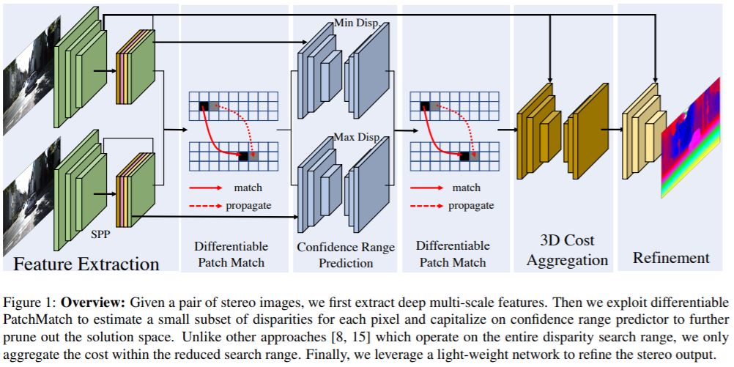
DeepPruner – Merging the Two Ideas
Notes:
DeepPruner, an algorithm published this year from the University of Toronto explores the idea of utilizing the PatchMatch algorithm within the context of stereo depth estimation as a method of pruning the search space of possible disparities for a given pixel. Within DeepPruner, PatchMatch is just one step for pruning, but from the diagram you can see that the model first starts with a down sampling and feature extraction layer, and ends with a more robust 3D Cost aggregation from the depth estimations produced by PatchMatch that also go through a refinement phase to produce a polished disparity map estimation.

Slide 6
Implementation
3 Models
Classic Stereo (Basic Block Matching)
My Implementation
Non-Differentiable Patch Match (hard arg min)
Includes random search step
Just one search at 50px radius (1/2 the total search radius)
DeepPruner’s Differentiable PatchMatch Implementation
Differentiable Patch Match (soft arg max)
Excludes random search step
Design
Python 3.8, NumPy 1.17.3, Matplotlib 3.0.2, PyTorch 1.3.0+cpu
Object-Oriented
Assumed disparity search radius of 100px
Notes:
For my implementation I focused on just implementing the pruning phase using the PatchMatch algorithm. To do this I used three different models. One rudimentary or “classic” model that just performed basic block matching, my algorithm that followed the original non-differentiable PatchMatch algorithm, and DeepPruner’s differentiable patch match that I adapted from their source code. One thing to note is that the DeepPruner’s differentiable patch match chose to remove the random search phase in order to decrease runtime, which I’ll discuss a bit more later on.

Slide 7
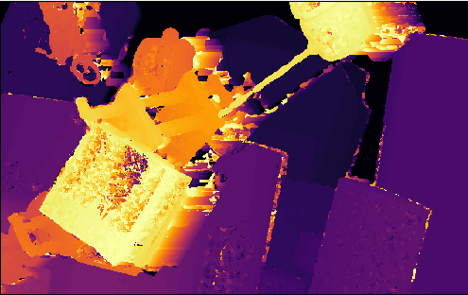
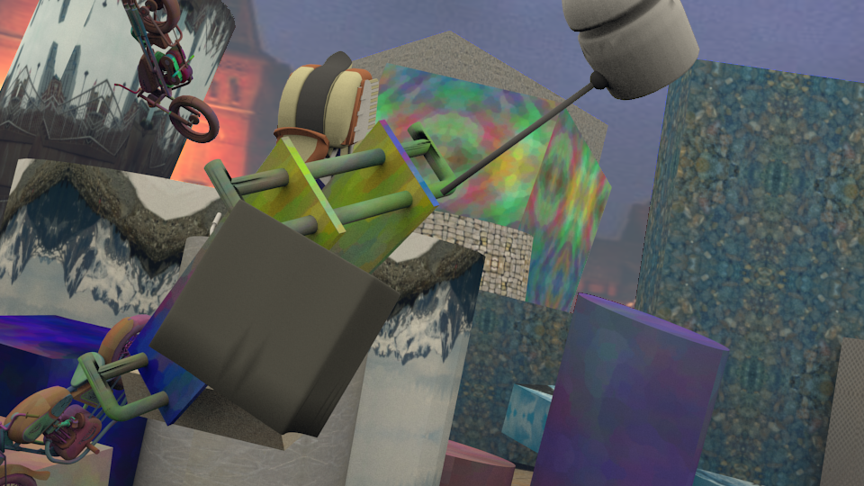
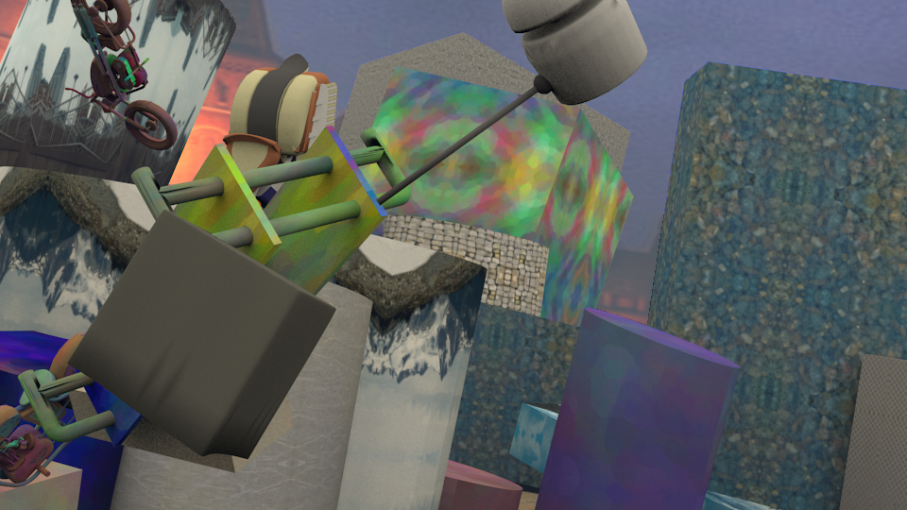

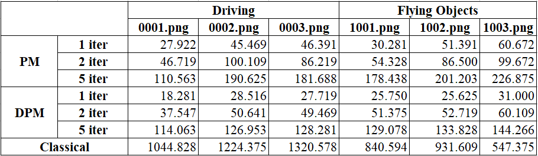
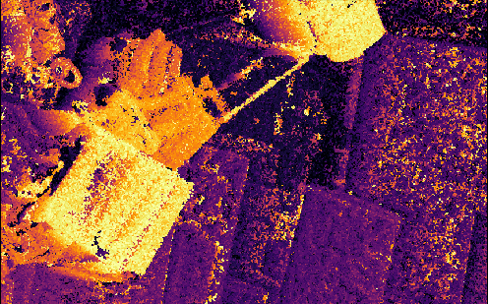
Experiments/Results
Basic Block Matching
Left Image
Right Image
My Algorithm (5 Iterations)
Runtime Results (seconds)
DeepPruner Differentiable
PatchMatch (5 Iterations)
Notes:
To compare the three models I created I used 6 sample stereo pairs from a bench mark dataset called “SceneFlow.” I ran both of the patch match algorithms using 1, 2, and 5 iterations. The runtime results can be seen in the table at the bottom and an example of one of the output disparity mappings can be seen on the right. As you can see, my algorithm ran a bit slower than DeepPruner’s differentiable PatchMatch, but much quicker than the basic block matching algorithm. Also, my algorithm performed significantly better in terms of error rate than differentiable PatchMatch. I believe a lot of the errors in differentiable PatchMatch that aren’t seen in the other two models can be explained by the elimination of the random search phase. These clumps of pixels likely found local minima at the initialization phase and propagated these findings to neighboring pixels without the chance to improve. Some of the other errors seen in all three of the models, such as at the front face of the block on the left, can be explained by the algorithms’ lack of global context. Smooth features such as this block make it difficult for small patches to discriminate between one patch vs another.

Slide 8
Conclusion/Discussion
Independent of a more sophisticated model, basic block matching does a poor job
PatchMatch can significantly reduce disparity search field
More research should be done into the random search phase
Notes:
Independent of a more sophisticated model, basic block matching does a poor job of accurately predicting depth between a set of stereo images. That being said, PatchMatch can be used to significantly reduce the search field for possible disparities to quickly converge at approximate nearest neighbor patches. Also, more research should be done into the pros and cons of removing the random search phase from the PatchMatch algorithm in the context of DeepPruner and other stereo depth estimating models.

