Slide 1
About Me
Currently employed at Battelle
Been developing for five years
Always learning about new technologies
Been attending CONDG for almost two years now

Slide 2
Xamarin Forms
A Love/Hate Story
By Travis Bay

Slide 3
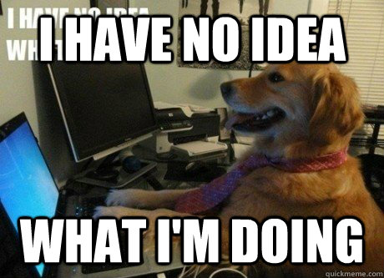
Xamarin – What We Think Is Easy
Assuming most of you know about Xamarin
Xamarin offers cross platform development which helps simplify mobile application creation (http://www.Xamarin.com)
I knew C# and had an idea for a mobile app

Slide 4
Problems and Issues Encountered
The issues encountered were not entirely Xamarin’s fault
Aapt.exe error – pretty common
Android sdk version’s don’t always play well with each other
Emulators are super slow to launch (Build 2017, Xamarin Live Player will be amazing)
There are other errors with initial setup but this was with VS2015. VS2017 fixed a lot of this mess.

Slide 5
Evolution of My Mobile Application
Xamarin Native Android
Wanted native feel as well as an easy beginner project
Had great UI options such as tabbing, layout design, and different types of inputs available
Xamarin Native reminded me of Windows Forms application development
Xamarin Forms
Losing out on “15% to 18%” of the market (iOS)
Didn’t want to reinvent the UI twice

Slide 6
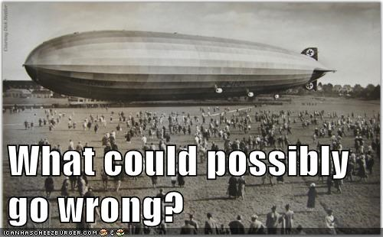
Moving From Native to Forms
Image Retrieved From: Here

Slide 7
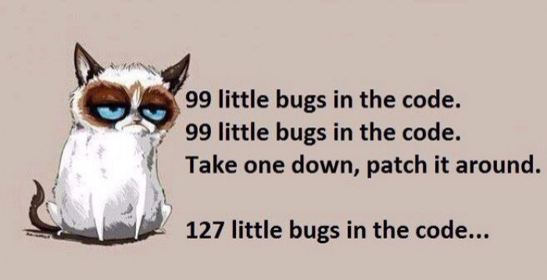
Everything Went Wrong!
Modal problems
Keyboard problems
Tabbed differences

Slide 8
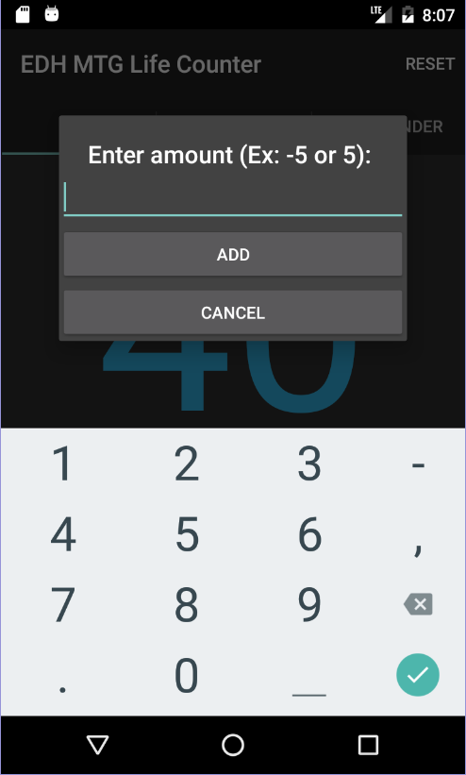
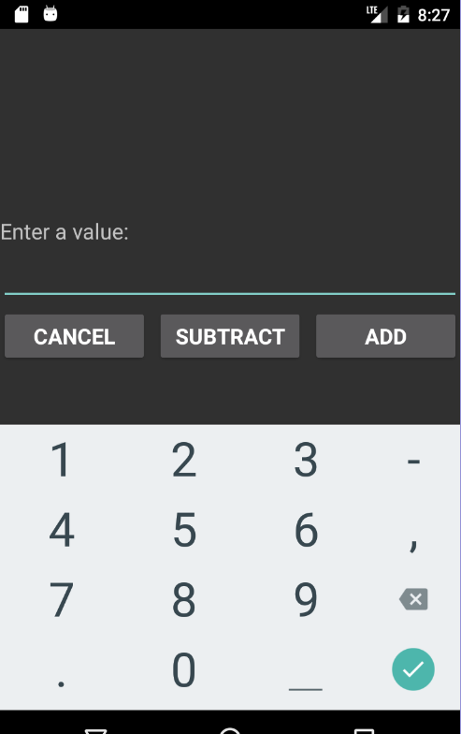
Modal Differences
Xamarin Native
Xamarin Forms

Slide 9
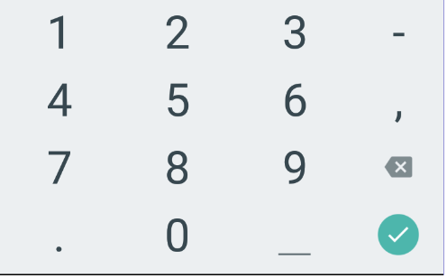
Keyboard Differences
Keyboard functionality is different in Xamarin Forms than in Xamarin Native
Minus key won’t work in Xamarin Forms, even if you say it is a number field
Solutions:
Add a custom keyboard renderer (But who wants to do that work?)
Get a third party library that plays well with Xamarin (Could cost money)
Handle the logic by adding buttons
Native
Forms

Slide 10
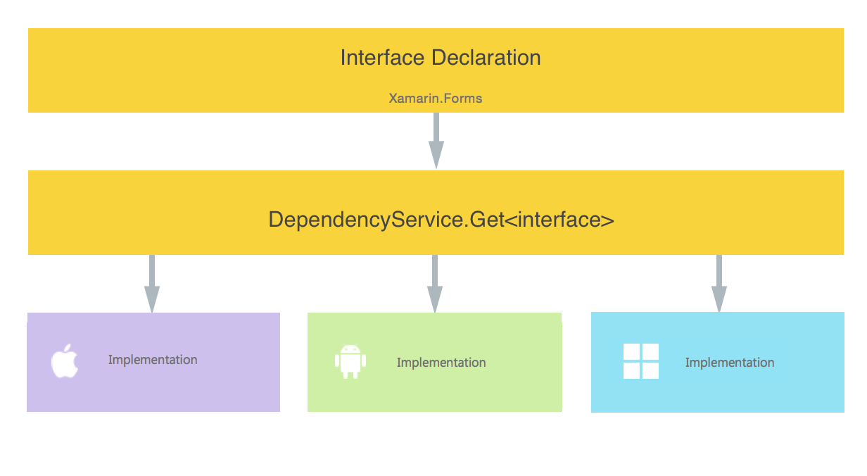
Dependency Service
Allows Xamarin Forms to call platform specific functionality from shared code
Handy to understand when dealing with API’s that are handled differently based on the platform (ex: Facebook API)

Slide 11

Code Example

